Slide 1
An exploratory analysis of temperature and precipitation trends in the Rio Grande Valley, Texas
Paola Granados

Slide 2
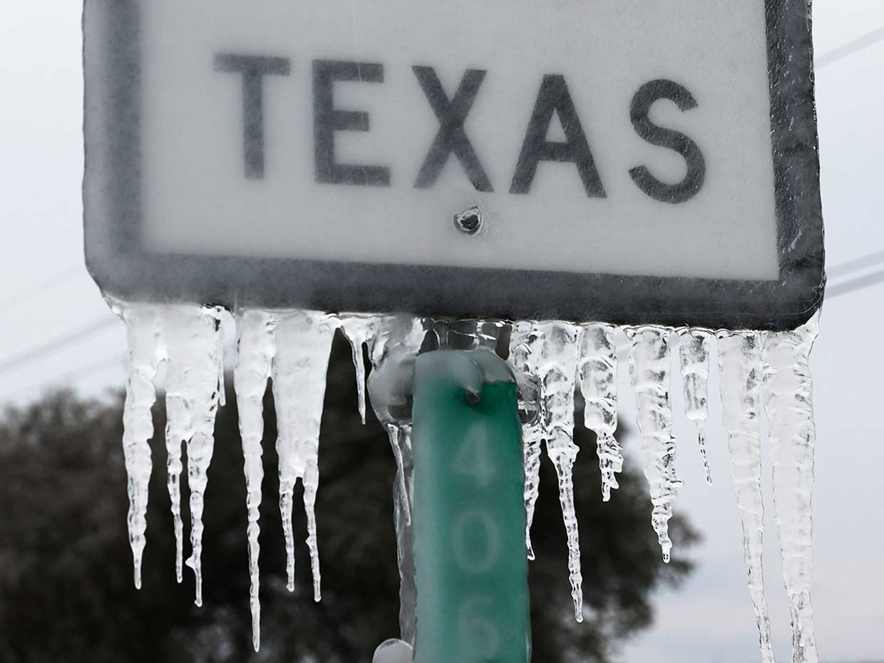
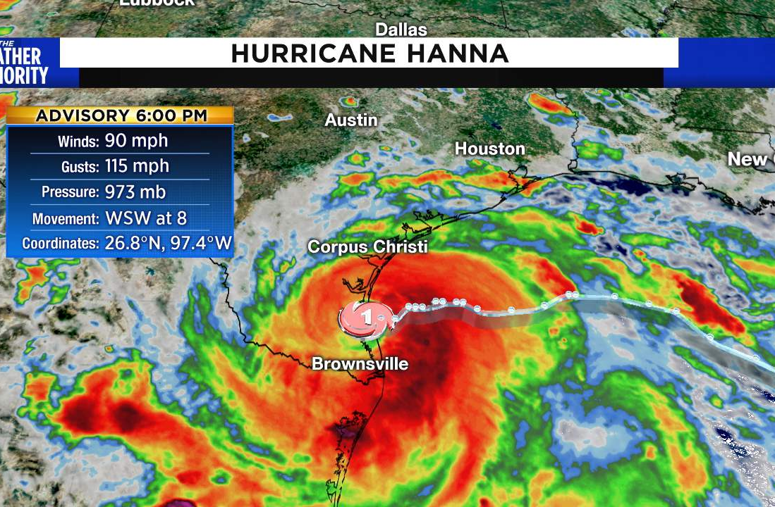
Purpose
Have there been changes in local climate?
Has there been an increase in extreme events?

Slide 3


Proposed Methodology
Data from NOAA
Mean Monthly Temperatures
Daily Summaries (Tmin,Tmax,Tavg,Prec)
Are there trends in current temperature/precipitation observations?
Fit to a regression model
Predict future temperature and precipitation patterns
FBProphet Package on Python
Analyze the frequency of extreme weather events
Record High/Record Low Temperatures

