Slide 1
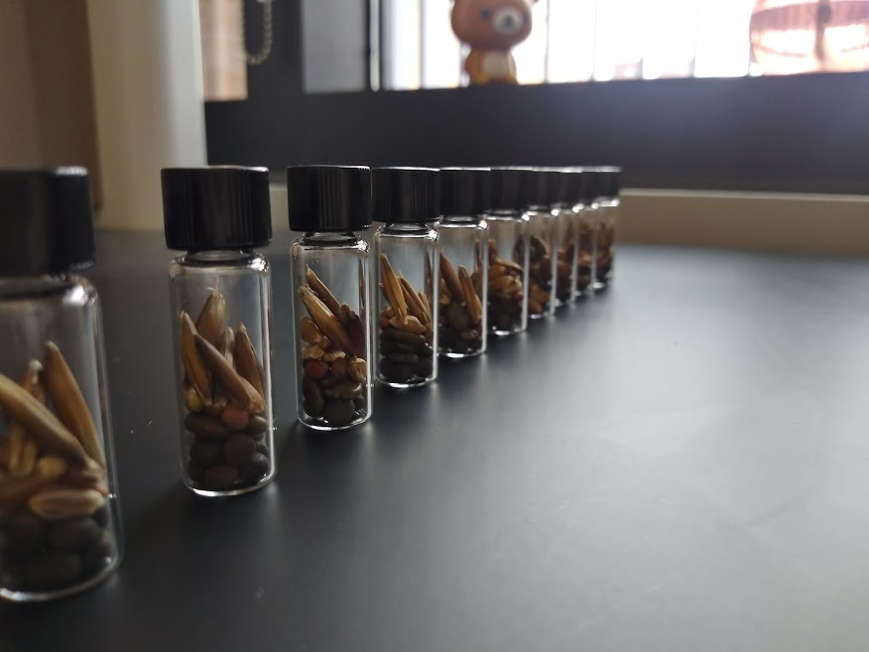
Harvester Ant Cover Crop Seed Preference
Lilly Elliott
Notes:
Harvester Ants are granivorous ants that reside in arid to semi arid regions of North America. They’re one of the larger ants in our region with a colony consisting of around 10k members. These ants collect surrounding seeds by preference, they choose a seed of choice and fill their seed depots with it. If preferred seed is unavailable, they choose the second best and rely on that until their preferred reappears and they empty their seed depots to later refill.

Slide 2
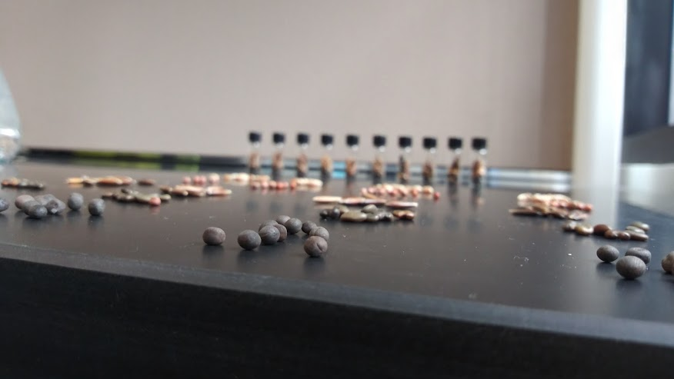
Why?
Negative Impacts on organic farmers
A Threatened Predator
Population Decline
Invasive Species
Notes:
Why should we find safe and sustainable methods of reducing harvester ant predation on cover crop seeds?
Using fewer desirable seeds would reduce harvester ant predation on crops and encourage native plant predation.
Not only are they the main food source to a local threatened species, the Texas Horned Lizard, (seen on right) but they are also under attack by invasive fire ants who are members of a more aggressive, highly populated colonies that outnumber harvester ant colonies 10 to 1. They are also competitive of the same resources of our native harvester ants and are not afraid to cause harm with their 80% mortality rate upon harvester ant colonies.

Slide 3

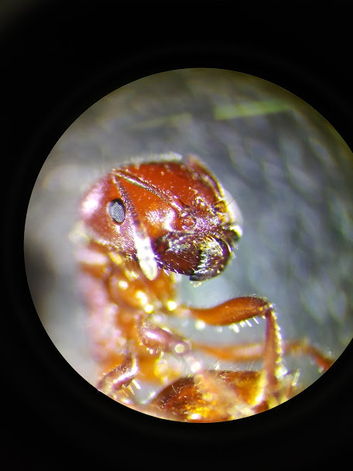
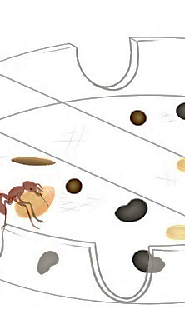
Survival Analysis
- Properly measure a ‘dying’ population over time.

