Slide 1
KisPainter
--小小涂鸦师

Slide 2

Kids Painter– design summary
This application is specially designed for kids to communication with their parents or friends in a unique way, painting and emailing.

Slide 3
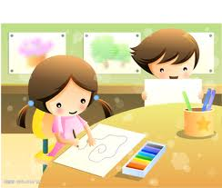
Kids Painter– design summary
What’s more, kids can cooperate with their partners to accomplish a painting, which improve their team spirit.

Slide 4
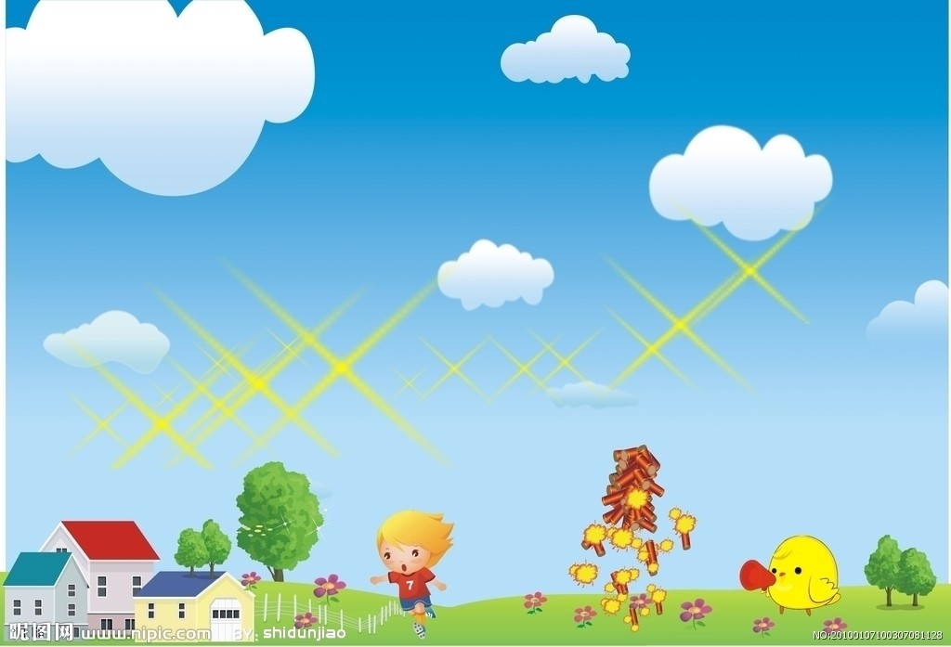
Function Model
Client Terminal
Server Terminal

Slide 5

Client terminal
Register
Parents should register to set up an unique account.
2. Login
Log in to use the application

Slide 6
Client terminal
3. Set the address book
This is executed by parents to realize the parents control. To set the email, name and picture of kid’s friends or relatives.

Slide 7
Client terminal
Painting
Kids can paint whatever they want, what they see and what they would like to share with their parents or friends.

Slide 8
Client terminal
5. Social part : send the painting to others via email, or share it with friends , add a friend, cooperate with friends to complete a painting.

Slide 9
Client terminal
6. Change personal information
Change the password, name, photo.
return

Slide 10

Server Terminal
Receive stream :
Streams of information, pictures and so on.
Store them in the database or send to the specific email address.
2. Send stream;
When requested by client, server sends it to the client terminal.
Next

