Slide 1
Shared E-scooters and bikes map in Calgary
ENGO551 Final Project
Chunsheng Xiao
Notes:
Hi Dr. Liang, TA Sepehr and the ENGO 551 class, my name is Chunsheng Xiao. This is my proposal for the final project. Its topic is shared E-scooters and bikes map of Calgary.

Slide 2
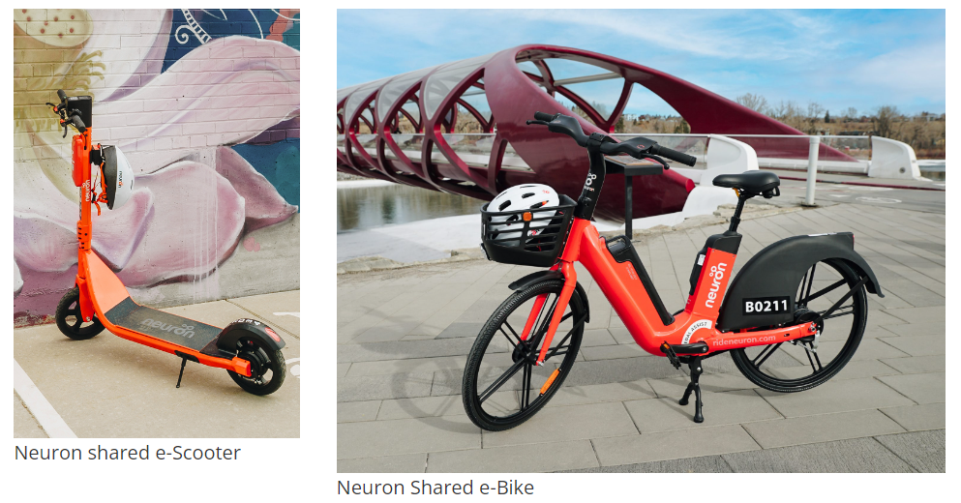
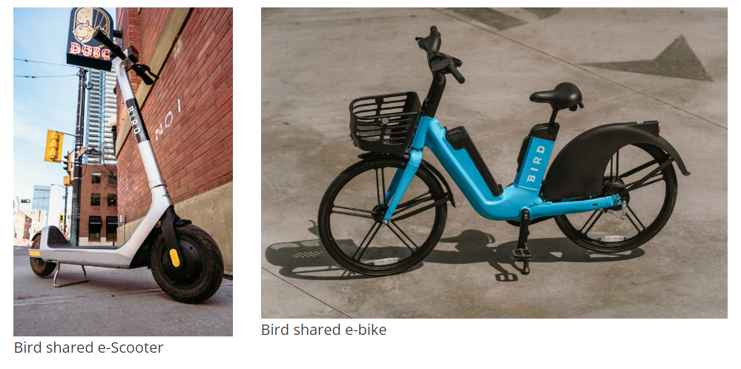
Problem Statement
The shared mobility such as shared bikes and e-scooter are getting more and more popular in Calgary.
However, the data from different companies are totally separated. Users need to install multiple apps to find the available shared mobility.
Notes:
As the world is getting aware of the environment and the climate change. Low-carbon transportations have becoming more and more popular. Shared bikes and shared e-scooters are the two representatives of them. These shared mobilities provide a perfect answer to cover a short distance. This not only reduce the emitted greenhouse gases and support the environment, but also introduce people new ways of enjoying their time and the view of the city.
In Calgary, currently there are two companies offering shared bikes and e-scooters. They are Neuron mobility, and Bird. You can see their facilities in the pictures on the right hand side. The facilities are mainly concentrated in downtown area and along the Bow river because these regions have the highest demand of shared mobilities in Calgary.
However, there is still a problem of using these facilities. The data from these two companies are totally separated. To get access to all the facilities, clients have to install both of the apps. This is not user friendly and it reduces people’s interest on using them.

Slide 3
Problem Statement
Therefore, an integrated shared bikes and e-scooters map application that combine the data from two companies will be very helpful for easing people’s pain looking for available facilities.
Notes:
Since then, an integrated shared bikes and e-scooters map application that combine data from two companies will be very helpful. Users can find all the available facilities just using this map application. The application will also tell users some useful information about the facilities so that user can better plan their day out.

Slide 4
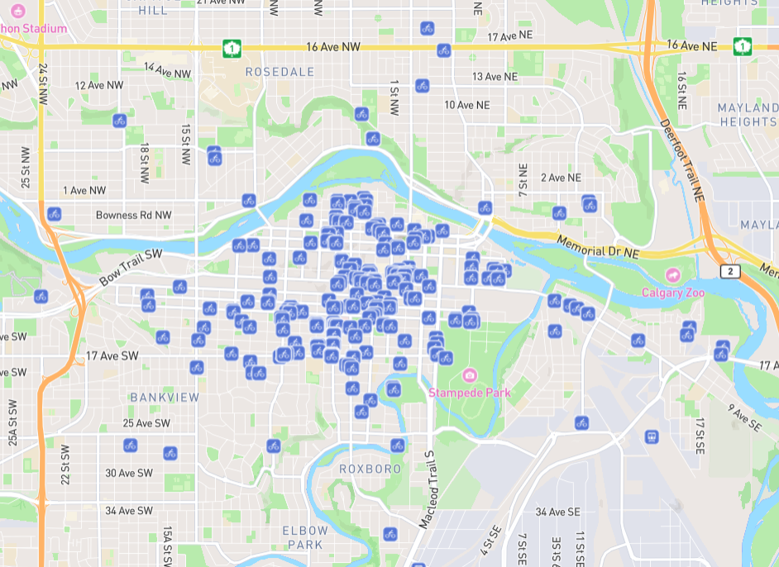
Objectives
Create an integrated maps for shared bikes and e-scooter available in Calgary.
Show all the available bikes and e-scooter at the moment
Legend for bikes and e-scooter from different companies respectively
Filter to certain type and company
Bikes or e-scooter
Neuron or Bird
A demo of the mapping frontend
Notes:
Moving to the objectives, the map application will provide three main functions. The first one is a mapping frontend. This mapping frontend will give users a clear visualization of the location of the available facilties. On the right hand side is a demo of the mapping frontend. It tells you the location of all the available facilities at the moment. To distinguish bikes or e-scooter, Neuron’s or Bird’s, we will have a clear legend for it. Filters to certain vehicle – bikes or e-scooter – and company – Neuron or Bird are also enabled to provide better searching fitting users’ demands. Users can also filter based on the remaining battery or range of the e-scooter. Some other buttons will also be available in the mapping frontend. Refresh button is an example. Once the users click on the refresh button, the map will go back to the default setup which is centered at the user’s location. And all filters will be cleared and all the layers will be visible.

Slide 5
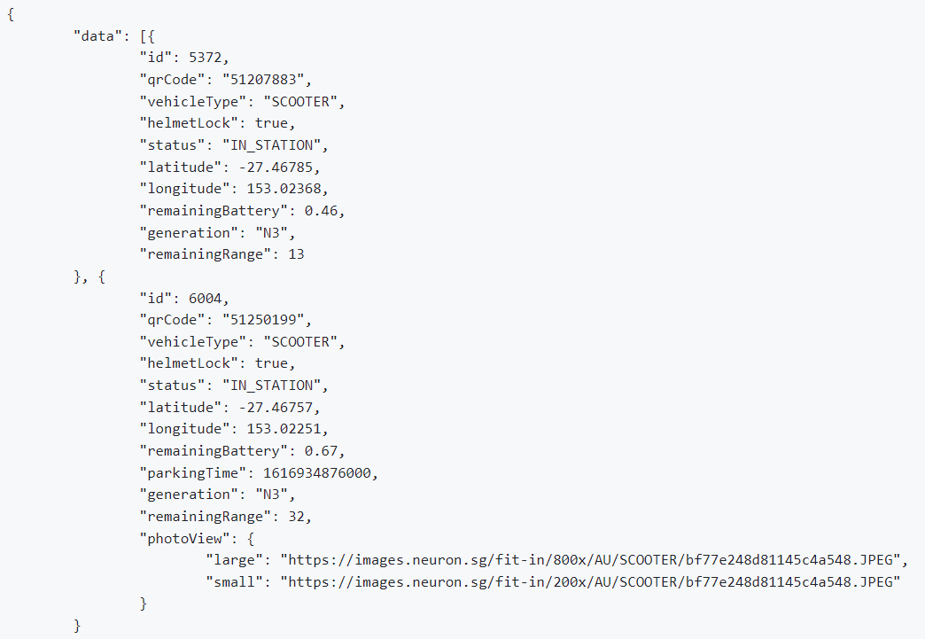
Objectives – Interactivity
Potential Information when click on the available facility:
Company
Vehicle type: e-scooter or bike
Distance to the bike
Remaining battery and range
A demo of the data requested from Neuron’s API
Notes:
After the searching is done, users are allowed to look into certain available facilities to check their status. Once users click on the icon, some information about the facility will be displayed. Here are some examples: the company that owns it, the vehicle type (e-scooter or bike), distance from user’s location to the bike, and the remaining battery and range. The remaining battery and range will be only available for e-scooter.
The picture on the left hand side is an example of the data requested from Neuron’s API. As we can see, it tells us the bike id, the vehicle type, position, remaining battery and range, and so on. This will be the source of the information. These information are helpful for people’s use of the facilities. For example, if the user unlock an e-scooter with low remaining battery, he will need to change to another one during his ride. This is annoying to the users. Since then, remaining battery and range are pretty necessary information for e-scooters.

Slide 6
Objectives – Use of Historical Data
Historical data is a good source for customization
Potential Customization
Better estimations of duration of the rides based on users’ previous records
A demo of the data requested from Neuron’s API
Notes:
The last functionality is the use of the historical data and the customization. The records of usage of the map application is an valuable resource for customization. The records contain the user and the ride information so that it can provide different users different customization. One of the potential customization applicable is better estimations of duration of the rides. Different people have different speed. However, google map will only give everyone one general estimation of the duration of a ride. This is not perfect for commute. The idea of the customization is to use the previous records stored in the database to find out the difference between estimation from google map and users’ real duration of rides so that the application can utilize the difference to provide better estimations on duration for each different user.

Slide 7
Data
Shared Mobility data
The data comes from two companies’ APIs
The API documentation comes from: https://github.com/ubahnverleih/WoBike/tree/master
Google map location data
The distance to the facility
The estimated time to get to the facility
User data
Sign-in and Sign-out
Record usage for future customization
Stored in a private Postgres database
Notes:
In terms of the data, we acquire data from three sources. The first one is the mobility data, which is the status and information of the available shared bikes or e-scooter. This data is acquired from the APIs of two companies. Here is the link of the API documentation.
The second data source is the google map location data. This data is used for telling users their distance to the facility, the estimated time to get to the facility, and the estimated duration of the ride if it’s for commute. This data is retrieved from Google map API.
The third data source is the user data. It’s created when the users register accounts. It’s used for sign-in and sign-out. And it will also record the users’ usage for future customization. This data will be stored in a private local Postgres database. The information of the users are stored in a dimensional Users table. The User table contains the information about the account such as user id and password. The information stored in this table is constant once created. The records are stored in a fact records table linking to the user table by the user id. Records table information contains start time and end time of the ride, vehicle type, ride type, and so on. Ride type is the attribute to distinguish between commute and fun. It’s helpful for better estimatimation the duration of ride as commute rides have a pretty constant speed while fun rides do not.

Slide 8
API
API is available for the application.
Available functionality including:
Location of all the available facilities
Information of the facilities
Filters to specify information retrieved
Notes:
The last characteristic is the RESTful API of the application. This API can handles clients’ different request and response in the standard format output of JSON. The information clients can retrieve from the API includes the location of all the available facilities at the moment, the information of the facilities, and the users’ records. The facilities information can be accessed without authentication from API. However, to access the user history, you will need an authentication to do that.
The API also has filter functionality. Clients can add specific filter to the request such as only sends the data of Neuron’s available bikes.

Slide 9
Thank you!

