Slide 1

RESTAURANT REVIEW ANALYSIS SYSTEM
Presented by
1. EERANKI SRI SURYA KRISHNA KARTHIK - 25B11CS253
2. KAMEPALLI VENKATA AKHILESH - 25B11CS381
3. CHOKKA SRI SOWMYA - 25B11CS194
4. BODDU LAKSHMI SURYA SAHITHI - 25B11CS115

Slide 2


INTRODUCTION
A system built to study and interpret patterns in restaurant reviews using simple python tools.
Reads a restaurantdataset containing restaurant names, locations, ratings, and customer reviews.
Also records customer feedback, review scores, and other restaurant details.
Cleans the raw data by handling missing values and inconsistent formats.
Converts the review data into a structured format suitable for analysis.
Uses Pandas to analyze customer reviews, ratings, and compare restaurant performance.

Slide 3
PROBLEM STATEMENT & OBJECTIVES
Restaurant reviews affect customers, restaurants, and their reputation every day.
Review information is scattered across large, unorganized raw datasets.
Studying thousands of customer reviews manually is time-consuming and error-prone.
It is difficult to identify which restaurants have the best or worst customer satisfaction.
Missing values and inconsistent formats make raw data hard to analyze directly.
Without visualization, review patterns and customer preferences stay hidden.
A simple, automated system is needed to clean, analyze, and visualize restaurant review data.

Slide 4
DATASET
Selected to analyse customer reviews and restaurant performance.
Contains both numerical ratings and textual feedback.
Suitable for data cleaning and analysis using Pandas and NumPy.
Helps identify customer satisfaction and feedback patterns.
Dataset is stored in an Excel file.
It contains 10 restaurant review records.
Each record represents one customer's review.

Slide 5
ATTRIBUTES
Review_ID – Uniquely identifies each review.
Restaurant_Name – Identifies the restaurant being reviewed.
Food_Rating – Shows customer satisfaction with food.
Service_Rating – Indicates the quality of service.
Ambience_Rating – Represents customer satisfaction with the restaurant's atmosphere.
Overall_Rating – Shows the customer's overall experience.
Review_Text – Contains the customer's written feedback.
Target Variable:
Feedback – Classifies the review as Positive, Neutral, or Negative.

Slide 6
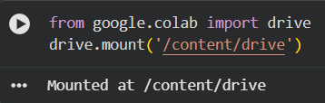
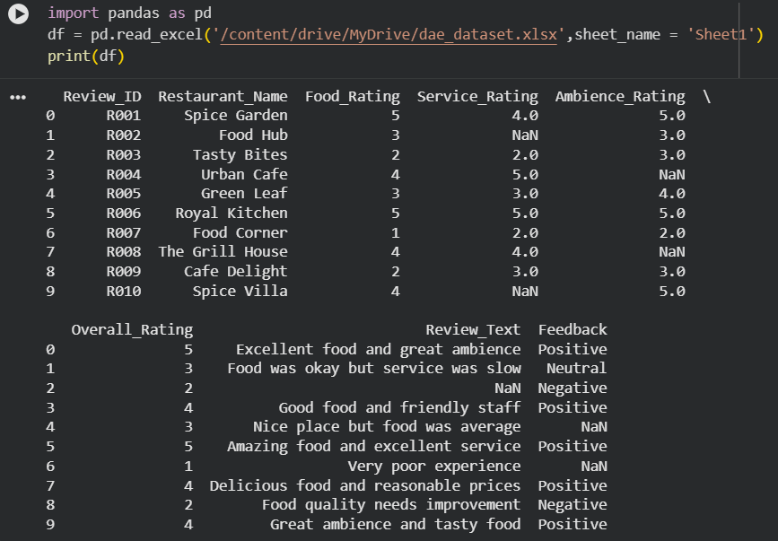
MOUNTING THE DRIVE INTO GOOGLE COLAB
DATA COLLECTION
DATA SET
The dataset was first downloaded from Kaggle.com.
The downloaded dataset was then uploaded and stored in Google Drive.
Google Drive was mounted and connected to Google Colab.
The dataset file was accessed from the mounted Google Drive.

Slide 7
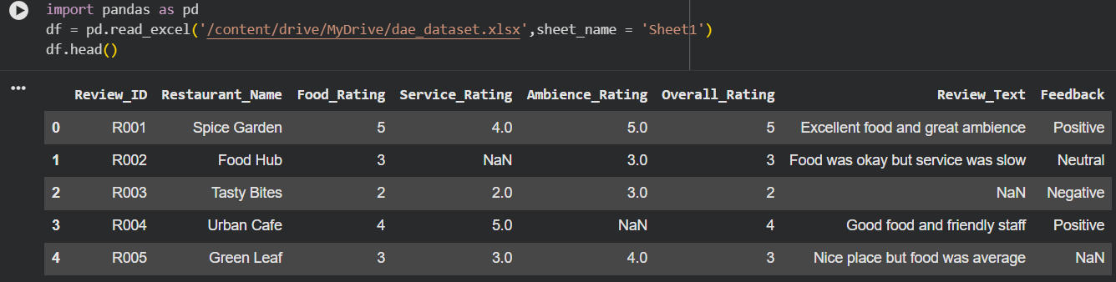
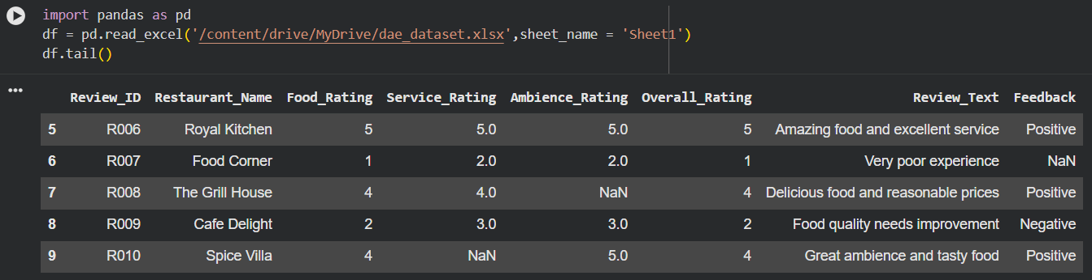
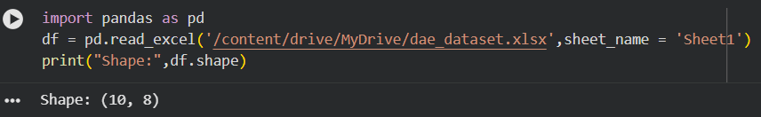
DATA CLEANING
1. head()
Used to display the first 5 rows of the dataset.
2. tail()
Used to display the last 5 rows of the dataset
3. shape
Used to find the number of rows and columns in the dataset.
It returns the result in the form (rows, columns).

Slide 8
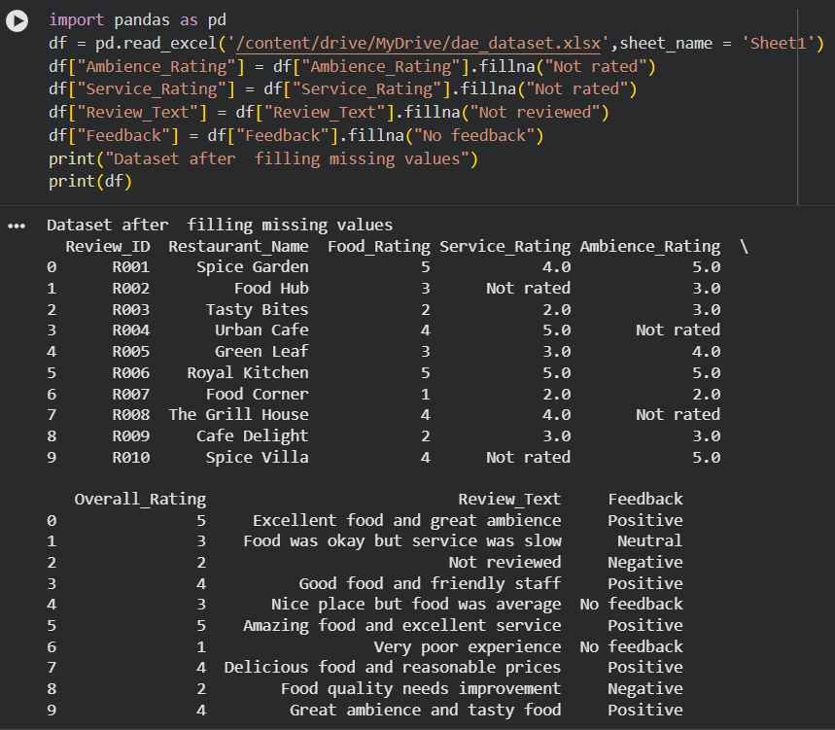
DATA CLEANING
Fillna():
fillna() is a Pandas function used to handle missing (NaN) values in a dataset.
It replaces empty or missing values with a specified value.
It helps make the dataset complete and suitable for analysis.
Syntax:
df["Review_Text"] = df["Review_Text"].fillna("No review provided")

Slide 9
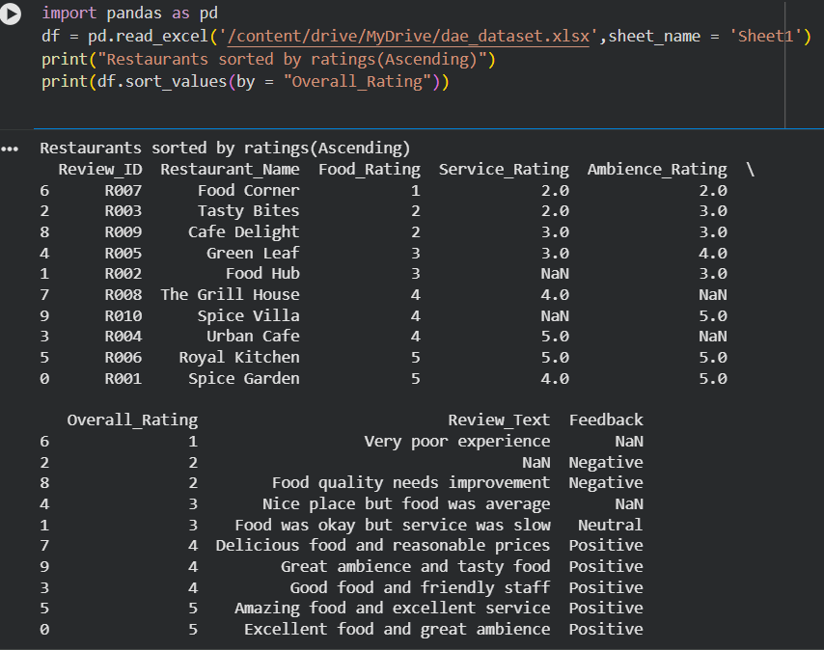
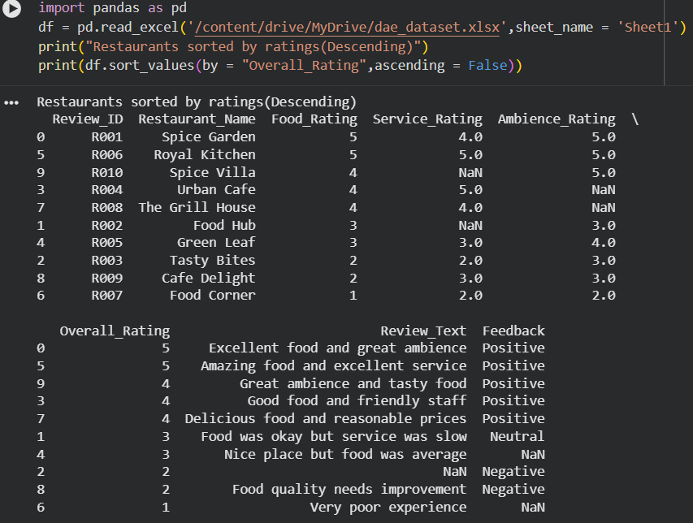
DATA PREPROCESSING
Ascending Order
These are used to sort the data in Pandas.
ascending=True
Arranges values from smallest to largest.
Descending Order
ascending=False
Arranges values from largest to smallest

Slide 10
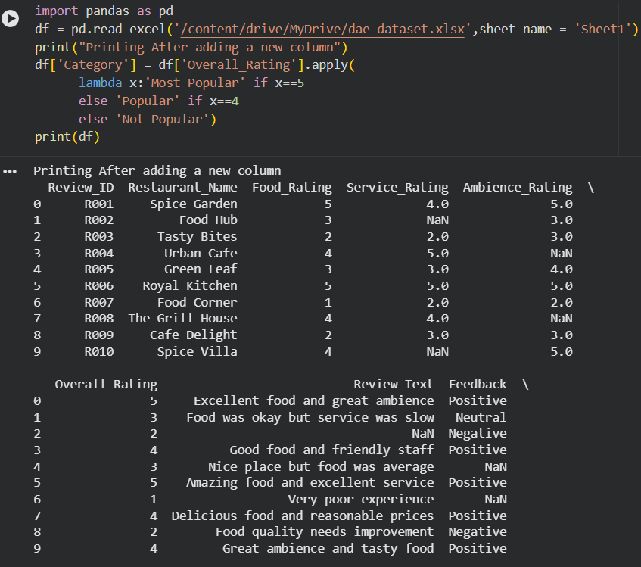
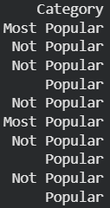
SETTING CONDITIONS
Used apply() to apply a condition to every value in the Overall_Rating column.
Used a lambda function to set multiple conditions.
If Overall_Rating = 5 → Most Popular.
If Overall_Rating = 4 → Popular.
If Overall_Rating < 4 → Not Popular.
A new column called Category is added to the dataset.
This helps classify restaurants based on their overall rating.

Slide 11
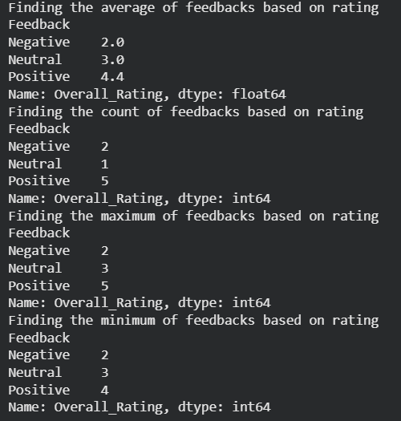
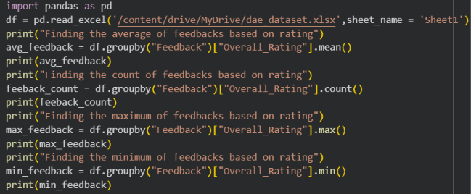
USING GROUPBY
MEAN() – Calculates the average value of a column.
avg_feedback = df.groupby("Feedback")["Overall_Rating"].mean()
COUNT() – Finds the number of non-empty values in a column.
feeback_count = df.groupby("Feedback")["Overall_Rating"].count()
MAX() – Finds the maximum value in a column.
max_feedback = df.groupby("Feedback")["Overall_Rating"].max()
MIN() – Finds the minimum value in a column.
min_feedback = df.groupby("Feedback")["Overall_Rating"].min()

Slide 12
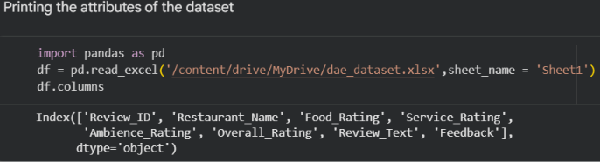
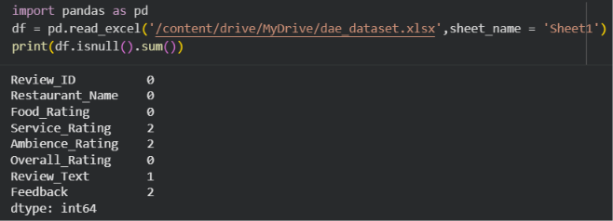
COMMANDS USED
The df.columns command is used to display all attributes (columns) of the dataset.
The dataset contains 8 attributes.
These attributes include Review_ID, Restaurant_Name, Food_Rating, and Service_Rating.
It also contains Ambience_Rating, Overall_Rating, Review_Text, and Feedback.
isnull().sum() is used to identify missing values in each column.
Service_Rating has 2 missing values.
Ambience_Rating has 2 missing values.
Review_Text has 1 missing value.
Feedback has 2 missing values.
The remaining columns have no missing values.
This step helps identify incomplete data before performing further analysis.

Slide 13
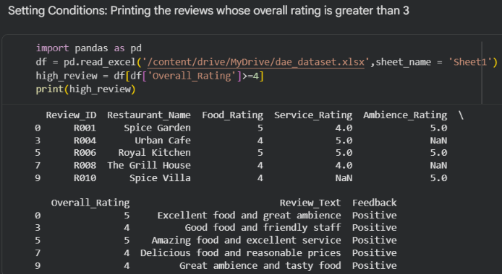
SETTING CONDITIONS
The condition Overall_Rating > 4 is used to filter the reviews.
The code selects restaurants with an Overall Rating greater than 4.
The filtered results include Spice Garden and Royal Kitchen, both with a rating of 5.
The output also shows reviews with a rating of 4 because the displayed code appears to use >= 4.
The filtered data includes restaurant name, ratings, review text, and feedback.
This helps identify restaurants with high overall customer ratings.

Slide 14
DATA VISUALIZATION
After cleaning and analysing the dataset, we use visualization to present the results clearly.
Charts and graphs make numerical data easier to understand and compare.
The bar chart is used to compare ratings between different restaurants.
The pie chart shows the distribution of Positive, Neutral, and Negative customer feedback.
The box plot compares the distribution of Overall Ratings across feedback categories.
The histogram shows the distribution and frequency of Food Ratings.
The line chart shows the variation in Food Rating and Service Rating across the records.
The scatter plot shows the relationship between Food Rating and Overall Rating.
These visualizations help us identify patterns, differences, trends, and relationships in the dataset.

Slide 15
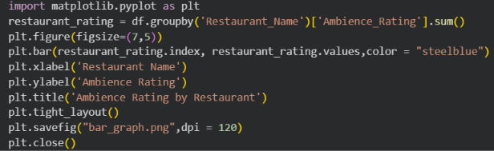
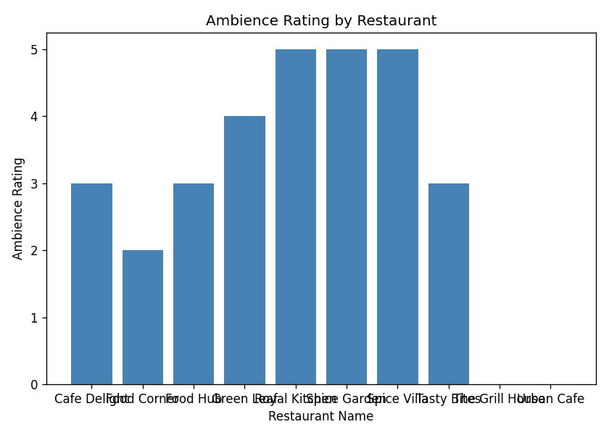
BAR CHART
The bar chart compares the ratings of different restaurants.
The X-axis represents the restaurant names.
The Y-axis represents the corresponding rating values.
Each bar shows the rating obtained by a particular restaurant.
Taller bars indicate higher ratings, while shorter bars indicate lower ratings.
The chart helps in easily comparing restaurant performance based on ratings.

Slide 16
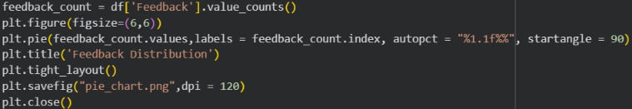
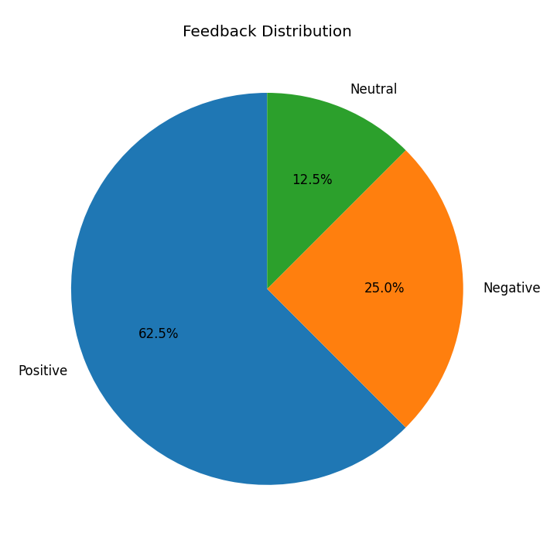
PIE CHART
The pie chart represents the distribution of customer feedback.
It shows categories such as Positive, Neutral, and Negative feedback.
Each slice represents the proportion of reviews in a particular category.
A larger slice indicates a higher number of reviews in that category.
The chart makes it easy to compare the different feedback categories.
It helps understand the overall pattern of customer satisfaction.

Slide 17
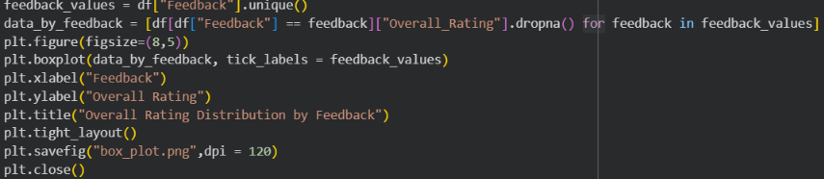
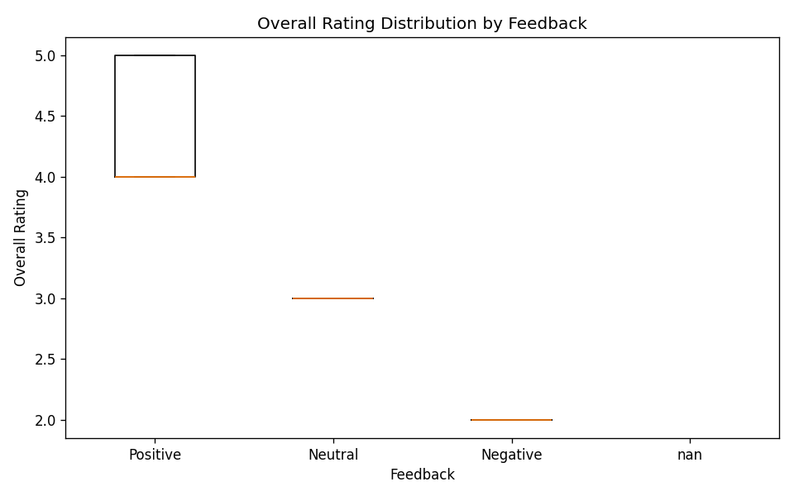
BOX PLOT
The box plot shows the distribution of Overall Ratings for different feedback categories.
The X-axis represents customer feedback categories such as Positive, Neutral, and Negative.
The Y-axis represents the Overall Rating.
The box shows the middle range of ratings, while the line inside represents the median.
Positive feedback mainly has ratings around 4–5, while Neutral and Negative feedback have lower ratings.
It helps compare rating patterns and understand customer satisfaction across feedback categories.

Slide 18
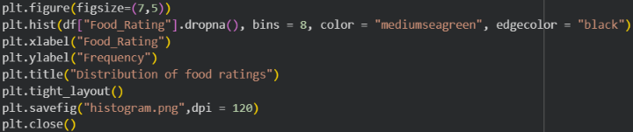
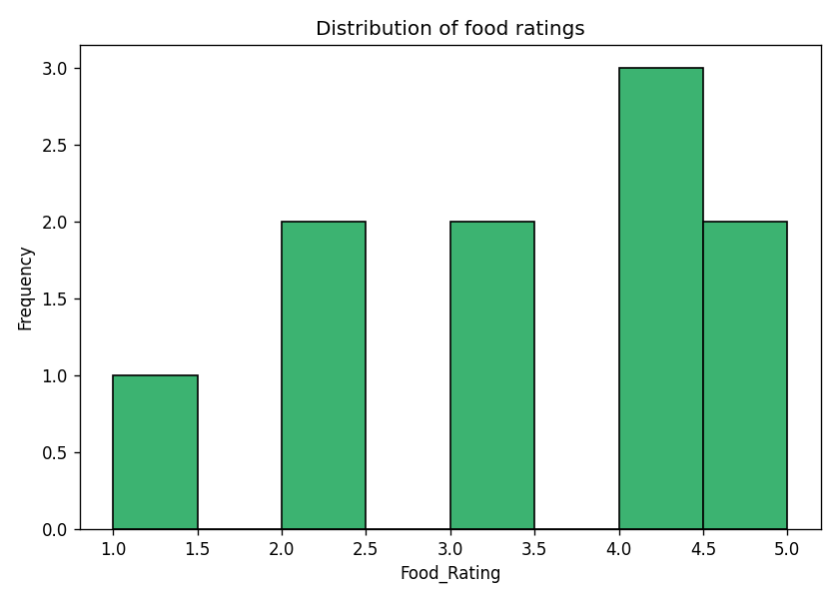
HISTOGRAM
The histogram shows the distribution of Food Ratings in the dataset.
The X-axis represents the Food Rating values from 1 to 5.
The Y-axis represents the frequency or number of restaurants for each rating.
Rating 4 has the highest frequency in the dataset.
Rating 1 has the lowest frequency.
It helps understand the overall distribution and variation of food ratings.

Slide 19
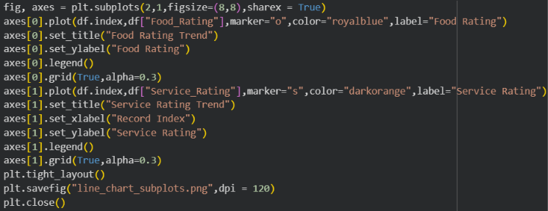
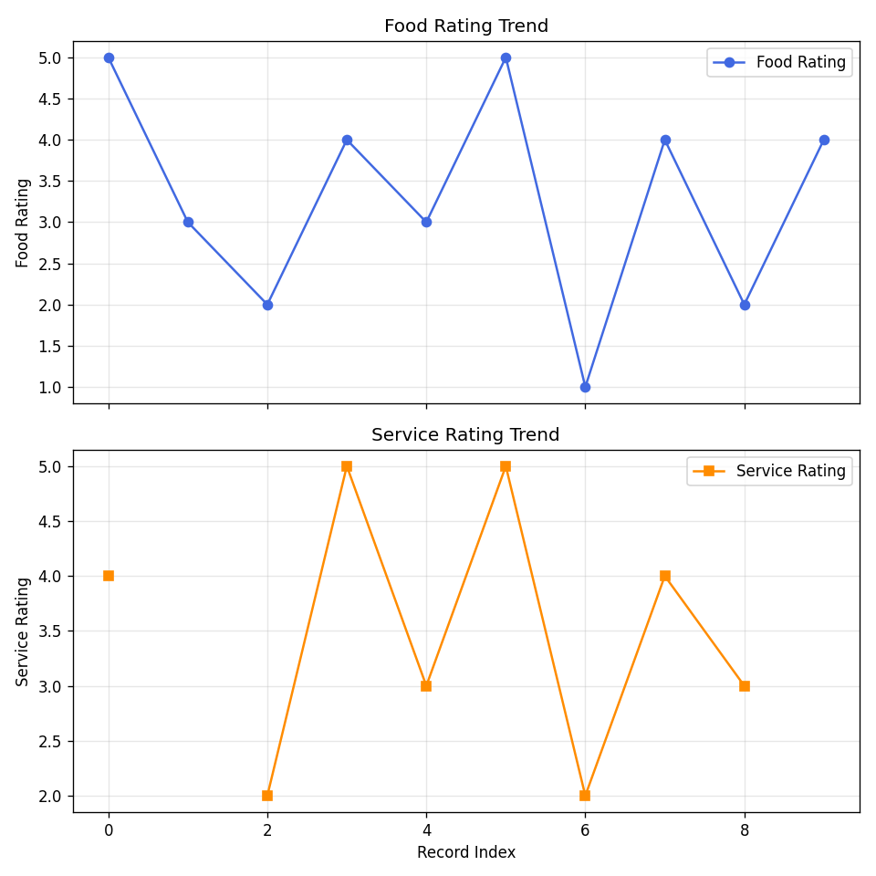
LINE CHART
The line chart shows the variation in Food Rating and Service Rating across restaurants.
The X-axis represents the restaurant names or review records.
The Y-axis represents the rating values from 1 to 5.
The lines show how Food and Service Ratings change from one restaurant to another.
It helps compare food quality and service performance.
It makes differences and patterns in ratings easy to identify.

Slide 20
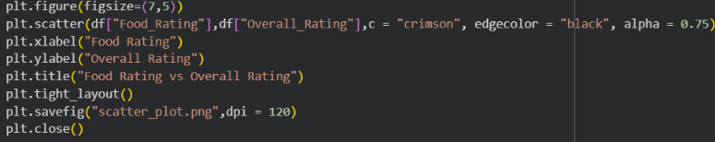
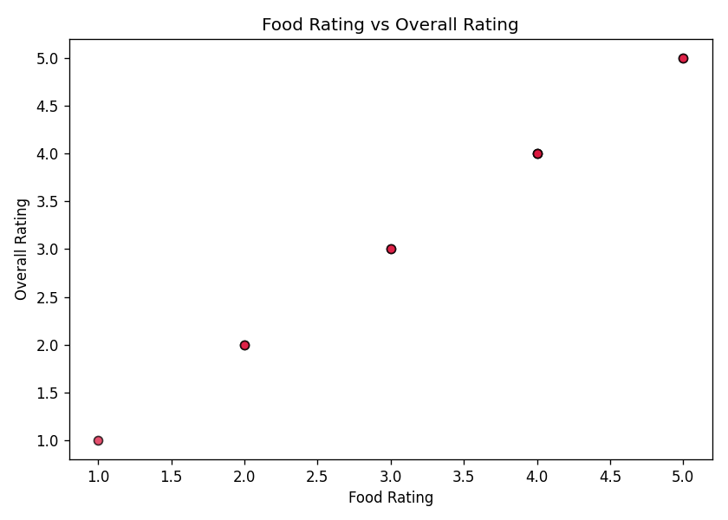
SCATTER PLOT
The scatter plot shows the relationship between Food Rating and Overall Rating.
The X-axis represents the Food Rating.
The Y-axis represents the Overall Rating.
Each point represents one restaurant review.
The points show a generally positive relationship between food quality and overall rating.
It helps identify patterns and understand how Food Rating affects Overall Rating.

Slide 21
FUTURE ENHANCEMENTS
Extend the system with sentiment analysis to automatically classify reviews as positive, negative, or neutral.
Predict customer satisfaction levels using basic statistical or machine learning models.
Enable personalized restaurant recommendations based on customer reviews and ratings.
Add real-time review data for continous monitoring of customer feedback.
Explore food quality, service, price, and ambience factors as additional predictors of customer satisfaction.

Slide 22
CONCLUSION
The Restaurant Review Analysis System successfully analyses customer reviews and restaurant ratings.
Pandas and NumPy were used for data cleaning, preprocessing, and analysis.
Missing values and data inconsistencies were handled to improve data quality.
Ratings were analysed using count, minimum, maximum, and mean operations.
Restaurants were categorized as Most Popular, Popular, or Not Popular based on their overall ratings.
Customer feedback was analysed to understand Positive, Neutral, and Negative responses.
Overall, the project helps identify customer preferences and restaurant performance and provides useful insights for better decision-making.

