Slide 1

Face analysis in a video call through image processing
Project Supervisor: Dr.N Srinivasan
Name of the Student: Cherukuri .Sai Sindhu Meghana
Register Number: 39110226

Slide 2
Presentation Outline
Course Certificate
Introduction
Objectives
Block Diagram
Project Implementation
Methodology
Results
Conclusion
References

Slide 3
Course Certificate

Slide 4
Abstract
Video-based facial recognition has received significant attention in recent years due to its widespread applications. The main challenges faced during face recognition has large variability of images due to pose variations, illumination conditions, facial expressions and image occlusion.
Similarly surveillance and mobile cameras are of low cost devices which affects the video frames quality which results in severe motion blur, out-of-focus blur and large range pose variation. To achieve Face recognition from video image processing and machine learning techniques are used.
The steps for processing involves Image acquisition, Image segmentation, feature extraction, classification and face detection. The features extracted are used in training the classifiers for images that are processed. Hence most recent algorithms developed give an idea of state of art of face recognition technology in video.

Slide 5
Objectives
we are going to face recognition using feature matching technique.
When the input face is matched with the image in the camera it will send the output image with time also.

Slide 6
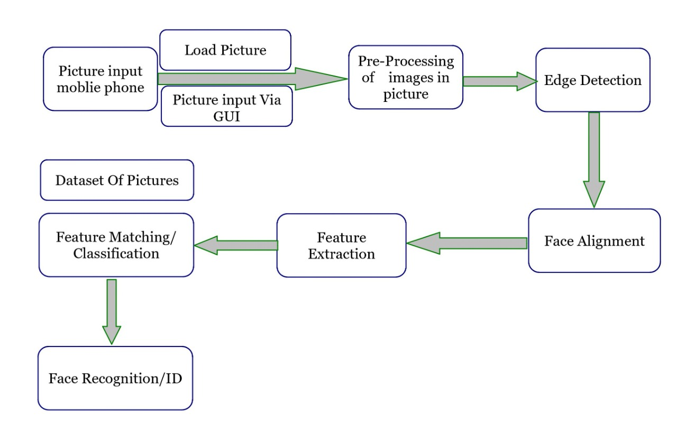
Architecture

Slide 7
Face Recognition Methods & Applications
Security cameras are presently common in airports, Offices, University, ATM, Bank and in any locations with a security system.
Face recognition is a biometric system used to identify or verify a person from a digital image.
This involves extracts its features and then recognize it, regardless of lighting, expression, illumination, ageing, transformations pose, which is a difficult task.

Slide 8
EXISTING SYSTEM
Thus, this work aims at designing and evaluating a smart disk system for face recognition through a Weightless artificial Neural Network (WNN).
It can be used by any application that needs to use artificial neural networks.
Extensive performance, circuit-area, energy consumption and network latency results shows that the coprocessor can efficiently learn and recognize faces faster.

Slide 9
PROPOSED SYSTEM
In this proposed system cameras are placed.
If we want to identify any face from that camera means, we will take the image as Input image.
We compare the input image with camera.
When the input image is matched with the camera means it will send the output image with time.

Slide 10
Description
First we can take a image from video. This is input image and then that image can be given to the feature extraction.
In this feature extracted technique Is feature matching technique and CNN algorithm.
The extracted image is given to the matching tool. In this tool input image is matching with the in built data sets.

Slide 11
Image Processing:
Image Processing is a technique to enhance raw images received from cameras/sensors placed on satellites, space probes and aircrafts or pictures taken in normal day-today life for various applications.
Various techniques have been developed in Image Processing during the last four to five decades. Most of the techniques are developed for enhancing images obtained from unmanned spacecraft’s, space probes and military reconnaissance flights.
computers, large size graphics software’s etc. Image Processing is used in various Techniques.

Slide 12
Pre-processing:
Pre-processing is a common name for operations with images at the lowest level of abstraction of both input and output are intensity images.
Different techniques: Data preprocessing is a data mining technique that involves transforming raw data into an understandable format. Data preprocessing is a proven method of resolving such issues.

Slide 13
Edge detection:
Edge detection is an image processing technique for finding the boundaries of objects within images.
It works by detecting discontinuities in brightness.
Edge detection is used for image segmentation and data extraction in areas such as image processing, computer vision, and machine vision.

Slide 14
Thresholding:
Automatic thresholding is a great way to extract useful information encoded into pixels while minimizing background noise. The idea is to separate the image into two parts; the background and foreground.
Select initial threshold value, typically the mean 8-bit value of the original image.
Divide the original image into two portions;
Pixel values that are less than or equal to the threshold; background
Pixel values greater than the threshold; foreground
Find the average mean values of the two new images
Calculate the new threshold by averaging the two means.
If the difference between the previous threshold value and the new threshold value are below a specified limit, you are finished. Otherwise apply the new threshold to the original image keep trying.

Slide 15
Segmentation
The popular techniques used for image segmentation are: thresholding method, edge detection based techniques.
Analyzing images using image thresholding techniques.
Image thresholding is a simple, yet effective, way of partitioning an image into a foreground and background.

Slide 16
Software required
OPEN CV
Python

Slide 17
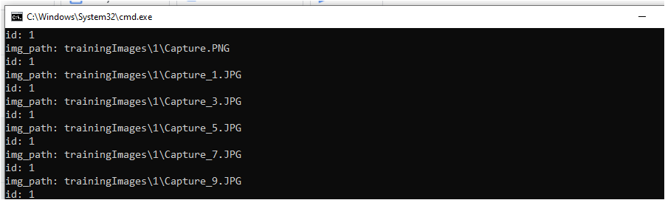
Training dataset:

Slide 18
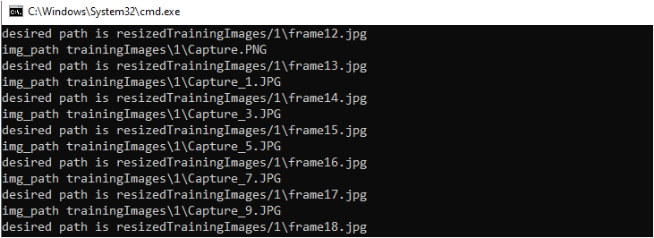
Resize images:

Slide 19
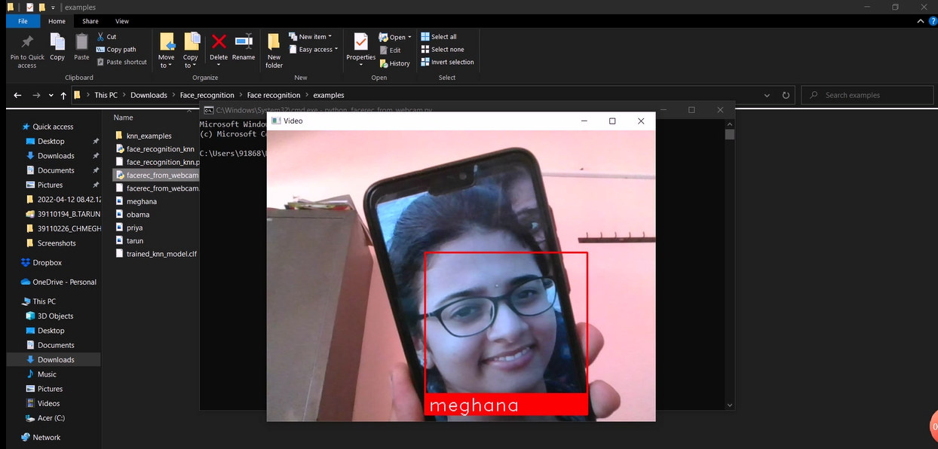
Result: Face detection

Slide 20
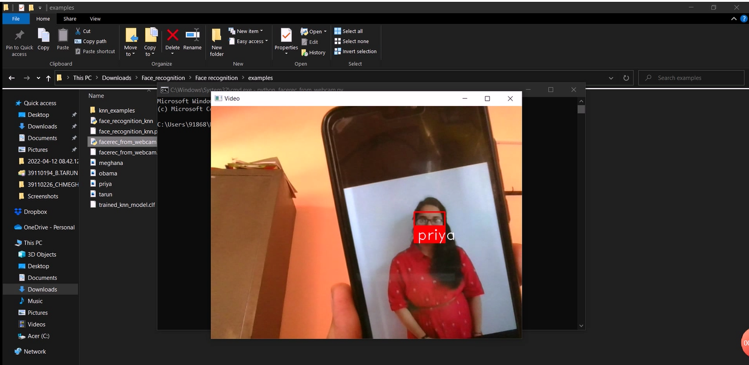

Slide 21
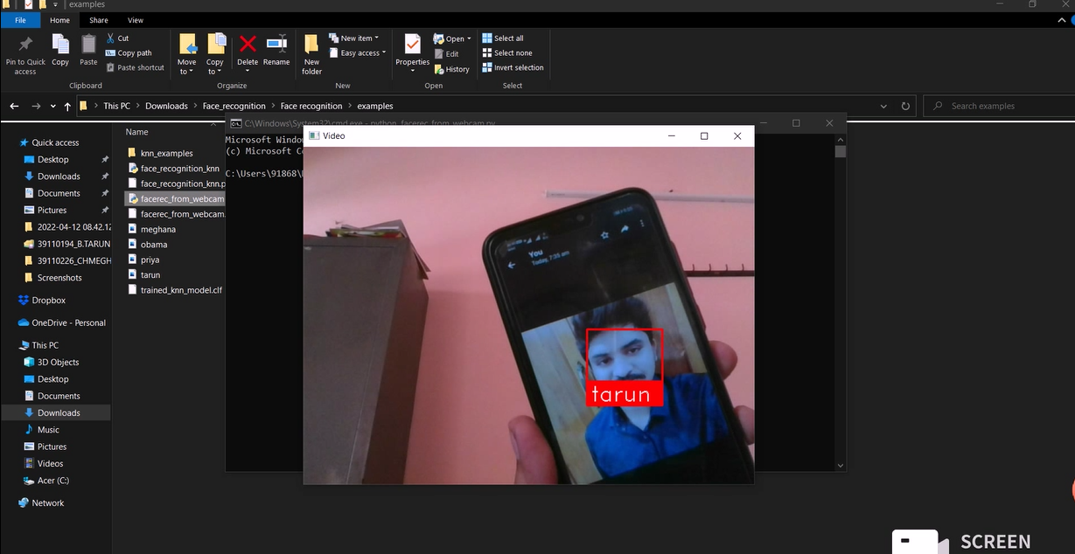

Slide 22
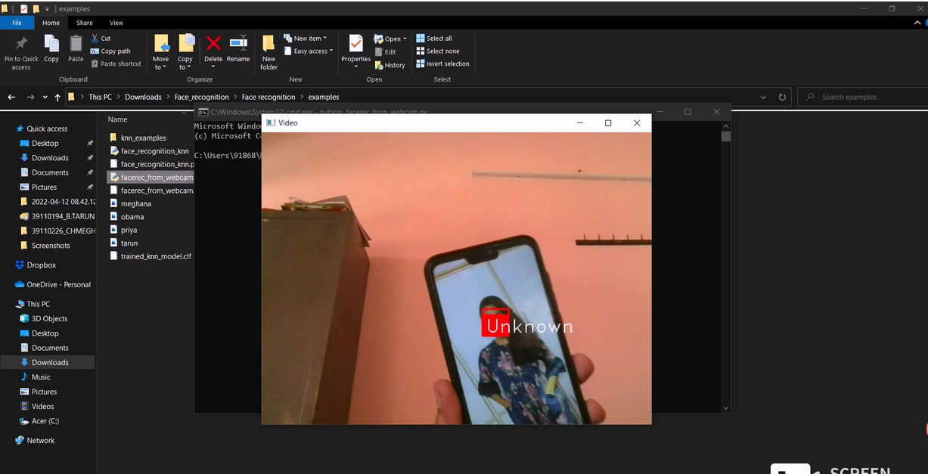

Slide 23
Conclusion:
The purpose of reducing the errors that occur in the traditional attendance taking system has been achieved by implementing this automated attendance system. In this paper, face recognition system have been presented using deep learning which exhibits robustness towards recognition of the users with accuracy of 98.3% .
The result shows the capability of the system to cope with the change in posing and projection of faces. From face recognition with deep learning, it has been determined that during face detection, the problem of illumination is solved as the original image is turned into a HOG representation that captures the major features of the image regardless of image brightness.
In the face recognition method, local facial landmarks are considered for further processing. After which faces are encoded which generates 128 measurements of the captured face and the optimal face recognition is done by finding the person’s name from the encoding. The result is then used to generate an excel sheet, the pdf of which is sent to the students and professors on weekly interval. This system is convenient to the user and it gives better security.

Slide 24
References:
1. N.Sudhakar Reddy, M.V.Sumanth, S.Suresh Babu, "A Counterpart Approach to Attendance and Feedback System using Machine Learning Techniques",Journal of Emerging Technologies and Innovative Research (JETIR), Volume 5, Issue 12, Dec 2018.
2. Dan Wang, Rong Fu, Zuying Luo, "Classroom Attendance Auto-management Based on Deep Learning",Advances in Social Science, Education and Humanities Research, volume 123,ICESAME 2017.
3. Akshara Jadhav, Akshay Jadhav, Tushar Ladhe, Krishna Yeolekar, "Automated Attendance System Using Face Recognition", International Research Journal of Engineering and Technology (IRJET), Volume 4, Issue 1, Jan 2017.
4. B Prabhavathi, V Tanuja, V Madhu Viswanatham and M Rajashekhara Babu, "A smart technique for attendance system to recognize faces through parallelism", IOP Conf. Series: Materials Science and Engineering 263, 2017.
5. Prajakta Lad, Sonali More, Simran Parkhe, Priyanka Nikam, Dipalee Chaudhari, " Student Attendance System Using Iris Detection", IJARIIE-ISSN(O)-2395-4396, Vol-3 Issue-2 2017.

