Slide 1
FACE ANALYSIS IN A VIDEO CALL THROUGH IMAGE PROCESSING

Slide 2
ABSTRACT
Video-based facial recognition has received significant attention in recent years due to its widespread applications. The main challenges faced during face recognition has large variability of images due to pose variations, illumination conditions, facial expressions and image occlusion. Similarly surveillance and mobile cameras are of low cost devices which affects the video frames quality which results in severe motion blur, out-of-focus blur and large range pose variation. To achieve Face recognition from video image processing and machine learning techniques are used. The steps for processing involves Image acquisition, Image segmentation, feature extraction, classification and face detection. The features extracted are used in training the classifiers for images that are processed. Hence most recent algorithms developed give an idea of state of art of face recognition technology in video.

Slide 3
SCOPE
To achieve Face recognition from video image processing and machine learning techniques are used.
The steps for processing involves Image acquisition, Image segmentation, feature extraction, classification and face detection.
The features extracted are used in training the classifiers for images that are processed.
Hence most recent algorithms developed give an idea of state of art of face recognition technology in video.

Slide 4
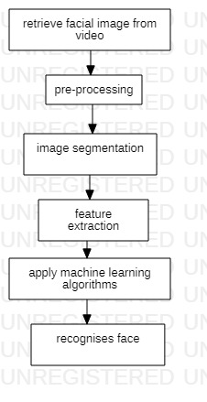
FLOWCHART

