Slide 1
Depth First Search(DFS) Topics on Trees

Slide 2
Content
DFS intro.
DFS applications
DFS on Trees
DFS code

Slide 3
DFS intro.
Depth First Search
Graph G=(V,E)
Search
Given source vertex s, want mark all vertices v such that there exist a path from s to v.
Time Complexity: O(V+E)

Slide 4
DFS intro.
1
5
3
Source node: 3
Mark node 3
2
4
6
7

Slide 5
DFS intro.
1
5
3
Mark node 1
2
4
6
7

Slide 6
DFS intro.
1
5
3
Mark node 2
2
4
6
7

Slide 7
DFS intro.
1
5
3
No more unvisited neighbor
nodes for node 2 -> Backtrack
2
4
6
7

Slide 8
DFS intro.
1
5
3
2
4
6
7

Slide 9
DFS intro.
1
5
3
2
4
6
7

Slide 10
DFS intro.
1
5
3
2
4
6
7

Slide 11
DFS intro.
1
5
3
Mark node 4
2
4
6
7

Slide 12
DFS intro.
1
5
3
Mark node 6
2
4
6
7

Slide 13
DFS intro.
1
5
3
Mark node 5
2
4
6
7

Slide 14
DFS intro.
1
5
3
No more unvisited neighbor
nodes for node 5 -> Backtrack
2
4
6
7

Slide 15
DFS intro.
1
5
3
2
4
6
7

Slide 16
DFS intro.
1
5
3
2
4
6
7

Slide 17
DFS intro.
1
5
3
2
4
6
7

Slide 18
DFS intro.
1
5
3
Mark node 7
2
4
6
7

Slide 19
DFS intro.
1
5
3
Backtrack
2
4
6
7

Slide 20
DFS intro.
1
5
3
2
4
6
7

Slide 21
DFS intro.
1
5
3
2
4
6
7

Slide 22
DFS intro.
1
5
3
DFS done!
2
4
6
7

Slide 23
DFS intro.
Given G=(V,E), problem provides adjacency vector for each node v.
Maintain:
a bool array to mark visited nodes
DFS is called recursively.

Slide 24
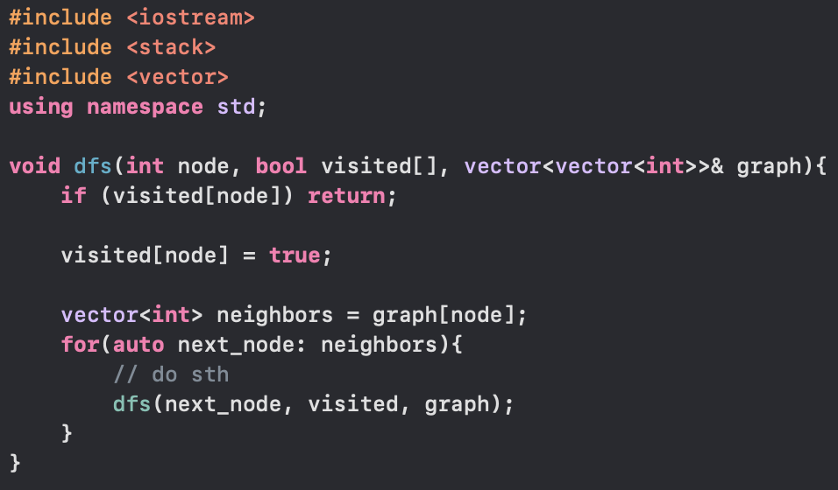

Slide 25
DFS applications
Count connected components(undirected graph)
Count strongly connected components(directed graph)
Determine connectivity
Subtree finding
Find bridges

Slide 26
DFS on Trees: Find all Subtrees of Tree
A Tree is a (1)undirected, (2)connected graph without cycles
Generally, we define root node for trees.

Slide 27
DFS on Trees: Find all Subtrees of Tree
1
1
5
5
3
3
2
2
4
6
4
6
Not a Tree
Tree
7
7

Slide 28
DFS on Trees: Find all Subtrees of Tree
Maintain:
a bool array to mark visited nodes → since each child node only has one parent, just pass the parent node to the next dfs iteration
Global timestamp
An array that tracks the starting timestamp of traverse
An array that tracks the ending timestamp of traverse
An array that tracks the node traversed at each timestamp
DFS is called recursively

Slide 29
DFS on Trees: Find all Subtrees of Tree
1
4
2
3
8
5
6
7

Slide 30
DFS on Trees: Find all Subtrees of Tree
1
4
8

Slide 31
DFS on Trees: Find all Subtrees of Tree
1
4
T = 0
START [1] = T
END [1] = ?
DFS_TRAV [T] = 1
8

Slide 32
DFS on Trees: Find all Subtrees of Tree
1
4
T = 1
START [4] = T
END [4] = ?
DFS_TRAV [T] = 4
8

Slide 33
DFS on Trees: Find all Subtrees of Tree
1
4
T = 2
START [8] = T
END [8] = ?
DFS_TRAV [T] = 8
8

Slide 34
DFS on Trees: Find all Subtrees of Tree
1
4
T = 2
END [8] = T
8

Slide 35
DFS on Trees: Find all Subtrees of Tree
1
4
T = 2
END [4] = T
8

Slide 36
DFS on Trees: Find all Subtrees of Tree
1
4
T = 2
END [1] = T
8

Slide 37
DFS on Trees: Find all Subtrees of Tree
1
4
START [] = {-1, 0, -1, -1, 1, -1, -1, -1, 2}
END [] = {-1, 2, -1, -1, 2, -1, -1, -1, 2}
DFS_TRAV [] = {1,4,8}
8

Slide 38
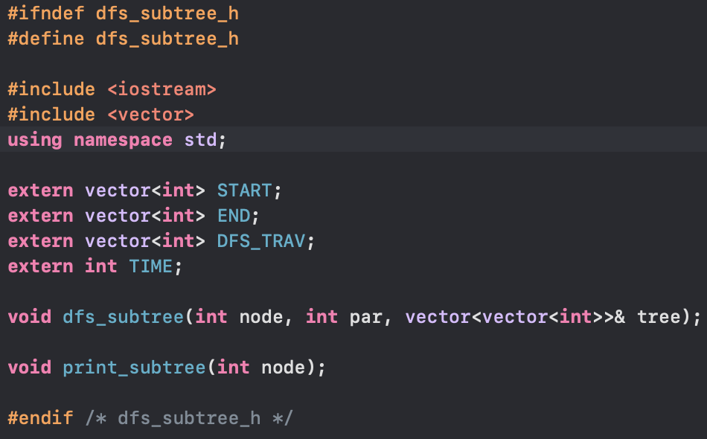

Slide 39
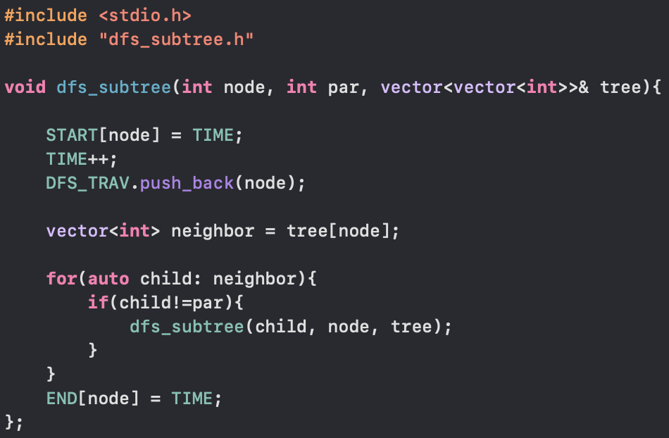

Slide 40
