Slide 1
ASP.NET MVC
Suresh Ch
About 10 years Experience
10 years in .net based Enterprise Application Development
Software Engineer
+91 9985177299 chsuresh3112@gmail.com

Slide 2
About Your
Web Application Development Experience
  Front-End (UI) Technologies
  Server Side Technologies
Design Patterns Used / Implemented

Slide 3
TABLE OF CONTENTS
ASP.NET MVC - Overview
ASP.NET MVC - Pattern
ASP.NET MVC - Environment Setup
ASP.NET MVC - Getting Started
ASP.NET MVC - Life Cycle
ASP.NET MVC - Routing
ASP.NET MVC - Controllers
ASP.NET MVC - Actions
ASP.NET MVC – Filters

Slide 4
TABLE OF CONTENTS
11. ASP.NET MVC – Selectors
12. ASP.NET MVC – Views
13. ASP.NET MVC - Data Model
14. ASP.NET MVC - Helpers
15. ASP.NET MVC - Model Binding
16. ASP.NET MVC - Databases
17. ASP.NET MVC - Validation
18. ASP.NET MVC - Security
19. ASP.NET MVC - Caching
20. ASP.NET MVC - Razor
21. ASP.NET MVC - Data Annotations

Slide 5
TABLE OF CONTENTS
22. Nuget Package Management
23. ASP.NET MVC - Web API/ WCF
24. ASP.NET MVC - Scaffolding
25. ASP.NET MVC - Bootstrap
26. ASP.NET MVC - Unit Testing
27. ASP.NET MVC – Azure Deployment
28. ASP.NET MVC - Self-hosting
29. Version Control - TFS
30. Sample Project by covering most of the above topics.

Slide 6
ASP.NET MVC Overview
ASP.NET MVC Overview
  Overview
  About MVC
  Benefits
  ASP.NET vs ASP.NET MVC

Slide 7
ASP.NET MVC Overview
Overview :
ASP.NET MVC is basically a web development framework from Microsoft, which combines the features of MVC (Model-View-Controller) architecture.
It is built on the top of ASP.NET, so developers enjoy almost all the ASP.NET features while building the MVC application.
There will be no illusions of state, there will not be such a thing as a page load and no page life cycle at all, etc.

Slide 8
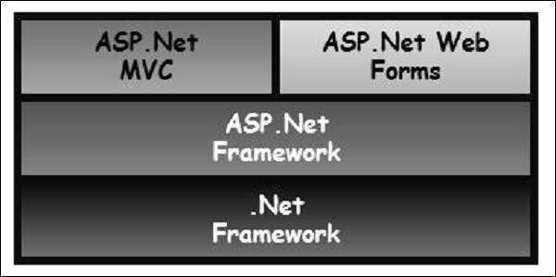
ASP.NET MVC Overview
Overview

Slide 9
ASP.NET MVC Overview
About MVC Architecture pattern.
  MVC stands for Model, View and Controller.
  Model is responsible for maintaining application data and business logic.
  View is a user interface of the application, which displays the data.
  Controller handles user's requests and renders appropriate View with Model data.

Slide 10
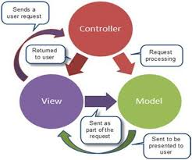
ASP.NET MVC Overview

Slide 11
ASP.NET MVC Overview
Benefits of ASP.NET MVC
  Makes it easier to manage complexity by dividing an application into the model, the view, and the controller.
  Enables full control over the rendered HTML and provides a clean separation of concerns.
  Facilitates adding more interactivity and responsiveness to existing apps.
  Provides better support for test-driven development (TDD).
  Works well for Web applications that are supported by large teams of developers and for Web designers who need a high degree of control over the application behavior.

Slide 12
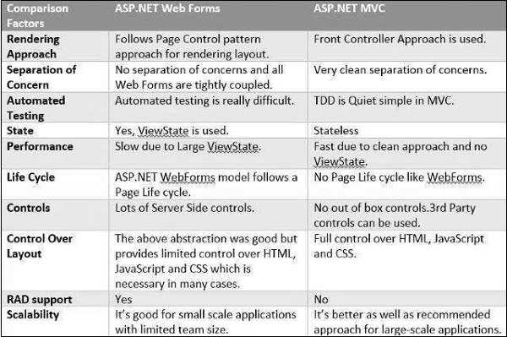
ASP.NET MVC Overview
ASP.NET vs ASP.NET MVC

Slide 13
ASP.NET MVC - Pattern
Flow Steps
  Step 1 − The client browser sends request to the MVC Application.
  Step 2 − Global.ascx receives this request and performs routing based on the URL of the incoming request using the RouteTable, RouteData, UrlRoutingModule and MvcRouteHandler objects.
  Step 3 − This routing operation calls the appropriate controller and executes it using the IControllerFactory object and MvcHandler object's Execute method.
  Step 4 − The Controller processes the data using Model and invokes the appropriate method using ControllerActionInvoker object
  Step 5 − The processed Model is then passed to the View, which in turn renders the final output.

Slide 14
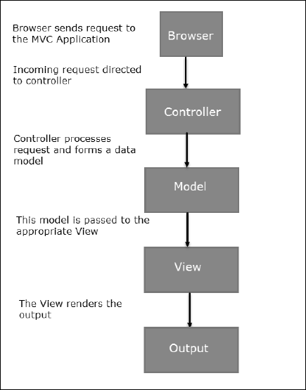
ASP.NET MVC pattern

Slide 15
ASP.NET MVC – SETUP
MVC development tool is included with Visual Studio 2012 and onwards.

Slide 16
GETTING STARTED
Create an MVC Application :
Step (1): Open the Visual Studio. Click File -> New -> Project menu option.
Step (2): From the left pane, select Templates -> Visual C# -> Web.
Step (3): In the middle pane, select ASP.NET Web Application.
Step (4): Enter the project name, MVCFirstApp, in the Name field and click ok to continue.
Step (5): To keep things simple, select the ‘Empty’ option and check the MVC checkbox in the Add folders and core references section. Click Ok.
Step (6) : Run application

Slide 17
Getting Started
Add Controller
  Step (1): To add a controller, right-click on the controller folder in the solution explorer and select Add -> Controller.
  Step (2): Select the MVC 5 Controller – Empty option and click ‘Add’ button.
  Step (3): Set the name to HomeController and click the Add button.
  Step (4) : Modify controller action code to run.
public string Index()
        {
        return "Hello World, this is ASP.Net MVC Tutorials";
      }

Slide 18
ASP.NET MVC - Life Cycle
At a high level, a life cycle is simply a series of steps or events used to handle some type of request or to change an application state.
MVC has two life cycles:
  1. The application life cycle
  2. The request life cycle

Slide 19
ASP.NET MVC - Life Cycle
The Application Life Cycle
  The application life cycle refers to the time at which the application process actually begins running IIS until the time it stops. This is marked by the application start and end events in the startup file of your application
  The Request Life Cycle
    It is the sequence of events that happen every time an HTTP request is handled by our application.
    The entry point for every MVC application begins with routing. After the ASP.NET platform has received a request, it figures out how it should be handled through the URL Routing Module.

Slide 20
ASP.NET MVC – Life Cycle
Steps:
  Modules are .NET components that can hook into the application life cycle and add functionality. The routing module is responsible for matching the incoming URL to routes that we define in our application.
  All routes have an associated route handler with them and this is the entry point to the MVC framework.
  The MVC framework handles converting the route data into a concrete controller that can handle requests.
  action invoker finds and selects an appropriate Action method to invoke the controller.
  After our action result has been prepared, the next stage triggers, which is Result Execution. MVC separates declaring the result from executing the result. If the result is a view type, the View Engine will be called and it's responsible for finding and rending our view.
  If the result is not a view, the action result will execute on its own. This Result Execution is what generates an actual response to the original HTTP request.

Slide 21
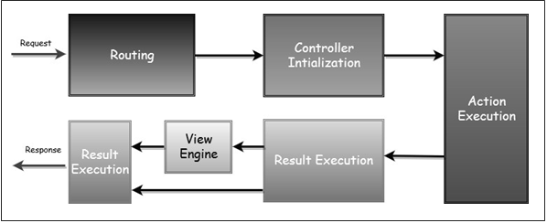
ASP.NET MVC – Life Cycle

Slide 22
ASP.NET MVC - Routing
This article describes how ASP.NET MVC routing works, Custom Routes, attribute routing, route constraints, Area Routing.
Routing is important feature of ASP.NET MVC. The routing module is responsible for mapping incoming browser request to unique controller action method. Routing is an entry point of ASP.NET MVC Request life cycle.
Routing enable us to define URL pattern that maps to the request handler. This request handler can be a file or class.
In ASP.NET Webform application, request handler is .aspx file and in MVC, it is Controller class and Action method.
Route must be registered in Application_Start event in Global.ascx.cs file
Register Routes :
All the configured routes of an application stored in RouteTable and will be used by Routing engine to determine appropriate handler class or file for an incoming request.
Multiple Routes:
You can register multiple custom routes with different names. MVC framework evaluates each route in sequence. It starts with first configured route and if incoming url doesn't satisfy the URL pattern of the route then it will evaluate second route and so on.
Below routes are valid.
  {language}-{country}/{controller}/{action}
  {controller}-{action}-{id}
  {controller}.{action}.{id}

Slide 23
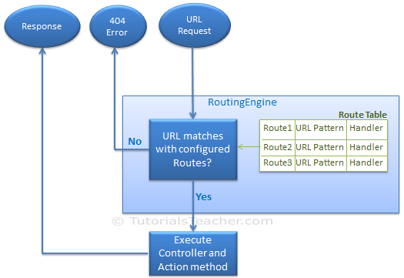
ASP.NET MVC - Routing

Slide 24
ASP.NET MVC - Routing
protected void Application_Start() { RouteConfig.RegisterRoutes(RouteTable.Routes);//Global.asax
public static void RegisterRoutes(RouteCollection routes)
{
routes.IgnoreRoute("{resource}.axd/{*pathInfo}");
routes.MapRoute(
name: "Student",
url: "students/{id}", defaults: new { controller = "Student", action =“Index"}
);
routes.MapRoute( "Order", "orders/{controller}/{action}/{id}“,
new { controller = "order", action = "Index", blogid = "" } // Parameter defaults );
routes.MapRoute(
name: "Default",
url: "{controller}/{action}/{id}",
defaults: new { controller = "Home", action = "Index", id = UrlParameter.Optional });
routes.MapRoute(
name: "Student",
url: "student/{id}/{name}/{standardId}", defaults: new { controller = "Student", action = "Index", id = UrlParameter.Optional, name = UrlParameter.Optional, standardId = UrlParameter.Optional },
constraints: new { id = @"\d+" } );
}

Slide 25
ASP.NET MVC - Routing
Attribute Routing
  Attribute Routing is new type of routing feature of ASP.NET MVC 5.
  Attribute routing uses attributes to create Routes. Attribute routing gives you more control to handle URI by adding routes directly on controller and actions.
  Attribute Routing should be registered in RegisterRoutes method of Global.asax or in RouteConfig file. It should be configured before convention based routing.
  public static void RegisterRoutes(RouteCollection routes)
  {
  routes.IgnoreRoute("{resource}.axd/{*pathInfo}");
  //Add the following line of code
  routes.MapMvcAttributeRoutes();
  //convention based routes
  }
  In case if you are using both Attribute routing and convention based routing, the actions which are configured for Attribute routing will work as per Attribute Routes and the actions which are not configured will work as convention based routes.

Slide 26
  Routing at Controller Level :
  [RoutePrefix("AppHome")]
  [Route("{action=index}")] //default action used when URL action parameter is not exist in controller. //e.g. //http://example.com/apphome or http://example.com/apphome/details
  public class HomeController : Controller {
  }
  Routing at Action Method:
  [Route("Users/about")]
  public ActionResult About()
  { …}
Catch-all Route:
  A catch-all parameter useful for a route to match part of a URL with an, unpredictable number of segments. If any query string used, it excludes from URL. A catch-all parameter is allowed only for the last segment of the route template.
  public static void RegisterRoutes(RouteCollection routes)
  {
  routes.MapRoute("catchallroute", "blog/{blog-name}/{*extrastuff}",
  new { controller = "blog", action = "showblog"));
  }

Slide 27
ASP.NET MVC - Routing
Interview Questions on Routing:
  What are routing in MVC?
  Where is the route mapping configured?
  Can we map multiple URL's to the same action?
  Explain attribute based routing in MVC? Advantages?
  Difference between Routing and URL Rewriting?

Slide 28
ASP.NET MVC - Routing
What are routing in MVC?
  Routing helps you to define user friendly URL structure and map those URL structure to the controller. Also, explain here how a routing is defined and how it maps to a specific controller.
Where is the route mapping configured?
  The route mapping code is written in "RouteConfig.cs" file and registered using "global.asax" application start event.
Can we map multiple URL's to the same action?
  Yes , you can , you just need to make two entries with different key names and specify the same controller and action..
  Also, using attribute routing. You can specify multiple attribute routes for the same action method.
Explain attribute based routing in MVC? Advantages?
  his is a feature introduced in MVC 5. By using the "Route" attribute we can define the URL structure at controller level or Action Method level.
  Advantage : easy to find out which action method is mapped to which URL.
Difference between Routing and URL Rewriting?
  URL rewriting is focused on mapping one URL (new url) to another URL (old url) while routing is focused on mapping a URL to a resource.
  Actually, URL rewriting rewrites your old url to new one while routing never rewrite your old url to new one but it map to the original route.

Slide 29
ASP.NET MVC - Helper
Action Link :
  @Html.ActionLink(string text,string Action Name, string controllerName, parameters)
  Eg : @Html.ActionLink(employee.Name, "Details", new { id = employee.EmployeeId })
  Sample Example :
  1. We want to display all the employees in a bulletted list as hyperlinks.
  2. When the hyperlink is clicked, the user will be redirected to employee details page, displaying the full details of the employee as shown below.
  Sample Example 2 :
  Work with multiple tables
  Dept -> Employess -> Employee Detais

Slide 30
ASP.NET MVC - Models
Business Objects :
  Business objects contain both state(data) and behaviour, that is logic specific to the business.
  In MVC there are several conventions that needs to be followed. For example, controllers need to have the word controller in them and should implement IController interface either directly or indirectly. Views should be placed in a specific location that MVC can find them.
  But with models, there are no strict rules. Infact "Models" folder is optional and they can live anywhere. They can even be present in a separate project.
  TEst

