Slide 1
Tic-Tac-toe using Min-Max Algorithm
Naga Anvesh Kunuguntla
Surya Teja Chinigepalli
Lakshmi Sai Nandan Ponakala

Slide 2

Table of contents
Tic Tac Toe
Objectives
Overview
Algorithms
Min-Max Algorithm
Algorithm Overview
Performance analysis
Code

Slide 3
Overview
Tic-tac-toe is a very popular game for two players, X and O, who take turns marking the spaces in a 3×3 grid. The player who succeeds in placing three of their marks in a vertical, horizontal or diagonal row wins the game.
There will be two players in a game. Two signs represent each player. The general signs used in the game are X and O. Finally, there will be a board with 9 boxes.
Here the opponent will be an AI enabled computer that predicts the users moves

Slide 4
Algorithms
Rinforcment Learning:- Agent : Entity learning about the environment and making decisions. We need to specify a learning algorithm for the agent that allows it to learn a policy
Environment: Everything outside the agent, including other agents
Rewards: Numerical quantities that represent feedback from the environment that an agent tries to maximize
Goal reward representation: 1 for goal, 0 otherwise
Action penalty representation: -1 for not goal, 0 once goal is reached
Min-Max Algortihm:- The algorithm evaluates the moves that lead to a terminal state based on the players’ turn. It will choose the move with maximum score when it is the AI’s turn and choose the move with the minimum score when it is the human player’s turn. Using this strategy, Minimax avoids losing to the human player.

Slide 5
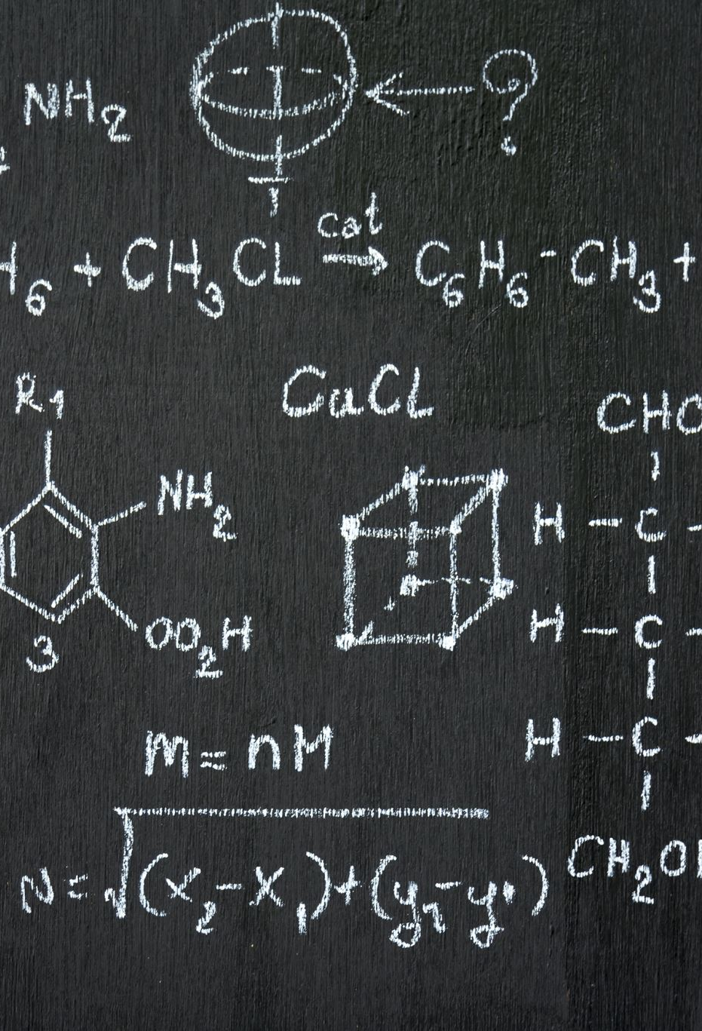
Min-Max Algorithm
A Minimax algorithm can be best defined as a recursive function that does the following things:
return a value if a terminal state is found (+10, 0, -10)
go through available spots on the board
call the minimax function on each available spot (recursion)
evaluate returning values from function calls
and return the best value

Slide 6
Algorithm Continued...
There’re two utility values called the min and max value that help the A.I. agent to decide its next optimal move.
For this case, the Agent prioritizes moves with a max value of 10 and then opts for a min value of -10. (Agent wants to win more than preventing its opponent to win) If there aren’t any moves with a min or max value greater than or less than 10, it selects the move with the highest absolute value of min plus max value.
Again, Minimax assumes that its opponent plays optimally.

Slide 7
Continued..
Min Value-This is the value where the A.I. agent seeks to minimize the possible loss for a worst-case scenario. For every horizontal, vertical, diagonal lane on the board position, the min value -1 per lane if the 3 positions have none of your moves. Then, for every additional opponent move on a lane, you -1 . However, if there are 2 opponent moves, your min value becomes –10.
MaX Value:-This is the value where the A.I. seeks to maximize the possible gain for a best-case scenario. For every horizontal, vertical, diagonal lane on the board position, you +1 per lane if the 3 positions have none of your opponent’s moves. Then, for every additional move you made on the lane, you +1 again(Only if your enemy didn’t make any move on that lane). However, if there are 2 of your moves, your max value becomes +10(You win by making a move there!).

Slide 8
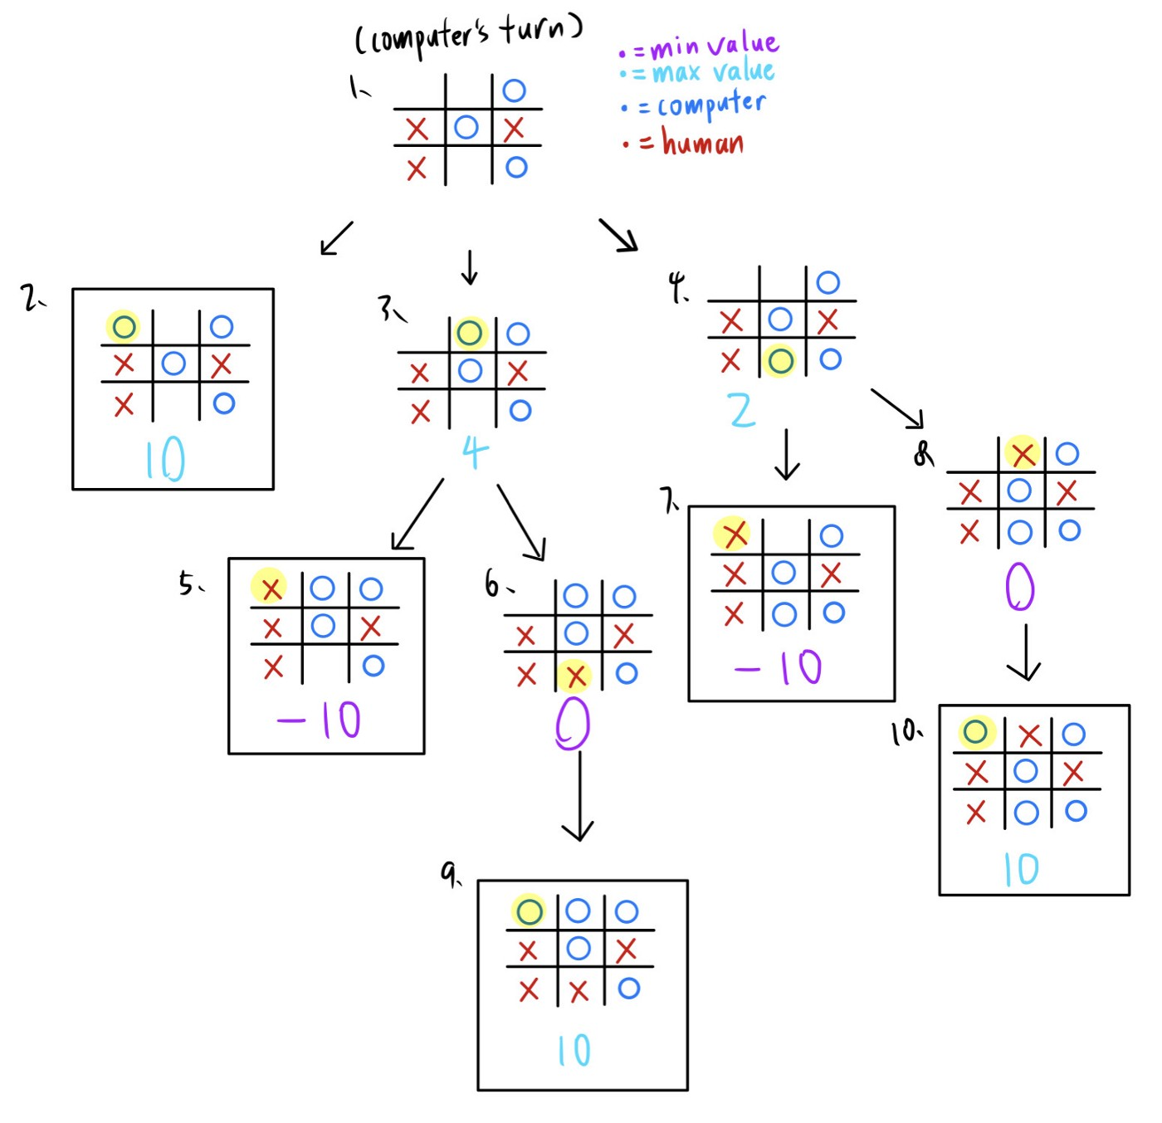
Algorithm Overview

Slide 9
Framework:-
Brute Force flow :- Brute Force Algorithms refers to a programming method that does not include any tricks to improve performance, but depends instead on brute computational power to try out all options until a problem is solved.
Alpha-Beta Flow:- Alpha-Beta Minimax algorithm is used to cut the branches of the tree which won’t contribute positively to the goal state that needs to be arrived at. Alpha – Beta Pruning allows the space to be used in a compact manner as well as use time efficiently.
The purpose of Tic-Tac-Toe is to win multiple games as well as efficient use of the system

Slide 10
Performance Analysis
The working requirement of Tic-Tac-Toe, we construct a PvC game with Brute force framework. This involves applying the marker at any randomly available square on the 3x3 grid. This not only decreases the chances of the System winning by 80% but has high space complexity. We can understand this by, the analysis of code used. For each loop used the complexity added N. For each loop nested within N is multiplied by outer loop. For each if-else statement complexity added is: 1. The complexity of brute force: O ((N×2) ×10+20*N+N^2).
Execution is recursive execute the same function again and again, it takes more time to reach the goal state. Although the complexity seems to be low in time, when compared to the optimal winning strategies achieved it is rendered useless. The algorithm is required to be not only efficient but also accurate. Improvised AB Algorithm for tic tac toe game Understanding that winning strategies begin with taking the corners, our Algorithm is set such that we take up the ends. Gradually as the player plays, the algorithm cuts down the state space by pruning and time with minimal recursive calls.The complexity calculated is O(bM)

