Slide 1
Smile Guru Data
Analysis Report and Visualizations

Slide 2
SOFTWARE USED
MY SQL WORKBENCH
POWER BI
MS EXCEL

Slide 3
TOPIC COVERED
Data Cleaning in SQL
Event Date Processing
Unique ID Column Addition
Null Value Handling
Missing values and invalid
Data Type Standardization
Handling Remaining Null Values
Exporting Cleaned Dataset
Conclusion of Data Cleaning
Data Visualization in Power BI
Bar Chart – Page Views
Tree Map – Event Names
Pie Chart – Event Type
Donut Chart – Device OS
Pie Chart – Device Category
Filter Pane (Slicers)
KPI Card
Conclusion of Visualization

Slide 4
Data Cleaning in SQL
Imported the dataset into SQL, ensuring all data was initially treated as text to prevent automatic conversions or misinterpretations.
This step helped maintain data integrity and allowed for controlled type conversions later in the process.

Slide 5
Null Value Handling
Event Date Processing
Checked for null values in the event date column and replaced them with a standard date to maintain consistency.
Converted the column from text format to a proper date type to enable accurate date-based analysis and filtering.
Unique ID Column Addition
Introduced an ID column to uniquely identify each record.
This helped in tracking data modifications and ensuring each row had a unique identifier.
Identified and removed records where critical fields (such as event name, device category, and page location) contained null values.
Ensured data completeness and avoided misleading or incomplete insights in further analysis.
Deleting the row which have minim 3 null values by which the data loss is controlled

Slide 6
Missing values and invalid
event_timestamp: 65 occurrences of "invalid_timestamp"
event_date: 103 occurrences of missing values
event_name: 91 occurrences of missing values
user_pseudo_id: 100 occurrences of missing values
device_category: 109 occurrences of missing values
device_os: 91 occurrences of missing values
page_location: 109 occurrences of missing values

Slide 7
Exporting Cleaned Dataset
Data Type Standardization
Converted numerical columns to appropriate data types (e.g., integer, float) for efficient calculations.
Standardized categorical fields to VARCHAR format for better readability and processing.
Applied constraints where necessary to maintain data consistency.
Handling Remaining Null Values
Instead of removing records with missing values in non-critical fields, replaced nulls with "Unknown" or default values.
This minimized data loss while still ensuring meaningful analysis.
After all cleaning steps, saved the final version of the dataset in CSV format.
This prepared the data for further visualization and analysis in Power BI.

Slide 8
Conclusion of Data Cleaning
Data Consistency & Integrity: Ensured proper data types, unique identifiers, and standardized missing values to maintain accuracy.
Improved Data Quality: Removed incomplete records and filled non-critical nulls with "Unknown" to retain valuable information.
Ready for Analysis: Exported the cleaned dataset for seamless integration and visualization in Power BI.

Slide 9
Data Visualization in Power BI
Interactive Dashboards – Users can explore data with filters, slicers, and drill-through features for deeper insights.
Diverse Visuals – Bar charts, pie charts, tree maps, and KPI cards help analyze trends, user behavior, and key metrics.
Real-Time Insights – Power BI connects to multiple data sources, enabling dynamic updates for accurate decision-making.

Slide 10
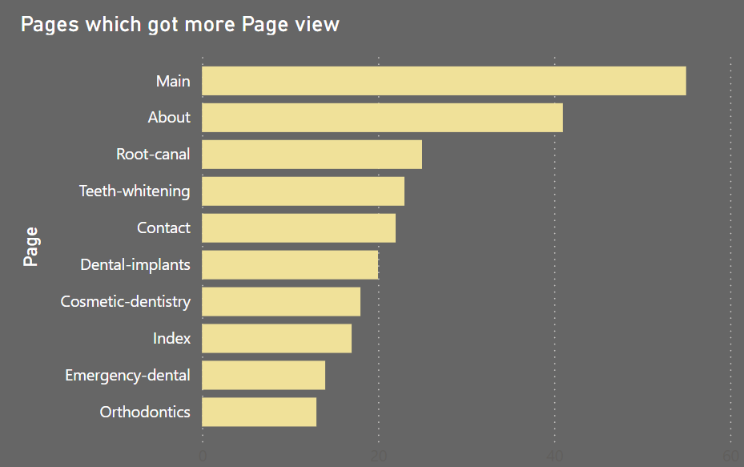
Bar Chart – Page Views
Highlights the most visited pages, with the Main and About pages receiving the highest views.
Less visited pages include Orthodontics and Emergency Dental, indicating areas for potential content improvement.

Slide 11
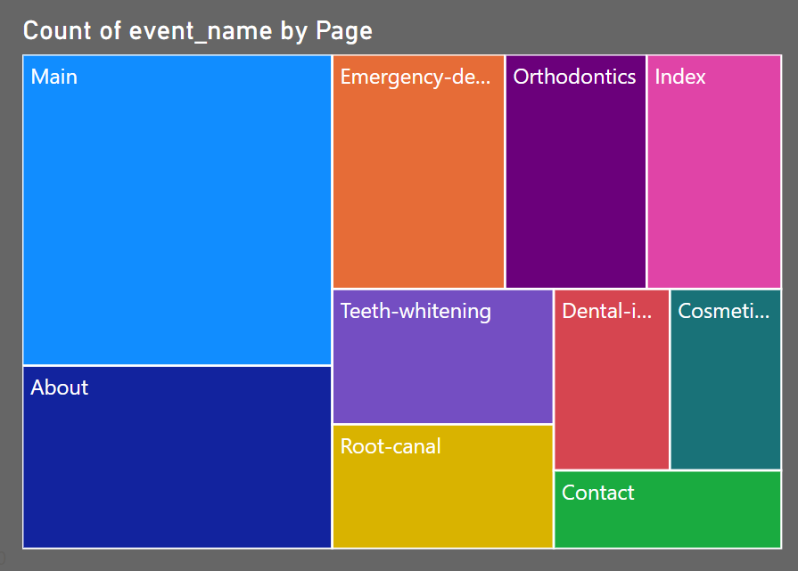
Tree Map – Event Names
Shows the distribution of user interactions on different pages.
The Main page has the highest engagement, while other service pages like Teeth Whitening and Root Canal also see notable activity.

Slide 12
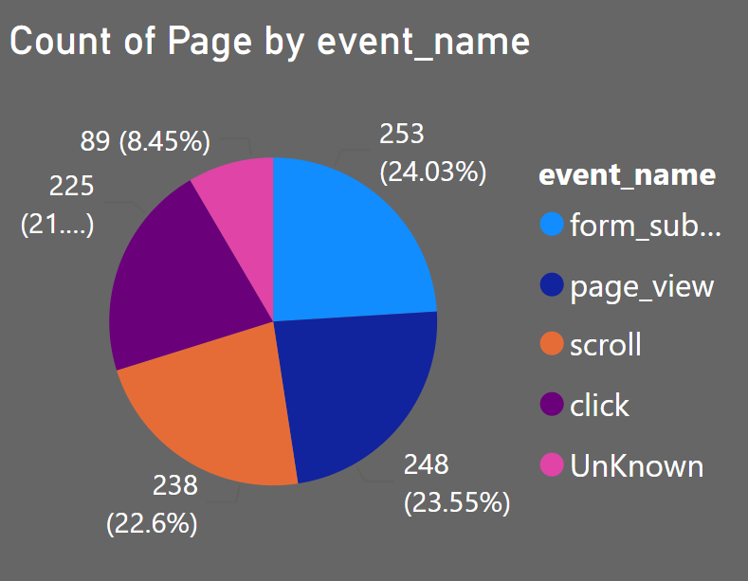
Pie Chart – Event Type
Page Views (24.03%) are the most recorded events, indicating users frequently navigate through pages.
Click (23.55%) and Scroll (22.6%) events show user engagement with content, while Form Submissions (8.45%) highlight conversion opportunities.

Slide 13
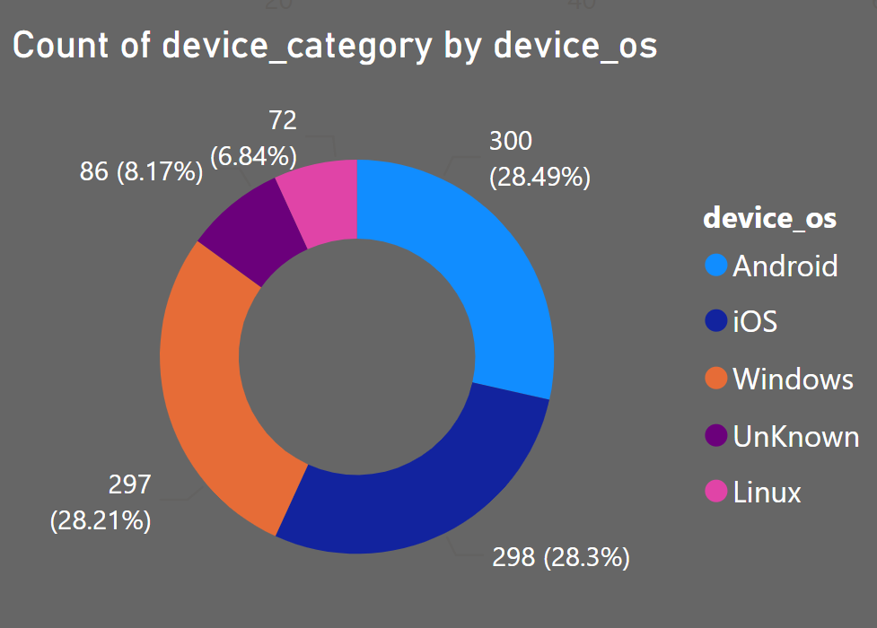
Donut Chart – Device OS
Android (28.49%) and Windows (28.3%) are the most used operating systems.
A significant number of users also access the site via iOS (28.21%), emphasizing the need for cross-platform optimization.

Slide 14
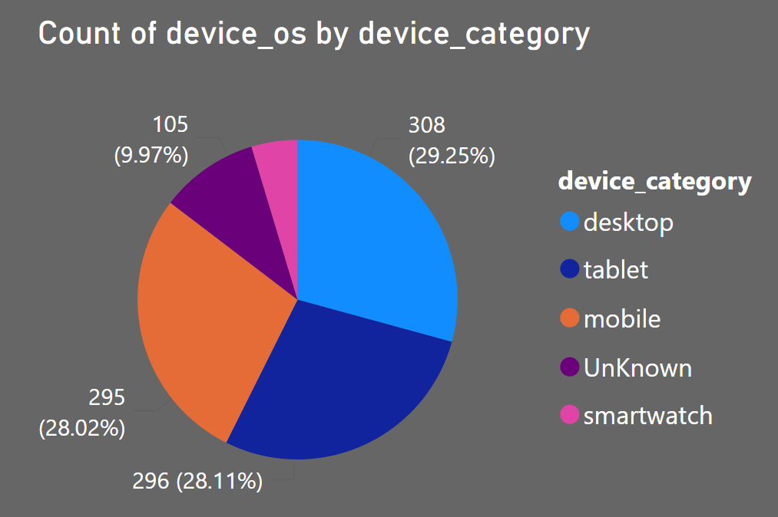
Pie Chart – Device Category
Mobile devices (29.25%) and Desktops (28.02%) are the most commonly used platforms.
Tablet users (26.02%) also form a large portion, suggesting the importance of tablet-friendly design.

Slide 15
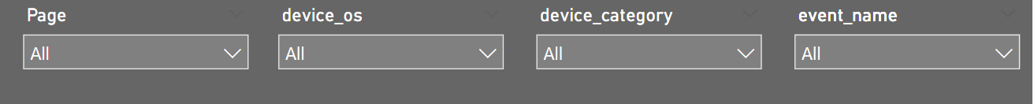
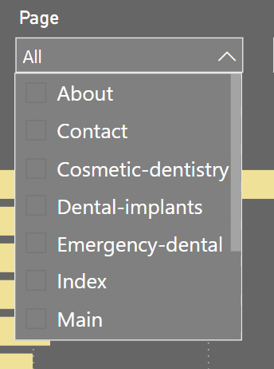
Filter Pane (Slicers)
These filters allow users to interactively analyze data by selecting specific pages, devices, categories, or events.
Users can apply multiple filters to get custom insights based on selected criteria.
Helps in narrowing down the data to understand trends for particular pages or devices.

Slide 16
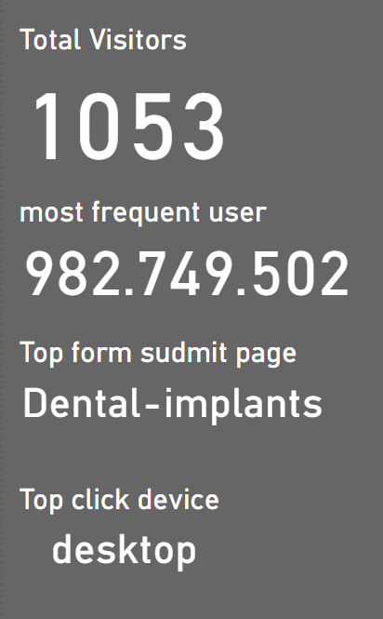
KPI Card
Total Visitors: The website received 1,053 visitors, indicating steady traffic.
Most Frequent User: The most active user has an ID 982.749.502, showing repeated engagement.
Top Form Submission Page: The "Dental-implants" page had the highest form submissions, highlighting a key area of interest.
Top Click Device: Desktop users dominated interactions, suggesting a preference for larger screens over mobile devices.

Slide 17
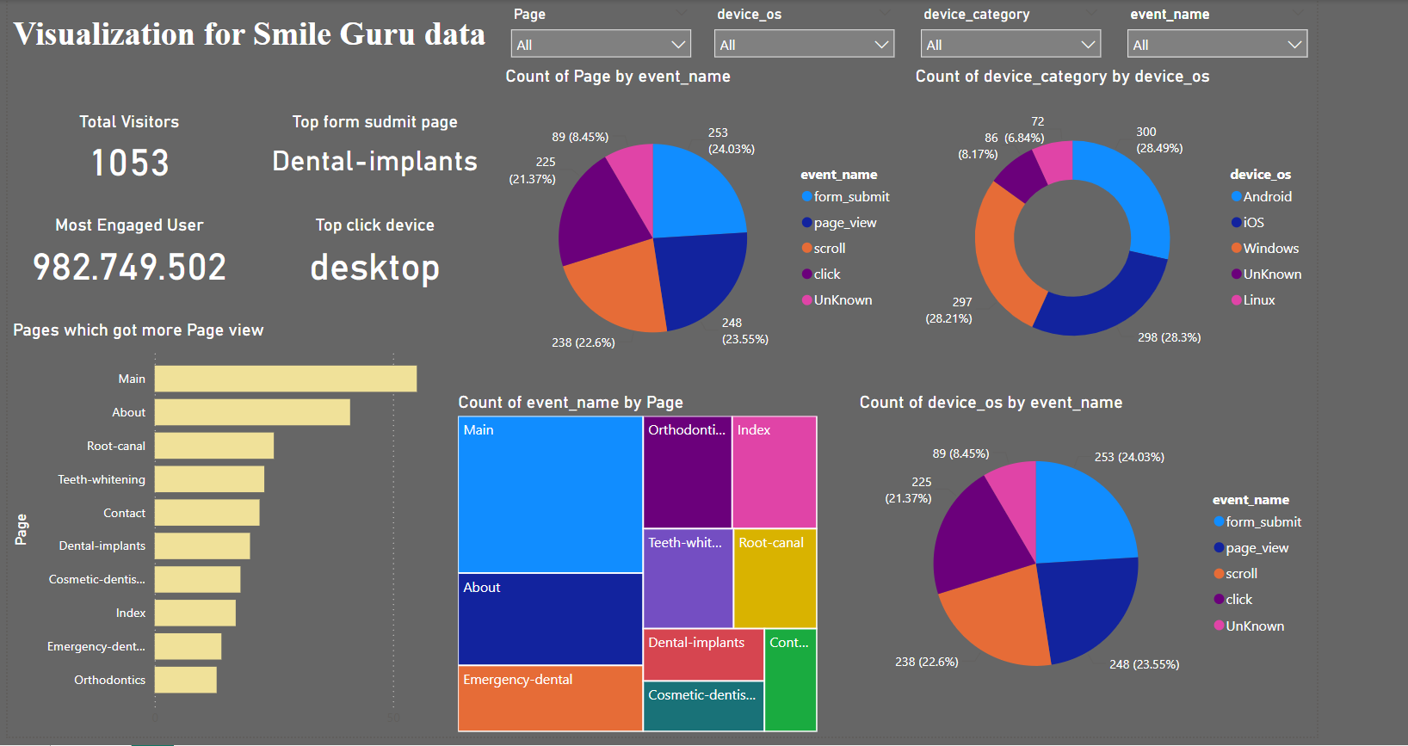

Slide 18
Conclusion of Visualization
Traffic & Engagement: Main and About pages get the most visits, while some service pages need improvement. Page Views, Clicks, and Scrolls show strong user interaction.
Device Insights: Mobile (29.25%) and Desktop (28.02%) lead usage, with tablets (26.02%) also significant—responsive design is key.
Total Visitors: 1,053

Slide 19
THANK YOU

