Slide 1
The Design Philosophy of the DARPA Internet Protocols

Slide 2
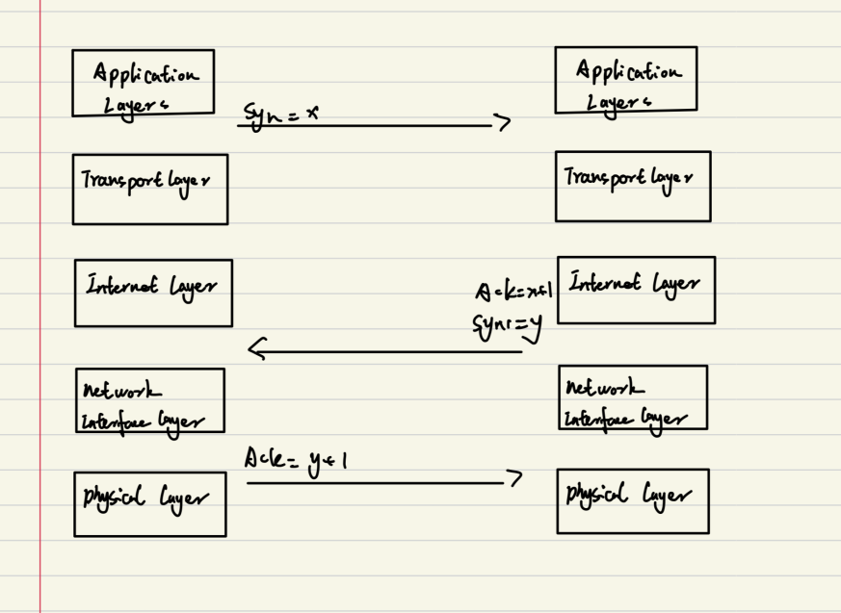
Background
The TCP/IP protocols were developed by DARPA, originally for military use, and later widely adopted in commercial systems
The design prioritized a connectionless “datagram model,” emphasizing flexibility and reliability.
To develop a method for effective multiplexed utilization of existing interconnected networks.
The initial focus was on interconnecting networks like APPANET and packet radio networks, facilitating accessing across them

Slide 3
Design goals and priorites
Key Design goals:
Survivability
Support for multiple communication services
Accommodate diverse networks
Distributed management
Cost-effectiveness
Ease of host attachment.
Accountability

Slide 4
Core Design principles and implementation
Packet switching:
Datagram Model and fate-sharing
Separation of Transport and Network layers

Slide 5
Challenges and Trade-offs
Performance vs. Reliability
Distributed Management and Routing
Efficiency issues

Slide 6
Future directions and Innovations
Flow Model:
Introduced the concept of flows to identify packet sequences between end points, addressing resources management and accountability limitations in datagrams
Proposed using soft state to maintain flow information at gateways balancing survivability and performance
Research Focus:
Improving resources management tools
Incorporating performance metrices into architecture design

