Slide 1
Data Ingestion Strategy
(Project Guardian)
Prepared By : Afe Feyissa – Domain Architect

Slide 2
Initiative Overview

Slide 3
Document Purpose (Ask of DAC)
Review & endorse various data ingestion patterns that can be applied across structured, unstructured and semi-structured data, in order to collect and move, source data to target data store (S3), primarily supporting Project Guardian requirements.
Recommends application design consideration to support future use cases that leverage data lake.

Slide 4
Review and Signoff
Document Details
Role | Name | Title | Date
Author | Afe Feyissa | Domain Architect | 20/01/2020
Product Owner | Mayur Gajera | Head of BI | 20/01//2020
Reviewers | Sarah Beumont | Business Architect | 20/01//2020
 | Kalyan Purkayastha | Data Architect | 20/01//2020
 | Kevin Hall | Tech Lead | 20/01//2020
 | Salfin Mathew | Senior BI Developer | 20/01//2020
 | Emerson Antony | Data Engineer | 20/01//2020
 | Architecture Team | Domain Architects | 22/01/2020 (Incorporate feedback from Architecture team)
Signoff | DAC

Slide 5
Overview
Australian Unity has a diverse set of line of business applications storing client information across the various platforms and functions.
As part of Project Guardian, building a golden record of customer master is a key enabler for delivering accurate member data register to comply with Australian Corporation Act which requires to have up to date register of ALL eligible customers as members.
Building customer master requires ingestion of client information from disparate data source running from various hosting platforms (Public Cloud, Managed Data Centre, SaaS, Third-party hosted, etc).
Existing analytics platform leverages traditional batch mode data ingestion framework primarily using SQL SSIS package.
Current batch mode ingestion, does not support proactive predictive and prescriptive analytics, instead provides reactive insights based on historical trends.

Slide 6
Data Ingestion
The process of collecting data from source systems and moving it to target data store where it can be stored, validated, cleansed, transformed, mastered and analysed.
Data, however is produced by various line of business applications and it stores the data in many different database engines, data stores and format. Eg:-
Whics uses Informix database
OneVue uses MS SQL database
Principle uses Ingress database
Employee data received as flat file (.txt)

Slide 7
Data Ingestion Operating Modes
Real-time - source system data changes are applied to data lake as soon as they happen.
Batch mode - source system data changes are applied to data lake based on pre-defined triggers in chunks (eg. Schedule, size)

Slide 8
Data Ingestion Challenges
Heterogenous data sources
Database engine (Informix, MS SQL, Ingress, etc)
Relational databases
Raw file extracts (TXT, CSV, JSON, XML)
Unstructured & semi-structure
Database version or license not supporting CDC – key dependency to support stream processing (real-time) data.
Change data capture not enabled in almost all applications
Legacy applications with limited options to connect to source system to extract data.
Rely on primary application database to pull data – lack of read-replica and risk of performance impact to live production system

Slide 9
Requirements – Project Guardian
Below are key data extract and ingestion requirements from the context of Project Guardian to ensure that source systems data are timely available through AWS data pipeline for data validation, cleansing, standardisation and data mastering.
# | Requirement
REQDI01 | Ongoing extraction of all structured data from all source systems that hold clients information (Refer appendix 1 for the full list of source systems)
REQDI02 | Support full and incremental extract of source system data and move to data lake raw zone.
REQDI03 | Detect any source system schema change and retain current data and changing database structure.
REQDI04 | Ability to scale to accommodate different data size and meets processing needs of current and future requirements
REQDI05 | Secure – support various data encryption protocols to ensure that sensitive customer data is protected at all times
REQDI06 | Loading new and updated records and ensure that data is available in less than 24 hours for data validation, cleansing, mastering and consumption of any down stream process.
REQDI07 | Monitoring & error handling – provides real-time insights of end-to-end data extract & ingestion activities

Slide 10
Problem Statement
Lack of data ingestion tool to collect data from various source systems and move it to target data store (AWS S3 bucket) where it can be stored, validated, cleansed, mastered and analysed.

Slide 11
Data Ingestion Practice Current State

Slide 12
Data Analytics & Operational Data Store
SSIS package is widely used to collect data for traditional analytics
DBMoto- data integration tool to support Informix data replication to ODS
SQL CDC is supported in SQL standard edition starting from SQL Server 2016 and above otherwise it requires SQL Server Enterprise license.
Diagram 1

Slide 13
Data Integration Candidate Options

Slide 14
Data Ingestion Tools – Evaluation Process
Project Guardian data stream looked at a wide range of existing, AWS native and managed open source data ingestion tools and options.
The team has run spike (where possible) to test & validate tools capabilities against project requirements.
Based on the results and initial research of tools capabilities, the team narrowed down to the lists shown below.
.
New tools
AWS Data Migration Services (DMS)
AWS Managed Secure Kafka (MSK)
AWS Glue
AWS Kinesis
Lambda functions
Spark
Ataccama
Existing tools
Synity (Formerly DBMotto)
WebMethods
SQL SSIS Package
Lesson: There’s no one-size-fits-all data integration tool - there are many data integration tools out in the market with varying strength supporting various use cases based on the type of sources and applications.

Slide 15
Options Analysis – AWS MSK
Key Capabilities | AWS MSK (Managed Secure Kafka)
Pros | Easily scalable and capability to provide real time data availability. Cloud agnostic. Same code can be deployed on different cloud vendors and still work as is. Wide variety of connectors and even makes streaming across multiple cloud environments possible. Supports batch like executions as well if need be. Being a managed service takes care of some of the maintenance activities that would otherwise have been required.
Cons | Monitoring is sometimes hard and will need to decide on a tooling to make it easier to track what's happening. Hard to find skills and will need a bit of scaling up as this is mostly a command line based tool
Scalability (tools can scale to accommodate different data size and meets the processing needs of AU to support current and future requirements) | Supported - AWS MSK Kafka streaming pipeline can be scaled without any downtime
Multiplatform support and integration (ability to extract all types of data from multiple data sources (on-premise, cloud) including structured, unstructured and semi-structure data. The tool regularly access data from various databases and operating systems without impacting performance. | Kafka is capable of handling most data sources in the market and different file types. A list is provided below https://docs.confluent.io/current/connect/managing/connectors.html
Adapt to schema change and change data structure | Supported
Monitoring & Failure handlings (provide real-time insights of end-to-end data extract & ingestion activities including delivery guarantees) | Kafka is highly fault tolerant. Monitoring may also be challenging although various solutions are available in the market to enable this
Portability (portability of code between different platforms) | Supported. The backend of MSK is open source. Any code written or deployed is something that can easily be lifted and shifted to any platform.
Ease of use (having user-friendly interface for unskilled user to support data ingestion) | Mainly command line based for configurations.
Security (ability tool to support various data encryption protocols - SSL, HTTPS, SSH, etc) | Supported
Traditional Batch Mode full data ingestion - ability to support schedule and on-demand full data extraction and load | Kafka does support intial data extract and real time streaming from then on. However on demand extract from the beginning might be challenging
Traditional Batch Mode incremental data ingestion - ability to support schedule and on-demand changed data capture and load | Supported
Stream processing - ability to support stream processing of data in real-time | Supported
Cost | ~$600 / month using 3 brokers instance (based on kafka.m5.large), 1TB storage including data transfer fees

Slide 16
Options Analysis – AWS DMS
Key Capabilities | AWS DMS (Data Migration Services)
Pros | Supports integration with wide range of SQL based source systems that holds client information facilitating both batch and real-time ingestion of data. Given Microsoft SQL based database is commonly used across many applications as primary data store within Australian Unity, DMS is good candidate to support data integration requirements Supports target parquet file format, encrypting S3 objects using AWS KMS Keys. Supports ingestion of data to any data store in AWS (S3, RDS, Redshift, etc). Supports basic transformations limited to rename schema, tables or column names.
Cons | SQL CDC is a pre-requisites for AWS DMS to facilitate ongoing ingestion of data through batch process or real-time ingest. Either upgrading source systems database to latest version of SQL or updating SQL server license to Enterprise version, is required to support CDC, however this change would need enormous test effort and increase cost of license hugely. Data Validation is not supported for S3 targets. Support only for structured data.
Scalability (tools can scale to accommodate different data size and meets the processing needs of AU to support current and future requirements) | Supported - cloudwatch notification and lambda can be used to dynamically size and scale DMS replication instances
Multiplatform support and integration (ability to extract all types of data from multiple data sources (on-premise, cloud) including structured, unstructured and semi-structure data. The tool regularly access data from various databases and operating systems without impacting performance. | Supports integration with most relational database using SQL database engine. DMS support integration with MS SQL Server using platform native sql connector. DMS also supports all SQL Server version from SQL server 2008 to the latest both Standard and Enterprise versions. DMS can connect to SQL instance running on-premise or cloud including AzureSQL.
Adapt to schema change and change data structure | Supports addition of columns in Source schema. Dropping columns requires reprocessing the file.
Monitoring & Failure handlings (provide real-time insights of end-to-end data extract & ingestion activities including delivery guarantees) | AWS DMS Task Status and Cloud Watch provides complete and real-time insights of all data ingestion activities.
Portability (portability of code between different platforms) | AWS supports provisioning of DMS resources through CloudFormation to support platform management as code.
Ease of use (having user-friendly interface for unskilled user to support data ingestion) | AWS DMS can easily be managed through user-friendly AWS console, CLI or using CloudFormation Template.
Security (ability tool to support various data encryption protocols - SSL, HTTPS, SSH, etc) | Supports establishment of secure tunnel between source system and target data store
Traditional Batch Mode full data ingestion - ability to support schedule and on-demand full data extraction and load | AWS DMS supports batch mode data ingest connecting to SQL based relational databases using pre-built connector
Traditional Batch Mode incremental data ingestion - ability to support schedule and on-demand changed data capture and load | AWS DMS supports capturing changed data and load to target data store suing CDC transactional log
Stream processing - ability to support stream processing of data in real-time | AWS DMS supports capturing changed data and load to target data store suing CDC transactional log
Cost | ~ $590 AUD / month using 2x r4xlarge instances. Monthly price could be reduced further if reserved instances are used.

Slide 17
Options Analysis – AWS Glue
Key Capabilities | AWS Glue
Pros | Managed ETL service. Supports integration with - S3 (parquet, ORC, delimited), On-Prem Relational DB, RDS, Redshift, etc. Supports complex transformations to add/drop columns, filters, grouping etc.
Cons | Additional time for provisioning adds to ETL processing time. Python scripts are tightly coupled with Glue Catalog. Migrating the scripts to another platform will require effort. Support for CDC requires a custom solution involving additional AWS services lik RDS.
Scalability (tools can scale to accommodate different data size and meets the processing needs of AU to support current and future requirements) | Supported - AWS Glue is serverless and does not require infrastructure provisioning.
Multiplatform support and integration (ability to extract all types of data from multiple data sources (on-premise, cloud) including structured, unstructured and semi-structure data. The tool regularly access data from various databases and operating systems without impacting performance. | Supports integration with - S3 (parquet, ORC, delimited), On-Prem Relational DB, RDS, Redshift, etc. Supports structured and semi-structured data.
Adapt to schema change and change data structure | Supports schema evolution via the Glue catalog.
Monitoring & Failure handlings (provide real-time insights of end-to-end data extract & ingestion activities including delivery guarantees) | View real time metrics using the Glue console dashboard. Cloud watch also provides real time insights of the data ingestion. Supports re-startability of jobs. Tracks processed data using job bookmarks.
Portability (portability of code between different platforms) | AWS supports provisioning of Glue resources through CloudFormation to support platform management as code.
Ease of use (having user-friendly interface for unskilled user to support data ingestion) | Basic ingestion jobs can be created through the AWS console. Advanced transformations would require knowledge of python.
Security (ability tool to support various data encryption protocols - SSL, HTTPS, SSH, etc) | Supports establishment of secure tunnel between source system and target data store
Traditional Batch Mode full data ingestion - ability to support schedule and on-demand full data extraction and load | Glue supports once-off batch mode data ingest using JDBC, RDS and Redshift.
Traditional Batch Mode incremental data ingestion - ability to support schedule and on-demand changed data capture and load | Support for CDC requires a custom solution involving additional AWS services like RDS.
Stream processing - ability to support stream processing of data in real-time | Does not natively support Streaming data. AWS has other services like Kinesis that support streaming data.
Cost | ~620 AUD / month based on 2 DPU (provides 2x4 vCPU and 2x16 GB of memory).

Slide 18
Options Analysis – SSIS Package
Key Capabilities | SSIS Package
Pros | SSIS packages are already available for majority of the sources. They would require modification to replace the current BI BIPROD destinations with new AWS S3 destinations. SSIS supports loading of data into AWS S3 buckets and files using third part tools from market place (Kingsway SSIS Productivity pack, ZappySys SSIS PowerPack, Cozyroc SSIS Suite)
Cons | SSIS requires installation of additional third party tools to facilitate connecting to AWS S3 from within. All tool suits are available from Visual Studio Marketplace, but paid licence is required. Some tools (like ZappySys) do not support ingestion in Parquet file format. Supports SQL based structured data processing only.
Scalability (tools can scale to accommodate different data size and meets the processing needs of AU to support current and future requirements) | Supported. SSIS can be set up with the Scale Out feature that provides high-performance execution of SSIS packages by distributing package executions across multiple computers. After Scale Out is set up, multiple package can be executed in parallel, in scale-out mode, from SQL Server Management Studio (SSMS). Some infrastructure provisioning may be required depending on the volume.
Multiplatform support and integration (ability to extract all types of data from multiple data sources (on-premise, cloud) including structured, unstructured and semi-structure data. The tool regularly access data from various databases and operating systems without impacting performance. | Limited support (SQL based structured data only).
Adapt to schema change and change data structure | Generally not supported. SSIS is very specific about the source metadata and any changes in the schema need to be handled by updating the SSIS package. Some third party tools (Cozyroc Data Flow Task Plus) support dynamic columns metadata at runtime.
Monitoring & Failure handlings (provide real-time insights of end-to-end data extract & ingestion activities including delivery guarantees) | SSIS offers monitoring capabilities when run through the SQL Server agent jobs. This is already utilised by the existing data feeds.
Portability (portability of code between different platforms) | Not supported. SSIS is specific to Microsoft SQL Server and even portability between different versions of SQL Server can be difficult.
Ease of use (having user-friendly interface for unskilled user to support data ingestion) | SSIS packages can be easily built, modified and supported in the Microsoft Visual Studio. The existing SSIS packages are already in use and can be modified to replace the current BI BIPROD destinations with new AWS S3 destinations.
Security (ability tool to support various data encryption protocols - SSL, HTTPS, SSH, etc) | Secure encrypted channel (TLS) is supported.
Traditional Batch Mode full data ingestion - ability to support schedule and on-demand full data extraction and load | SSIS supports batch mode processing by scheduling SQL Server agent jobs.
Traditional Batch Mode incremental data ingestion - ability to support schedule and on-demand changed data capture and load | SSSIS supports CDC only when using CDC feature in SQL Server. This would require migration/ upgrade of existing SQL based source system to support CDC.
Stream processing - ability to support stream processing of data in real-time | Not supported.
Cost | ~ $1200 / year (third party tool license cost)

Slide 19
Enterprise Data Platform (Data Lake)

Slide 21
Data Ingestion Layers

Slide 23
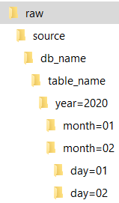
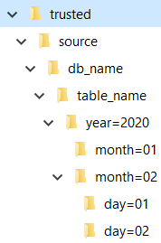
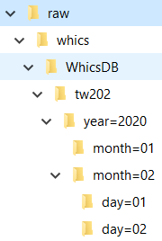

Raw & Trusted Zone – Partitioning Schema
Diagram 2
Diagram illustrates partitioning schema used for daily loads of data.
The ‘SystemDBName’ directory contains all the transaction at the database level
The ‘TableName’ directory contains all data stored in specific table
Within the table directory, the files are organised by year (eg \raw\whics\whicsDB\year=2020)
inside a year by month (…\year=2020\month=01)
Inside a month by day (..\month=1\day=01)
This directory schema allows to direct each query to the files that may contain the data needed by the query. Eg
(Select * from whicsDB where year=2020 and month=2 and day=1). This query would only read data from whics database …\whicsDB\... \year=2020\month=2\day=1
Example

Slide 24
Naming Convention
NAMING CONVENTION
S3 bucket name | [zone name]-zone-[Env] where [zone name] = raw| trusted [Env] = dev| test| stage| prod
Folder structure | [zone name]-zone-[Env]\[sub_zone]\[source]\[Source System DB Name]\[TableName\ where [zone name] = raw | trusted [Env] = dev| test| stage| prod [subzone] = Temp| Raw | Archive | clean | exception [source] = source system name (eg. Whics, OneVue, PeoplePoint, etc) [source system db] = source system database name [TableName] = this directory stores each table data
AWS Glue Database | [zone name]_zone_[Env] where [zone name] = raw | trusted [Env] = dev| test| stage| prod
AWS Glue Table | [sub_zone]_[source]_[Source System Schema Name]_[TableName] {Using the folder structure to prepare the table name} [subzone] = Temp| Raw | Archive | clean | exception [source] = source system name (eg. Whics, OneVue, PeoplePoint, etc) [source system schema Name] = source system schema name [TableName] = this directory stores each table data
Please avoid the use of ‘-’ special character in Glue because it requires special handling in some applications.
Table 1

Slide 25
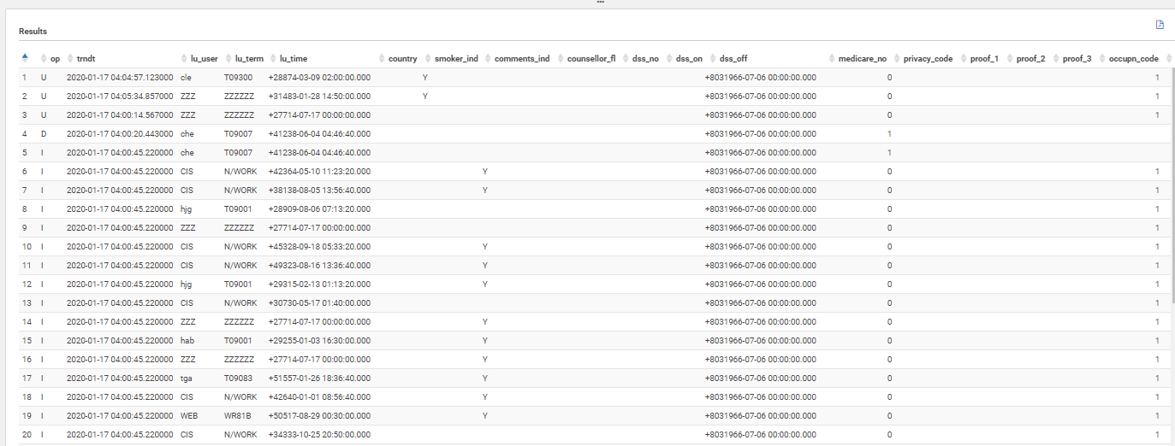
Parquet File Schema & Flags
Data ingestion process will append each parquet file containing incoming record from the source to the raw subzone as I= for insert, U= for update, D= for delete.
Ingestion process will also append ingestion time stamp as of it arrives the raw zone first time.
Diagram 3

Slide 26
Data Ingestion Framework (Structured, Unstructured, Semi-Structure)

Slide 27
Data Ingestion Framework
Data ingestion framework securely connects to different sources, captures the changes, and replicates the data in the data lake.
The data ingestion framework keeps the data lake consistent with the data changes at the source systems.
Data ingestion framework consists of two components
Collect the data from the source system
Move the data in to the data lake

Slide 28
Data Ingestion Framework
Target file format – Data from a source system is ingested in to raw zone as parquet file or in a format that can be converted to parquet file (columnar data representation, improved compression)
Copy files directly to raw zone – copy file extract (csv, txt, json, xml) from a drop-off location directly to raw zone and subsequently convert to parquet file format using lambda function.

Slide 29
Data Ingestion Framework
Full load – is a process to collect and move the entire data of a table
Full load can be once-off or batched as per pre-set schedule
Incremental - capture of differential data
Incremental capture of change data can be
real-time
Orchestrated

Slide 30
Data Ingestion Framework
Full load for incremental data capture– if CDC is not enabled in the source system, full load of selected tables should be considered at pre-set time to facilitate capture of differential data orchestrated by custom build processing engine (Spark).
Orchestrated incremental data capture -
Facilitated by custom processing engine (Spark)
Employ to capture incremental data if CDC is not an option
Consider selected tables only, in order to reduce computational time
Compare previous & current full load to prepare differential records
Appends time stamp & correct flag (Insert, Update, Delete) in the parquet file while moving incremental record to raw sub zone

Slide 31
Proposed Data Ingestion Frequency & Mode (Supporting Project Guardian)
Diagram 4
Project Guardian will leverage once off full & daily incremental batch layer to ingest only tables that contains critical data elements.

Slide 32
Data Ingestion Framework (Design Pattern Supporting Structured Data)

Slide 33
Data Ingestion Decision Workflow (SQL Source)
Diagram 5

Slide 34
Data Ingestion Pattern 1A – SQL Source
Pattern # | Description
1A | supports real-time ingestion of data between SQL source where CDC is enabled and AWS S3 target data store
Diagram 6

Slide 35
Data Ingestion Pattern 1B – SQL Source
Pattern # | Description
1B | Supports batch ingestion of data between SQL source and AWS S3 target data store
Diagram 7

Slide 36
Data Ingestion Pattern 1C – SQL Source
Pattern # | Description
1C | Pattern supporting real-time ingestion of data between SQL based source system where CDC is not an option and target S3 bucket using SQL server replication and CDC enabled intermediary SQL database.
Diagram 8

Slide 37
Data Ingestion Pattern 1D – SQL Source
Pattern # | Description
1D | Pattern supporting orchestrated incremental ingestion of SQL based source data to S3 using custom Spark application .
Diagram 9

Slide 38
Data Ingestion Pattern 2A – File Extract
Pattern # | Description
2A | This pattern supports transfer of source system file extract in its original format to S3 target store.
Diagram 10

Slide 39
Data Ingestion Decision Workflow (Whics)
Diagram 11

Slide 40
Data Ingestion Pattern 3A – Whics Data
Pattern # | Description
3A | Pattern supporting real-time ingestion of Informix data to AWS S3 bucket using Syniti (Formerly DBMoto).
Diagram 12

Slide 41
Data Ingestion Pattern 3B – Whics Data
Pattern # | Description
3B | Pattern supporting batch based ingestion of Informix data using custom Spark application. Consider this pattern tool like Syniti is not an option.
Diagram 13

Slide 42
Data Ingestion Pattern 3C – Whics Data
Pattern # | Description
3C | Pattern supporting orchestrated incremental ingestion of Informix data to S3 using custom Spark application.
Diagram 14

Slide 43
Data Ingestion Framework (Design Pattern Supporting Un-Structured & Semi-Structured Data)

Slide 44
Data Ingestion Pattern 4A
Pattern # | Description
4A | Pattern supporting stream processing of unstructured and semi-structure data.
Diagram 15

Slide 45
Data Ingestion Supporting Project Guardian

Slide 46
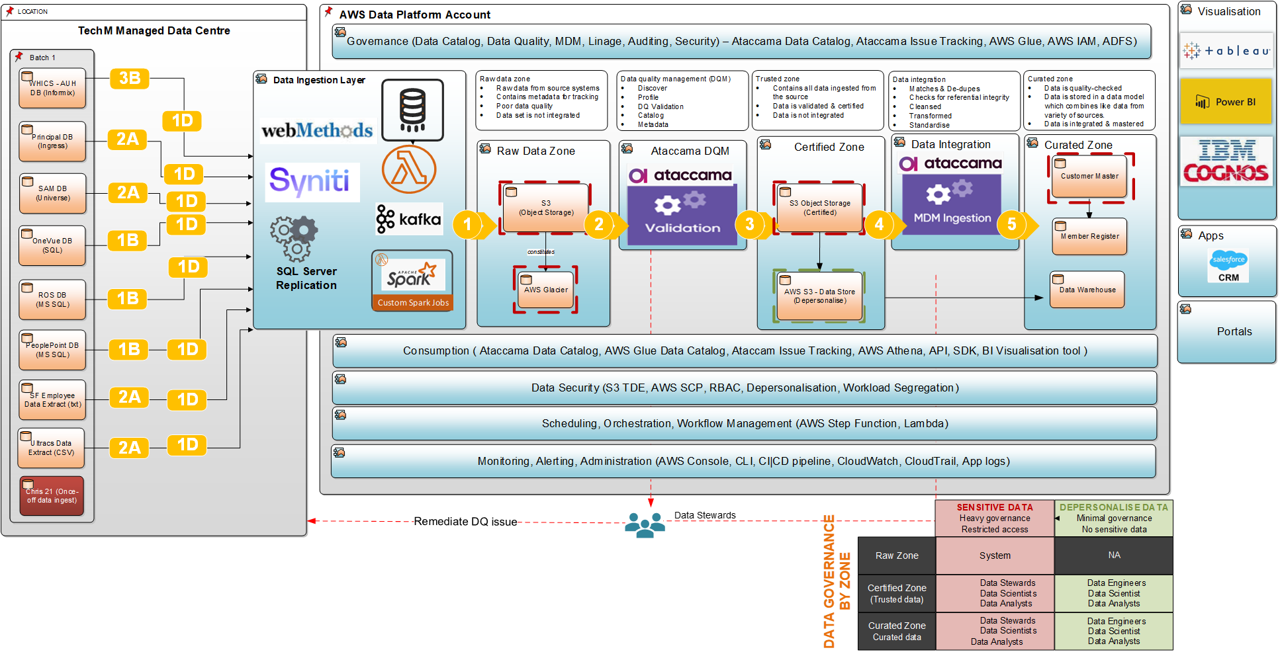
Ingestion Pattern # | Description
1A | Pattern that supports real-time ingestion of data between SQL source where CDC is enabled and AWS S3 target data store
1B | Supports batch ingestion of data between SQL source and AWS S3 target data store (CDC is not enabled in source system)
1C | Pattern supporting real-time ingestion of data between SQL based source system where CDC is not an option and target S3 bucket using SQL server replication and CDC enabled intermediary SQL database.
1D | Pattern supporting orchestrated incremental ingestion of source data using custom Spark application .
2A | This pattern supports capture of source system extract data , convert to parquet format and store the file in target store.
3A | Pattern supporting real-time ingestion of Informix data to AWS S3 bucket using Syniti (Formerly DBMoto).
3B | Pattern supporting batch based ingestion of Informix data using custom Spark application.
4A | Pattern supporting stream processing of unstructured and semi-structure data.

Slide 47
Recommendation – Design Consideration
Consider introduction of the following application design practices as architecture principles
Implementation of change data capture (CDC) to any source system containing client information to support stream processing of client data through data lake.
Synchronous replication of master database to a secondary node as read-replica to facilitate real-time streaming of data through the data lake and avoid performance impact to live production system.
Revisit existing application architecture as part of life-cycle upgrade and consider if CDC & read-replica can be introduced.

