Slide 1
Evaluation Function for
Computer Go

Slide 2
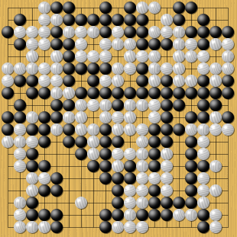
Game Objective
Surrounding most area on the board

Slide 3
Game Stages
Opening stage
Middle stage
Ending stage

Slide 4
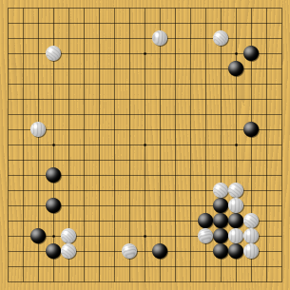
Opening game stage
Establish groups
Extend from own group
Prevent extension from opponent group
Reinforce weak group
Threaten invasion to opponent group

Slide 5
Rules overview through a game
(opening 1)
Black and White move alternately by putting one stone on an intersection of the board.

Slide 6
Rules overview through a game
(opening 2)
Black and White aims at surrounding large « zones »

Slide 7
Rules overview through a game
A white stone is put into « atari » : it has only one liberty (empty intersection) left.

Slide 8
Rules overview through a game
(defense)
White plays to connect the one-liberty stone yielding a four-stone white string with 5 liberties.
CIG07 Hawaii Honolulu

Slide 9
Rules overview through a game
(atari 2)
It is White’s turn. One black stone is atari.

Slide 10
Rules overview through a game
White plays on the last liberty of the black stone which is removed

Slide 11
Human reasoning
Territory
Potential
Urgent Move
Large Move
Framework

Slide 12
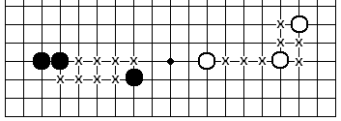
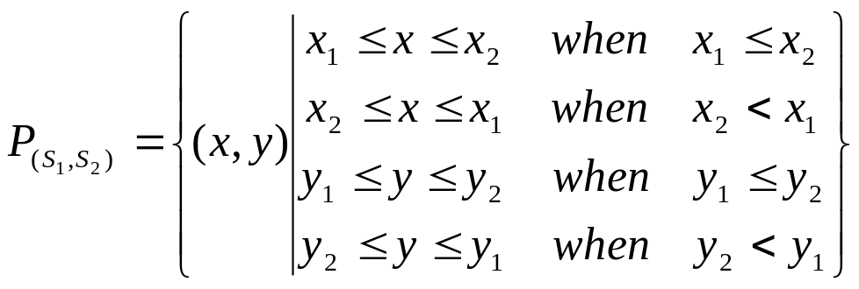
Drawing Border

Slide 13
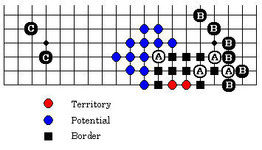
Territory and Potential

Slide 14
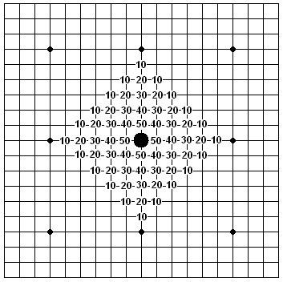
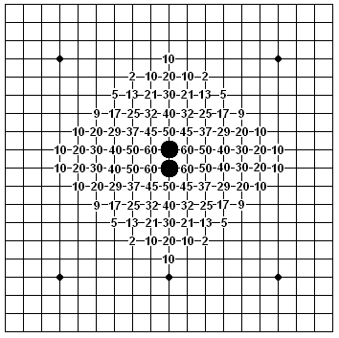
Stones potential
Zobrist A (1970)

Slide 15
Hybrid System
Future development
Fuzzy reasoning
Pattern recognition
Neural network
Search tree
Genetic algorithm

Slide 16
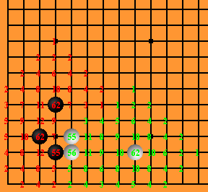
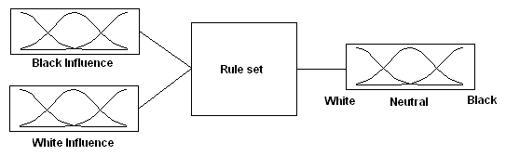
Fuzzy Influence
Conventional method
Fuzzy Influence

Slide 17
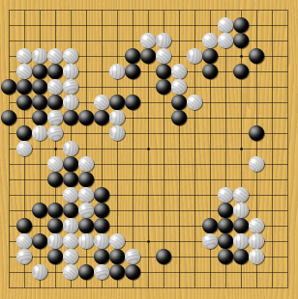
Middle game stage
Invade opponent territory
Defence their own territory

Slide 18
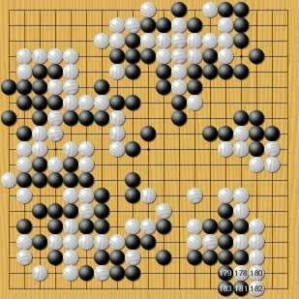
End game stage
Close the gap between each groups

