Slide 1
ARTIFICIAL INTELLIGENCE
2010/2011 Semester 2
Introduction: Chapter 1

Slide 2
Course overview
Introduction and Agents (chapters 1,2)
Search (chapters 3,4,5,6)
Logic (chapters 7,8,9)
Planning (chapters 11,12)
Uncertainty (chapters 13,14)
Learning (chapters 18,20)
Natural Language Processing (chapter 22,23)

Slide 3
Search (Ch 3,4,5,6)
Ch3: Solving problems by searching
  Problem =➔ Search
Ch4: Informed Search and Exploration
  A* search /Heuristic Search
  Simulated annealing search / Genetic algorithms
Ch5: Constraint Satisfaction Problems
  Constraint Satisfaction Problems (CSP)
  Backtracking search for CSPs / Local search for CSPs
Ch6: Adversarial Search
  Optimal decisions / α-β pruning
  Imperfect, real-time decisions

Slide 4
Logical Agents
Logical Agents
  Knowledge-based agents
  Inference rules and theorem proving
First-Order Logic
  Syntax and semantics of FOL
  Knowledge engineering in FOL
Inference in FOLs
  First-order inference / Unification
  Generalized Modus Ponens

Slide 5
Knowledge Representation
Knowledge Representation
  Ageneral ontology / categories / Actions / Mental
  reasoning about categories
Planning
  Planning with State-Space Search
  Planning with Propositional Logic

Slide 6
Uncertainty and Inference
Uncertainty
  Probability / Syntax and Semantics
  Inference / Independence and Bayes' Rule
Probabilistic Reasoning
  Syntax and Semantics of Bayesian networks
  Exact inference by enumeration / variable elimination
  Approximate inference by stochastic simulation/ MCMC
Probabilistic Reasoning over Time
  Inference: Filtering, prediction, smoothing
  Hidden Markov models
  Kalman Filters (a brief mention)

Slide 7
Learning (chapters 18,20)
  Active and Interactive Learning
Natural Language Processing (chapter 22,23)
Computer Vision
Search / Data Mining (Doc / Image / Video / Event )
Multi-agents / Interactions
Knowledge Organization

Slide 8


Slide 9
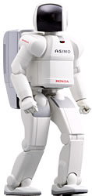
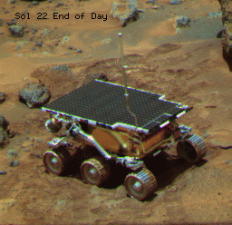

Intelligent Systems

