Slide 1
GNU FreeIPMI Hackers Meet 2005
GNU FreeIPMI Project
Anand Babu <ab@zresearch.com>
FreeIPMI Core Team

Slide 2
Session I
IPMI 1.5 / 2.0
Introduction to GNU FreeIPMI
Z RESEARCH's Commitment
Hardware Compliance
GNU FreeIPMI at LLNL as Example
Software License: GNU GPL v2 or Later
Demo Session – SR870BN4 Quad Itanium2

Slide 3
Session II
Hacking GNU FreeIPMI
Preparing for 0.2.0 Release
Plans for 0.3.0 Release
Free Software Community and Third Party
Architecture Discussion
Project Management and Source Organization

Slide 4
IPMI
Platform Management
Industry Standard IPMI
1.5 and 2.0 Specification
Future of IPMI

Slide 5
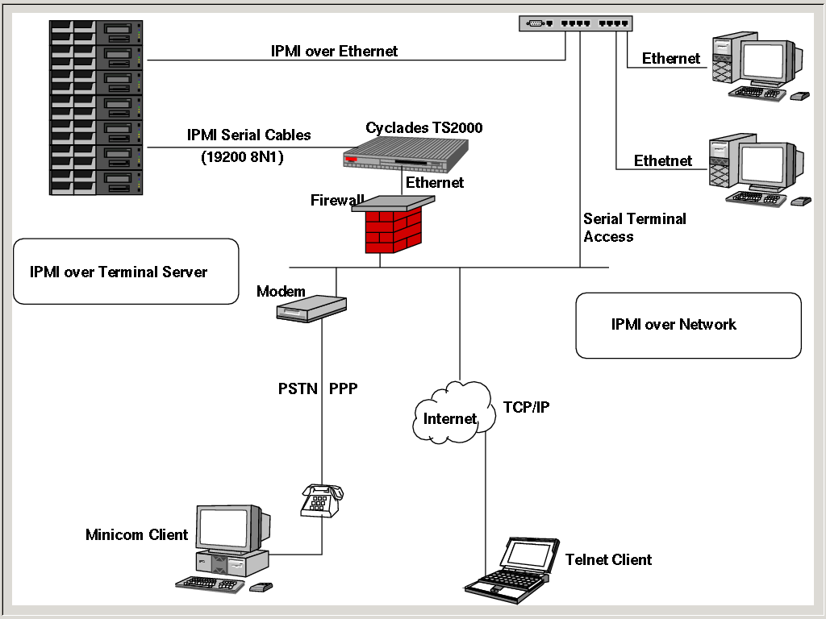
IPMI Network Layout

Slide 6
Introduction to GNU FreeIPMI
What is GNU FreeIPMI
History of GNU FreeIPMI
GNU FreeIPMI Components
Current Status

Slide 7
GNU FreeIPMI Components
KCS, SMIC, SSIF, LAN and probing drivers
libfreeipmi - C library interface
fish - Scheme extensible, readline based IPMI shell.
ipmi-power - Power Management utility
ipmi/rmcp-ping - IPMI Discovery and Reachability
ipmi-sensors - Monitoring and Diagnostics utility
bmc-config[-auto] - IPMI Configurator
ipmi-sel - System Event Log utility
ipmi-sold – IPMI SOL Daemon (IPMI-2.0 onwards)
bmc-info - BMC Version, Features

Slide 8
Z RESEARCH's Commitment
VA Linux -> CaliforniaDigial -> Z RESEARCH
Continued commitment / collaboration with the Free Software Community
GNU FreeIPMI in Gluster Project
Commercial backing and Support

Slide 9
LLNL and IPMI
Transfer to Albert Chu
GNU FreeIPMI at LLNL
Thunder by Example
Future Plans

Slide 10
Hardware Compliance
Firmware Correctness
GNU FreeIPMI Certification
Compliance Test Utility
Reporting on the mailing list
Cooperation with the Free Software Community

Slide 11
Software License
GNU GPL V2 or Later
Lesser GPL ???

Slide 12
Demo Session
SR870BN4 – Quad Itanium2 System
  IPMI 1.5
  Debian GNU/Linux OS
  Demo by Balamurguan

Slide 13
Design Goals
Performance
Completeness
Portability
Correctness

Slide 14
GNU FreeIPMI Stack
ipmi-sensors, bmc-config,
bmc-info, ipmi-sel, discovery
ipmipower, bmc-watchdog,
ipmi-ping, rmcp-ping
FreeIPMI Shell (fish)
Shell
Extension
Scripting
FreeIPMI “C Library”
SEL, SDR, FRU, PEF, Chassis, IPM Device Global,
Messaging Support, LAN, Serial/Modem
LAN
KCS
SMIC

Slide 15
Desecting “libfreeipmi”
Architecture
Unified Driver Model
Example Code - utm-test.c
Debugging Techniques

Slide 16
Locking, Synchronization
Semaphores
Per Command Transaction
Handled inside the device driver

Slide 17
Interface Definition
FIID (FreeIPMI Interface Definition)
  fiid_obj_alloc
  fiid_obj_len
  fiid_obj_field_lookup
  fiid_obj_get
  fiid_obj_set

Slide 18
Sample FIID
fiid_template_t tmpl_get_sel_info_rs =
{
{8, "cmd"},
{8, "comp_code"},
{4, "sel_version_major"},
{4, "sel_version_minor"},
{16, "log_entry_count"}, //LS byte first
{16, "free_space"}, //LS byte first
{32, "recent_addition_timestamp"}, //LS byte first
{32, "recent_erase_timestamp"},
{1, "get_sel_alloc_info_cmd_support"},
{1, "reserve_sel_cmd_support"},
{1, "partial_add_sel_entry_cmd_support"},
{1, "delete_sel_cmd_support"},
{3, "reserved"},
{1, "overflow_flag"},
{0, ""}
};

Slide 19
FreeIPMI SHell
Shell Interface
Customization
Extension
Scripting

Slide 20
FISHing
;; fish.scm: default fish configuration scm
;; Customize Fish:
(fi-set-prompt! "fish# ")
;; Set driver SMS IO Base port
; (fi-set-sms-io-base! #x0CA2)
;; Set Driver Internals:
; (fi-set-default-driver-poll-interval 10)
;; Example Group Aliases
; (set! sensors-group-alias-list
; '(
; (mysystem . (Processor Fan "Power Supply" Current Memory Chassis))
; (power . ("Power Supply"))
; (security . ("Platform Chassis Intrusion Platform Security Violation"))
; ))

Slide 21
Preparing 0.2.0 Release
Whats new in 0.2.0
Unified Driver Model
  Theory
  APIs
  Thread Safety
  Sequencing Packet Retries and Connection State
  Locking and Synchronization
Hardware Probing
IPMI Sensors APIs
Automated Configuration
Pending Tasks and Release Date

Slide 22
Plans for 0.3.0 Release
IPMI 2.0 Standards
SOL
FIID Enhancements
Multi-host LAN Configuration
Intel Active Management Technology
Other Emerging Standards
Ease of Use (Curses, GTK+, PHP??)
Roadmap

Slide 23
Collaboration with the community
Merging, Integration and Collaboration with other projects
Common Headers and Libraries
Vendor Involvement

Slide 24
Project Management
CVS and Source Reorganization
Release Management

Slide 25
Contact us
Home Page
  http://www.gnu.org/software/freeipmi
Project Page
  https://savannah.gnu.org/projects/freeipmi/
Mailing List
  https://savannah.gnu.org/mail/?group=freeipmi
Contact Me
  Anand Babu <ab@zresearch.com>

