Slide 1
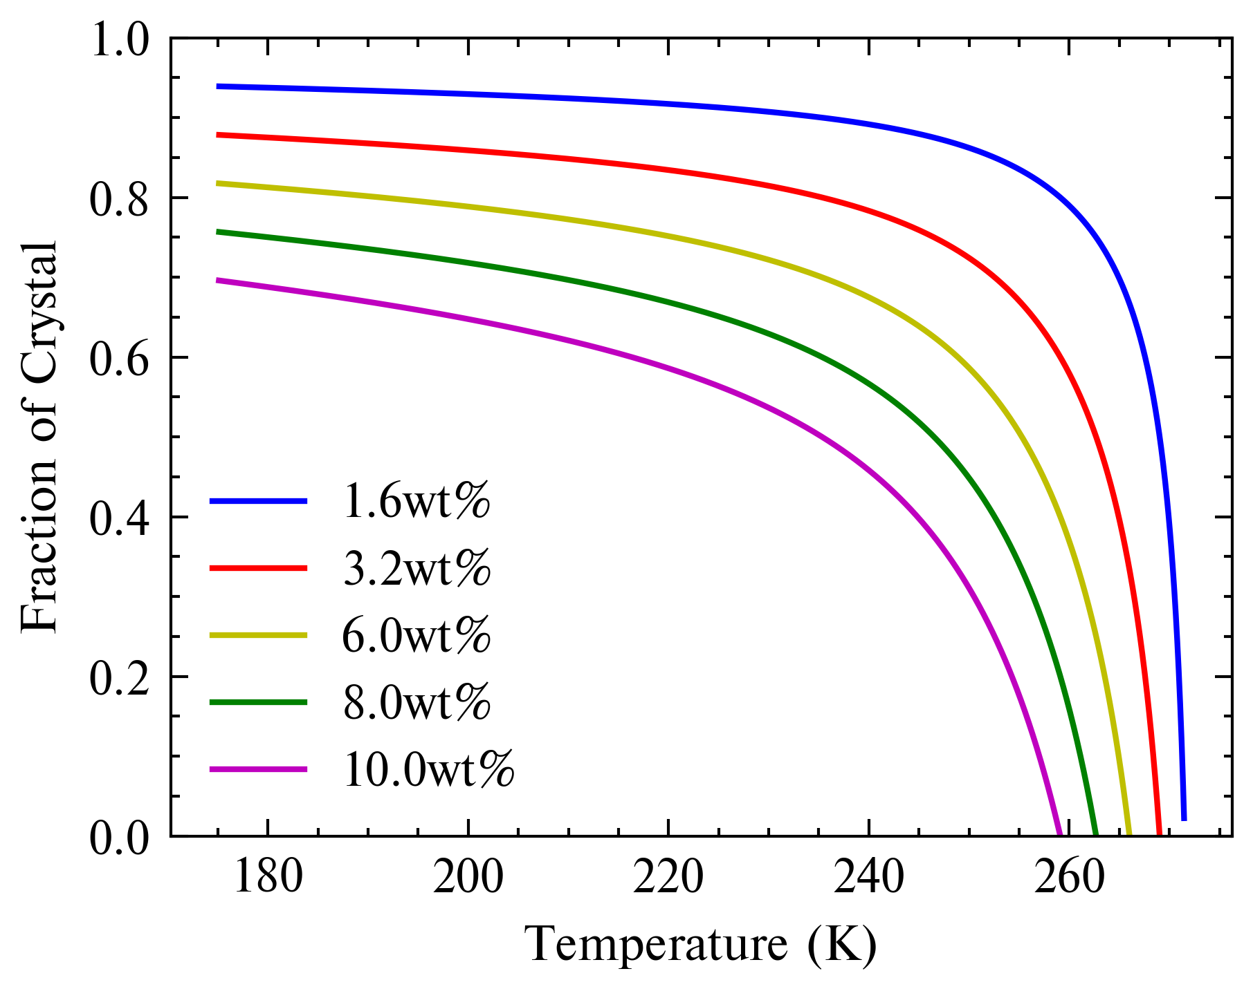
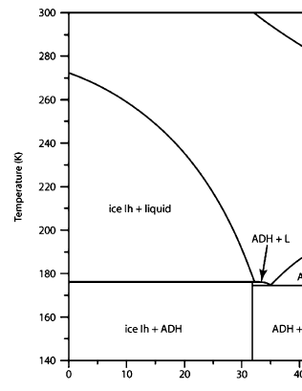
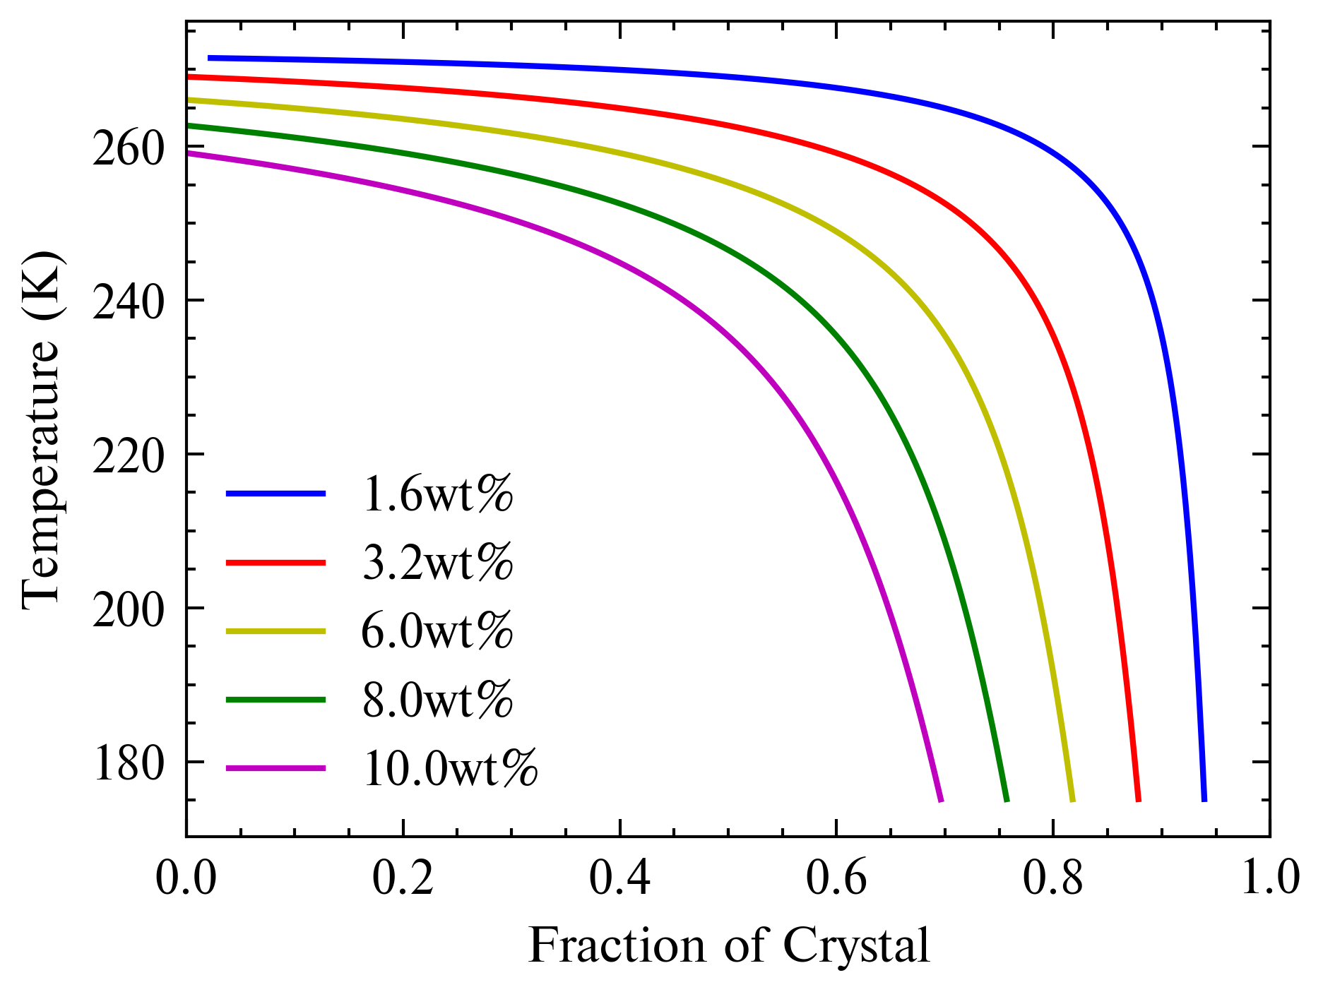


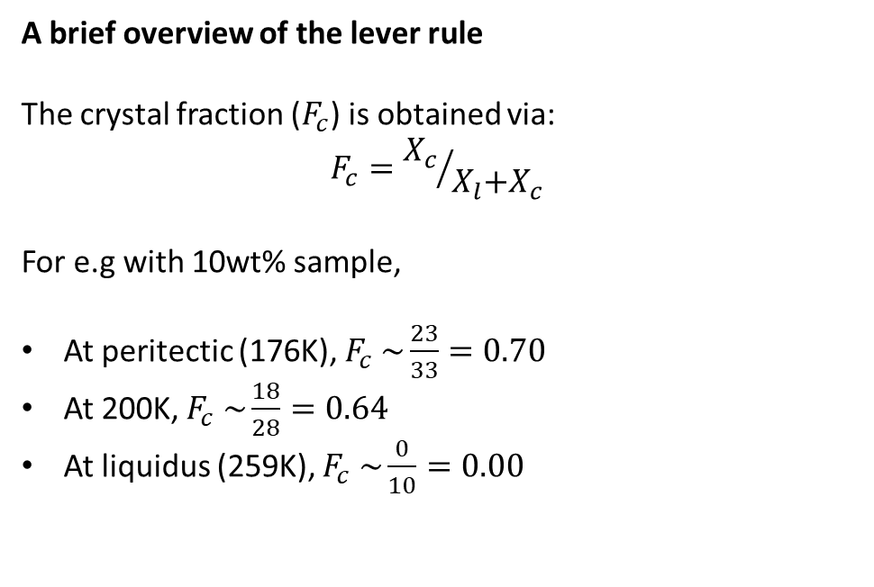



Fraction of Crystals
The Fc curves obtained
A brief overview of the lever rule The crystal fraction ($F_{c}$) is obtained via: $$F_{c}={X_{c}}/{X_{l}\text{+}X_{c} }$$
For e.g with 10wt% sample,
At peritectic (176K), $F_{c} \sim \frac{23}{33}=0.70$
At 200K, $F_{c} \sim \frac{18}{28}=0.64$
At liquidus (259K), $F_{c} \sim \frac{0}{10}=0.00$
$$X_{l}$$
$$X_{l}$$
$$X_{c}$$
$$X_{l}$$
$$X_{c}$$

Slide 2
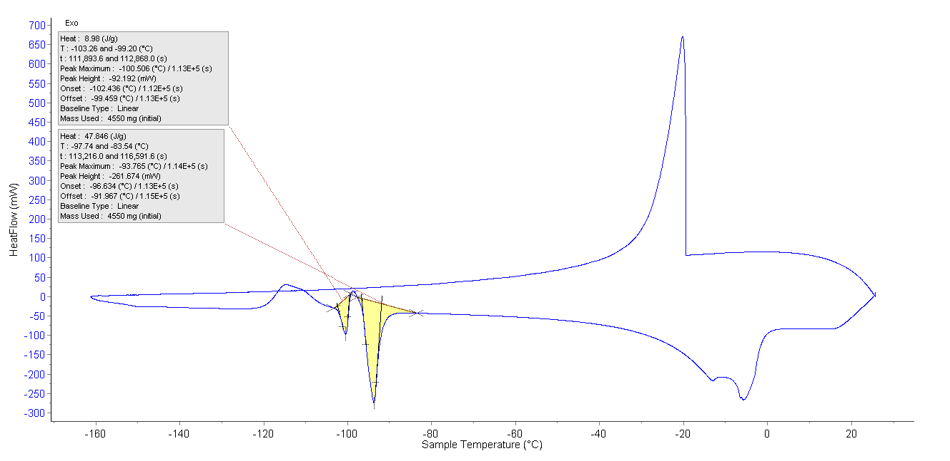
Peaks – Onset for AMH & ADH
 | Onset Temps (K)
Samples | AMH Melt | Offset | ADH Melt | Offset
1.6 wt.% | 171.18 | 0.18 | 177.19 | 1.06
3.2 wt.% | 171.07 | 0.07 | 176.53 | 0.40
6 wt.% | 170.62 | -0.38 | 176.49 | 0.36
8 wt.% | 170.71 | -0.29 | 176.52 | 0.39
10 wt.% | 170.15 | -0.85 | 176.71 | 0.58
Theoretical | 171 |  | 176.13

Slide 3
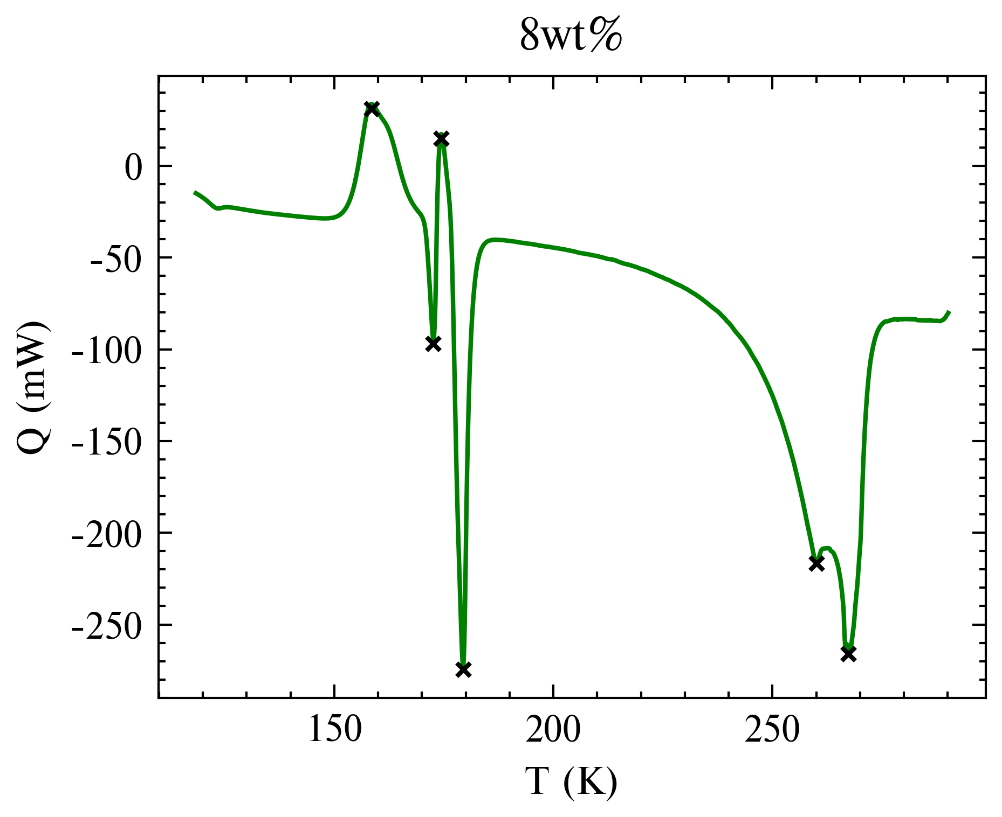
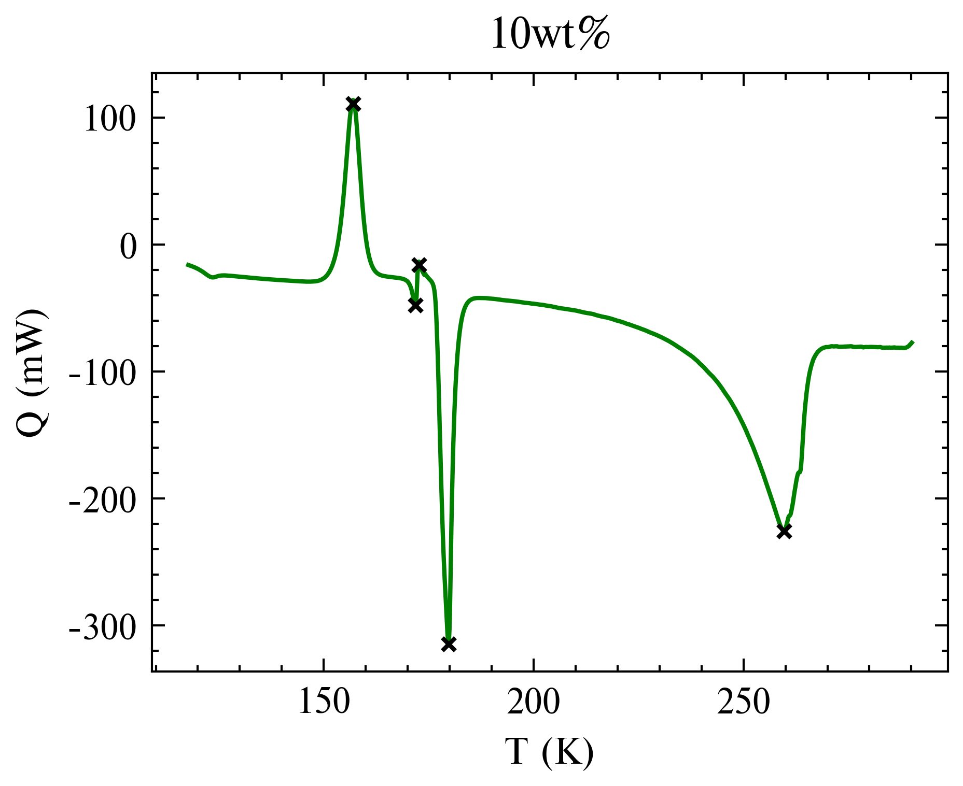
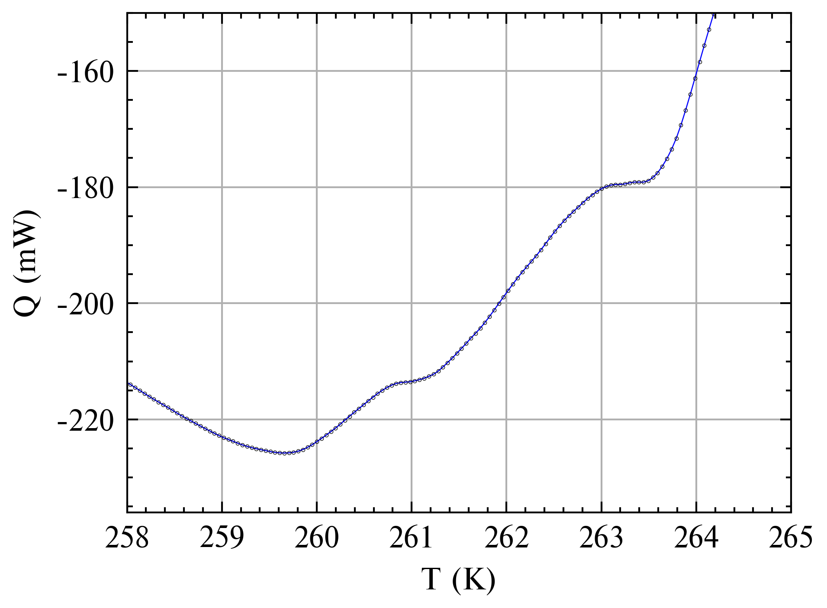
Peaks – Max for H2O
Samples | Liquidus | Peak 1 | Offset 1 | Peak 2 | Offset 2 | Peak 3 | Offset 3
1.6 wt.% | 271.47 | 277.90 | 6.43 | 278.29 | 6.82
3.2 wt.% | 269.01 | 272.19 | 3.18 | 277.48 | 8.47
6 wt.% | 266.02 | 268.87 | 2.85 | 269.50 | 3.48 | 271.89 | 5.87
8 wt.% | 262.64 | 260.09 | -2.55 | 267.31 | 4.67
10 wt.% | 259.07 | 259.66 | 0.59 | 260.94 | 1.87 | 263.34 | 4.27
Some peaks are picked up by the in-built function [argelextrema()] (coloured yellow in table)
For these peaks, the plot was zoomed and peaks were manually selected (coloured blue in table)
Some peaks are small and missed by the in-built function

Slide 4
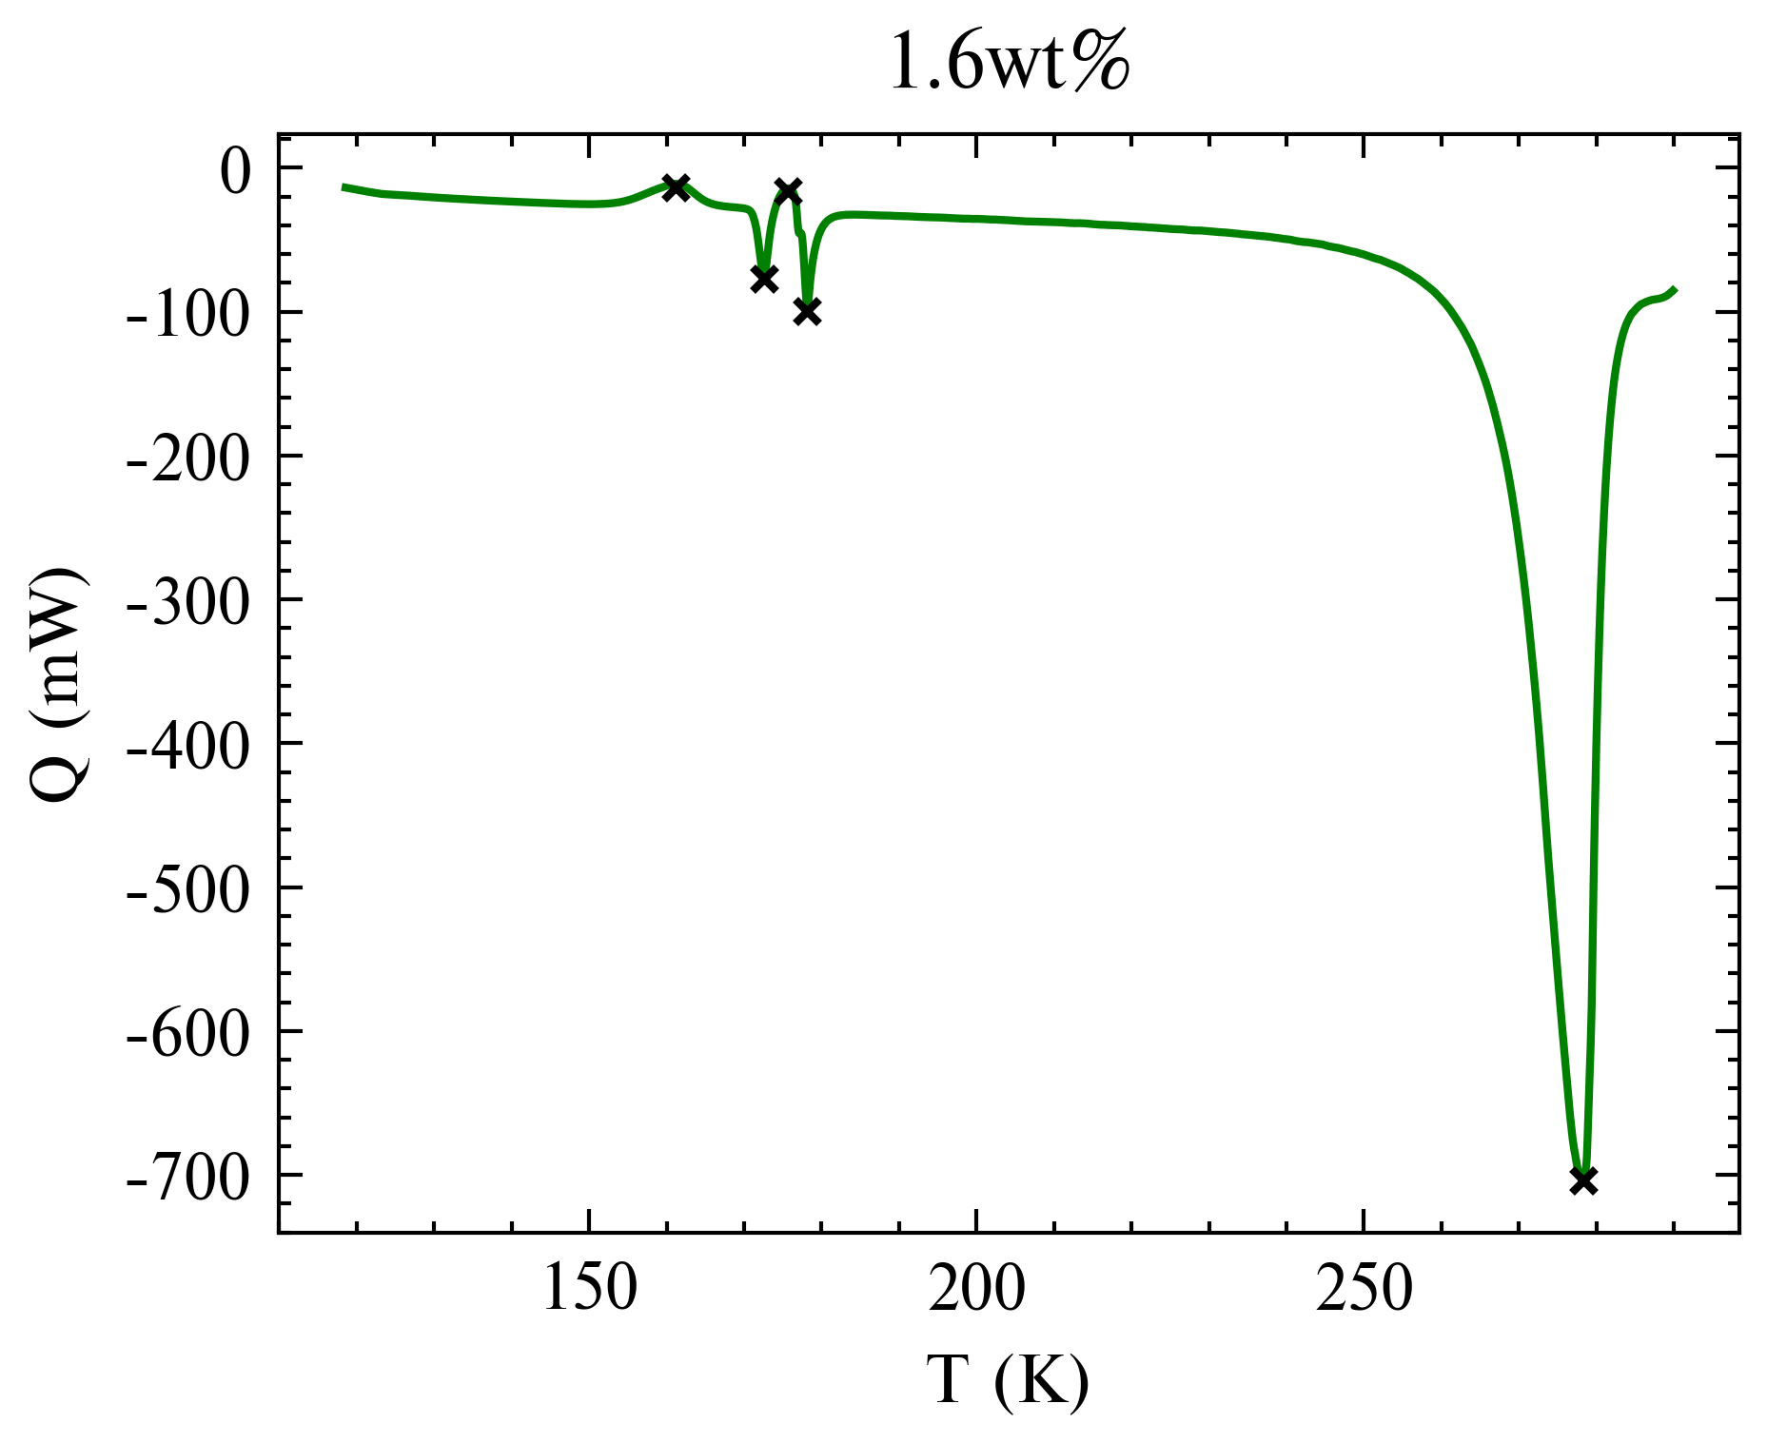
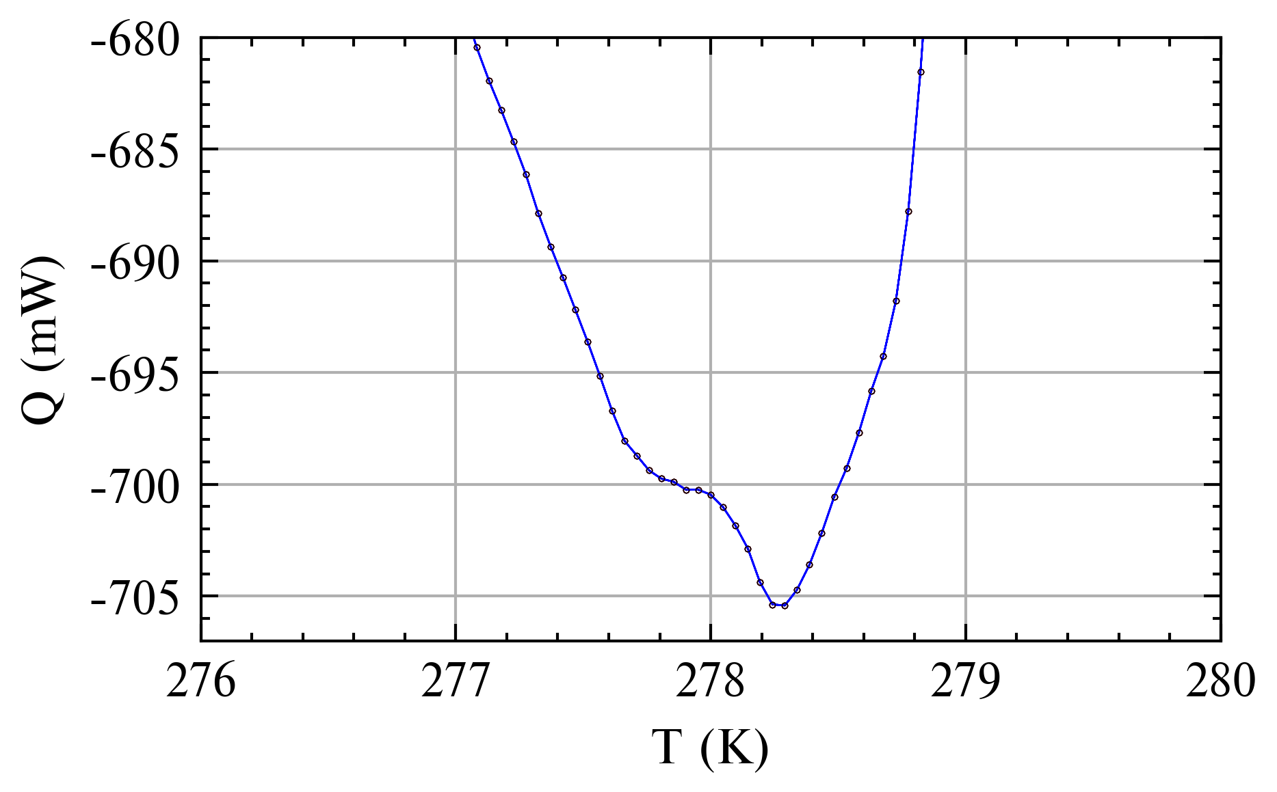
Peaks – Max for H2O (1.6wt%)
Samples | Liquidus | Peak 1 | Offset 1 | Peak 2 | Offset 2 | Peak 3 | Offset 3
1.6 wt.% | 271.47 | 277.90 | 6.43 | 278.29 | 6.82
3.2 wt.% | 269.01 | 272.19 | 3.18 | 277.48 | 8.47
6 wt.% | 266.02 | 268.87 | 2.85 | 269.50 | 3.48 | 271.89 | 5.87
8 wt.% | 262.64 | 260.09 | -2.55 | 267.31 | 4.67
10 wt.% | 259.07 | 259.66 | 0.59 | 260.94 | 1.87 | 263.34 | 4.27

Slide 5
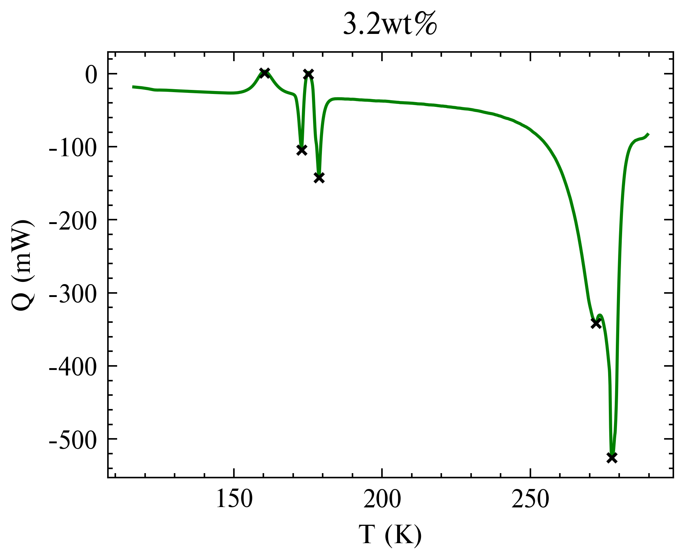
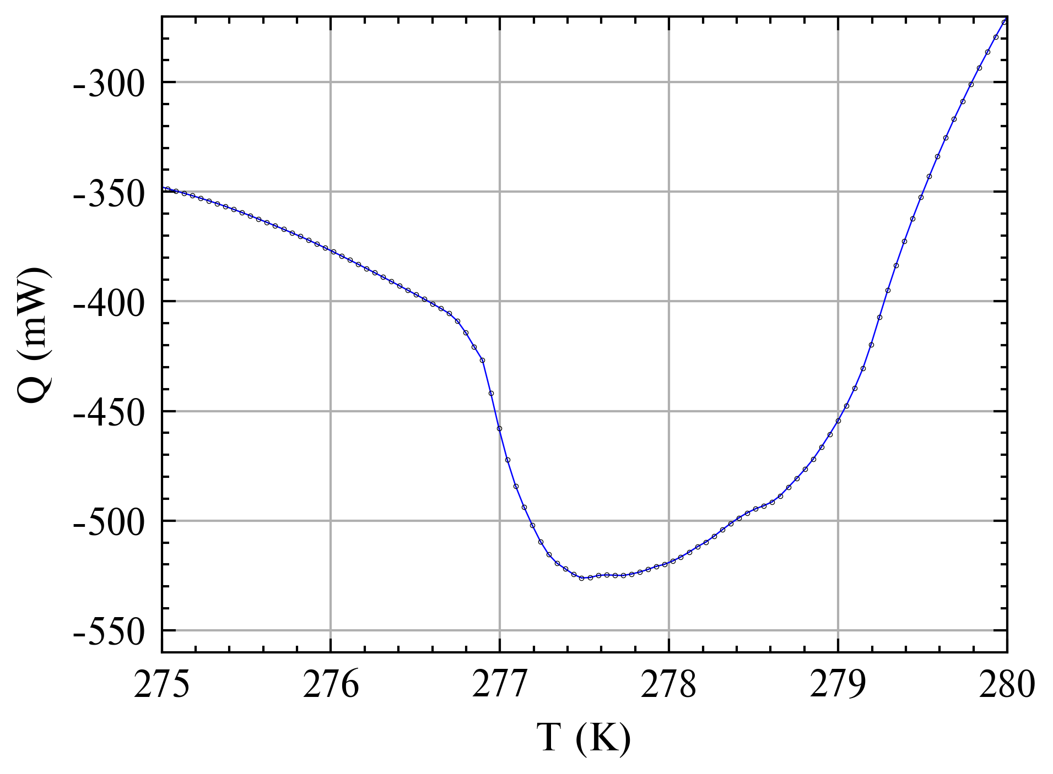
Peaks – Max for H2O (3.2wt%)
Samples | Liquidus | Peak 1 | Offset 1 | Peak 2 | Offset 2 | Peak 3 | Offset 3
1.6 wt.% | 271.47 | 277.90 | 6.43 | 278.29 | 6.82
3.2 wt.% | 269.01 | 272.19 | 3.18 | 277.48 | 8.47
6 wt.% | 266.02 | 268.87 | 2.85 | 269.50 | 3.48 | 271.89 | 5.87
8 wt.% | 262.64 | 260.09 | -2.55 | 267.31 | 4.67
10 wt.% | 259.07 | 259.66 | 0.59 | 260.94 | 1.87 | 263.34 | 4.27
Similar levelling off as to 6, 8, 10wt%

Slide 6
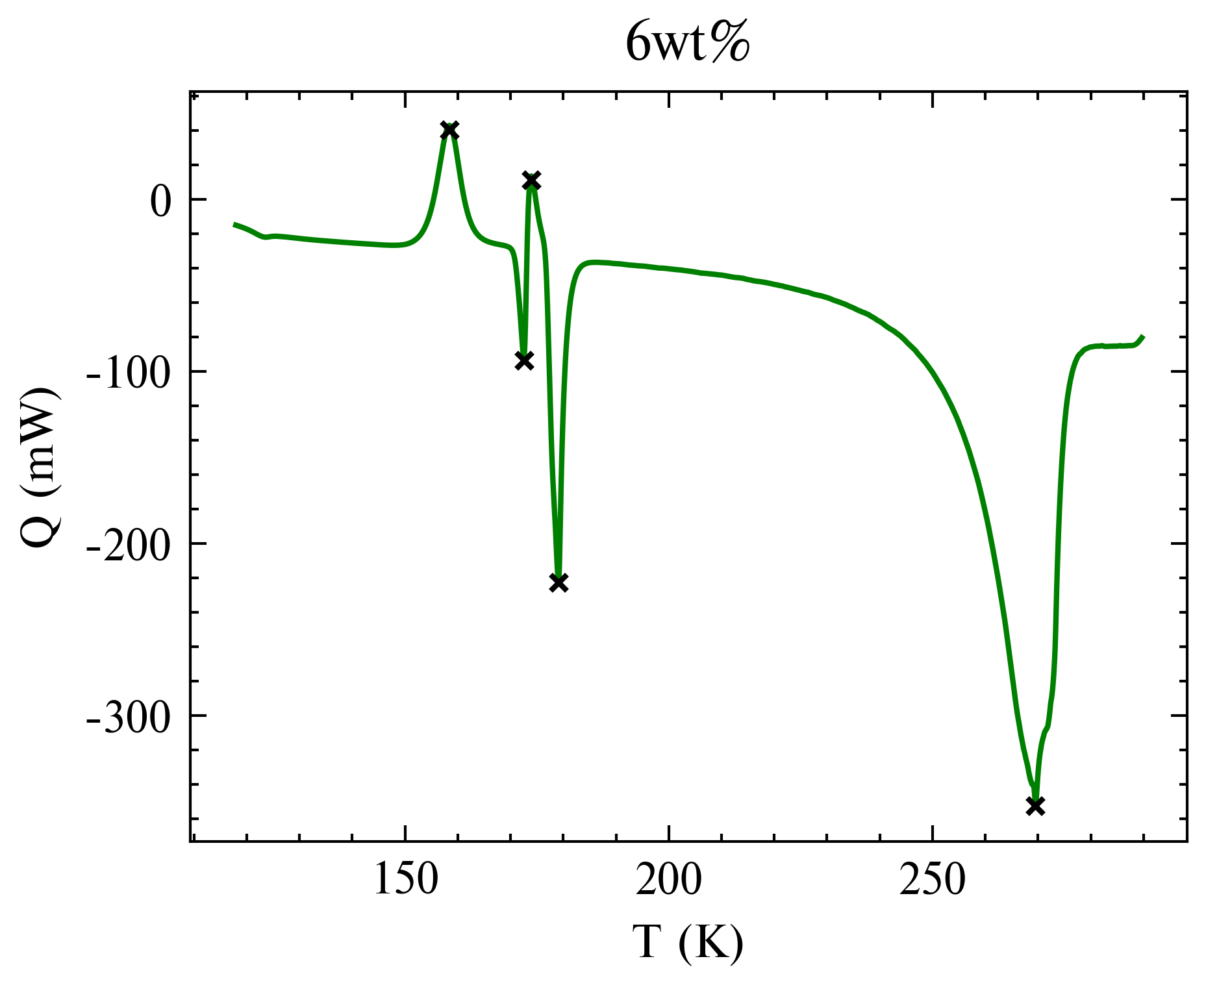
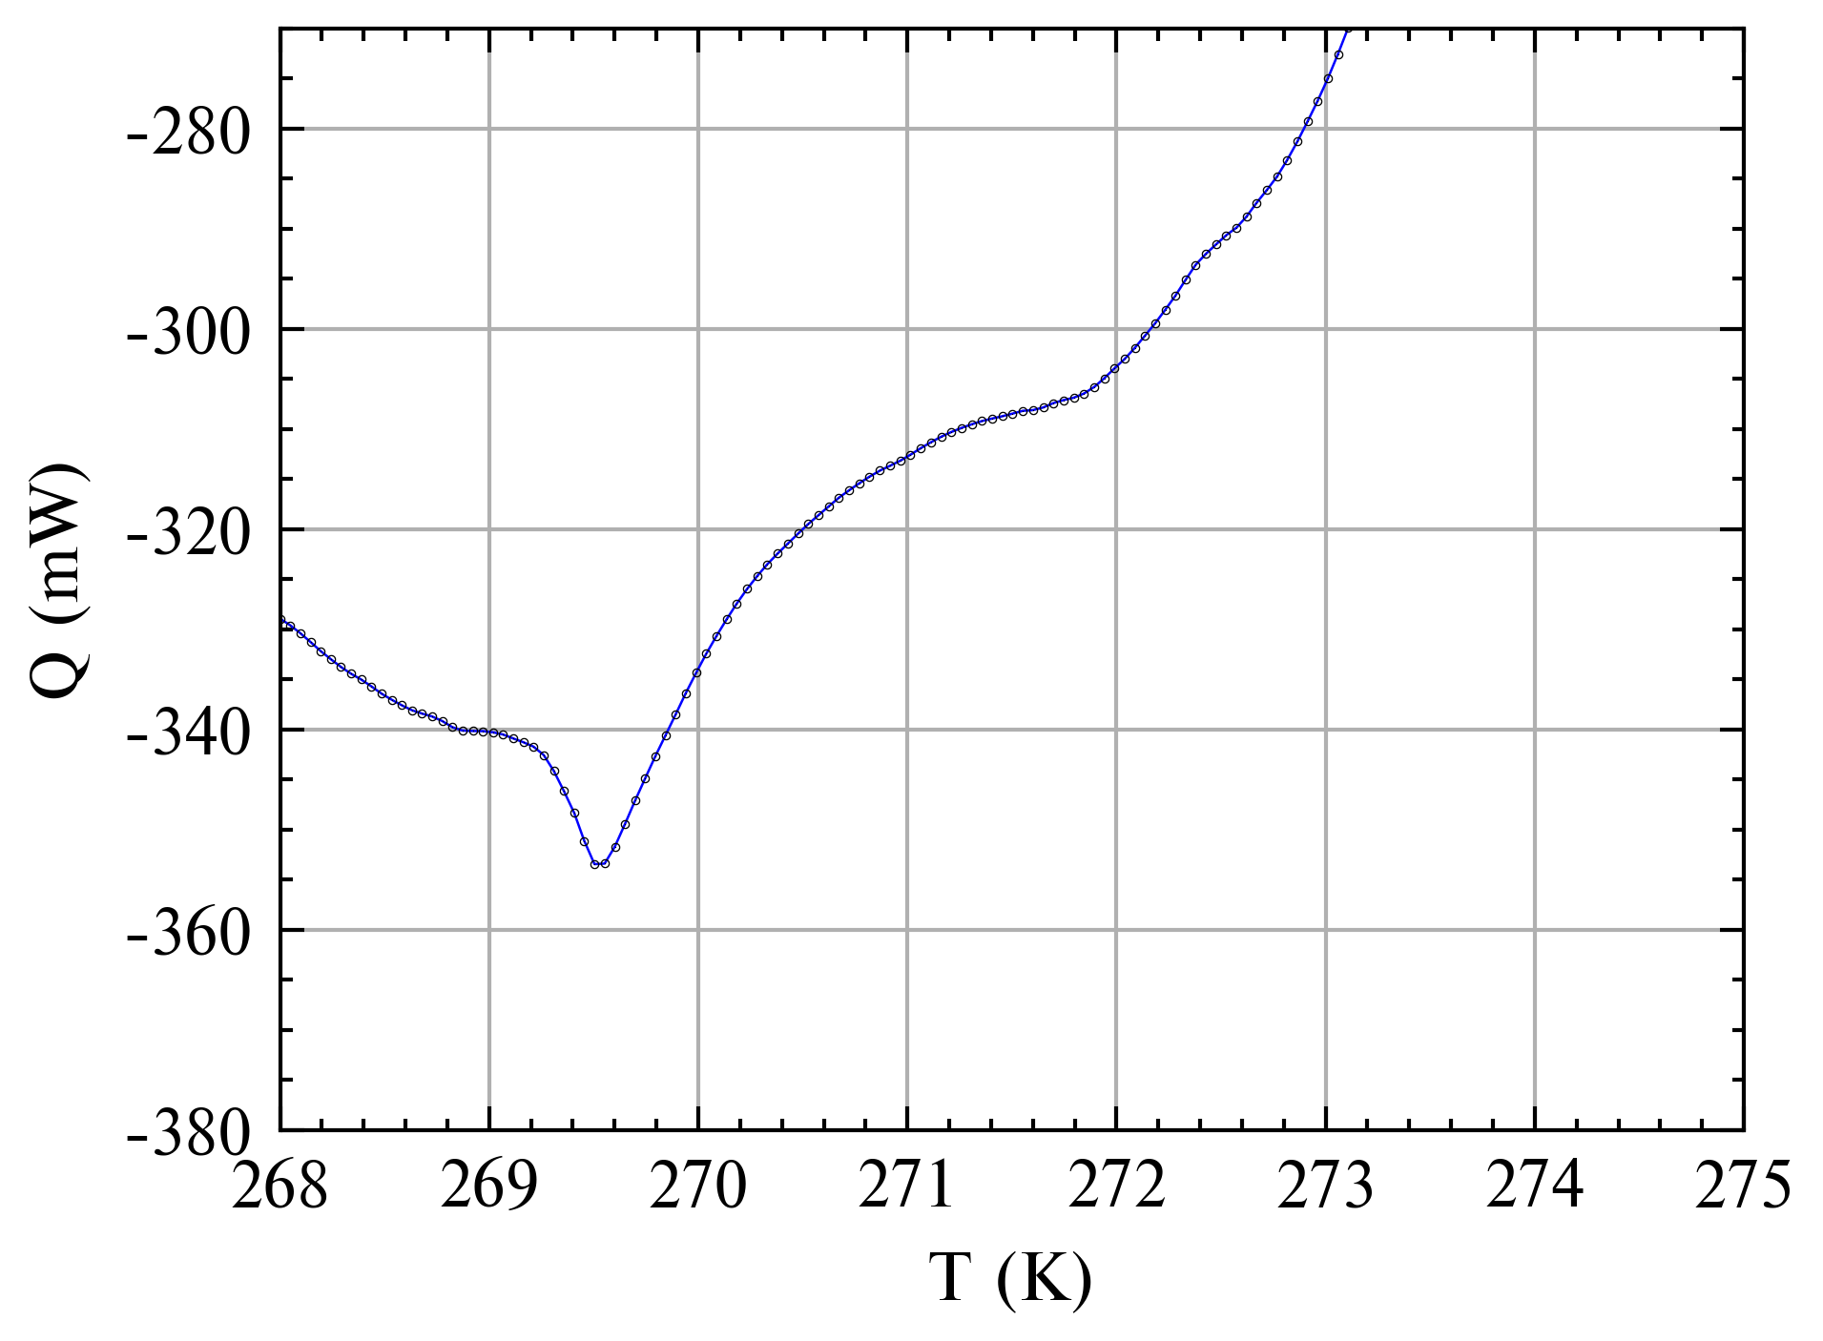
Peaks – Max for H2O (6wt%)
Samples | Liquidus | Peak 1 | Offset 1 | Peak 2 | Offset 2 | Peak 3 | Offset 3
1.6 wt.% | 271.47 | 277.90 | 6.43 | 278.29 | 6.82
3.2 wt.% | 269.01 | 272.19 | 3.18 | 277.48 | 8.47
6 wt.% | 266.02 | 268.87 | 2.85 | 269.50 | 3.48 | 271.89 | 5.87
8 wt.% | 262.64 | 260.09 | -2.55 | 267.31 | 4.67
10 wt.% | 259.07 | 259.66 | 0.59 | 260.94 | 1.87 | 263.34 | 4.27

Slide 7
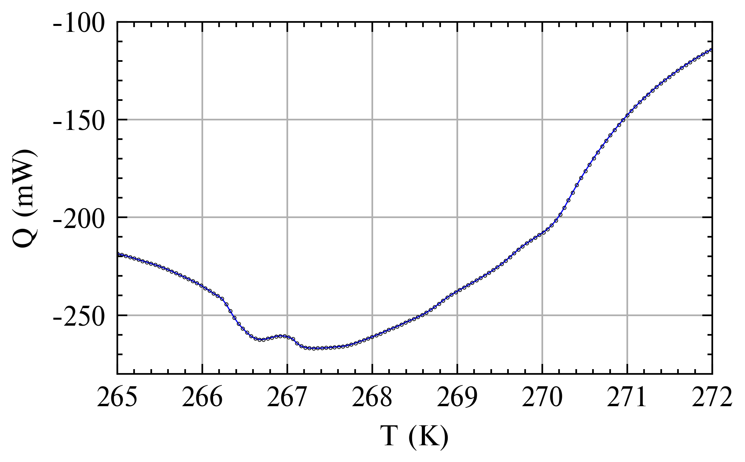
Peaks – Max for H2O (8wt%)
Samples | Liquidus | Peak 1 | Offset 1 | Peak 2 | Offset 2 | Peak 3 | Offset 3
1.6 wt.% | 271.47 | 277.90 | 6.43 | 278.29 | 6.82
3.2 wt.% | 269.01 | 272.19 | 3.18 | 277.48 | 8.47
6 wt.% | 266.02 | 268.87 | 2.85 | 269.50 | 3.48 | 271.89 | 5.87
8 wt.% | 262.64 | 260.09 | -2.55 | 267.31 | 4.67
10 wt.% | 259.07 | 259.66 | 0.59 | 260.94 | 1.87 | 263.34 | 4.27
Similar mini-double peak as to 2wt%, 6wt%
Similar levelling off as to 4, 6, 10wt%

Slide 8
Peaks – Max for H2O (10wt%)
Samples | Liquidus | Peak 1 | Offset 1 | Peak 2 | Offset 2 | Peak 3 | Offset 3
1.6 wt.% | 271.47 | 277.90 | 6.43 | 278.29 | 6.82
3.2 wt.% | 269.01 | 272.19 | 3.18 | 277.48 | 8.47
6 wt.% | 266.02 | 268.87 | 2.85 | 269.50 | 3.48 | 271.89 | 5.87
8 wt.% | 262.64 | 260.09 | -2.55 | 267.31 | 4.67
10 wt.% | 259.07 | 259.66 | 0.59 | 260.94 | 1.87 | 263.34 | 4.27

Slide 9
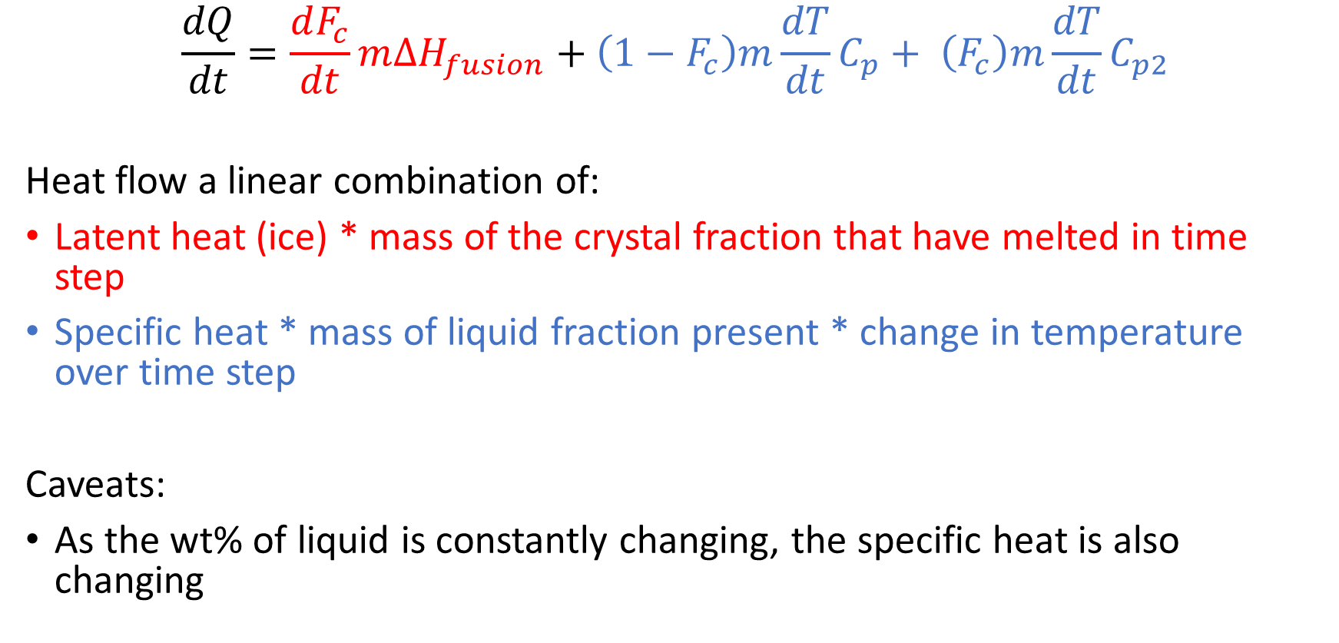
Linear Combination
$$\frac{dQ}{dt}=\frac{dF_{c}}{dt}m{∆H}_{fusion}+\left(1−F_{c}\right)m\frac{dT}{dt}C_{p}+ \left(F_{c}\right)m\frac{dT}{dt}C_{p2}$$
Heat flow a linear combination of:
Latent heat (ice) * mass of the crystal fraction that have melted in time step
Specific heat * mass of liquid fraction present * change in temperature over time step
Caveats:
As the wt% of liquid is constantly changing, the specific heat is also changing

Slide 10
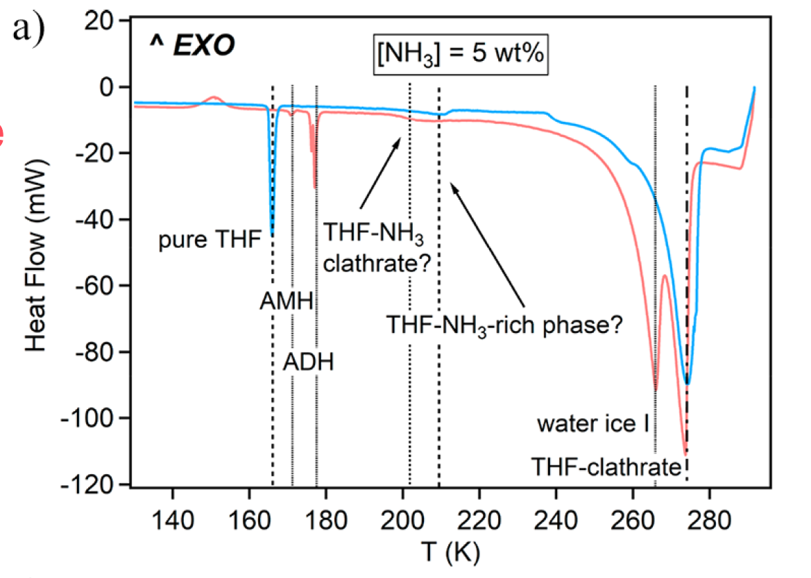
Double Peaks
THF contamination → similar double peaks
Are there other users of the fume hood? Contamination may have occurred in the pipette, beaker etc.
Pressure solution → volatiles introduced into sample
Munoz-Iglesias et al. 2021 commented with 80% empty volume in chamber, pressure is negligible. Ours is 42% empty.

