Slide 1
Summary
1.76wt%, 8wt%, new bottle
Comparisons with literature

Slide 2
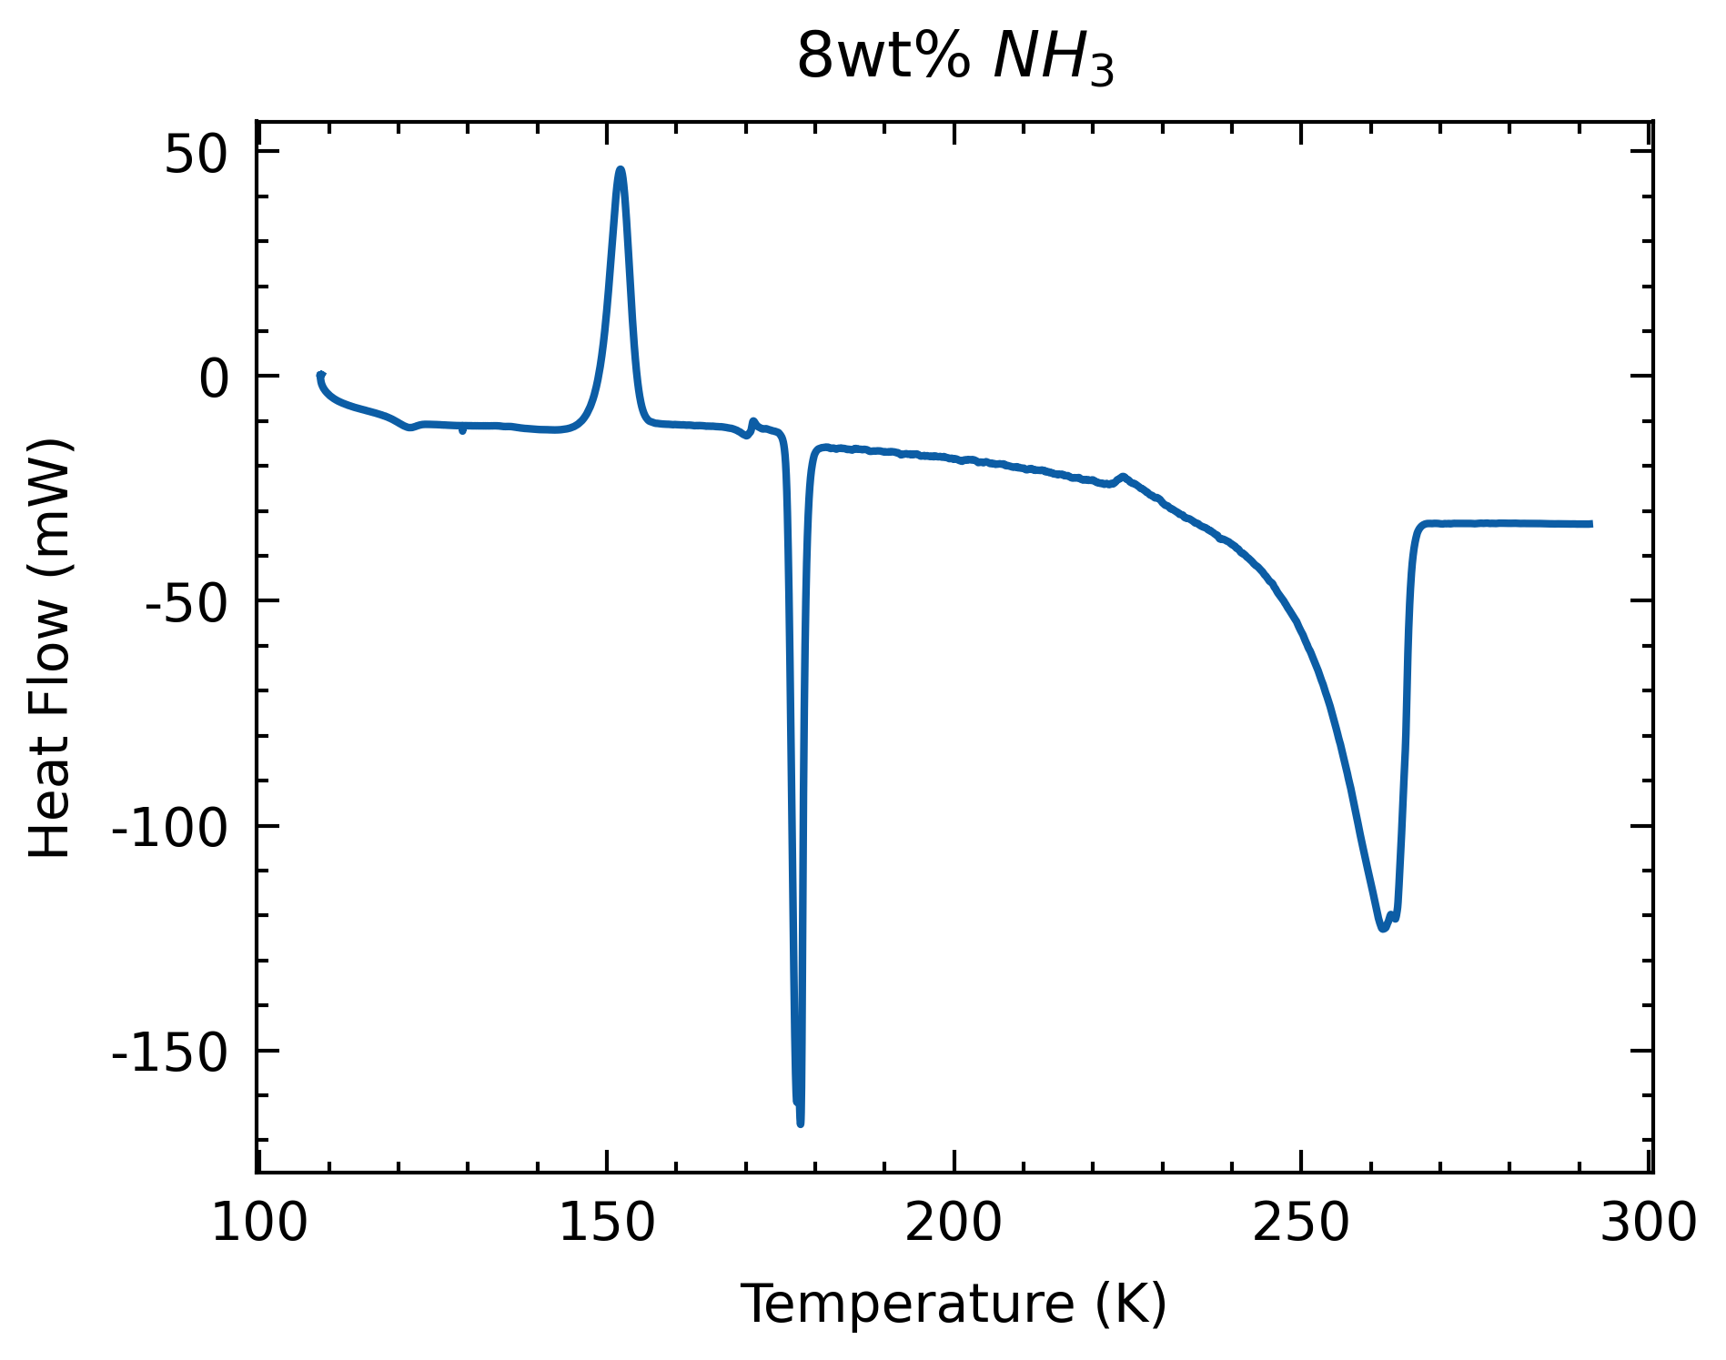
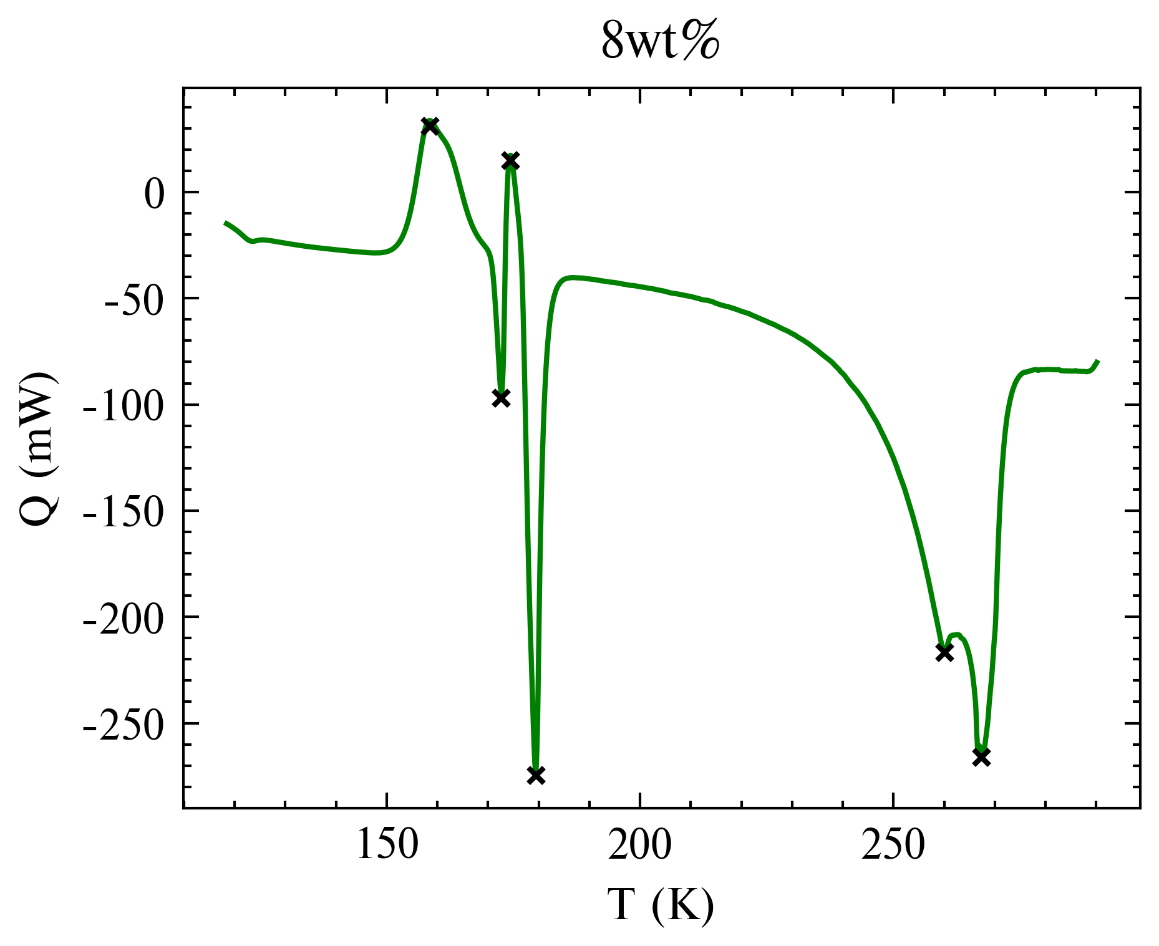
Samples | ADH Melt | Offset | H2O | Offset | Liquidus
0.1K/min | 175.98 | -0.02 | 262.893 | 0.25 | 262.64
0.25K/min | 176.52 | 0.39 | 260.09 | -2.55 | 262.64
8wt%
Much smaller AMH melt, ADH crystallization peak
Small kink during partial melting
Minor double peak

Slide 3
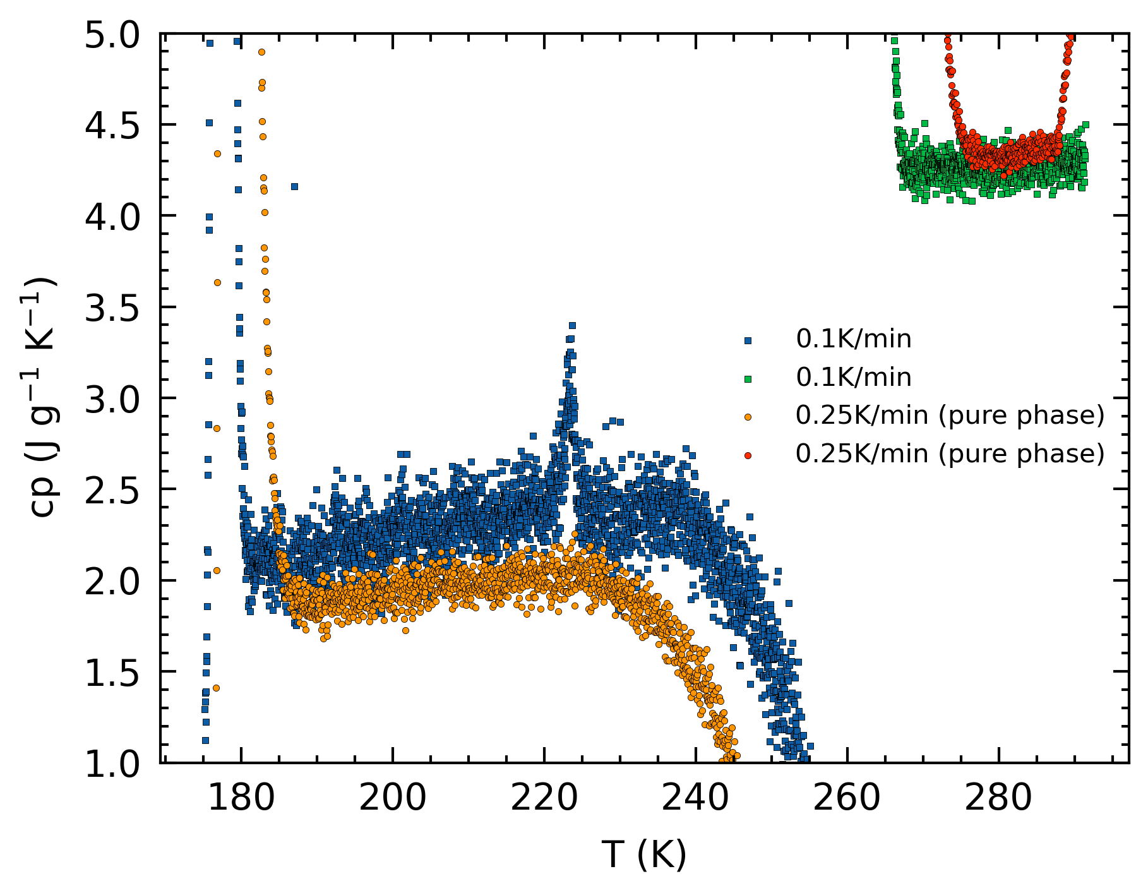
Samples | ADH Melt | Offset | H2O | Offset | Liquidus
0.1K/min | 175.98 | -0.02 | 262.893 | 0.25 | 262.64
0.25K/min | 176.52 | 0.39 | 260.09 | -2.55 | 262.64
8wt%
0.25K/min cp higher for pure phase.
0.25K/min cp lower for melting phase: higher calculated contribution to melt ice.

Slide 4
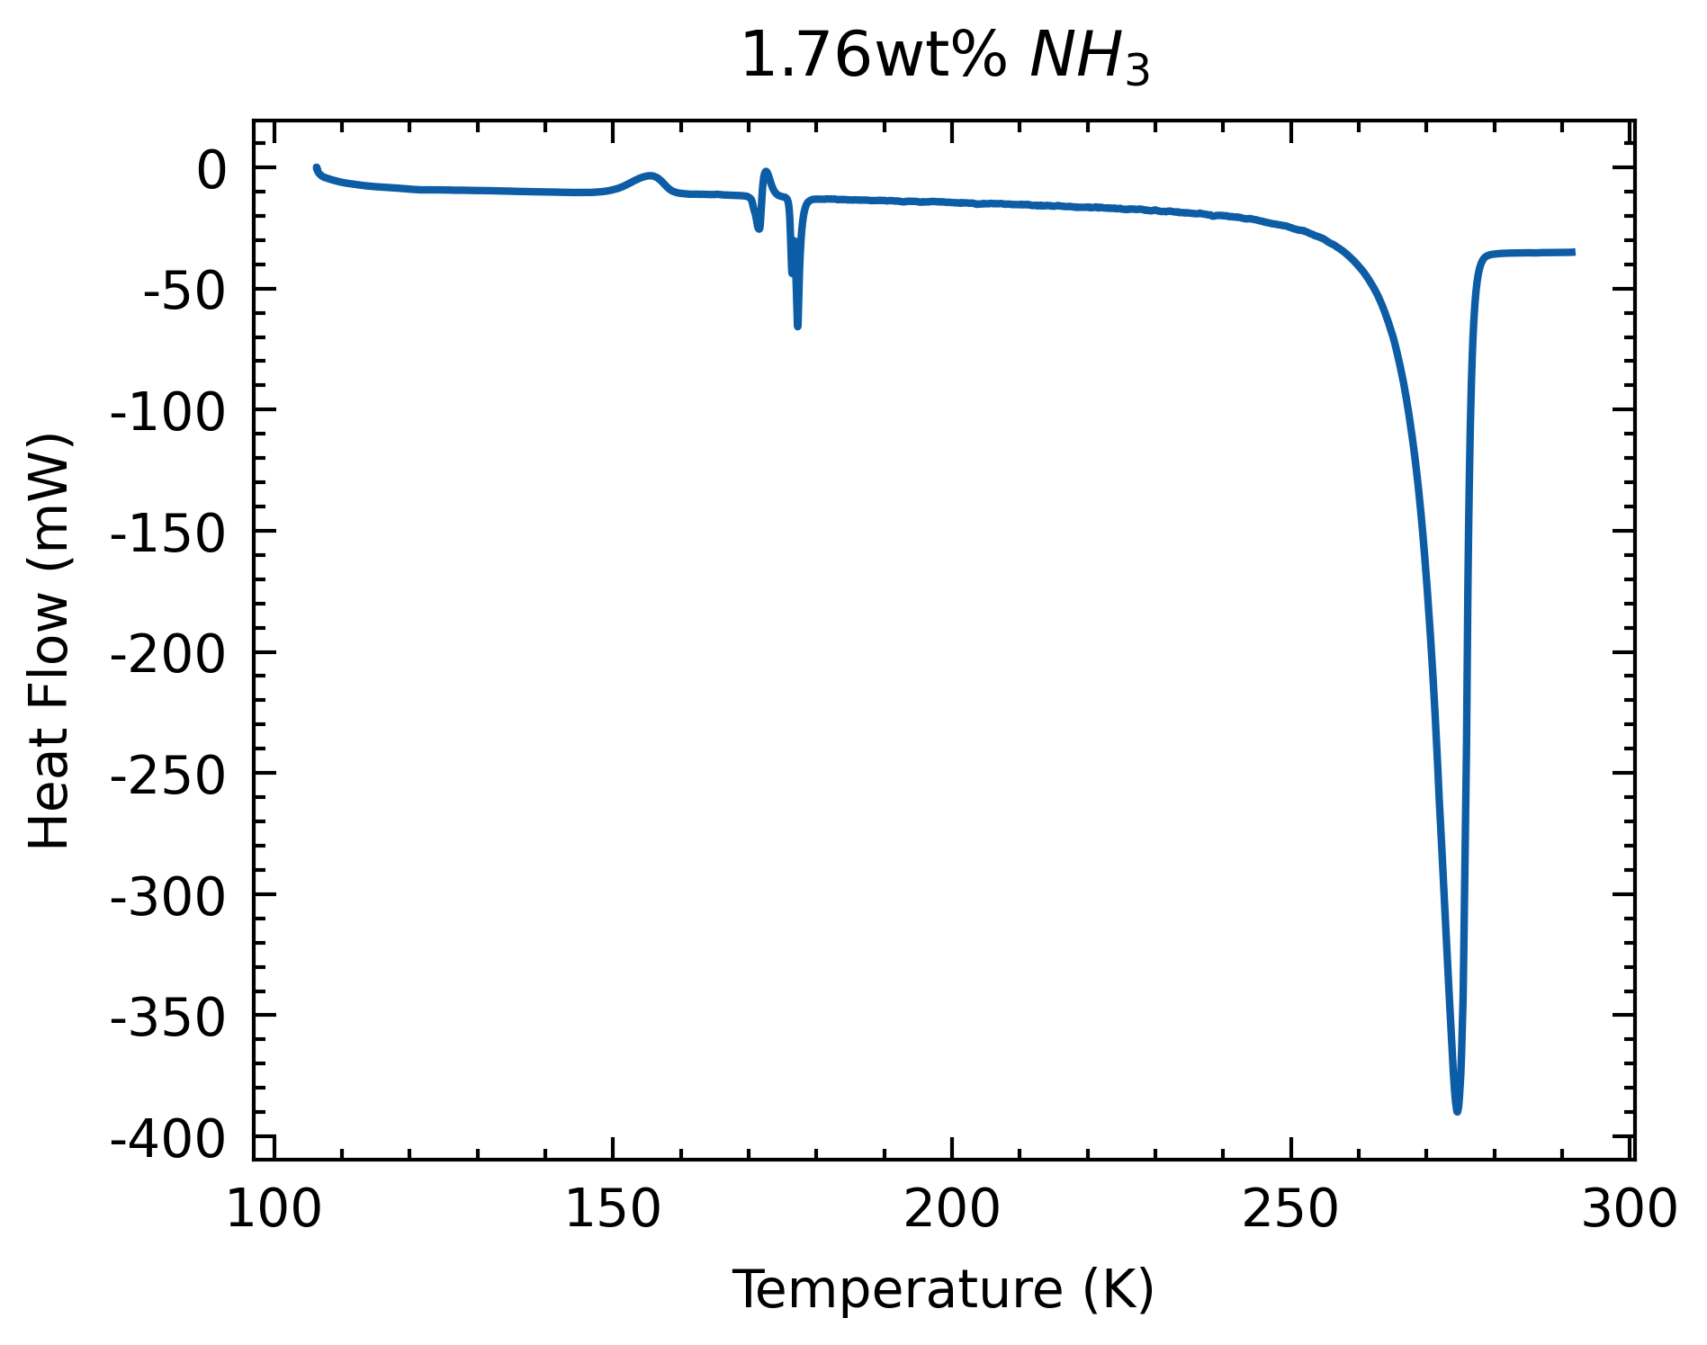
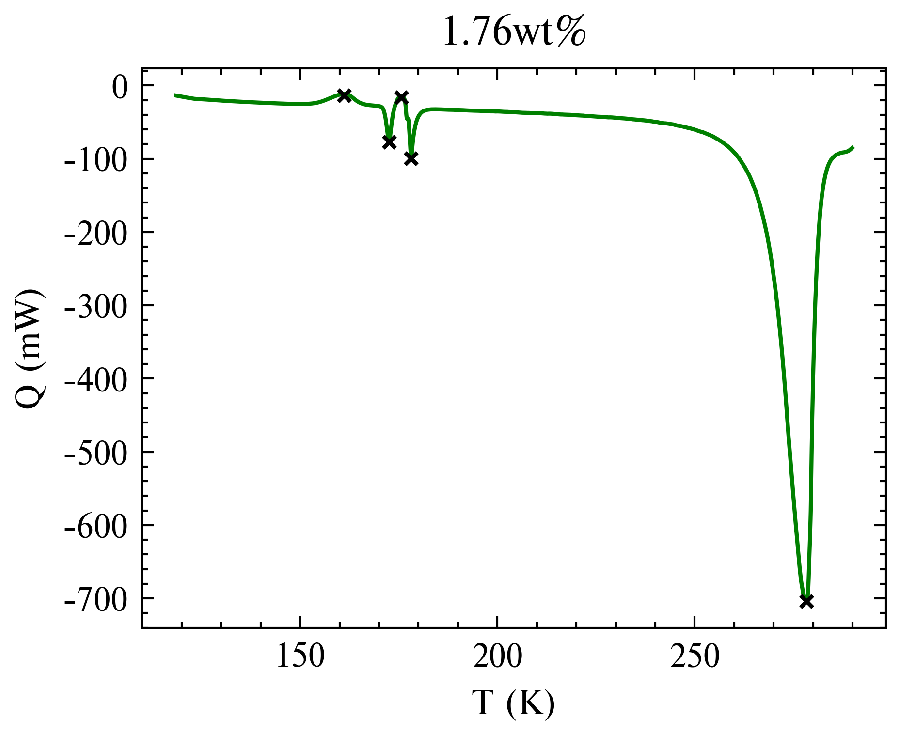
Samples | ADH Melt | Offset | H2O | Offset | Liquidus
0.1K/min | 176.15 | 0.15 | 274.54 | 2.78 | 271.76
0.25K/min | 177.19 | 1.06 | 278.29 | 6.53 | 271.76
1.76wt%
Somewhat similar
Offsets are slightly better (note ADH melt onset is a rough estimate)

Slide 5
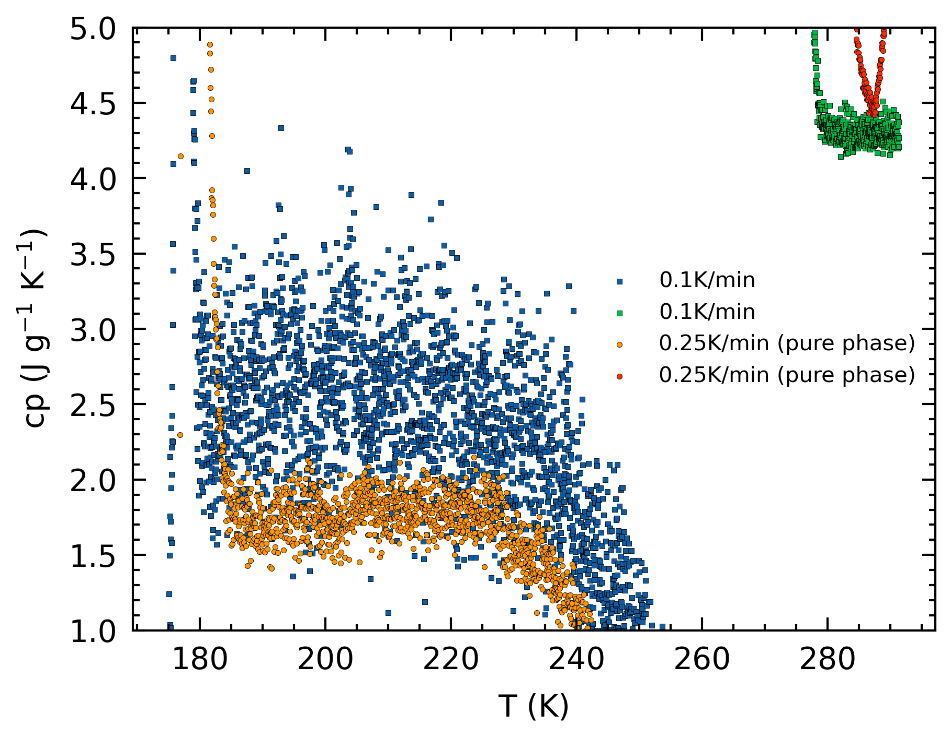
Samples | ADH Melt | Offset | H2O | Offset | Liquidus
0.1K/min | 176.15 | 0.15 | 274.54 | 2.78 | 271.76
0.25K/min | 177.19 | 1.06 | 278.29 | 6.53 | 271.76
1.76wt%
0.25K/min cp higher for pure phase.
0.25K/min cp lower for melting phase: higher calculated contribution to melt ice.

Slide 6
0.1K/min vs 0.25K/min
Melting phase < Pure phase:
Contributions to melting water ice assumes (higher) constant latent heat (set at 273.15K)
Overestimation of heat to melt ice, underestimation of heat to warm liquid
As T increases, molality decreases. Slope is thus lower-ish

Slide 7
8wt% vs 1.76wt%
Larger spread with lower wt%

Slide 8
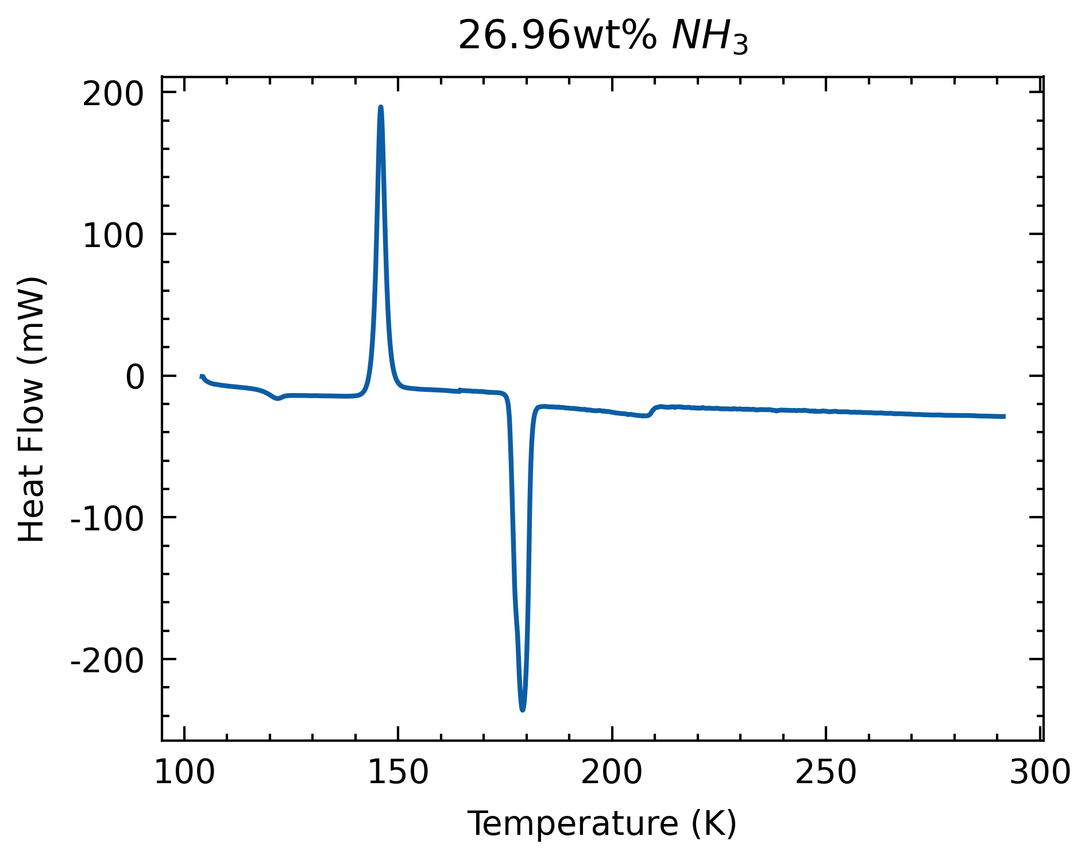
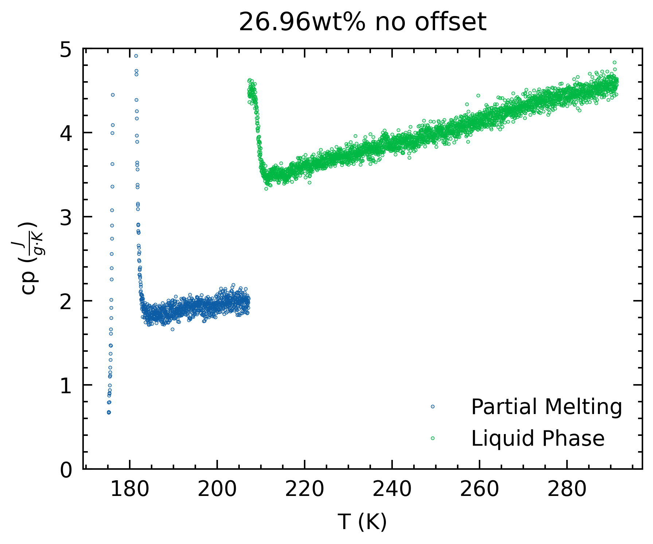
ADH Melt | Offset | H2O | Offset | Liquidus
175.99 | -0.01 | 207.15 | 0.00 | 207.15
New bottle (~28-30wt%)
Melting phase more linear.
Further calculations assume 26.96wt%, to fit liquidus.

Slide 9
Tillner-Roth & Friend 1998
Specific heat sources:
Reference | Year | T-range (K) | X (NH₃) | Remarks
Chan & Giauque | 1964 | 183-288 | 0.333
Hildenbrand & Giauque | 1953 | 197-290 | 0.49-0.65 | TR & F reported X of 0.5, 0.6, 0.67
Wrewsky & Kaigorodoff | 1924 | 275-334 | 0.01-0.40 | Source not found
Zinner | 1934 | 203-453 | 0.1-0.9 | Saturated liquid enthalpy. Source not found

Slide 10
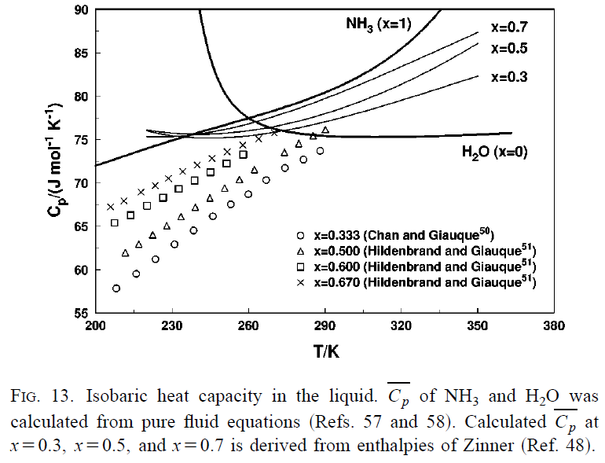
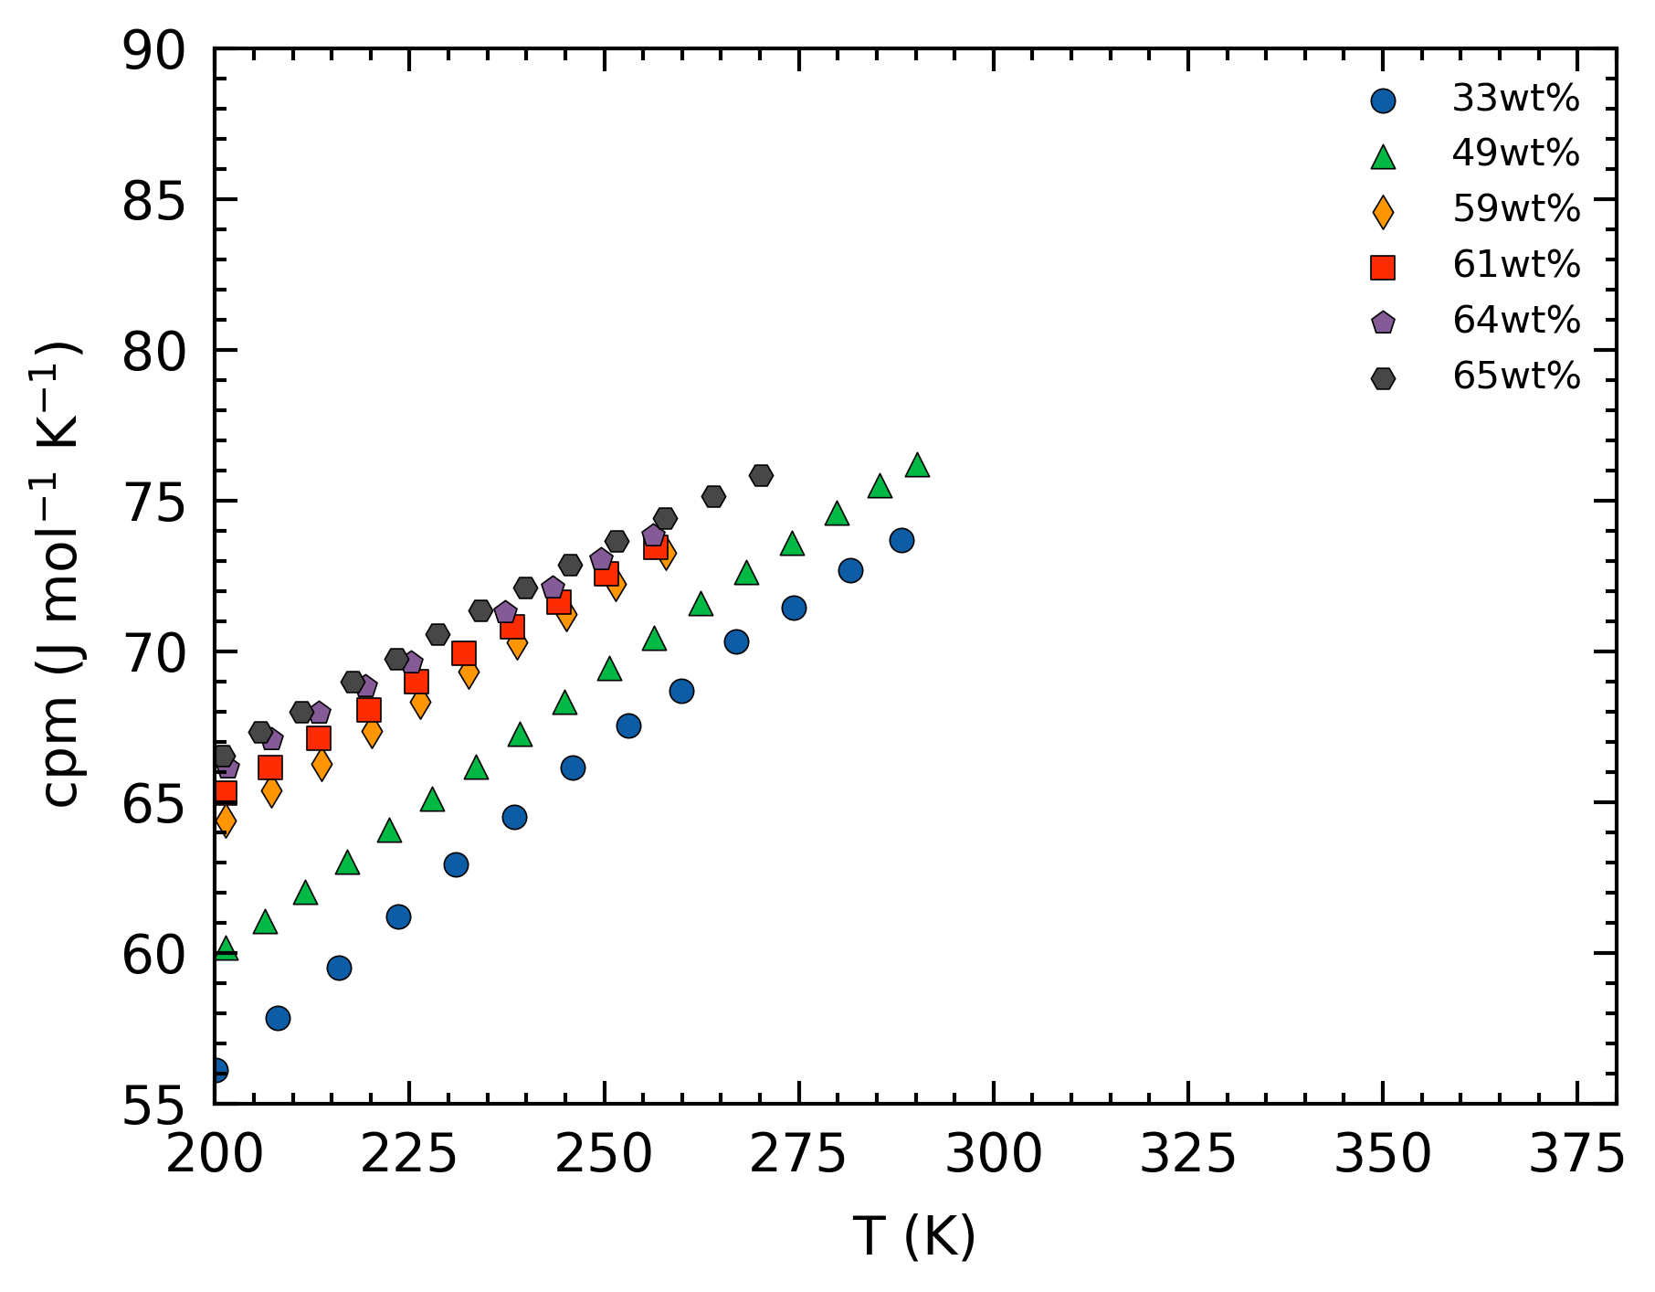
Tillner-Roth & Friend 1998

Slide 11
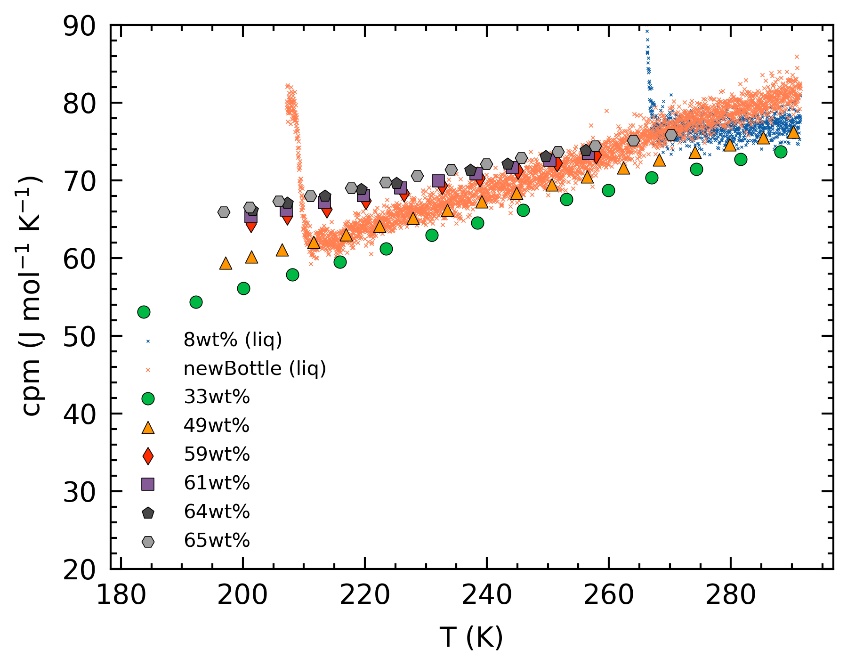
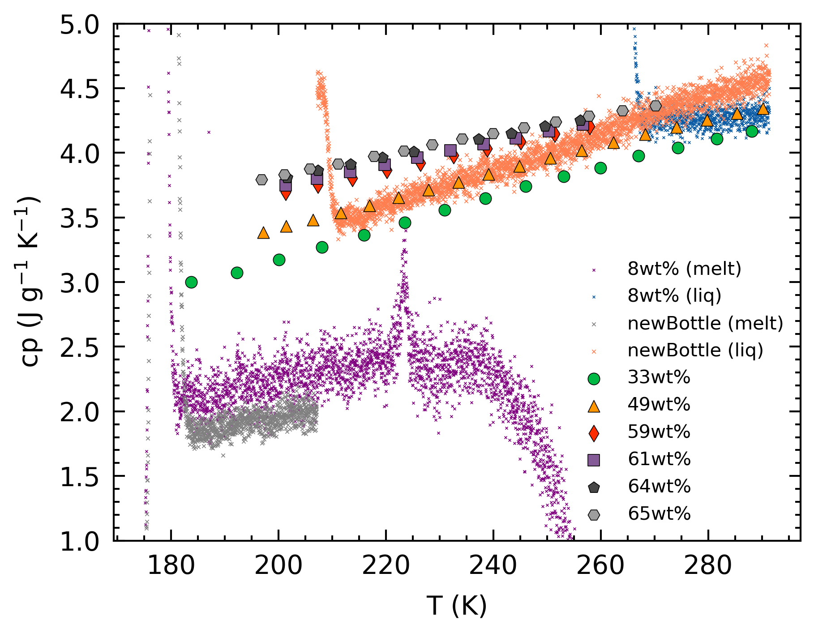
A check
New bottle (~26.96wt%)
Our pure phase data is slightly higher than the trend from literature
Our melting phase data is lower

Slide 12
Questions to ponder
Are our pure phase data more reliable than that of literature?
Is the difference between pure phase and melting phase cp expected?
Note: for melting phase cp values, as T increases, wt% decreases.
Is the difference between melting phase cp for different wt% reconcilable?
Theoretically, they should represent the same liquid wt% and same T.
Is the difference in gradients of the pure phases for 26.96wt% and 8wt% significant?

Slide 13
Questions to ponder
Density of ammonium hydroxide: it is dependent on the concentration (20wt%), not always at 0.9g/ml?

Slide 14
Experiments to run
5-8Aug → blank
11-15Aug → 0 wt%
16-19Aug → 8 wt%
22-25Aug → new bottle wt%
29-1Sep → 1.76 wt%
2-6Sep → 3.52 wt%
8-12Sep → 6 wt%
13-16Sep → 10 wt%

Slide 15
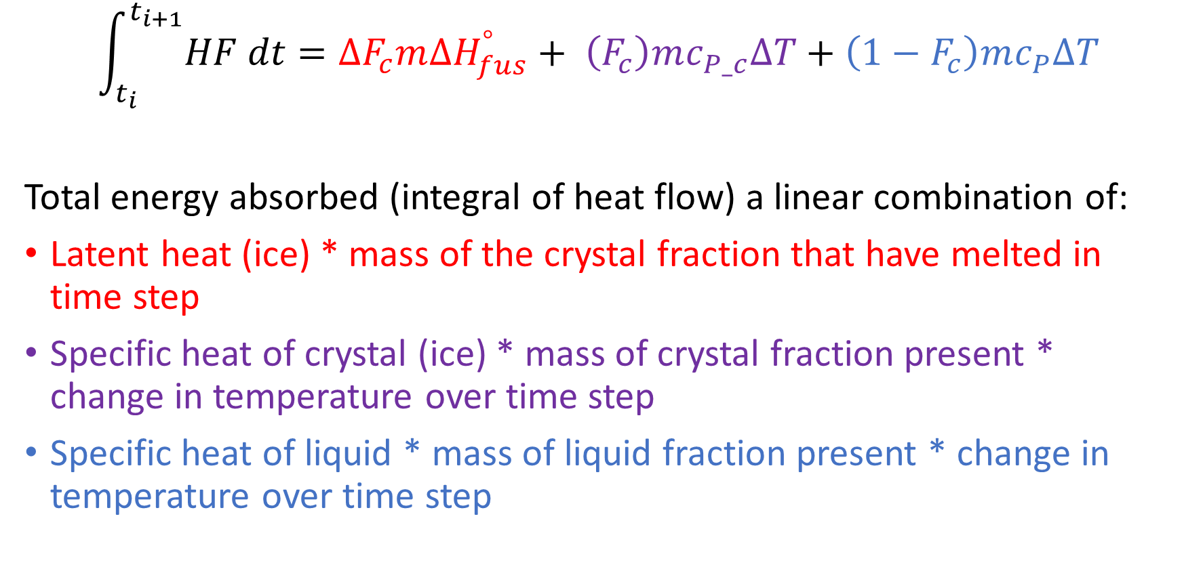
Specific Heat Retrieval
$$\int_{t_{i}}^{t_{i+1}}{HF dt}=∆F_{c}m{∆H}_{fus}^{°}+ \left(F_{c}\right)mc_{P_c}∆T+\left(1−F_{c}\right)mc_{P}∆T$$
Total energy absorbed (integral of heat flow) a linear combination of:
Latent heat (ice) * mass of the crystal fraction that have melted in time step
Specific heat of crystal (ice) * mass of crystal fraction present * change in temperature over time step
Specific heat of liquid * mass of liquid fraction present * change in temperature over time step

Slide 16
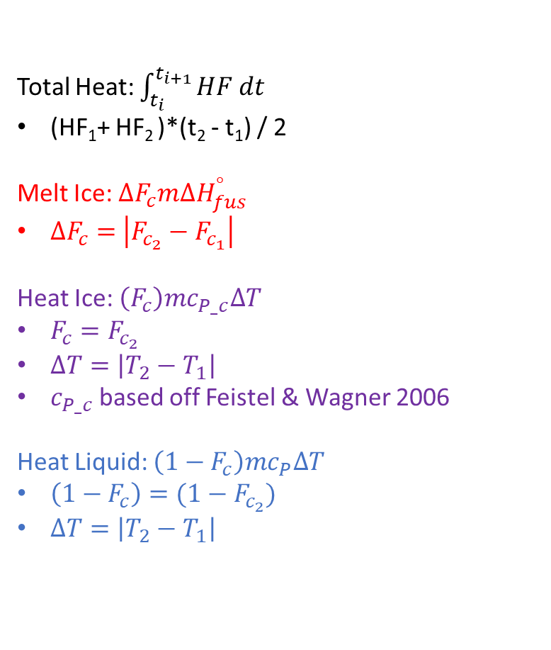
Specific Heat Retrieval
Total Heat: $\int_{t_{i}}^{t_{i+1}}{HF dt}$
(HF₁+ HF₂ )*(t₂ - t₁) / 2
Melt Ice: $∆F_{c}m{∆H}_{fus}^{°}$
$∆F_{c}=$ $\left|F_{c_{2}}−F_{c_{1}}\right|$
Heat Ice: $\left(F_{c}\right)mc_{P_c}∆T$
$F_{c}=F_{c_{2}}$
$∆T=\left|T_{2}−T_{1}\right|$
$c_{P_c}$based off Feistel & Wagner 2006
Heat Liquid: $\left(1−F_{c}\right)mc_{P}∆T$
$\left(1−F_{c}\right)=(1−F_{c_{2}})$
$∆T=\left|T_{2}−T_{1}\right|$
HF
(HF₁, t₁, T₁, Fc₁,)
(HF₂, t₂, T₂, Fc₂)
t

