Slide 1
Density Measurements
New bottle
Temporal variation of the 1 ml measurement
Volumetric variation: 5 ml measurement, higher density
Possible reasons for variation
Volatile loss
Temperature (?)
Date | Volume | Mass (g) | Density
Aug 22 | 5 ml | 3.7778 | 0.7556
Sep 12 | 1 ml | 0.6158 | 0.6158
Sep 26 | 1 ml | 0.6765 | 0.6765
Oct 04 | 1 ml | 0.7184 | 0.7184
Oct 04 | 1 ml | 0.7092 | 0.7092
Oct 04 | 5 ml | 3.8104 | 0.7621
Oct 04 | 5 ml | 3.8533 | 0.7707

Slide 2
Repeat Mass Measurements
Aim: Quantify errors in solution preparation process
Using 0.712 ml NH₄OH (26.9 wt%, 0.7092 g/ml) 4.288 mL H₂O, for 2.84 wt%
Mean = 4.7648 g
SD = 0.0137 g
Range = 0.0436 g
Mass (g)
4.7913
4.7610
4.7589
4.7480
4.7548
4.7477
4.7644
4.7722
4.7735
4.7761

Slide 3
Further Mass Measurements
Use calibrated masses
Change pipette tips for every single time we pipette
Account for manufacturing variation in pipette tips
Find a pipette tip box
10x (?) of same volume ratio, but at 1 ml
Determine if larger volume result in higher mass readouts
If time permits, do for 2.5 ml (or 3 ml)
Do preparation in a glovebox instead of a fumehood
To check if there are unaccounted for reactions occurring with air
183-213

Slide 4
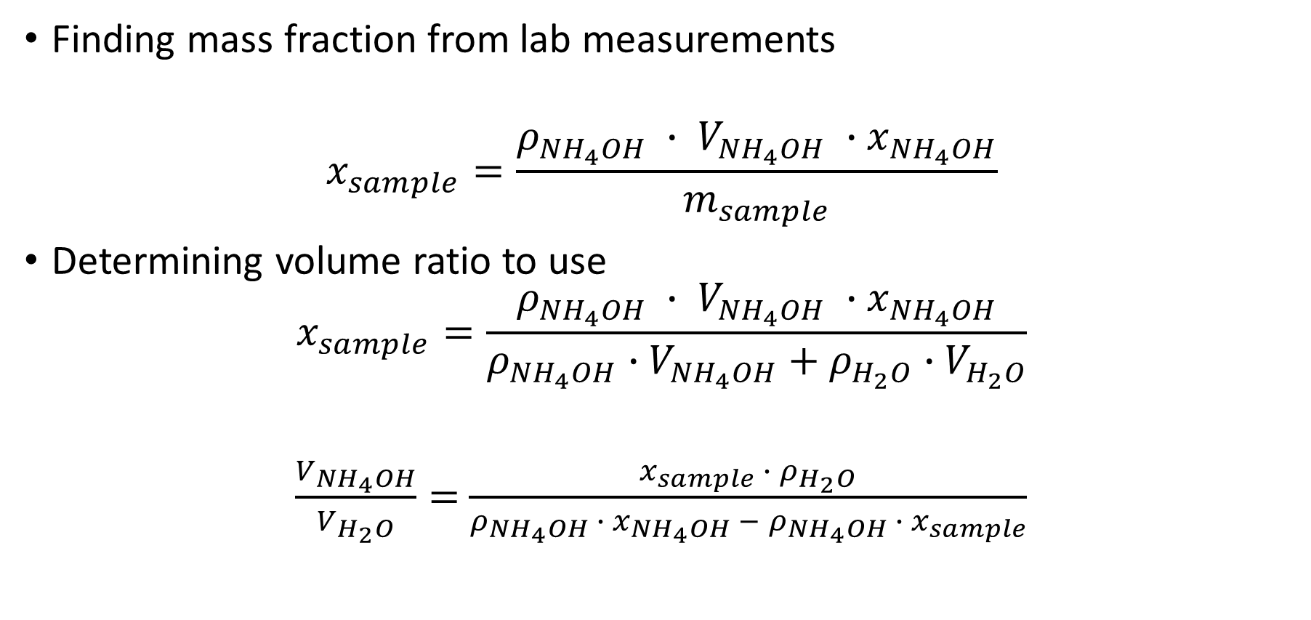
Wt% measurements
Finding mass fraction from lab measurements
$$x_{sample}=\frac{ρ_{{NH}_{4}OH} ∙ V_{{NH}_{4}OH} ∙{ x}_{{NH}_{4}OH}}{m_{sample}}$$
Determining volume ratio to use
$$x_{sample}=\frac{ρ_{{NH}_{4}OH} ∙ V_{{NH}_{4}OH} ∙{ x}_{{NH}_{4}OH}}{ρ_{{NH}_{4}OH}∙V_{{NH}_{4}OH}+ρ_{H_{2}O}∙V_{H_{2}O}}$$
$\frac{V_{{NH}_{4}OH}}{V_{H_{2}O}}=$ $\frac{x_{sample} ∙{ ρ}_{H_{2}O}}{ρ_{{NH}_{4}OH} ∙ x_{{NH}_{4}OH} − ρ_{{NH}_{4}OH} ∙{ x}_{sample}}$

