Slide 1
Summary
Update of Latest Data
Summary of Mass Measurements
PlanetProfile incorporation

Slide 2
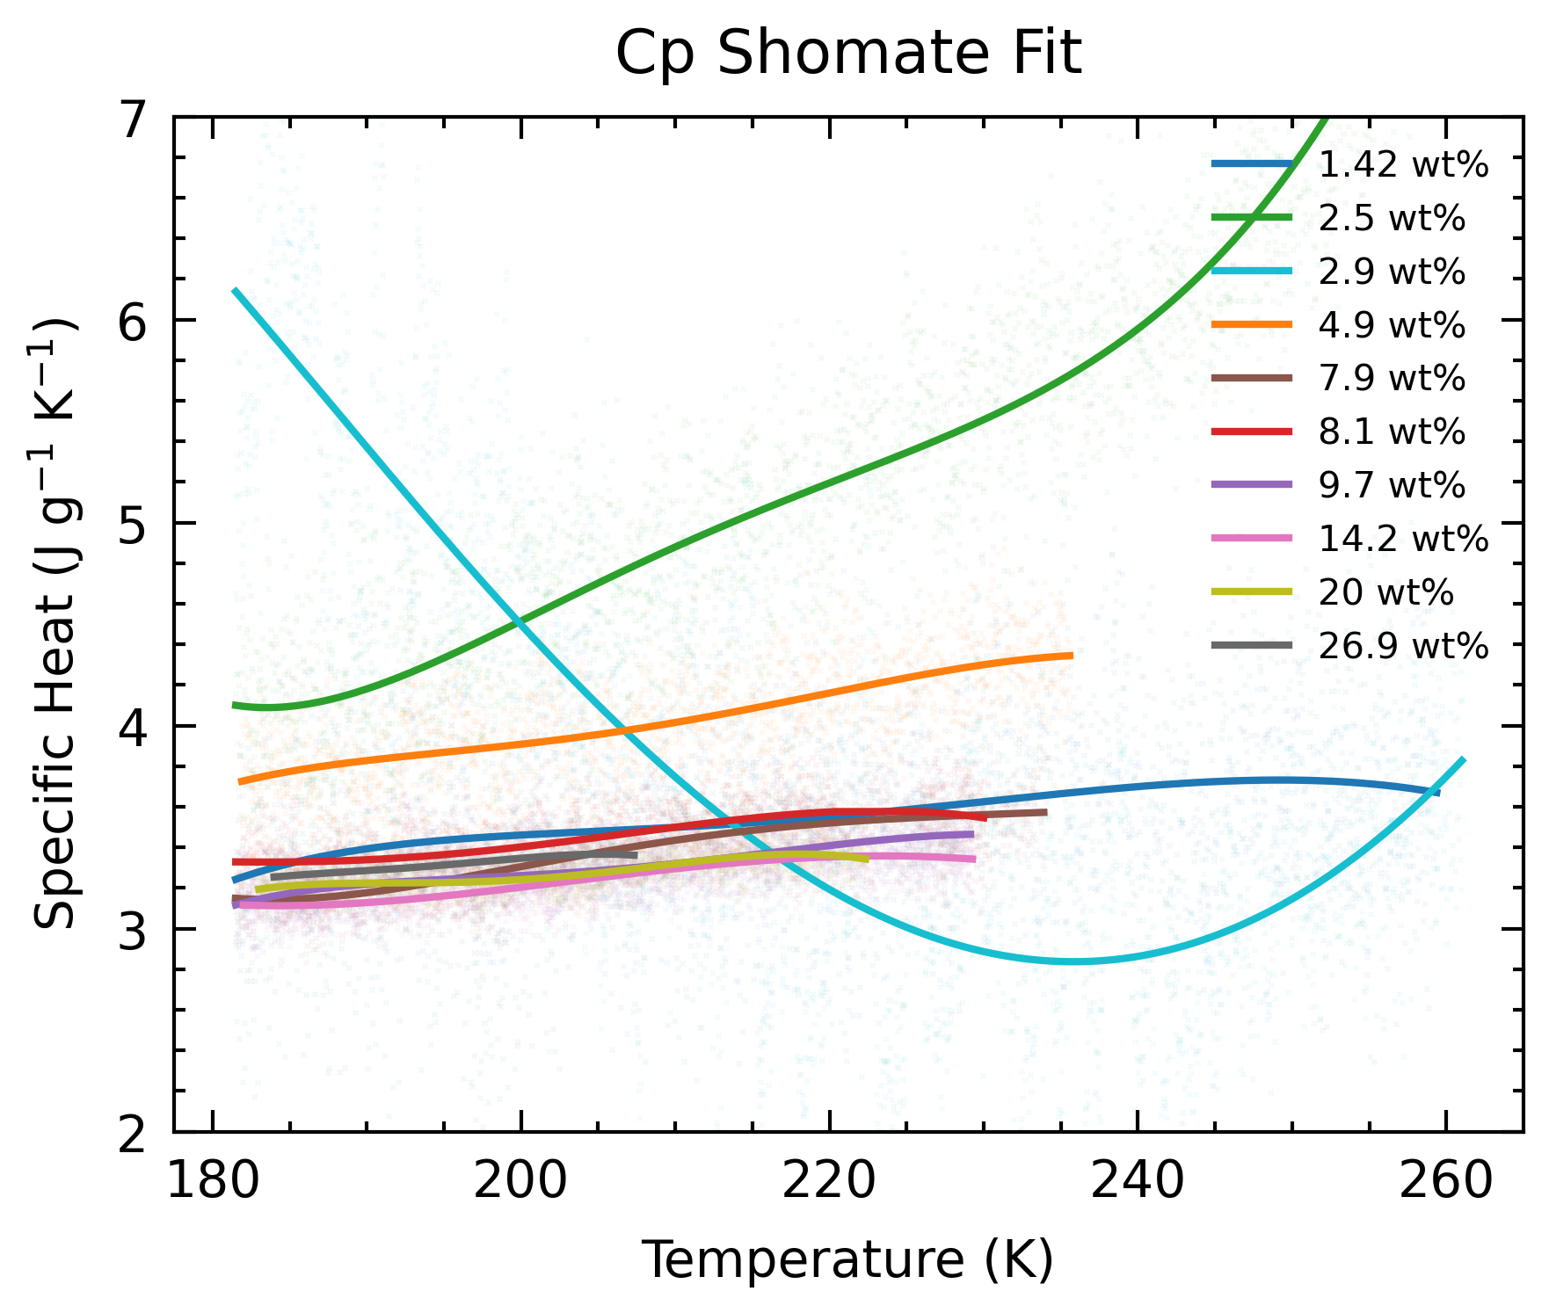
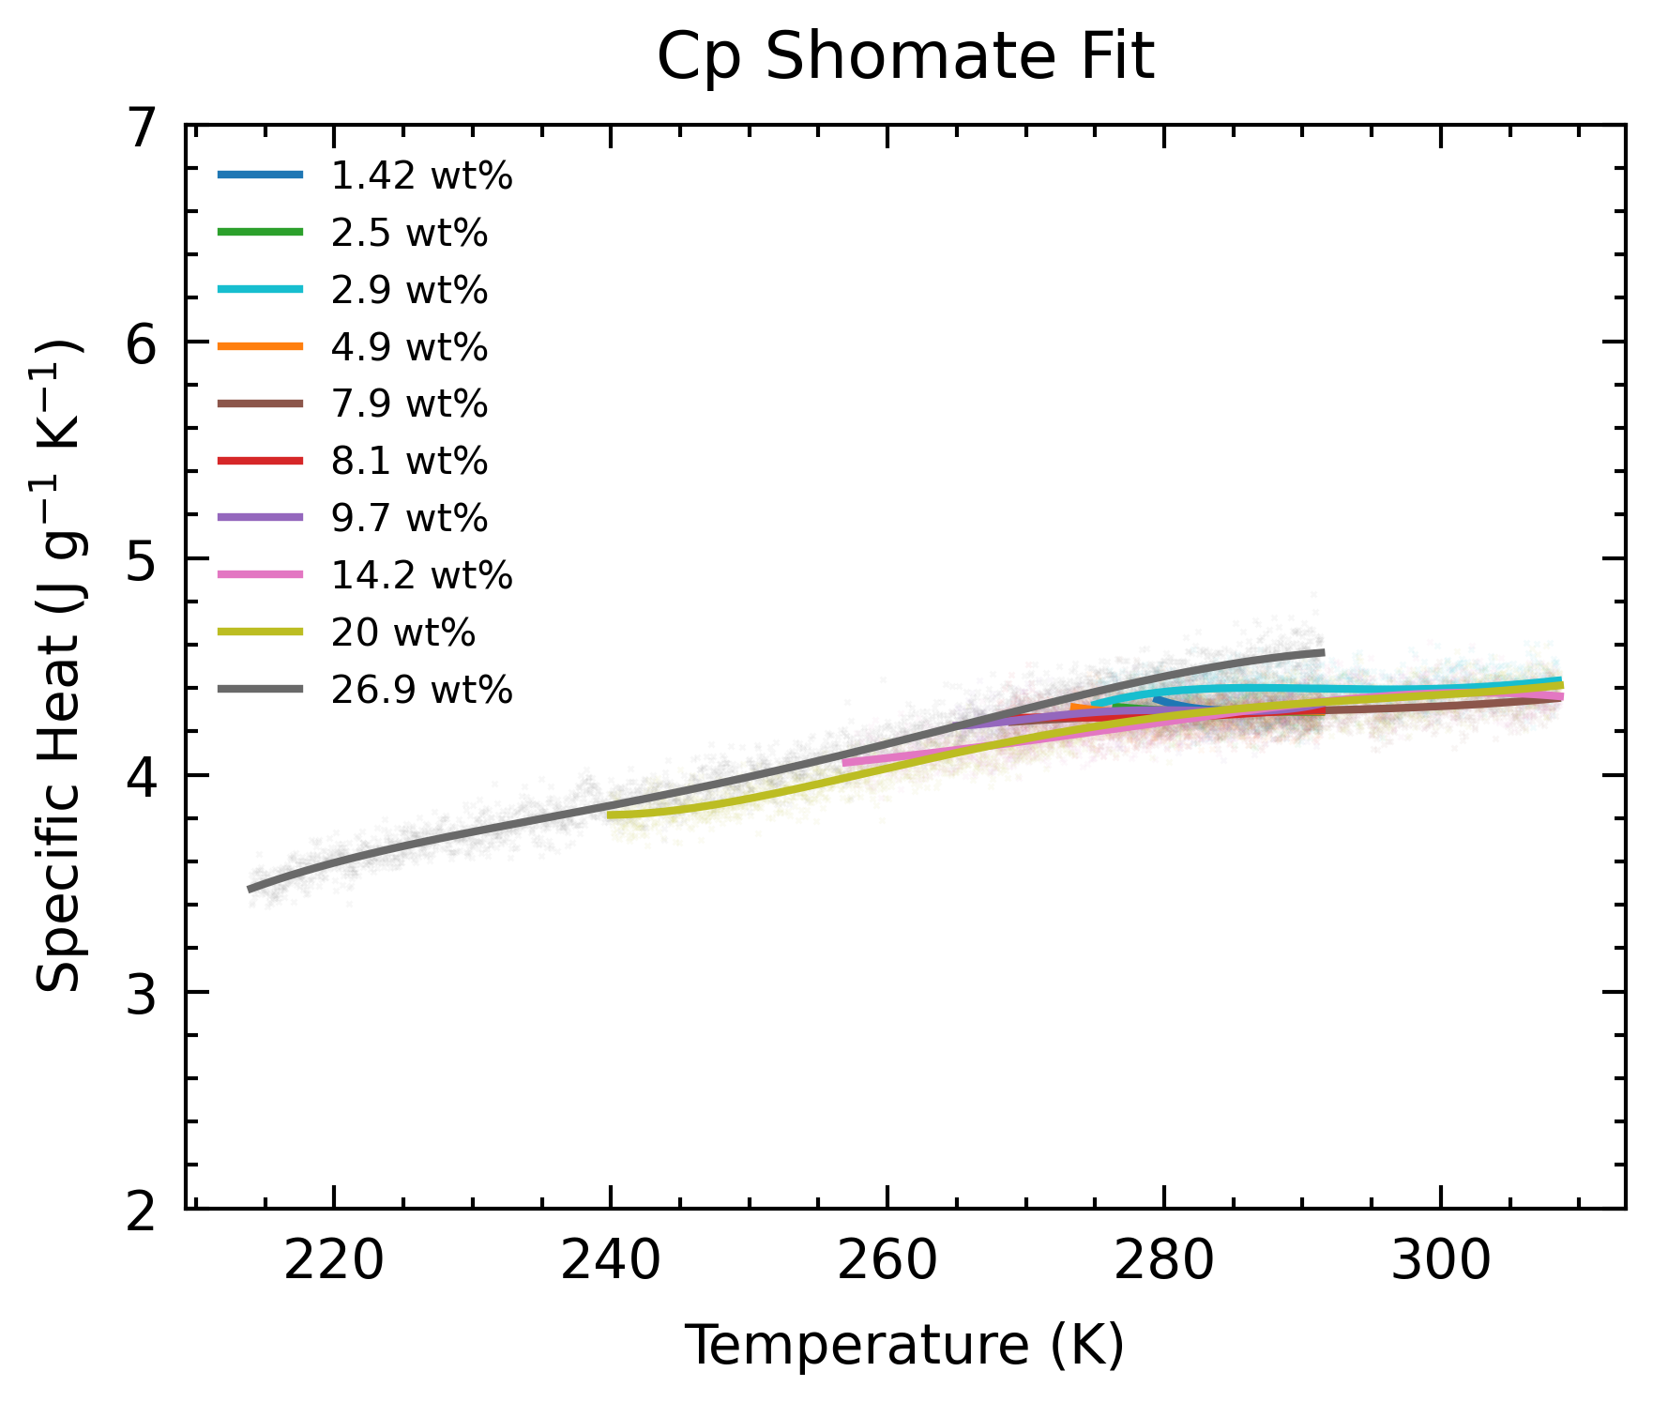
Latest Data
2.9 wt% Small Heat Flow | 7.9 wt% Large Heat Flow

Slide 3
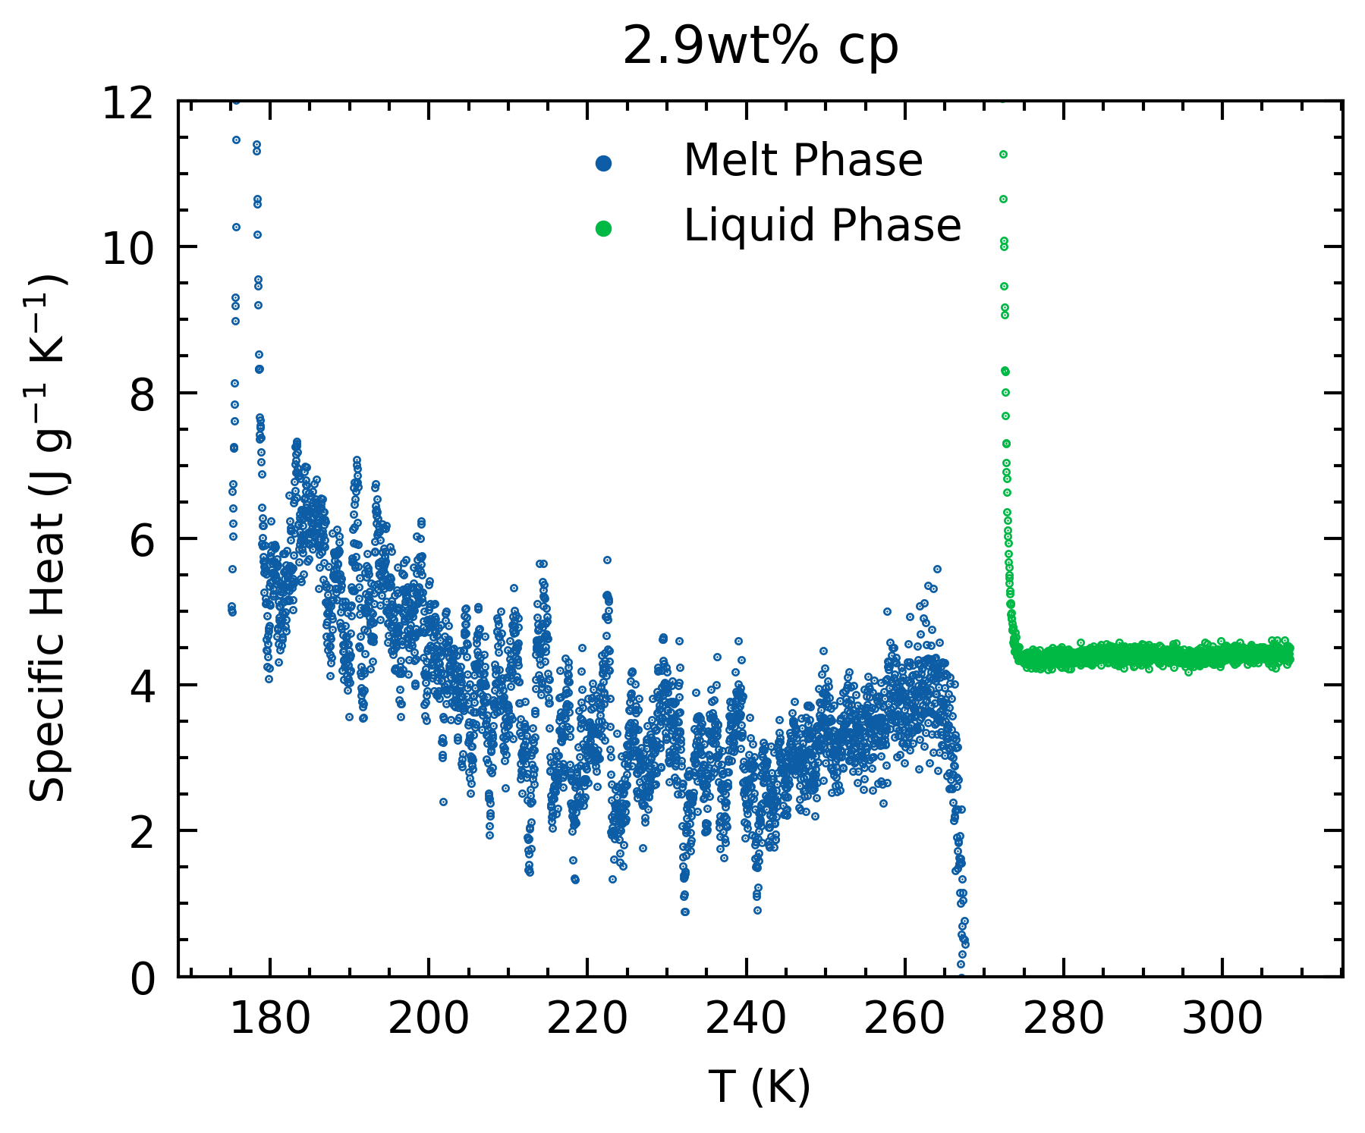
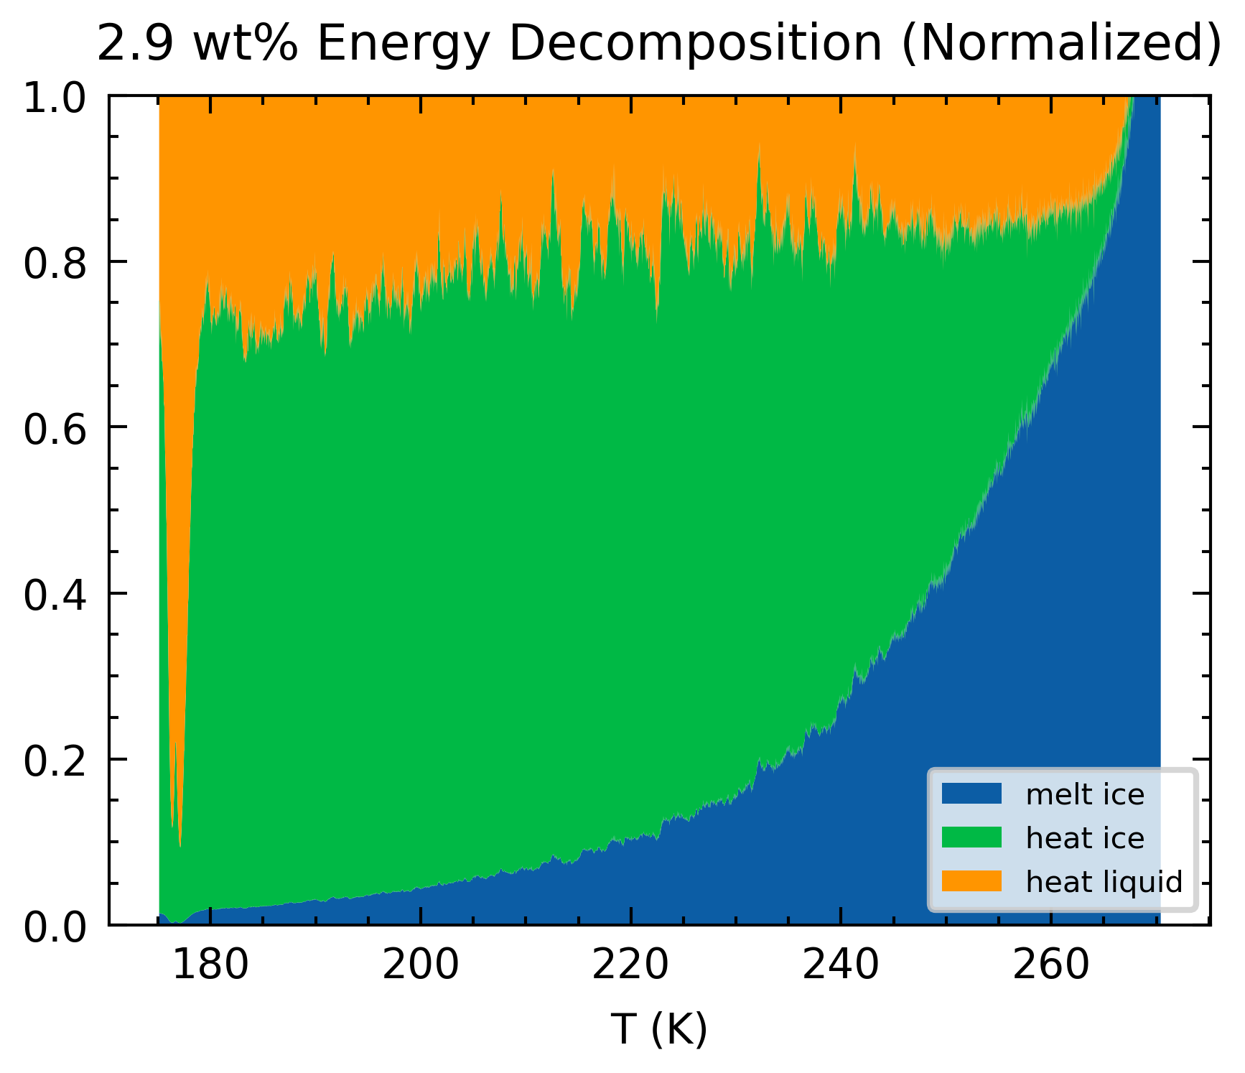
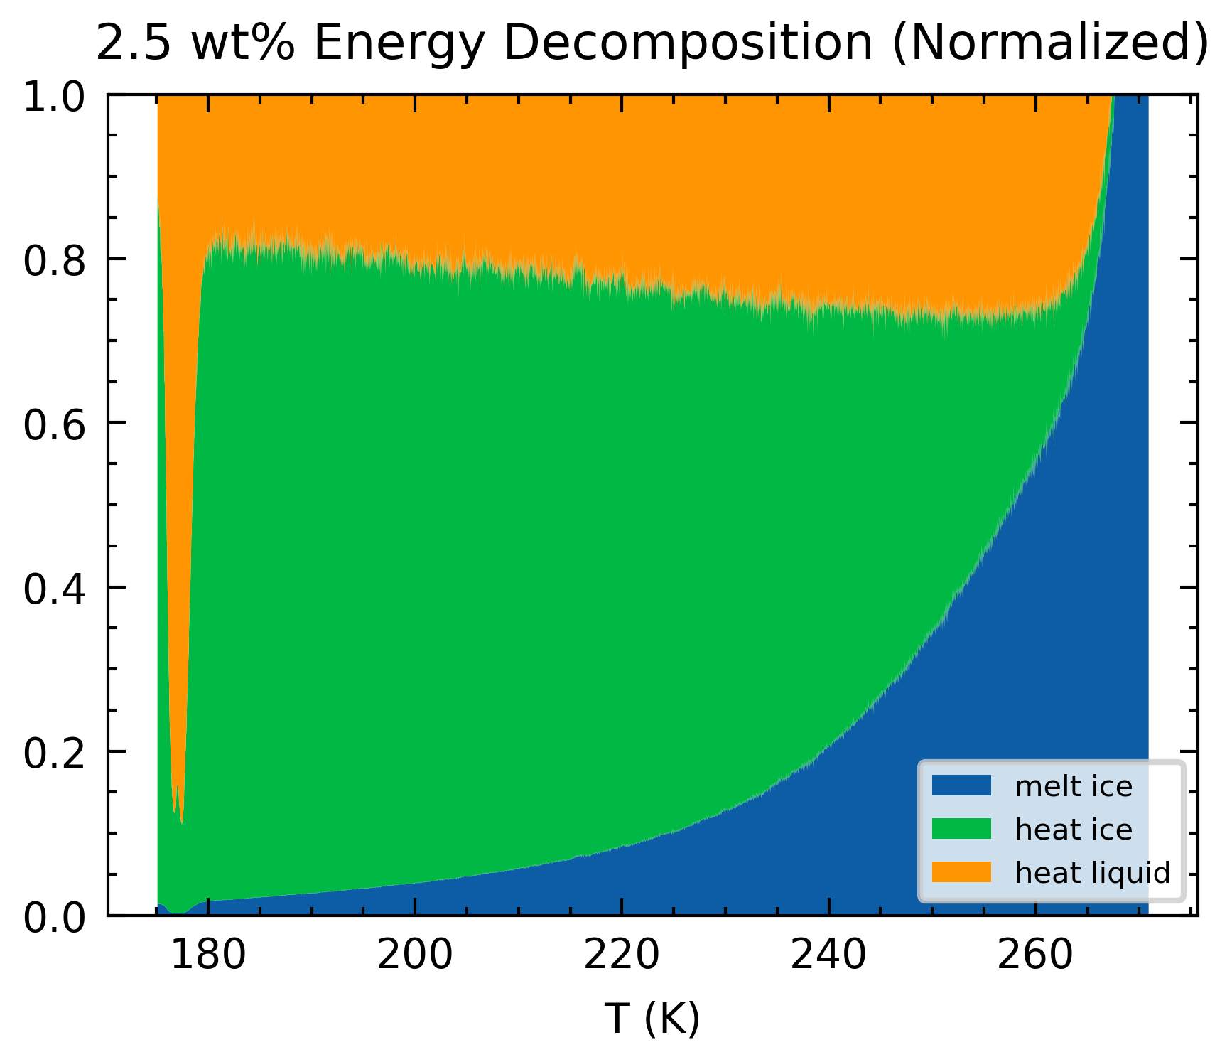
Latest Data
2.9 wt% Small Heat Flow | 7.9 wt% Large Heat Flow
Wild behavior in melt phase
Smaller sample V (1 mL) → inc. percentage variation delta mass of water ice → inc. variability in the heat used to heat the ice.

Slide 4
Latest Data
2.9 wt% Small Heat Flow | 7.9 wt% Large Heat Flow
Wild behavior in melt phase
Smaller sample V (1 mL) → inc. percentage variation delta mass of water ice → inc. variability in the heat used to heat the ice.
Higher than others (2.5, 4.9) in pure phase
Why?
Blank is not accurate?

Slide 5
Latest Data
2.9 wt% Small Heat Flow | 7.9 wt% Large Heat Flow
Miscalculated volume ratios to be used in sample (was supposed to go for 6 wt%)

Slide 6
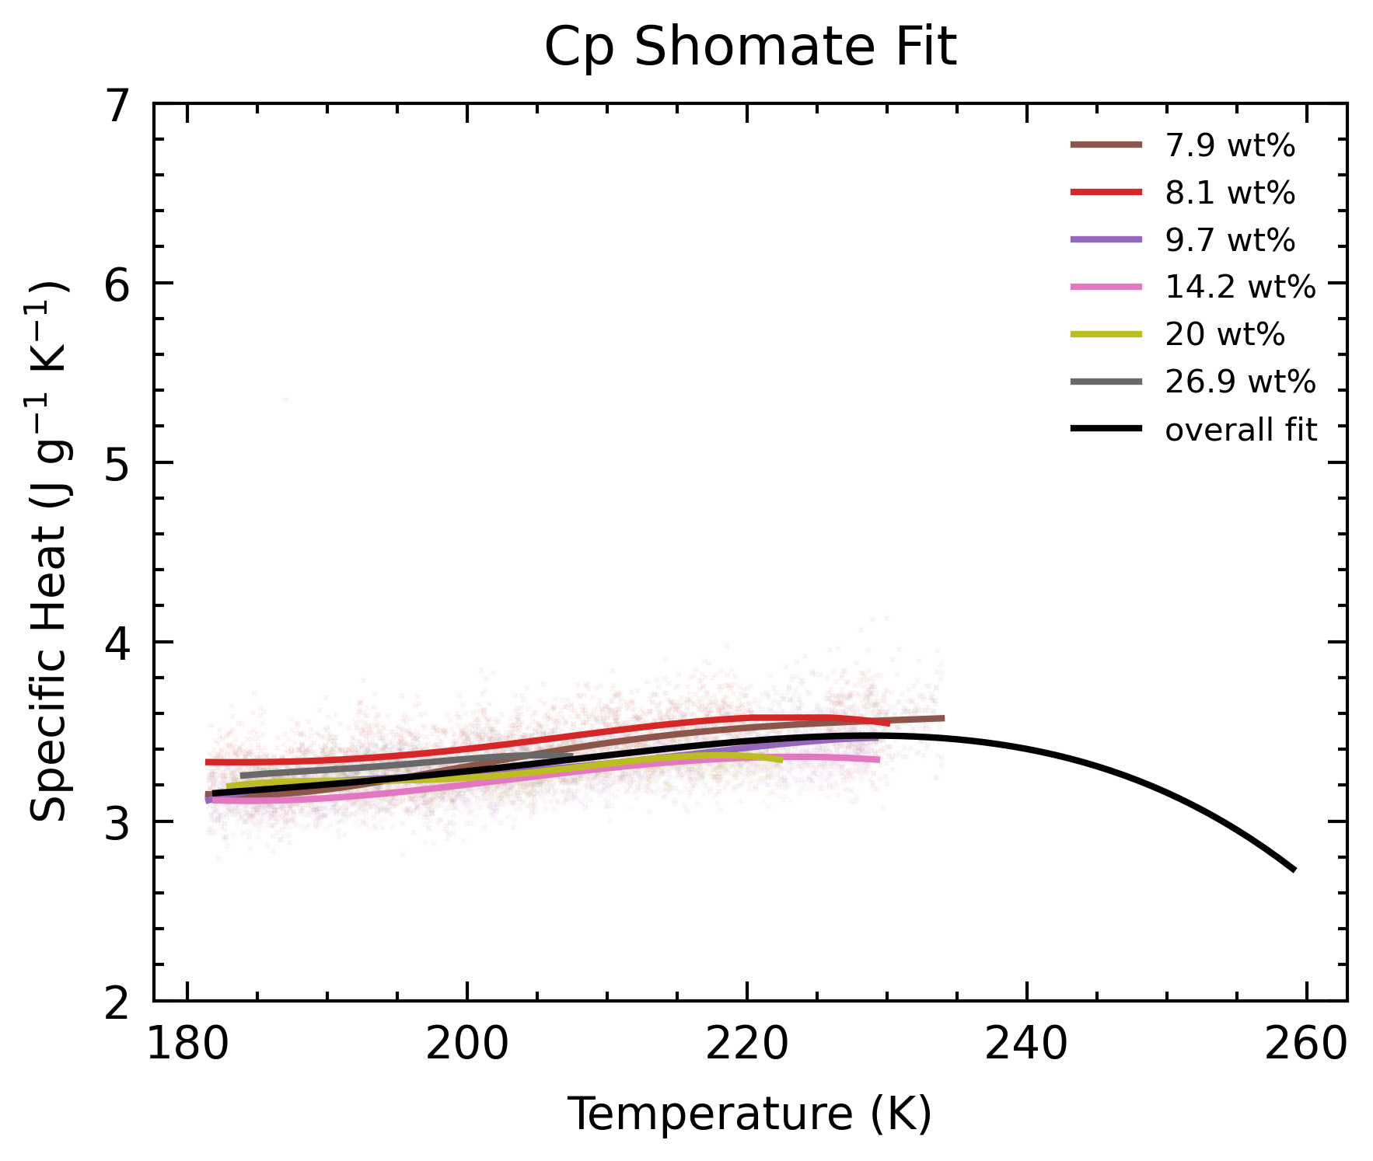
Fit of “good” data
Extrapolation is bad
Weighted Average Best Fit
Is based on coefficients of Shomate Equation

Slide 7
Mass Measurements
Independent Mass Balance
Evaporation
Other Volatiles
Drops of NH₄OH
To answer:
Why are our measured density of NH₄OH (~0.7) is lower than theoretical (~0.9)?
Why are 1 mL densities lower than 5 mL densities (~0.03 lower)?

Slide 8
OHL Mass Balance
A small 0.002 g offset.
This, combined with the pure water calibration test, I am convinced that our mass balance is calibrated.
 | cell | cell + samp
624 | 70.1138 | 70.7974
OHL | 70.1117 | 70.7950
Difference | 0.0021 | 0.0024

Slide 9
Evaporation
4 tests:
Outside: cell left on mass balance outside the fume hood
Hood: cell place inside the hood, and taken out to measure on mass balance
Mass balance in the hood does not work due to wind shield on mass balance
Small difference in/out of hood
Greater loss with greater volume
In sample prep, cell is uncapped < 1min, with <3 mL NH₄OH, maximal losses of ~0.02 g.
 | 1 ml, outside |  | 1ml, hood |  | 5ml, outside |  | 5ml, hood
 | Mass | Change | Mass | Change | Mass | Change | Mass | Change
start* | 0.6830 |  | 0.6699 |  | 4.3052 |  | 4.1466
1min | 0.6710 | 0.0120 | 0.6543 | 0.0156 | 4.2847 | 0.0205 | 4.1247 | 0.0219
2min | 0.6591 | 0.0119 | 0.6446 | 0.0097 | 4.2639 | 0.0208 | 4.1042 | 0.0205
3min | 0.6501 | 0.0090 | 0.6347 | 0.0099 | 4.2447 | 0.0192 | 4.0870 | 0.0172

Slide 10
Other Volatiles
THF | 5 ml | 5 ml rho | diff | 1 ml | diff
Theoretical | 4.1676 | 0.8335 | -0.0555 | 0.8382 | -0.0508
0.889 | 4.1763 | 0.8353 | -0.0537 | 0.8320 | -0.0570
 | 4.1716 | 0.8343 | -0.0547 | 0.8341 | -0.0549
From theoretical rho:
Lower
Between 1 mL vs 5 mL:
No difference
Methanol | 5 ml | 5 ml rho | diff | 1 ml | diff
Theoretical | 3.8379 | 0.7676 | -0.0244 | 0.7688 | -0.0232
0.792 |  |  |  | 0.7681 | -0.0239

Slide 11
Other Volatiles
THF | 5 ml | 5 ml rho | diff | 1 ml | diff
Theoretical | 4.1676 | 0.8335 | -0.0555 | 0.8382 | -0.0508
0.889 | 4.1763 | 0.8353 | -0.0537 | 0.8320 | -0.0570
 | 4.1716 | 0.8343 | -0.0547 | 0.8341 | -0.0549
From theoretical rho:
Lower
Between 1 mL vs 5 mL:
No difference
Main Observation
All liquids do not experience dripping from pipette during preparation.
Only NH₄OH drips.
Surface tension values do not show this?
NH3 represent pure ammonia
For ~25 wt%, value is 52.5 (T not mentioned)
Methanol | 5 ml | 5 ml rho | diff | 1 ml | diff
Theoretical | 3.8379 | 0.7676 | -0.0244 | 0.7688 | -0.0232
0.792 |  |  |  | 0.7681 | -0.0239
Surface Tension (mN/m at 20C)
H2O | NH3 | THF | CH3OH
72.8 | 22.0 | 26.4 | 22.7

Slide 12
Drips
Very basic tests
Drops during sample prep not counted
Roughly around 3-5 drops per pipette
Equates to 0.05, 0.07, 0.08 g loss
Drops Lost | Mass | Mass/Drop Mean
4 | 0.6714 | 0.0167
4 | 0.6675
6 | 0.6318
6 | 0.6405

Slide 13
Mass measurement summary
Density difference from theoretical (0.7 vs 0.9, ~0.2 g) may be due to:
Unaccounted drips from pipette ~ 0.05 – 0.08 g
Something about the mass balance, which also affected other volatile solutions ~ 0.02 – 0.05 g
Evaporative loss (< 10 s) < 0.01 g
Adds up to 0.08 – 0.14 g
Plausible, but incomplete reason.
Density difference between 1 mL vs 5 mL still unexplained.

Slide 14
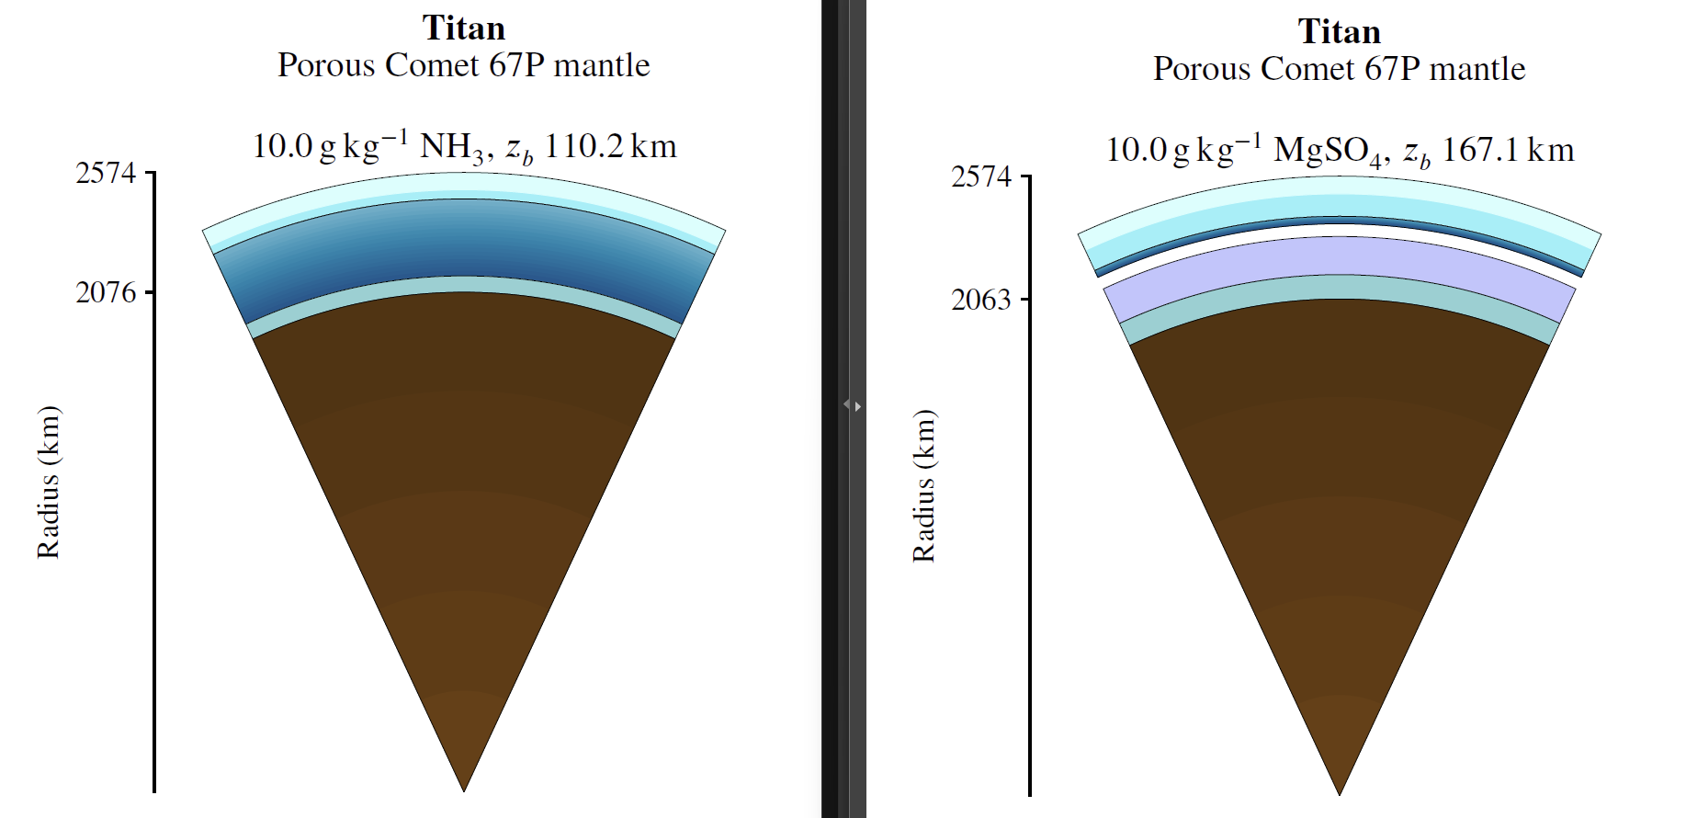
PlanetProfile
Just managed to get it working today.
Preliminary observations
Larger ocean due to anti-freeze
Lower MOI:
NH₃ lower density
Less mass near surface
Lower MOI
Require silicate modifications to compensate
Porosity

Slide 15
Plan Forward
Moving forward, aim to redo anomalous experiments
Oct 28-31: 6 wt%
Nov 03-07: 4 wt%
Nov 08-11: 2 wt%

Slide 16
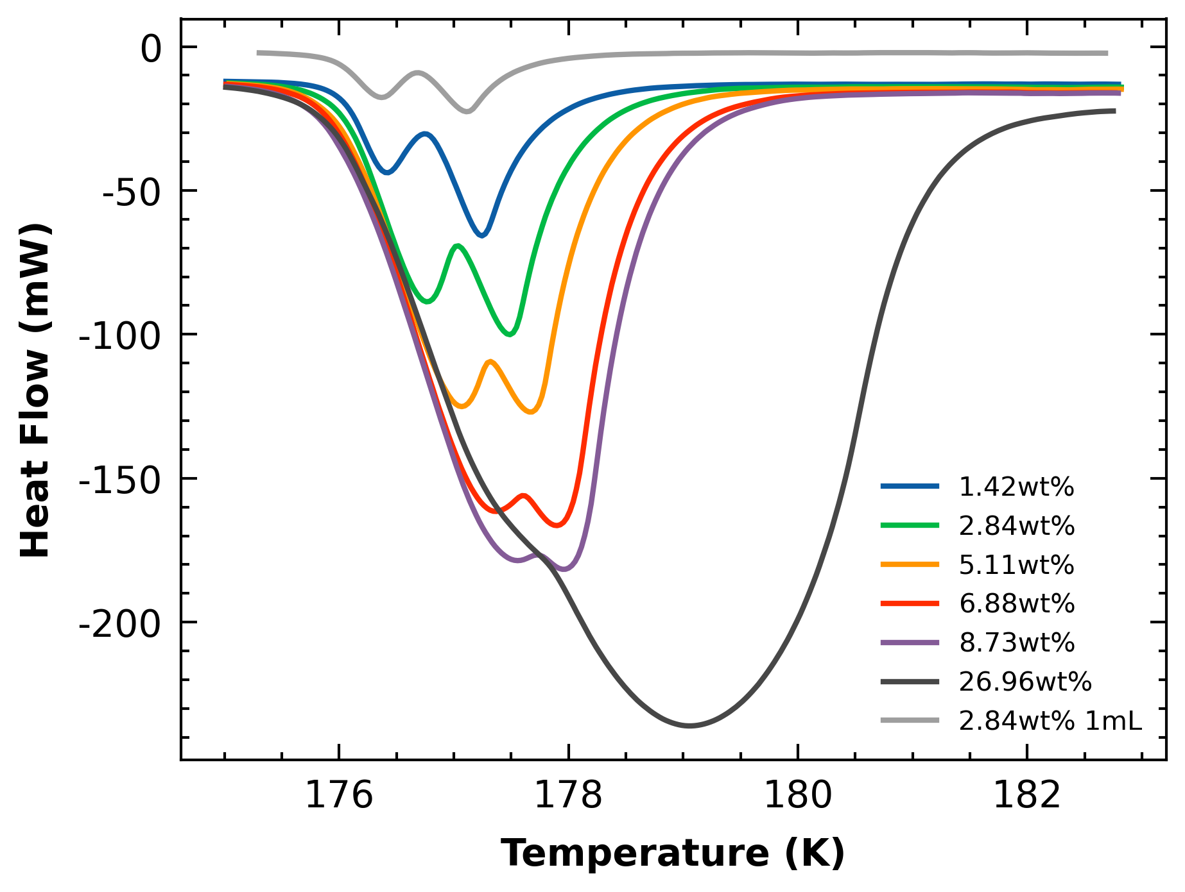
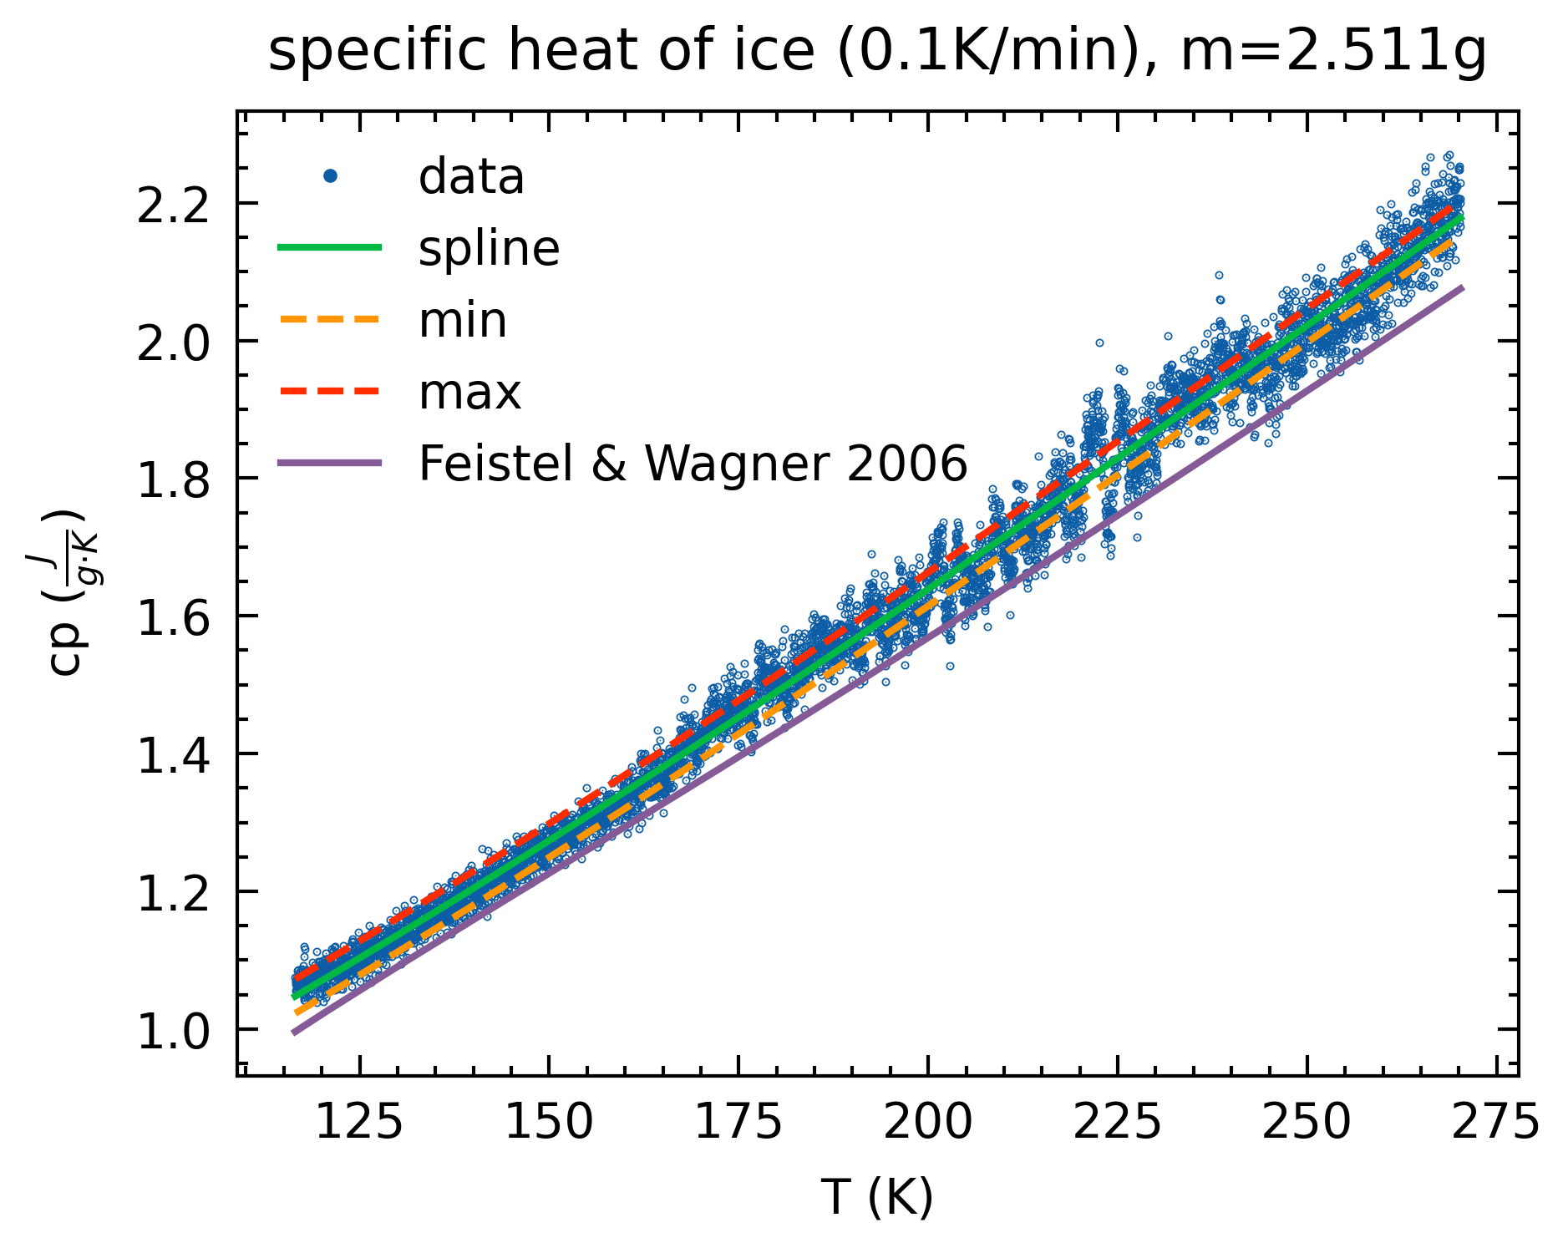
Unanswered Questions
Affects Cp results:
Ice Cp being lower than literature
Density measurements being lower than lit
Does not affect Cp results:
ADH double peaks

