Slide 1
Summary
Deviations from literature
Low T density check
Update of Latest Data
Error Propagation
Manuscript draft process

Slide 2
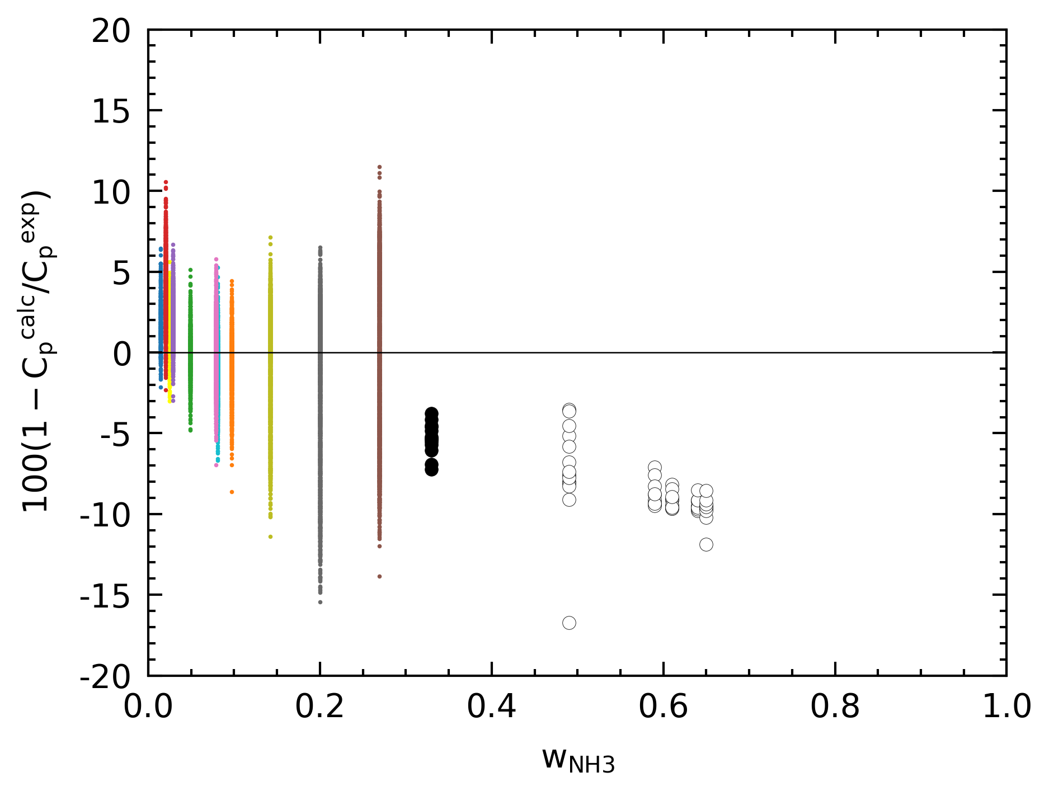
Deviations from TRF
Some data differences from Giauque and others

Slide 3
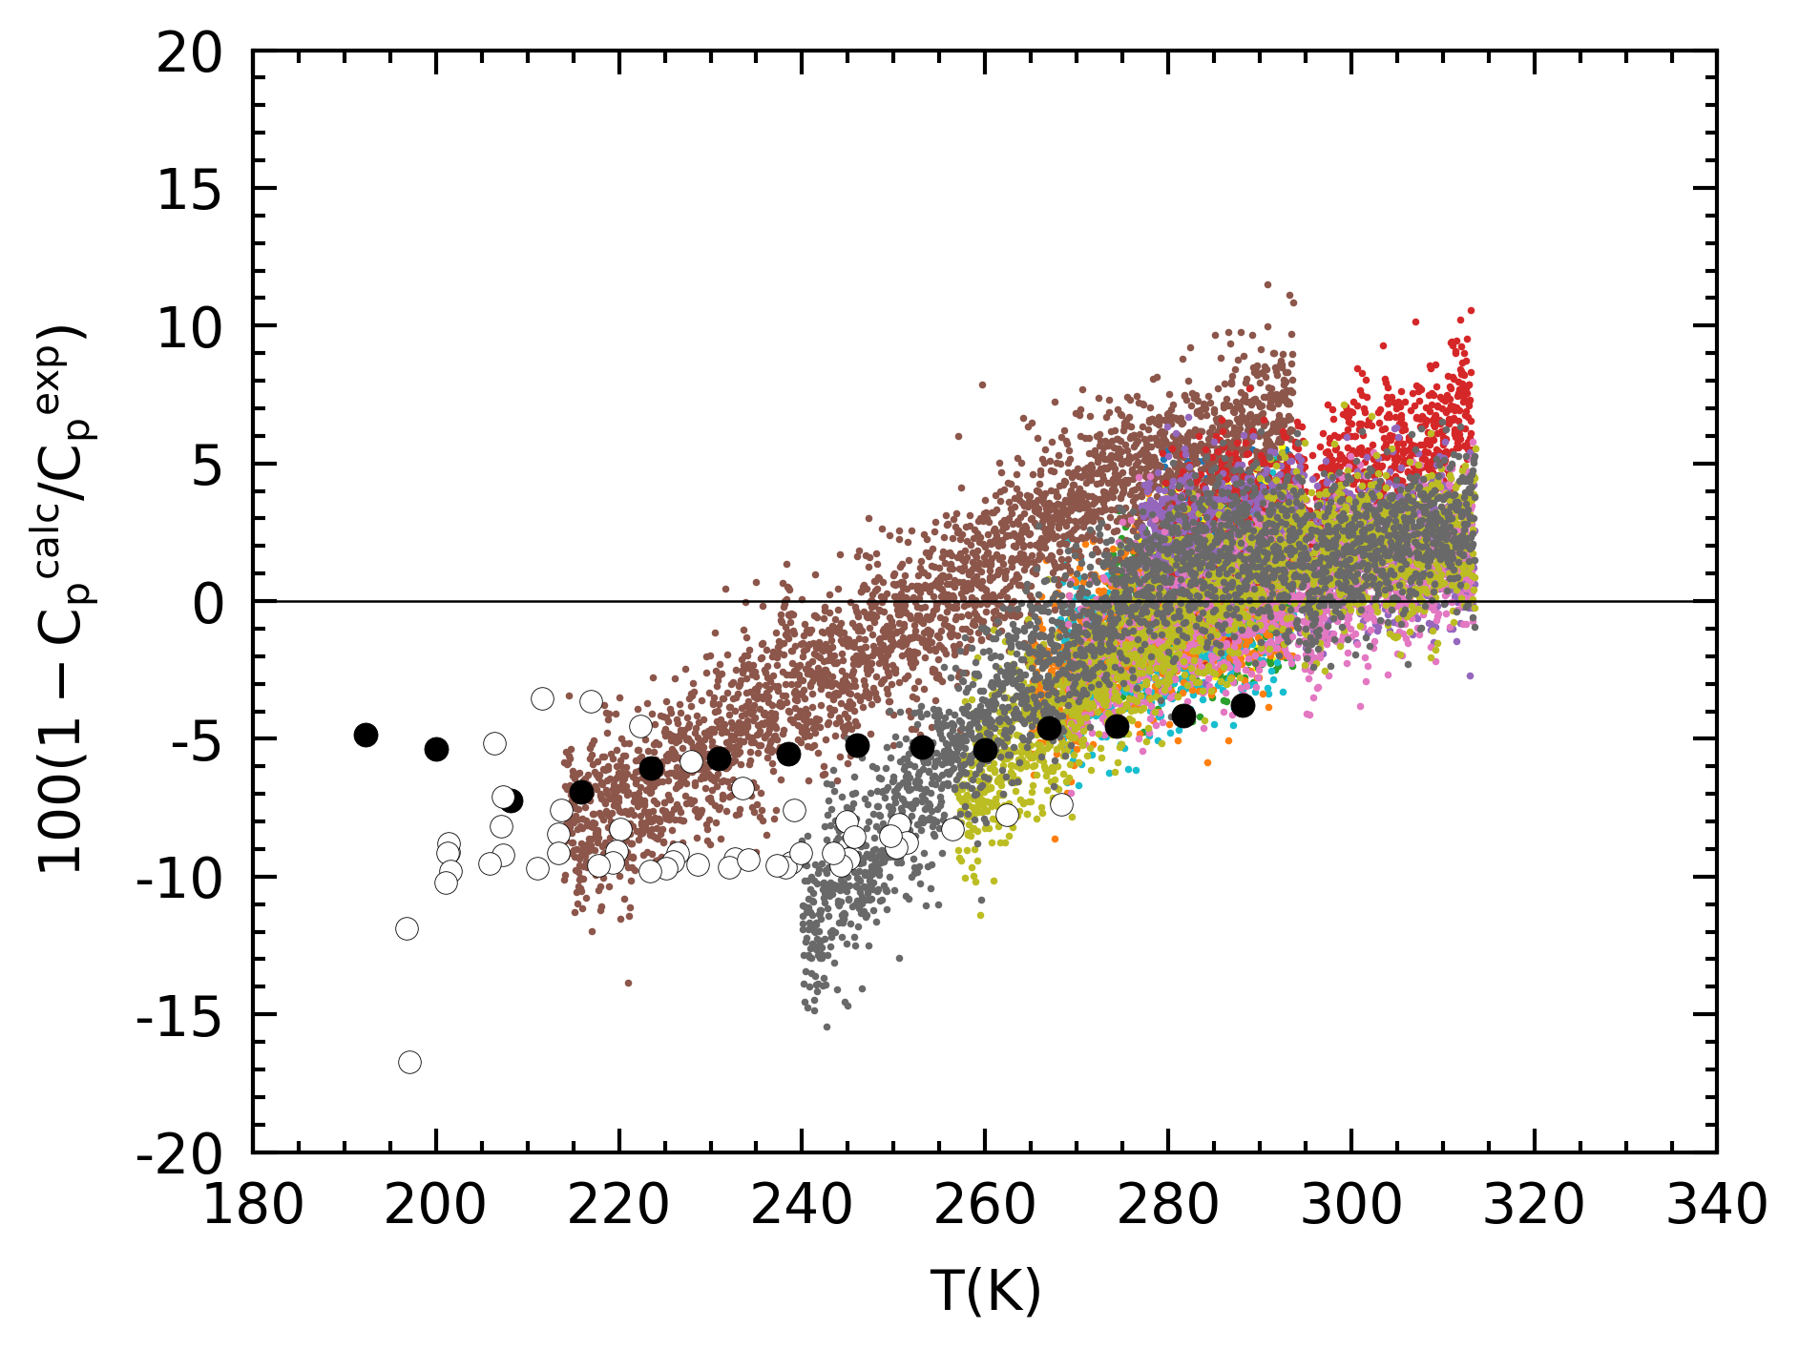
Deviations from TRF
Seem to suggest a gradient offset
Next steps? Modify TRF equation?

Slide 4
Low T density check
Lower Temperature, higher measured mass
1) Generally, lower T, higher density, higher mass (by 0.01 in our T range)
2) Lower T, lower vapor pressure, less pressure build-up within pipette, less volumetric loss from pipette, higher mass
Conclusion: due to vapor pressure, some volume is lost in preparation, resulting in lower than expected mass measurements.
Note: volumetric loss begins immediately after pipetting, even if the tip is still submerged
Potential workaround : pre-wetting the tip.
T bottle (C) | Mass (g) | Theoretical Density (g/cm³) | Difference
4.5 | 0.8227 | 0.9130 | -0.0903
8.0 | 0.8096 | 0.9112 | -0.1016
9.3 | 0.7949 | 0.9104 | -0.1155
10.3 | 0.8125 | 0.9099 | -0.0974
10.5 | 0.8001 | 0.9098 | -0.1097
21.1 | 0.7095 | 0.9034 | -0.1939

Slide 5
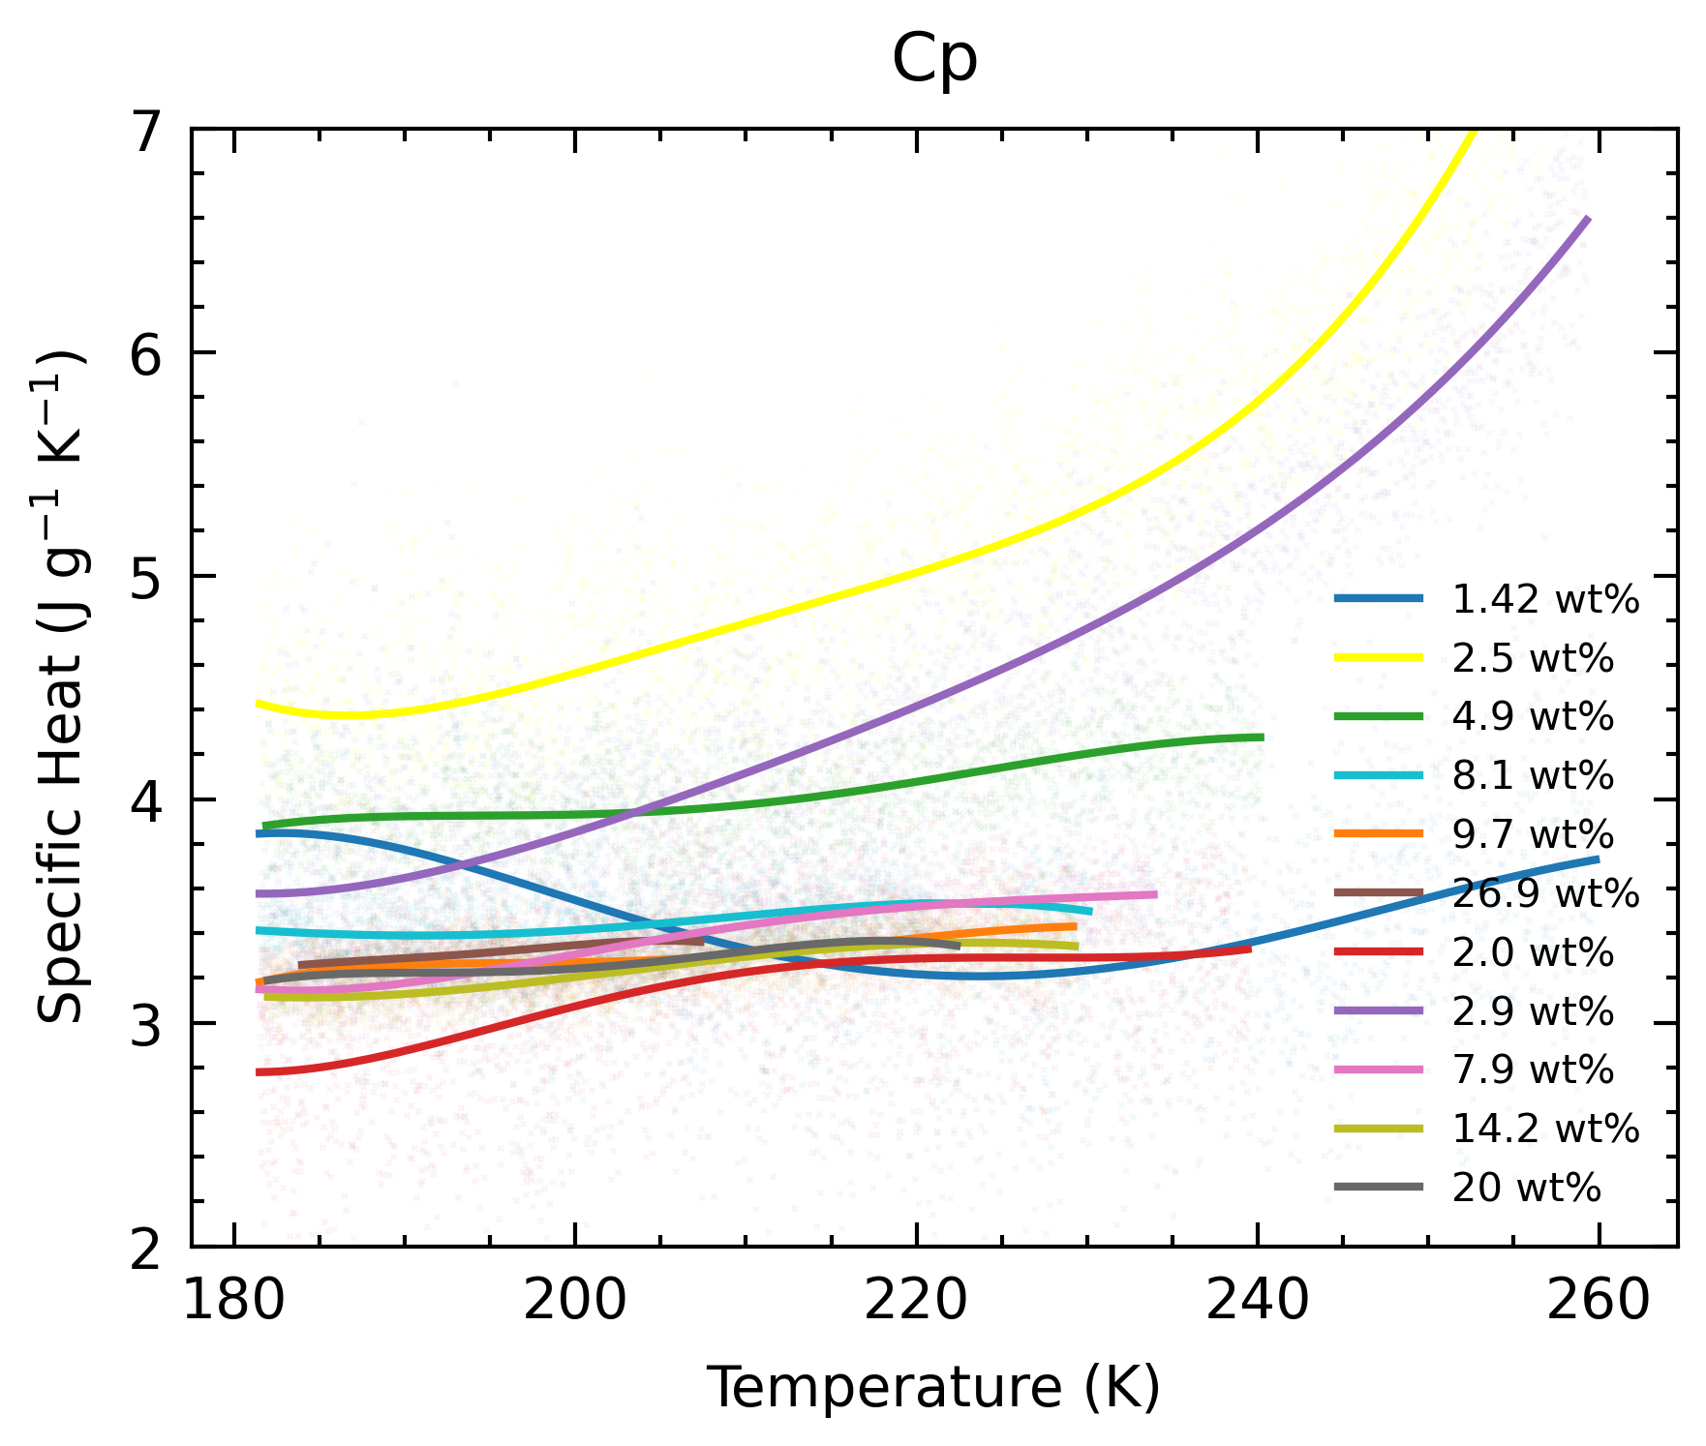
2.0 wt%, 2.9 wt%
2.9 wt% is wild
2.0 wt% is not as wild
BUT 2.0 wt% melt peak at 273.4 K, wt% undetermined by liquidus
Minor tweaks to model
Low wt% behavior changes by quite a bit
Will check changes again

Slide 6
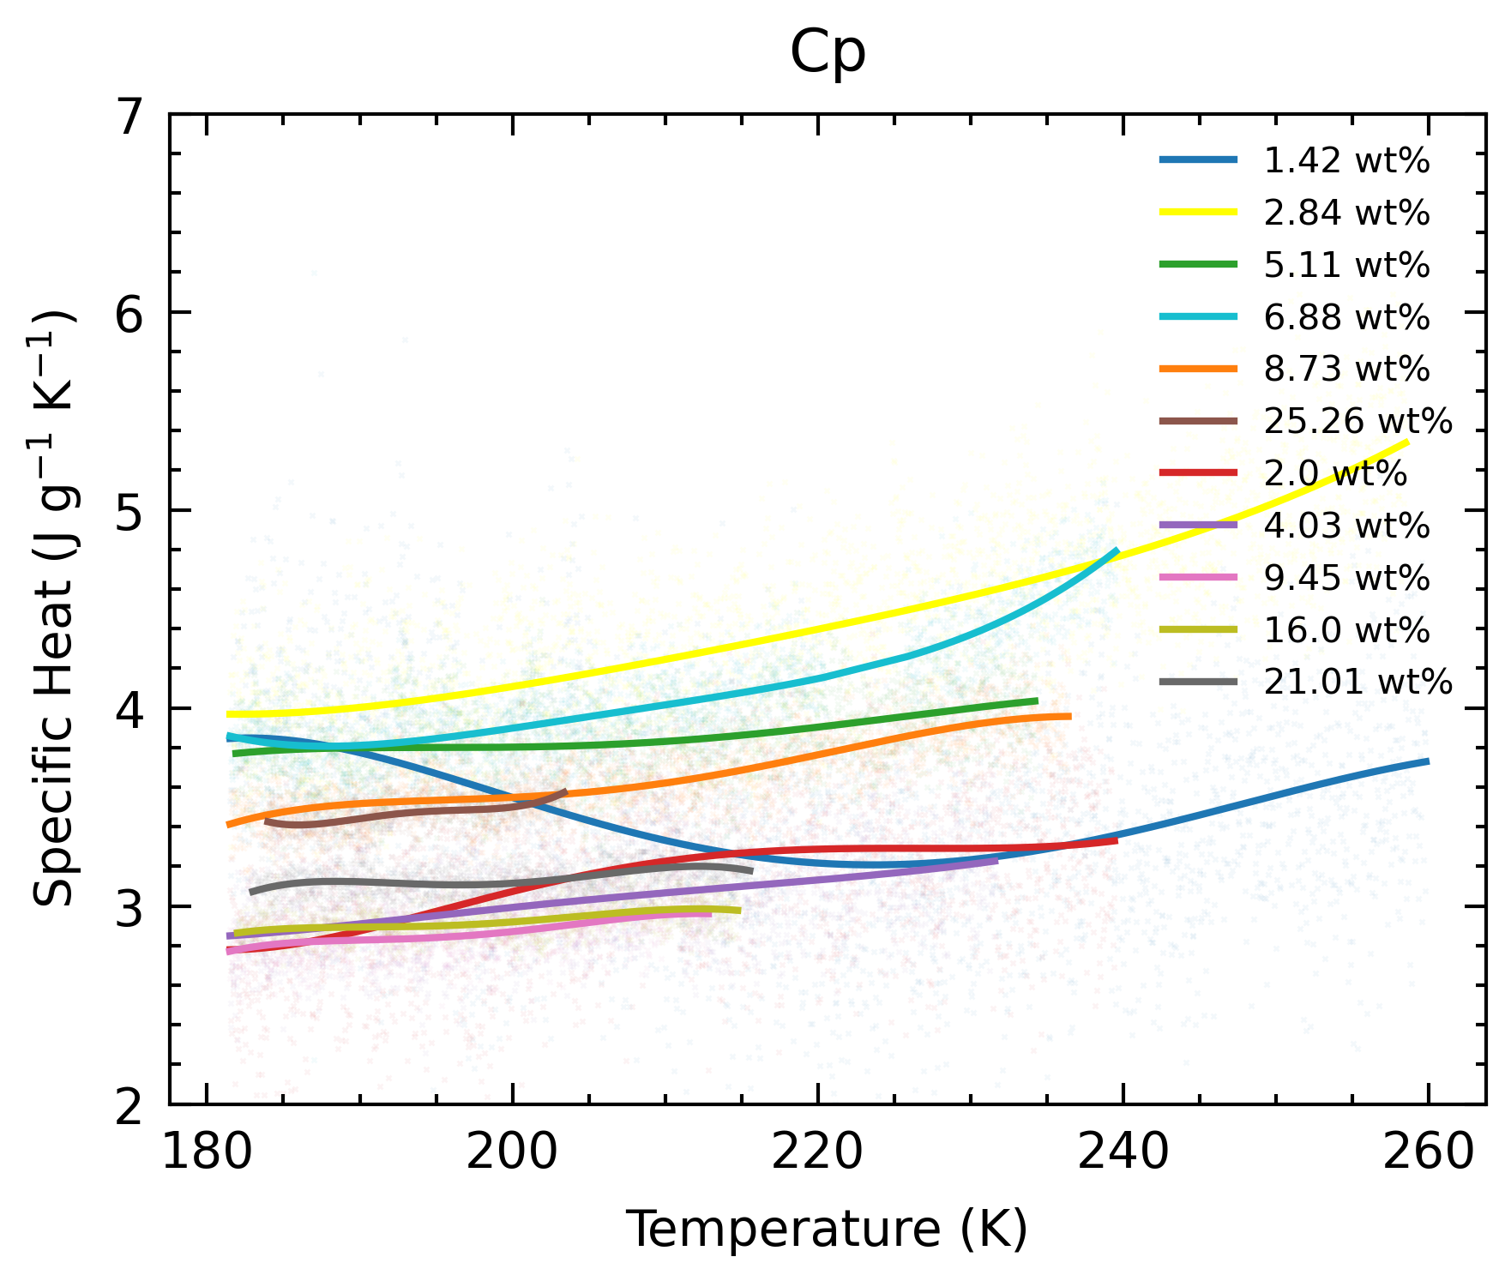
2.0 wt%, 4.03 wt%
Using lab derived wt%, later experiments (with new bottle) have better agreement

Slide 7
2.0 wt%, 4.03 wt%
Thought process:
Measurement-derived wt% are unreliable for old bottle experiments (top 5/6)
Due to unconstrained old supply bottle wt% and density
Measurement-derived wt% may not be reliable for new bottle
Unconstrained volumetric loss from pipette during preparation
Liquidus-derived wt% are highly erroneous for low wt % (< 5 wt%, err >10 %)
Due to 0.5 K uncertainty in T, error propagated onto wt % is large, which greatly determines Cp’s variation. OR
Model breaks down at low wt% (uncertainty of model?)
Keep liquidus-derived wt%, discard <5 wt% values.

Slide 8
2.0 wt%, 4.03 wt%
Thought process:
Measurement-derived wt% are unreliable for old bottle experiments (top 5/6)
Due to unconstrained old supply bottle wt% and density
Measurement-derived wt% may not be reliable for new bottle
Unconstrained drips from pipette in preparation
Liquidus-derived wt% are highly erroneous for low wt % (< 5 wt%, err >10 %)
Due to 0.5 K uncertainty in T, error propagated onto wt % is large.
Keep liquidus-derived wt%, discard <5 wt% values.
wt % | error | % error
*1.42
*2.0
2.5 | 0.45 | 18.0
2.9 | 0.4 | 13.8
4.9 | 0.5 | 10.2
7.9 | 0.3 | 3.8
8.1 | 0.3 | 3.7
9.7 | 0.3 | 3.1
14.2 | 0.3 | 2.1
20.0 | 0.2 | 1.0
26.9 | 0.1 | 0.4

Slide 9
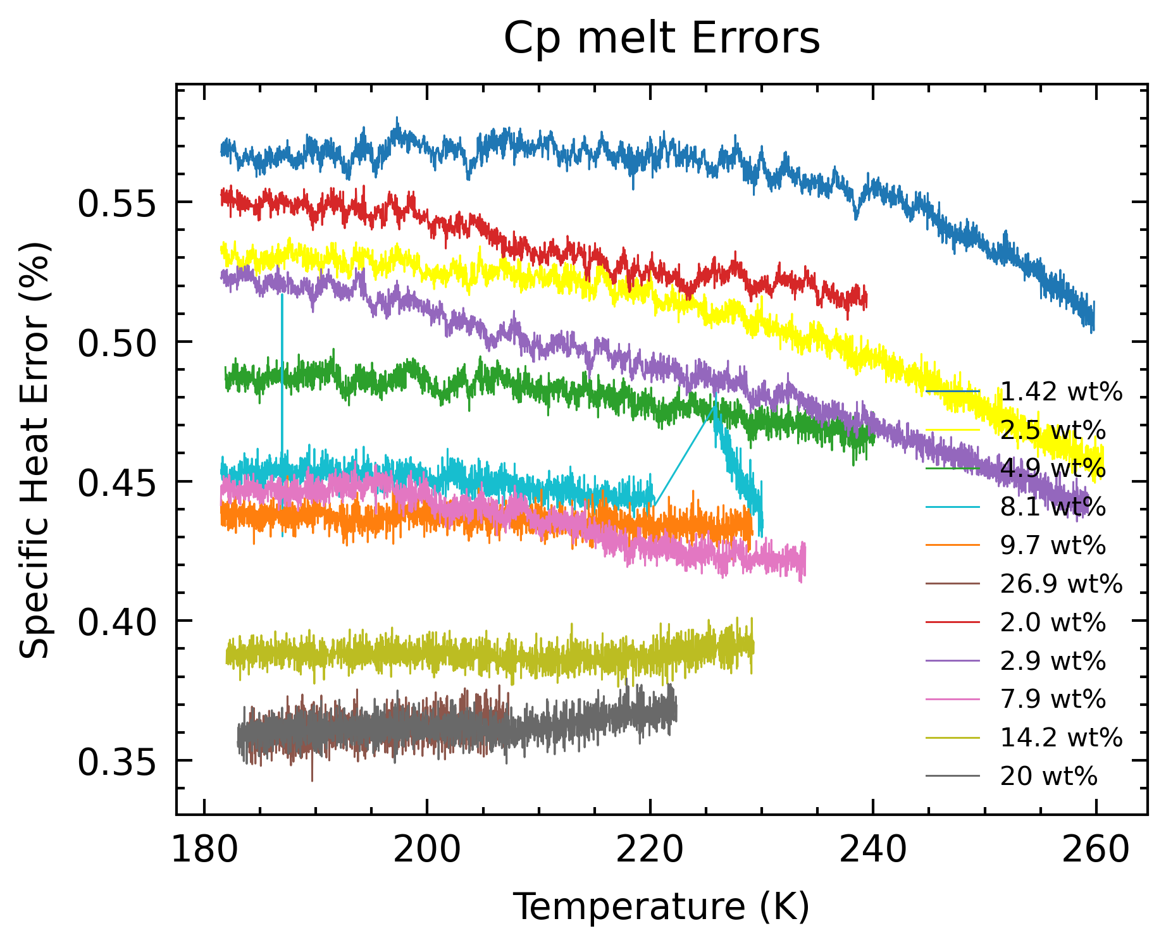
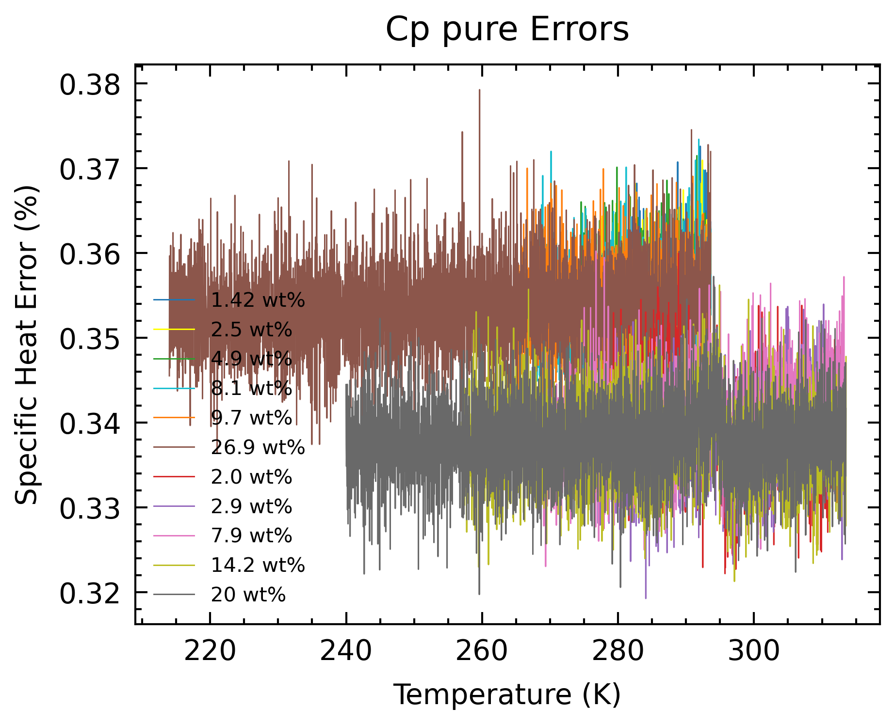
Cp Errors
Based on heatflow and T sensitivity of 0.1 µW and 0.1 mK, mass error of 0.1 mg
In melt, lower wt %, lower error
In liquid, larger T profile (46 C), larger T interval per step, lower error.

Slide 10
Cp Errors
Based on heatflow and T sensitivity of 0.1 µW and 0.1 mK, mass error of 0.1 mg
In melt, lower wt %, lower error
In liquid, larger T profile (46 C), larger T interval per step, lower error.
Melt Cp errors incomplete: - errors from latent heat of fusion of ice not yet accounted for (SeaFreeze).

Slide 11
Wt % errors
Based on 0.5 K reported by Victoria (0.1 K/min). How?
Will be taking onset T for the pure ice run tomorrow from Calisto
ADH onset T at 0.1 K/min errors are <0.05 K
BUT 1.42 wt% and 2.0 wt% runs, the liquidus are >0.05 K greater than 273.15K
wt % | error | % error
*1.42
*2.0
2.5 | 0.45 | 18.0
2.9 | 0.4 | 13.8
4.9 | 0.5 | 10.2
7.9 | 0.3 | 3.8
8.1 | 0.3 | 3.7
9.7 | 0.3 | 3.1
14.2 | 0.3 | 2.1
20.0 | 0.2 | 1.0
26.9 | 0.1 | 0.4

Slide 12
Manuscript Draft
As I write, questions pop up. For now, I’ll collate them as comments in the overleaf project, for discussion points during these meetings
For simpler questions, I’ll email relevant people as and when they appear.
Timeline:
Nov 24:
Complete Introduction, Experimental Methods, Results
Review of Tillner-Roth and Friend comparison
Meeting to lay out Discussion and application to planetary science
Dec 8:
Complete Discussion and Conclusion
Meeting to review contents

Slide 13
Ticket Items
What are the next steps for comparison with Tillner-Roth and Friend?
I will, keep liquidus-derived wt%, discard <5 wt% values. Is that okay?

Slide 14
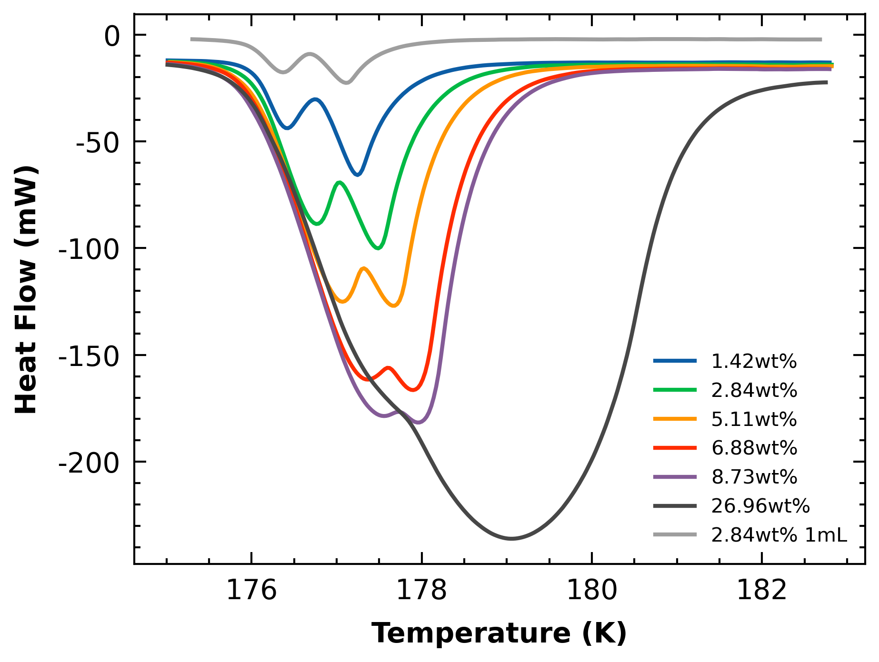
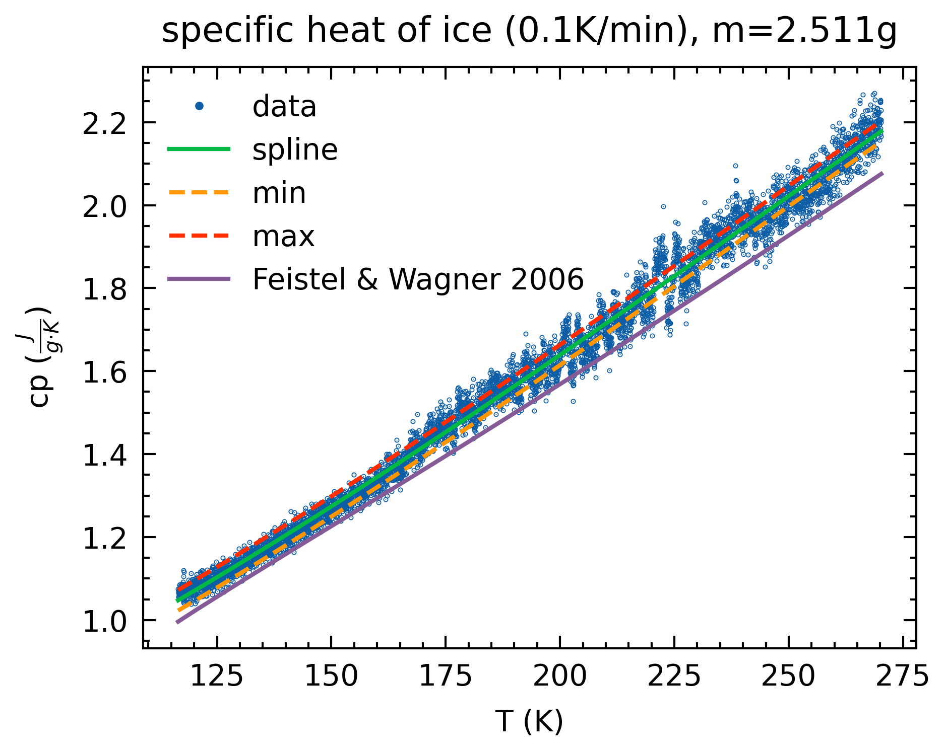
Unanswered Questions
Affects Cp results:
Ice Cp being lower than literature
Density measurements being lower than lit
Does not affect Cp results:
ADH double peaks

