Slide 1
Summary
Deciding on results to use
Oscillations
Degree of smoothing
Current Result

Slide 2
ramp | 0.25 K/min | 0.10 K/min
supply bottle | old | old | new
no. of Expt | 6 | 5 | 7 | 18
Results
0.25 K/min discarded (n=6)
Hysteresis – recorded heat flow may not represent equilibrium flow at specified Temperature
Liquidus peak temperatures >5 K from 273.15 K, impossible to determine wt%
< 5 wt% discarded (n=4)
Wt% highly sensitive to temperature
>10 % relative error in wt%
Further unconstrained error from using min. peak T versus peak-onset T.
We have 8 datasets.

Slide 3
Results
Temperature offset adjustment
Higher wt%, lower offset.
Changes up to 0.4 wt%
Without Temperature Offset |  |  |  | With Temperature Offset
Peak T (K) | wt% | abs error | rel error (%) | T_offset (K) | Adj T (K) | adj wt% | abs error | rel error (%)
271.0 | 2.5 | 0.5 | 20.0 | 0.5 | 270.5 | 2.9 | 0.5 | 17.2
270.5 | 2.9 | 0.4 | 13.8 | 0.5 | 270.0 | 3.3 | 0.4 | 12.1
267.8 | 4.9 | 0.5 | 10.2 | 0.5 | 267.3 | 5.2 | 0.5 | 9.6
267.7 | 4.9 | 0.5 | 10.2 | 0.5 | 267.2 | 5.2 | 0.5 | 9.6
262.8 | 7.9 | 0.3 | 3.8 | 0.5 | 262.3 | 8.2 | 0.3 | 3.7
262.5 | 8.1 | 0.3 | 3.7 | 0.5 | 262.0 | 8.4 | 0.3 | 3.6
259.6 | 9.7 | 0.3 | 3.1 | 0.4 | 259.2 | 10.0 | 0.2 | 2.0
250.7 | 14.2 | 0.3 | 2.1 | 0.4 | 250.3 | 14.4 | 0.2 | 1.4
235.2 | 20.0 | 0.2 | 1.0 | 0.3 | 234.9 | 20.1 | 0.1 | 0.5
207.4 | 26.9 | 0.1 | 0.4 | 0.1 | 207.3 | 26.9 | 0.0 | 0.2

Slide 4
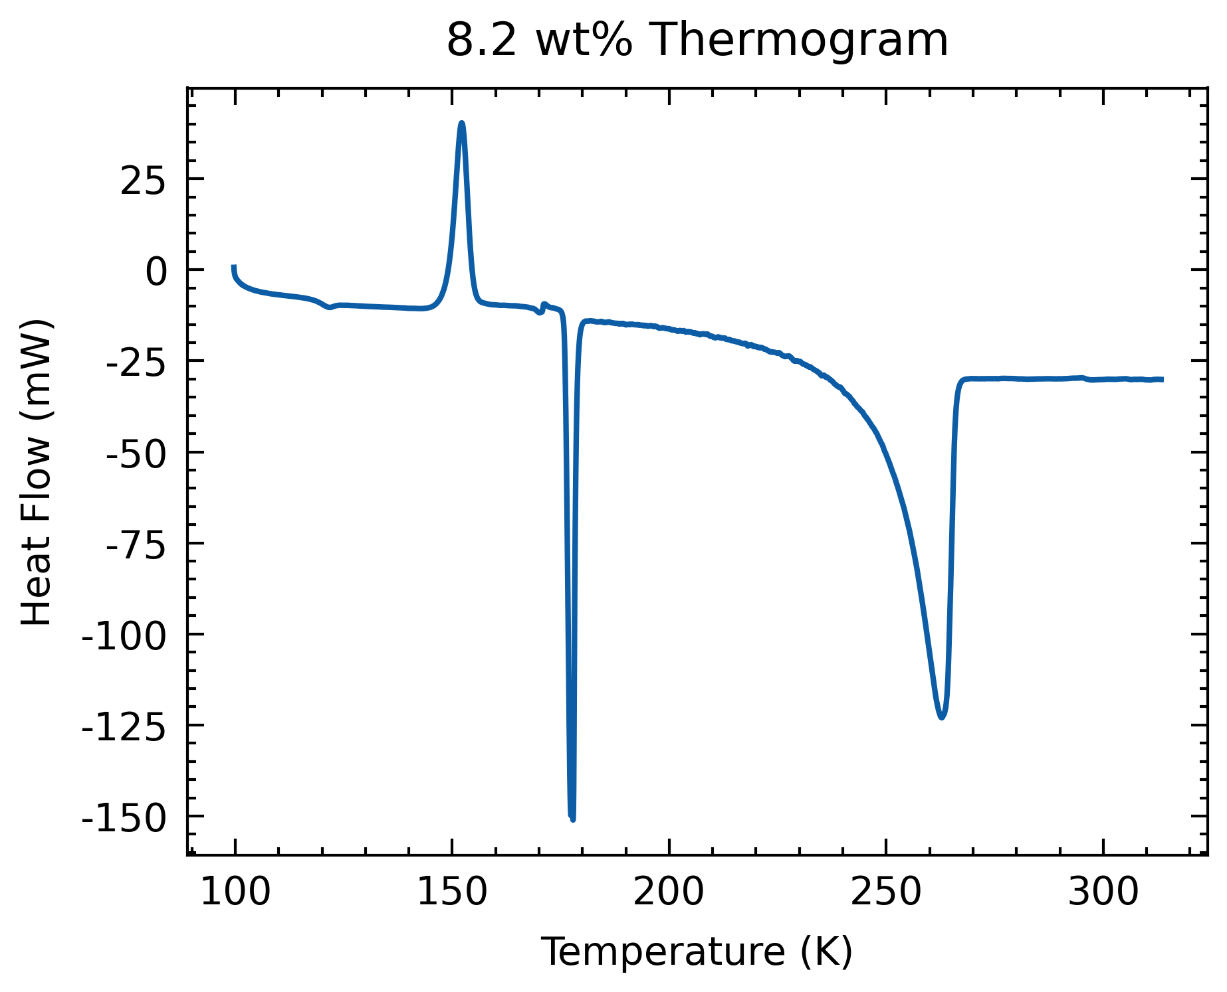
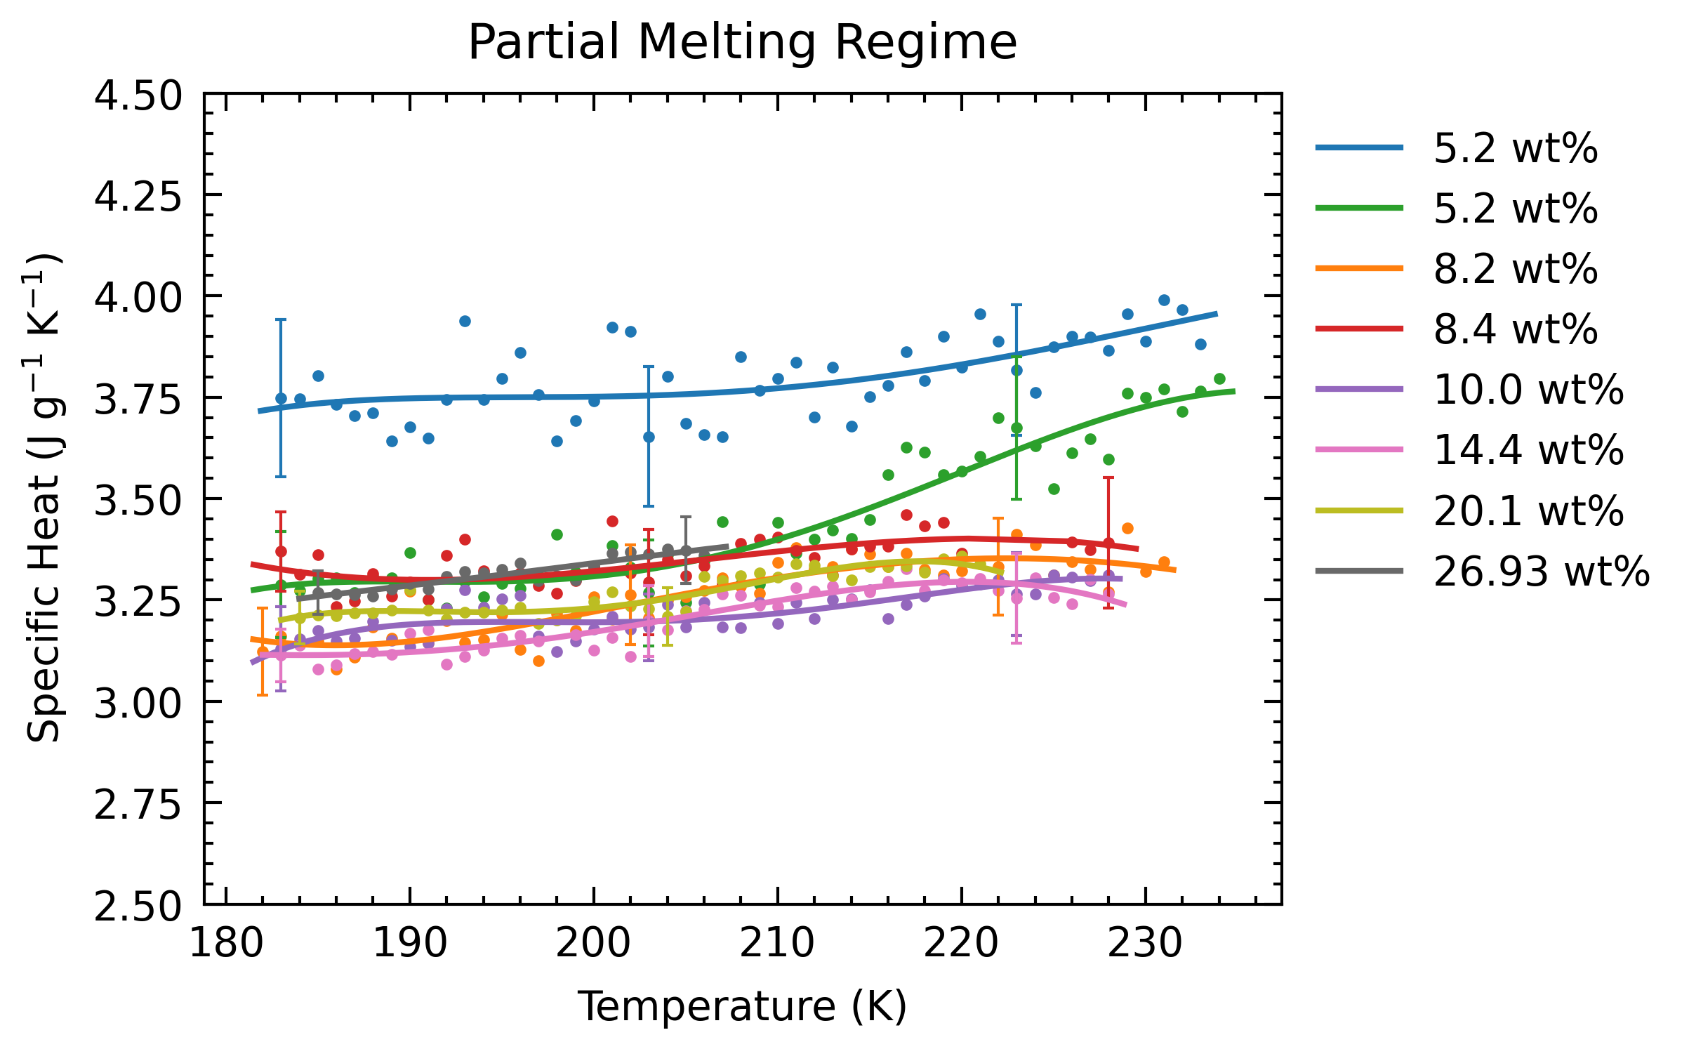
Oscillations
Can be found in heatflow data
Goal is to eliminate this

Slide 5
Oscillations
Tried FFT

Slide 6
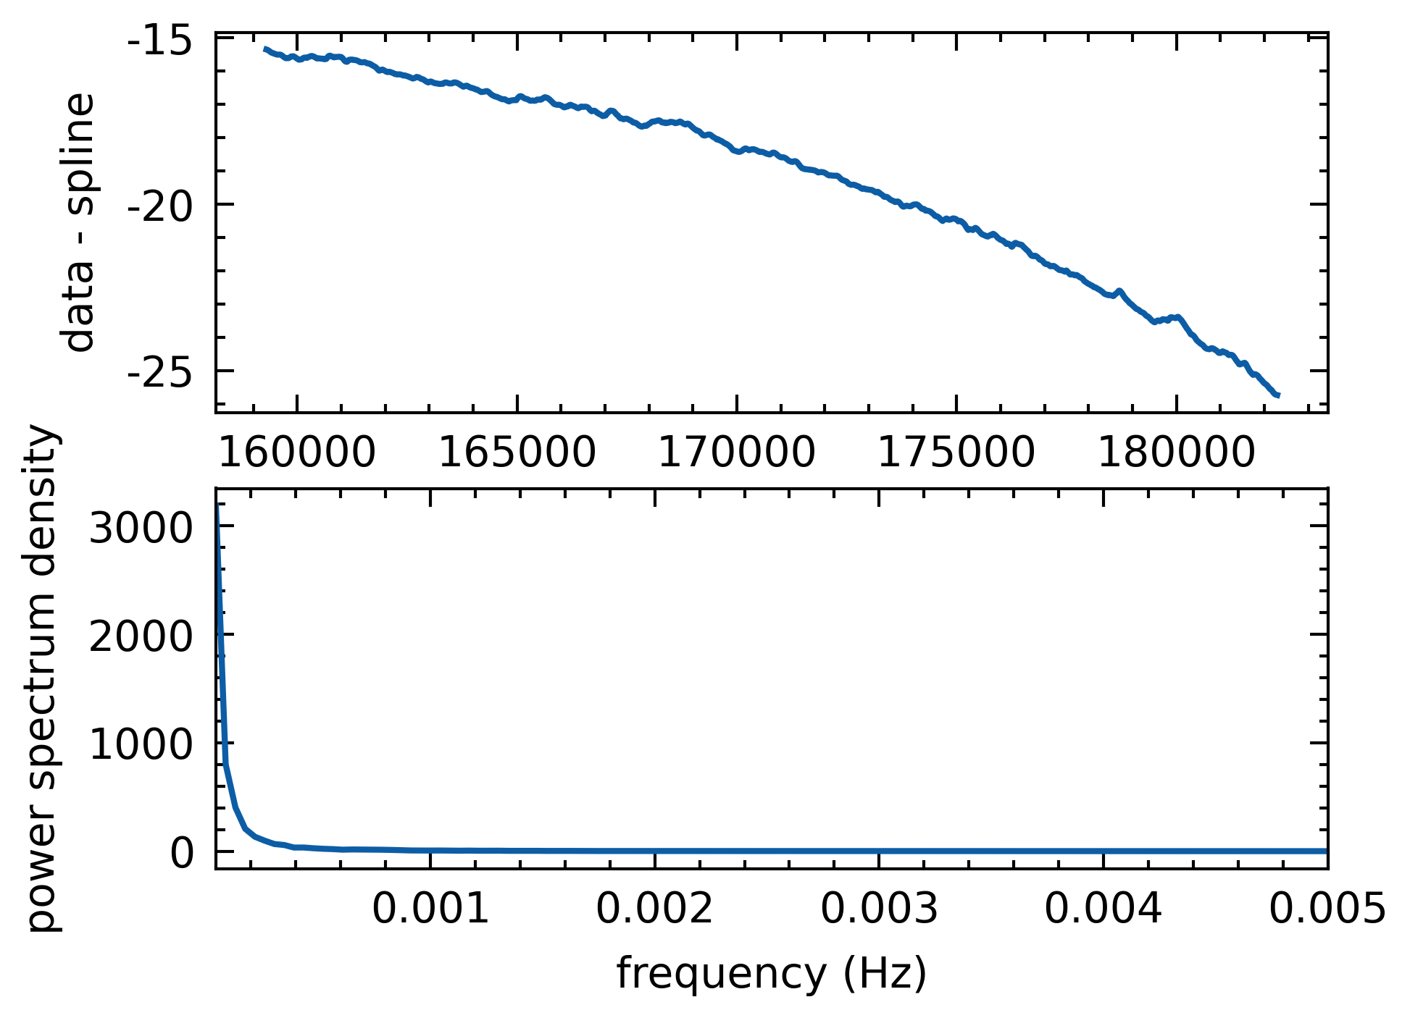
Oscillations
Tried FFT
Doesn’t work on heat flow data
data

Slide 7
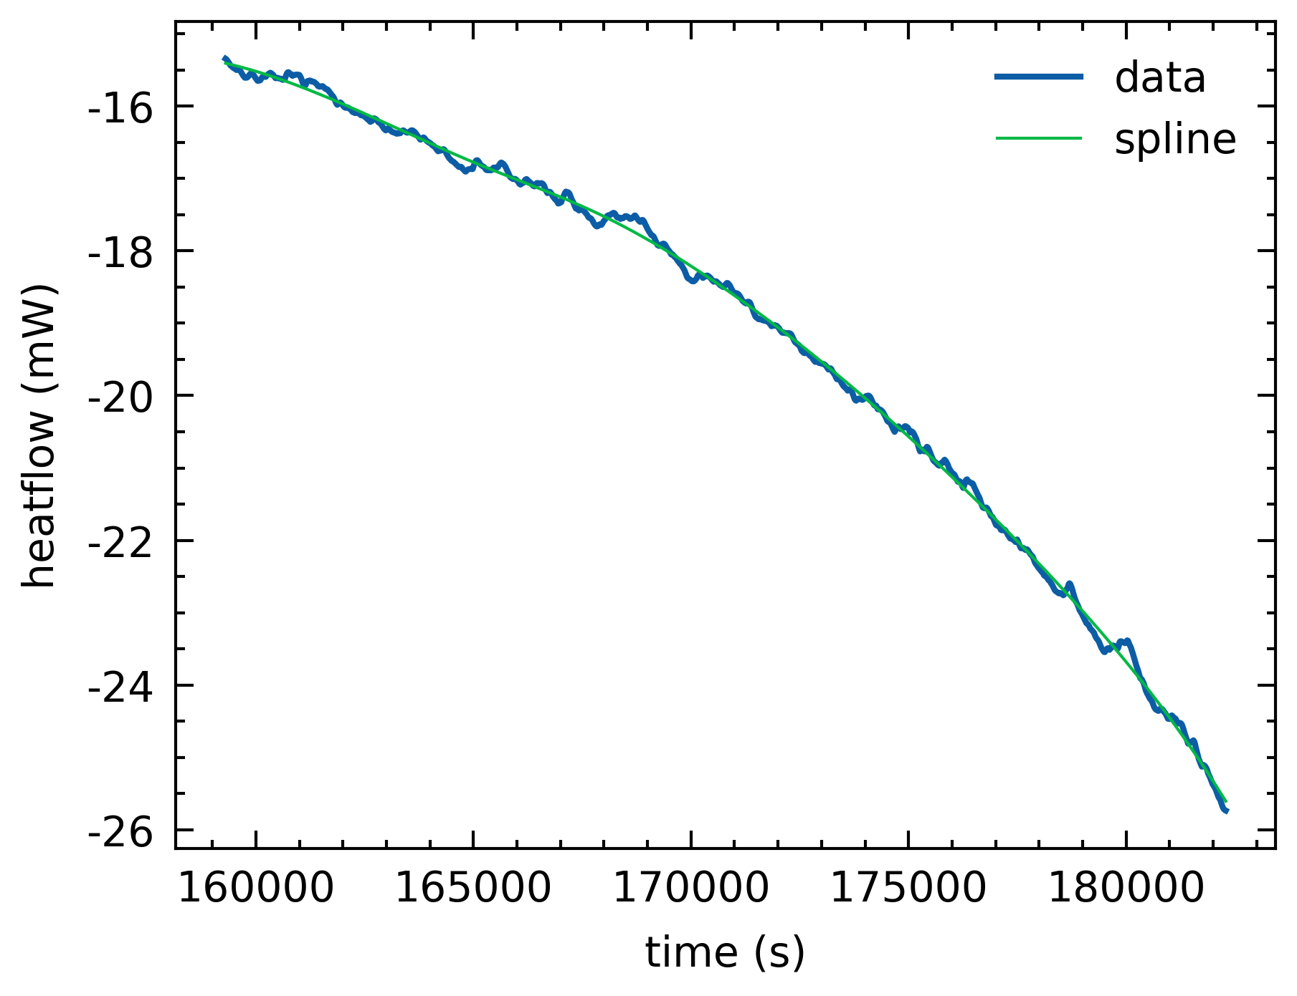
Oscillations
Tried FFT
Doesn’t work on heat flow data
Tried with deviations from a spline

Slide 8
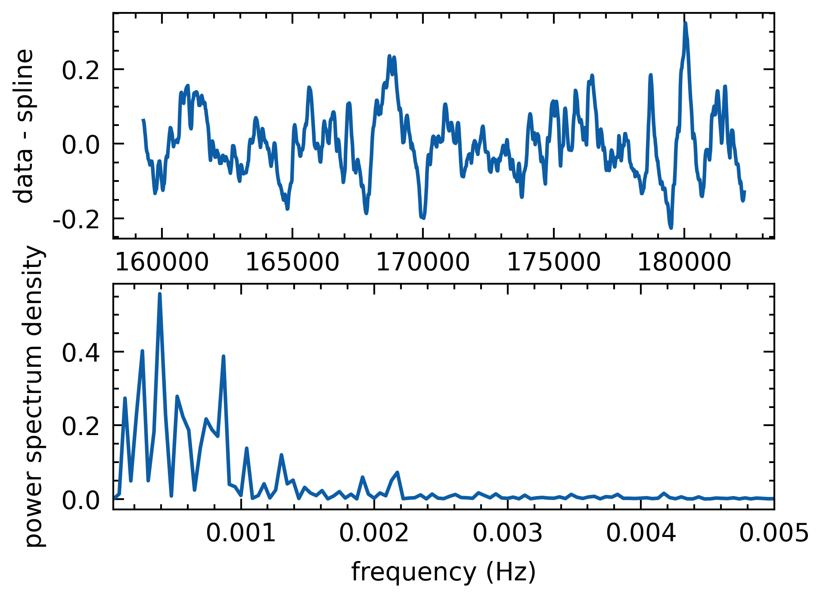
Oscillations
Tried FFT
Doesn’t work on heat flow data
Tried with deviations from a spline

Slide 9
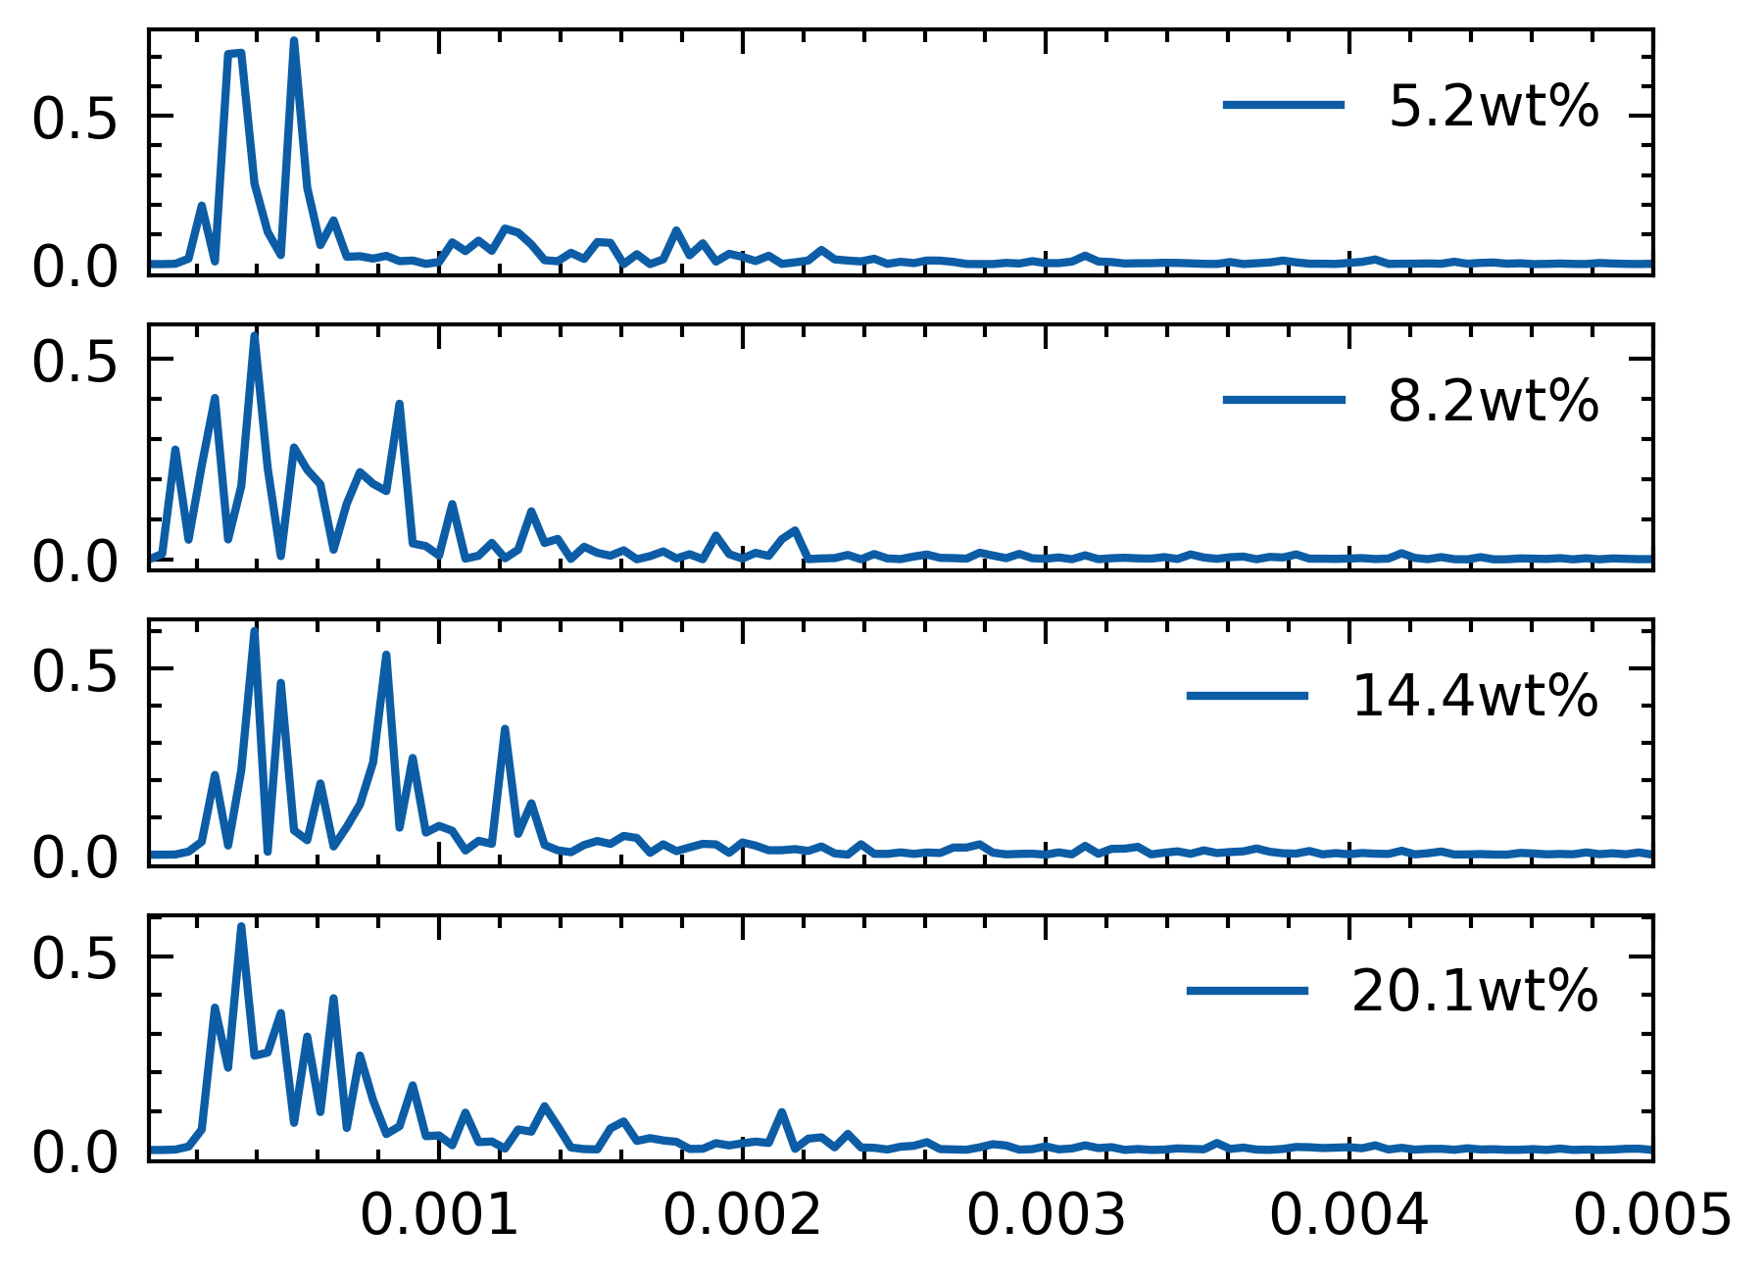
Oscillations
Tried FFT
Doesn’t work on heat flow data
Tried with deviations from a spline
Some similar freq, Not clear.

Slide 10
Oscillations
Oscillations are not entirely consistent across runs

Slide 11
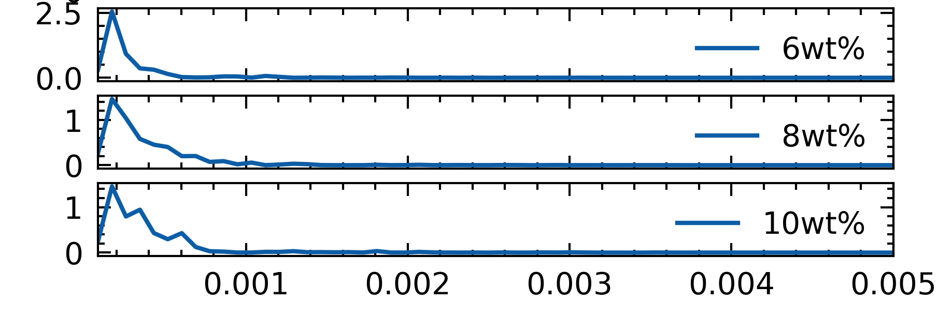
Oscillations
Oscillations are not entirely consistent across runs
Oscillations different with different ramp rate
Not sure if taking deviations from a fit is the right way
0.25 K/min
0.1 K/min

Slide 12
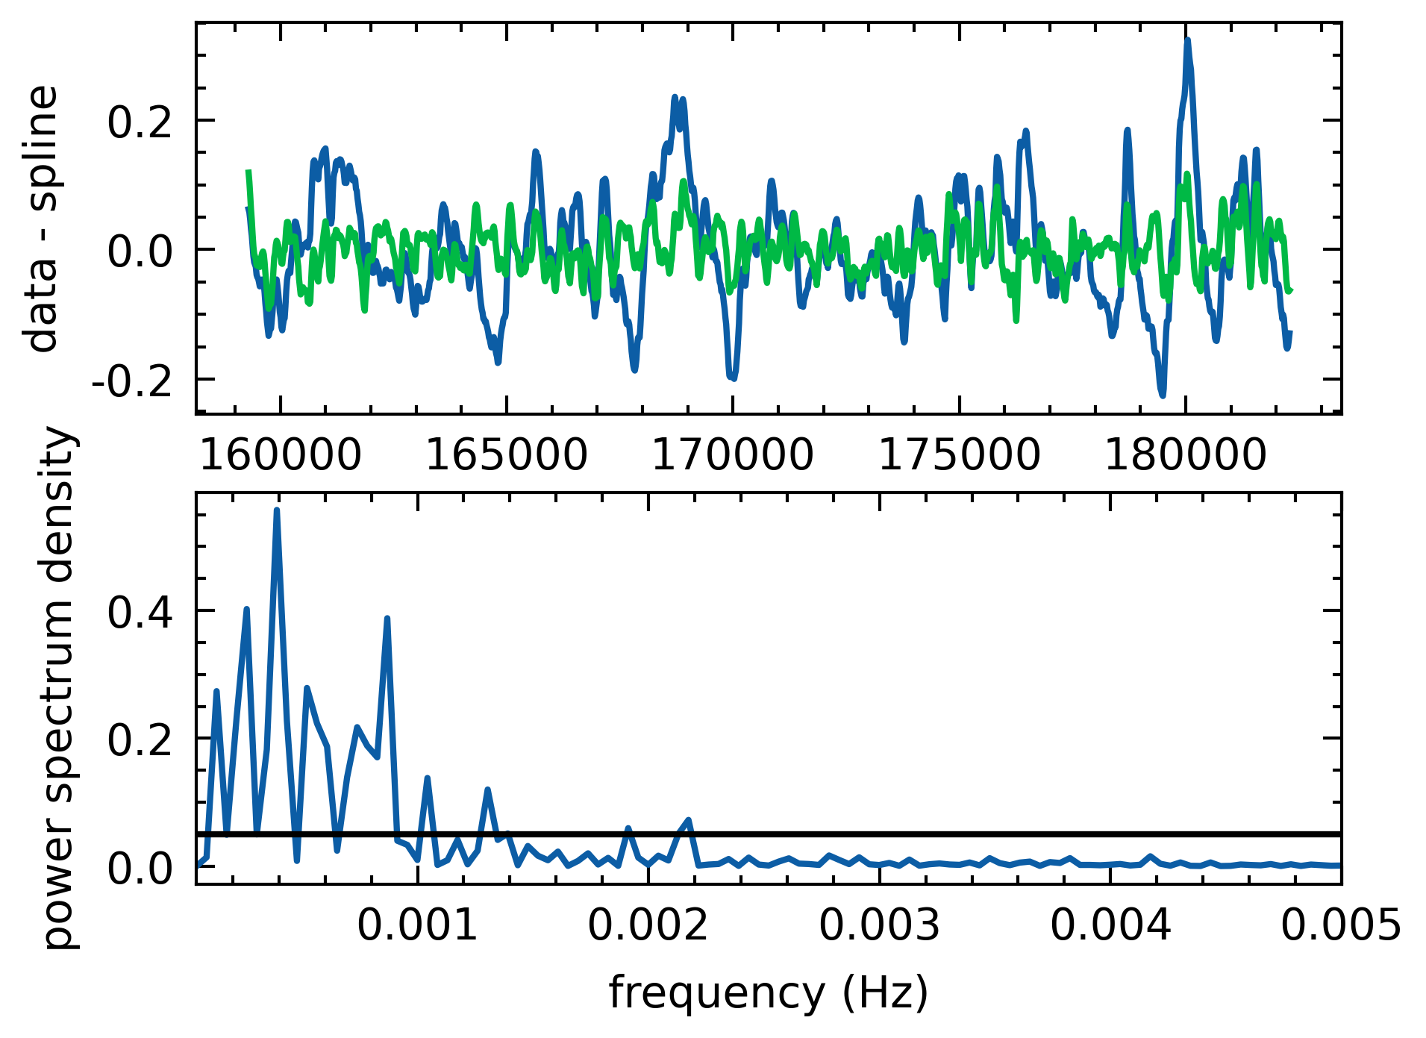
Oscillations
If the goal is to eliminate oscillations, we do so by:
Identifying systematic errors, applying a filter to remove systematic noise
Fitting thermogram to a spline?

Slide 13
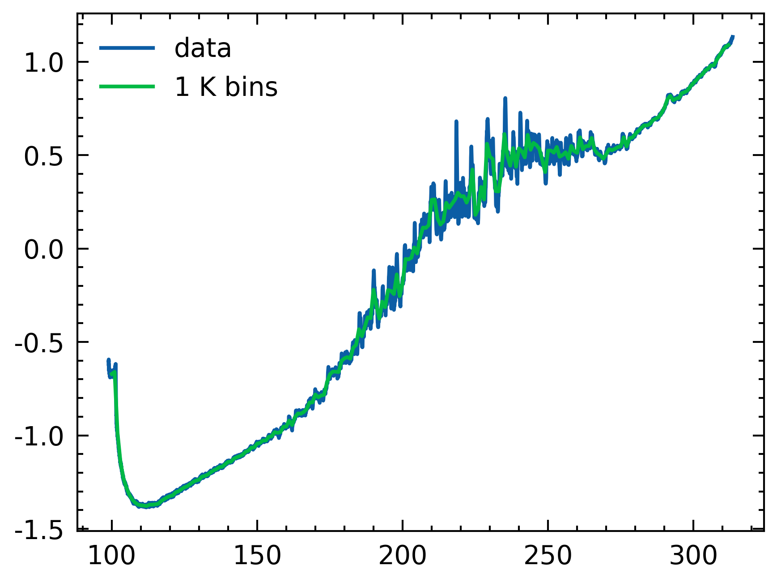
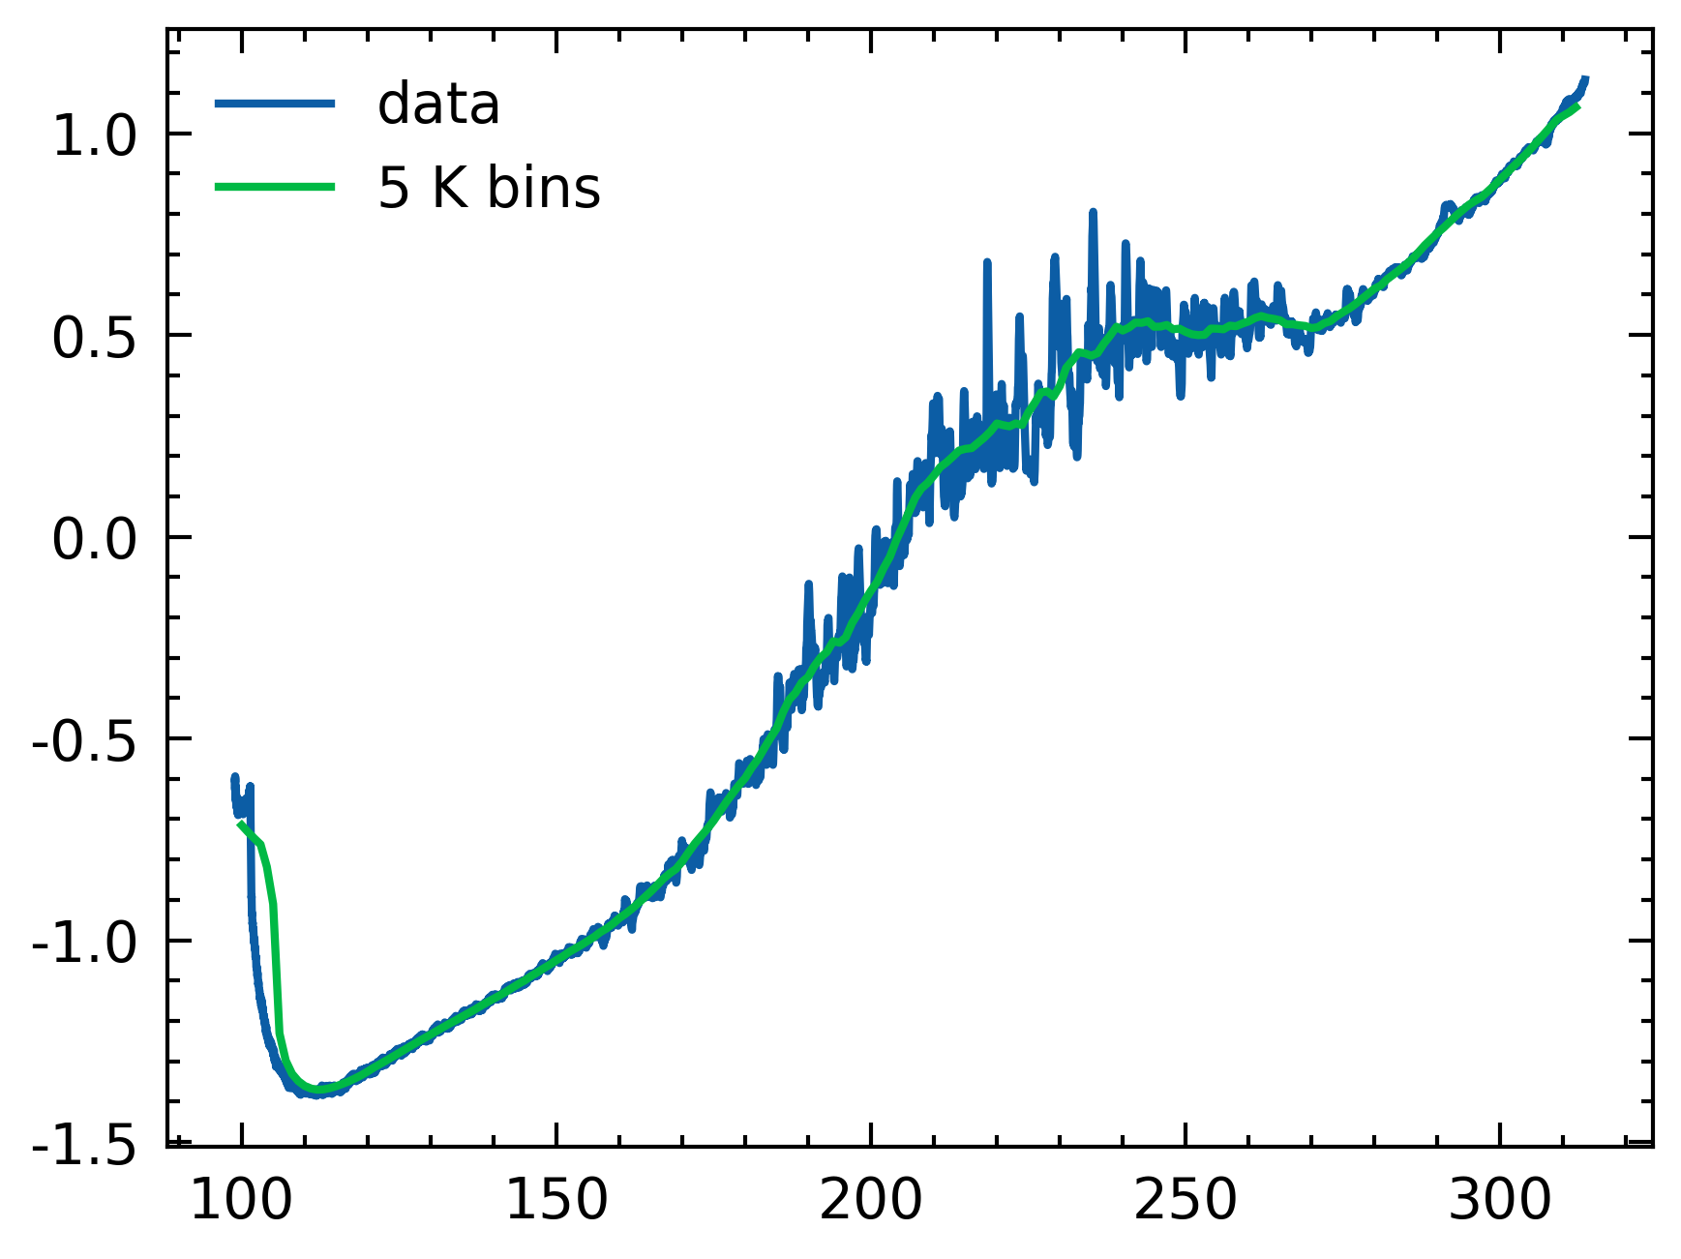
Averaging
What is the approach to determine how much smoothing?
Smooth blank/heat flow data until variability is removed?

Slide 14
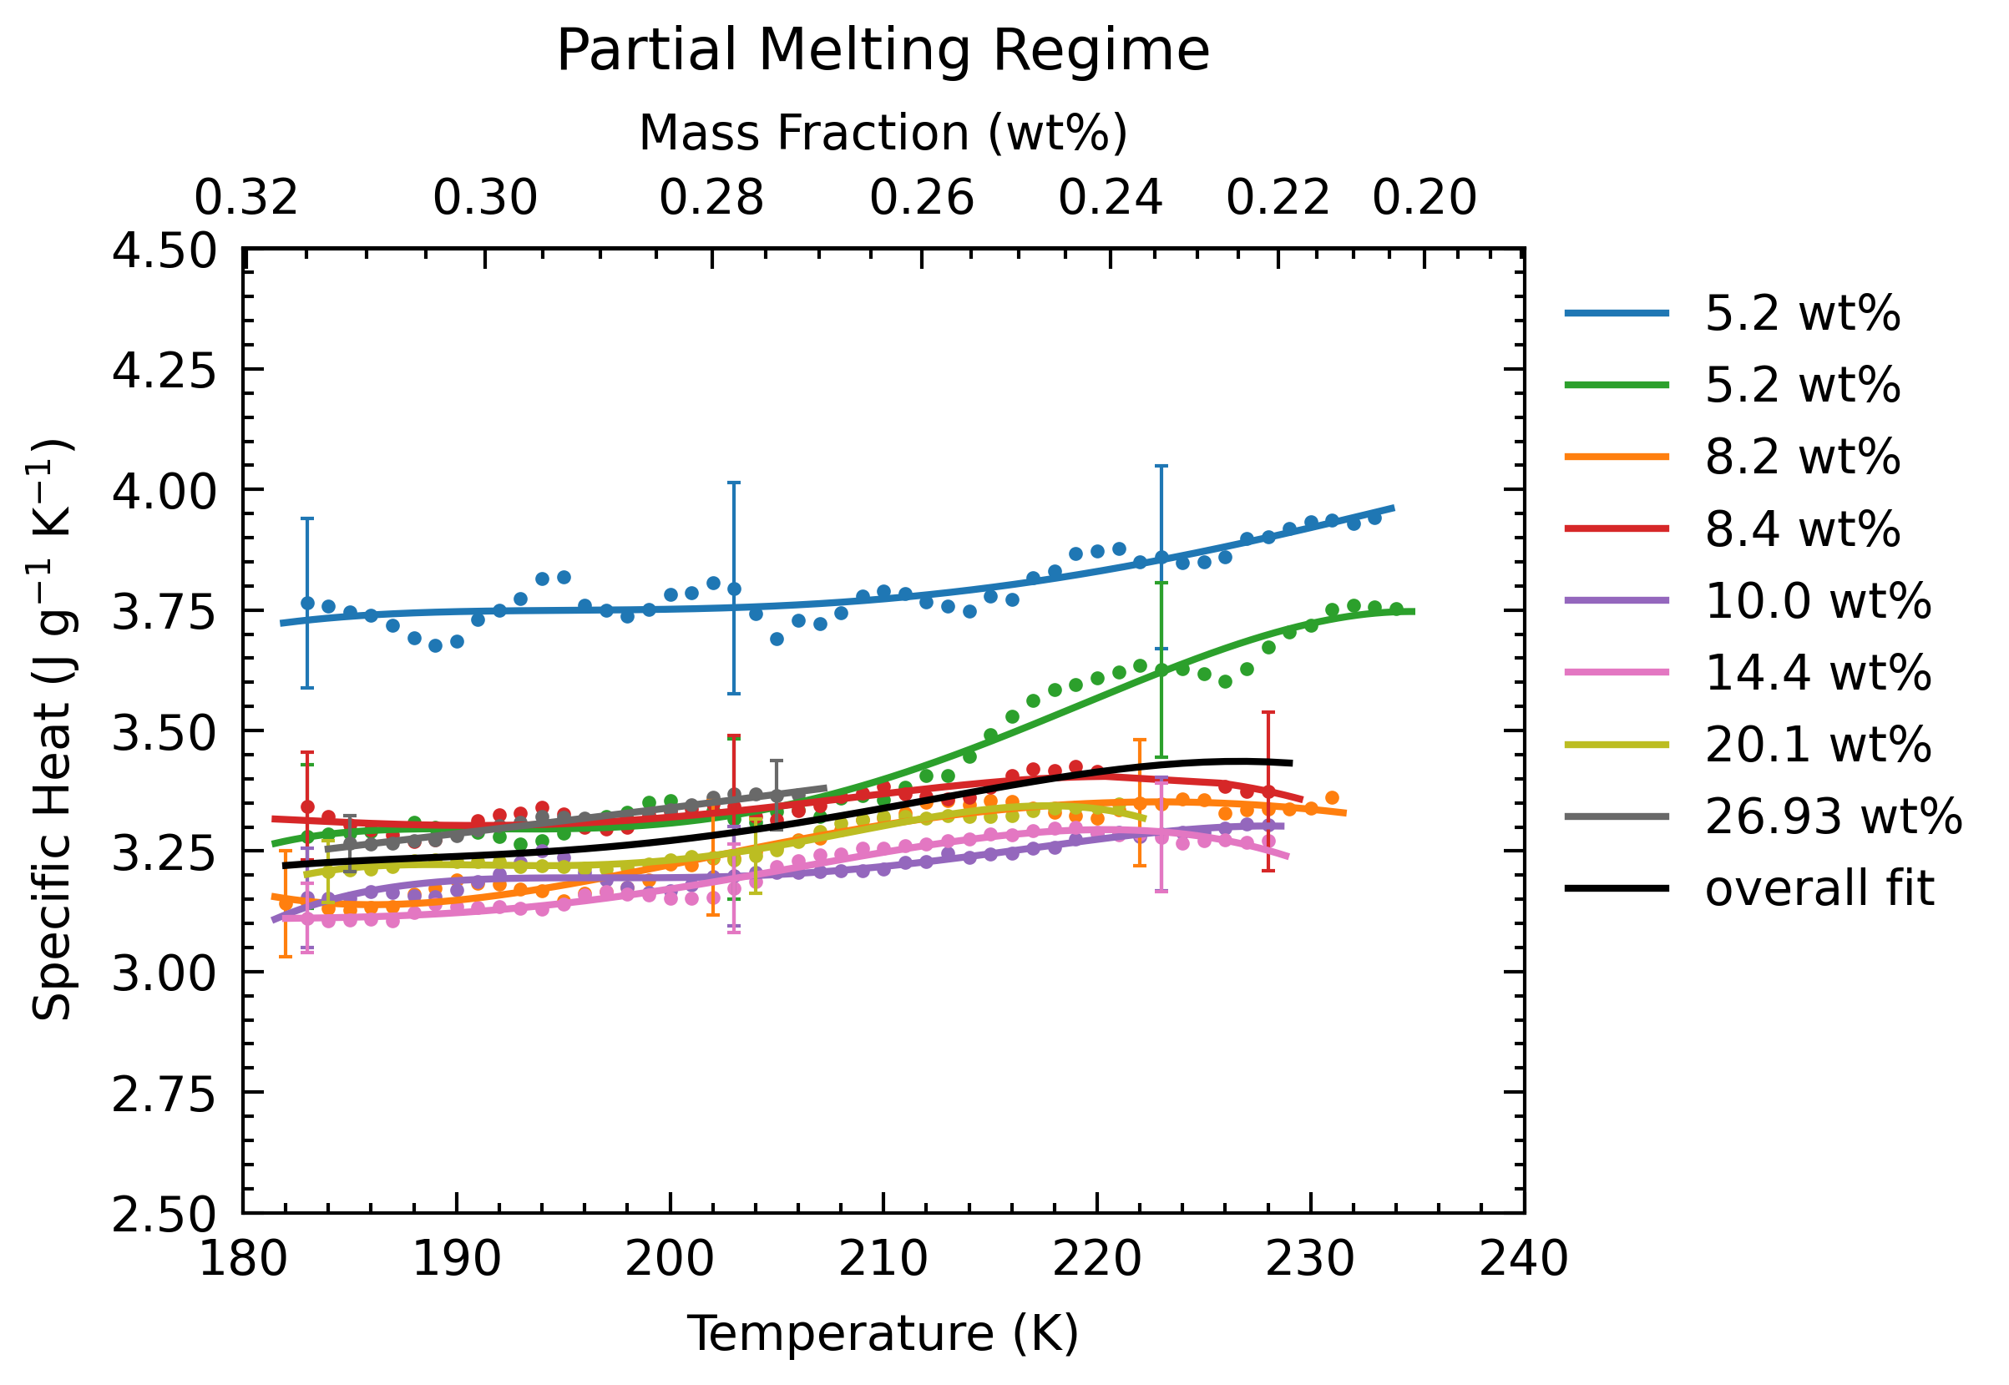
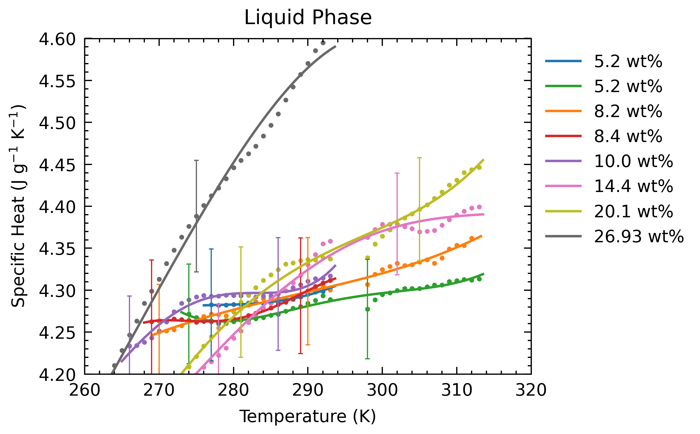
Current Result (3K averaging)
Dealing with oscillations & error bars: are they acceptable for applications?

Slide 15
Manuscript in progress
https://www.overleaf.com/3299537498fhjqhckknjms
Introduction is complete
Experimental Methods is 90% complete
Need to update how I narrowed down this dataset
Working on results next
If current results are final
Pursuing FFT and systematic noise removal of oscillations?
Using a spline on thermogram data to smooth?
Deciding on moving average smoothing Temperature bin?

Slide 16
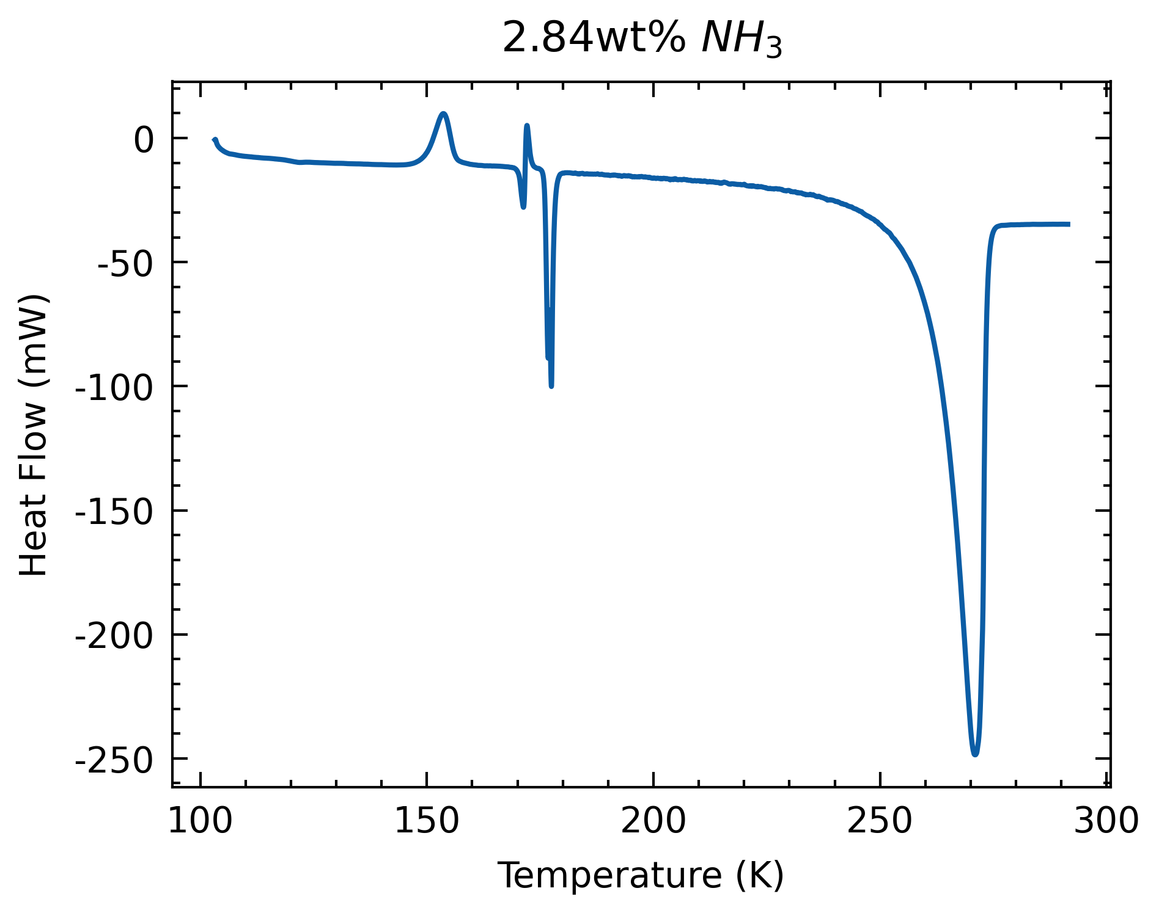
Process
Start with thermogram
Extract cp from partial melt regime & pure liquid phase

Slide 17
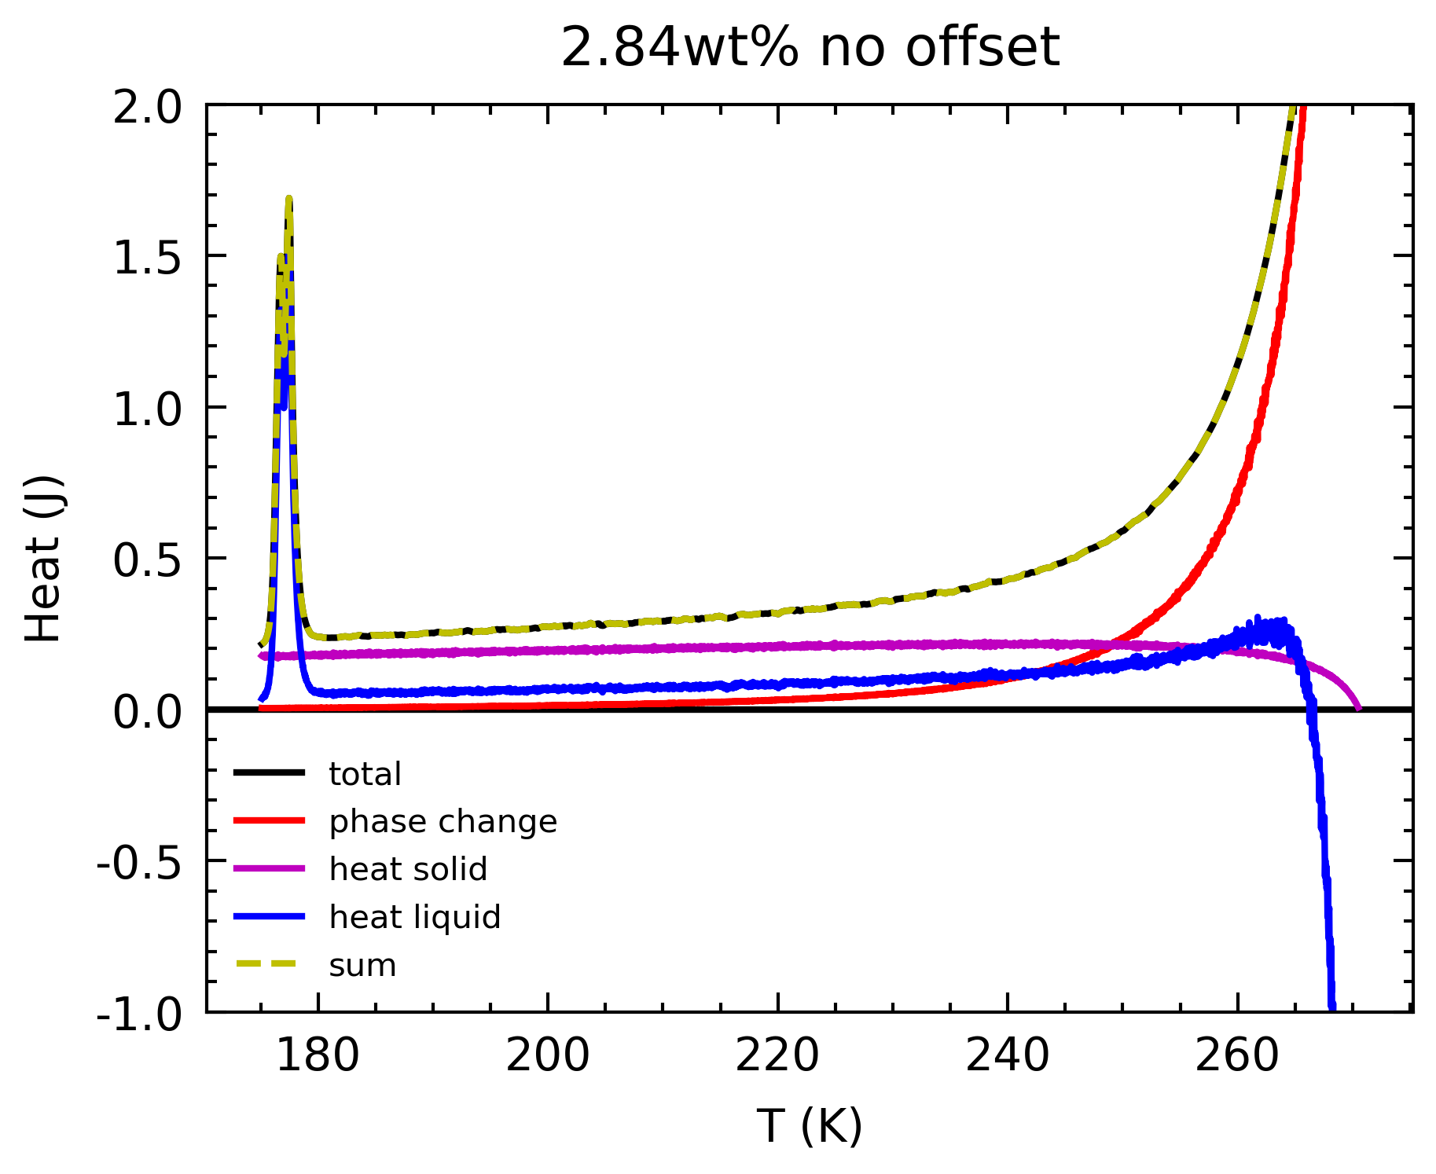
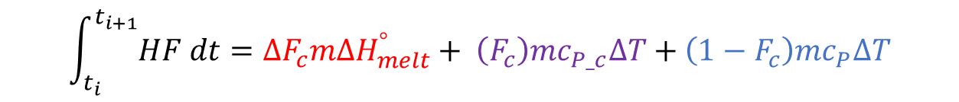

$$\int_{t_{i}}^{t_{i+1}}{HF dt}=∆F_{c}m{∆H}_{melt}^{°}+ {\left(F_{c}\right)mc}_{P_c}∆T+\left(1−F_{c}\right)mc_{P}∆T$$
Deconvolution
Melting phase: combination of 3 processes:
Heat to melt ice
Heat to warm ice
Heat to warm liquid
$HF$, $T$ and $m$terms from expt
$F_{c}$ terms extracted from lever rule (depends on wt%)
$c_{P_c}$ extracted from Feistel & Wagner, 2006
${∆H}_{melt}^{°}$ extracted from SeaFreeze
Find $c_{P}$

Slide 18
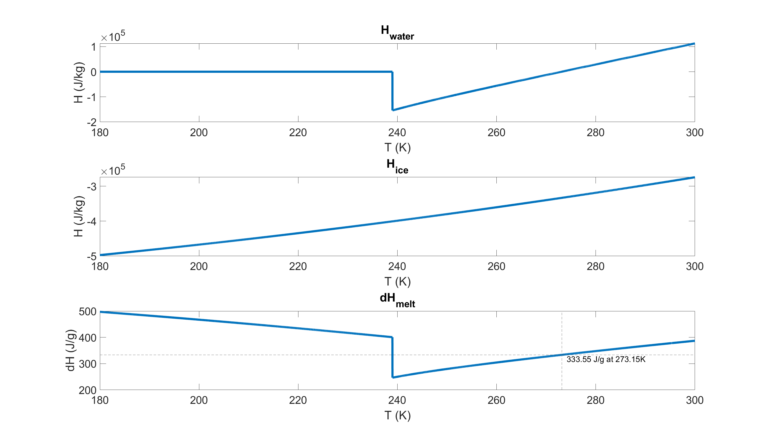
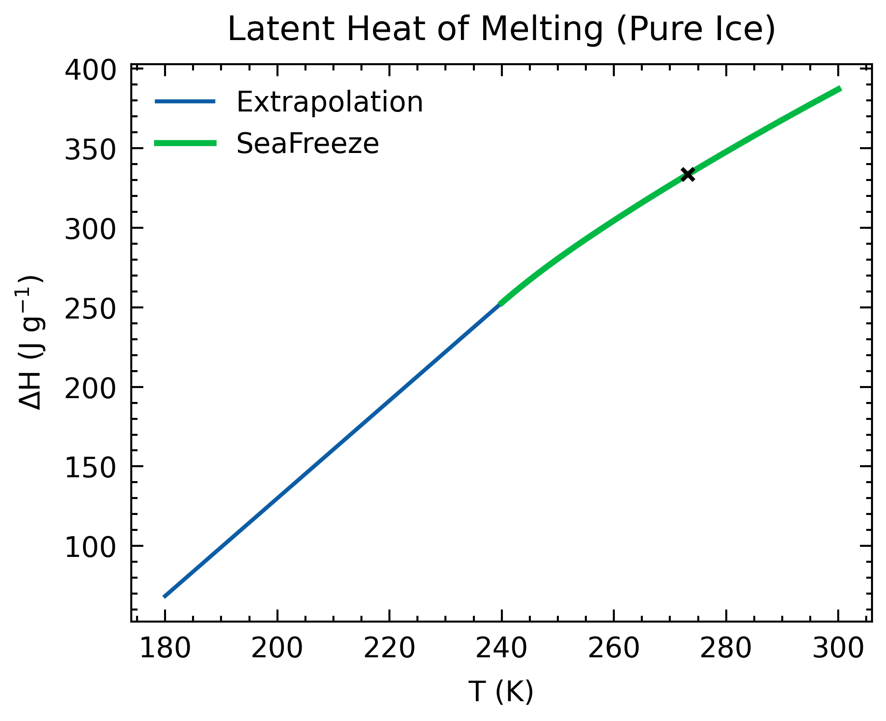


$$\int_{t_{i}}^{t_{i+1}}{HF dt}=∆F_{c}m{∆H}_{melt}^{°}+ \left(F_{c}\right)mc_{P_c}∆T+\left(1−F_{c}\right)mc_{P}∆T$$
Latent Heat
${∆H}_{melt}^{°}$ extracted from SeaFreeze
H_{water} – H_{ice}
Extrapolate for values below 240K

