Slide 1
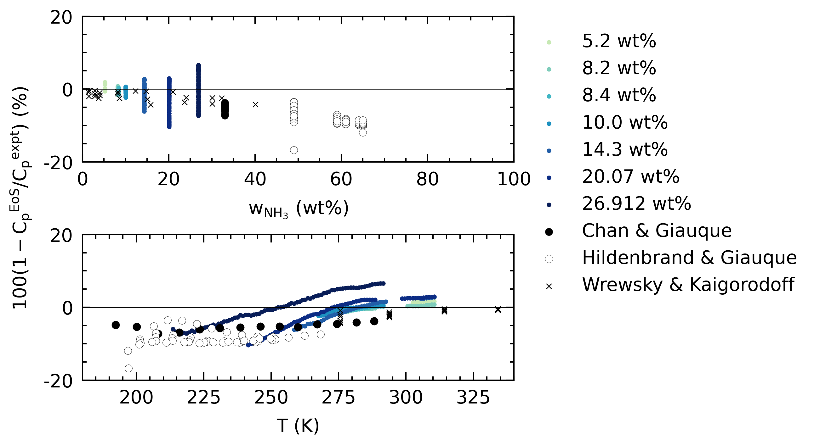
Deviations between our data and current accepted model for H₂O-NH₃

Slide 2
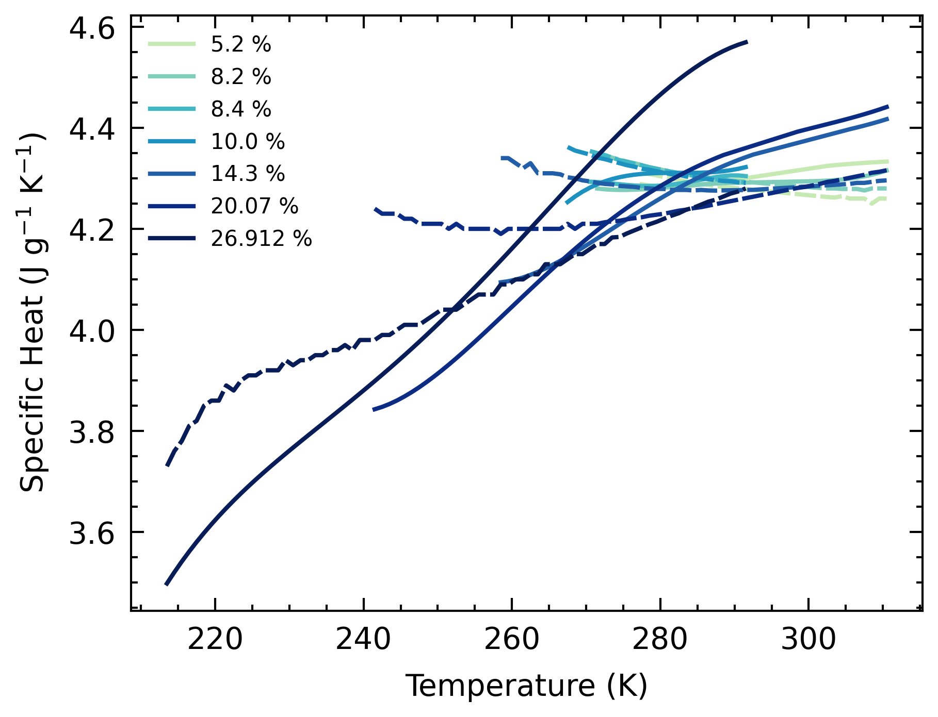
Plot of our specific heat data and the currently accepted model

