Slide 1
Summary
Double Peak
Peak Temperatures
Cp linear combination

Slide 2
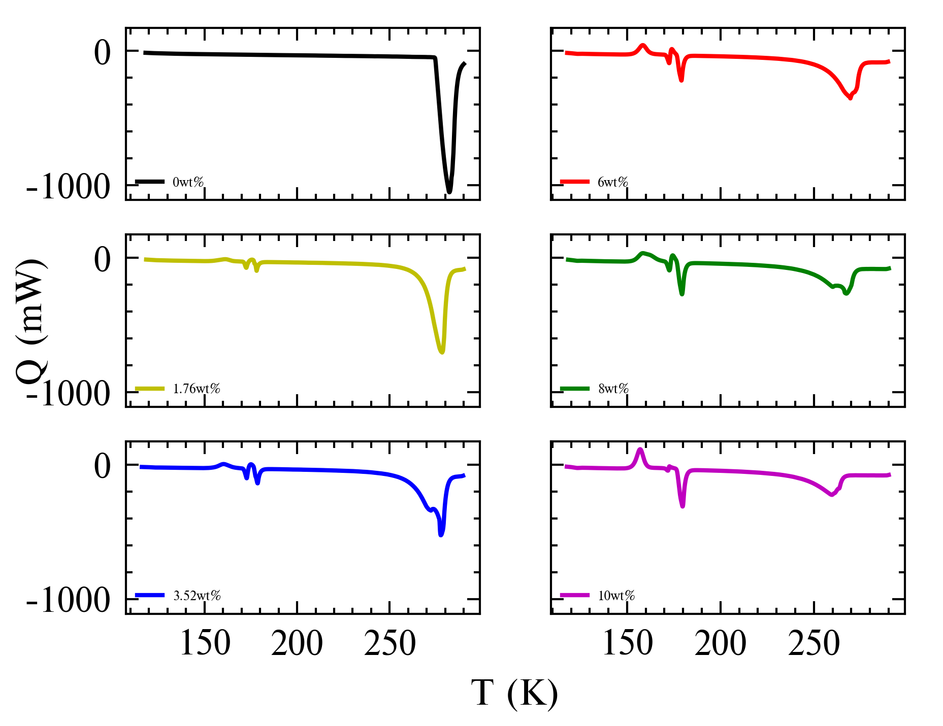
Double Peaks
DP appears in 3.52wt%, 8wt%
Small wiggle after main peak in most samples

Slide 3
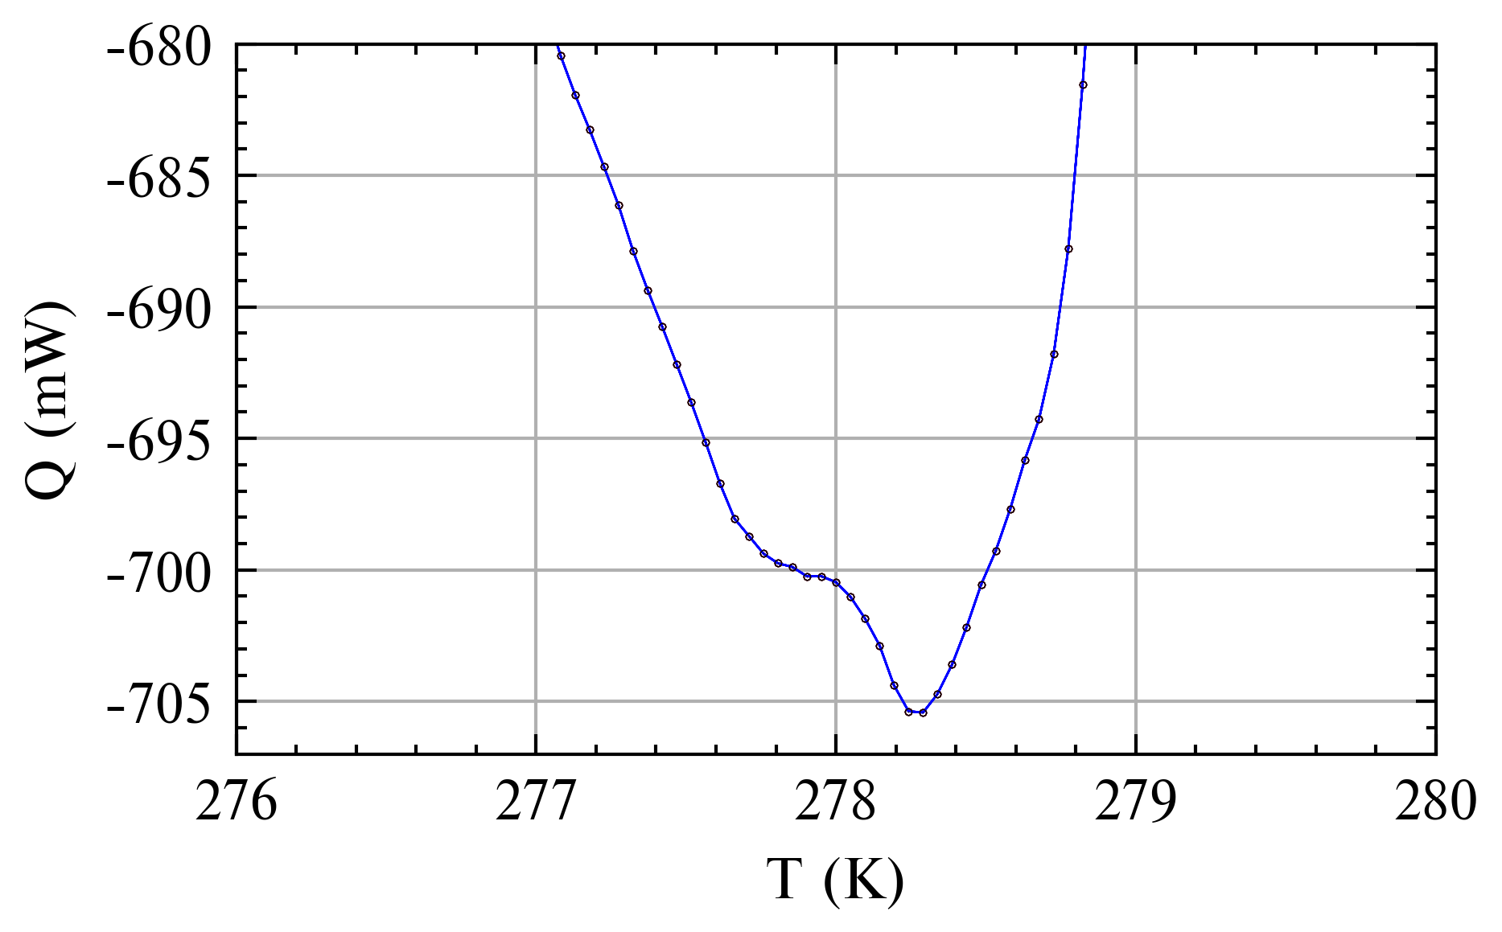
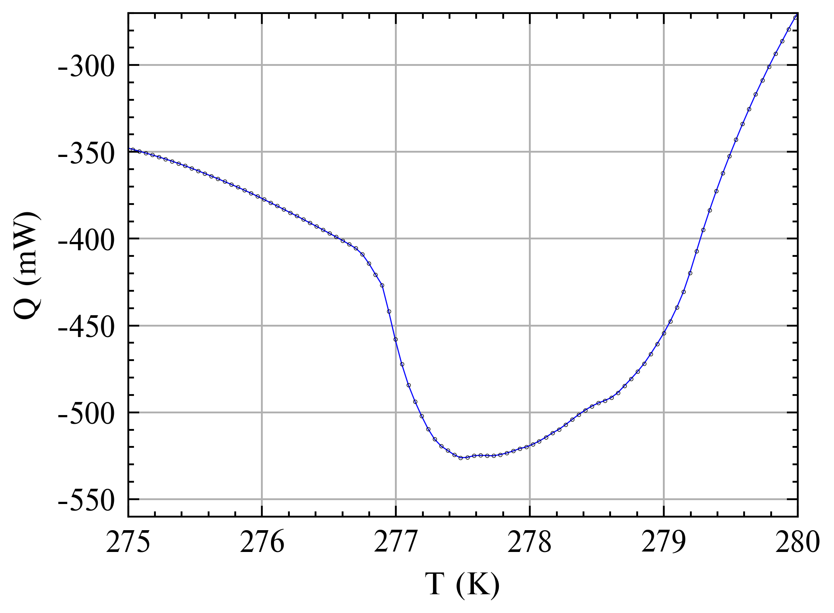
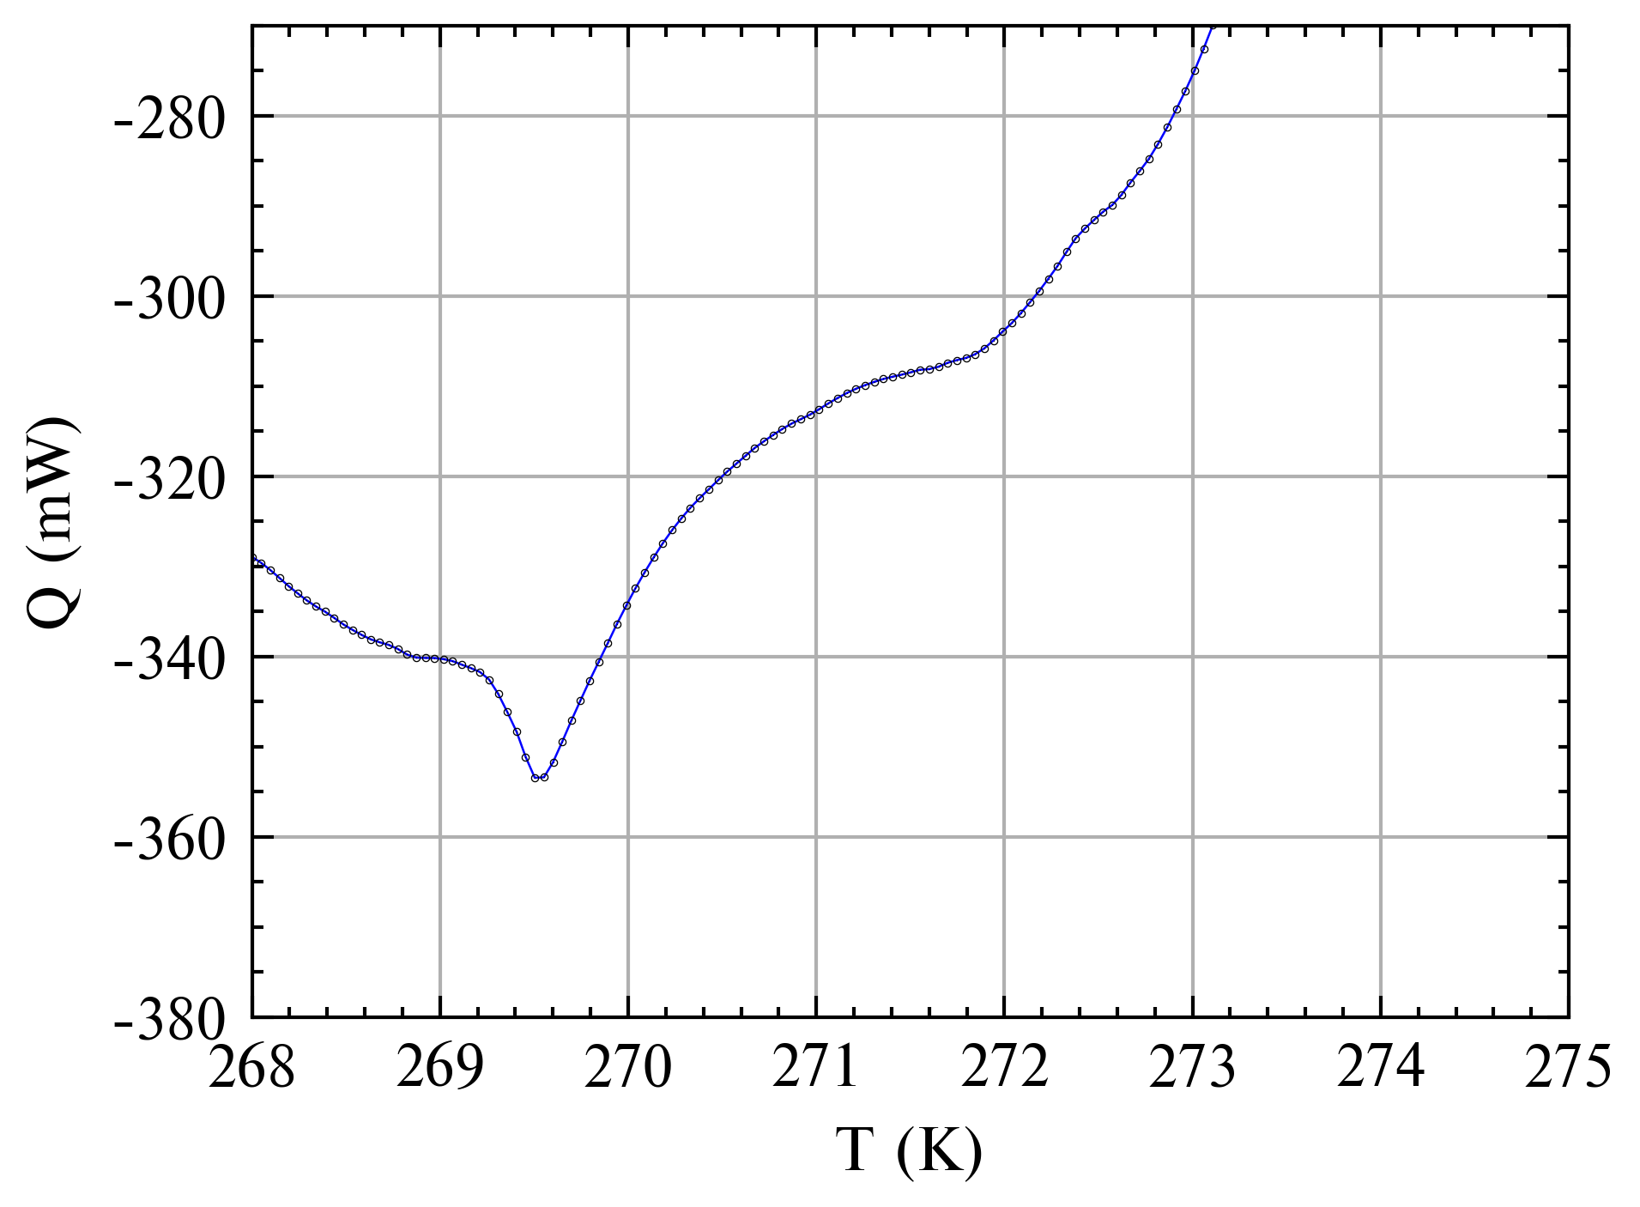
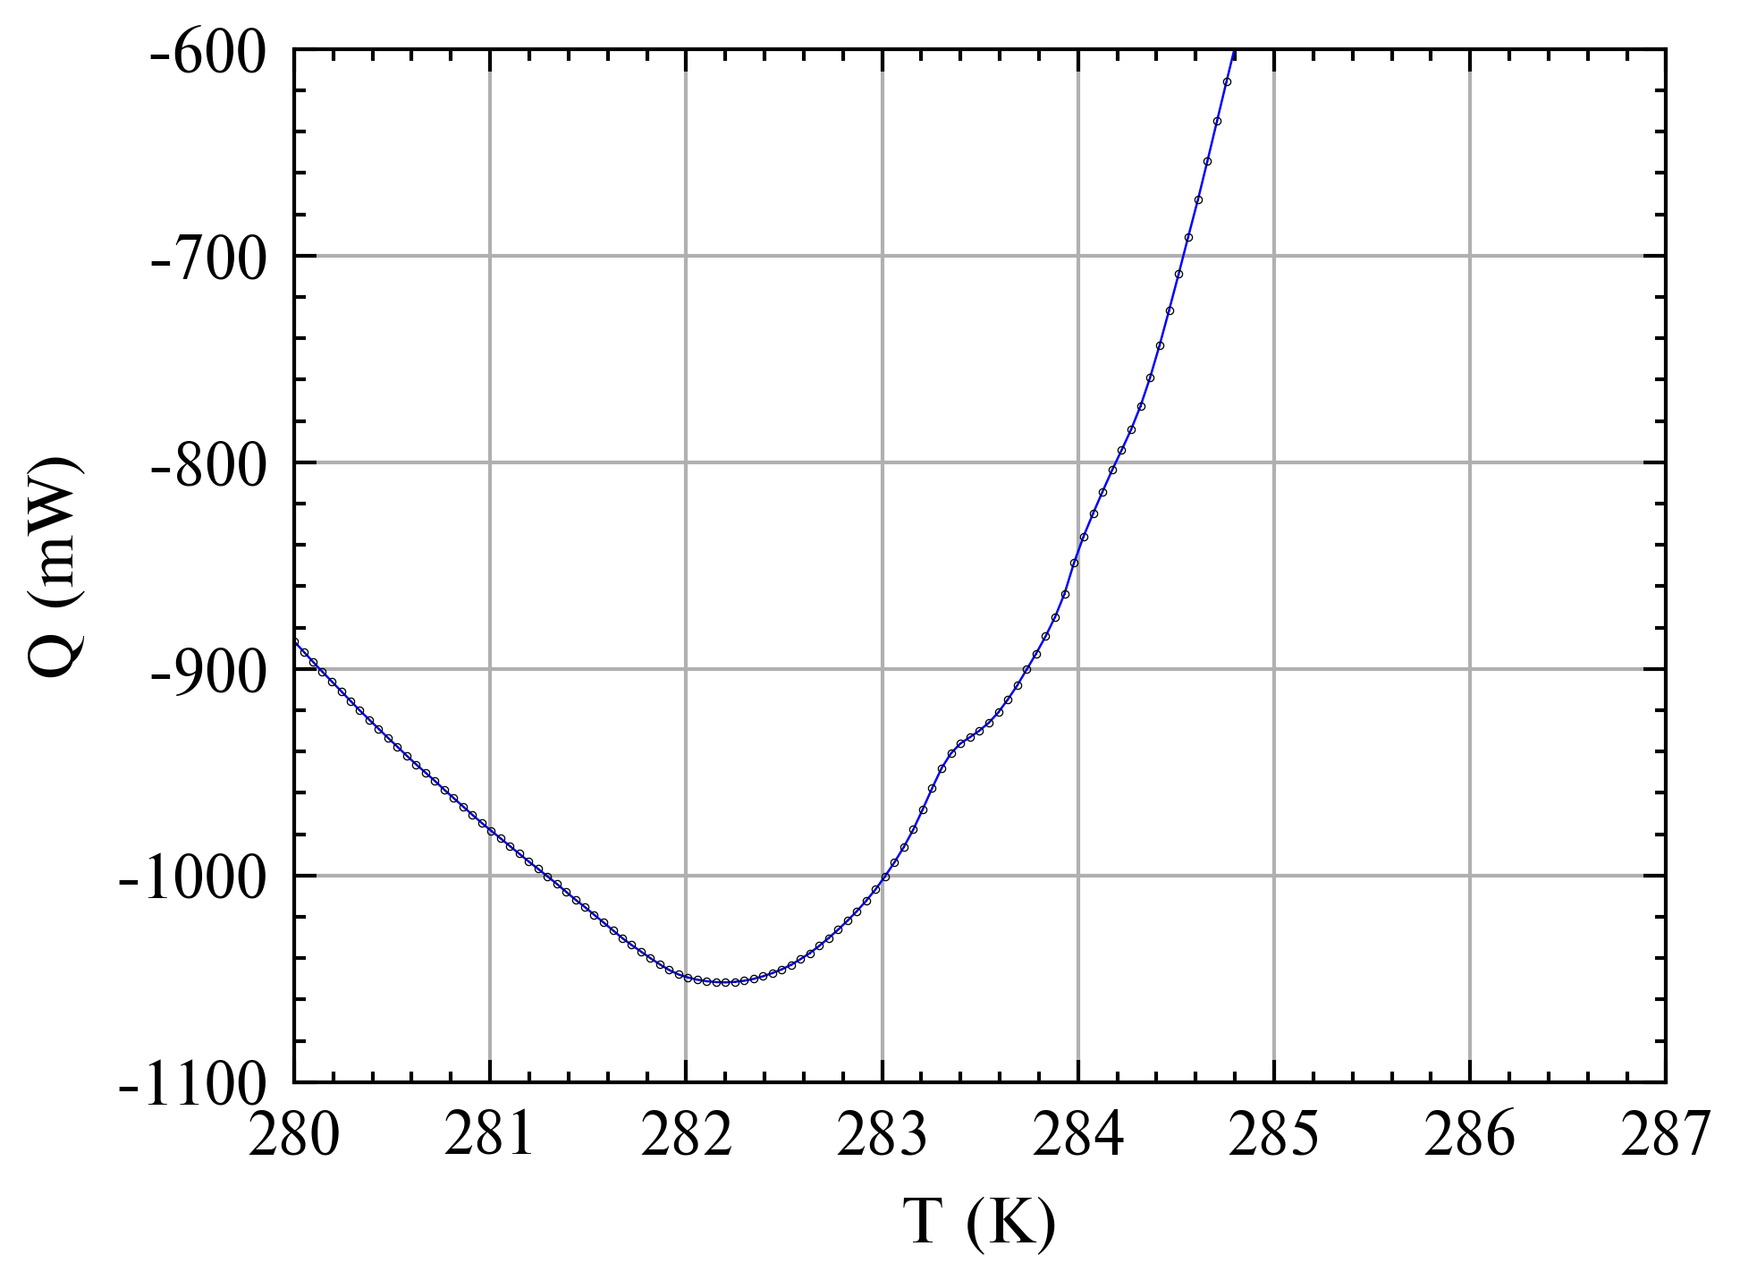
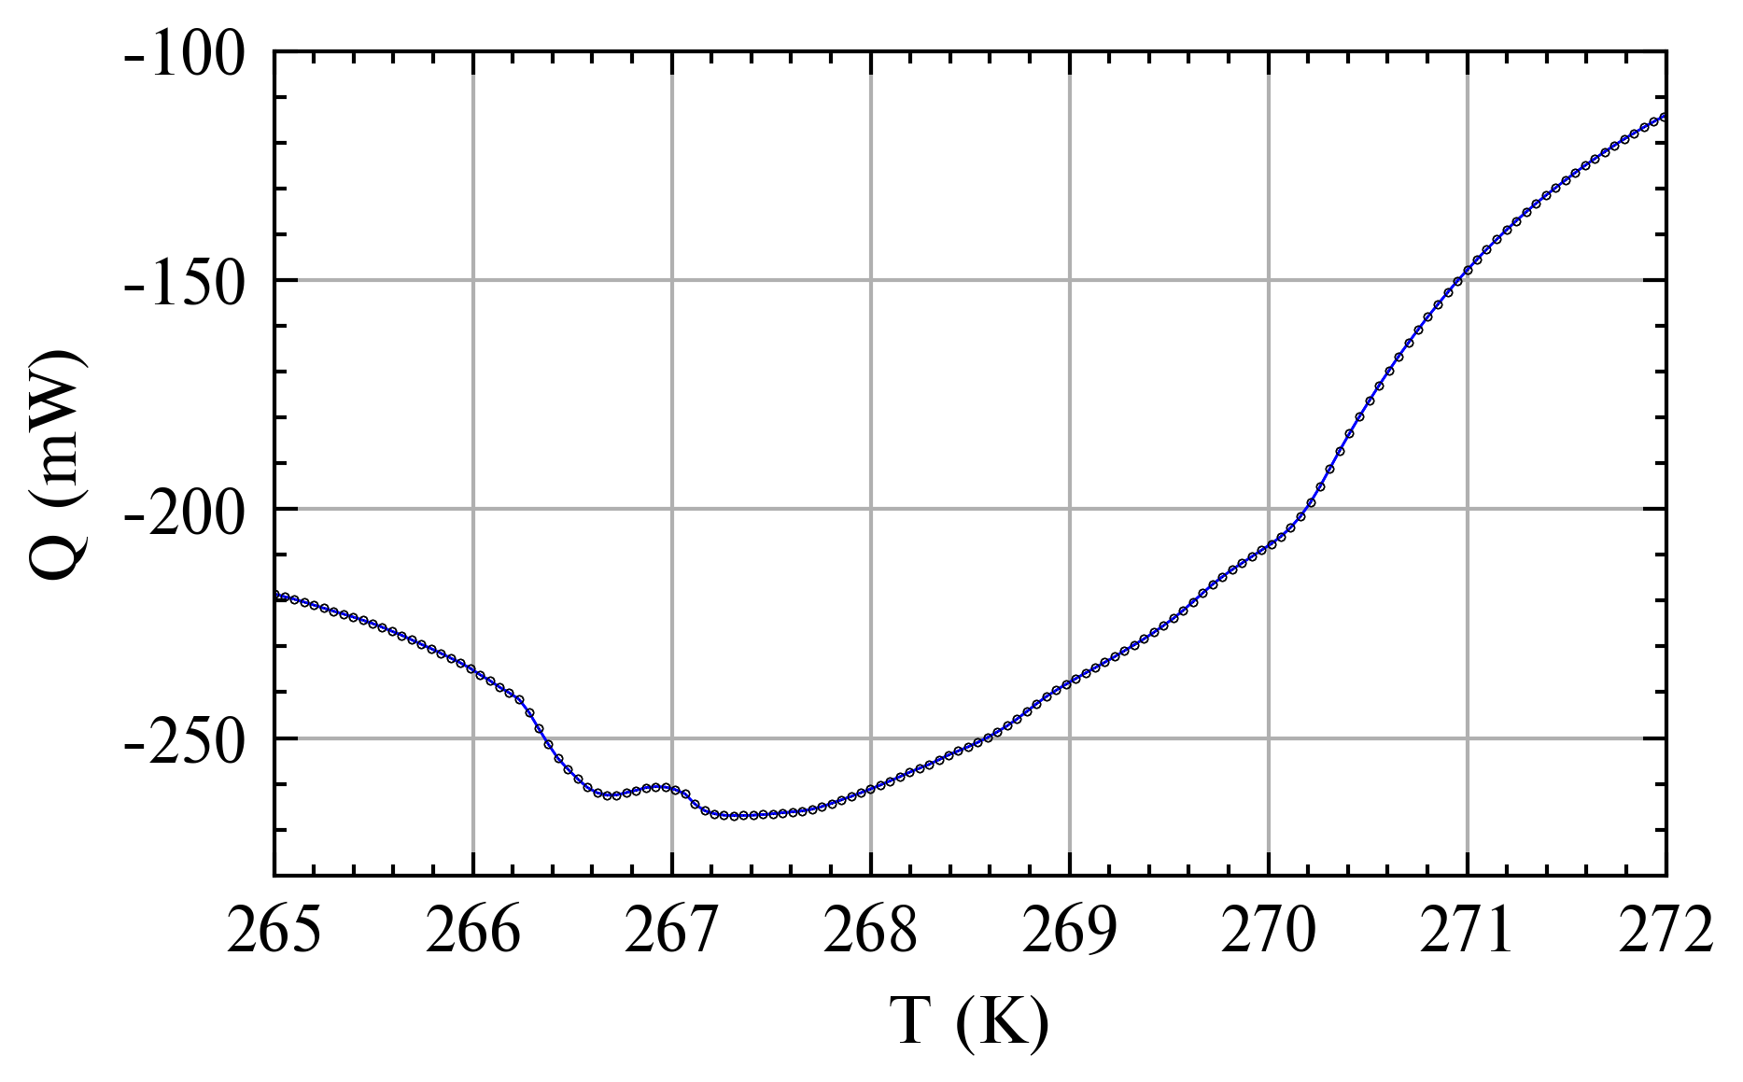
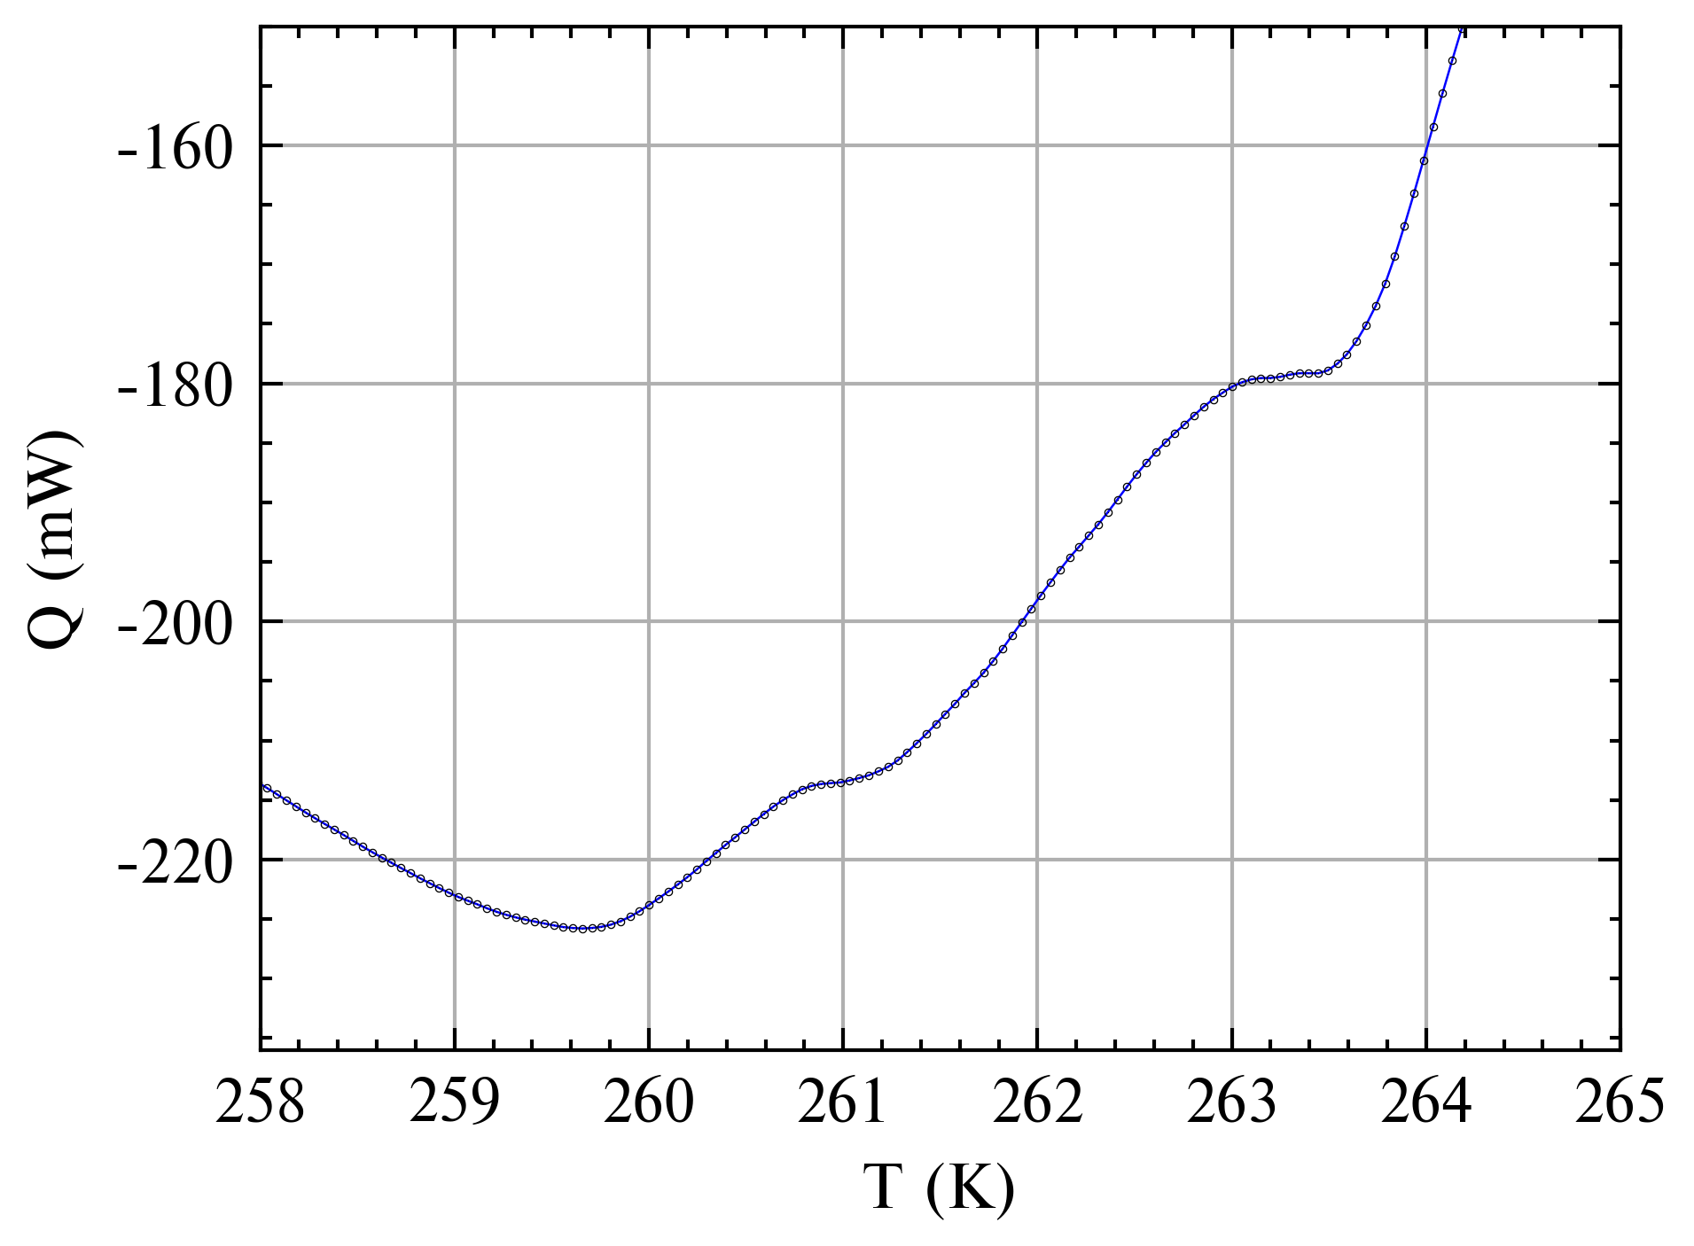
Double Peaks
Small peak wiggles after the main peak is seen across most samples, including 0wt%
1.76wt%
3.52wt%
6wt%
0wt%
8wt%
10wt%

Slide 4
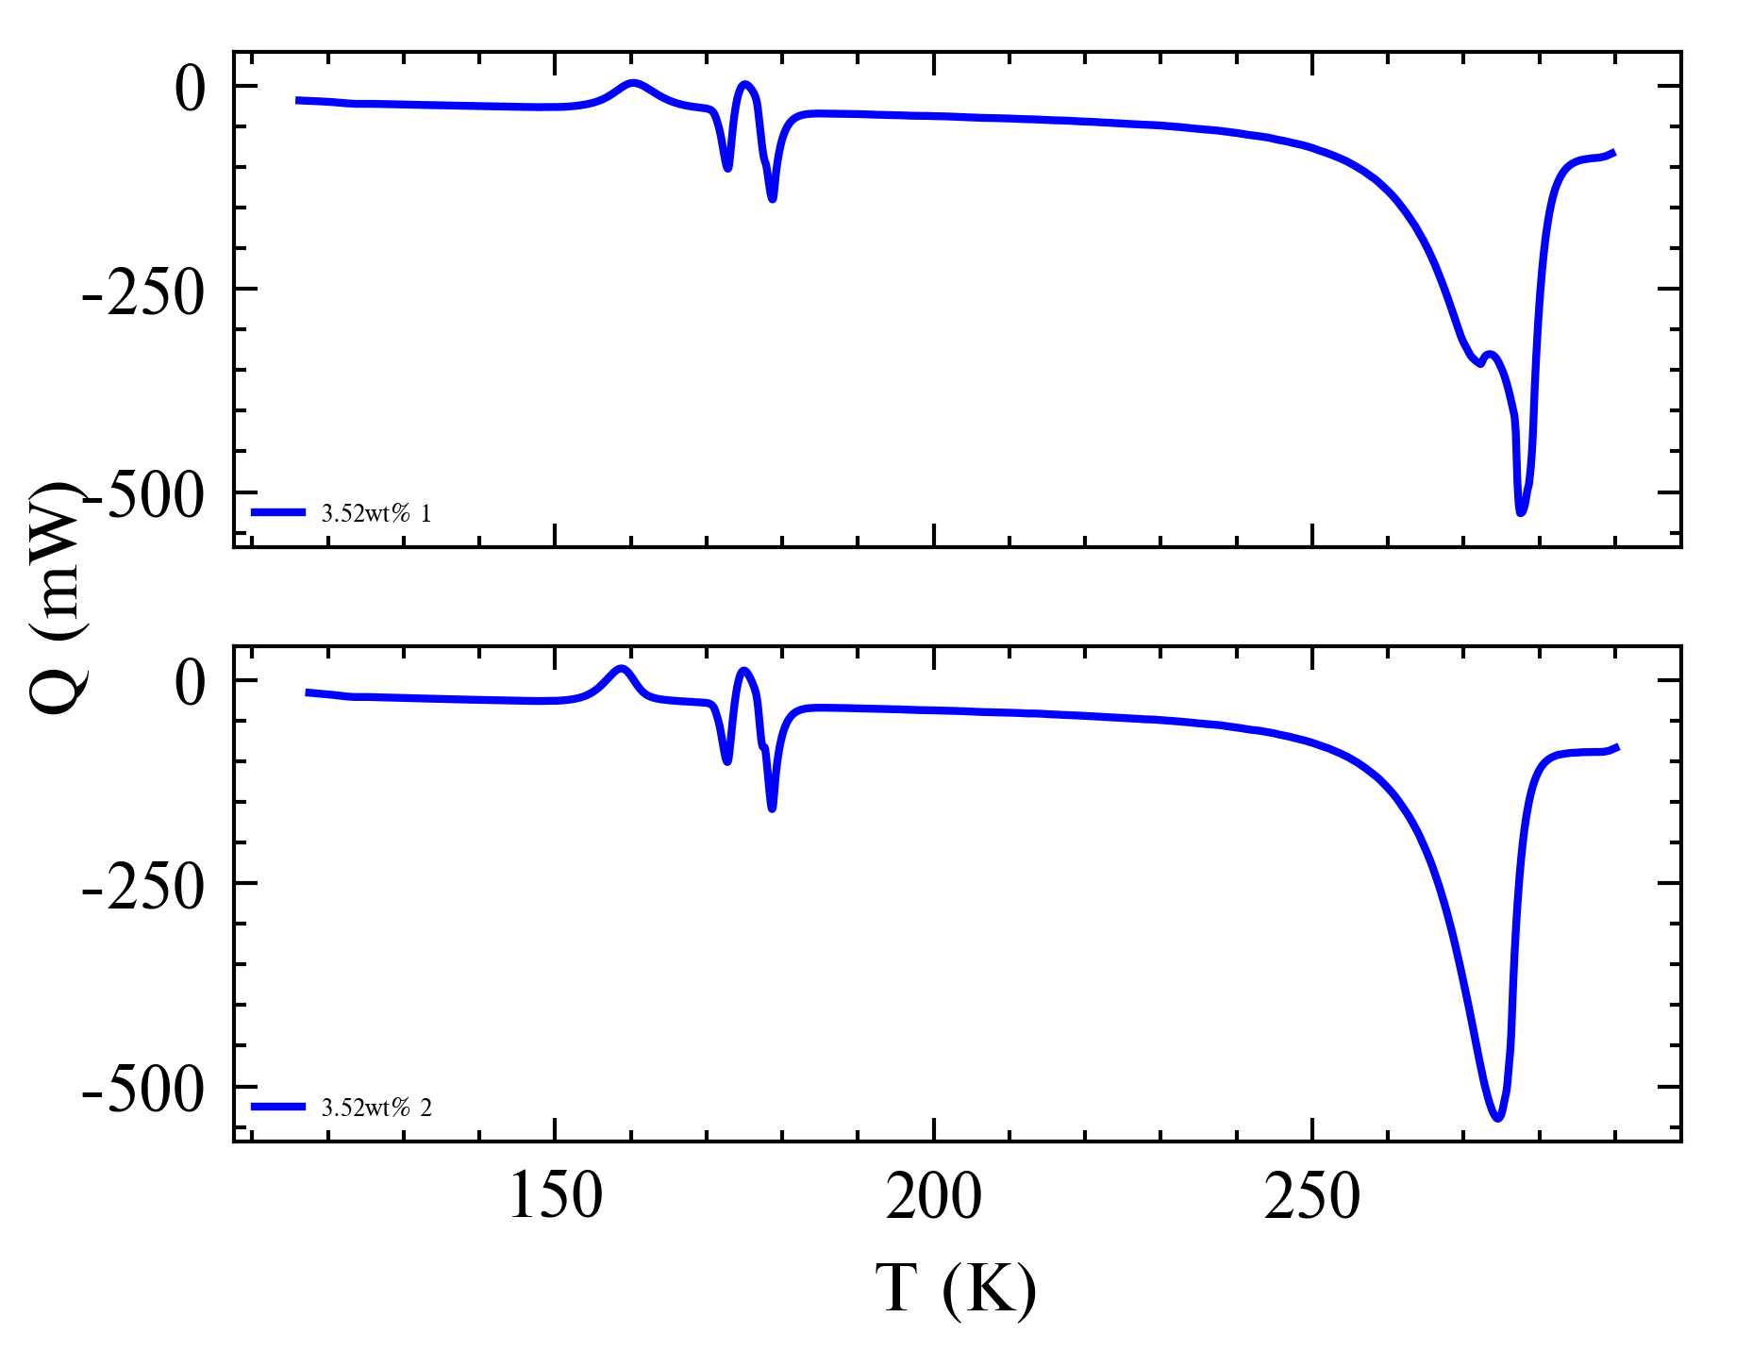
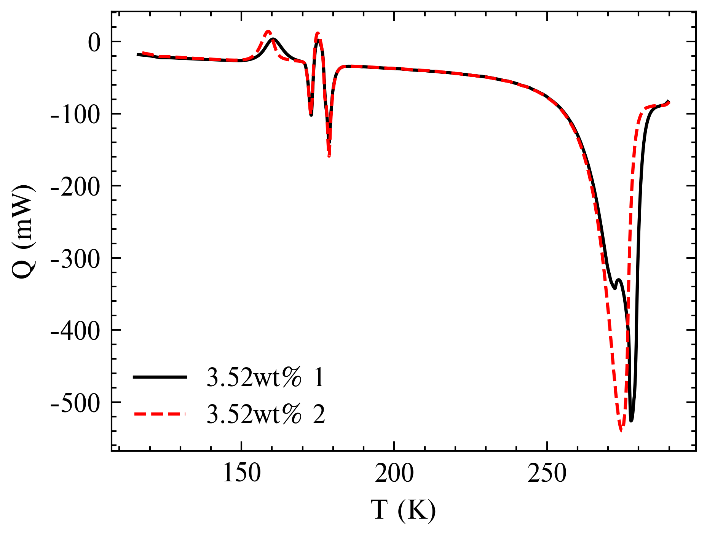
Double Peaks
Rerun of 3.52wt% produced no double peak
Potential reasons:
Sample was not well mixed, causing inhomogeneous crystallization
Contamination (unlikely)

Slide 5
Double Peaks Conclusions
Small wiggles can be disregarded (?)
Double peak likely an experimental anomaly
Suggestion: re-run 8wt% and confirm (non-)existence of DP for that sample

Slide 6
Peak Temps
Peak Temps for AMH/ADH phase change somewhat within uncertainties (<1K)
Peak Temps for water ice phase change very variable
How do we use this information to determine how much to offset?
 | Onset Temps
Samples | AMH Melt | Offset | ADH Melt | Offset
1.76 wt.% | 171.18 | 0.18 | 177.19 | 1.06
3.52 wt.% | 171.07 | 0.07 | 176.53 | 0.40
3.52 wt.%_2 | 172.74 | 1.74 | 178.67 | 2.54
6 wt.% | 170.62 | -0.38 | 176.49 | 0.36
8 wt.% | 170.71 | -0.29 | 176.52 | 0.39
10 wt.% | 170.15 | -0.85 | 176.71 | 0.58
Theoretical | 171 |  | 176.13
 | AMH |  | ADH
Samples | H2O liquidus | Peak 1 | Offset | Peak 2 | Offset 2
1.76 wt.% | 271.76 | 278.29 | 6.53
3.52 wt.% | 269.64 | 272.19 | 2.55 | 277.48 | 7.84
3.52 wt.%_2 | 269.64 | 274.56 | 4.92
6 wt.% | 266.02 | 269.50 | 3.48
8 wt.% | 262.64 | 260.09 | -2.55 | 267.31 | 4.67
10 wt.% | 259.07 | 259.66 | 0.59
0 wt.% | 273.15 | 282.20 | 9.05

Slide 7
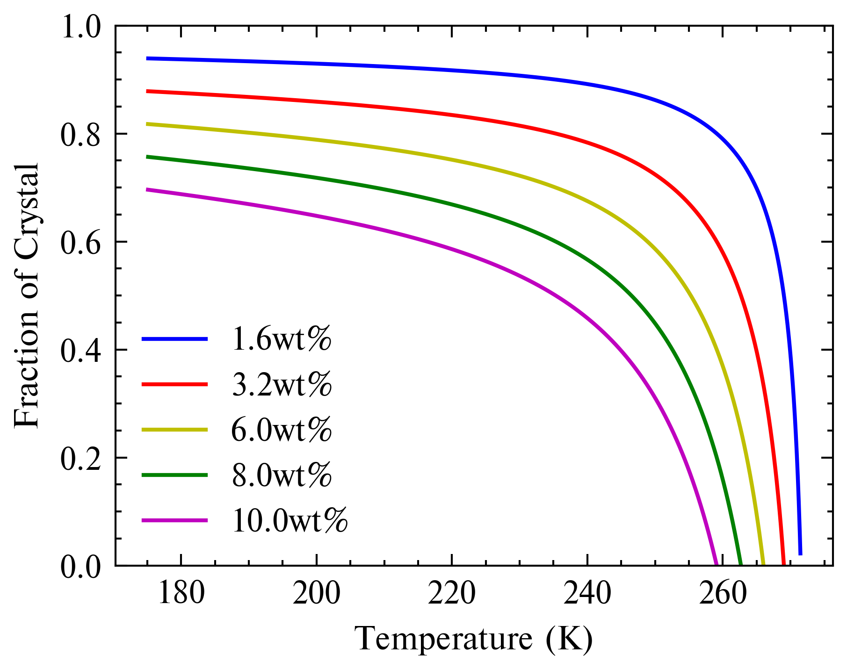
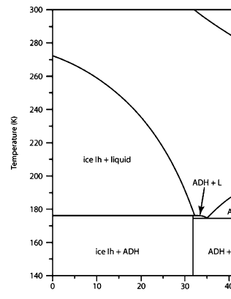
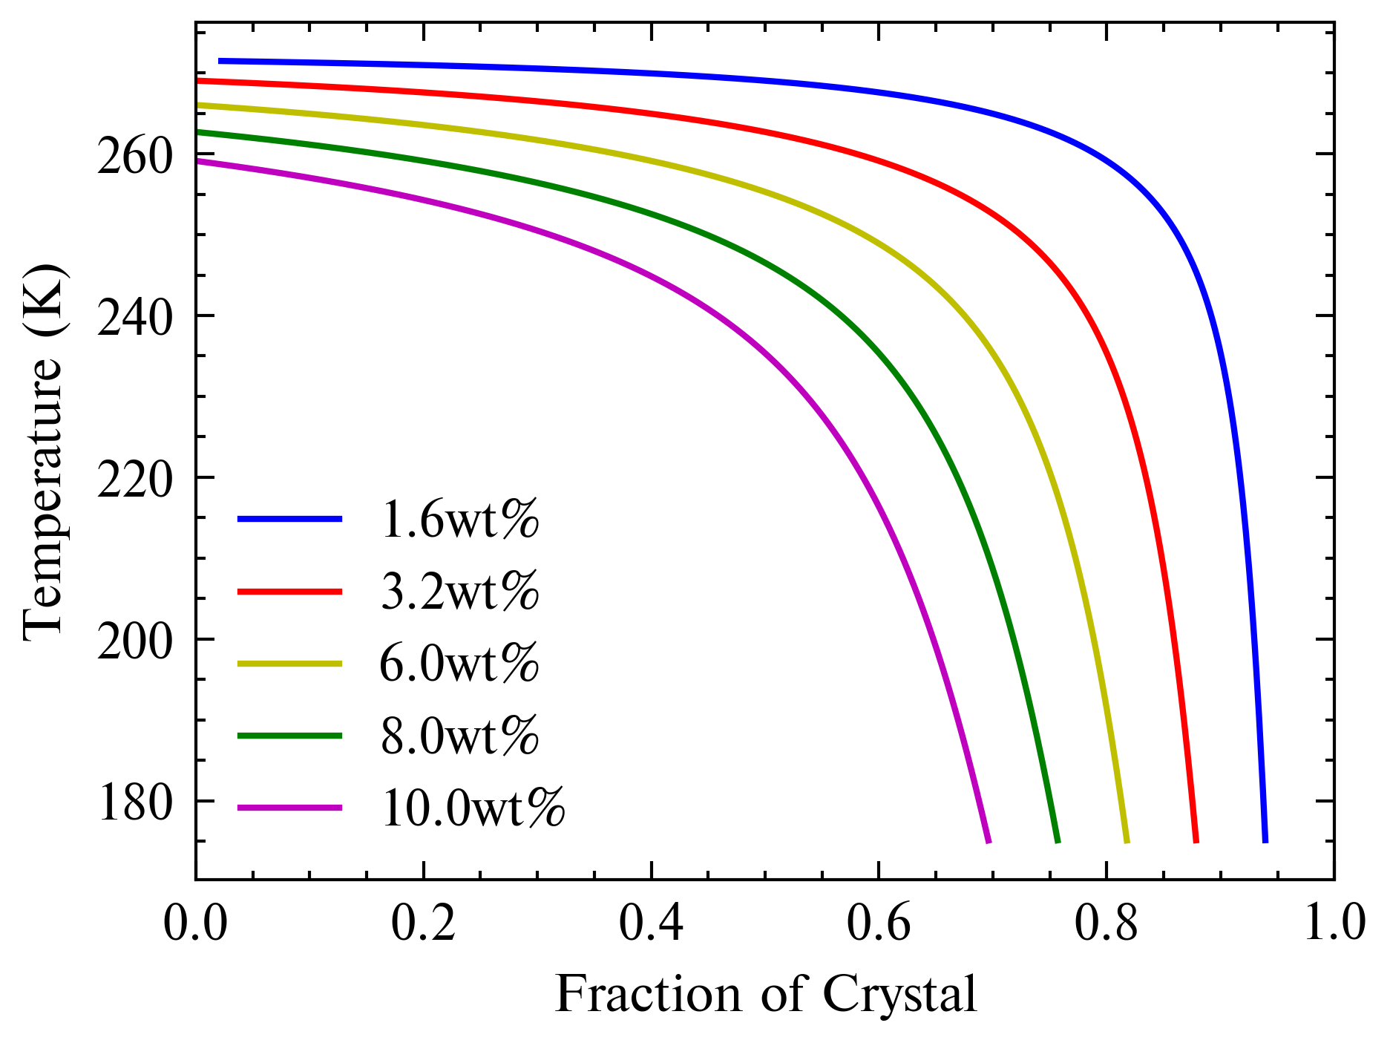


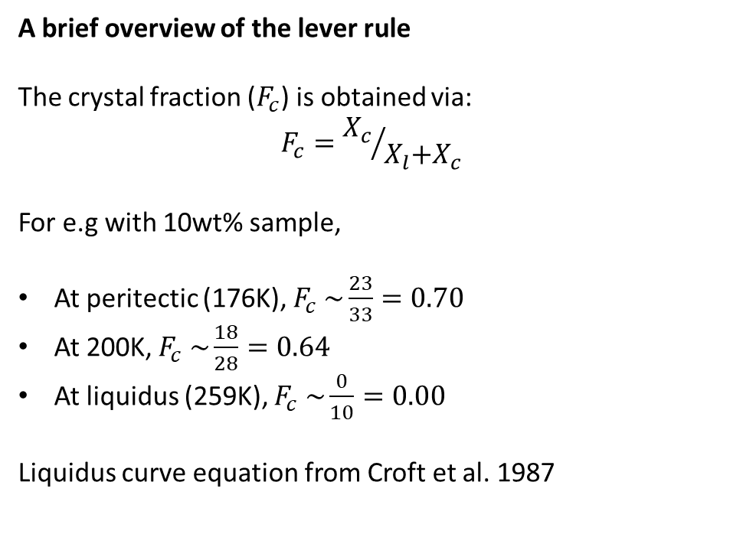



Fraction of Crystals
The Fc curves obtained
A brief overview of the lever rule The crystal fraction ($F_{c}$) is obtained via: $$F_{c}={X_{c}}/{X_{l}\text{+}X_{c} }$$
For e.g with 10wt% sample,
At peritectic (176K), $F_{c} \sim \frac{23}{33}=0.70$
At 200K, $F_{c} \sim \frac{18}{28}=0.64$
At liquidus (259K), $F_{c} \sim \frac{0}{10}=0.00$
Liquidus curve equation from Croft et al. 1987
$$X_{l}$$
$$X_{l}$$
$$X_{c}$$
$$X_{l}$$
$$X_{c}$$

Slide 8
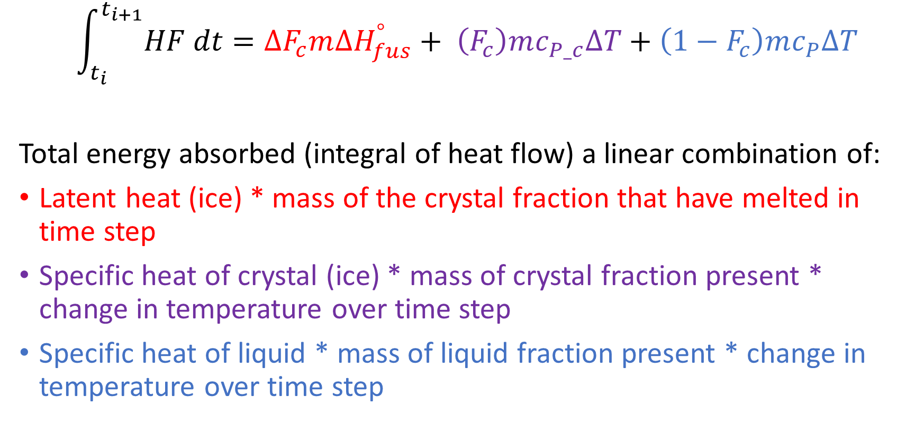
Linear Combination
$$\int_{t_{i}}^{t_{i+1}}{HF dt}=∆F_{c}m{∆H}_{fus}^{°}+ \left(F_{c}\right)mc_{P_c}∆T+\left(1−F_{c}\right)mc_{P}∆T$$
Total energy absorbed (integral of heat flow) a linear combination of:
Latent heat (ice) * mass of the crystal fraction that have melted in time step
Specific heat of crystal (ice) * mass of crystal fraction present * change in temperature over time step
Specific heat of liquid * mass of liquid fraction present * change in temperature over time step

Slide 9
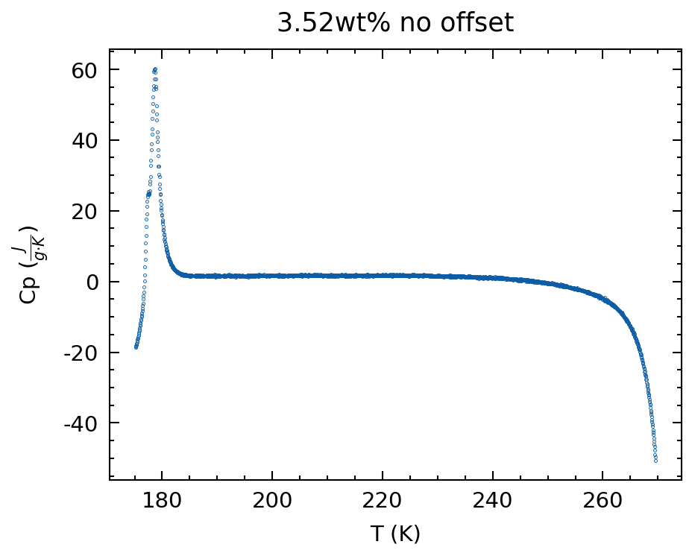
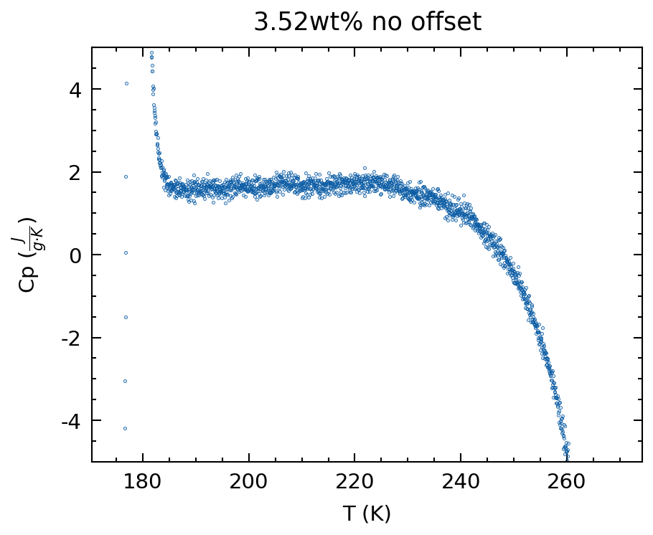

Linear Combination
Calculated within T-range with valid Fc (theoretical partial melting range)
${∆H}_{fus}=334 Jg^{−1}$ (note its at 273.15K/1atm)
$c_{P_c}$ based on data by Feistel & Wagner 2006 (10K interval)

Slide 10
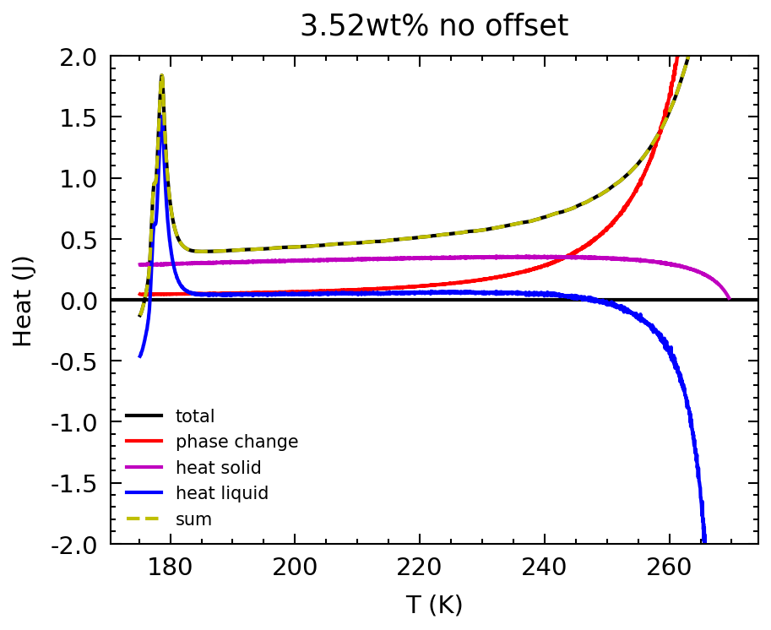
Linear Combination
Fc range intersects ADH melting (176K)
Liquidus point (~269.64K) before peak heatflow (~274.56K)

Slide 11
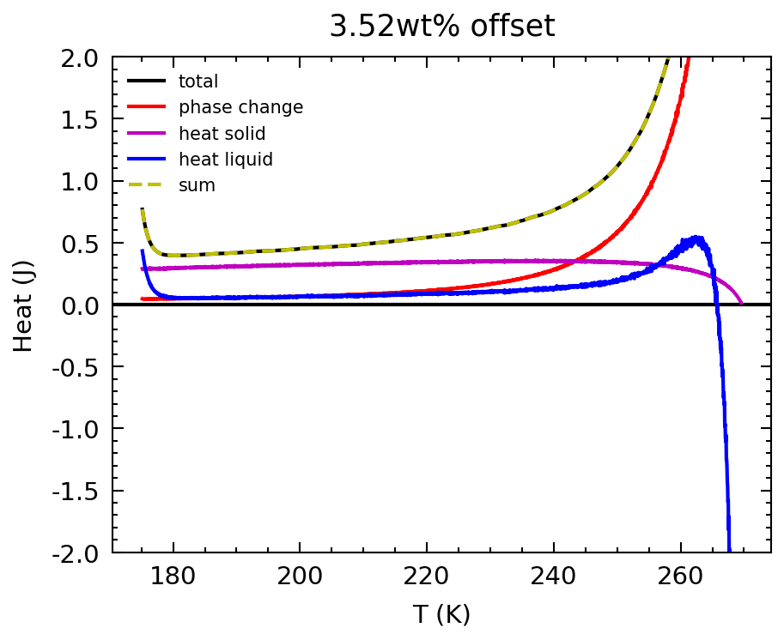
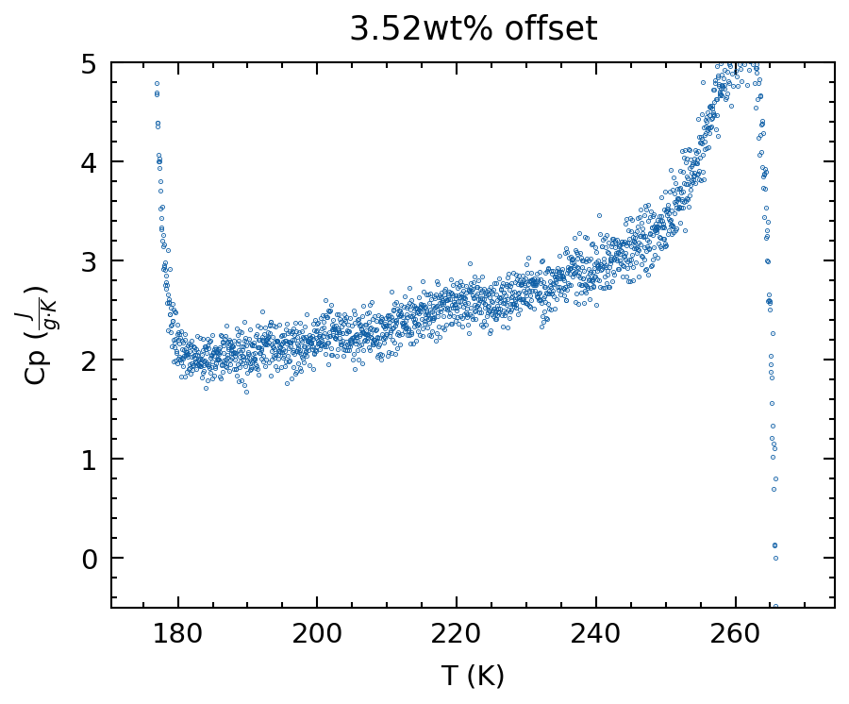
Linear Combination
Arbitrary offset: aligning peak heatflow to liquidus point

Slide 12
Linear Combination
Arbitrary offset: aligning peak heatflow to liquidus point
For other samples, graphs found in Github repo ~/o_specificHeat/

Slide 13
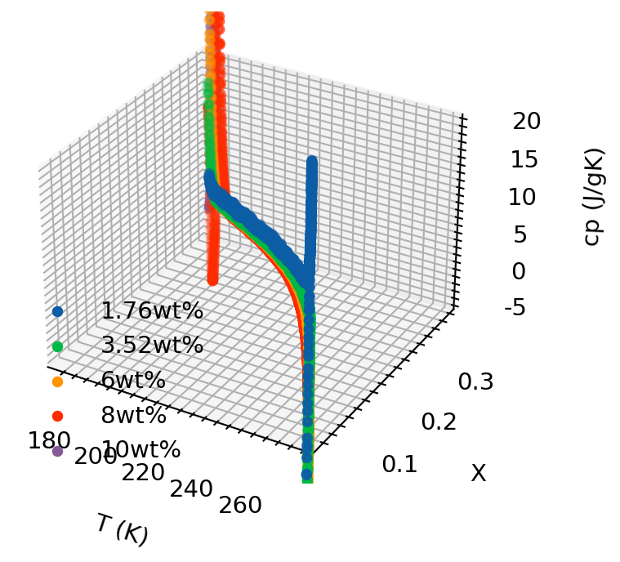
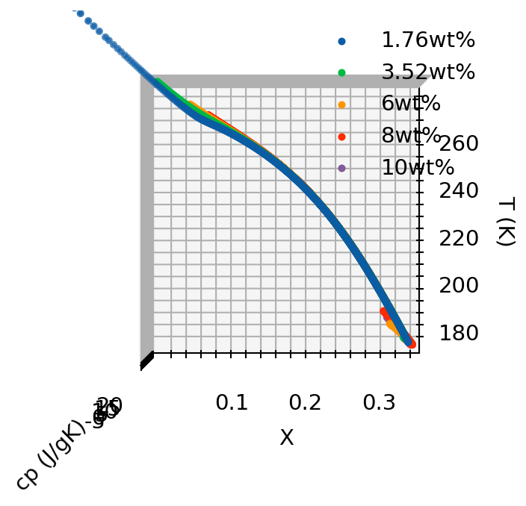
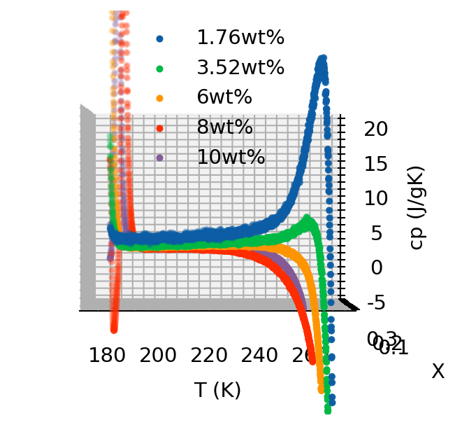
Linear Combination
wt% (X) is proportional to T
Regardless of wt% used in runs, the wt% of liquid phase at a particular T in the partial melting regime is fixed (it runs along the liquidus)

Slide 14
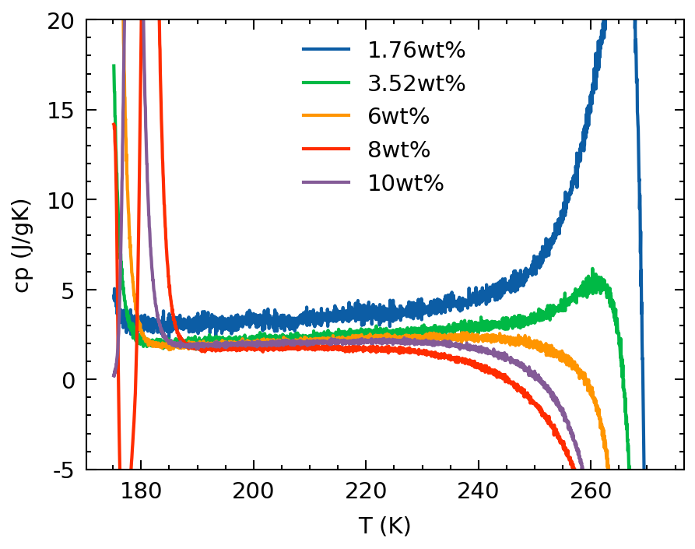
Linear Combination
wt% (X) is proportional to T
Regardless of wt% used in runs, the wt% of liquid phase at a set T in the partial melting regime is fixed.

Slide 15
Next Steps
Determining correct method for temperature offset
Determining if cp equations makes sense
Clarifying objective of current experiment
Determining cp of H2O-NH3 at 176-273K, 1atm.
From cp → Gibb’s Free Energy → Minimization of GFE → EOS
Long Term Plan of the primary project I’ll be working on
Provide as much data possible for PlanetProfile (Ocean thermodynamic data for NH3, possibly other organics/salts)
Specific Heat → EOS → other thermodynamic properties required for PP
Plan to have a meeting with Steve & Mathieu when Steve’s back

Slide 16
Next Steps
0wt%, 2.5ml, 0.1K/min
Blank, 0.1K/min
8wt%, 2.5(?)ml, 0.1K/min
Other wt%

