Slide 1
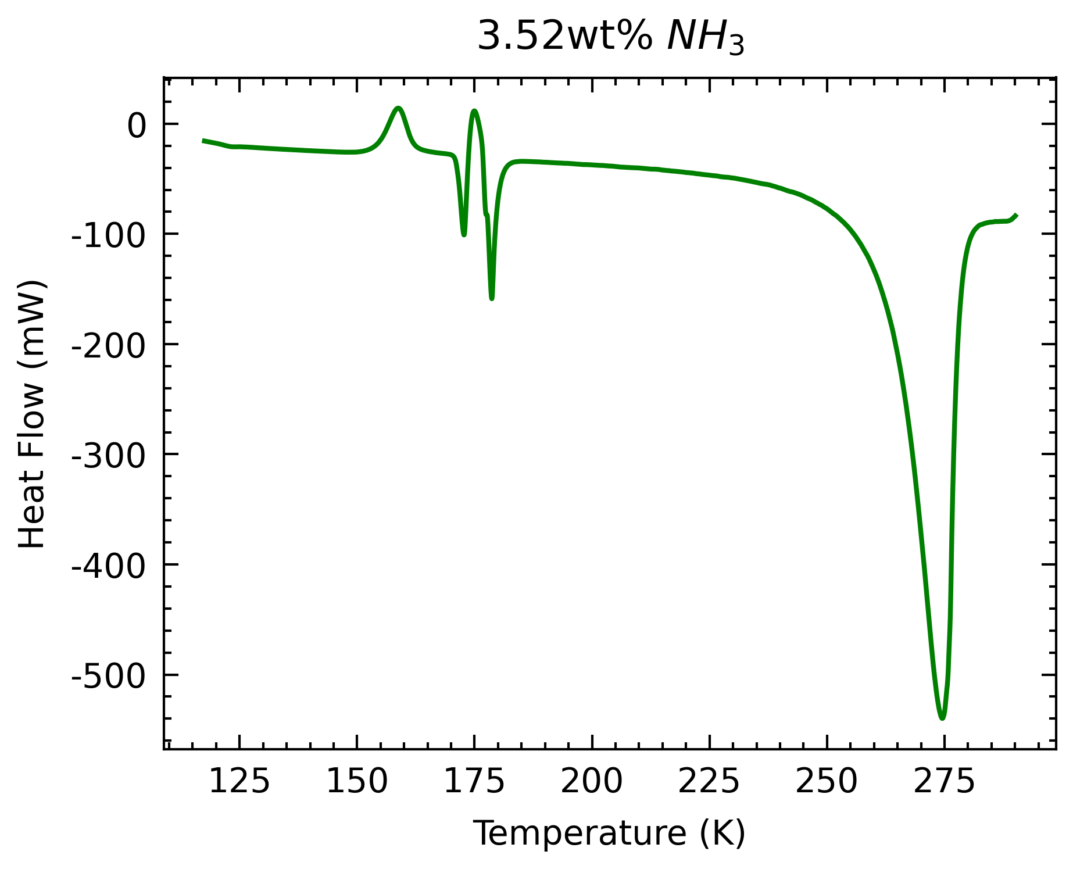
Summary
3
1
Plot of measured heat flow over temperature
Endothermic and exothermic peaks indicate phase transitions
Chose to characterize specific heat in ice Ih partial melting regime (~185K to ~280K)
2
4
5
Glass transition,
2) NH₃H₂O melting,
3) NH₃2H₂O forming
4) NH₃2H₂O melting,
5) H₂O partial melting

Slide 2
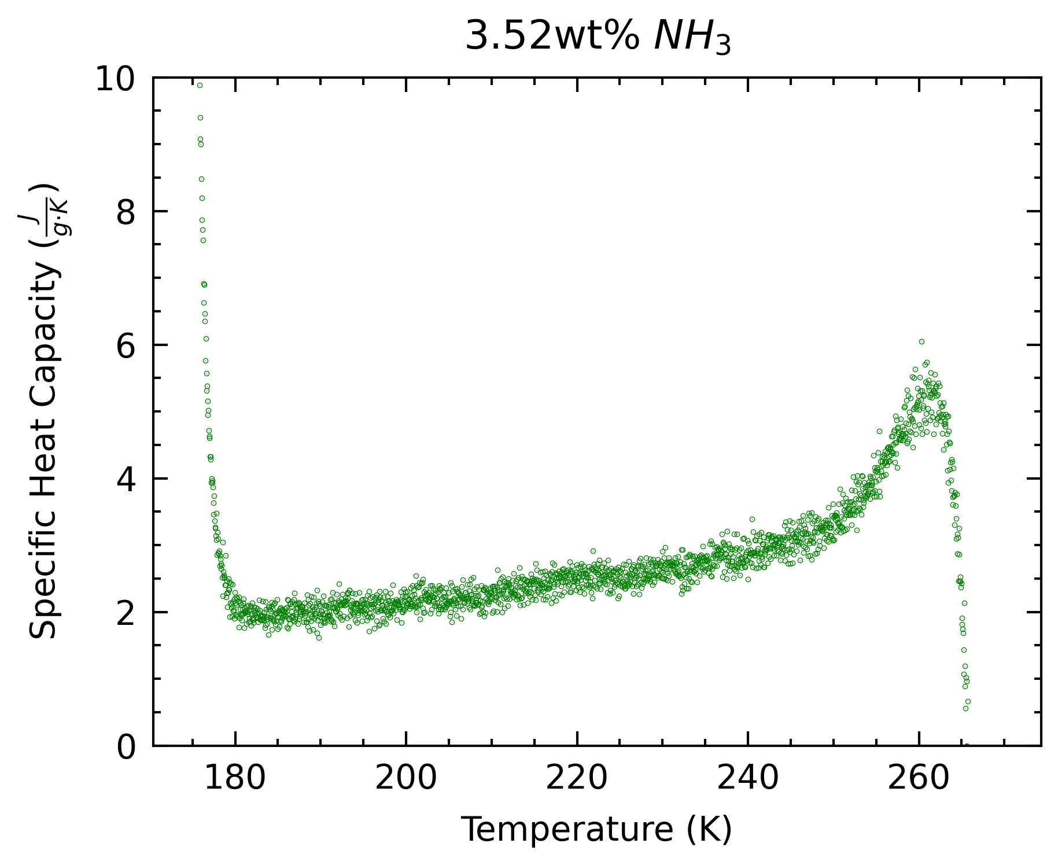
Summary
Plot of calculated specific heat capacity of liquid over temperature
General expected increasing trend, with extremes near phase transition peaks

Slide 3
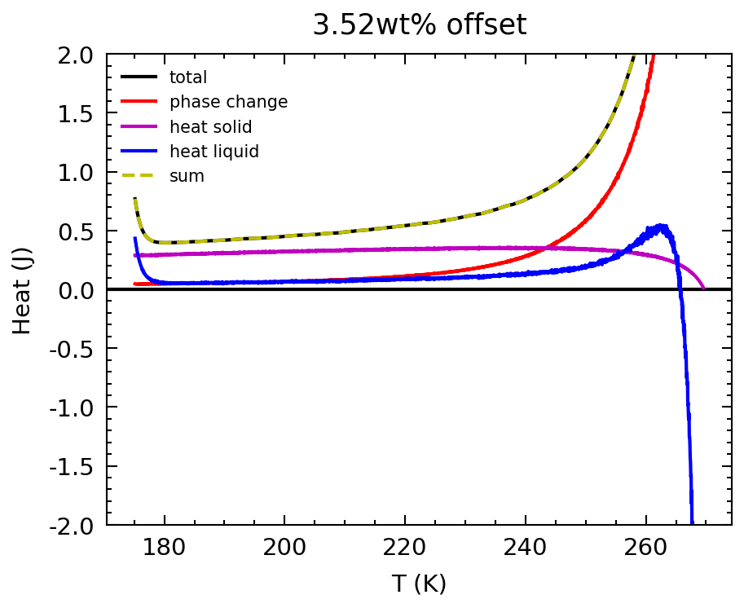
Linear Combination
Total energy absorbed (integral of heat flow) a linear combination of:
Energy to melt ice
Energy to heat ice
Energy to heat solution
We’re finding this specific heat

Slide 4
Current work
Calorimeter:
Re-running experiments at lower temperature ramp rate
Determine temperature shift corrections (due to lag time of melting)
Others:
Meeting with Richard Otis to (start to) understand PyCalphad
Learning Perple_X

