Slide 1
Summary
Uncertainties in measurement
Mass fraction calculation options
NH₃ EOS errors of rho and cp w.r.t T and m
Periodicity in melting phase
Mass fraction dependence in pure phase
Thermogram double peaks

Slide 2
Error Propagation
Mass of NH₄OH (mass balance) = 0.7889 ± 0.001 g
Some mass fluctuation at 0.0001 scale, thus I manually raised the uncertainty. (It increases density uncertainty by 0.001.
Volume of NH₄OH (pipette) = 1.000 ± 0.006 ml
Density of NH₄OH = 0.789 ± 0.006 g/ml
Mass Fraction of NH₃ = 1.42 – 8.7 ± 0.02 – 0.1 %
Molality of NH₃ = 0.85 – 5.6 ± 0.03 – 0.2
Temperature of Sample Error = 0.5 K (Muñoz-Iglesias et. al. 2018)

Slide 3
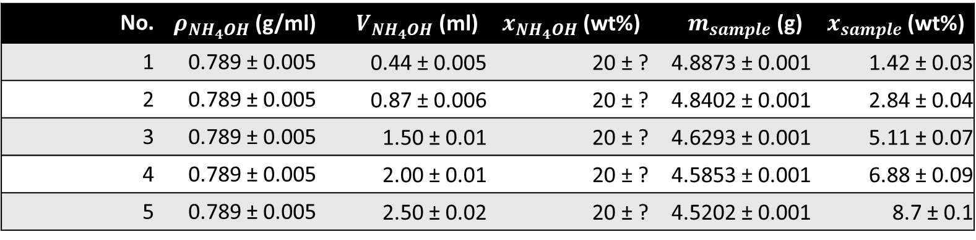

Mass fraction calculation option 1
From laboratory measurements
Based on density, volume and concentration of NH₄OH, with mass of sample
$x_{sample}=\frac{ρ_{{NH}_{4}OH} ∙ V_{{NH}_{4}OH} ∙{ x}_{{NH}_{4}OH}}{m_{sample}}$
No. | $ρ_{{NH}_{4}OH}$(g/ml) | $V_{{NH}_{4}OH}$ (ml) | ${ x}_{{NH}_{4}OH}$ (wt%) | $m_{sample}$ (g) | $x_{sample}$ (wt%)
1 | 0.789 ± 0.005 | 0.44 ± 0.005 | 20 ± ? | 4.8873 ± 0.001 | 1.42 ± 0.03
2 | 0.789 ± 0.005 | 0.87 ± 0.006 | 20 ± ? | 4.8402 ± 0.001 | 2.84 ± 0.04
3 | 0.789 ± 0.005 | 1.50 ± 0.01 | 20 ± ? | 4.6293 ± 0.001 | 5.11 ± 0.07
4 | 0.789 ± 0.005 | 2.00 ± 0.01 | 20 ± ? | 4.5853 ± 0.001 | 6.88 ± 0.09
5 | 0.789 ± 0.005 | 2.50 ± 0.02 | 20 ± ? | 4.5202 ± 0.001 | 8.7 ± 0.1

Slide 4
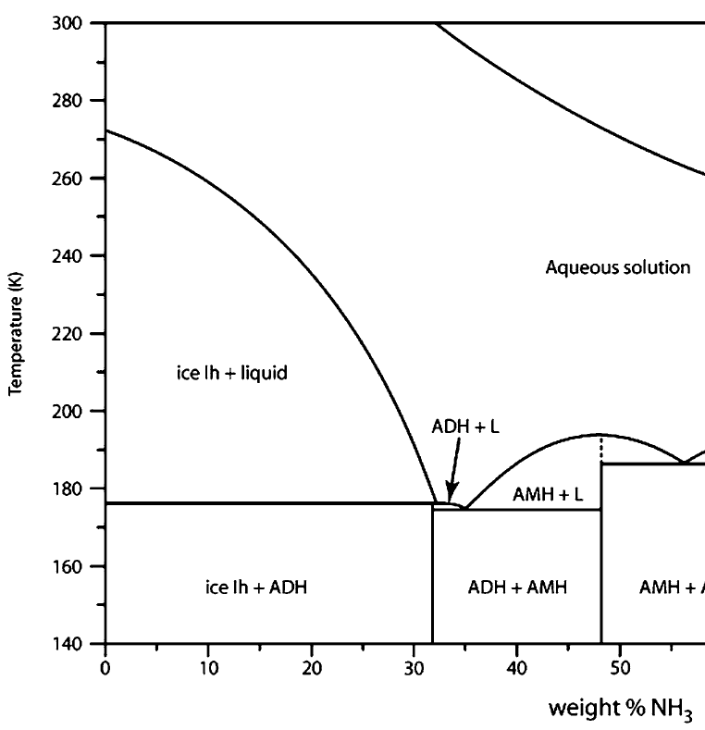
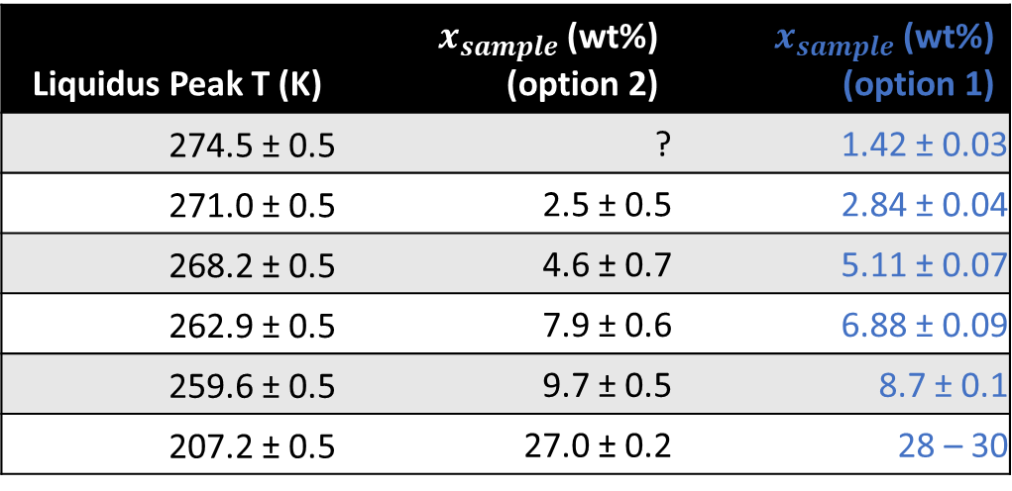
Mass fraction calculation option 2
From using the temperature of the measured liquidus peak to determine theoretical mass fraction via the liquidus curve
Liquidus Peak T (K) | $x_{sample}$ (wt%) (option 2) | $x_{sample}$ (wt%) (option 1)
274.5 ± 0.5 | ? | 1.42 ± 0.03
271.0 ± 0.5 | 2.5 ± 0.5 | 2.84 ± 0.04
268.2 ± 0.5 | 4.6 ± 0.7 | 5.11 ± 0.07
262.9 ± 0.5 | 7.9 ± 0.6 | 6.88 ± 0.09
259.6 ± 0.5 | 9.7 ± 0.5 | 8.7 ± 0.1
207.2 ± 0.5 | 27.0 ± 0.2 | 28 – 30

Slide 5
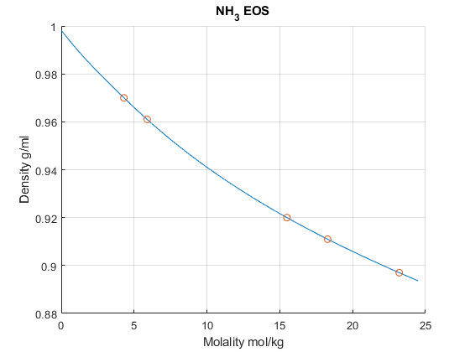
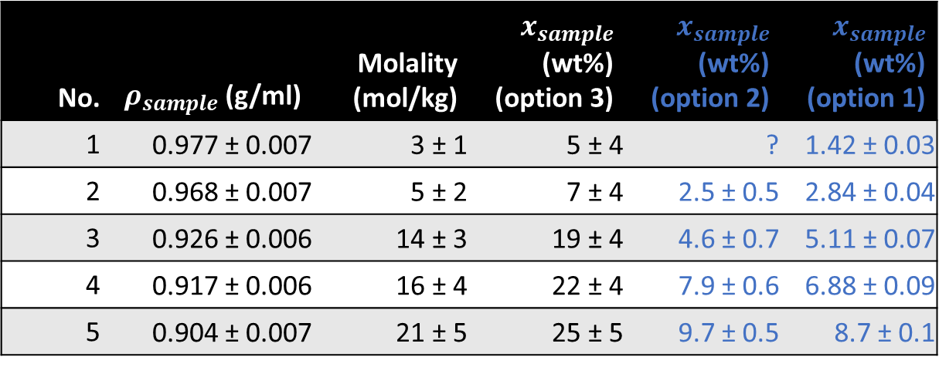
Mass fraction calculation option 3
From NH₃ EOS, extract mass fraction based on density of sample
Assumed measurements done at 25°C
No. | $ρ_{sample}$(g/ml) | Molality (mol/kg) | $x_{sample}$ (wt%) (option 3) | $x_{sample}$ (wt%) (option 2) | $x_{sample}$ (wt%) (option 1)
1 | 0.977 ± 0.007 | 3 ± 1 | 5 ± 4 | ? | 1.42 ± 0.03
2 | 0.968 ± 0.007 | 5 ± 2 | 7 ± 4 | 2.5 ± 0.5 | 2.84 ± 0.04
3 | 0.926 ± 0.006 | 14 ± 3 | 19 ± 4 | 4.6 ± 0.7 | 5.11 ± 0.07
4 | 0.917 ± 0.006 | 16 ± 4 | 22 ± 4 | 7.9 ± 0.6 | 6.88 ± 0.09
5 | 0.904 ± 0.007 | 21 ± 5 | 25 ± 5 | 9.7 ± 0.5 | 8.7 ± 0.1

Slide 6
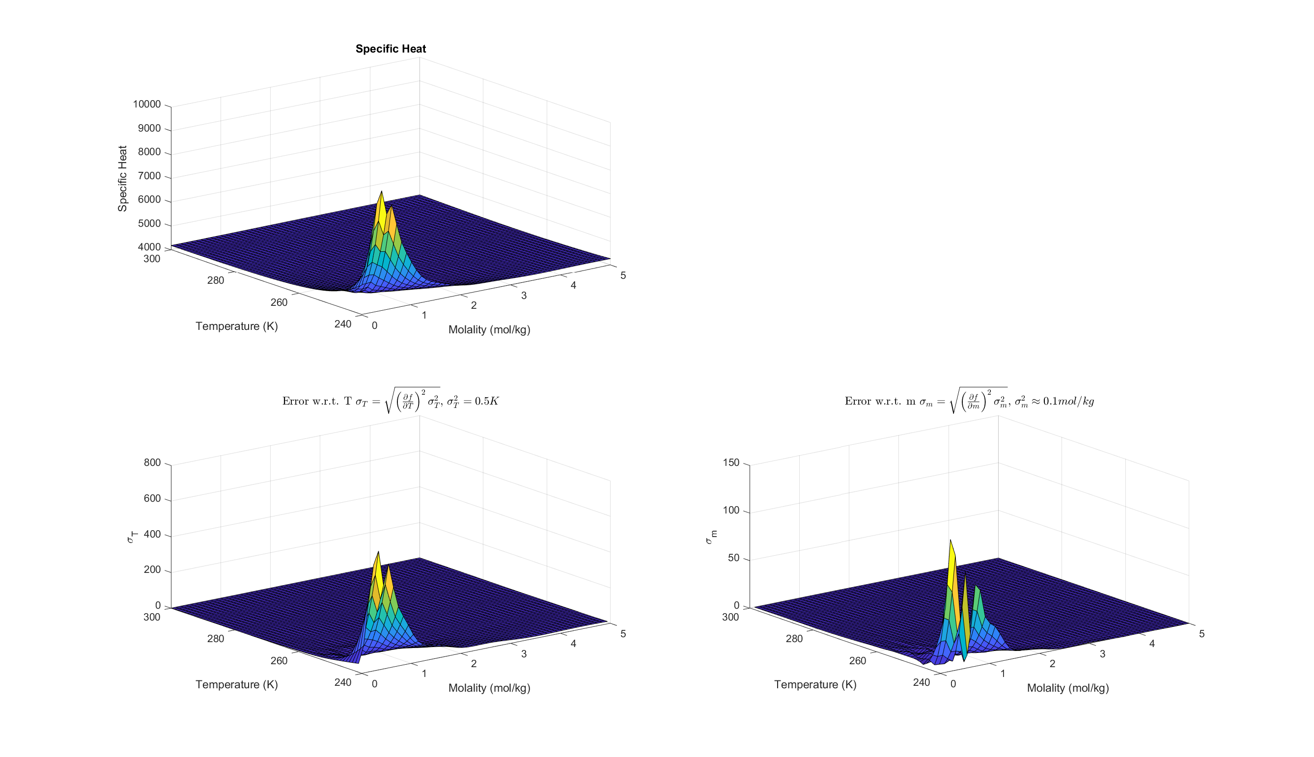
NH₃ EOS Errors (specific heat)
I assumed m in PTm inputs in Seafreeze corresponds to molality (mol/kg)
Rotatable .fig files attached in email

Slide 7
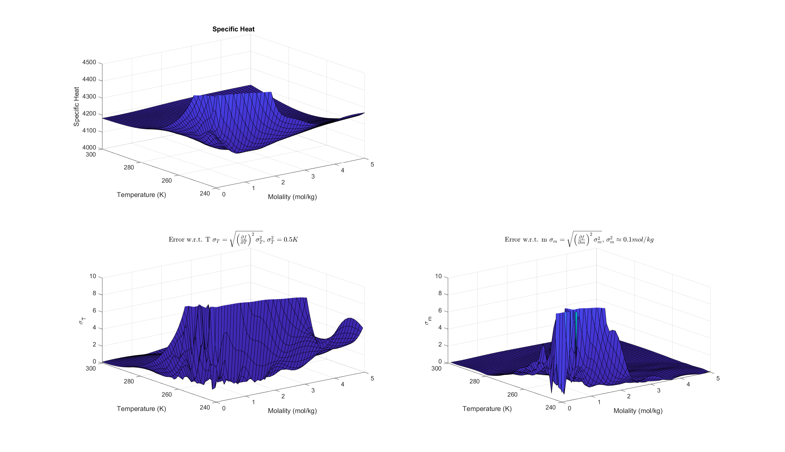
NH₃ EOS Errors (specific heat)
Zoomed in

Slide 8
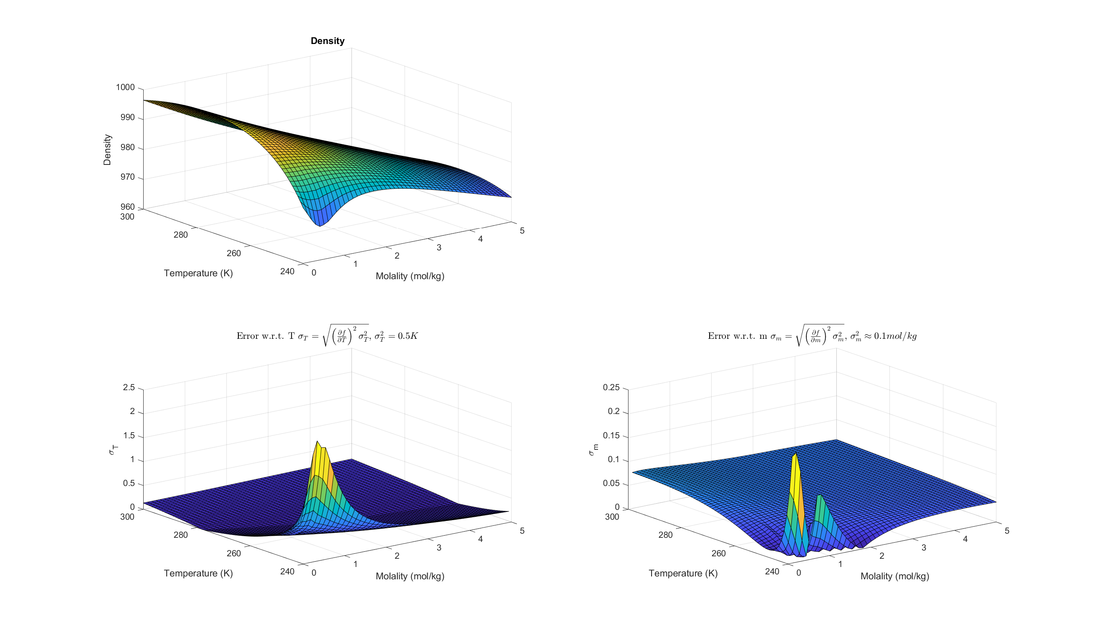
NH₃ EOS Errors (density)
I assumed m in PTm inputs in Seafreeze corresponds to molality (mol/kg)
Rotatable .fig files attached in email

Slide 9
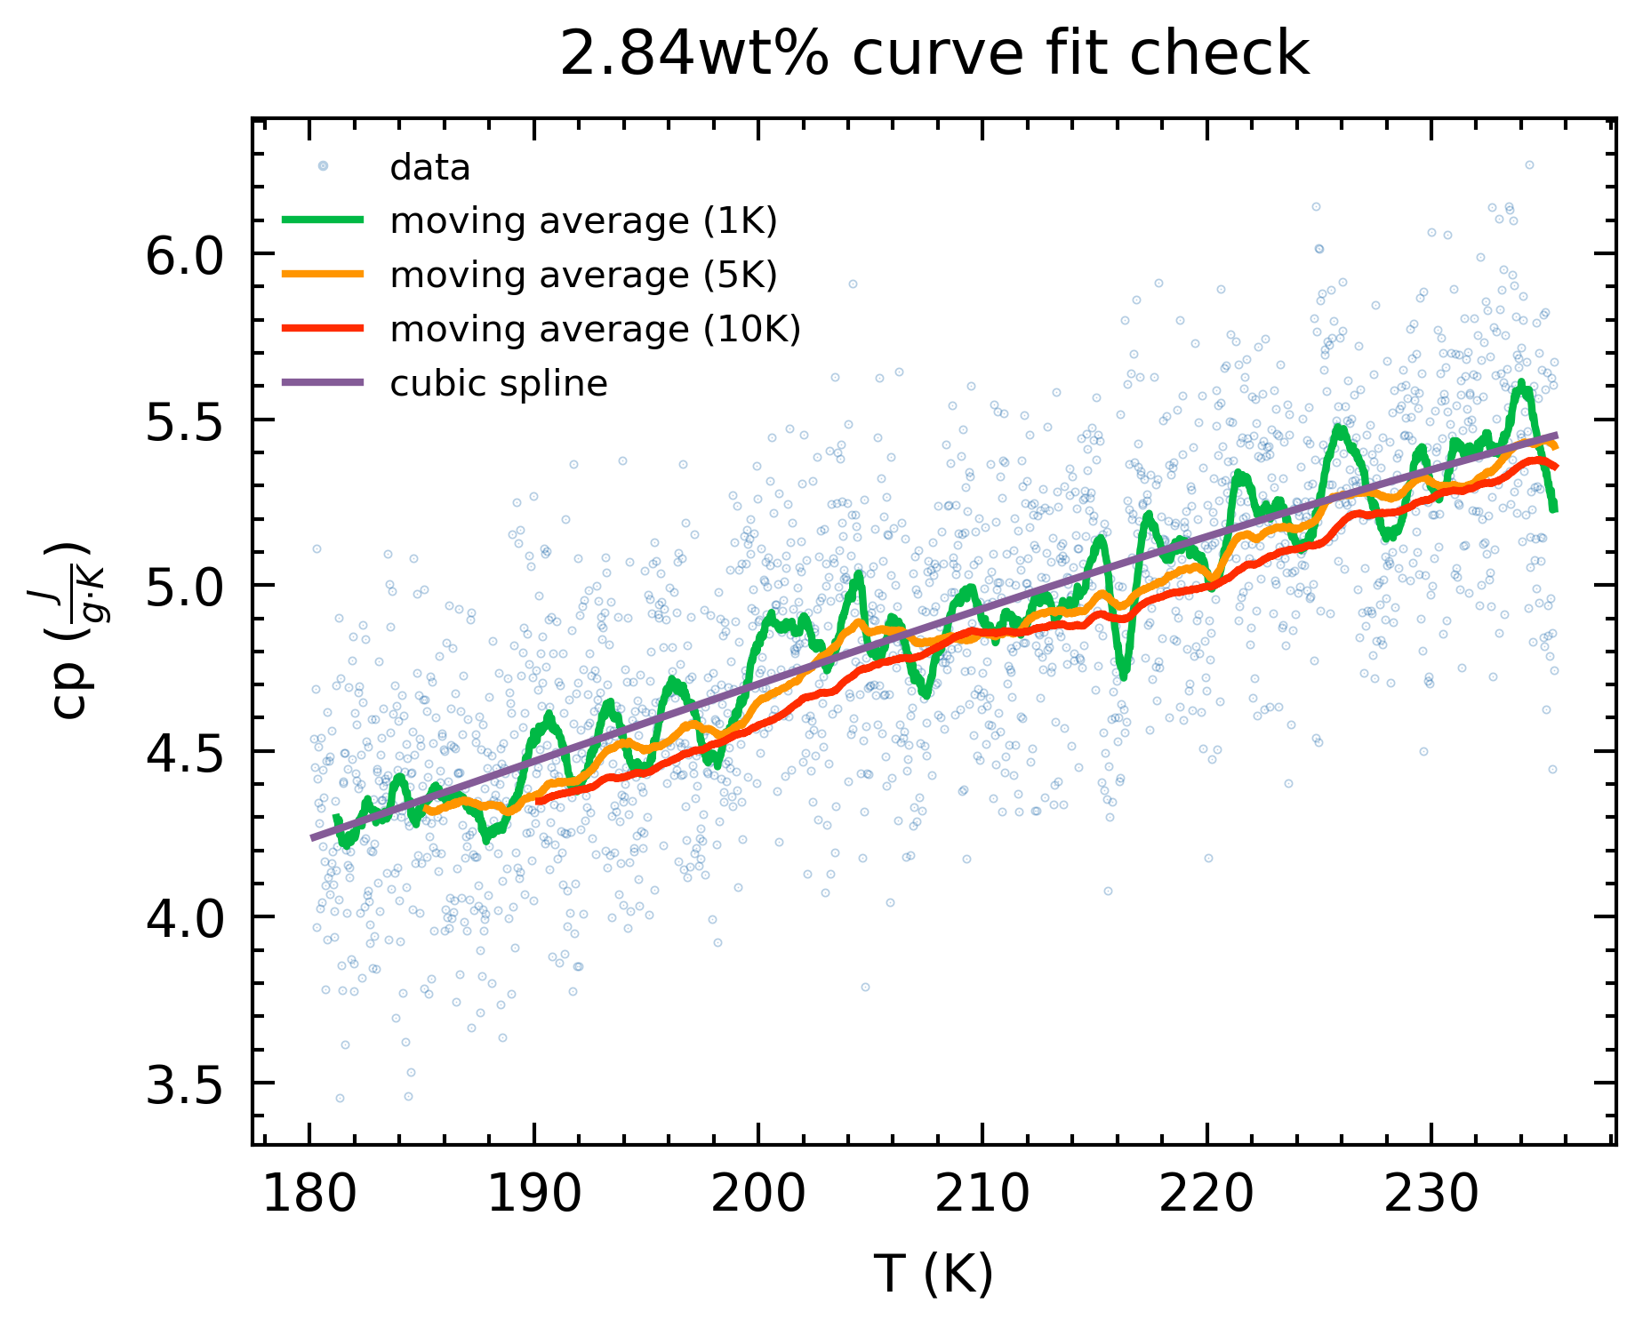
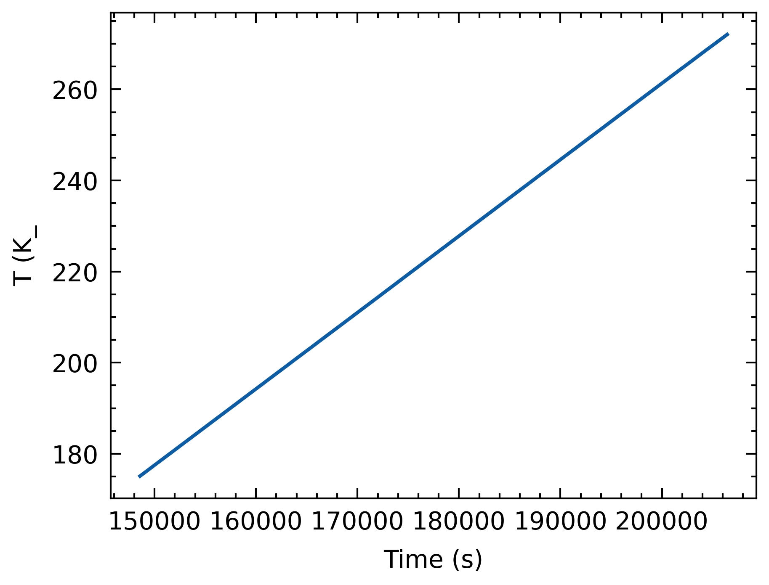
Moving averages & splines
Apparent periodicity in 1K bin moving average
Time and T are linearly proportional (interchangeable)

Slide 10
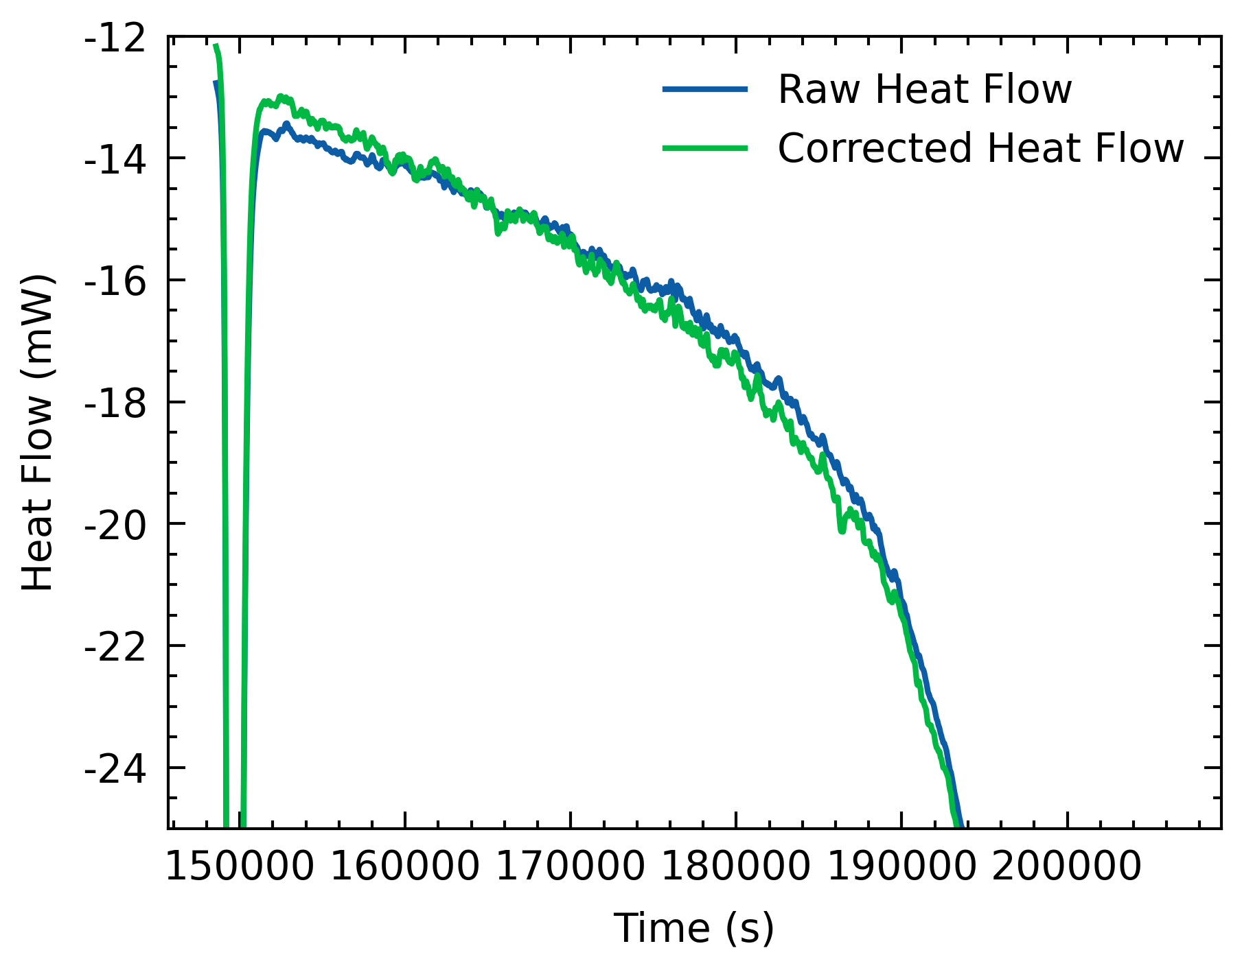
Moving averages & splines
Periodicity appears in heatflow (both in uncorrected and corrected)
Currently figuring out how to extract frequencies (FFT)

Slide 11
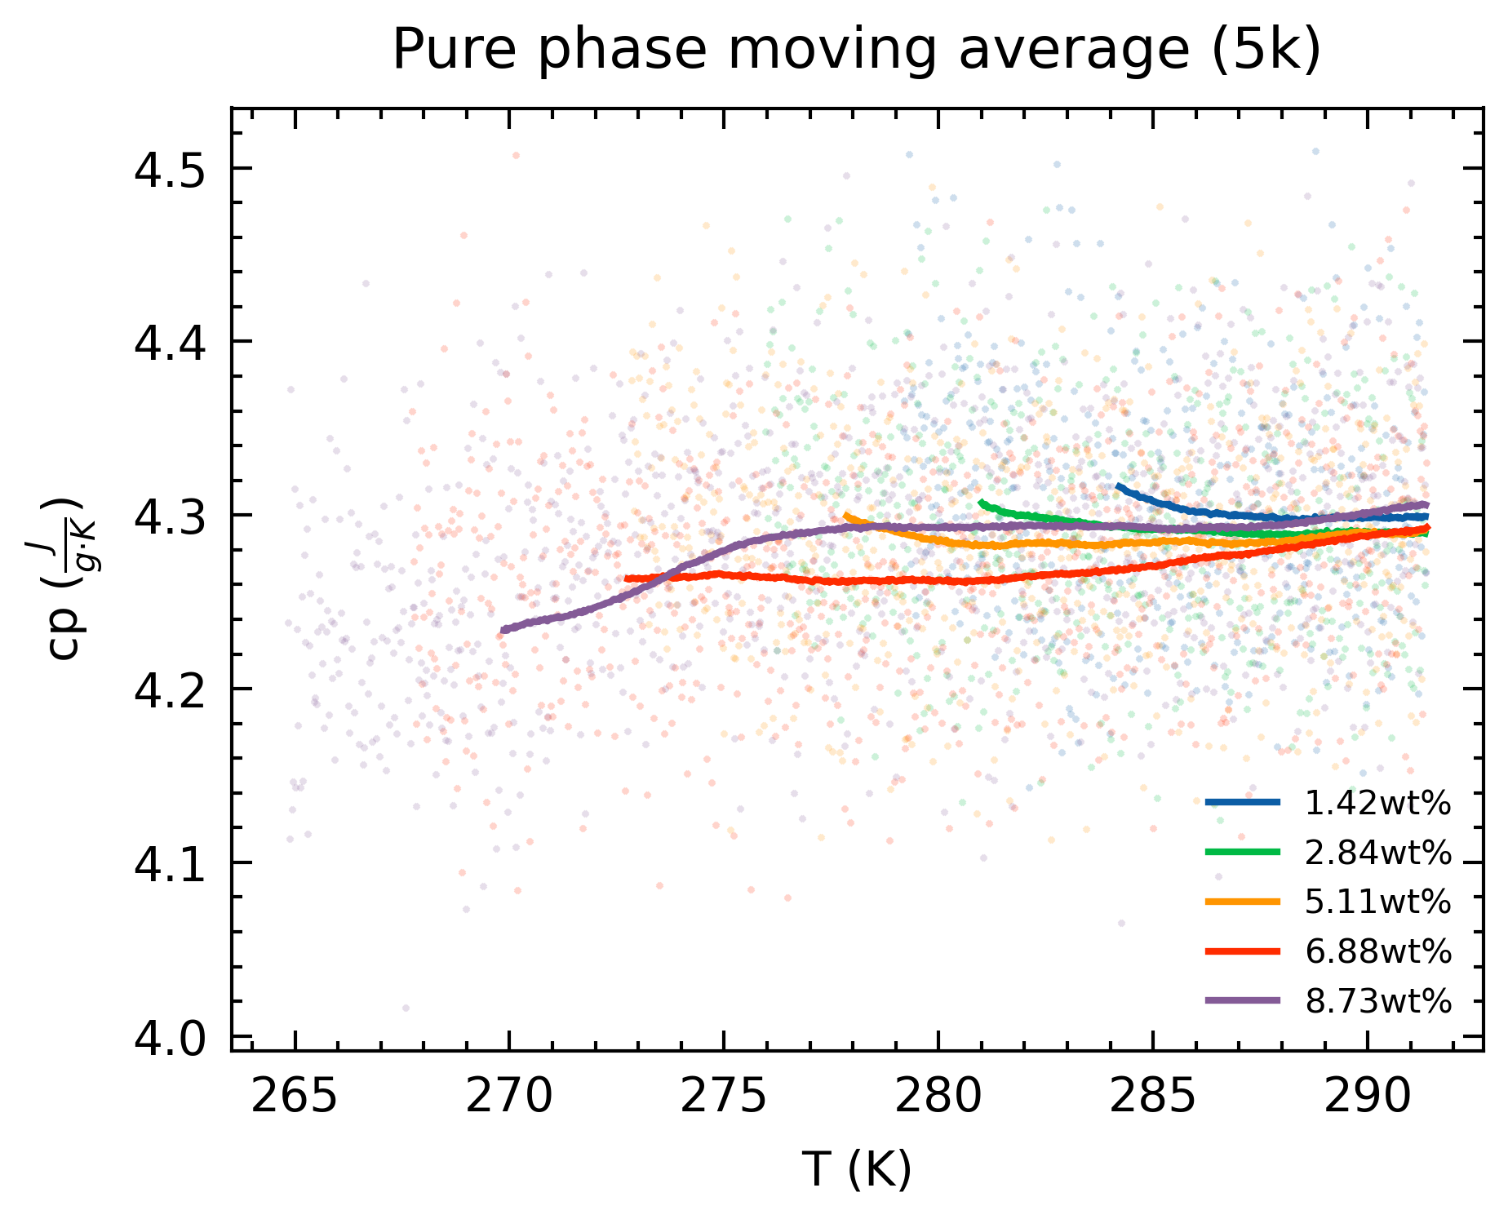
Pure phase
cp dependence on mass fraction
Initial slope downwards may be due to remnant from endothermic peak of ice melting
Fixable with more stringent cut-off of data?
8.73 wt% defies inverse relationship, but 27 wt% also has greater cp.

Slide 12
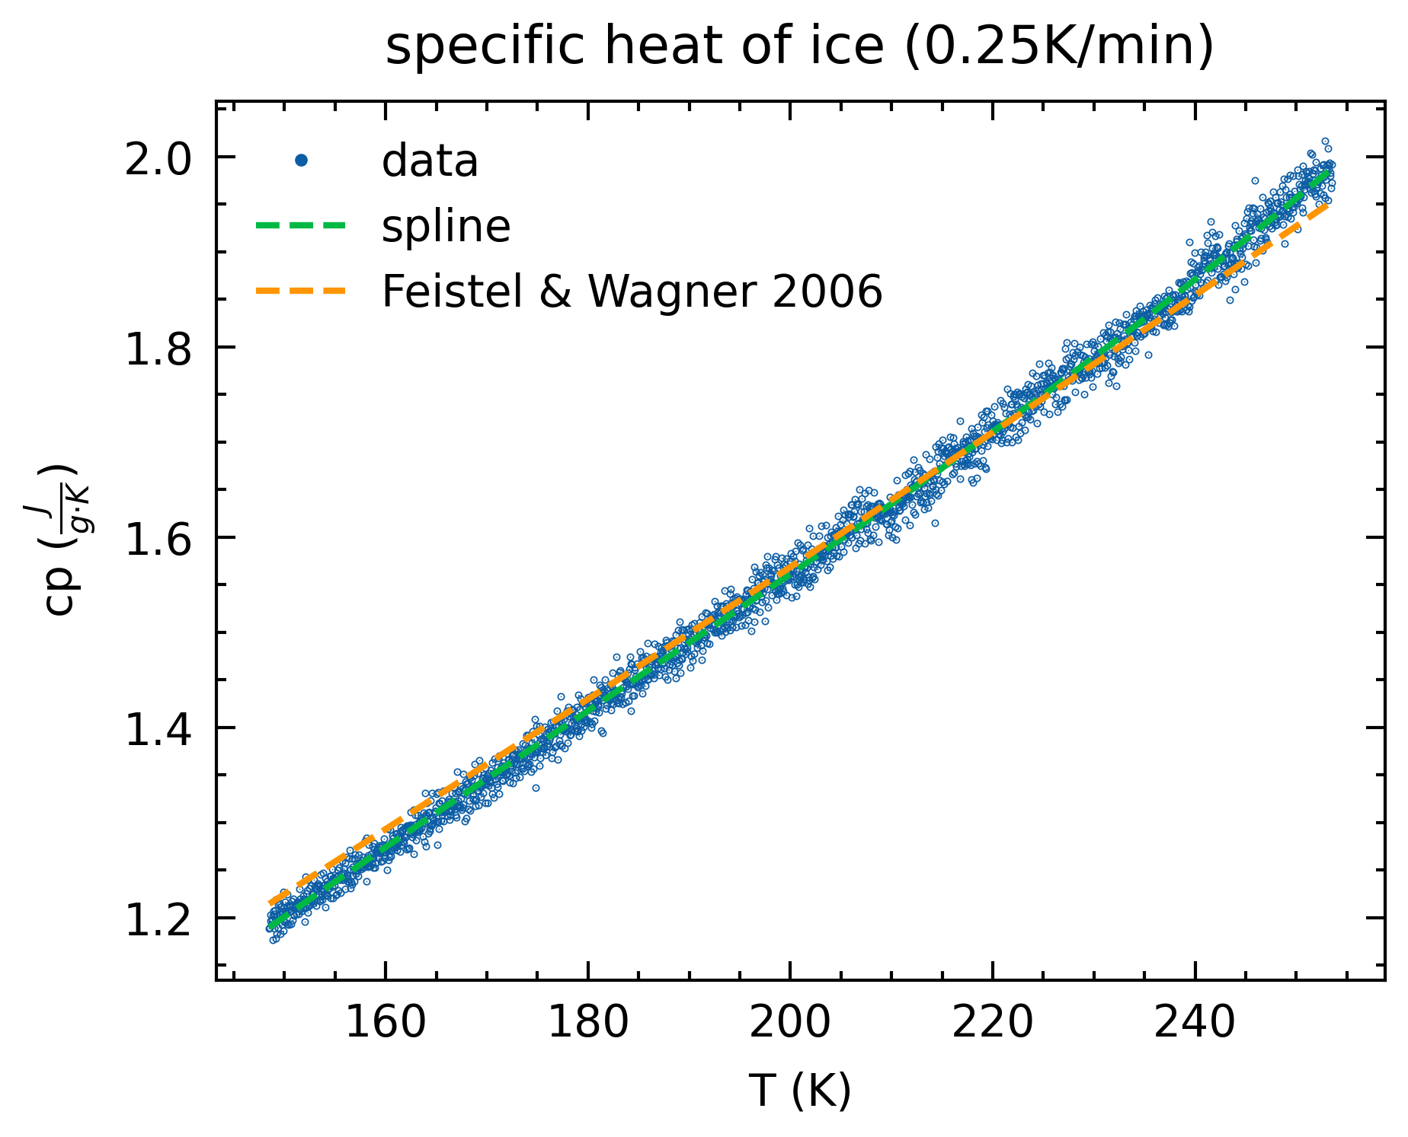
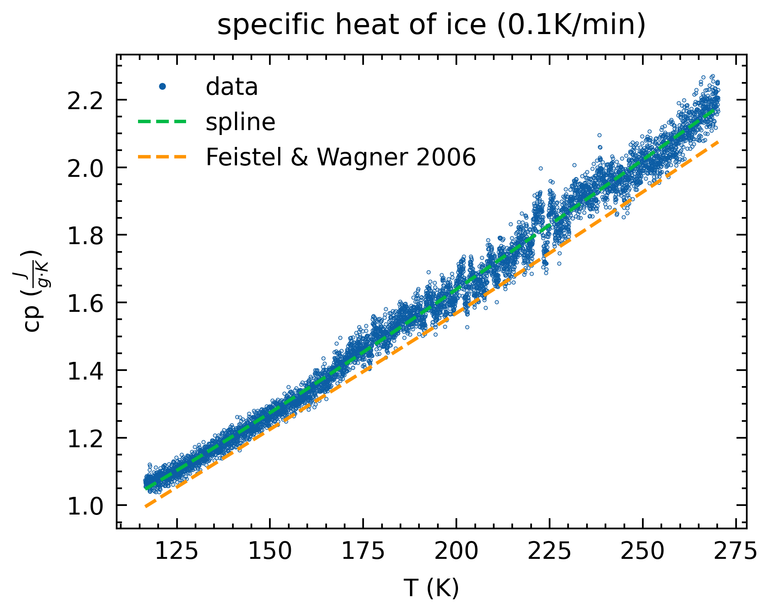
Ice specific heat
Data from pure H₂O, 2.5 ml, 0.1 K/min AND 0.25 K/min

Slide 13
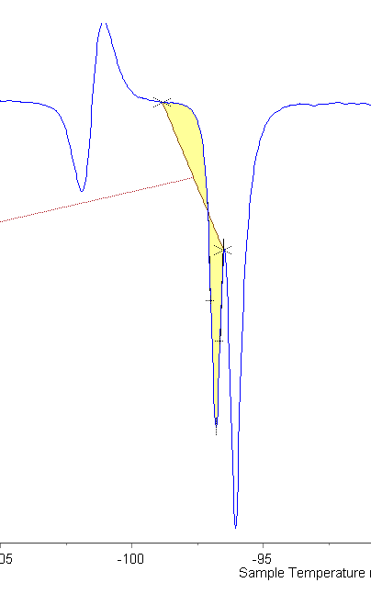
Double peak at ADH melt
Double peak still exists in 1mL, 0.1K/min, Small Heat Flow run

