Slide 1
Main Updates
Experiment Plans
Results
Discussion

Slide 2
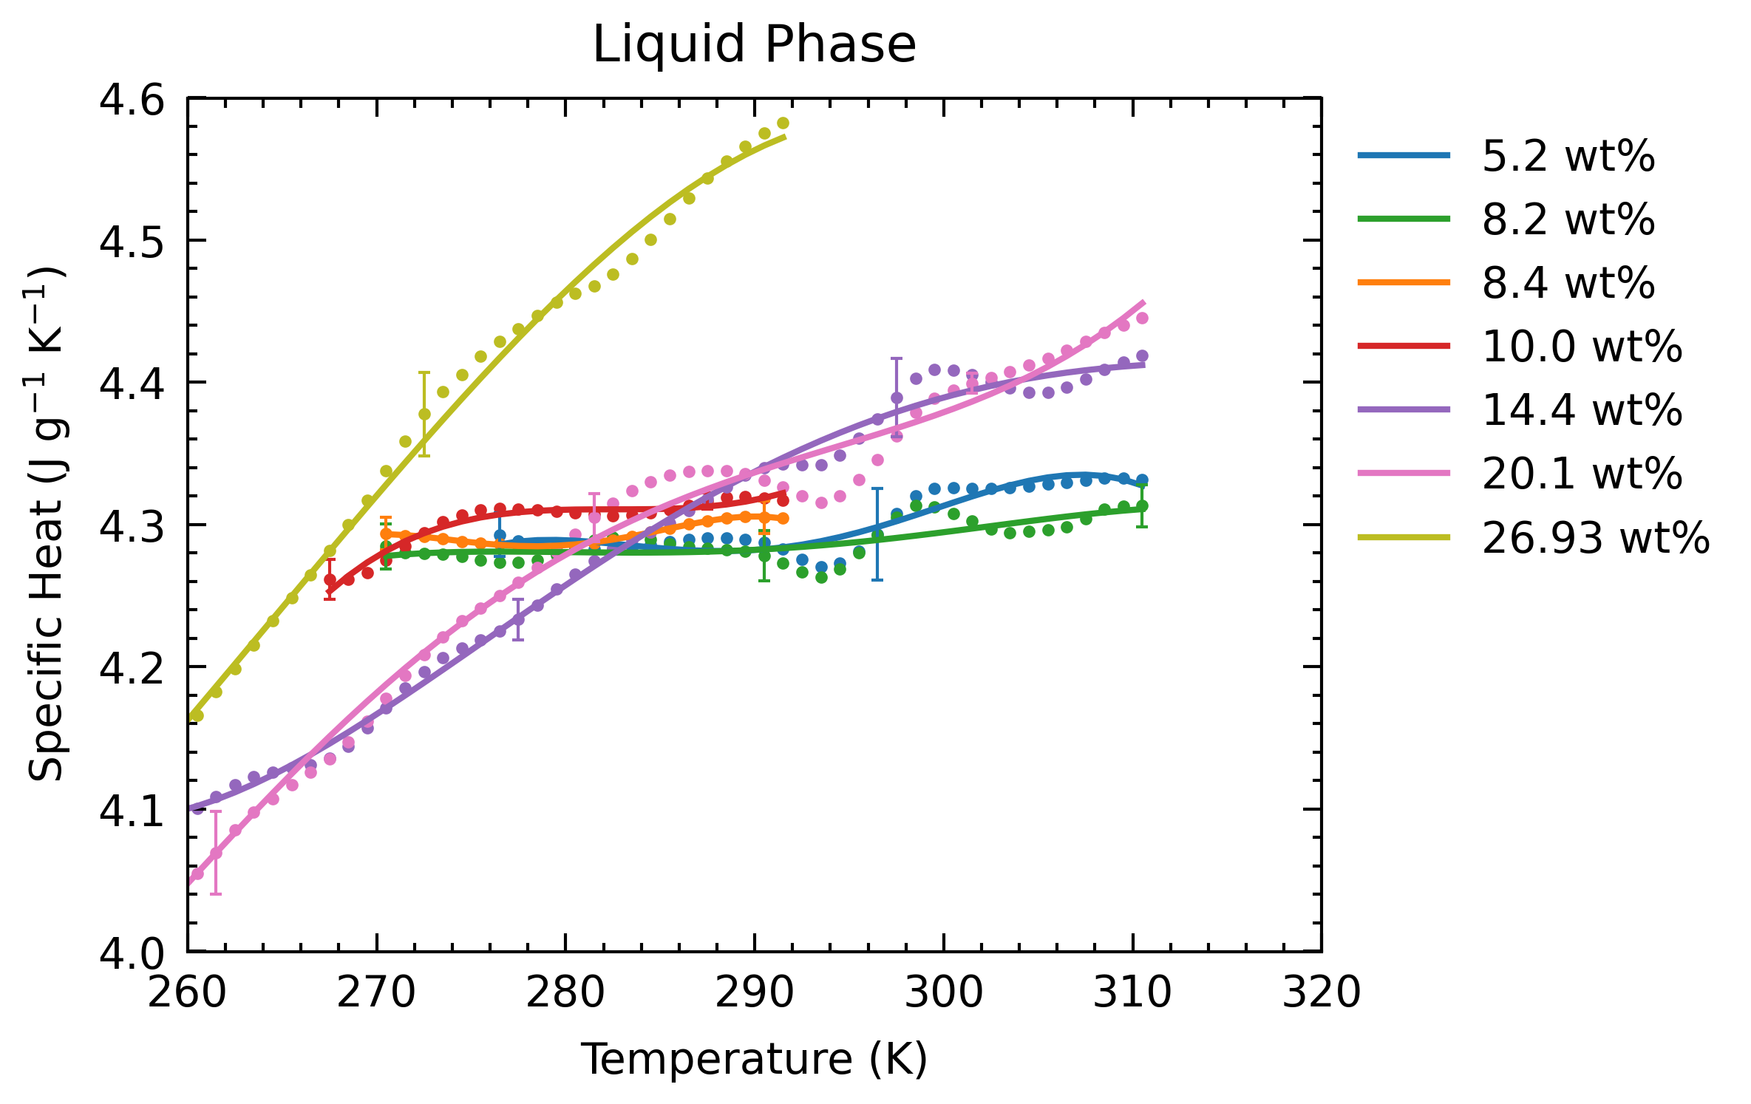
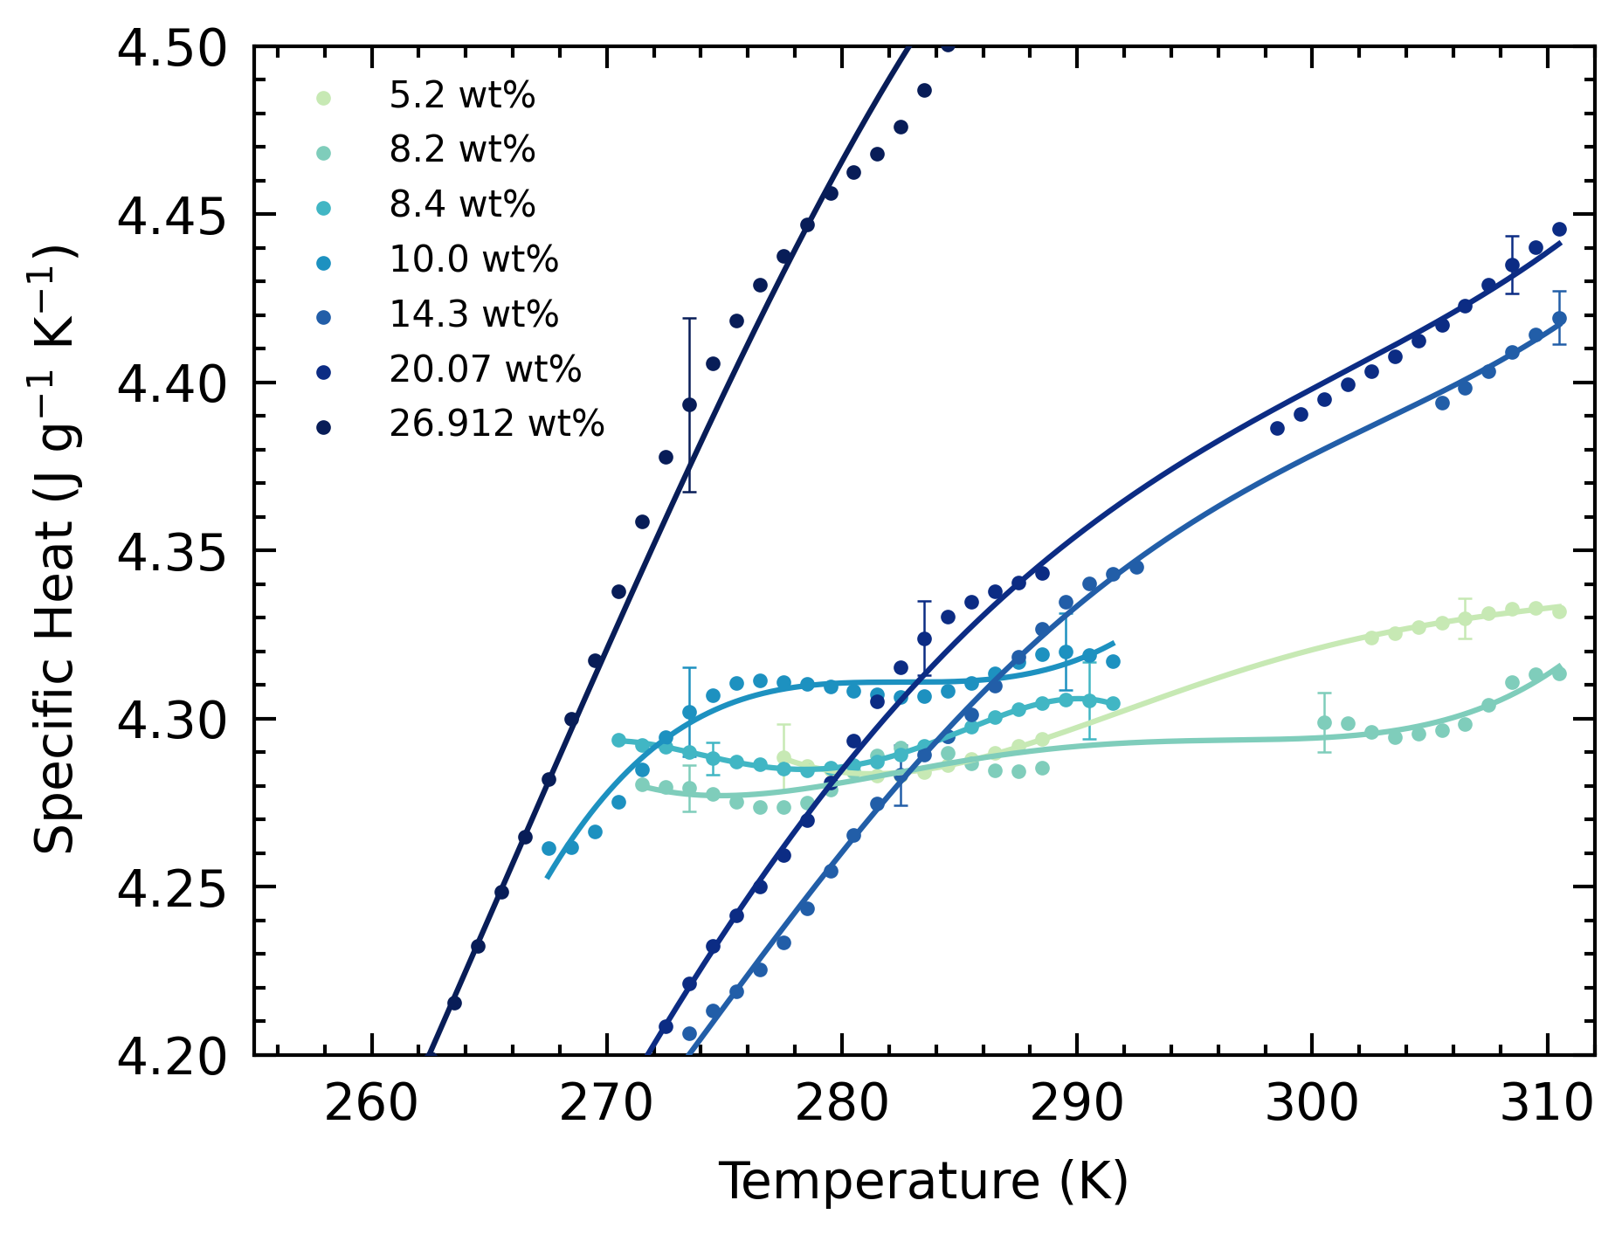
Experiments Plan
Motivation: current dataset has a kink (calorimeter systematic error), which breaks up trend. Goal is to obtain data beyond 310 K to extend trend.

Slide 3
Experiments Plan
One experiment a week.
6 Experiments by end-Feb
Prioritize on:
Extending 291 K data (8.4, 10.0, 26.912 wt%)
Checking off-trend data (5.2 wt%)
2 additional experiments
Vary wt%, or repeat previous experiments

Slide 4
Results
Goal for this discussion:
Refine current write-up points for results
Identify other points we may expand on
Liquid domain Cp
Comparison with Tillner-Roth & Friend
Partial melting domain Cp
Thermogram observations
Liquidus double peak
ADH double peak

Slide 5
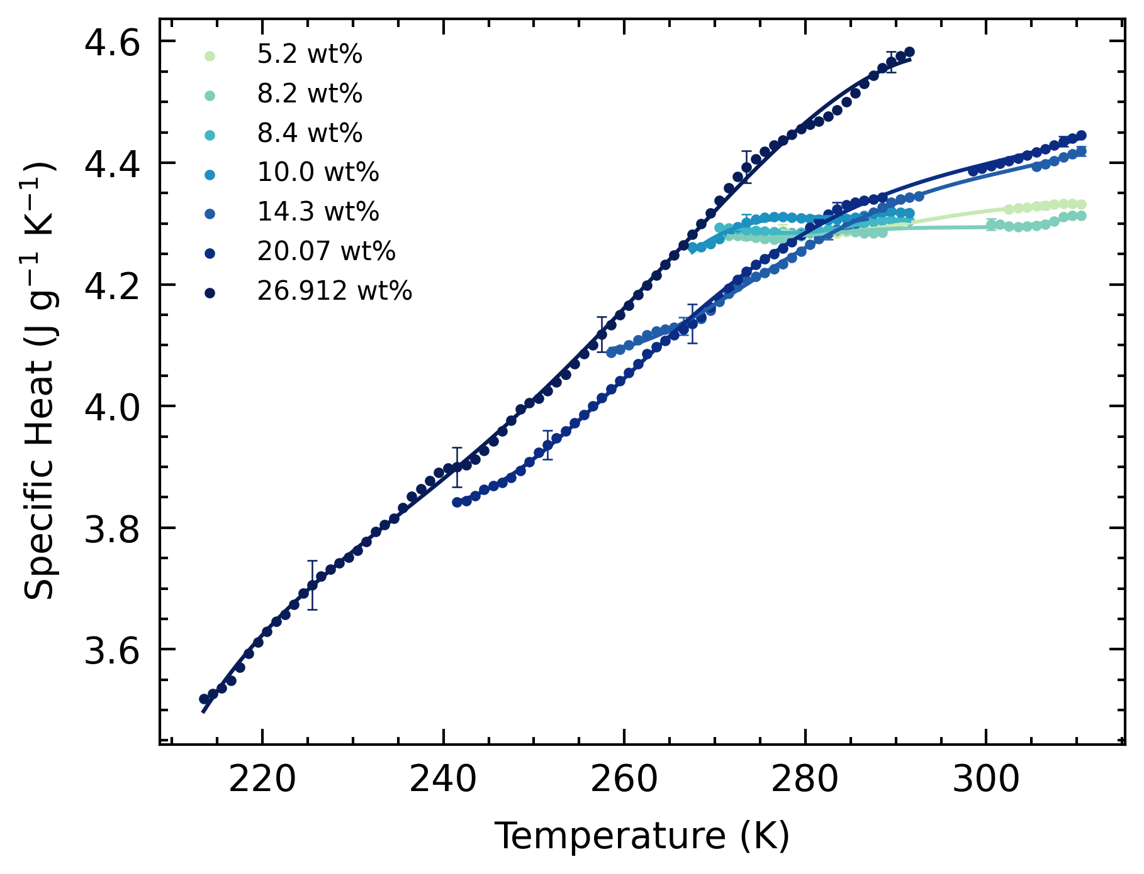
Results
Liquid domain Cp:
Generally increasing with increasing T
Higher wt%, steeper gradient
Change in gradient for 14.3, 20.07 wt% at 285 K
Above 285 K, Cp is proportional to wt% (except 5.2 wt%)
Below 285 K, higher wt% Cp values cross below lower wt%
Above 273.15 K, all Cp above that of water

Slide 6
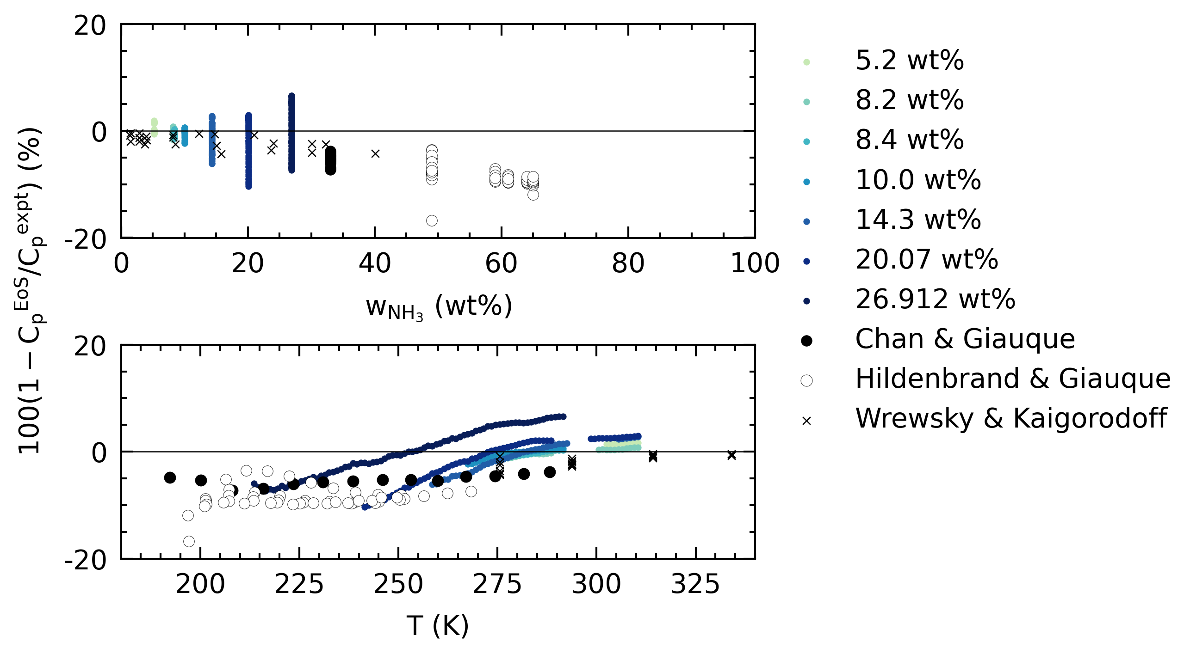
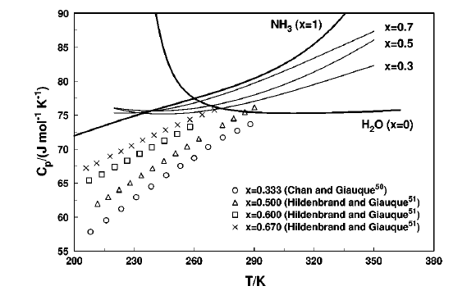
Results
Comparison with Tillner-Roth & Friend:
Deviation consistently with 10% on both T and wt% axes.
Trend in deviations along T axis.
“increasing trend”
Cp from EoS for low wt%, at <300 K, increase with decreasing T.
May be due to EoS construction using supercooled H₂O?
EoS not reliable in prediction low T, low wt% Cp.

Slide 7
Results
Comparison with other data (?):
33, 49 – 65 wt%.
All datapoints higher than 33 wt%.
1 – 33 wt%, 275 – 334 K.
Cp ranges from 4.04 – 4.29 J/gK
Generally, our data is higher (4.26 – 4.5)

Slide 8
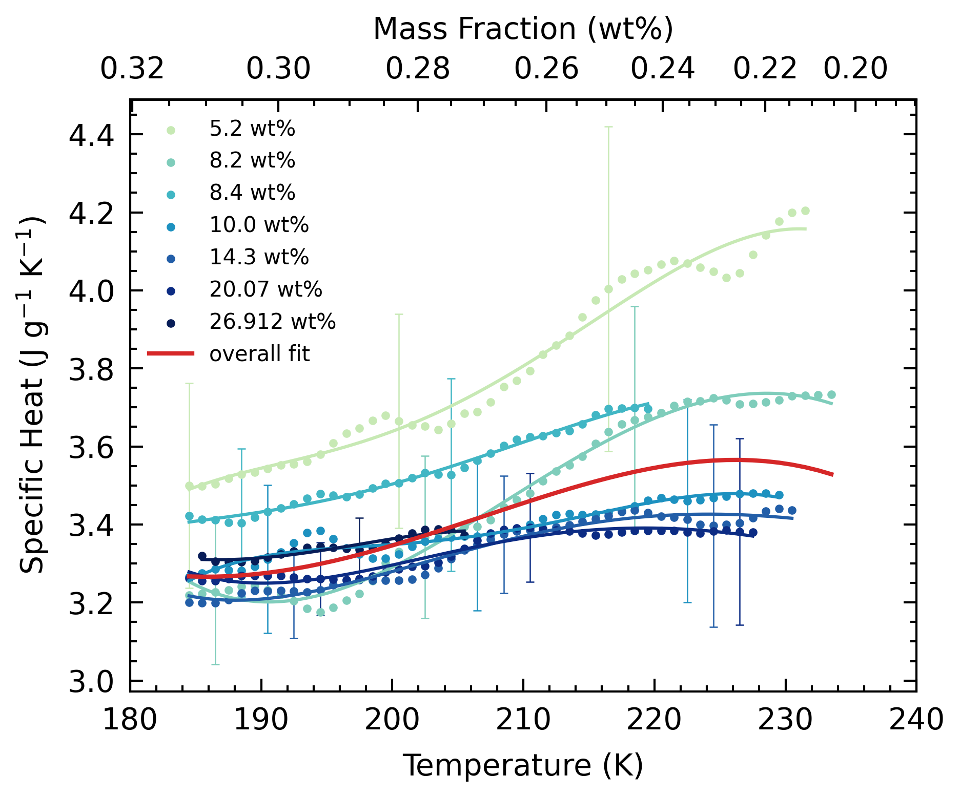
Results
Partial Melting Domain Cp:
General agreement with higher wt% datasets
Low wt% datasets have greater Cp, that diverges at higher T
All datasets almost fall within 1-sigma error of each other
Overall fit falls within errors
Small uptrend of Cp due to combination of higher Cp with higher T and lower Cp with lower wt%.

Slide 9
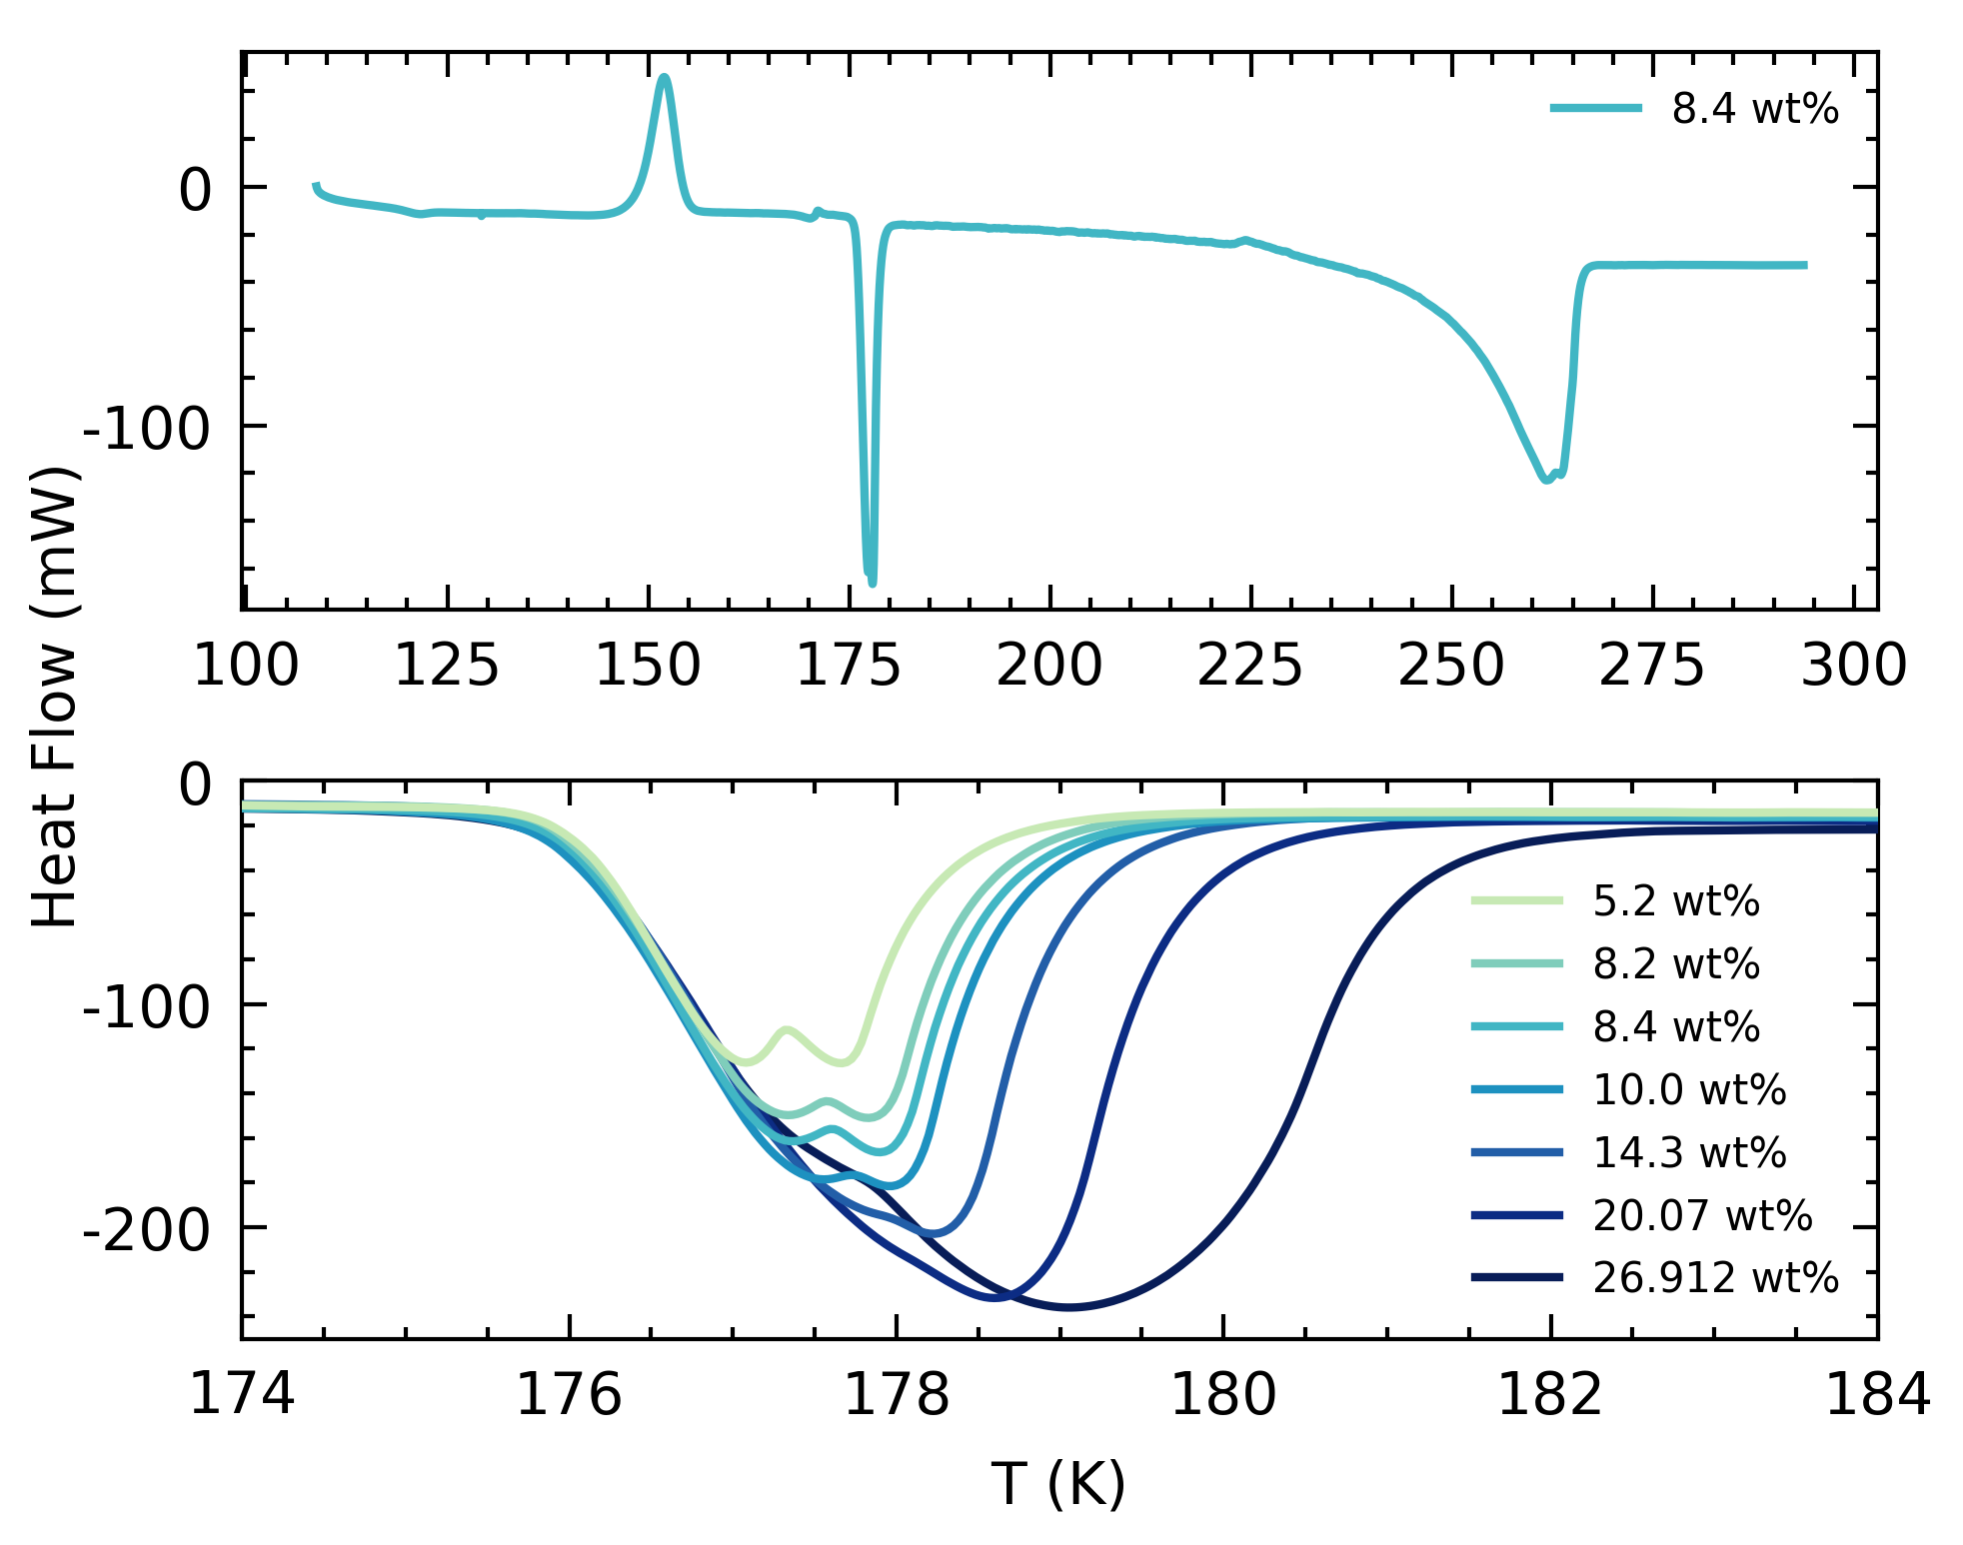
Results
Thermogram observations (?):
Liquidus double peak:
Due to poor mixing, inhomogeneous crystallization
Crystal melt at different times and rates, hence double peak
ADH melting double peak:
Low wt%, more pronounced
Low wt%, inhomogenous crystallization of ADH
At higher ramp (0.25 K/min), not observed due to low T-resolution

Slide 10
Discussion
Interior Models:
Extrapolate our low T, low wt%, 0.1 MPa data to higher pressures:
Current EoS underestimation of Cp > 280 K, overestimation of Cp <280 K.
Shallow region of ocean with NH₃ → cooler (Tb ~250 K), lower Cp than modelled.
Deeper regions → warmer, higher Cp than modelled.
Overall higher Cp of ocean → more heat required to warm ocean → colder temperature profile → thinner ocean.
Thermal evolution models → higher Cp, longer time required for cooling and crystallization
Usefulness of partial melting domain data:
Melt pockets in ice-shells?

Slide 11
Discussion (Low Pressure)
Ice Shells
Considering the T-range of our study, applicable to base of ice shells (partial melting domain)
Cometary Studies
Discussion here primarily due to our data being low pressure.
Discussions on volatilization of NH₃

