Slide 1
Quick Updates
Calorimeter out of service
Waiting for Setaram’s reply
Partial melting domain microscope images
Earth Space Chemistry vs Planetary Science Journal
Discussion
Timeline Plan

Slide 2
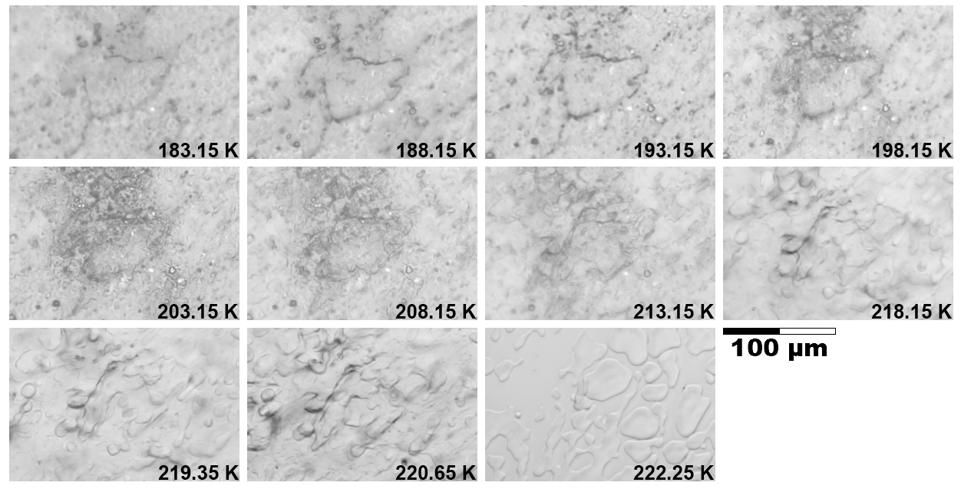
Microscope Images
Cuvette slide at 0.3 K/min ramp from 173 K

Slide 3
Microscope Images
Cuvette slide at 0.3 K/min ramp from 173 K
Shows that partial melting proceeds gradually until liquidus → equilibrium conditions in partial melting domain → Cp extraction in partial melting domain is justified

Slide 4
Journal Choice
I do not have enough experience to make a certain decision
I find Earth Space Chem more suited for reporting generally applicable lab data
PSJ appears more targeted in terms of planetary bodies
Personally favor Earth Space Chem

Slide 5
Planetary Implications
Interior Models:
Temperature of oceans: T_{b} (250 – 270 K) + 5 K
Near liquidus, TRF EoS overestimates C_{p}
Our data suggests lower ocean C_{p} → warmer temperature adiabatic profile → thinner HP ice (if present)
Base of Ice Shells:
Ice Shell—Ocean interface: partial melting domain
Compared to pure Ice Ih shell, Ice Ih and water—ammonia melt pockets have a higher C_{p} → cooler adiabat → thicker ice shell.

Slide 6
Discussion
Interior Models:
I would like to test this with PlanetProfile and TRF EoS:
Understand Steve’s TRF EoS .mat file
Implement in Python PlanetProfile
Get a radial profile of a reference body at a wt% of our expt (5.2 wt%)
Switch out C_{p} with our data C_{p}
Assume deviation is constant with increasing Pressure
Get a 2nd radial profile
Compare the difference between the two profiles
Is this a worthwhile investigation?

Slide 7
Timeline
Feb 16, Thursday
Finish complete draft
JPL internal presentation
MoonsGG: Mar 8 or Mar 1 (Wednesday)

