Slide 1
Interior Model Test
See effect of the change in Cp, compared to a model using TRF, on interior structure
Challenging implement TRF NH3 into Python PlanetProfile
Using 5.2 wt%, multiplying (1+deviation) to pure water Cp
Extrapolate (data T range 276 – 312 K, model T range 255 – 261 K)
In PP, we set Tb = 255 K, way below liquidus (of even pure H2O)*

Slide 2
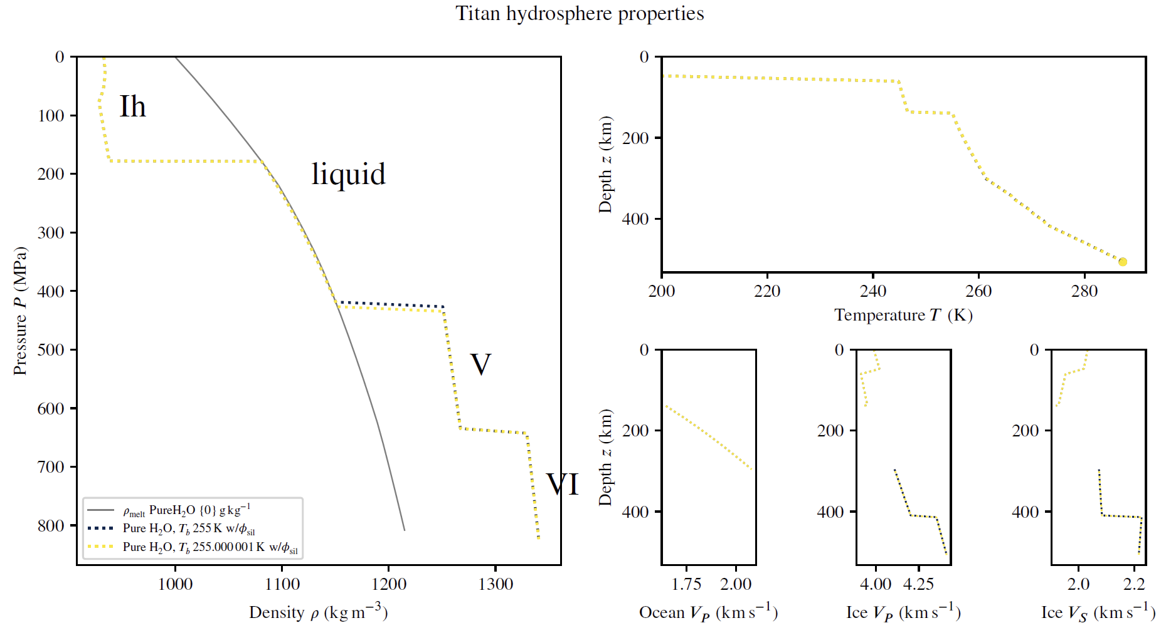
Interior Model Test
Yellow – modified Cp
Changes:
Ocean – HP ice transition depth. By one pressure step (5 km)
Very small temperature adiabat change 0.32 K
Notes:
Increase dP
Figure 2, figure 3
Latent heat
Enthalpy of mixing

Slide 3
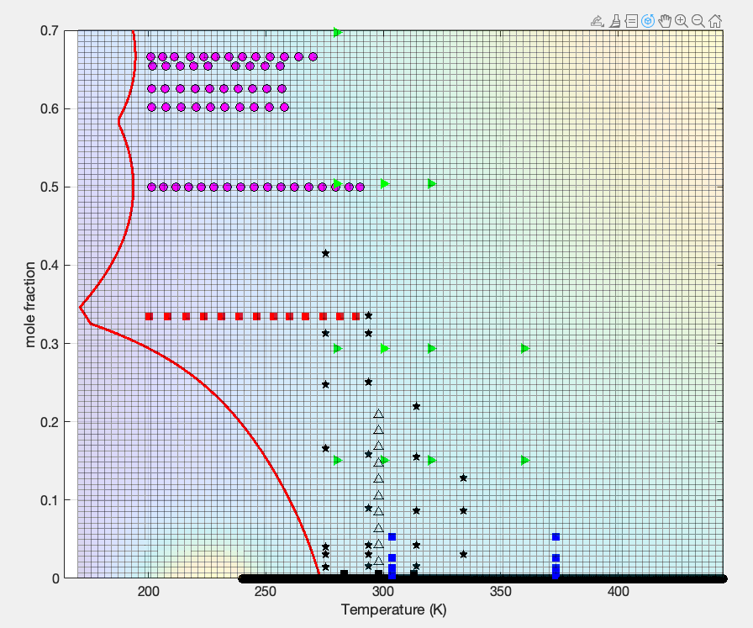
Literature Data
What does the colorscale represent
What is the data of:
Green triangle
Blue square

Slide 4
Manuscript
Look through the manuscript
Review content, phrasing, figures.

