Slide 1
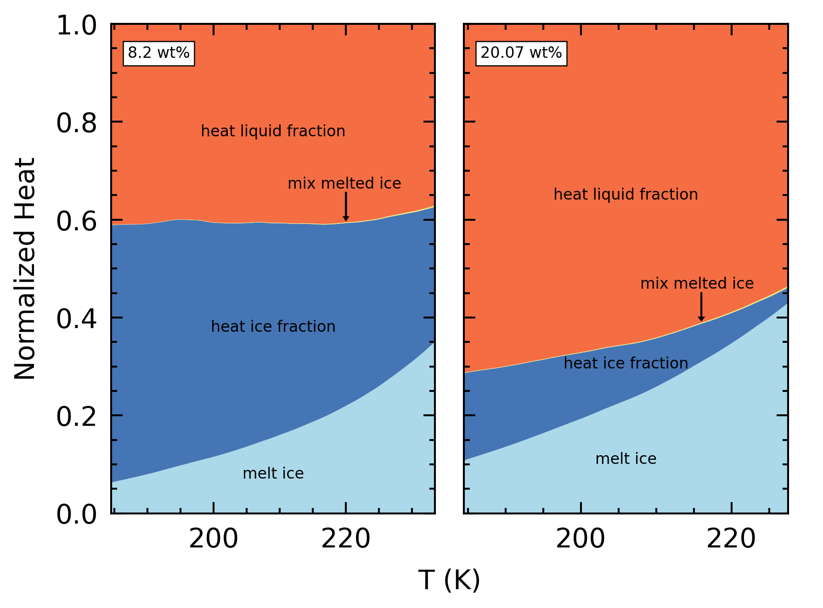
Mixing Enthalpy

Slide 2
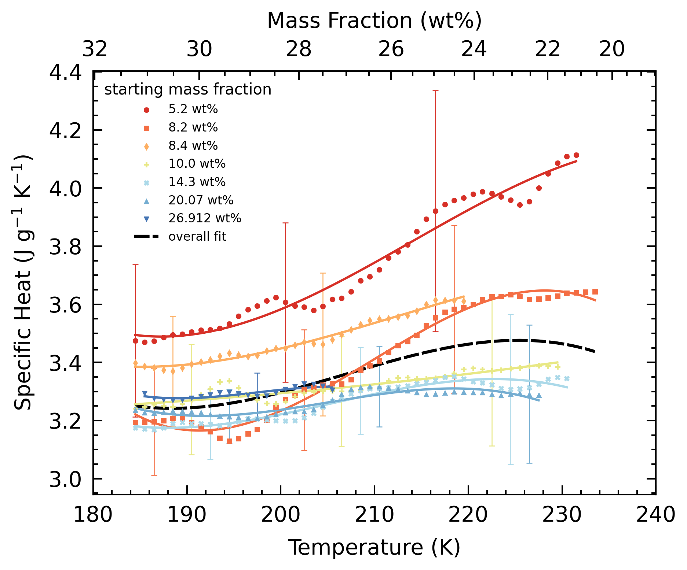
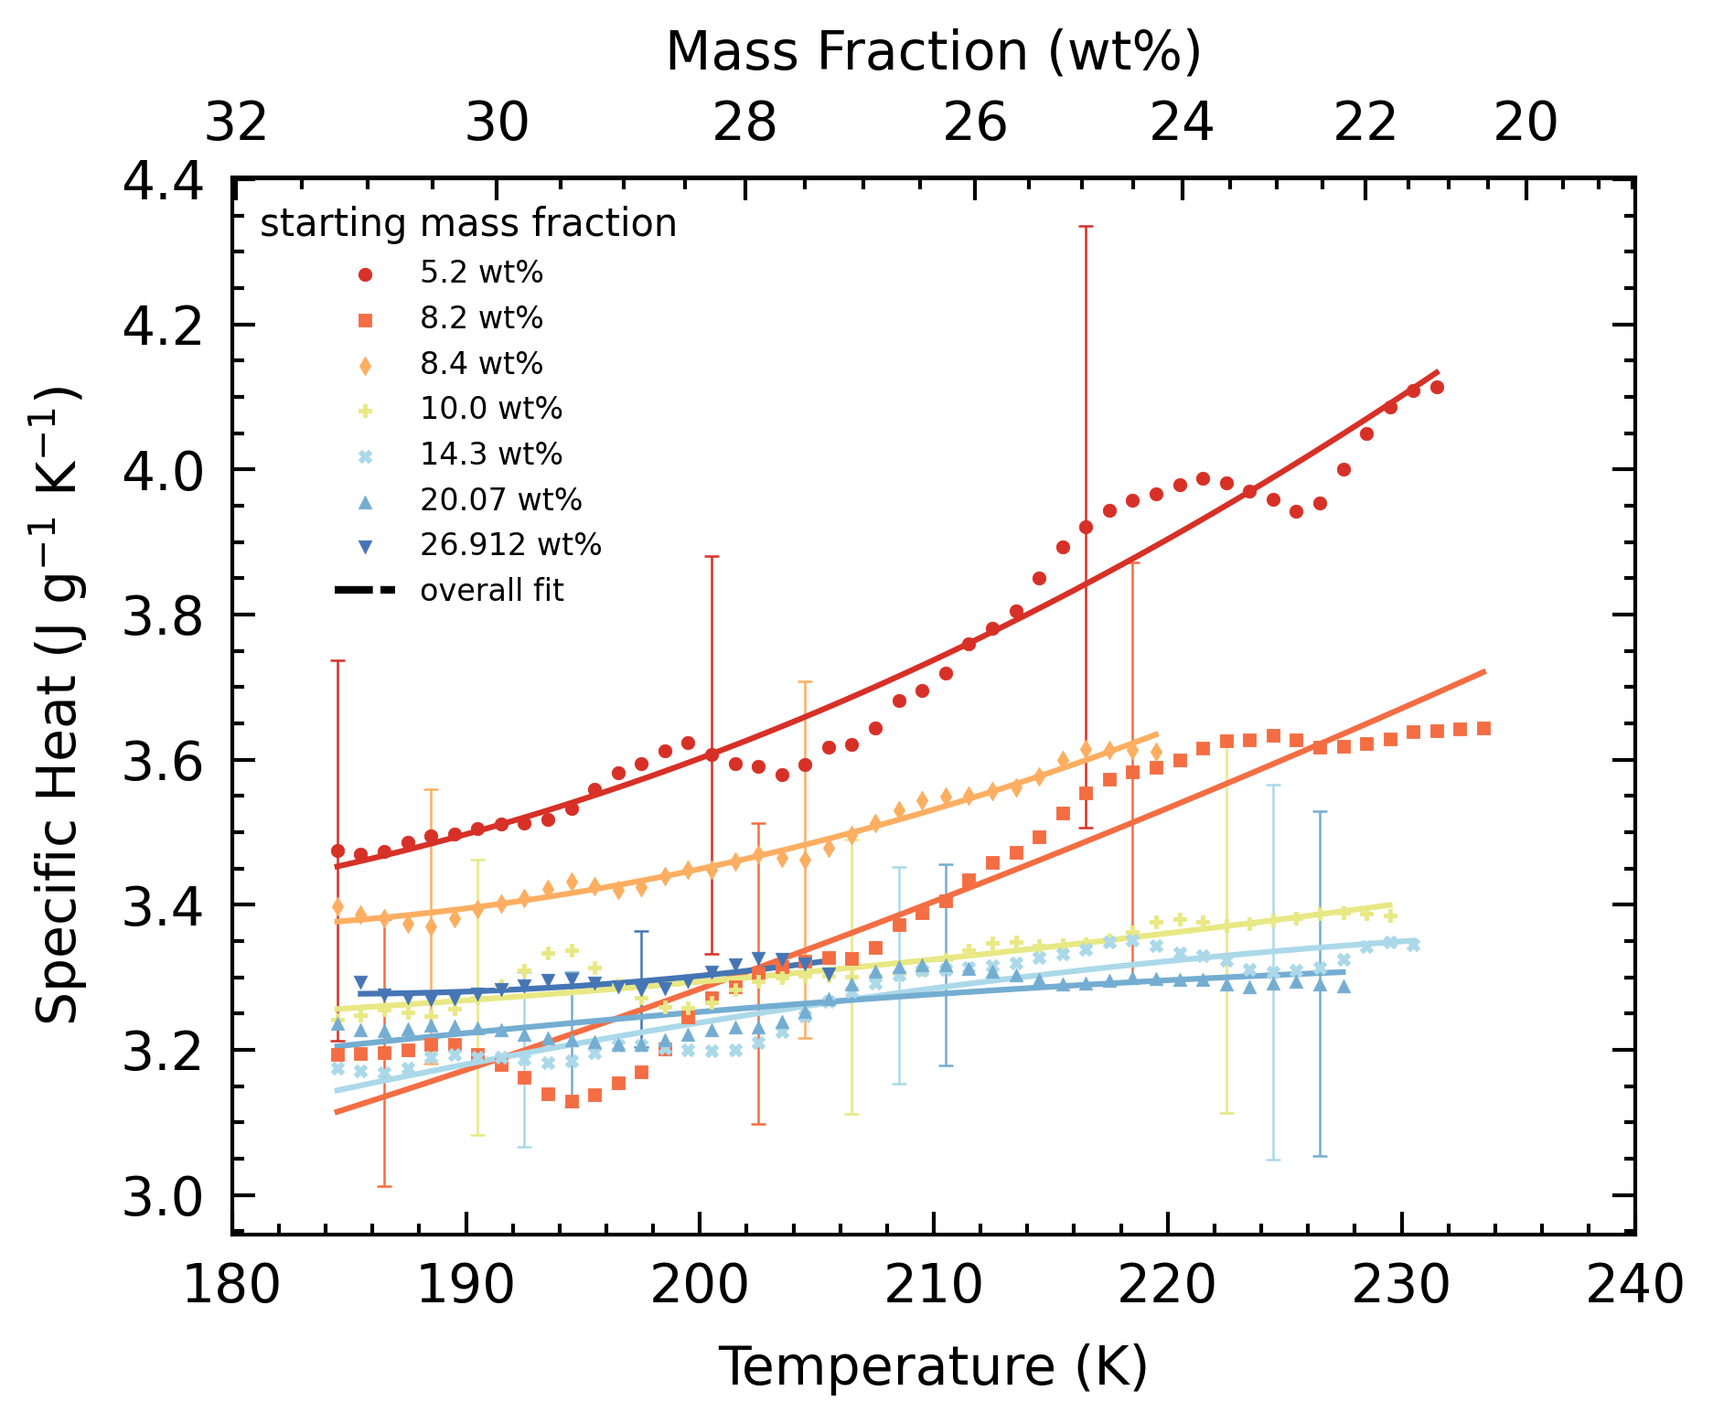
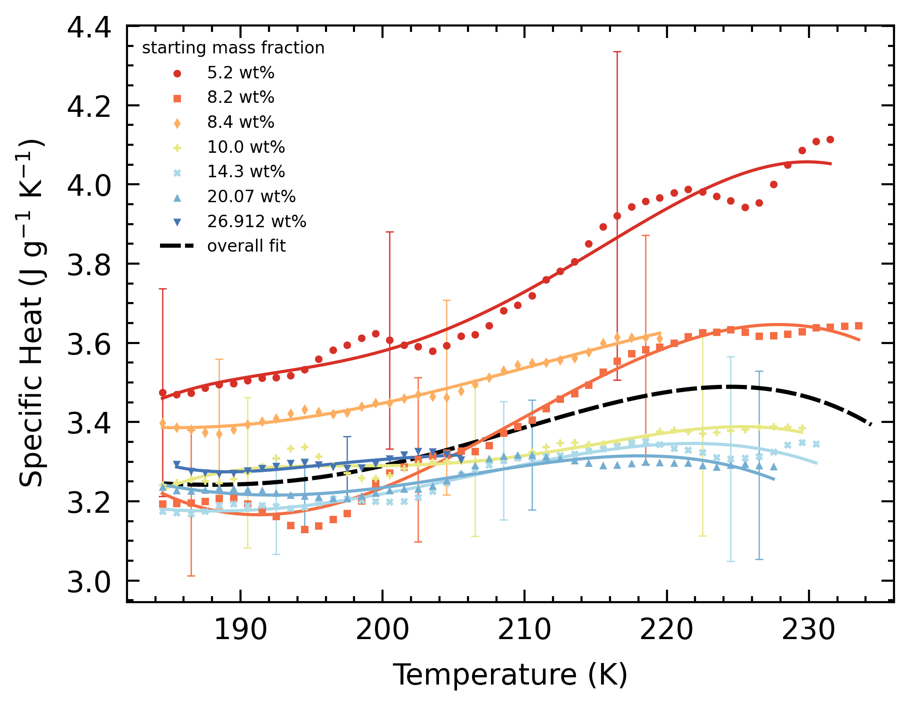
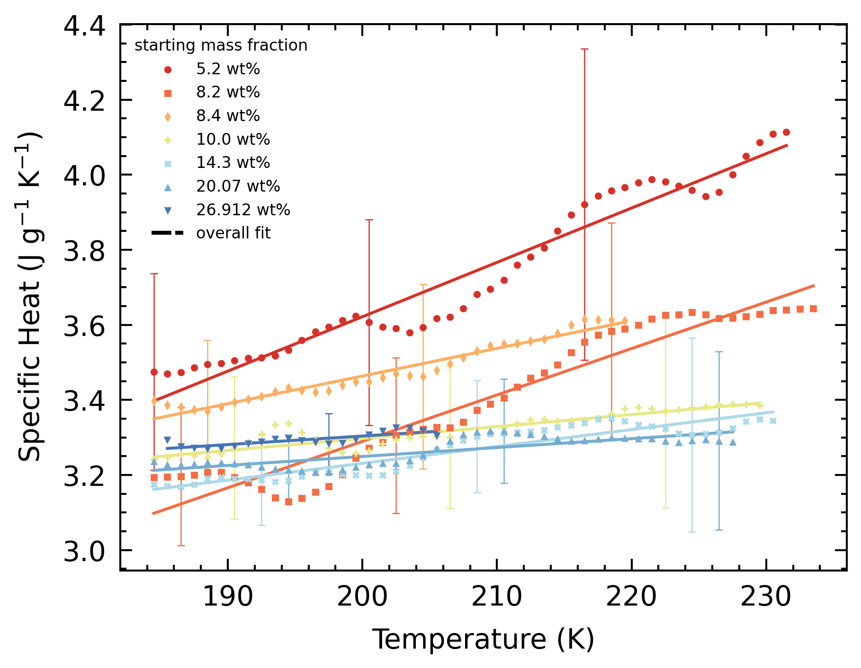
quadratic
Shomate terms
Shomate
cubic
Choose linear: “Due to large scatter in the data, a linear fit was chosen to reduce curve features.
linear

Slide 3
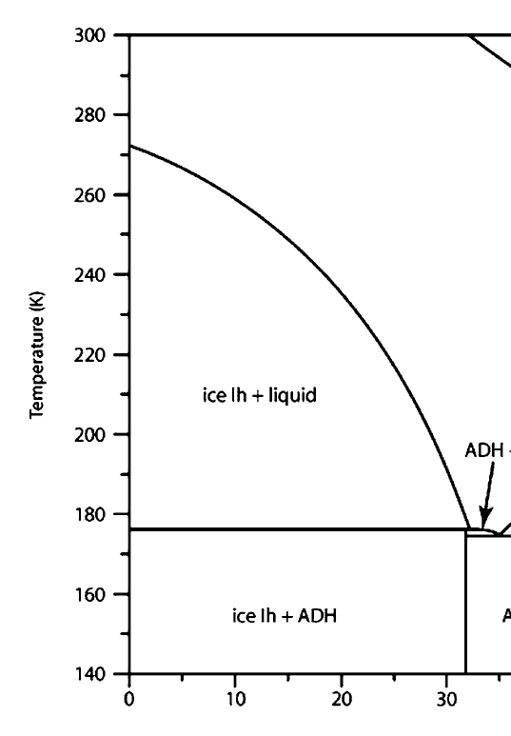
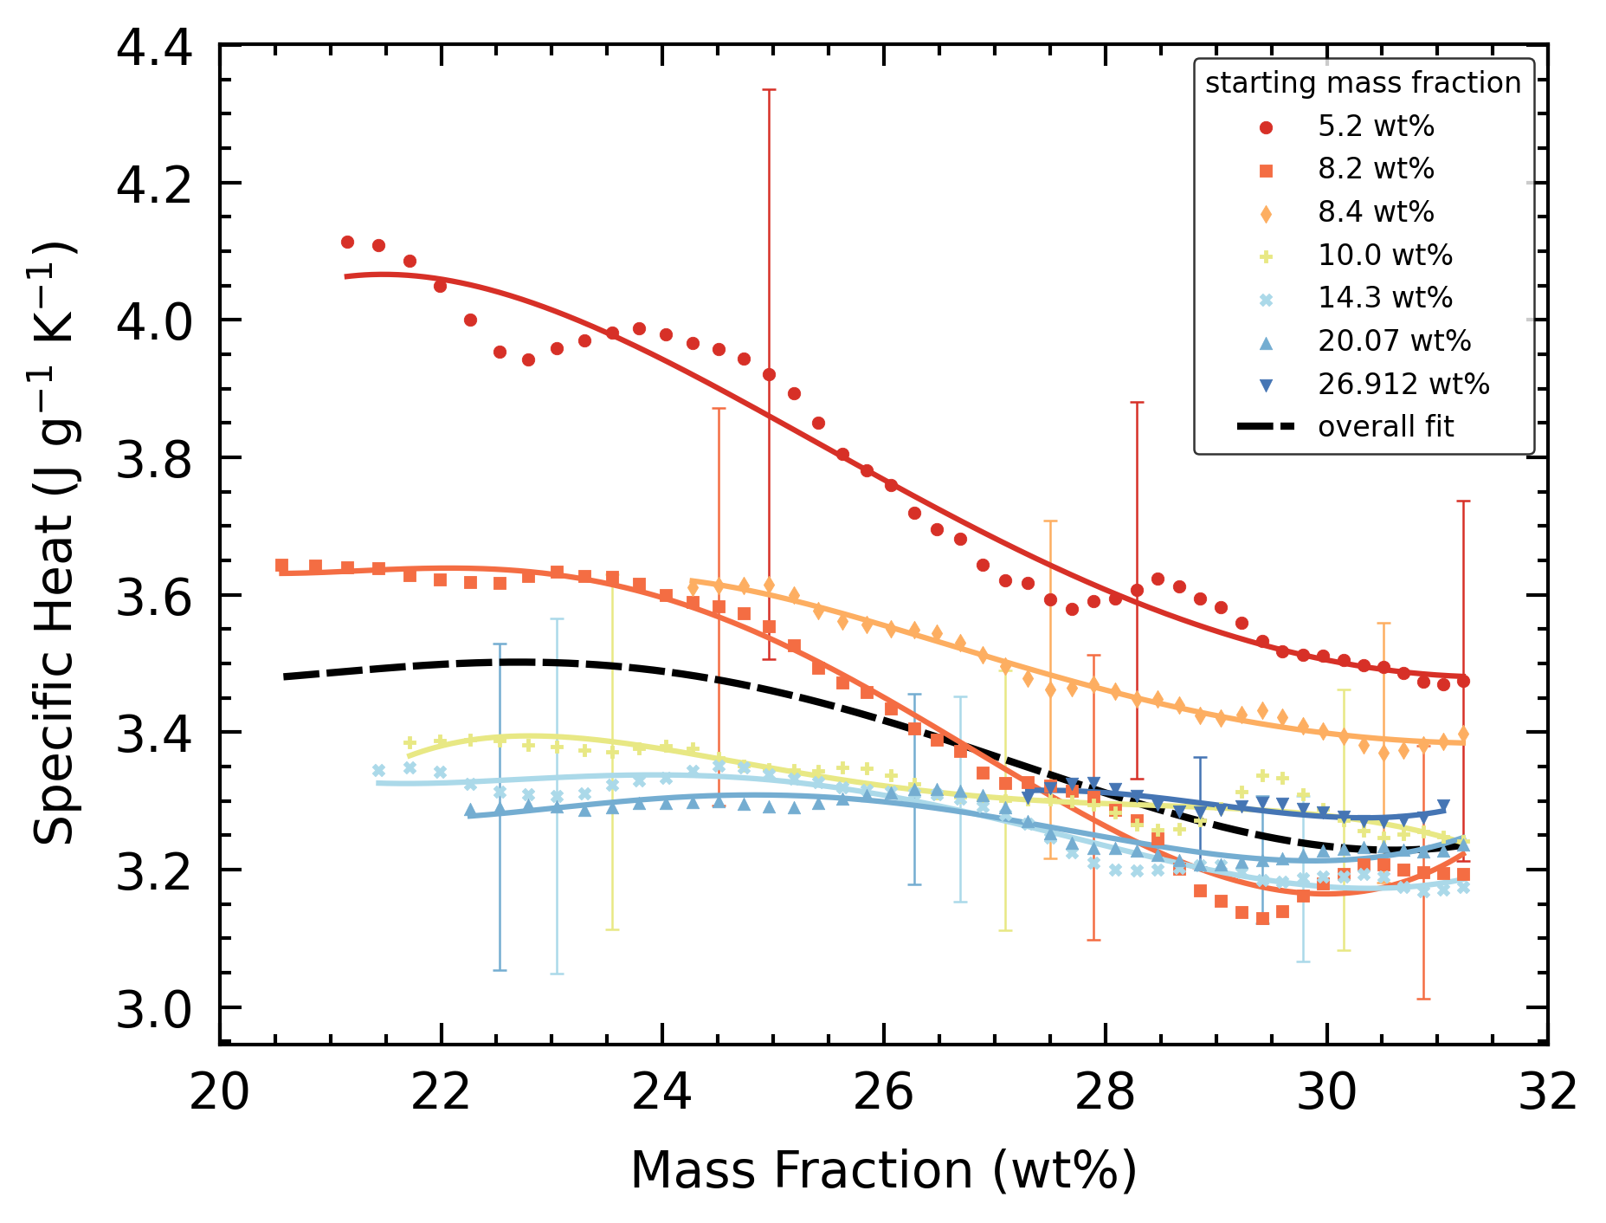
Cp-concentration

Slide 4
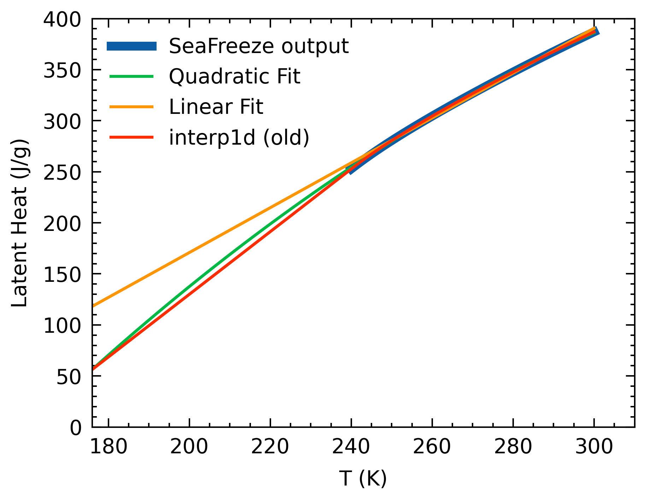
Ice latent heat
Choose to go with quadratic

Slide 5
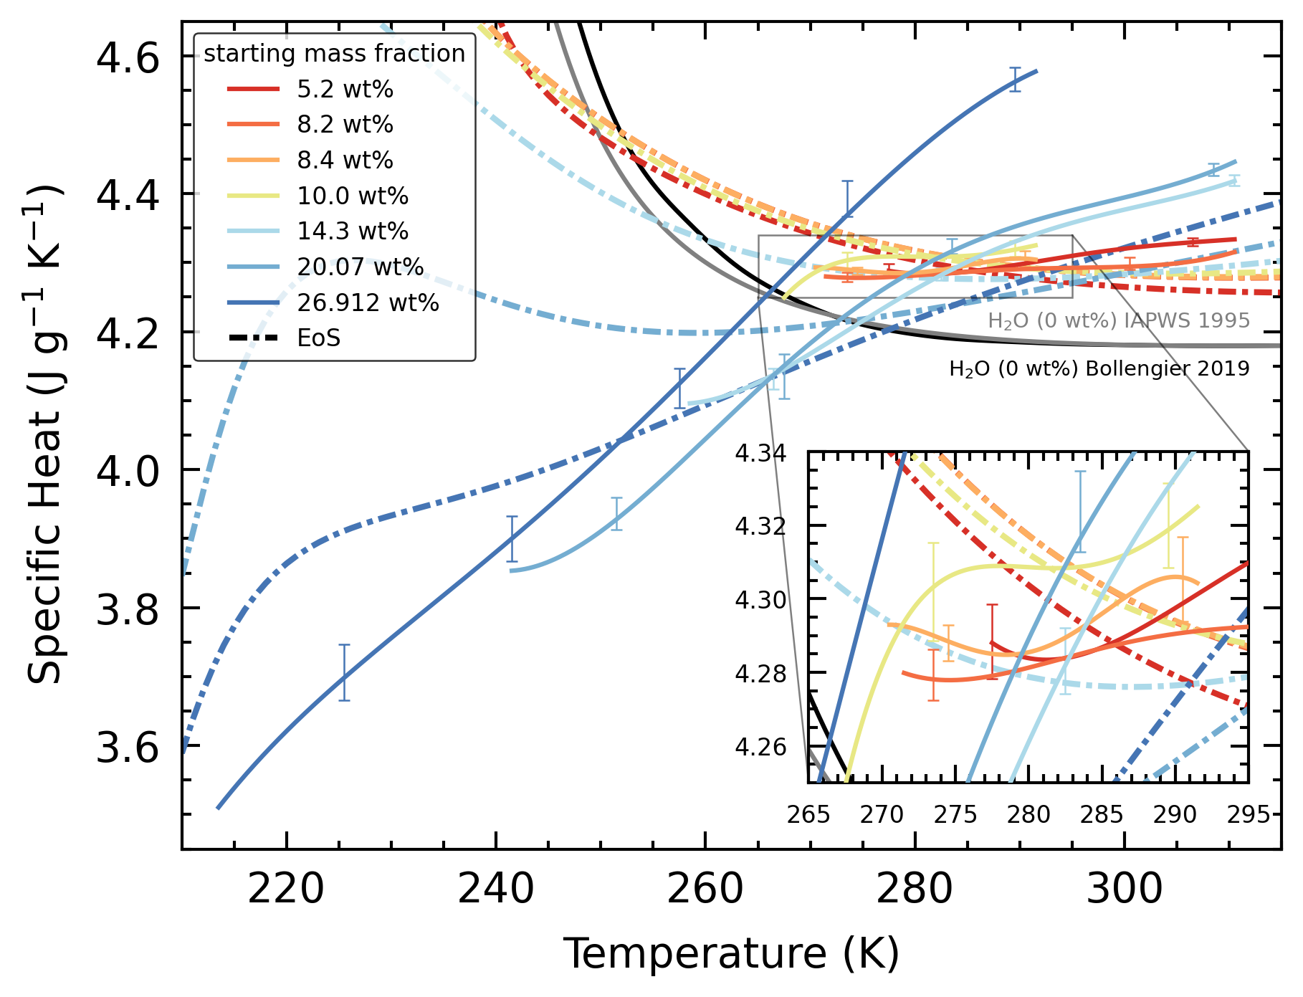
Bollengier and IAPWS
(are the labels ok? Should I switch their positions?)

Slide 6
20/27 wt% < 250 K are smaller than TRF
TRF less steep due to effect of behavior of supercooled water

Slide 7
TRF less steep / reverse gradient
Due to effect of behavior of supercooled water
As liquid is in eqm, properties of metastable supercooled water should not apply

Slide 8
How can our data be applied for LBF EoS
To reduce dependence on using supercooled water properties to describe H2O-NH3 at low T.
EoS predicts properties across phase transitions. How are they handled? m

Slide 9
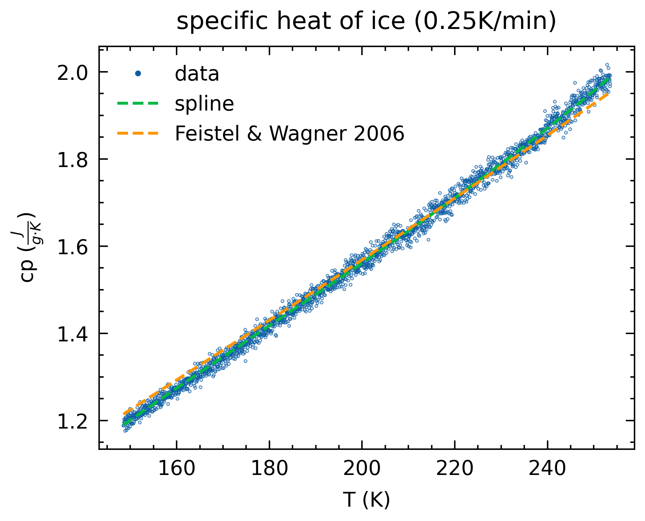
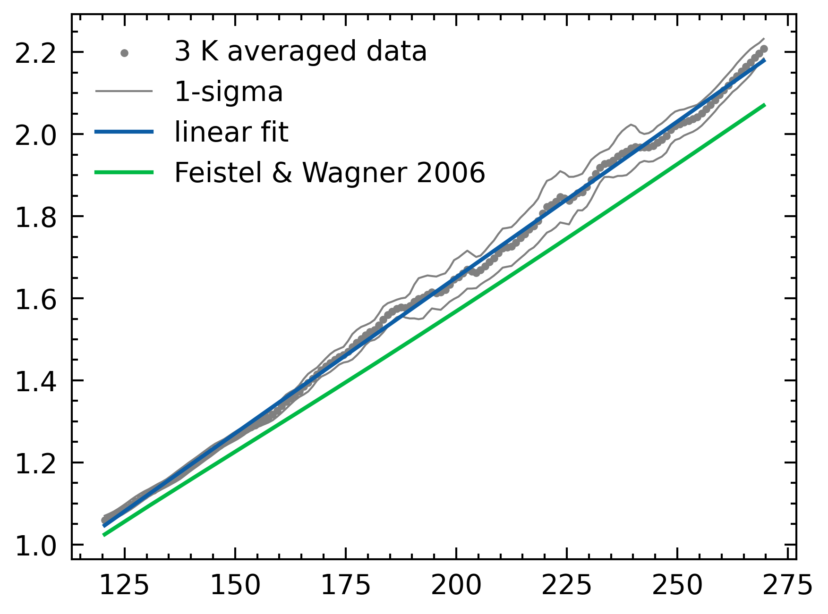
Comparing Cp

