Slide 1
TriageXR
Train for the chaos before it happens
SPATIAL HACK AI
Spatial computing + AI for mass-casualty incident readiness
Notes:
Team: Weishuo, Guan, and Shreeraj. Brief 8: How might we train first responders for a mass casualty incident with spatial computing and AI?
[Sources]
- Local project source: /Users/shreeraj/projects/triagexr/TriageXR/README.md and Swift implementation files.
- User-supplied images are identified on the relevant slide.
[/Sources]

Slide 2
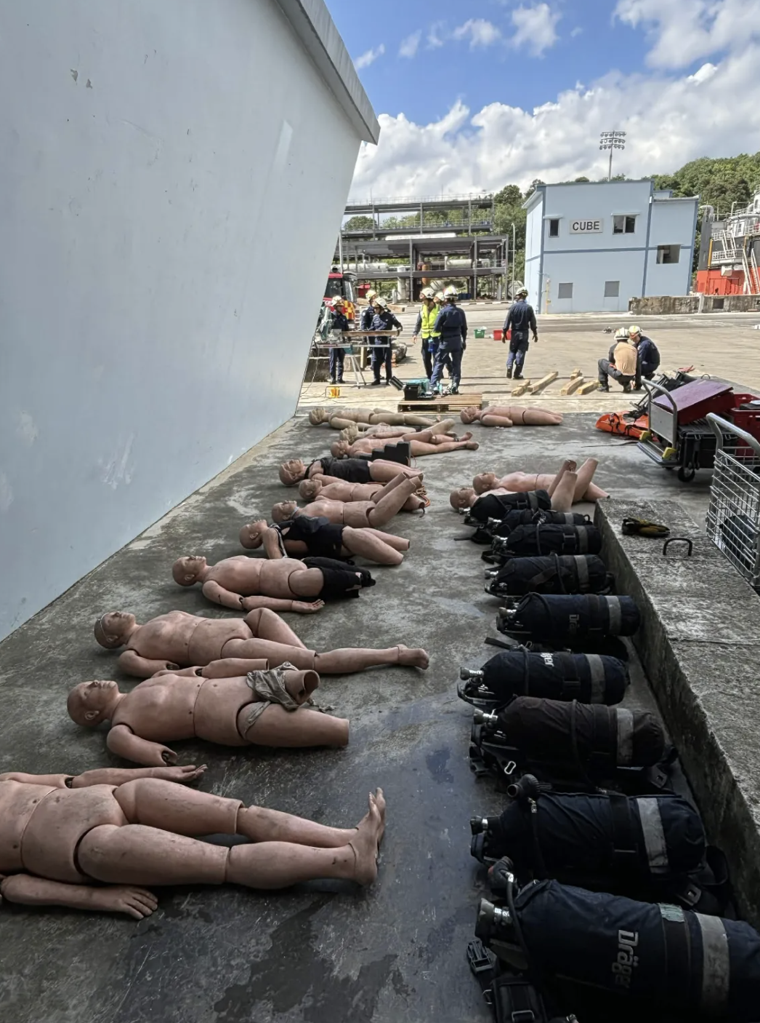
Live drills are scarce. Decisions still need practice.
High-stakes, low-frequency
Live exercises need space, actors, equipment, instructors, and reset time.
Decisions happen under pressure
Trainees must survey hazards, prioritise casualties, coordinate roles, and reassess as conditions change.
Notes:
The photograph was supplied by the user: /var/folders/p_/p663ljhn16l7xm3y7c77vgvm0000gp/T/TemporaryItems/NSIRD_screencaptureui_c4iEZ1/Screenshot 2026-08-10 at 10.35.18 AM.png.
[Sources]
- Local project source: /Users/shreeraj/projects/triagexr/TriageXR/README.md and Swift implementation files.
- User-supplied images are identified on the relevant slide.
[/Sources]

Slide 3
TriageXR turns any safe room into a repeatable, evidence-rich incident
SPATIAL
ADAPTIVE
ACCOUNTABLE
See the whole scene
A mixed-reality roadside collision surrounds the trainee with casualties, vehicles, hazards, and sector beacons.
Feel time pressure
Casualty state changes on a clinically meaningful clock; reassessment and sustained team action alter outcomes.
Explain every choice
Every action becomes attributed evidence for a deterministic score and grounded AI coaching.
Notes:
TriageXR is a visionOS prototype for Apple Vision Pro. It trains scene awareness, prioritisation, reassessment, and communication—not physical medical procedures.
[Sources]
- Local project source: /Users/shreeraj/projects/triagexr/TriageXR/README.md and Swift implementation files.
- User-supplied images are identified on the relevant slide.
[/Sources]

Slide 4
One incident. Four trainable decisions.
The trainee moves from briefing to immersive action, then finishes with a reconstructable after-action review. Each step produces evidence—not just completion.
01
SURVEY
Turn through front, left, rear, and right sectors; identify the fuel spill and request resources.
02
ASSESS
Reach to 3D targets; hand tracking verifies response, breathing, perfusion, and injury checks.
03
TRIAGE
Assign P1, P2, P3, or Expectant, then reassess when visible evidence changes.
04
DEBRIEF
Replay actions, consequences, role ownership, score breakdown, and the next best drill.
Notes:
The flow is implemented across the briefing window, mixed immersive space, spatial verification coordinator, incident state engine, and after-action review.
[Sources]
- Local project source: /Users/shreeraj/projects/triagexr/TriageXR/README.md and Swift implementation files.
- User-supplied images are identified on the relevant slide.
[/Sources]

Slide 5
The demo proves perception, coordination, and learning in one loop
ENTER
RESPOND
LEARN
Immersive scene survey
Scan four sectors, identify the fuel hazard, and establish a safe approach.
Verified team action
Assess and tag three casualties while another responder sustains simulated CPR coverage.
Evidence replay
Step through successful, failed, corrected, and system-generated events with causal explanations.
Notes:
The default Demo 8x pace compresses the clinically meaningful deterioration clock for a stage-ready demonstration while keeping the simulated CPR hold duration in real time.
[Sources]
- Local project source: /Users/shreeraj/projects/triagexr/TriageXR/README.md and Swift implementation files.
- User-supplied images are identified on the relevant slide.
[/Sources]

Slide 6
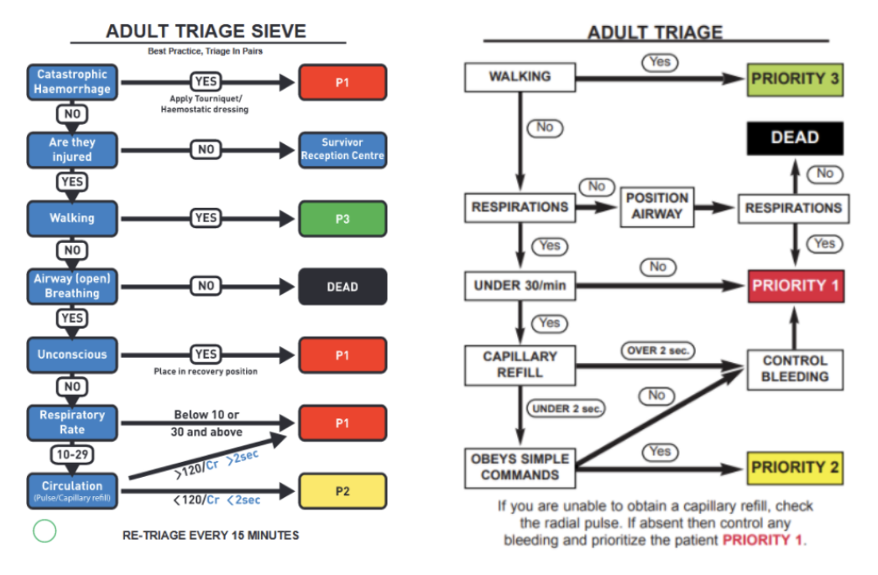
Triage logic must be visible—and revisited
A structured decision path
The experience mirrors adult triage reasoning: mobility, breathing, perfusion, response, catastrophic bleeding, and priority assignment.
Reassessment changes the answer
Jordan’s untreated cardiac arrest progresses over time. The learner must respond to new evidence—not memorise a static label.
Notes:
The adult triage chart was supplied by the user: /var/folders/p_/p663ljhn16l7xm3y7c77vgvm0000gp/T/TemporaryItems/NSIRD_screencaptureui_zi9gR1/Screenshot 2026-08-10 at 10.35.30 AM.png. The prototype encodes deterministic assessment, priority, deterioration, and reassessment rules.
[Sources]
- Local project source: /Users/shreeraj/projects/triagexr/TriageXR/README.md and Swift implementation files.
- User-supplied images are identified on the relevant slide.
[/Sources]

Slide 7
Built beyond a simulation: TriageXR measures how teams think
Verified spatial assessment
ARKit confirms sustained reach and hand poses at casualty-specific 3D targets.
Collaborative incident command
SharePlay synchronises a host-authoritative scene with role permissions and shared spatial placement.
Causal evidence replay
Every material action records the cue, actor, outcome, consequence, and spatial snapshot.
Grounded AI coaching
The AI can only cite verified replay event IDs; it never changes the deterministic score.
Notes:
The prototype also supports a simulator fallback for repeatable demos and a deterministic local coaching fallback when the secure AI relay is unavailable.
[Sources]
- Local project source: /Users/shreeraj/projects/triagexr/TriageXR/README.md and Swift implementation files.
- User-supplied images are identified on the relevant slide.
[/Sources]

Slide 8
The hackathon build already delivers the full training loop
WORKING PROTOTYPE
Native visionOS experience with three casualties, an interactive hazard, role-aware equipment, scenario timing, collaboration, scoring, and an evidence-grounded debrief.
4
3
100
spatial survey sectors must be inspected
casualties with distinct, changing evidence
point deterministic score across five domains
Notes:
The five score domains are Safety, Assessment, Triage, Treatment, and Communication. The local Swift package includes deterministic tests for spatial verification, timing, roles, transport policy, collaboration encoding, and AI citation validation.
[Sources]
- Local project source: /Users/shreeraj/projects/triagexr/TriageXR/README.md and Swift implementation files.
- User-supplied images are identified on the relevant slide.
[/Sources]

Slide 9
From hackathon prototype to deployable training platform
PROTOTYPE | VALIDATE | EXPAND | PILOT | SCALE
Vision Pro scenario + evidence loop
Test with first responders and instructors
Add authoring tools and scenario library
Run station-level pilot
Measure skill transfer and team performance
Multi-agency deployment with governance and analytics
Notes:
Roadmap items are proposed next steps, not completed capabilities. Validation should include clinical governance, accessibility, privacy, facilitator workflow, and measurable transfer to live exercises.
[Sources]
- Local project source: /Users/shreeraj/projects/triagexr/TriageXR/README.md and Swift implementation files.
- User-supplied images are identified on the relevant slide.
[/Sources]

Slide 10
Train decisions.
Rehearse teamwork. Save time when it matters.
SPATIAL HACK AI
TriageXR • Weishuo, Guan & Shreeraj
Notes:
Closing ask: partner with first-responder instructors to validate the scenario, triage logic, debrief usefulness, and operational fit.
[Sources]
- Local project source: /Users/shreeraj/projects/triagexr/TriageXR/README.md and Swift implementation files.
- User-supplied images are identified on the relevant slide.
[/Sources]

