Slide 1

Spatial Hack AI
TriageXR
Project By :
Shreeraj, Guan Yu, Weishuo
2026

Slide 2

Problem Statement
Brief 8:
How might we train first responders for a mass casualty incident with spatial computing and AI?

Slide 3
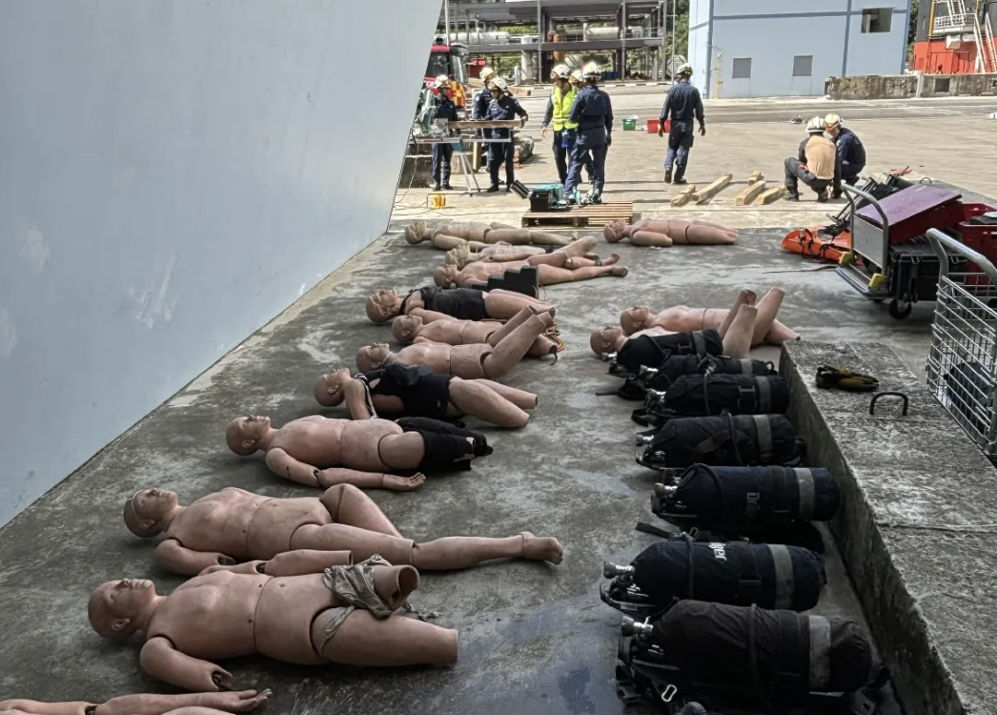
THE TRAINING GAP
Live exercises are essential—but difficult to repeat
Mass-casualty readiness depends on decisions made under pressure: survey the scene, identify hazards, prioritise casualties, coordinate roles, and reassess.
COSTLY TO STAGE
Space, actors, equipment, instructors, and reset time.
HARD TO REPEAT
Every live run varies, making deliberate practice difficult.
DIFFICULT TO MEASURE
A final score rarely explains what the learner saw or missed.
LIVE TRAINING EXERCISE
TRIAGEXR • SPATIAL HACK AI
03
Notes:
This slide frames the operational training problem without claiming that spatial simulation replaces live exercises.
[Sources]
- Local project: /Users/shreeraj/projects/triagexr/TriageXR/README.md and relevant Swift/relay implementation files.
- User-supplied training photograph: /var/folders/p_/p663ljhn16l7xm3y7c77vgvm0000gp/T/TemporaryItems/NSIRD_screencaptureui_c4iEZ1/Screenshot 2026-08-10 at 10.35.18 AM.png.
[/Sources]

Slide 4
THE PRODUCT
TriageXR turns a safe room into a dynamic incident
A native Apple Vision Pro experience trains the decision loop—not physical medical procedures.
01
02
03
04
05
SURVEY
ASSESS
TRIAGE
REASSESS
DEBRIEF
Turn through four spatial sectors and identify the fuel hazard.
Reach to 3D targets; hand tracking verifies sustained checks.
Tag P1, P2, P3, or Expectant from revealed evidence.
Respond when casualty condition and the correct priority change.
Replay the cue, actor, consequence, and next best action.
DEMO MOMENT
Jordan deteriorates on a meaningful clock while sustained simulated CPR coverage pauses the decline—forcing the team to notice, communicate, and act.
TRIAGEXR • SPATIAL HACK AI
04
Notes:
The experience flow is implemented in the briefing window, immersive space, spatial assessment coordinator, incident engine, and after-action review.
[Sources]
- Local project: /Users/shreeraj/projects/triagexr/TriageXR/README.md and relevant Swift/relay implementation files.
[/Sources]

Slide 5
DYNAMIC SCENARIO
A casualty can change—and the learner must notice
Jordan begins in untreated cardiac arrest. The evidence evolves with elapsed scenario time and sustained team response.
0 MIN
6 MIN
10 MIN
ACTION
Recognise
Risk escalates
Outcome changes
Team intervention
Unresponsive, not breathing normally, no palpable pulse.
Visible deterioration makes reassessment urgent.
Without effective team response, the simulation reaches a fatal outcome.
Sustained simulated CPR coverage pauses deterioration and becomes replay evidence.
The learning objective is not memorising a label. It is seeing new evidence, updating the shared picture, and changing the decision.
TRIAGEXR • SPATIAL HACK AI
05
Notes:
The 6-minute neurological-risk and 10-minute simulation-outcome thresholds are scenario rules in the repository. They are used for training logic, not presented as a general medical protocol.
[Sources]
- Local project: /Users/shreeraj/projects/triagexr/TriageXR/README.md and relevant Swift/relay implementation files.
[/Sources]

Slide 6
TECHNICAL DESIGN
Spatial, shared, and explainable by design
Three connected systems turn immersive interaction into reliable training evidence.
01
02
03
SPATIAL INPUT
AUTHORITATIVE STATE
GROUNDED REVIEW
RealityKit scene + ARKit hand tracking
Deterministic incident engine + SharePlay
Evidence replay + secure AI relay
Sector beacons and casualty-specific 3D targets verify what the trainee physically inspected.
One host owns the clock and scene state; role permissions and targeted commands keep teams aligned.
The score stays deterministic. AI coaching must cite exact replay event IDs or it is rejected.
Works offline with deterministic local coaching; the optional AI relay adds grounded narrative without becoming a single point of failure.
TRIAGEXR • SPATIAL HACK AI
06
Notes:
Architecture is grounded in SpatialAssessmentCoordinator.swift, IncidentCollaboration.swift, Core/TriageDomain.swift, AICoachService.swift, and relay/src/worker.js.
[Sources]
- Local project: /Users/shreeraj/projects/triagexr/TriageXR/README.md and relevant Swift/relay implementation files.
[/Sources]

Slide 7
WHY TRIAGEXR
We measure how teams think—not just what they clicked
VERIFIED ACTION
TEAM COORDINATION
Findings unlock only after a sustained pose at the correct spatial target.
Incident commander, triage, airway, and instructor roles have explicit responsibilities and permissions.
CAUSAL REPLAY
SAFE AI
Each material action preserves the visible cue, responsible role, consequence, and reconstructed scene.
Coaching is grounded in verified event IDs and cannot alter the deterministic 100-point score.
TRIAGEXR • SPATIAL HACK AI
07
Notes:
Differentiators are implemented capabilities. The deck does not claim improved clinical outcomes or replacement of certified practical training.
[Sources]
- Local project: /Users/shreeraj/projects/triagexr/TriageXR/README.md and relevant Swift/relay implementation files.
[/Sources]

Slide 8
WORKING PROTOTYPE
The complete training loop already runs end to end
Built natively for visionOS, with deterministic tests and a stage-ready simulator path.
4
3
5
100
SPATIAL SECTORS
CASUALTIES
SCORE DOMAINS
POINTS
must be inspected before the survey is complete
with distinct findings and changing evidence
Safety, Assessment, Triage, Treatment, Communication
deterministic and separated from AI-written coaching
DEMO IN 75 SECONDS
Survey → assess → coordinate → watch Jordan change → finish → replay the exact decision trail. Demo 8× compresses scenario deterioration while keeping the responder hold interaction in real time.
TRIAGEXR • SPATIAL HACK AI
08
Notes:
The 75-second stage duration refers to the repository's Demo 8× timing, where the ten-minute scenario threshold arrives after 75 real seconds. It is a demo configuration, not a product-performance claim.
[Sources]
- Local project: /Users/shreeraj/projects/triagexr/TriageXR/README.md and relevant Swift/relay implementation files.
[/Sources]

Slide 9
Ready to train?
Help us validate the scenario, decision logic, and after-action review with first-responder instructors.
WEISHUO • GUAN • SHREERAJ
Notes:
Closing ask: secure domain-expert validation before expanding scenarios or deployment scope.
[Sources]
- Local project: /Users/shreeraj/projects/triagexr/TriageXR/README.md and relevant Swift/relay implementation files.
[/Sources]

