Slide 1
30.102 Electromagnetics & Applications
Underwater Wireless Communications
Acoustic vs Optical vs RF / Magneto-Inductive
"On land, we take wireless connectivity for granted. Put that same radio 10 meters underwater, and it's dead within centimeters. Why?"
SUTD | Term 5 Presentation
30.102 Electromagnetics & Apps | Underwater Wireless Communications
1 / 7
Notes:
Hook: land vs underwater wireless asymmetry. Land WiFi/cellular works at MHz-GHz; the same frequencies are useless underwater because of skin-depth loss in conductive seawater. This sets up the three-way comparison: why acoustic, optical, and RF/MI each exist.

Slide 2
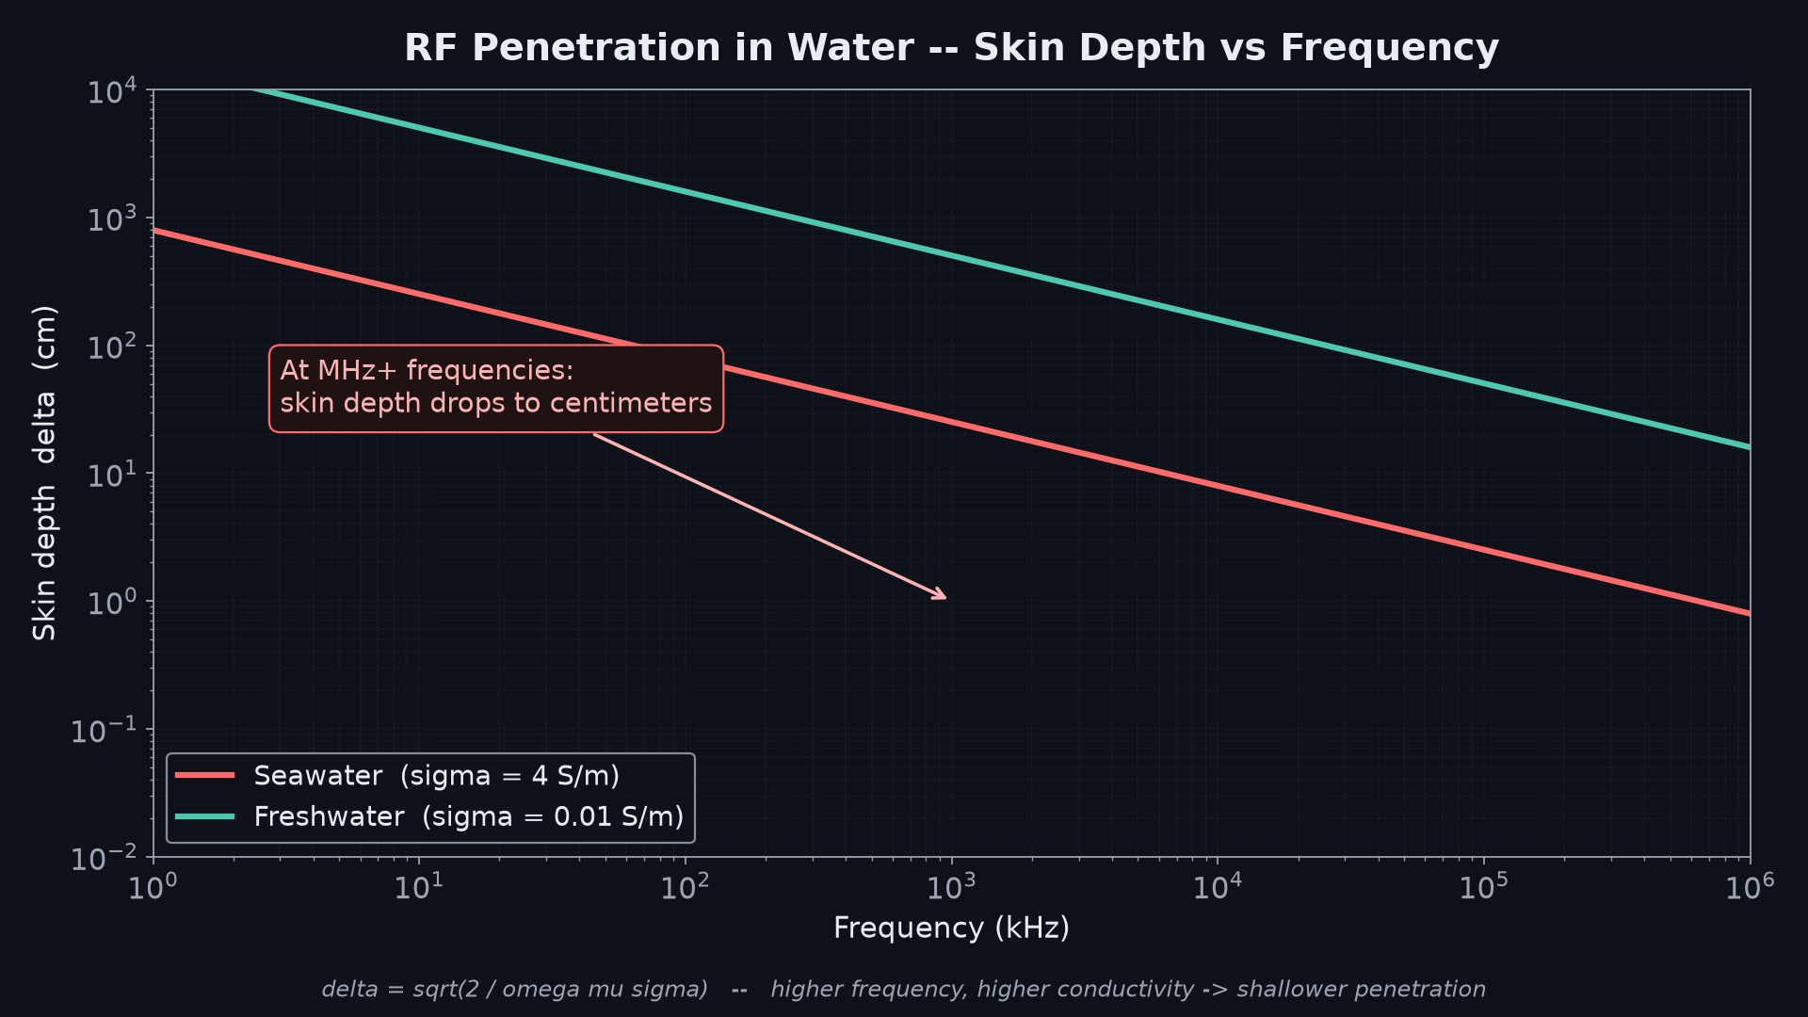
The Core Problem: Seawater Eats RF
• Seawater is a lossy conductive medium — σ ≈ 4 S/m
• Skin depth shrinks fast with frequency: δ = √(2 / ωμσ)
• At MHz+: penetration is centimeters, not meters
• Decent bandwidth (MHz+) is exactly where seawater kills the signal
• No single dominant technology — only tradeoffs
• This divergence is why the entire underwater comms field exists
Key insight: RF works on land because air has σ ≈ 0. The ocean is 4 billion times more conductive.
30.102 Electromagnetics & Apps | Underwater Wireless Communications
2 / 7
Notes:
Anchor the audience in the physics. The skin-depth equation is the entire reason the talk exists. Show that at 1 MHz, seawater skin depth is on the order of 10 cm; at 100 MHz it is mm. Mention the conductivity contrast vs air to make the asymmetry visceral.

Slide 3
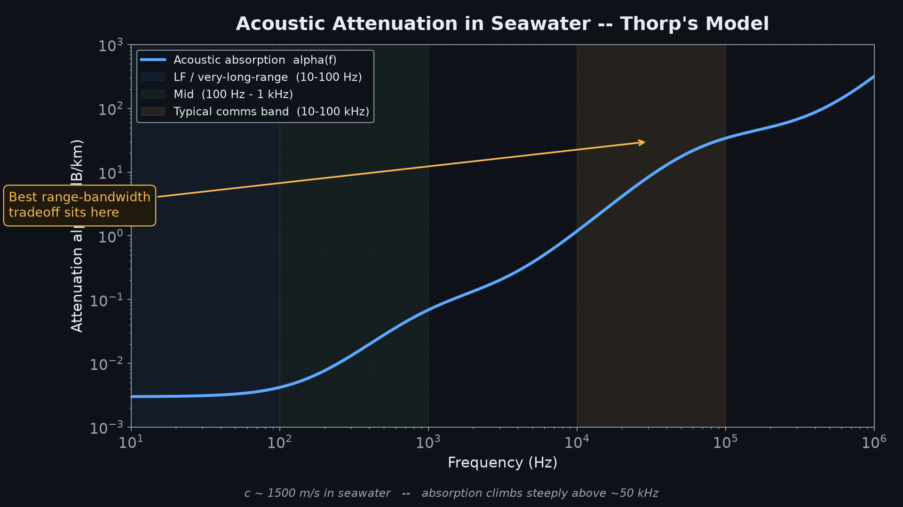
Acoustic: Long Range, Low Rate
• Physics Sound at c ≈ 1500 m/s, 4× faster than air; much lower attenuation than RF
• Range km to tens of km for typical comms; SOFAR-channel VLFs can reach 100s of km at bps rates
• Bandwidth kbps, drops with range — hard range-bandwidth tradeoff
• Impairments Multipath from surface/seafloor reflections → severe ISI
• Doppler Worsened by platform motion (subs, AUVs)
• Latency Seconds-scale round trip → ARQ/retransmission breaks
• Best for Submarine comms, ocean sensor backbone, AUV command/control
Absorption climbs steeply above ~50 kHz — bandwidth is the price paid for range.
30.102 Electromagnetics & Apps | Underwater Wireless Communications
3 / 7
Notes:
Acoustic is the workhorse of underwater networking. Reference the Thorp curve: at 30 kHz absorption is a few dB/km, at 100 kHz it's tens of dB/km. Mention Stojanovic's 2008 JASA review as a one-stop reference. If asked: yes, low-frequency long-range acoustic (e.g., 3-30 Hz) can reach ocean-basin scales, but at bps-level data rates.

Slide 4
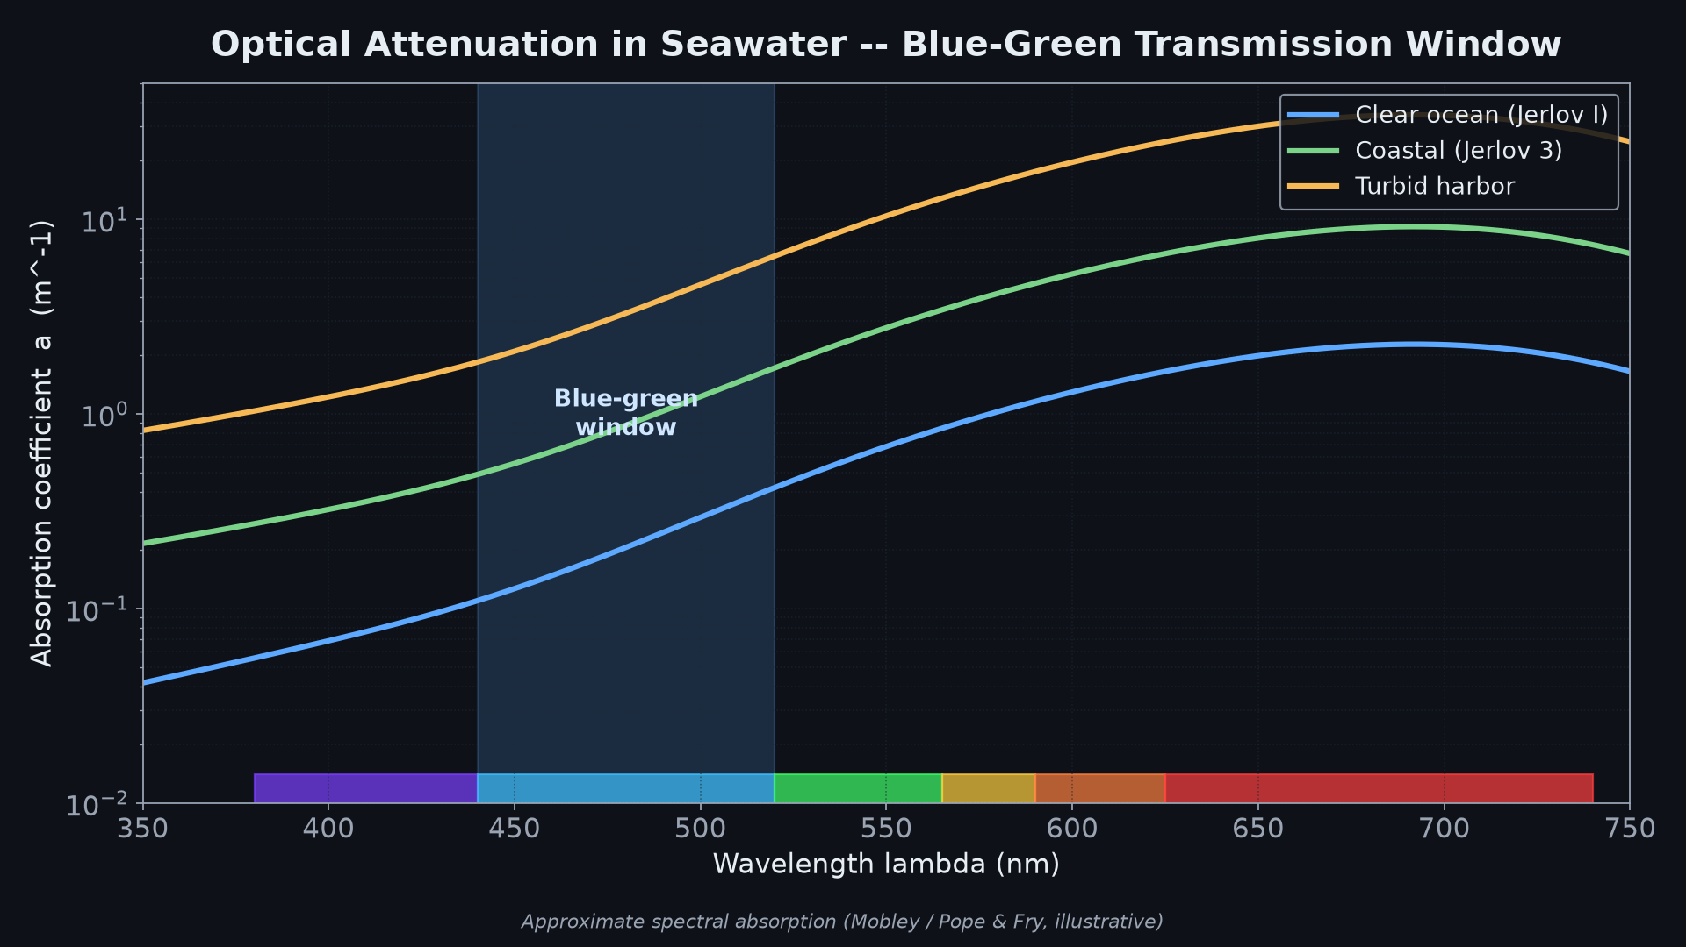
Optical (Blue-Green): Short Range, High Rate
• Physics Blue-green (~450-550 nm, min near 418 nm in pure water) is the minimum-absorption window
• Range 10s to ~100 m, depending heavily on turbidity
• Bandwidth Mbps to Gbps — orders of magnitude above acoustic
• Turbidity Clear ocean vs murky coastal water: night-and-day difference
• Pointing Tight alignment required — hard for anything mobile
• Best for AUV docking-station offload, ROV-to-surface HD video/sensor dumps
Reference systems: Sonardyne BlueComm (10 Mbps), WHOI optical modems, Ambalux.
30.102 Electromagnetics & Apps | Underwater Wireless Communications
4 / 7
Notes:
Optical is the complement to acoustic: order-of-magnitude more bandwidth at order-of-magnitude less range. Mention that natural seawater absorption peaks in the red and IR; the blue-green window is the residual 'hole' that lets light penetrate. This is also why deep-sea bioluminescence is mostly blue-green: it has the best chance of being seen.

Slide 5
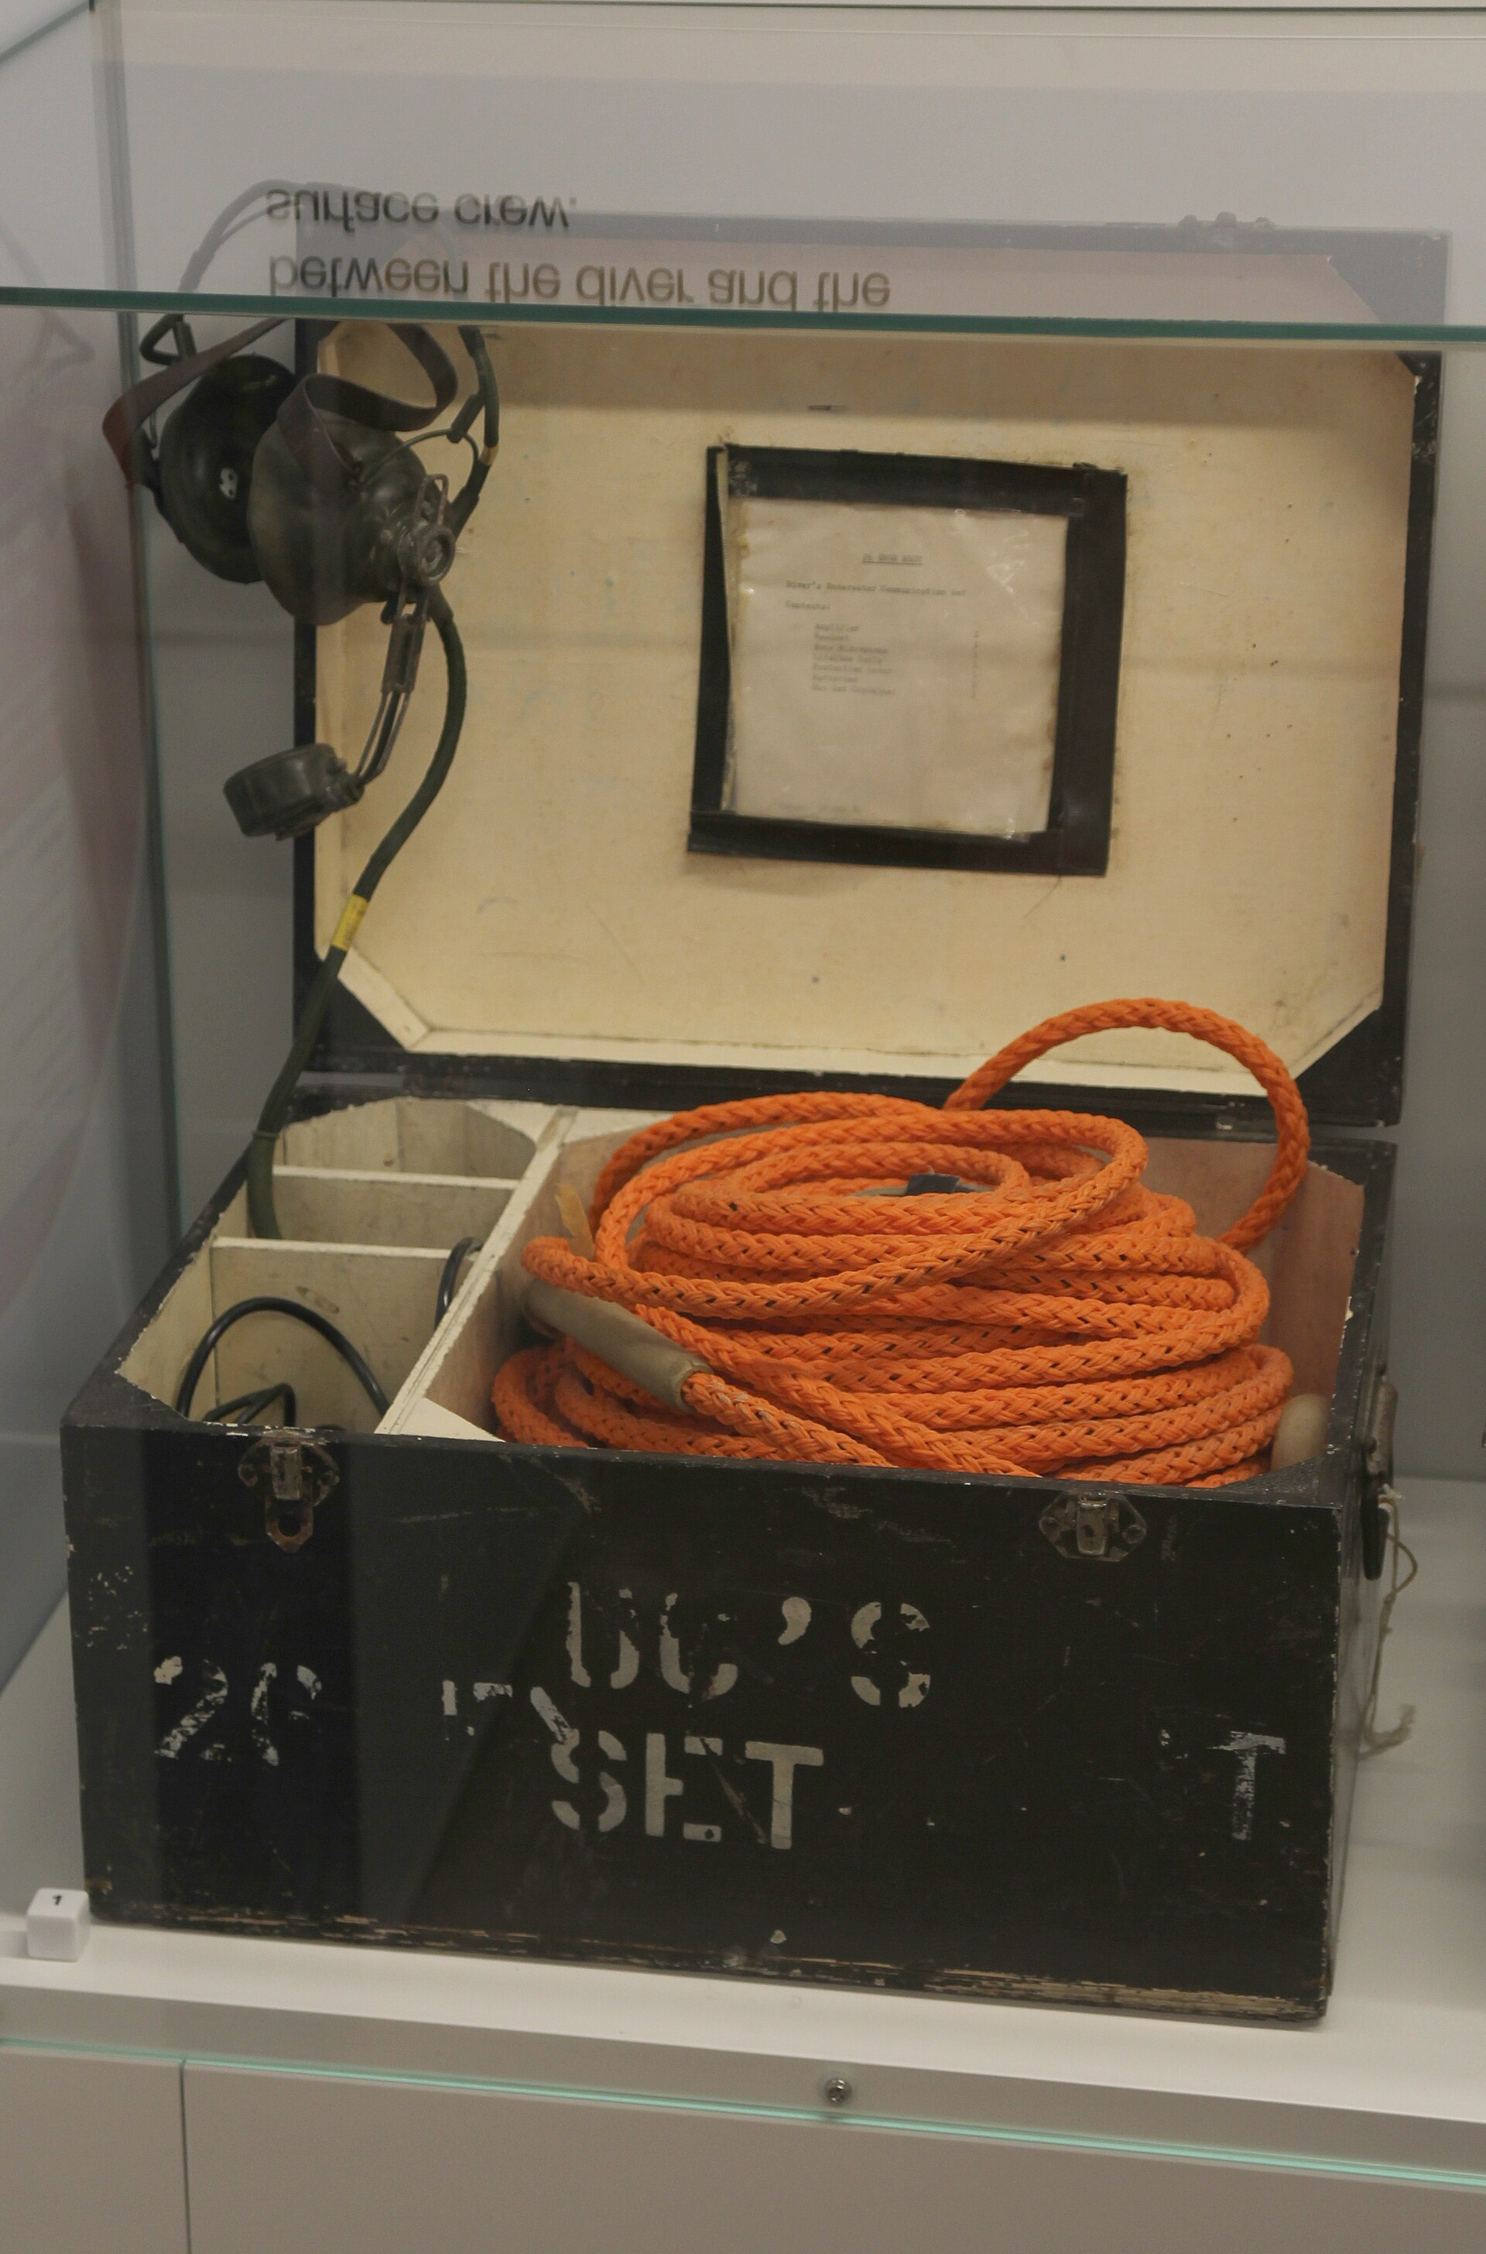
RF / Magneto-Inductive: Tough Conditions, Short Range
• Physics Near-field magnetic induction sidesteps far-field RF propagation loss
• Range Typically under 10 m
• Bandwidth Moderate — better than acoustic at short range, lower than optical
• Key advantage Insensitive to turbidity and multipath — physics doesn't care about water clarity
• Tradeoff Range drops fast with distance beyond near-field coupling
• Best for Diver-to-diver, short buoy-to-surface links, turbid or reflective water
Reference: diver with through-water comms rig.
Magneto-inductive links operate in the near field — coupling rather than radiation.
30.102 Electromagnetics & Apps | Underwater Wireless Communications
5 / 7
Notes:
Magneto-inductive (MI) communication is a near-field technique using coil-to-coil magnetic coupling. It exploits the fact that seawater is essentially transparent to quasi-static magnetic fields (unlike EM waves). Tradeoff: 1/r^3 rolloff in coupling is steep, so range is bounded. Useful where acoustics break down — high multipath, very turbid, or noise — and where you only need a few meters of range. Reference: MIT / WHOI publications on MI links for divers.

Slide 6
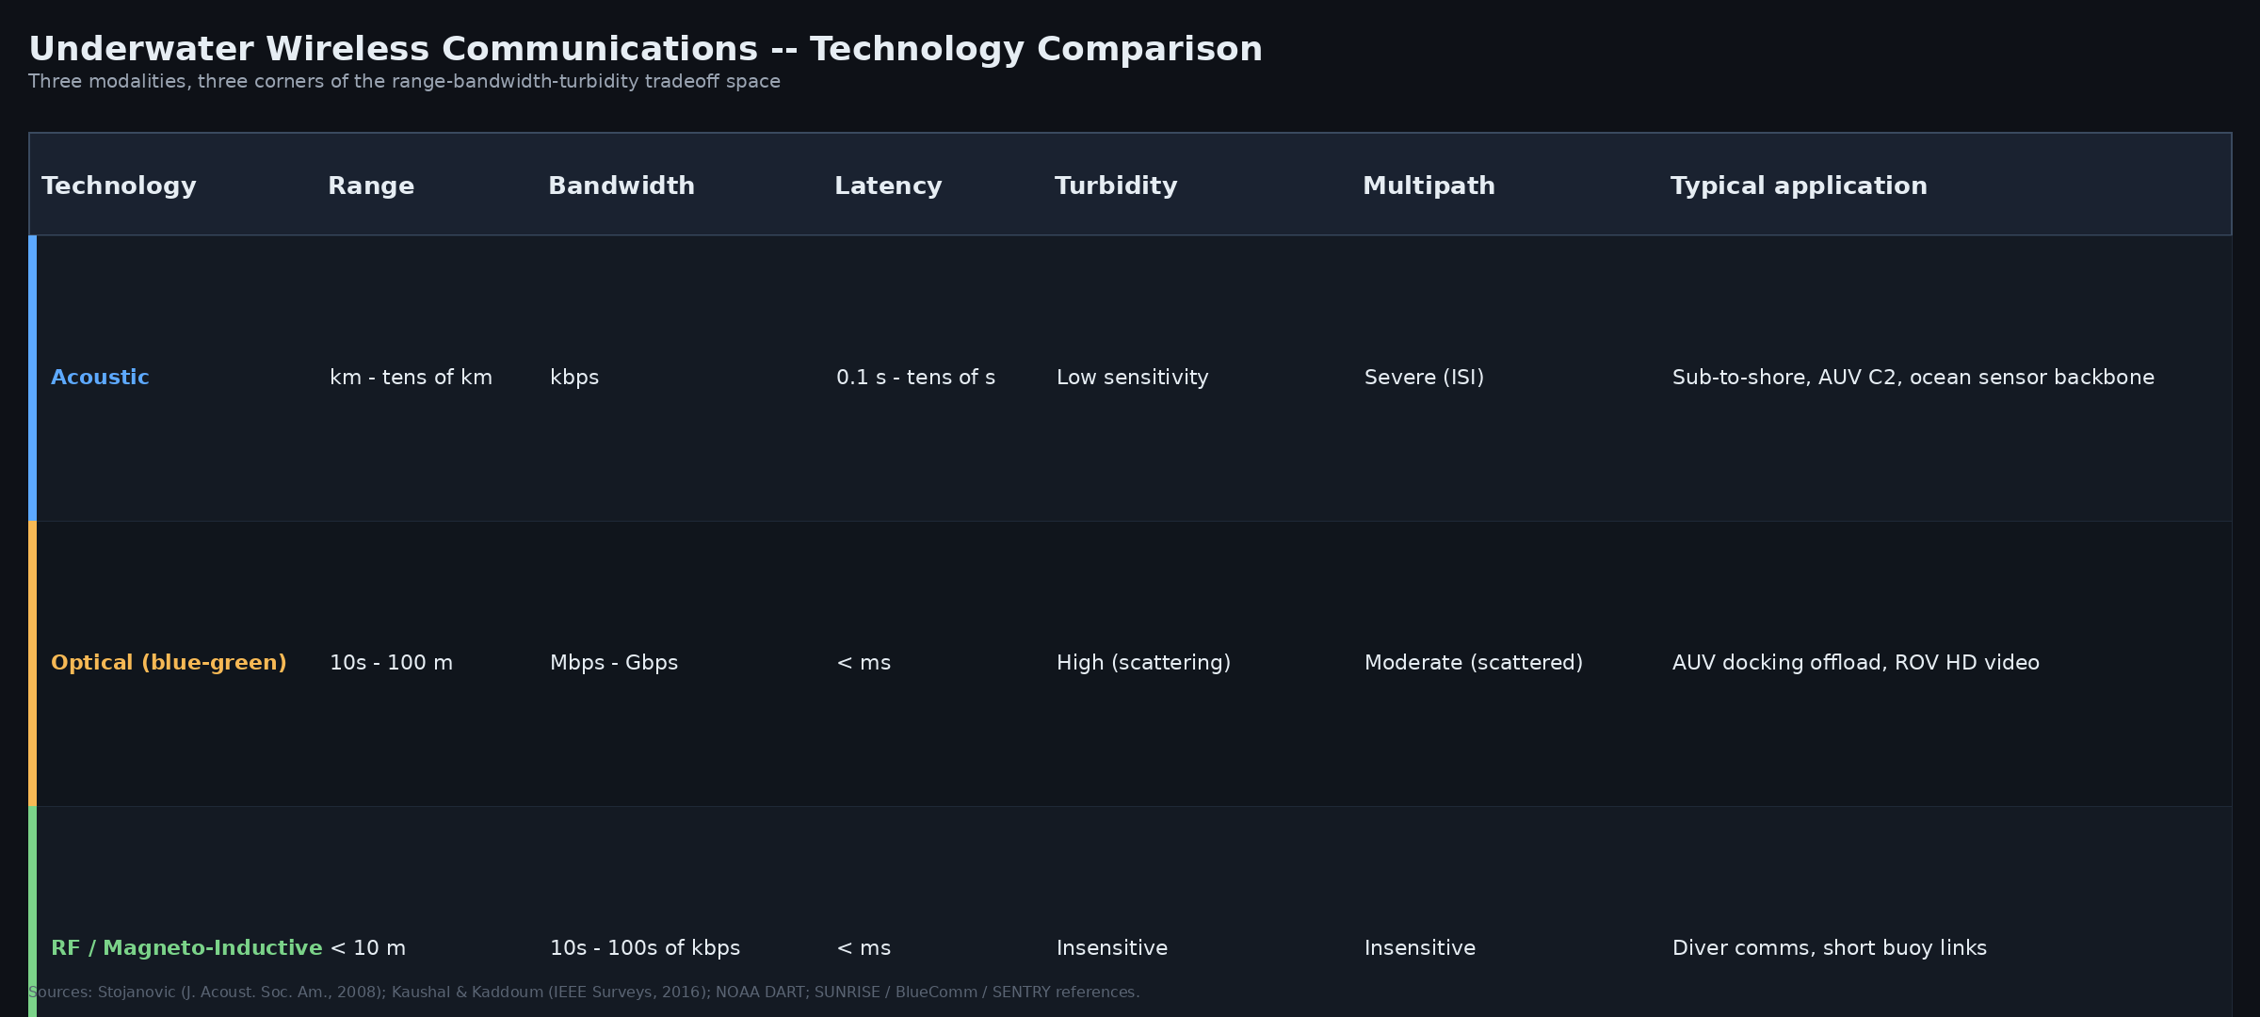
Comparison Table — The Slide People Screenshot
30.102 Electromagnetics & Apps | Underwater Wireless Communications
6 / 7
Notes:
This is the centerpiece. Walk left-to-right: acoustic has range but is sensitive to multipath; optical has bandwidth but loses to turbidity; RF/MI shrugs off both but only at short range. If asked 'which is best?' — point to the row matching the mission, not the column.

Slide 7
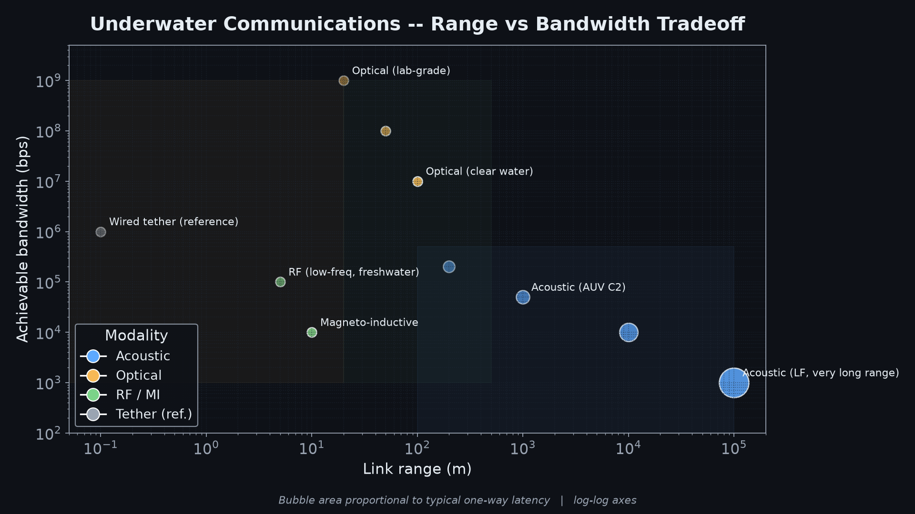
No Universal Winner — Hybrid Systems Win
Takeaways
• Each technology occupies a different corner of the tradeoff space
• Real systems increasingly hybridize modalities
• AUV example: acoustic for long-range C2, optical for high-rate bursts at the dock
• Match the technology to the mission, not the other way around
"The ocean forces you to pick your poison — the real engineering question is knowing which poison fits your mission."
30.102 Electromagnetics & Apps | Underwater Wireless Communications
7 / 7
Notes:
Close on the hybrid message. Modern AUVs are the canonical example: REMUS, Sentry, Autosub all use acoustic for command/telemetry and increasingly optical for high-bandwidth offload at docking stations. The map on the left makes it visually obvious why you cannot pick one technology and solve all underwater comms problems.

