Slide 1
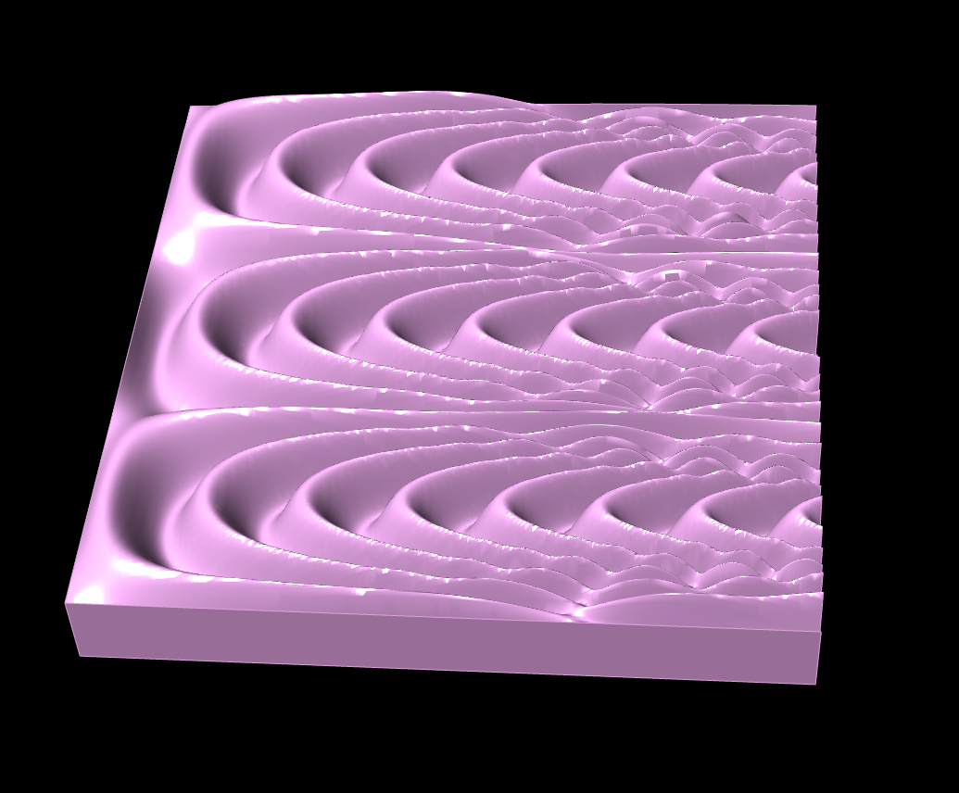
P1
<Computational Design Thinking>
<Parametric Design>
P1
Assignment
Context
Course
Date
Parametric
Design
Freshmore
Term 1
Computational
Design Thinking
2024
Student
<Description and Overview>
Chua Heng Li
1008931
This structure is a 3D rendered object that is constructed with the use of mathematical concepts. The design contains three repeating spiral-like structures that gets more complex from left to the right.
It starts with a wave like pattern like that of a sine wave. With variation of the parameters and modification of mathematical values, this structure is produced with sine waves of different periods and amplitudes.
Hence the x and y values vary, and coordinates are transposed to different locations, creating the structure with spiral like shapes.
This model is then transposed onto a square surface to be 3D printed.
Instructor
Yeow Zhi Wei Michael Augustine​

Slide 2
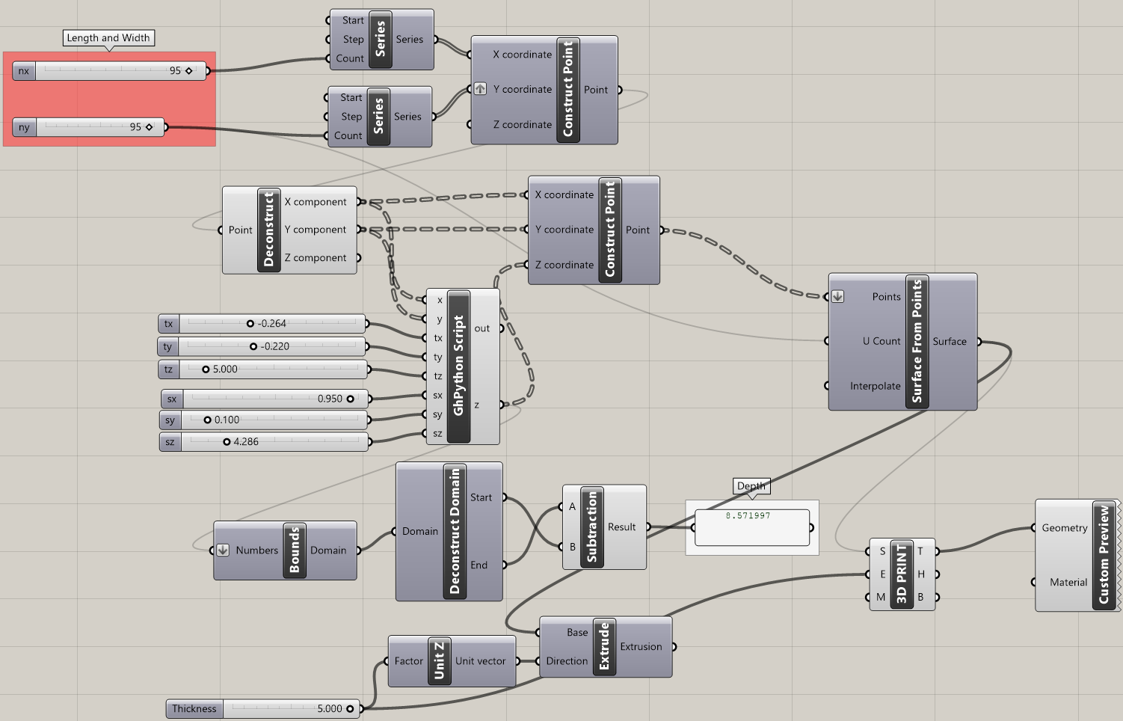
P2
<Computational Design Thinking>
<Parametric Design>
P2
Captions
01 Grasshopper Circuit
<Grasshopper Circuit>
The grasshopper circuit plots points that are used to create a surface. The z-coordinates of the points are dependent on an equation in the python script. The surface is then transposed onto the 3D square surface such that it can be easier to 3D print.
From the given layout under data landscapes that was gone through in lesson, I have adjusted the equation in the python script relating the variables by adding another sine function with a different relationship between Sx and Sy. This adjustment is to show that with just a simple sine function, it can be used to create an even more complex model.
By varying the parameters, I was able to arrive at a more different model compared to the normal sine wave model at the beginning. Due to the requirement of printing the model, a simpler model was what I arrived at due to the 3D printing constraints.
01

Slide 3
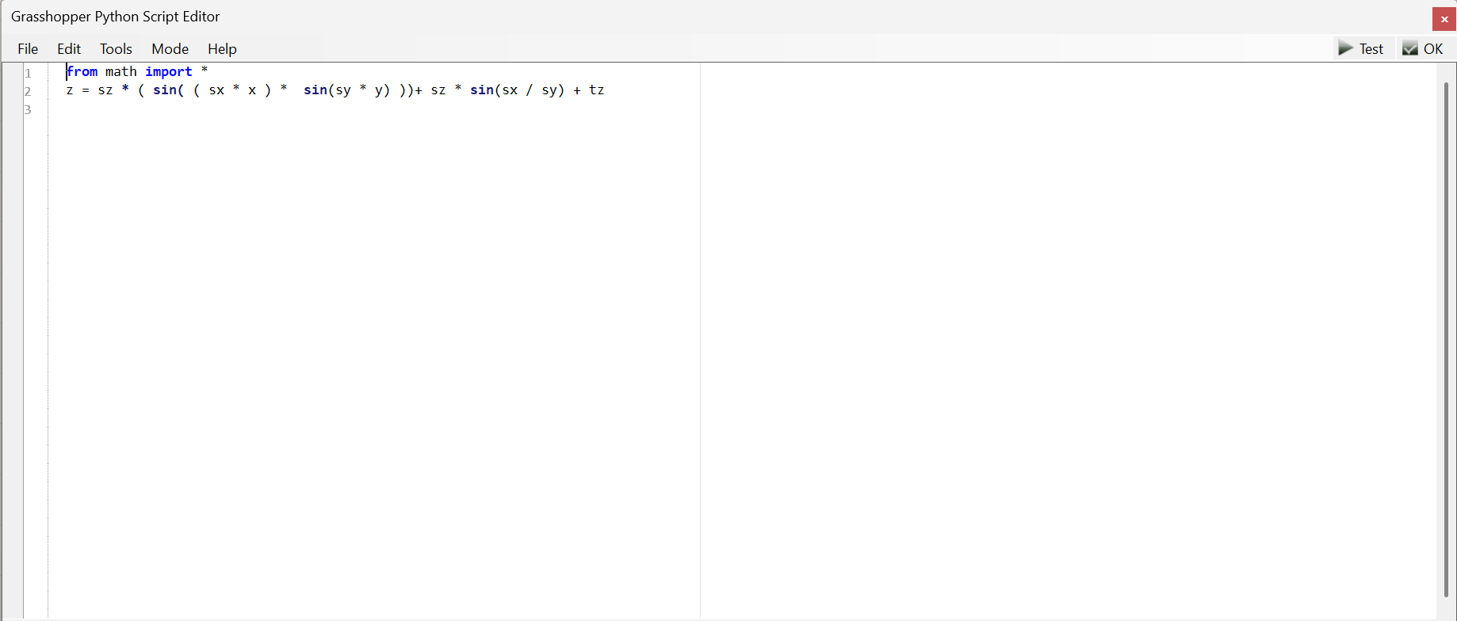
P3
<Computational Design Thinking>
<Parametric Design>
P3
Captions
01 Python Script
<Python Script>
The Python Script is made up of a bunch sine functions that are varied with multiplication and division functions between Sx, Sy, x, y.
The product of Sx and x, with product of Sy and y are placed into sine functions. The sine functions are then multiplied together and scaled by a factor of Sz.
This is followed by the adding a factor Sz of the sine of Sx divided by Sy and finally adding tz to the equation.
01

Slide 4
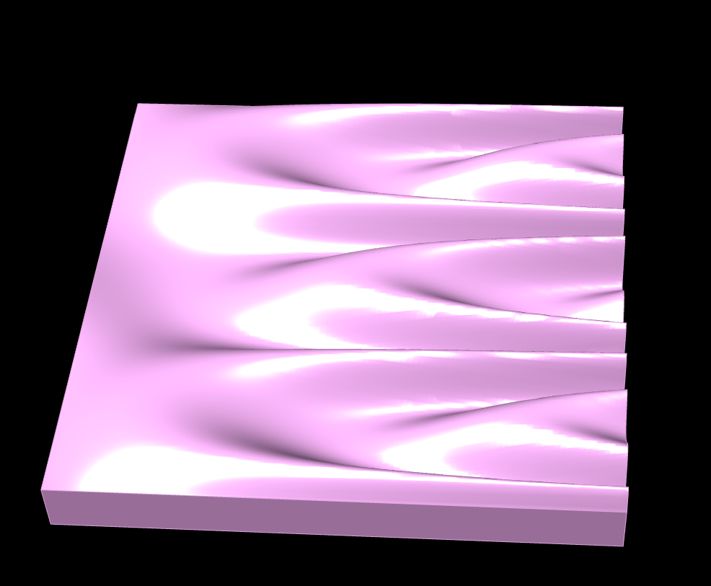
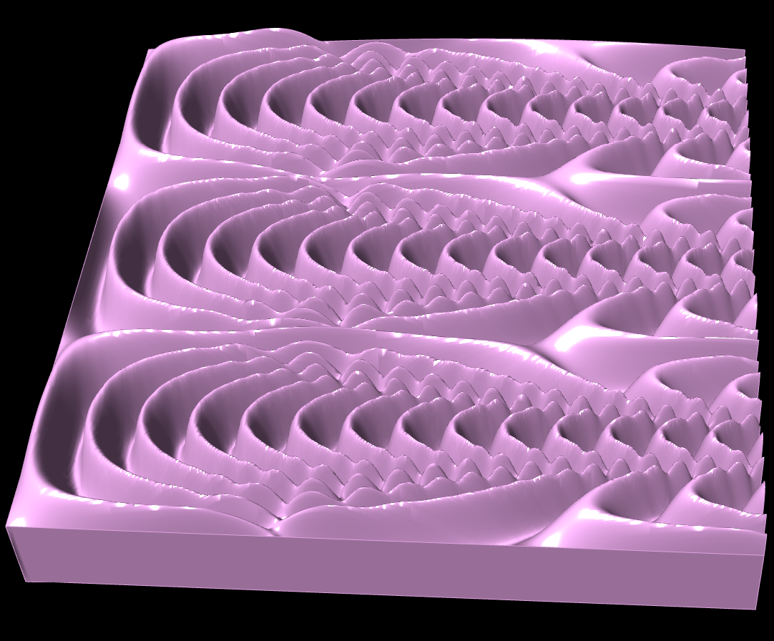
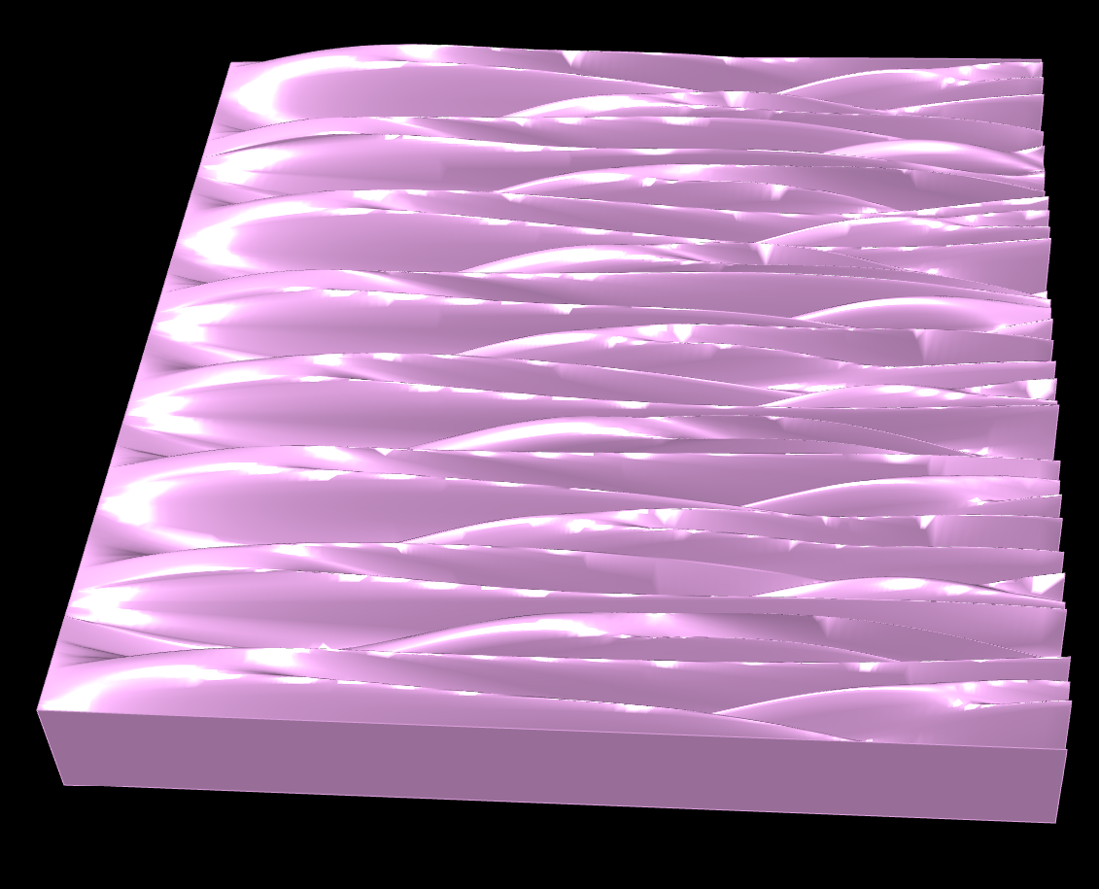
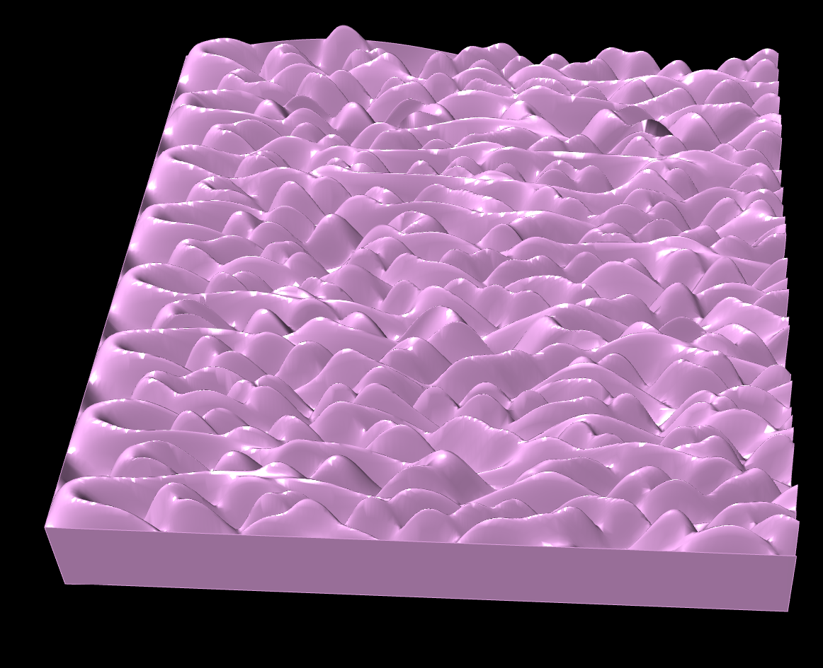
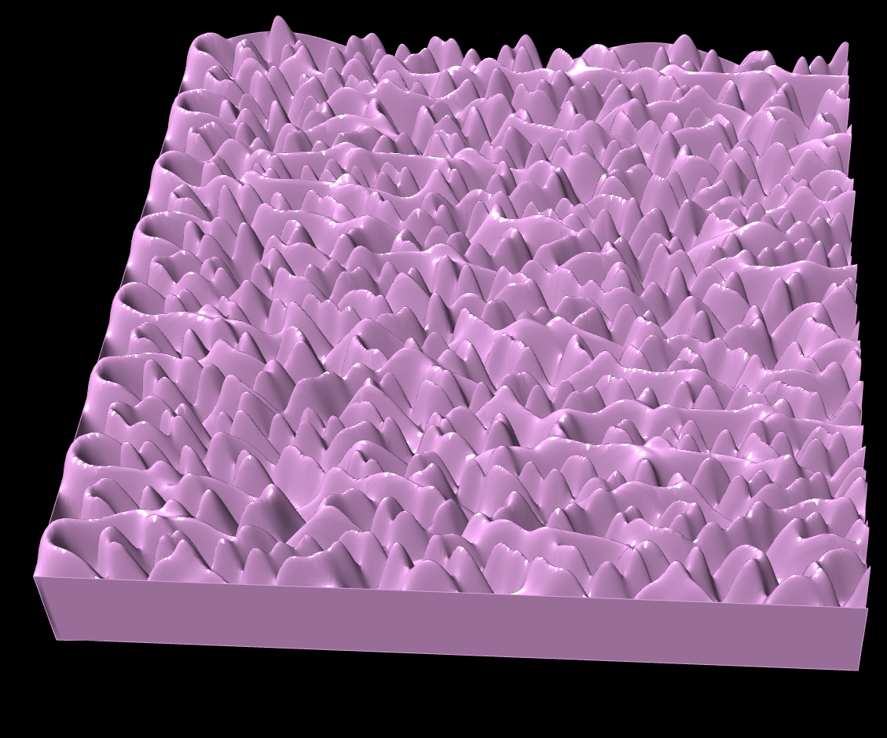
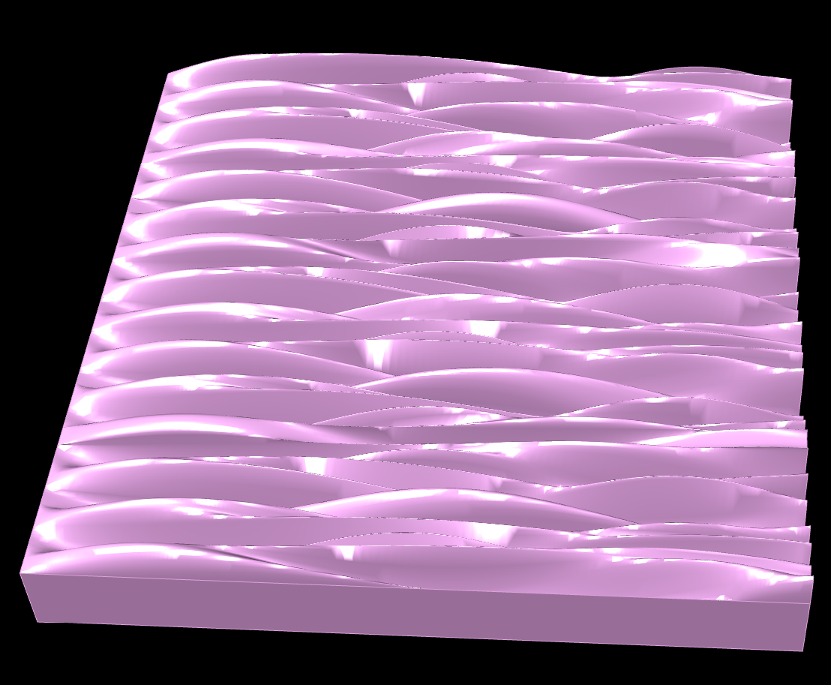
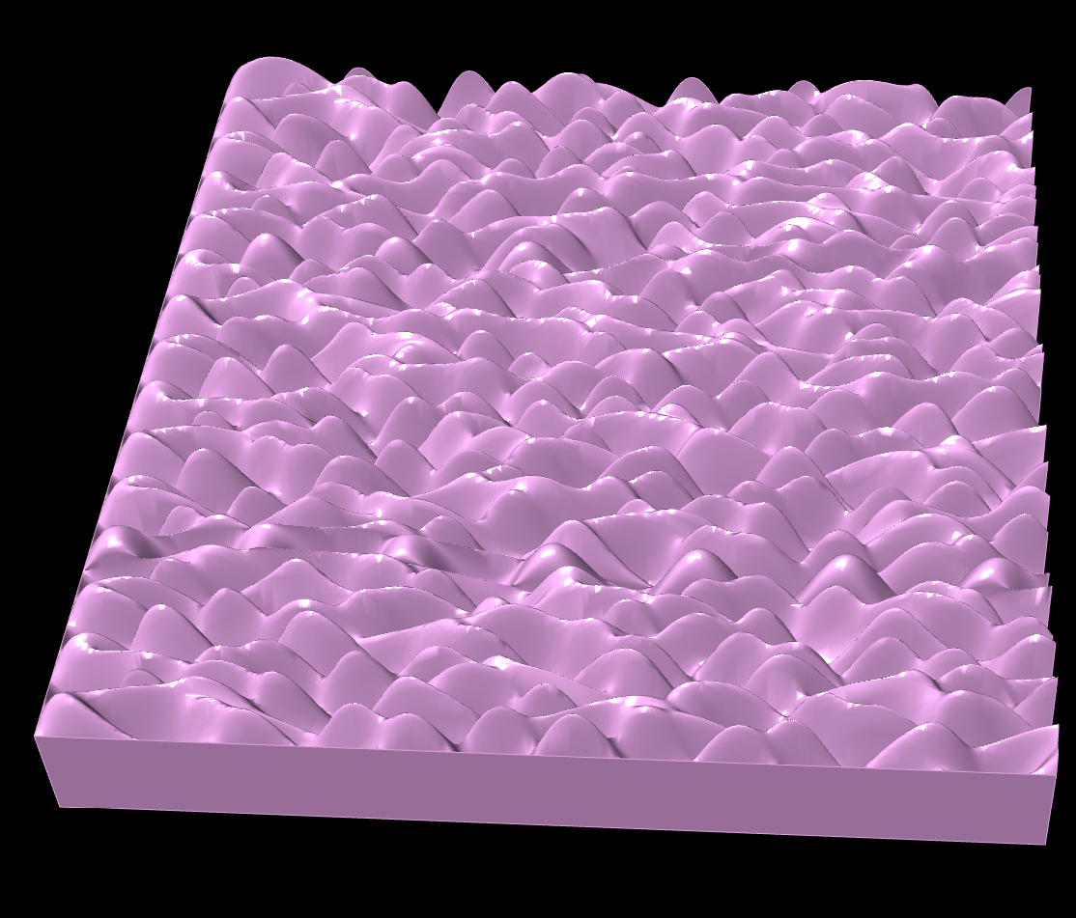
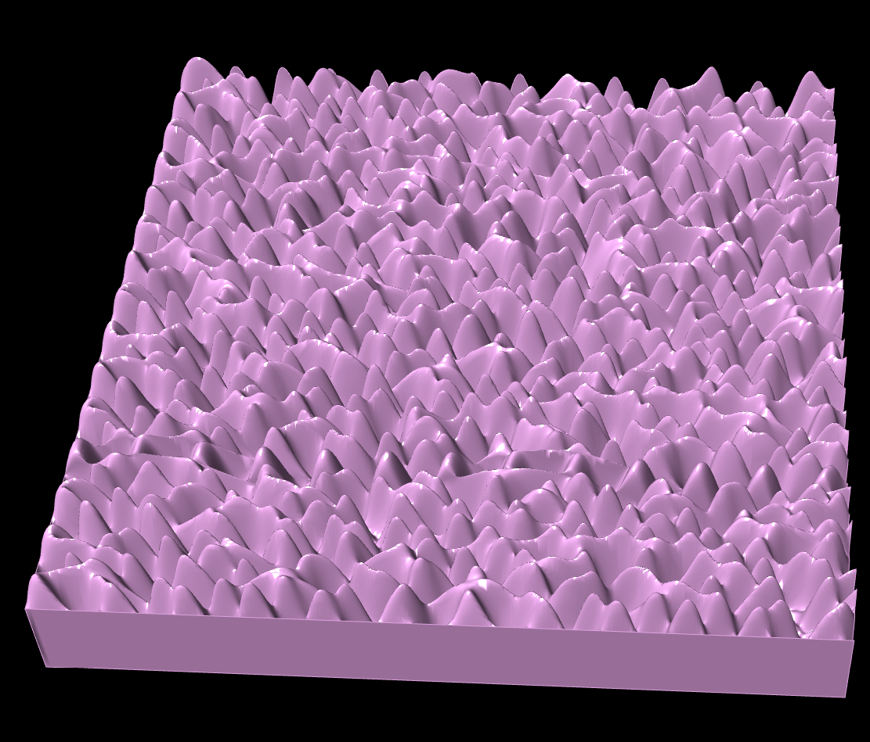
P4
<Computational Design Thinking>
<Parametric Design>
P4
Sx = 0.10
Sx = 0.50
Sx = 0.95
Sy = 0.10
Sy = 0.50
Captions
01 Variation mapping
Sy = 0.95
01

Slide 5
P5
<Computational Design Thinking>
<Parametric Design>
P5
<Design Evaluation>
Low Quality
Low Quantity
High Quality
High Quantity
Sx: 0.10
Sy: 0.10
Area: 12745
Time taken: 1h 14min
Sx: 0.95
Sy: 0.10
Area: 38079
Time taken: 2h 47min
After looking through the models, with varying quality and quantity, I have decided to choose the model with high quality and low quantity.
This is because it has the complexity and distinct structure that separates itself from the rest of the possible models. Furthermore, after finding out the time taken, surface area and cost of production, I feel that this model is the most feasible to 3D print
High Quality
Low Quantity
Low Quality
High Quantity
Sx: 0.50
Sy: 0.10
Area: 34025
Time taken: 2h 25min
Sx: 0.95
Sy: 0.95
Area: 41551
Time taken: 4h 8min
Captions
01 LL
02 HH
03 HL
04 LH
<Qualitative>
The quality of the model is defined as how aesthetically pleasing the model and how unique the model is relative to the other models of different parameters
<Quantitative>
It is defined as the amount of material being used, measured by surfaced area and volume. This is related to the cost of production and time taken for production
01
02
03
04

