Slide 1

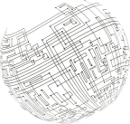
{Company}
{CampaignName}
{CampaignID}
{PerformanceID}

Slide 2

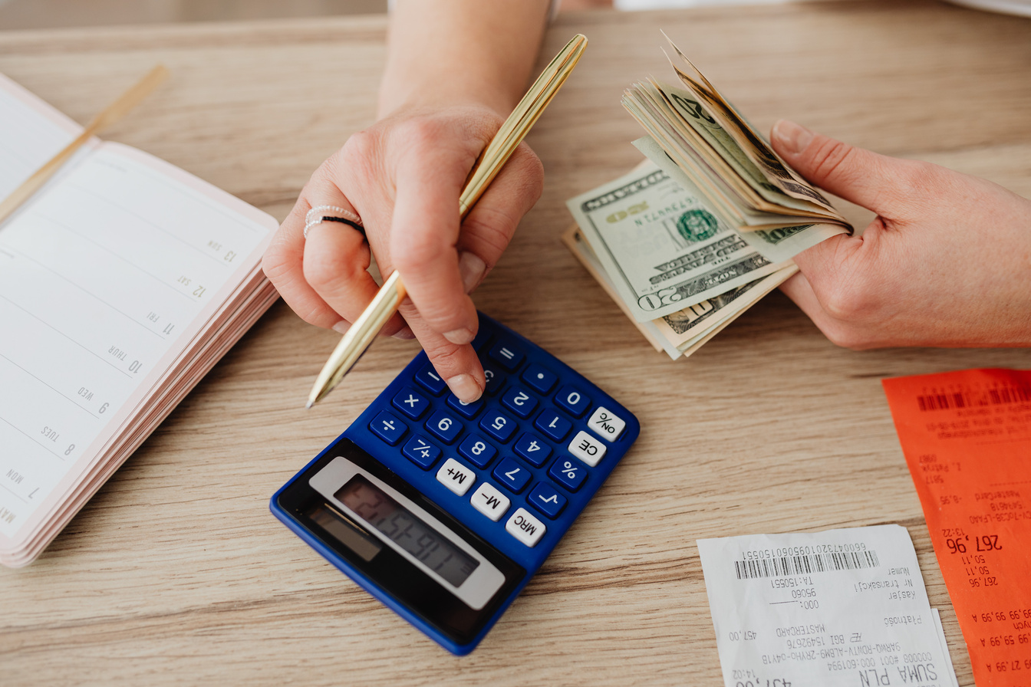



Ad Overview
Campaign Period
Total Spend
{StartDate} - {EndDate}
{Cost}
({CampaignDurationDays} days)
{SpendUsage}% of campaign spend
Ad Platform
Objective
Ad Format
{AdPlatform}
{Objective}
{AdFormat}

Slide 3



Target Audience
Target Gender
Target Age Group
{TargetGender}
{TargetAgeGroup}
Target Interest (s)
{TargetInterests}

Slide 4





Ad Performance Summary
({PerformanceID})
Impressions
Clicks
{Impressions}
{Clicks}
CPM
CTR
CPC
RM {CPM}
{CTR}
RM {CPC}

Slide 5

THANK YOU

