Slide 1

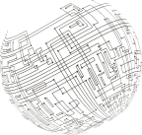
{Company}
{CampaignName}
{CampaignID}

Slide 2

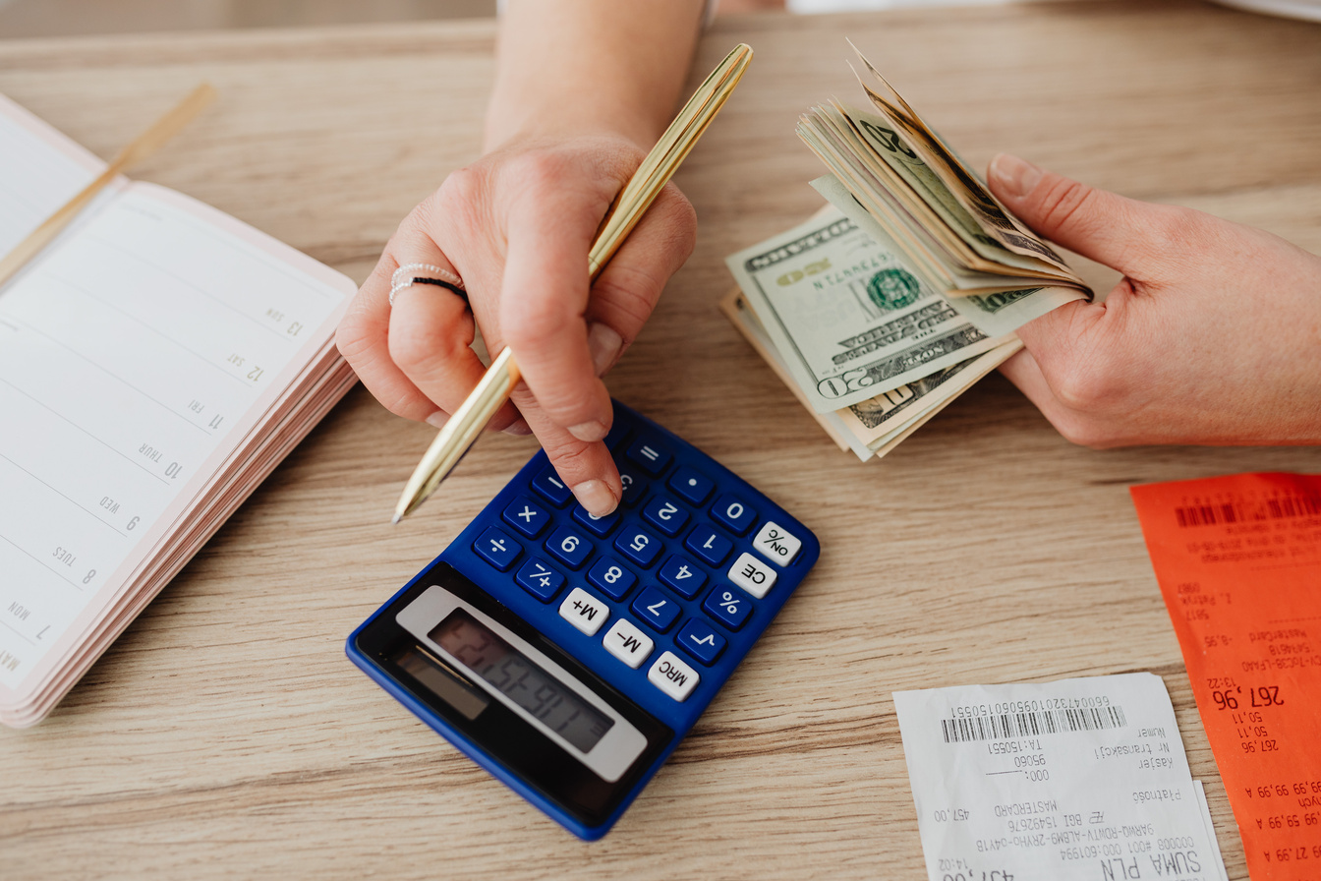



Campaign Overview
Campaign Period
Total Spend
{StartDate} - {EndDate}
{TotalSpend}
({CampaignDurationDays} days)
of {CampaignBudget} budget • {BudgetUsedPct}% used
Total Ads
Ad Platform
Objective
{TotalAds}
{AdPlatform}
{Objective}

Slide 3



Target Audience
Target Gender
Target Age Group
{TargetGender}
{TargetAgeGroup}
Target Interest (s)
{TargetInterests}

Slide 4





Campaign Performance Summary
({CampaignID})
Impressions
Clicks
{TotalImpressions}
{TotalClicks}
CPM
CTR
CPC
(Avg.)
(Avg.)
{AverageCPM}
{CTR}
{AverageCPC}

Slide 5
Campaign Performance
Spend by Ad Format
Impressions by Ad Format
{SpendByAdFormatChart}
{ImpressionsByAdFormatChart}

Slide 6
Top Performing Ads
Top 10 Ads by Spend
Top 10 Ads by Impressions
{TopAdsBySpendChart}
{TopAdsByImpressionsChart}

Slide 7

THANK YOU

