Slide 1
FinSecure Pay: Automating a Cloud-Native DevOps Pipeline
Capstone, NUS DevOps and DevSecOps programme. Jason Chua, November 2026.
A Spring Boot transaction validation API delivered from a Git push to a monitored, alerting service on Google Kubernetes Engine by Jenkins, with security gates that block the release.
Repository: https://github.com/chuajason/finsecure-pay
Image: hub.docker.com/r/chuajason/finsecure-pay
Notes:
Title. 45 seconds. State the business problem from the brief and that everything shown is live; start the pipeline run right after this slide.

Slide 2
The problem is the delivery system, not the validation logic
FinSecure Pay in the brief
10
10
Deployments done by hand, with downtime and no record of what is running where
Problems discovered by customers, not by monitoring; no alerting path
Security checks inconsistent or absent; vulnerable dependencies reach production
Configuration and secrets managed ad hoc
pipeline stages, failing stage stops the run
Jenkins builds: success, failed test, release, rollback, blocked CVE, fix
15
2
What I built
JUnit tests on every build
replicas, never fewer than 2 ready during a rollout
Git push to GitHub starts Jenkins through a webhook; 10 stages from Checkout to Smoke Test
Tests, SpotBugs and two Trivy scans must pass before anything is pushed or deployed
GKE Deployment with 2 replicas, probes, zero-downtime rollouts and one-click rollback
Prometheus, Grafana, Alertmanager to Gmail, Cloud Logging, and an Isolation Forest watcher
4
16
Prometheus alert rules, email on fire and resolve
CRITICAL CVEs the gate found in my own first image
Notes:
Overview. 45 seconds. Left: the business problem; right: the numbers that summarise what was built and exercised.

Slide 3
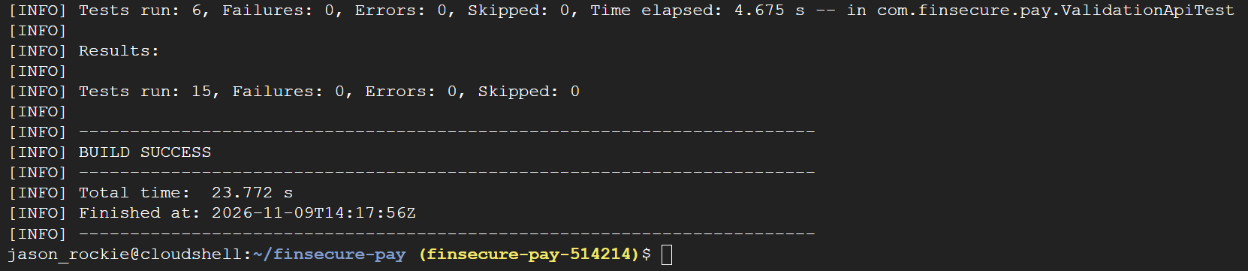
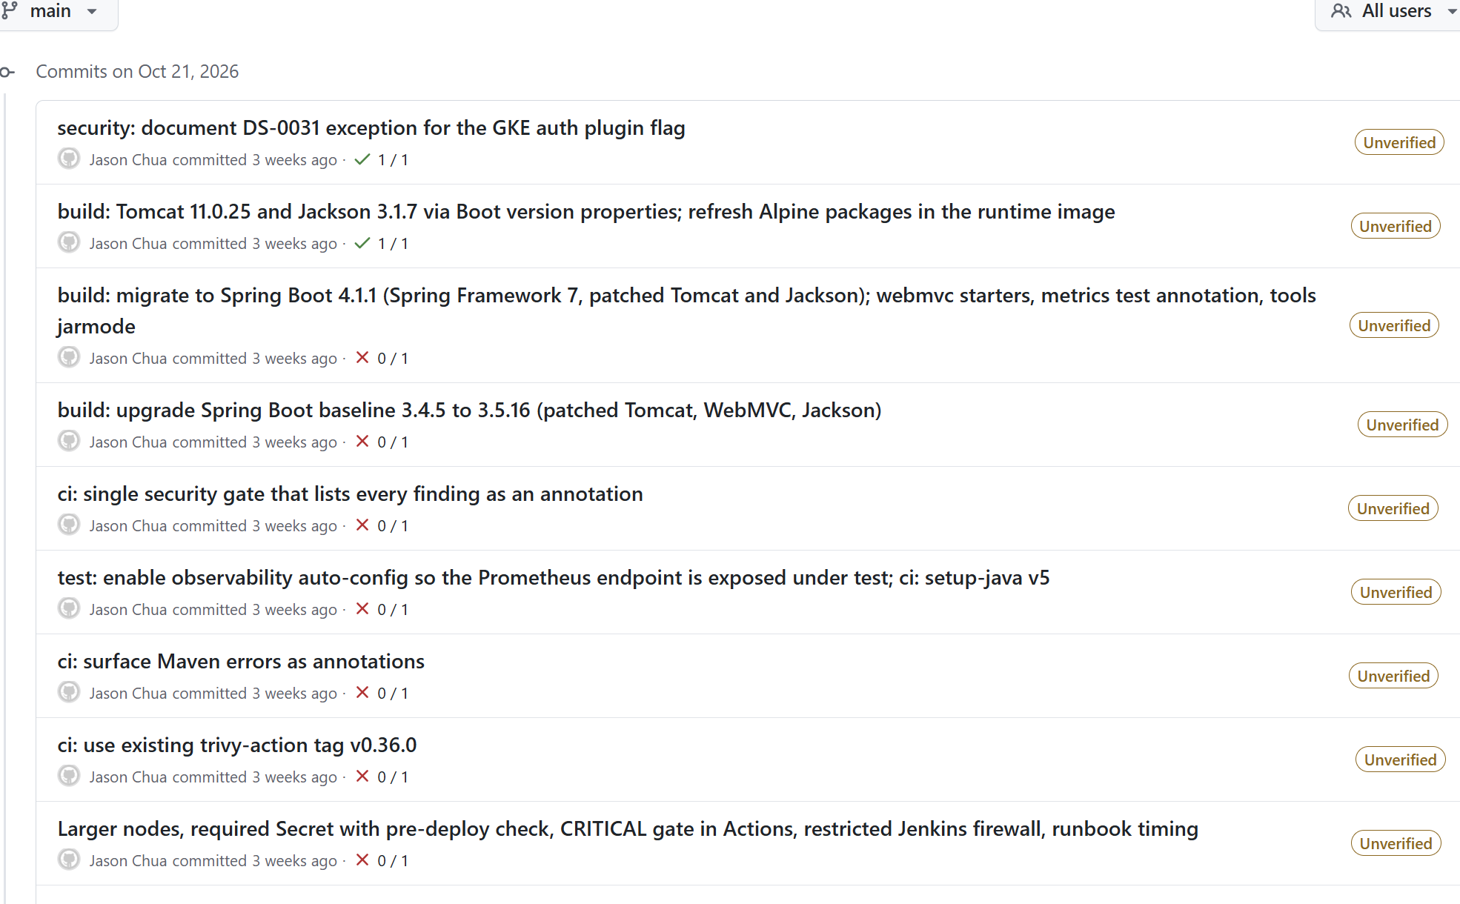
Task 1: application and version control
Spring Boot 4.1.1 on Java 21, Maven, layered jar. Migrated from 3.4 after Trivy found 16 CRITICAL CVEs in Tomcat and Spring WebMVC
POST /validate: 8 rules (amount, decimals, currency, timestamp skew and age, duplicate id, per-account velocity). 200 APPROVED, 422 REJECTED with reason codes, 400 malformed
GET /health: version, start time and whether the secret is configured, never its value. Actuator probes and /actuator/prometheus
Limits come from a Kubernetes ConfigMap, not the code
15 JUnit tests: 9 on the validator with a fixed clock, 6 through MockMvc including the metrics counter
Public repo chuajason/finsecure-pay. The history is real, including the failing Actions runs that drove the Boot 4 upgrade
mvn test: 15 tests, 0 failures
Commit history with the Actions result on each commit
Notes:
Application and Git. 60 seconds. Point at the commit list: red crosses are the CVE-driven upgrade, not noise.

Slide 4
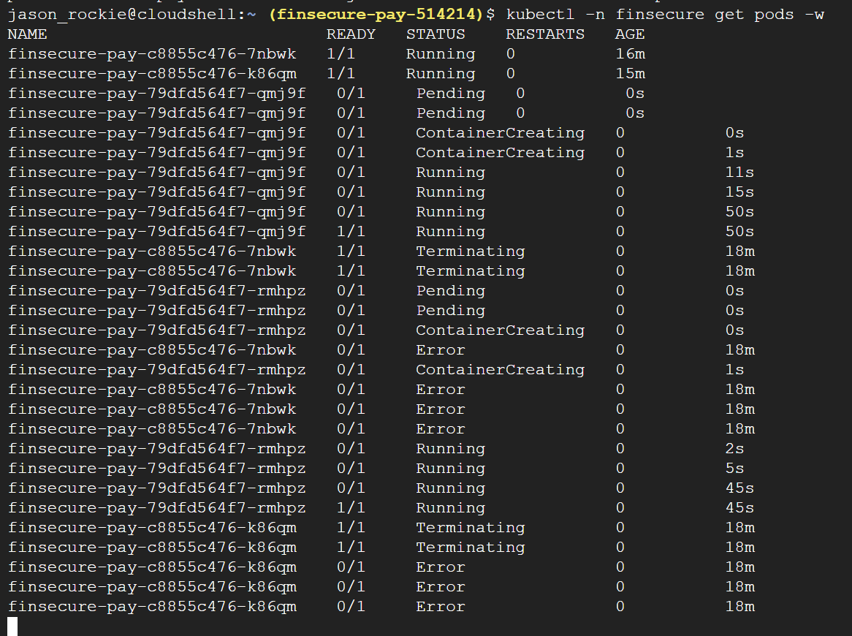
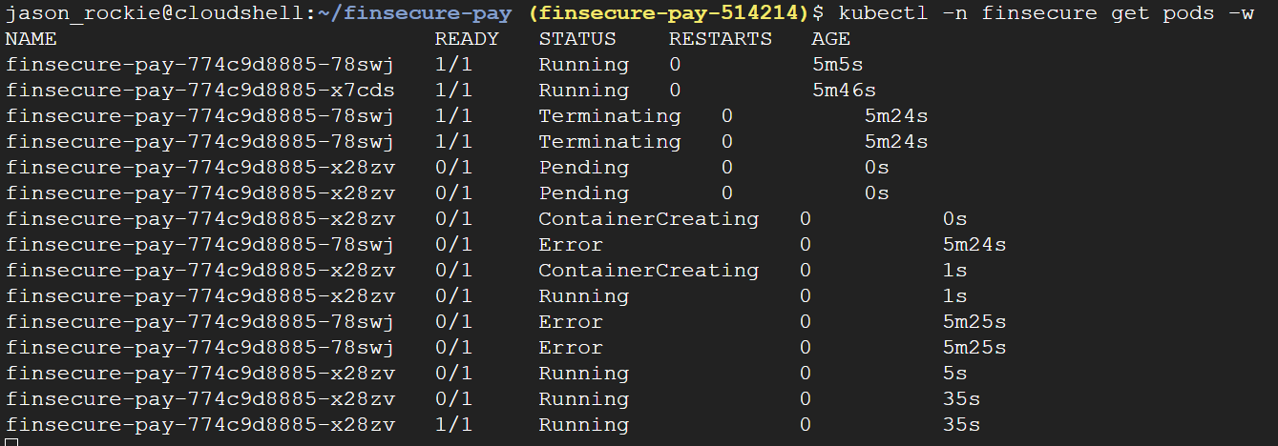
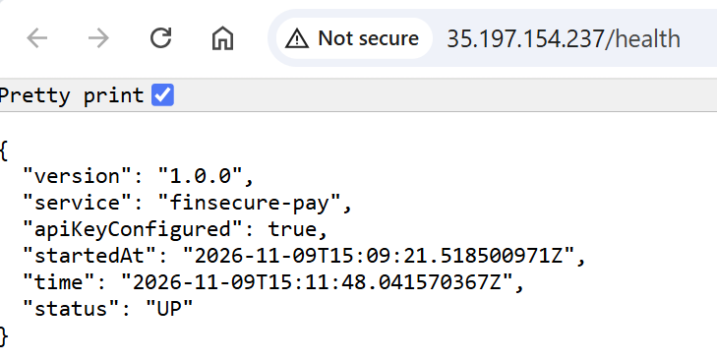
Tasks 2 and 3: container and GKE deployment
Container
Multi-stage Dockerfile: Maven build stage, Temurin 21 JRE on Alpine runtime, apk upgrade, HEALTHCHECK
Layered jar so the dependency layer is cached between builds
Non-root numeric uid 10001. Tagged pom-build-sha and pushed to Docker Hub by the pipeline
2 pods Running and Ready behind the LoadBalancer
Kubernetes (GKE, zonal, 2 x e2-standard-2)
Deleted pod recreated in 35 s
Deployment with 2 replicas, RollingUpdate maxSurge 1 maxUnavailable 0, startup, readiness and liveness probes on Actuator
LoadBalancer Service, ConfigMap via envFrom, required Secret created by hand, PodDisruptionBudget
Pod security: runAsNonRoot, read-only root filesystem, all capabilities dropped, RuntimeDefault seccomp
Lesson: the first pod failed with CreateContainerConfigError because the image user was a name. runAsNonRoot needs a numeric uid
Rolling update: new pod Ready before old pod terminates
/health through the external IP
Notes:
Container and Kubernetes. 75 seconds. Then switch to Cloud Shell for get pods and the health curl.

Slide 5
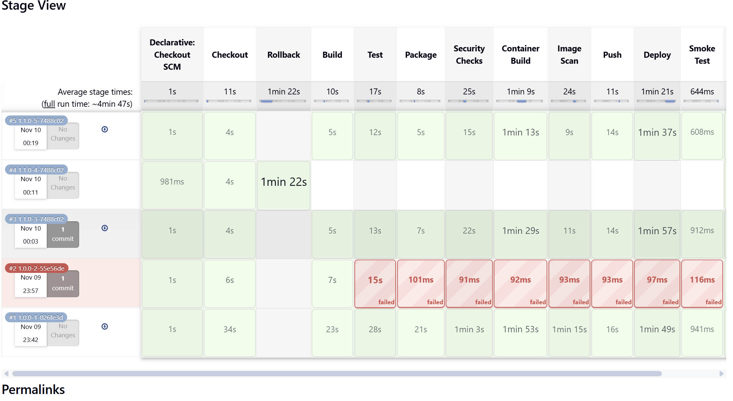
Task 4: Jenkins pipeline, 10 builds that tell the story
Checkout, Build, Test, Package, Security Checks, Container Build, Image Scan, Push, Deploy, Smoke Test. Any failure stops the run
Version tag = pom version, build number, short SHA. Every image traces to one commit
Deploy applies the manifests, annotates the revision with the build number, waits for rollout status; a failed rollout triggers rollout undo automatically
ROLLBACK parameter: skip the build, roll back in one click (build #4, 82 s, back to 1.0.0)
GitHub webhook starts builds; SCM polling as fallback. Email with console log and scan reports on every result
Build #2: controlled failing test, pipeline red at Test, production untouched, FAILED email
Stage View, builds #1 to #5: success, failed test (nothing after Test ran), release 1.1.0, ROLLBACK run, redeploy
Notes:
CI/CD. 90 seconds. Switch to Jenkins live: the build started at the beginning should be mid-pipeline. Click #2 to show the Test stage and skipped stages.

Slide 6
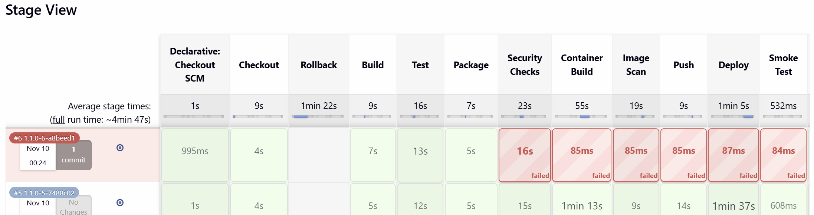
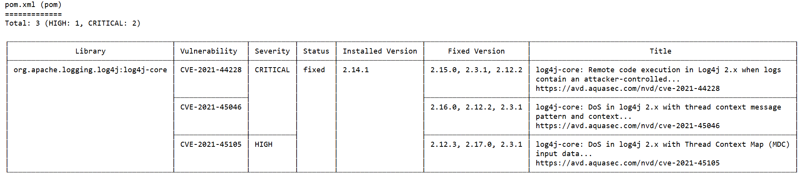
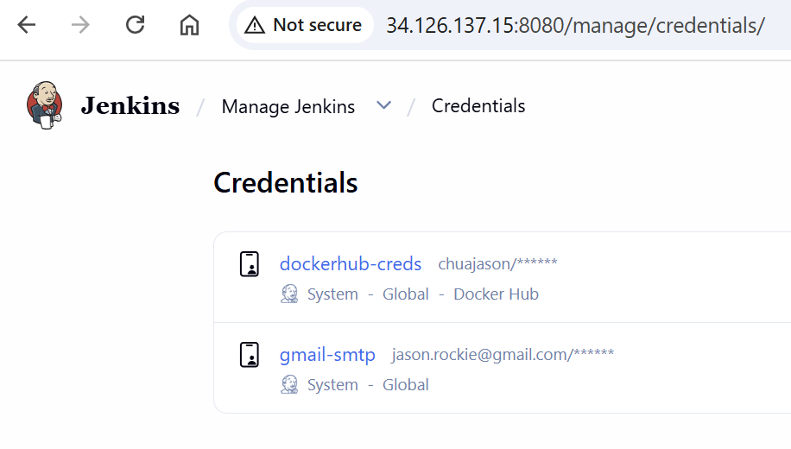
Task 5: security gates that block, secrets that stay out of Git
SpotBugs (high-priority bugs fail), Trivy on the repository (dependencies, Dockerfile and Kubernetes misconfiguration, secrets), Trivy on the built image. Policy: any CRITICAL fails before push
The same policy runs in GitHub Actions on every push as a second opinion. It found the 16 CRITICALs in my own first image
Remediation: remove the dependency, build #7 green. DS-0031 is a documented exception in .trivyignore
Credentials: Docker Hub and Gmail in Jenkins credentials (masked); GKE access through the VM service account, container.developer only; app secret is a Kubernetes Secret created by hand, required, checked before deploy
Jenkins UI reachable only from my IP and GitHub webhook ranges
Build #6: log4j-core 2.14.1 added, pipeline stopped at Security Checks in 16 s, nothing after it ran
Trivy report archived by the build: CVE-2021-44228 and CVE-2021-45046 CRITICAL, fixed version listed
Jenkins credentials, values masked
Notes:
DevSecOps. 90 seconds. Show build #6 console with the Trivy table, then Manage Jenkins, Credentials.

Slide 7
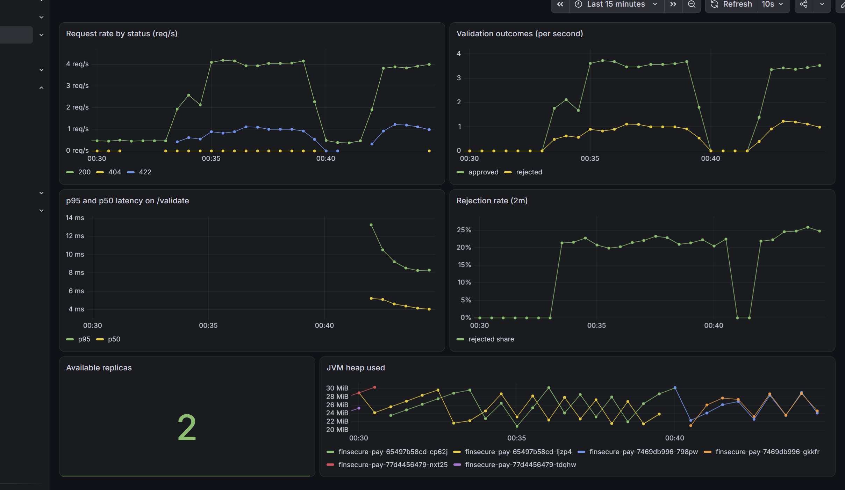
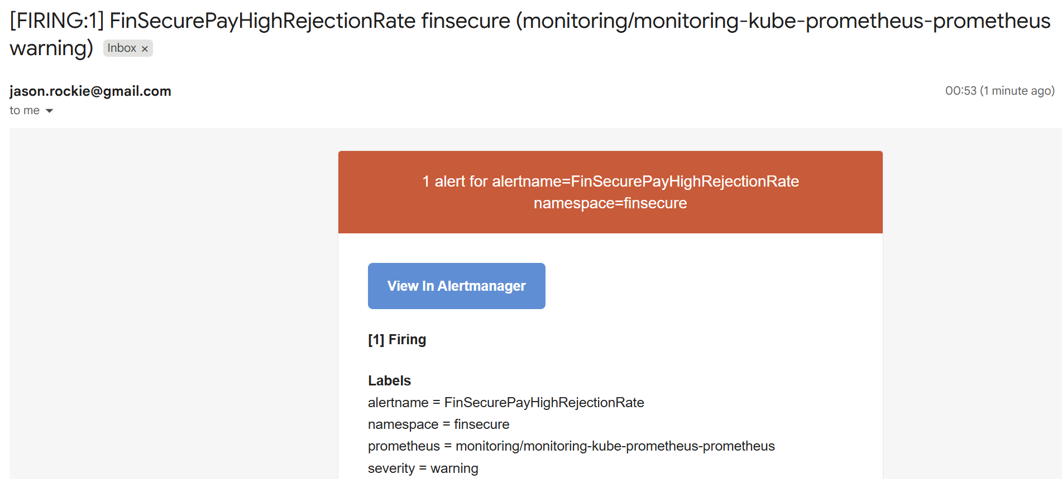
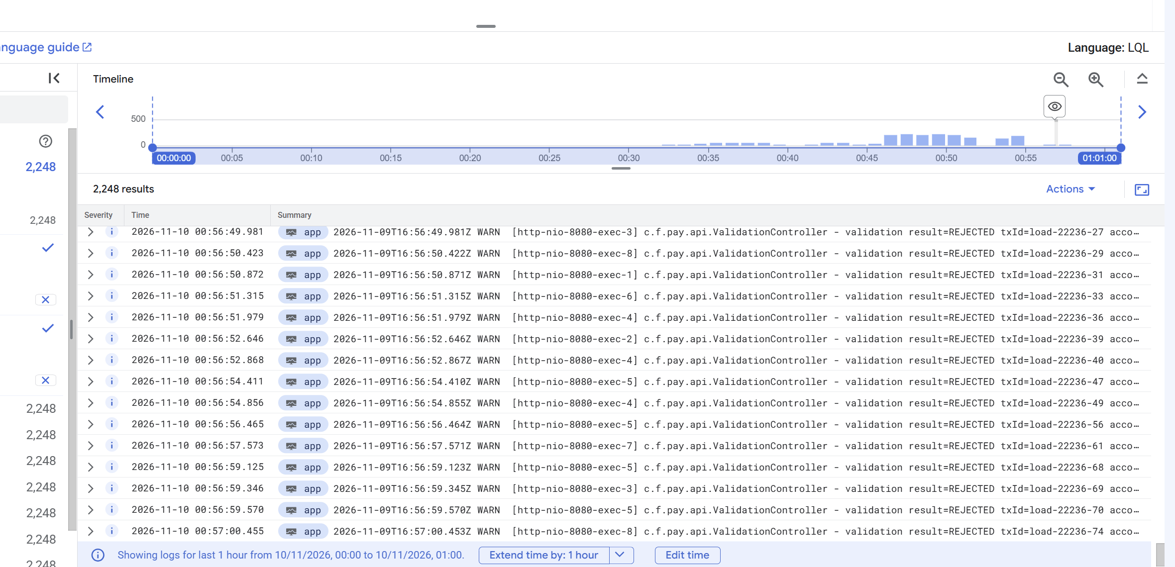
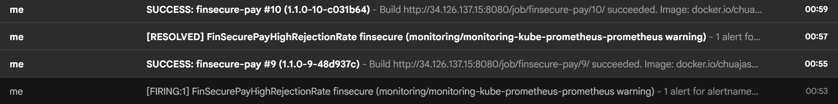
Task 6: monitoring, alerting and logging
Alertmanager email: 84.57% rejected
Cloud Logging: 2,248 REJECTED entries
kube-prometheus-stack by Helm; ServiceMonitor scrapes Actuator; dashboard from a ConfigMap
4 rules: Down, HighRejectionRate (> 50% for 2 min), HighLatency (p95 > 500 ms), ReplicasLow
Triggered with load at 80% invalid: Pending, Firing, email 30 s later, RESOLVED 4 min after load stopped
Alertmanager routes only namespace=finsecure to email; GKE control-plane noise goes to a null receiver
Structured log line per validation to stdout; kubectl logs per pod, Cloud Logging across pods
Lesson: Boot publishes no histogram buckets by default; p95 was empty until build #8 fixed it. And a wrong Gmail app password only shows in Alertmanager logs (535)
Grafana: request rate by status, approved vs rejected, p95 and p50, rejected share, replicas, JVM heap
FIRING, RESOLVED and Jenkins emails in one inbox
Notes:
Monitoring. 2 minutes. Switch to Grafana live, then Alert rules, then Gmail, then Logs Explorer.

Slide 8
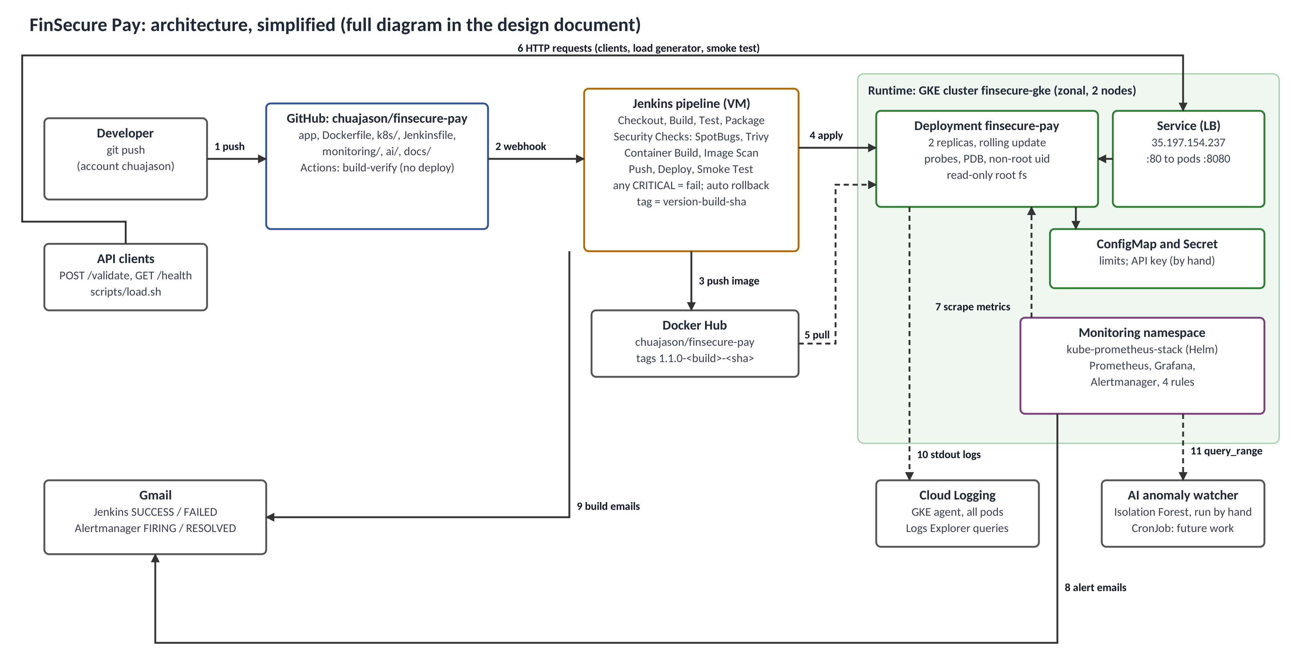
End-to-end architecture and the decisions behind it
Jenkins outside the cluster
Deployer separate from what it deploys; VM pauses on its own; service account instead of key files
Zonal GKE, 2 small nodes
Real LoadBalancer and Cloud Logging, free control plane, near-zero cost when paused
Trivy twice, Actions as mirror
One policy, two engines; repository scan catches dependencies before an image exists
Cloud Logging, not Loki
loki-stack is deprecated; GKE ships stdout with nothing to run
Known limit
Duplicate and velocity state is per pod; production needs Redis or a database
Notes:
Architecture, simplified for the slide. Numbered arrows follow one change from push to a monitored, alerting service. The full diagram is Figure 1 in the design document and docs/architecture.png.

Slide 9
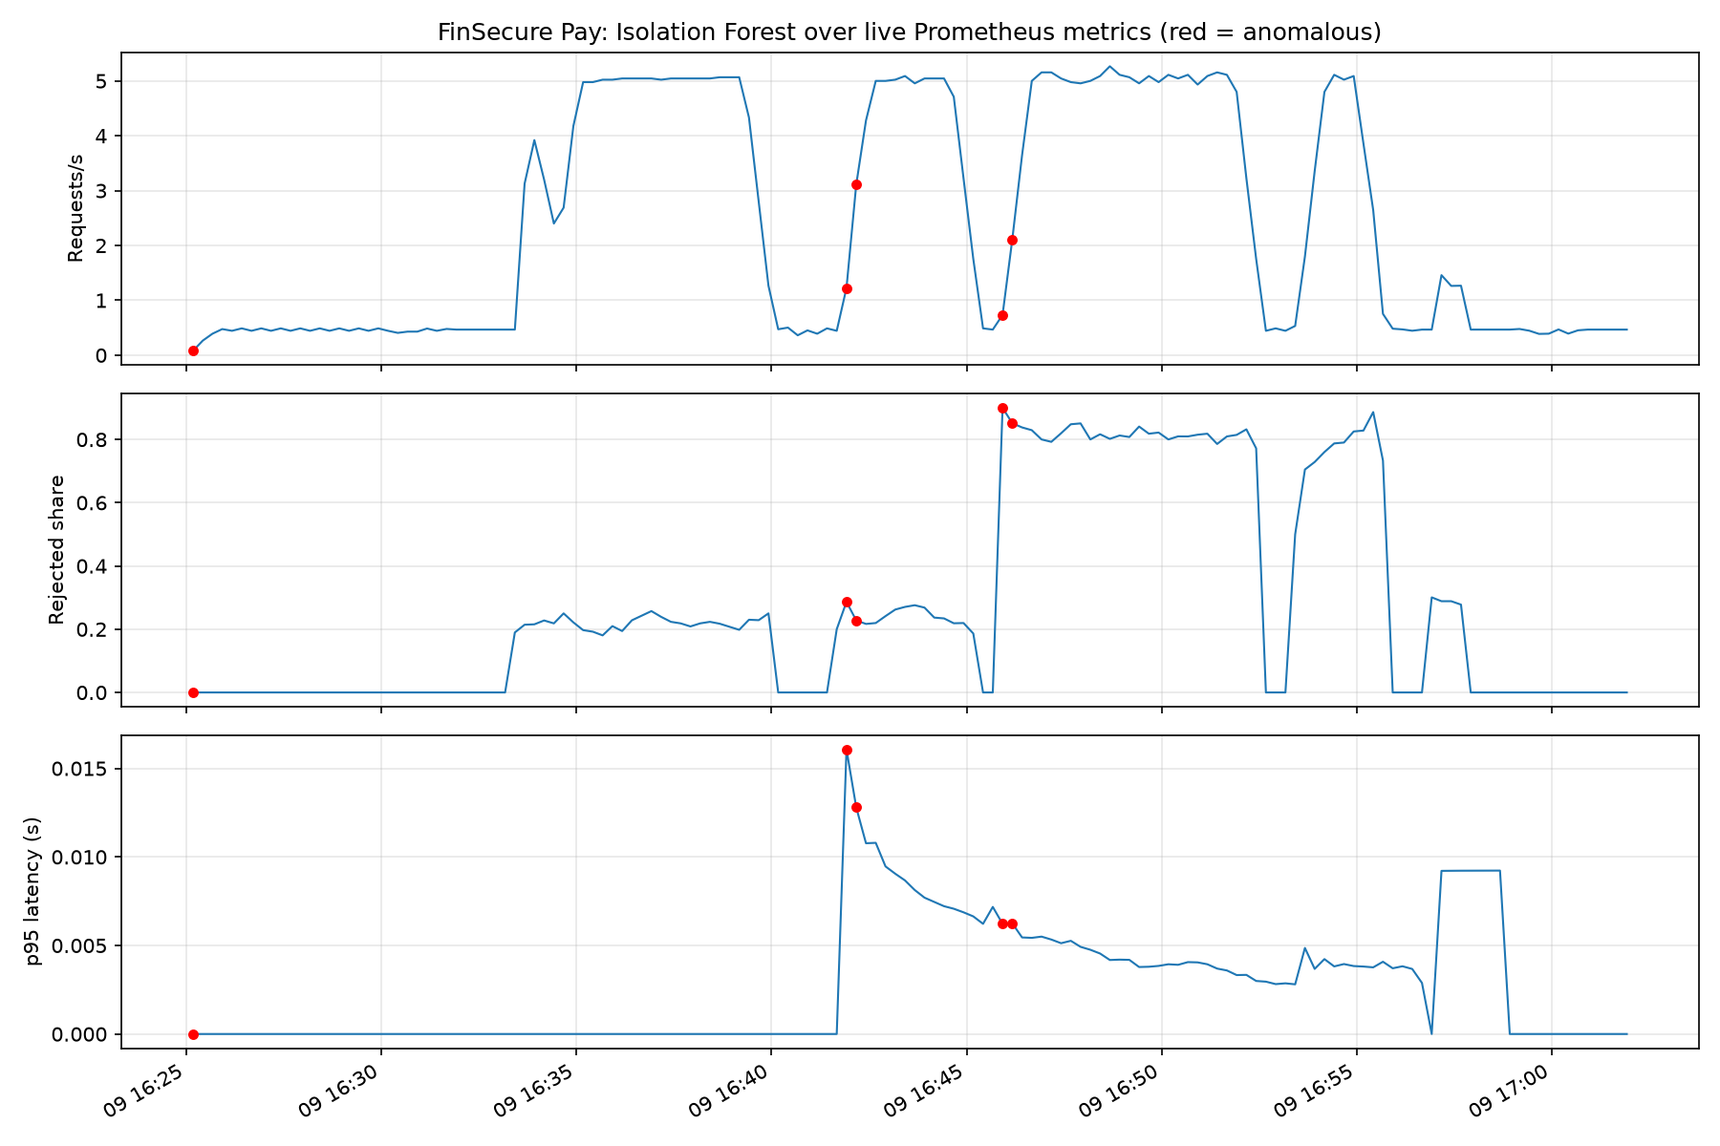
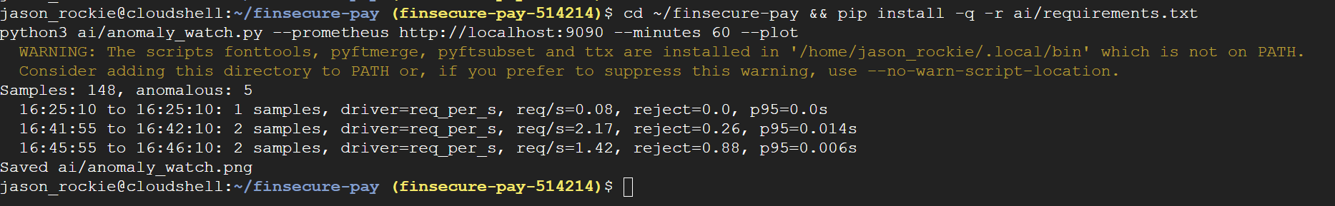
Task 7: AI use case, anomaly detection on the same metrics
1
Problem and why AI
Threshold rules only catch what I anticipated. An unsupervised model learns normal from the metrics and flags what does not fit, with no threshold per signal. Cheap false positives: a human glance, not an action
2
Inputs
3 PromQL series at 15 s resolution over 60 min: request rate, rejected share, p95. scikit-learn IsolationForest, contamination 3%
3
Benefit seen
Flagged the first 30 s of the 80% run (reject 0.88); the static rule needed 2 min of breach. Also the quiet gap when build #6 was blocked
4
Limits and governance
A 6 min incident is 10% of a 60 min window, so the plateau became normal and only its edges were flagged. Driver attribution is a heuristic and was wrong once. Not explainable: triage signal only, never automated remediation
Isolation Forest over req/s, rejected share and p95; red = flagged. 3 of 148 windows
5
Integration
CronJob in the monitoring namespace writes an anomaly score as a Prometheus metric; a fifth rule alerts on it through the same Alertmanager and inbox
Notes:
AI use case. 90 seconds. Run the watcher live in Cloud Shell against the port-forwarded Prometheus and read the flagged windows.

Slide 10
Test results, lessons learned and where to look
Test case | Result | Evidence
Run unit tests | 15 pass in Cloud Shell, Actions and every Jenkins build | T1-tests
Controlled failing test | Build #2 red at Test, no deploy, FAILED email, /health unchanged | T4-failed-test
Container /health | UP locally and via LoadBalancer | T2-run-health, T3-external-health
Deployment inspection | 2 pods Running, Ready | T3-pods-svc
Deploy new version | Build #3, 1.1.0, zero-downtime rollout, revision annotated | T4-rollout
Delete a pod | Recreated in 35 s | T3-recovery
Controlled CRITICAL finding | Build #6 blocked at Security Checks; #7 green after fix | T5-blocked, T5-scan-reports
Trigger an alert | HighRejectionRate fired, email at 84.57%, RESOLVED | T6-alert-firing, T6-alert-email
Rollback | Build #4, ROLLBACK=true, back to 1.0.0 in 82 s | T4-rollback-health
Lessons learned
Security gates bite the author first: 16 CRITICALs in my own image forced the Boot 4 upgrade
runAsNonRoot needs a numeric uid; a named user gives CreateContainerConfigError
Spring Boot publishes no histogram buckets unless asked; p95 was silently empty
A wrong Gmail app password fails quietly; Alertmanager logs told the truth
Per-pod validator state is a real limit; note it, do not hide it
Future work
Staging namespace with a promotion step
HTTPS with a managed certificate; TLS for Jenkins and Grafana
Least-privilege IAM and RBAC for the Jenkins service account; rootless image builds
HPA on request rate; anomaly watcher as a CronJob with its own alert
Repository and evidence: https://github.com/chuajason/finsecure-pay Design document: docs/FinSecure_Pay_Design_Document.docx Test evidence: docs/FinSecure_Pay_Test_Evidence.docx Evidence screenshots: docs/evidence/
Notes:
Close. 60 seconds. Walk the table, then the lessons, then links. Stop recording.

