Slide 1
Optimizing Fertilizer Usage for Sustainable Farming
Chua Jing Jie
12th June 2024

Slide 2
Problem Statement
Challenging for farmers to determine the optimal amount of fertilizer to use for their crops.
Too much fertilizer = soil degradation and wasted resources
Too little fertilizer = poor crop growth and low yield
Building a decision support system to provide optimal fertilizer amount to use based on:
Soil conditions
Weather conditions
Crop types
Farmers can input these easily obtainable data into the system to receive optimal fertilizer amount to use to:
Increase crop yield
Reduce costs
Minimise environmental impact

Slide 3
Data Schema for Dummy Data
Assumptions:
10 Features, 1000 Rows of dummy data generated
Features like soil content, weather, crop type, and plant health affect optimal fertilizer amount
Farmers can collect these data easily to get recommendations
Low percentage of outliers and missing data to mimic real-world imperfections
Temperature and rainfall values are based on Indonesia's tropical climate
Crop types are limited to common crops grown in Indonesia (wheat, corn, rice)
Plant health conditions are randomly assigned as healthy, yellowing, or wilting.
Fertilizer amount calculated with a simplified formula based on input features
Feature | Type | Description
soil_color | String | Qualitative measure of soil color (e.g., dark brown, reddish)
soil_ph | Float | Soil pH level
soil_n | Float | Nitrogen content in soil (ppm)
soil_p | Float | Phosphorus content in soil (ppm)
temp | Float | Current temperature (°C)
rainfall | Float | Recent rainfall (mm)
forecast_temp | Float | Forecasted temperature (°C)
forecast_rainfall | Float | Forecasted rainfall (mm)
crop_type | String | Type of crop being grown
plant_health | String | Qualitative measure of plant health (e.g., healthy, yellowing, wilting)
optimal_fertilizer_amount | Float | Target value: Optimal fertilizer amount (kg/ha)

Slide 4
Model Development Process
Simplified model development process to predict optimal fertilizer usage
Process:
Data Splitting: dummy data split into 67% train and 33% test sets
Preprocessing Pipeline
Fill missing values with median
Scale numeric features
Encoded categorical features
Model training: Trained an XGBRegressor model using preprocessed train data
Evaluation: RMSE of 4.28 when predicting on test set

Slide 5
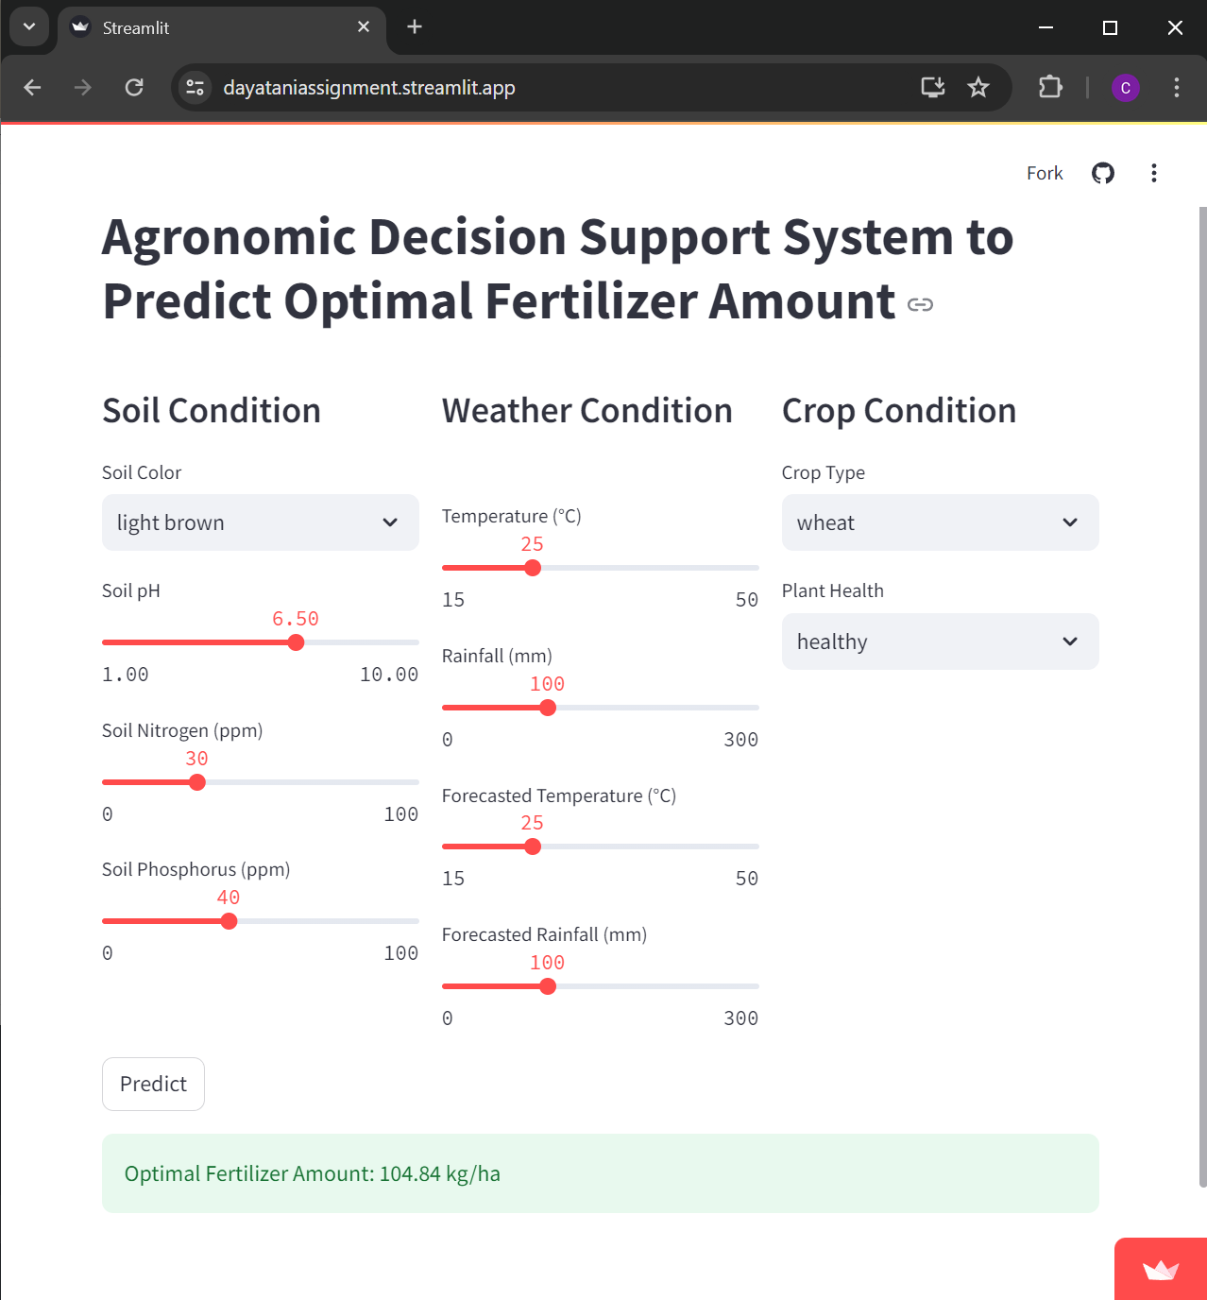
Recommendations for Farmers (2 ways to give practical recommendations)
Give general recommendations for optimal fertilizer amounts by using the model to predict based on pre-defined scenarios:
Yellowing wheat with low rainfall and low soil nutrient levels: Use 132.80 kg/ha of fertilizer
Healthy rice with high rainfall and high soil nutrient levels: Use 105.19 kg/ha of fertilizer
Wilting wheat with very low nutrient levels and low rainfall: Use 136.64 kg/ha of fertilizer
2. Give tailored recommendations to farmers by predicting based on the specific data that the farmer provided.
Created a simple Streamlit web app to host the model to demonstrate how farmers can access the model via web/mobile apps:
Link to web app: https://dayataniassignment.streamlit.app/
Farmers enter soil, weather, crop data
Receive predicted optimal fertilizer amount

Slide 6
Thank You

