Slide 1
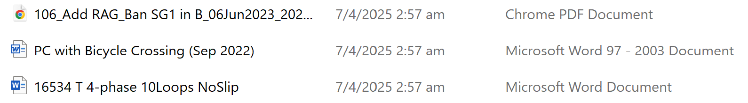
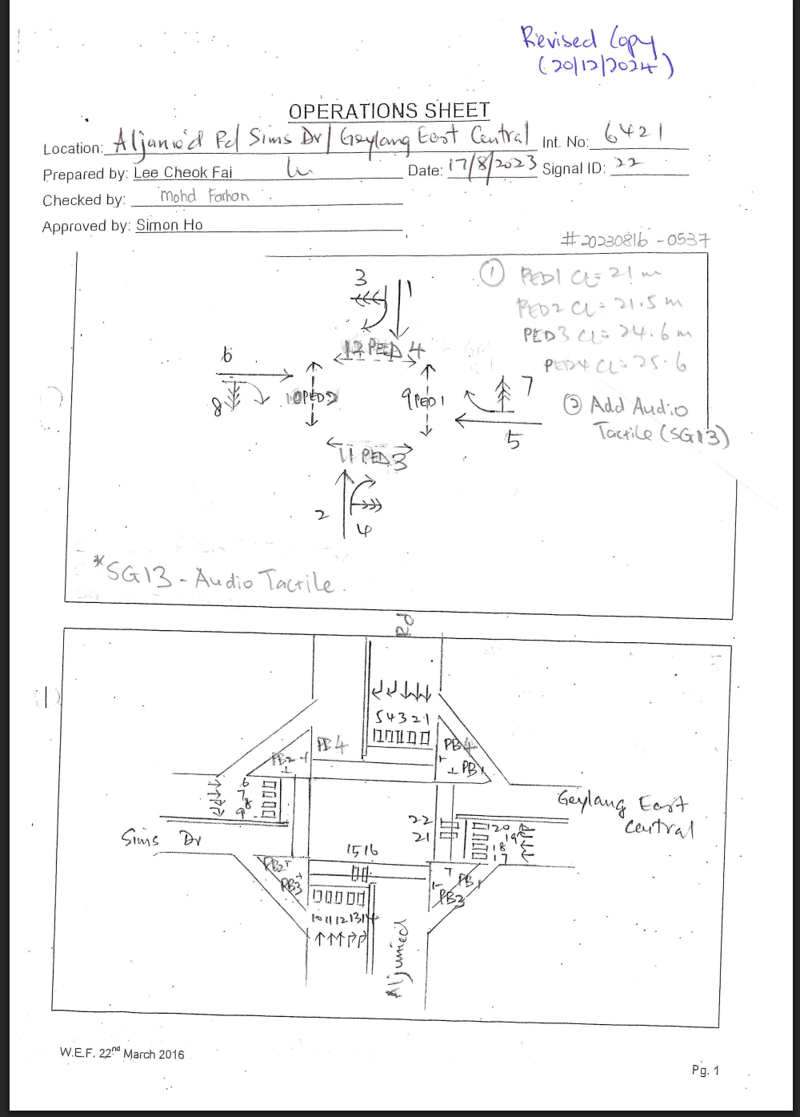
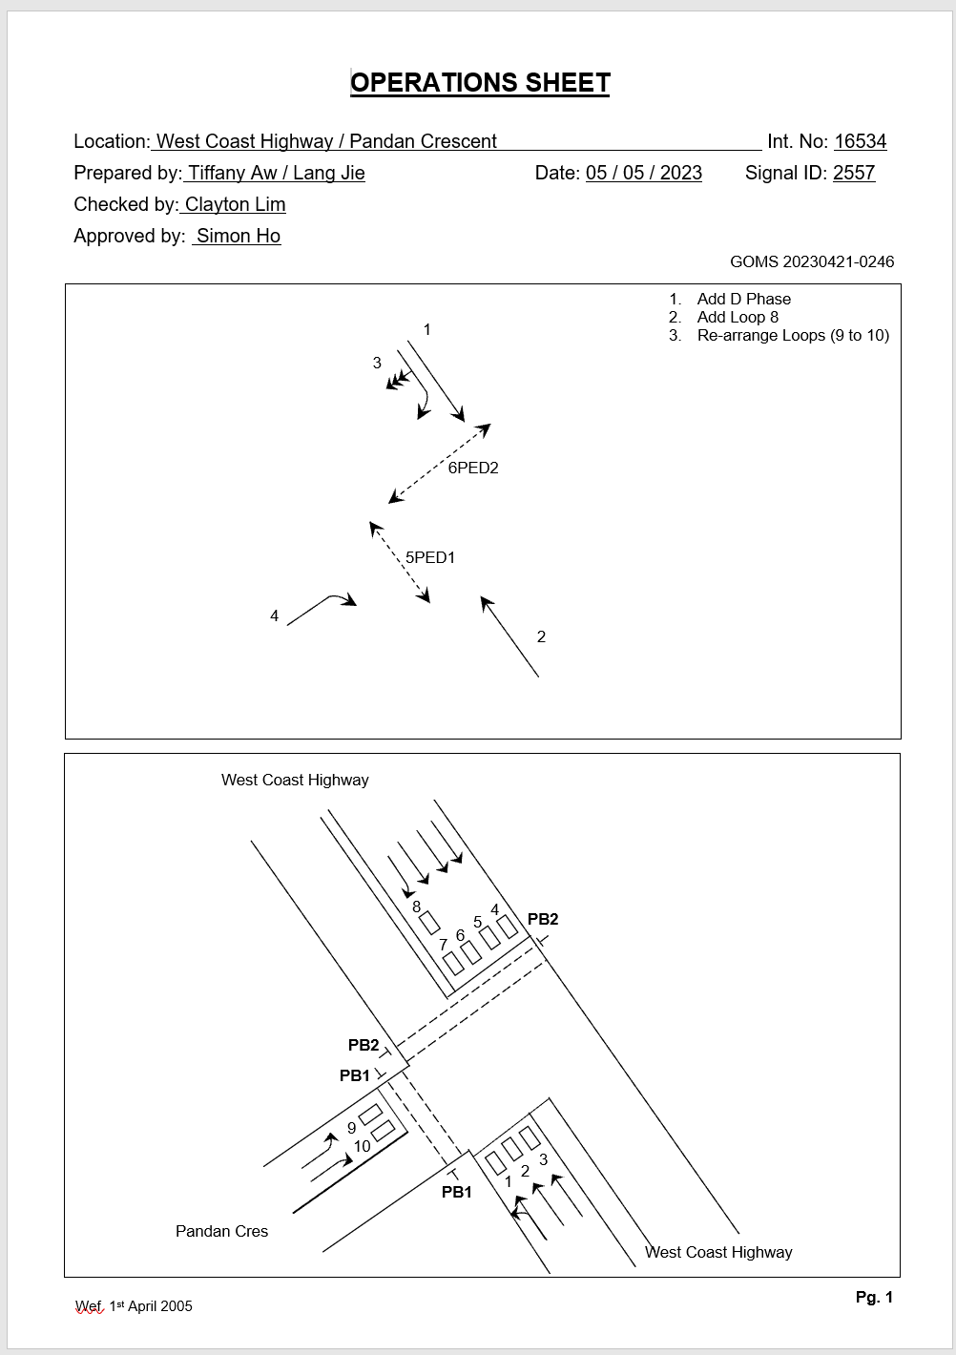
Format of Ops Sheet
Digital
Handwritten
Has at least 3 formats:
PDF
Word Doc
97-2003 Word Doc
Scanned copy of physical ops sheet

Slide 2
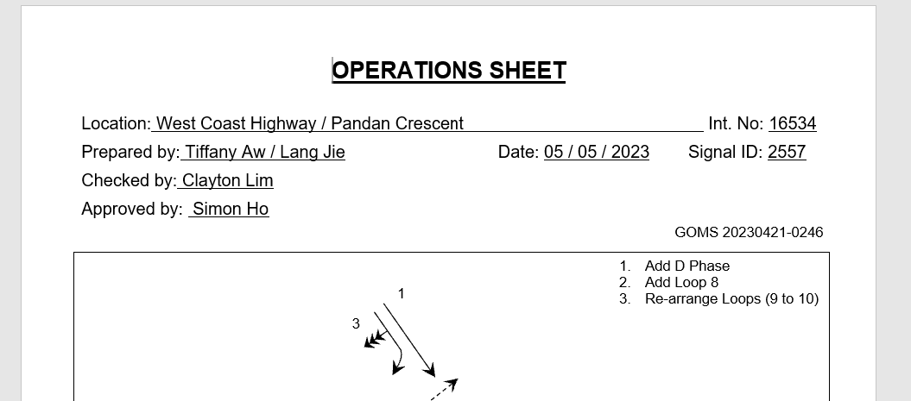
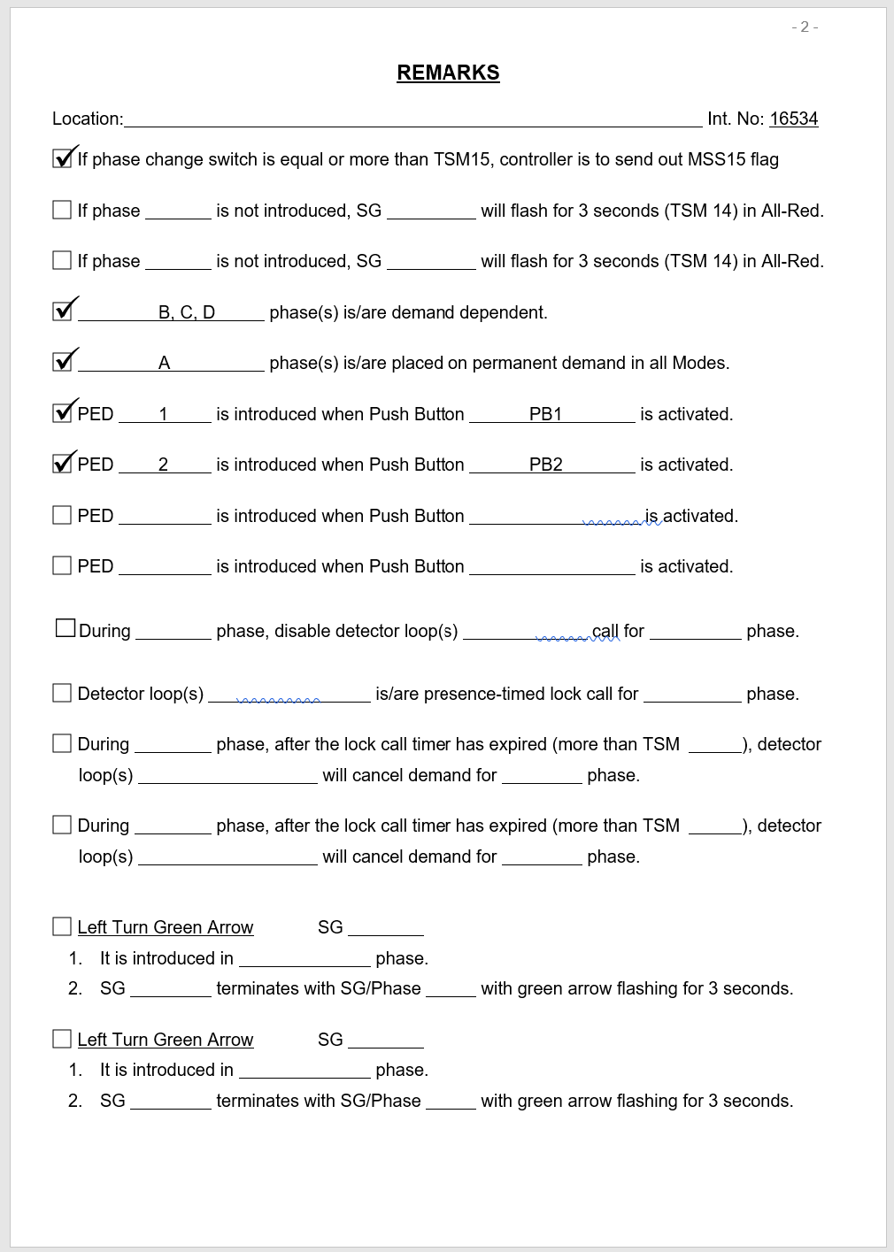
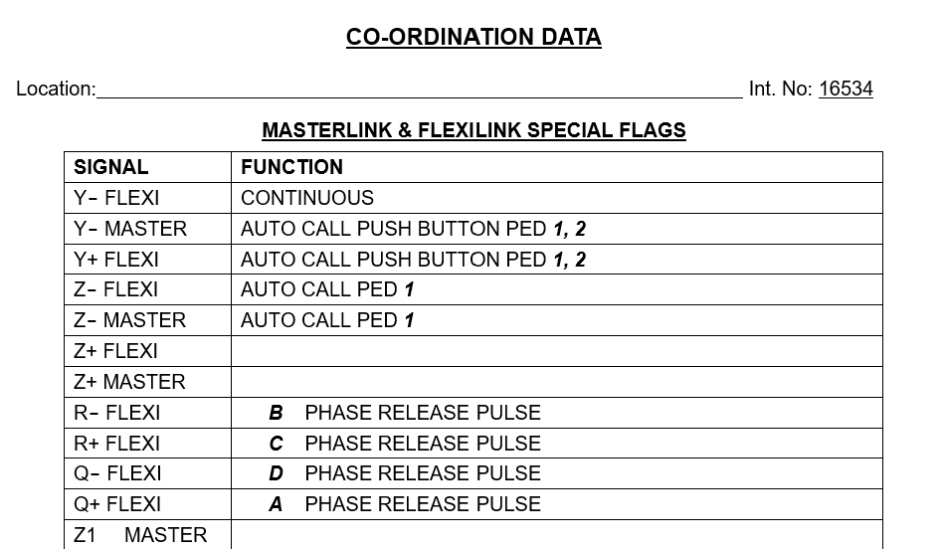
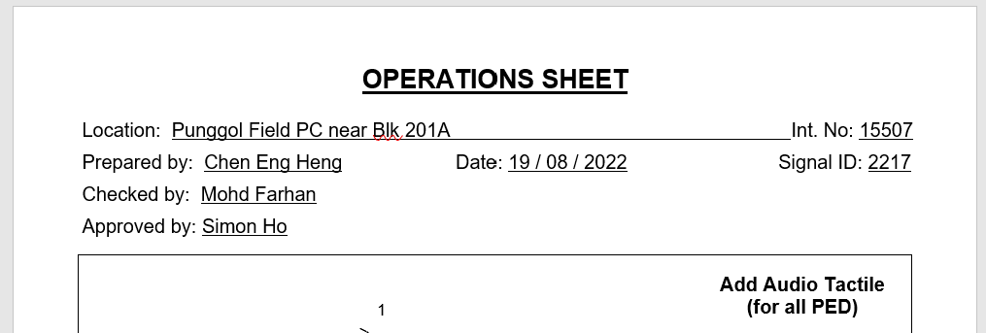
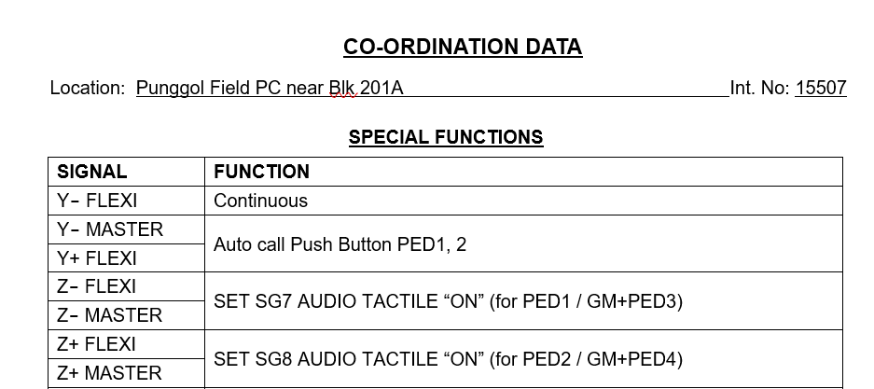
Format of Digital Ops Sheet
It seems that the format / template of the ops sheet are not standardised. For example:
Page 1
Page 2
Page 9
Some have GOMS number, others don’t have
Some have don’t have this Remarks Page
Table headers and format are not consistent (Python code needs to cater to both formats)

Slide 3
Format of Digital Ops Sheet
26 attributes to extract from each Ops Sheet
21 are easier to extract - Completed
3 are not so easy to extract – In Progress
2 are difficult to extract – In Progress

Slide 4
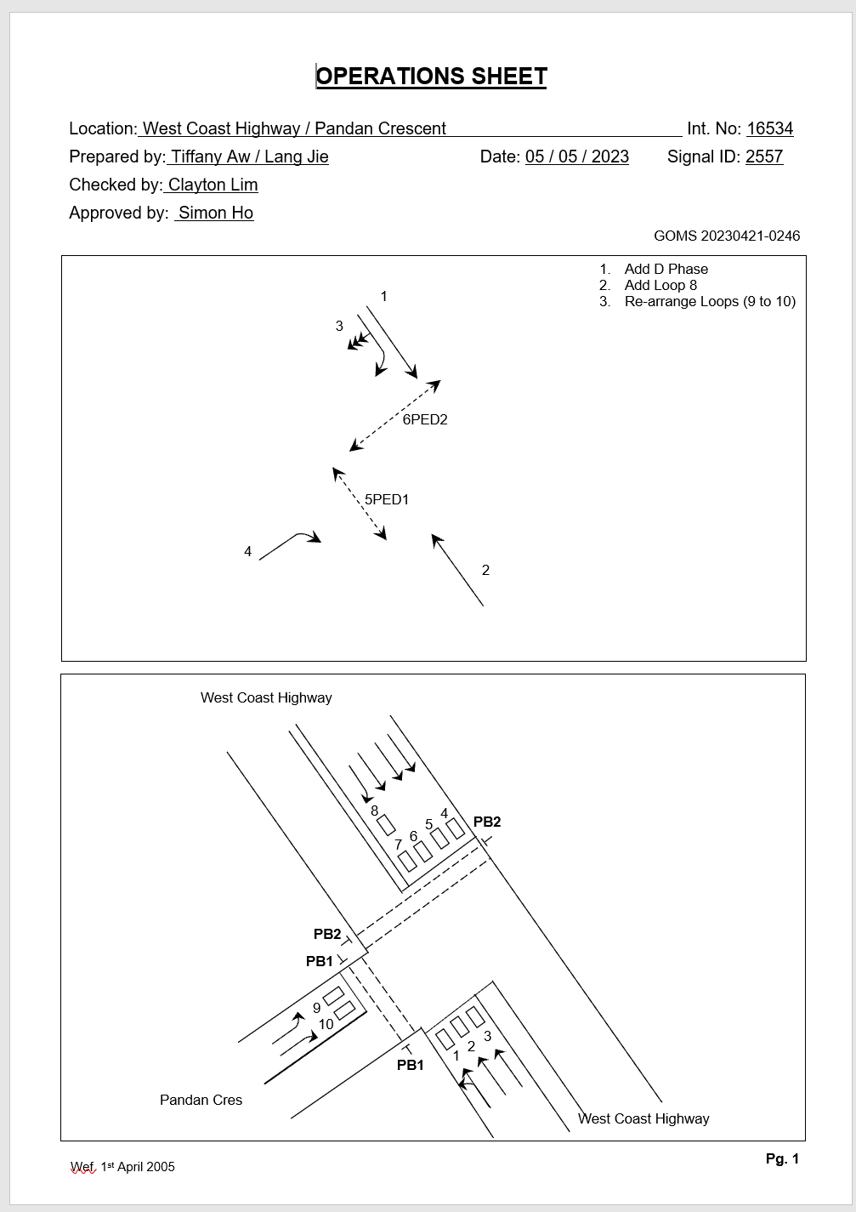
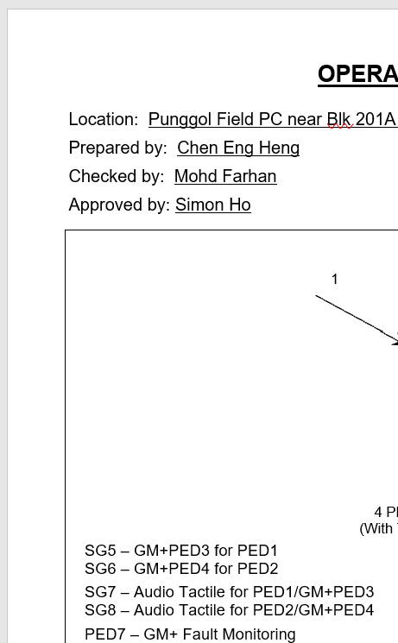
Data to Extract from Digital Ops Sheet
No. | Attribute | Value | Search Condition
1 | Location | West Coast Highway / Pandan Crescent | Extract using Python
2 | Date | 05 / 05 / 2023 | Extract using Python
3 | Int No. | 16534 | Extract using Python
4 | Signal ID | 2557 | Extract using Python
5 | GOMS* | 20230421-0246 | Extract using Python
6 | GMP | No | Extract using Python
7 | Audio Tactile | No | Extract using Python
8 | RAG | Yes | use CV /AI to check if RAG exists in phase (three arrow heads)
9 | Junction Layout | T Junction | Use CV / AI to determine junction layout from picture
10 | Number of Lanes | 9 | Use CV / AI to determine number of lanes
Only Ops Sheets with GM+ and Audio Tactile will have this information
Data Extraction Difficulty
* Some Ops Sheets don’t have GOMS number
Easier | Not as Easy | Difficult

Slide 5

Data to Extract from Digital Ops Sheet
No. | Attribute | Value | Search Condition
11 | Right Turn Green Arrow* | No | Use CV / AI to check if either box 2 or 3 is checked
12 | Left Turn Green Arrow* | No | Use CV / AI to check if either box 14 or 15 is checked
* Some Ops Sheets don’t have this page
Data Extraction Difficulty
Easier | Not as Easy | Difficult

Slide 6
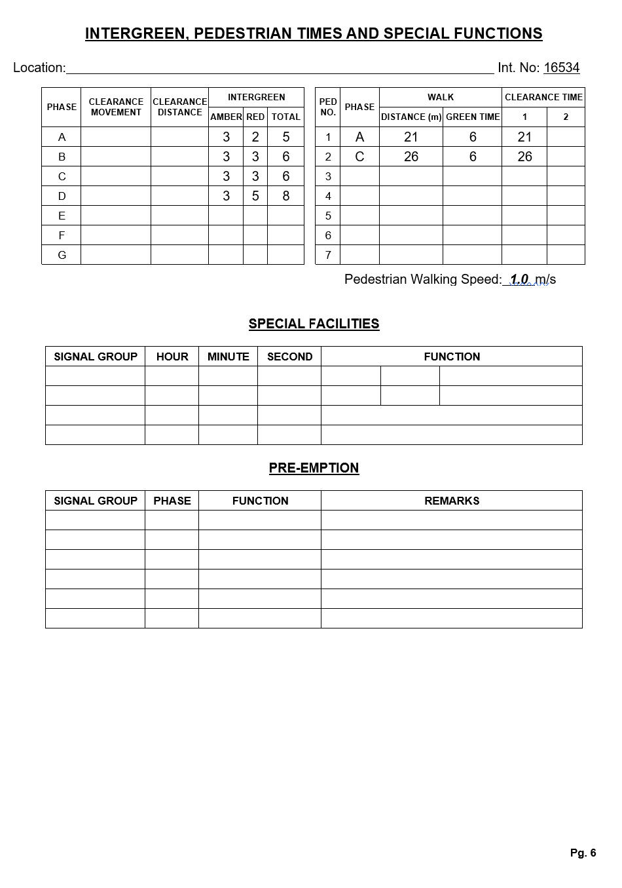
Data to Extract from Digital Ops Sheet
No. | Attribute | Value | Search Condition
13 | Special Facilities | No | Use Python to check if there is any text under the Special Facilities box and return either Yes or No
14 | Pre-Emption | No | Use Python to check if there is any text under the Pre-Emption box and return either Yes or No
15 | Pedestrian Walking Speed | 1.0m/s | Extract using Python
Data Extraction Difficulty
Easier | Not as Easy | Difficult

Slide 7
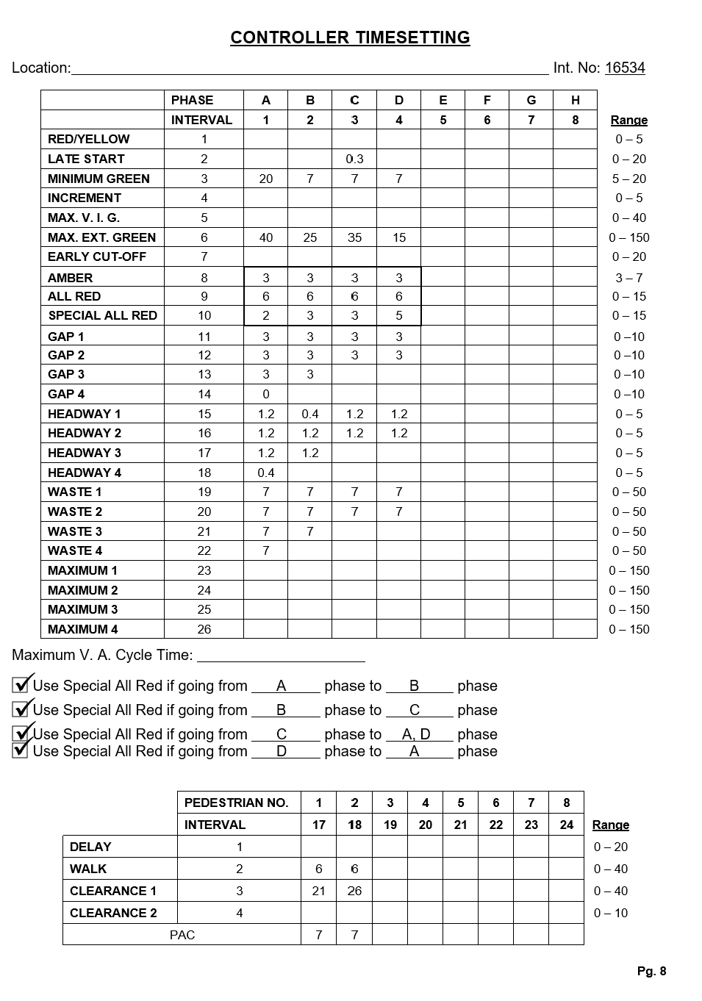
Data to Extract from Digital Ops Sheet
No. | Attribute | Value | Search Condition
16 | Red/Yellow | {A: None, B: None, C: None …. H: None} | Use Python to extract data into a machine readable format. From there we can display into a nicer format e.g. Red/Yellow Phase A: None Phase B: None ….
17 | Late Start | {A: None, B: None, C: 0.3 …. H: None}
18 | Minimum Green | {A: 20, B: 7, C: 7 …. H: None}
19 | Increment | {A: None, B: None, C: None …. H: None}
20 | Max V.I.G. | {A: None, B: None, C: None …. H: None}
21 | Max Ext. Green | {A: 40, B: 25, C: 35 …. H: None}
22 | Early Cut-Off | {A: None, B: None, C: None …. H: None}
23 | Amber | {A: 3, B: 3, C: 3 …. H: None}
24 | All Red | {A: 6, B: 6, C: 6 …. H: None}
25 | Special All Red | {A: 2, B: 3, C: 3 …. H: None}
Data Extraction Difficulty
Easier | Not as Easy | Difficult

Slide 8
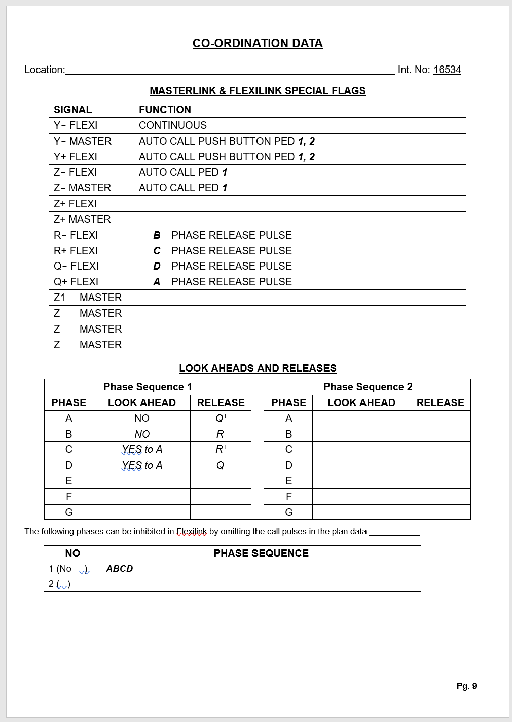
Data to Extract from Digital Ops Sheet
No. | Attribute | Value | Search Condition
26 | Phase Sequence | Y- MASTER, Y+ FLEXI | Use Python to search for “AUTO CALL PUSH BUTTON”, then return the corresponding SIGNAL
Data Extraction Difficulty
Easier | Not as Easy | Difficult

Slide 9
Format of Digital Ops Sheet
Data extraction from these 21 text-based fields is rule-based so there will be no errors in extracting these attributes
(assuming that there is no issue with the doc e.g. deviation from template, typos, etc)
As these 5 drawing-based attributes will be extracted using CV/ AI, it might not accurately extract them all the time (AI is probabilistic).
Will calculate the accuracy rate with a larger sample size of Ops Sheet once the code to extract these fields are ready
No. | Attribute
1 | Location
2 | Date
3 | Int No.
4 | GOMS
5 | Signal ID
6 | GM+
7 | Audio Tactile
8 | Special Facilities
9 | Pre-Emption
10 | Pedestrian Walking Speed
11 | Red/Yellow
No. | Attribute
12 | Late Start
13 | Minimum Green
14 | Increment
15 | Max V.I.G.
16 | Max Ext. Green
17 | Early Cut-Off
18 | Amber
19 | All Red
20 | Special All Red
21 | Phase Sequence
No. | Attribute
1 | RAG
4 | Right Turn Green Arrow
5 | Left Turn Green Arrow
2 | Junction Layout
3 | Number of Lanes

Slide 10
Format of Handwritten Ops Sheet
Scanned copy of Ops Sheet that is handwritten
60~70% might be handwritten by the same person

Slide 11
Format of Handwritten Ops Sheet
In the process of exploring the feasibility of using OCR tools to extract these 21 text-based fields:
Still in process of finding suitable tools to extract from these 5 drawing-based fields:
No. | Attribute
1 | Location
2 | Date
3 | Int No.
4 | GOMS
5 | Signal ID
6 | GM+
7 | Audio Tactile
8 | Special Facilities
9 | Pre-Emption
10 | Pedestrian Walking Speed
11 | Red/Yellow
No. | Attribute
12 | Late Start
13 | Minimum Green
14 | Increment
15 | Max V.I.G.
16 | Max Ext. Green
17 | Early Cut-Off
18 | Amber
19 | All Red
20 | Special All Red
21 | Phase Sequence
No. | Attribute
1 | RAG
3 | Junction Layout
4 | Number of Lanes
5 | Right Turn Green Arrow
6 | Left Turn Green Arrow

Slide 12
Summary
Completed script to extract data from 21/26 attributes from digital ops sheet
Created a prototype web app
Next Steps
Extract 5/26 remaining attributes from digital ops sheet
Explore feasibility of extract 26/26 attributes for handwritten ops sheet
Explore feasibility of using DWG file to automate ops sheet

