Slide 1
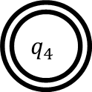
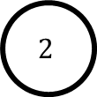
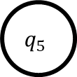
1.16
b
a,b
$$q_{5}$$
$$q_{4}$$
a
1
$$2$$
1
0
0,1

