Slide 1

AI for Finance
Financial sentiment of cryptocurrency microblog content
Name: Phoe Chuan Bin
Supervisor: A/P Erik Cambria
Examiner: Prof. Mo Li
Notes:
Good afternoon Prof. Erik and Prof. Mo, I am Chuan Bin and I will be presenting my FYP project, AI for Finance today. More specifically, we will look into determining the financial sentiment of cryptocurrency microblog contents in this project.

Slide 2



Motivations
Huge Trading Opportunity
The rise in prominence of cryptocurrencies have led to increased volatility and trading in cryptocurrency exchanges
Usage of Alternative Data
Financial institutions are now embracing the use of alternative data especially towards social media commentary to increase their investment returns
Using Behavioural Finance
Financial decisions are significantly driven by emotion and mood
Opinion mining allows sentiment data from media to be fused with other structured data coming from the stock market for investing decisions
Notes:
Studies in behavioural finance have shown that investment decisions are significantly driven by emotion and mood. Many financial institution are now embracing alternative data to drive their investment decisions. With the rise of cryptocurrencies in the post pandemic era, there is a huge opportunity for traders due to the increased volatility in the market. Generating structured data via text mining is therefore essential as it is the first step in many downstream tasks such as price predictions and volatility forecast.

Slide 3

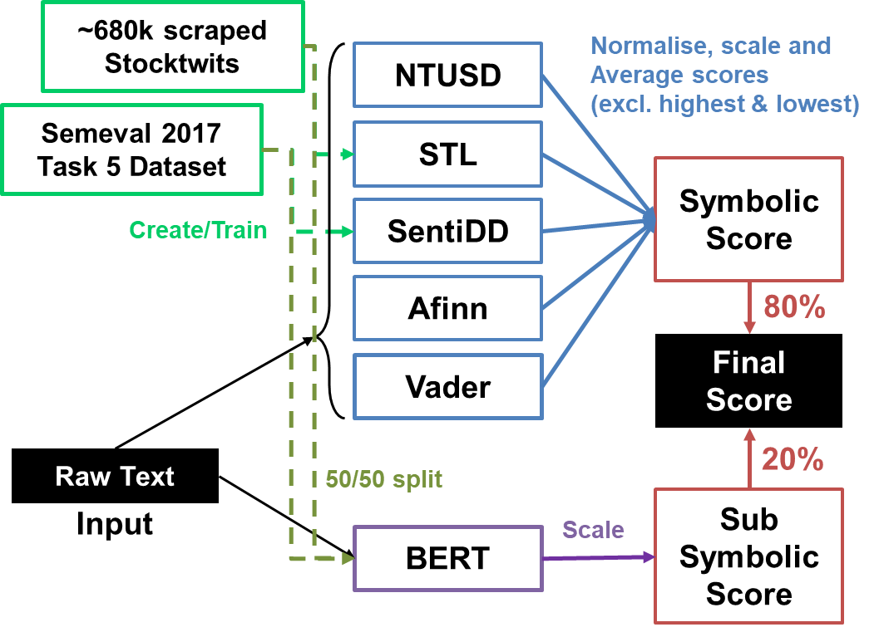


Project Objectives
Leverage the use of Text Mining and NLP techniques to better predict the financial sentiment of social media cryptocurrency content
Proposed Hybrid Architecture
Symbolic
via Lexicons
+
Outperforms individual lexicons
Subsymbolic
via Learning-based models
Outperforms deep learning methods
Notes:
As such, in this project, I will be leveraging on the use of Text Mining and NLP techniques to better predict the financial sentiment of social media cryptocurrency content. We will take both Symbolic and Sub Symbolic approaches in tackling this problem using lexicons and learning-based language models respectively. Our results show that for this sentiment classification problem, the proposed hybrid architecture outperforms individual lexicons and deep learning methods in the current literature.

Slide 4


Datasets
Why use multiple datasets?
Ensure proposed solution is well-generalised
Data from StockTwits and Twitter may differ in length due to the limits of the platform (1000 and 280 characters respectively)
Better capture social media lingo
Users of different platforms may use different lingos that are not present in others
Prevent overlap usage of datasets
Some of the datasets will be used to create new lexicons or train neural networks and as such cannot be used as test sets to ensure the legitimacy of our experiments
Notes:
We used 4 different datasets in this project which can be found in the data folder. Using multiple datasets as test sets helps us to ensure that our proposed solution is well-generalised and not specific to a particular dataset. This is especially so since data from StockTwits and Twitter may differ in length due to the limits of the platform (1000 and 280 characters respectively). Furthermore, users of different platforms may use different lingos that are not present in others and the use of multiple datasets allow us to capture them. We will also need multiple datasets since some of the datasets will be used to create new lexicons or train neural networks. To enure the legitimacy of our experiments, they cannot be used as test sets.

Slide 5
Datasets
Data1
Semeval 2017 Task 5 Dataset
from Stocktwits and Twitter
Data3
Scrapped from Stocktwits
Data4
Scrapped from Stocktwits
1161 self-labelled rows
Cohen Kappa score 0.855
680933 unlabelled rows
(Use sentiment tags as proxy)
2023 labelled rows
Equal proportion from these tickers:
Data2
IEEE Dataset
from Twitter
General Market | SPY, DJIA, QQQ, VIX
Cryptocurrency Specific | BTC.X, ETH,X, XRP.X, ADA.X, SOL.X.
875 labelled rows
Notes:
Data 1 is sourced from the SemEval 2017, the 11th international workshop on semantic evaluation. More specifically, we will be using the Task 5 dataset which consists of financial-related microblog messages and their corresponding sentiment scores for the stocks mentioned. This contains 2023 labelled rows.
Data 2 is sourced from IEEE Data Port. This data was downloaded from Twitter using the Twitter REST API search. Tweets were filtered out for the English language and were manually annotated by the author and reviewed by a second independent annotator. This gives us 875 labelled rows.
Data 3 and 4 are StockTwits that have been scrapped manually by myself by calling the StockTwit API. Since the API can only return results based on searched symbols, a list of suitable financial tickers have been chosen to collect appropriate StockTwits for our task. This consists of tickers that track the General Market and Cryptocurrencies sentiment.
Since the US has the world’s largest stock markets, we have chosen the 3 major indexes to get a gauge on the General Market sentiment. In addition, we added in the CBOE Volatility Index VIX. This is used by investors to quantify the level of risk, fear, or stress in the market to influence their investment decisions.
We chose the top 5 cryptocurrencies based on their coin market cap and the number of users who watch the coin on the StockTwits platform. We excluded all coins that are pegged to the US Dollar.

Slide 6



Datasets
Why use Scrape from Stocktwits?
Data3
Data4
Advantages of “crowd-sourced” Sentiment Tags
Users of the platform were able to add sentiment tags to the message that they post. Although it might not be entirely accurate, I believe that this presents 2 advantages
Law of Large Numbers
An observed sample average sentiment value of a token from a large sample will be close to the true population average
By scraping huge amounts of sentiment-tagged data, we are able to aggregate a pool of natural language syntax to build our proposed lexicons on with a good chance of reflecting the true “sentiment” of various tokens
No need for huge time & human effort costs
Do not need manual annotations and avoiding bias which will help to generate huge costs savings
This solution of scraping data will allow for the automatic collection of big data from a large pool of independent “annotators” and alleviate the problems mentioned
Notes:
I choose StockTwits as users of the platform were able to add sentiment tags to the message that they post. Although it might not be entirely accurate, I believe that this presents 2 advantages to us.
First, lending the concept from the Law of Large Numbers, an observed sample average sentiment value of a token from a large sample will be close to the true population average. As such, by scraping huge amounts of sentiment-tagged data, we are able to aggregate a pool of natural language syntax to build our proposed lexicons on with a good chance of reflecting the true “sentiment” of the tokens.
Next, manual annotations require huge amount of time and human effort which are not easily available. Furthermore, sentiments are subjective in general and thus manual annotations needs to be reviewed to prevent bias, adding to the huge costs. This solution of scraping data will allow for the automatic collection of big data from a large pool of independent “annotators” and alleviate the problems mentioned above.

Slide 7
Datasets
Data1
Semeval 2017 Task 5 Dataset
from Stocktwits and Twitter
Data3
Scrapped from Stocktwits
Data4
Scrapped from Stocktwits
1161 self-labelled rows
Cohen Kappa score 0.855
680933 unlabelled rows
(Use sentiment tags as proxy)
2023 labelled rows
Equal proportion from these tickers:
Data2
IEEE Dataset
from Twitter
General Market | SPY, DJIA, QQQ, VIX
Cryptocurrency Specific | BTC.X, ETH,X, XRP.X, ADA.X, SOL.X.
875 labelled rows
Notes:
For Data 3, I collected collect approximately 200 StockTwits per symbol and manually annotate each tweet’s sentiment value. This gives us 1161 self-lablled rows.
As a proxy to measure the inter-rater reliability of Data 4, I calculated the Cohen’s Kappa Coefficient based on the tweet’s actual sentiment values (Bearish/Bullish) with what I actually annotated them with. A score of 0.855 puts the annotations to be “near perfect agreement” which proves the reliability of using the crowd-sourced sentiment values from StockTwits.
For Data 4, we collect approximately 110,000 StockTwits per symbol giving us a total of 680k unlabeled rows.

Slide 8
Symbolic Approach
Notes:
Now lets move on to our Symbolic Approach

Slide 9
Problem with current techniques
Lack of temporal awareness
01
02
Unable to recognise social media lingo
E.g.
‘Inflation’ has a much stronger negative connotation today (2022) compared to a year ago due to our macro environment.
‘Transitory’ has a negative connotation today (2022) compared to a year ago, since FOMC Chair J.Powell “retired” the term to describe the inflation dynamics
E.g.
General terms:
‘Stonks’, ‘Rip’, ‘LFG’
Crypto terms: ‘Staking’, ‘Soldana’
Many terms used in social media for finance are not formal words
Problems
Sold + Solana
Notes:
Lexicon-based sentiment analysis plays a key role in opinion mining. If the lexicon is missing words that are important indicators of sentiment, or if it incorrectly assigns sentiment strengths to words, the accuracy of the resulting sentiment analysis will be negatively impacted. However, through my literature review, I realise that most lexicons are not created:
For the specific use in the Cryptocurrency and Financial domain and
To process social media microblog content;
And be easily updated to reflect the current economic or societal influences
This results in the 2 problems shown.
First, there is a lack of temporal awareness. After careful analysis on mislabelled StockTwits via the use of traditional lexicons, I noticed that the meaning and sentiment of words change over time.
For example, “Inflation” has a much stronger negative connotation today compared to a year ago due to changes in our macro environment especially in light on the consecutive higher CPI reports.
The word “Transitory” also has a negative connotation today compared to a year ago. Ever since FOMC Chairman Jerome Powell effectively “retired” the term to describe the inflation dynamics affecting our economy, the term is no longer considered a “dovish” term as interpreted by users but more likely used as an mockery to the past inaction of the FED which contributed to the high inflationary environment faced today.
Second, there is a lack of ability to capture social media lingo. A closer inspection also revealed how many social media lingo terms were not present in existing lexicons. These terms tend to be informal words or present a different meaning in the financial cryptocurrency space.
Some examples of these terms are like “stonks”, a term to express a financial decision that results in financial gain or “Staking” which is the process of locking up crypto holdings in order to obtain rewards or earn interest.

Slide 10
Solution: Build dynamic lexicons based on corpus
Data4
Scrapped from Stocktwits
StockTwitLexi (STL)
Technique based on:
Labille, Kevin & Gauch, Susan & Alfarhood, Sultan. (2017).
Creating Domain-Specific Sentiment Lexicons via Text Mining.
680933 unlabelled rows
Probabilistic Score
Informatic Theoretic Score
Results:
Norm = Normalise to -1 to 1 range
Std = Standardise to normal distribution
Sum = Add both scores up
Experiment | Accuracy | F1_score
norm_sum | 0.6489 | 0.7714
std_sum | 0.601 | 0.5640
sum | 0.6693 | 0.6992
sum_norm | 0.6514 | 0.7724
sum_std | 0.6738 | 0.7067
Norm_sum: Norm each score, then sum both scores
Std_sum: Std each score, then sum both scores
Sum: Just sum both scores
Sum_norm: Sum both scores, norm resultant score
Sum_std: Sum both scores, std resultant score
Notes:
To avoid this problem, we propose to build a dynamic lexicons based on corpus.
The first lexicon is called StockTwitLexi where I used the proposed methods in the paper “Creating Domain-Specific Sentiment Lexicons via Text Mining” to generate a financial cryptocurrency and microblog specific lexicon. Since the methods proposed depends on both probabilistic and informatic theoretic scores which work best on large datasets, we used Data4. The probabilistic score is based on Baye’s Theorem while the Information Theoretic score is based on the TF-IDF logic from information retrieval.
After generating both scores, I tested on a few permutations to see how best to combine them to generate the final lexicon. Our testing revealed that performing a sum of both scores before normalising them to a -1 to 1 range works best.

Slide 11
Solution: Build dynamic lexicons based on corpus
Data4
Scrapped from Stocktwits
Senti-DD
Score
680933 unlabelled rows
Technique based on:
Park, Jihye & Lee, Hye & Cho, Sungzoon. (2021).
Automatic Construction of Context-Aware Sentiment Lexicon in the Financial Domain Using Direction-Dependent Words.
Results:
Data1
Semeval 2017 Task 5 Dataset
Trained using | Accuracy | F1_score
data_1 | 0.7213 | 0.7406
data_4 | 0.6858 | 0.6927
2023 labelled rows
Notes:
The second lexicon is called SentiDD where I used the proposed methods in the paper “Automatic Construction of Content-Aware Sentiment Lexicon in the Financial domain using Direction-Dependent Words” to automatically construct a context-aware lexicon named Senti-DD using Data 1 and 4.
The constructed lexicon comprise of a pairing of a directional word and a direction-dependent word. This is to capture the true sentiment of a given word as its semantic orientation changes according to the context in which it is being used.
For example, ‘profit’ conveys a positive sentiment while ‘profit decrease’ conveys a negative sentiment. This cause unigram lexicons to not perform well when the text to be processed is not straightforward.
Our test results on data 2 and 3 reveals that using Senti-DD built on Data 1 is better than the one built on Data 4.

Slide 12
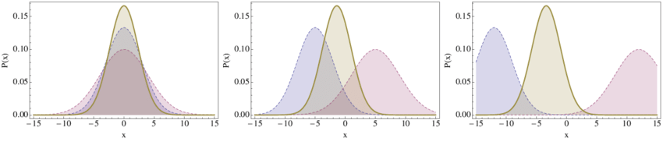
Leverage use of multiple lexicons
Hypothesis:
Ensemble will help to reduce the spread or dispersion of the scores and thus increase lexicon performance
Intuitively, our observations of the scores generated by individual lexicons indicate that some lexicons are not able to capture the degree of sentiment intensity as well as others, albeit capturing strong-sentiment tokens better. This implies that a combination of lexicons should be complementary.
Notes:
For our overall Symbolic Approach, we propose the use of Lexicon Ensemble. Our hypothesis is that an ensemble will help to reduce the spread or dispersion of the scores and thus increase performance. Intuitively, our observations of the scores generated by individual lexicons indicate that some lexicons are not able to capture the degree of sentiment intensity as well as others. This implies that a combination should be complementary.

Slide 13
Individual lexicon results
Lexicon | Average of 2 Test Datasets
 | Accuracy | F1 Score
NTUSD | 0.712135 | 0.765286
STL* | 0.629407 | 0.755706
Senticnet | 0.626706 | 0.714841
Vader | 0.648328 | 0.657089
SWN | 0.596784 | 0.638872
Afinn | 0.628022 | 0.624538
SentiDD* | 0.543308 | 0.422547
Test Datasets
Data2
IEEE Dataset
875 labelled rows
Data3
Scrapped from Stocktwits
1161 self-labelled rows
Cohen Kappa score 0.855
*Created lexicons
Notes:
First, we tested all the lexicons individually using Data 2 and 3 and found that NTUSD performed best. STL performed well coming in close as the 2nd with an F1 score of 0.755. This shows that the constructed lexicon performs well individually, beating other well-known lexicons such as SenticNet and Vader for the purpose of classifying financial sentiment of cryptocurrency microblog texts.
On the other hand, Senti-DD does not perform well individually and came in last amongst all 7 lexicons used. This maybe due to the lack of directional word and directional-dependent word pairings present in such corpus, resulting in calculated scores that are not fine-grained enough.

Slide 14
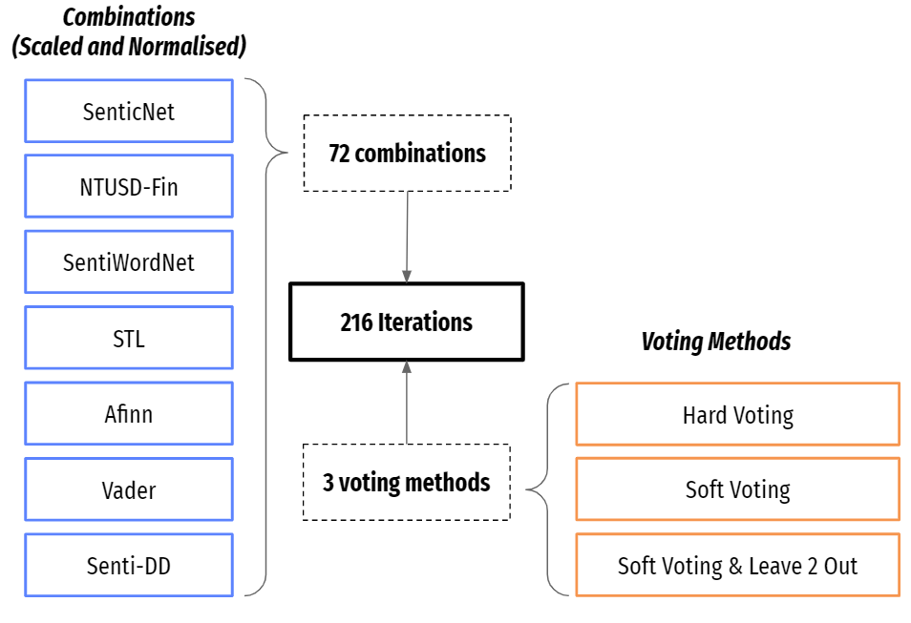
Ensemble experiments
Notes:
To test our hypothesis, we iterate 216 different combinations of lexicons and voting methods for each test dataset and see which gives us the best results. The 3 types of voting methods is shown in the bottom right table. Soft Voting predicts the class with the largest summed probability from models ; Hard Voting predicts the class with the largest sum of votes from models ; Soft Voting & Leave 2 out excludes highest and lowest lexicon scores before performing soft voting. We then compare our results to see if an ensemble really performs better than individual lexicons.

Slide 15
Combination of multiple lexicons
Iterate all possible combinations of lexicons and all possible combination methods.
Combination methods
Soft voting: Average of resultant scores
Hard voting: Generate classes based on scores and find the majority class
Leave 2 out: Exclude highest and lowest score in calculation
Top 3 Combination Techniques | Average of 2 Test Datasets
 | Accuracy | F1 Score
Soft voting & Leave 2 out - NTUSD, STL, Afinn, Vader, SentiDD | 0.756192 | 0.807582
Soft voting & Leave 2 out - NTUSD, SWN, STL, Vader, SentiDD | 0.750179 | 0.805732
Soft voting only– NTUSD, SWN, STL, Vader | 0.751049 | 0.804324
Notes:
The combination of NTUSD-Fin, STL, Afinn, Vader and Senti-DD lexicons using Leave 2 Out method has the highest F1_Score of 0.808. This beats the highest individual F1_Score by a huge margin. This proves our hypothesis right that an ensemble of lexicons will help to boost performance. In fact, 51.7% (103/199) of the ensemble variants has an F1_Score higher than the highest individual F1_Score. We can also see that Senti-DD, a lexicon that did not perform well individually, is actually present in the best Lexicon Ensemble. It is also present in 3 of the top 5 best performing variants. This implies the strong complementary value of the lexicon when combining with other lexicons.

Slide 16
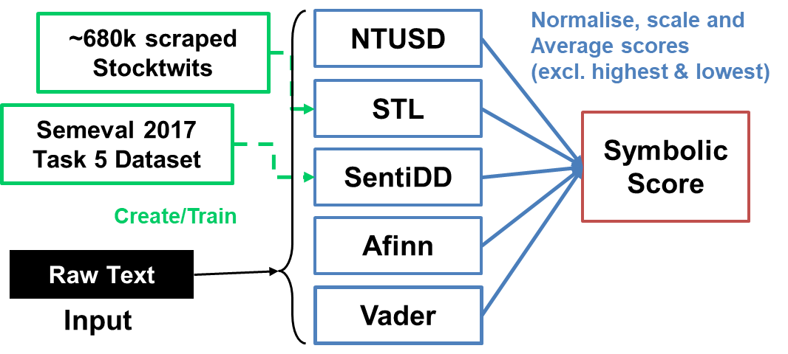
Symbolic Approach Architecture
Data4
Scrapped from Stocktwits
680933 unlabelled rows
Data1
Semeval 2017 Task 5 Dataset
2023 labelled rows
NTUSD:
Chung-Chi Chen, Hen-Hsen Huang and Hsin-Hsi Chen. 2018.
NTUSD-Fin: A Market Sentiment Dictionary for Financial Social Media Data Applications.
Afinn & Vader:
Standard sentiment analysis lexicons
Standardised based on no. words processed
Normalise to -1 till 1 based on score range of each lexicon
Notes:
Backed by our experimental results, we propose the use of Ensemble Lexicon to calculate the Symbolic Score. The architecture above highlights the whole process of generating this score.

Slide 17
Subsymbolic Approach
Notes:
Next, let’s discuss our subsymbolic approach

Slide 18

Using RNNs and BERT to capture nuances in financial text
Why use Language Models?
Networks used:
Training and Validation Datasets:
Overcoming Polysemy Disambiguation (Word with different meanings)
Language models able to sieve out the different meaning of a word in different context which differentiates from traditional rule based models or simple vectorisation techniques such as Bag-Of-Words, TF-IDF and word2vec
BERT
RNN
Unidirectional LSTM
Bidirectional LSTM
Unidirectional GRU
Bidirectional GRU
Data 1
Data 4 (Sample of 4000)
Combined Data from Data 1 and 4 (Equal proportions)
Notes:
We proposed the use of Language Models for our Sub Symbolic Approach. This differentiates from traditional rule based models or simple vectorisation techniques such as Bag-Of-Words, TF-IDF and word2vec with a key advantage of overcoming the biggest limitation of previous method: polysemy disambiguation (a word with different meanings). Language models being able to sieve out the different meaning of a word in different context.
We experimented with various networks such as BERT, Unidirectional and Bidirectional RNNs like LSTM and GRUs. We also experimented with various train datasets such as using individual datasets 1 and 4 and their combined dataset.

Slide 19
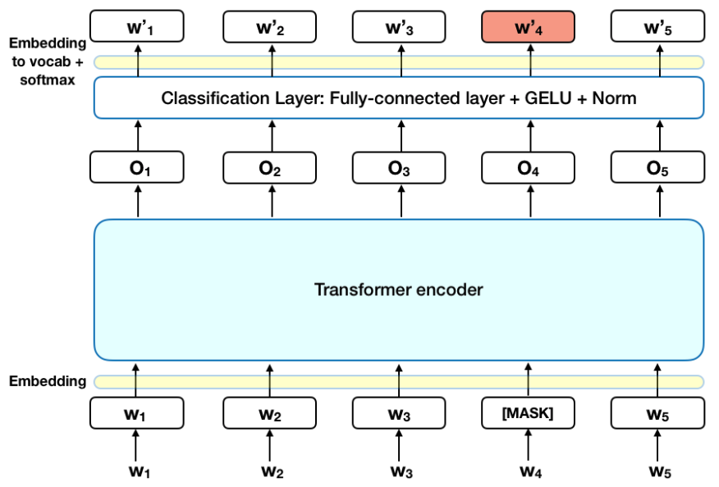
Hypothesis: BERT performs better than RNNs
BERT’s key technical innovation is applying the bidirectional training of Transformer, a popular attention model, to language modelling. This is in contrast to previous efforts which looked at a text sequence either from left to right or combined left-to-right and right-to-left training (RNNs like LSTM).
Notes:
Our hypothesis is that BERT will outperform the RNNs as the use of transformers will allow the model to apply bidirectional learning.

Slide 20
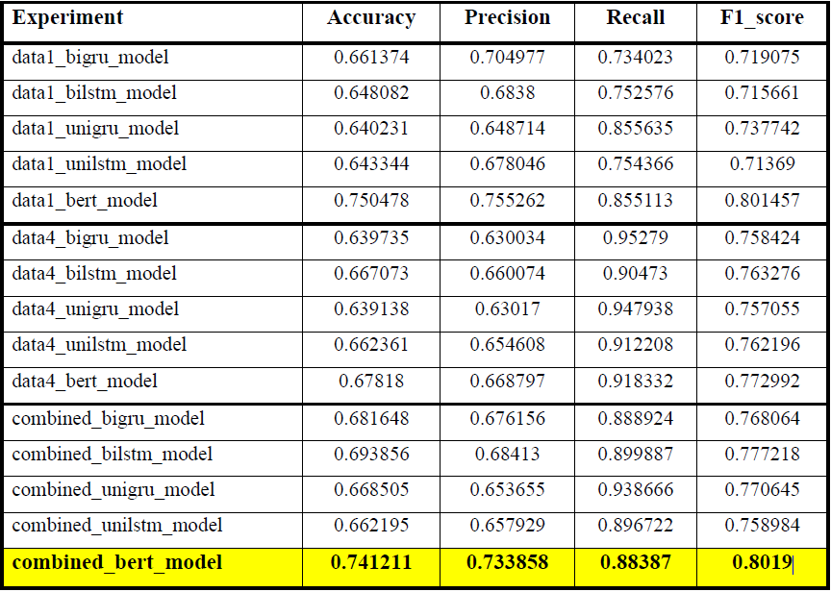
Subsymbolic Results
BERT performs better than RNNs
Notes:
From our results, we can see the BERT model generally outperforms all the other RNNs variants for both test datasets.

Slide 21
Subsymbolic Results
Data4
Scrapped from Stocktwits
BERT
Probability
680933 unlabelled rows
Technique based on:
Jacob Devlin, Ming-Wei Chang, Kenton Lee, and Kristina Toutanova. (2019).
BERT: Pre-training of Deep Bidirectional Transformers for Language Understanding. In
Results:
Data1
Semeval 2017 Task 5 Dataset
Trained using | Accuracy | F1_score
data_1 | 0.7505 | 0.8014
data_4 | 0.6782 | 0..7730
combined | 0.7412 | 0.8019
2023 labelled rows
Notes:
In all of our experiments, the BERT model trained on the combined dataset performs best, with an average F1_score of 0.8019.
The use of a combined dataset of a 50/50 split between Data 1 and 4 could have given a better generalisation of the model, allowing it to outperform those that are only trained on either dataset.

Slide 22
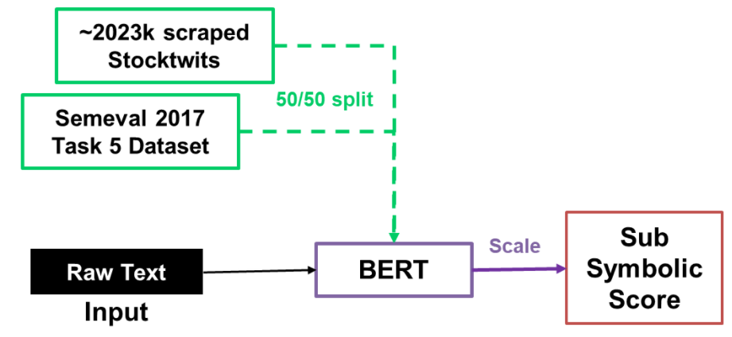
Subsymbolic Approach Architecture
Notes:
Backed by our experimental results, we propose the use of the BERT Model trained on the combined dataset to calculate the Sub Symbolic Score. The SoftMax probability is scaled to the range of -1 to 1 for this purpose. The architecture shown highlights the whole process of generating this score.

Slide 23
Hybrid Approach
Notes:
Finally our hybrid approach

Slide 24
Proposed Architecture
Hybrid Architecture
Test out various % combinations
20/80
40/60
60/40
80/20
Notes:
After generating both Symbolic and Sub Symbolic scores, we propose the combination of scores by giving each score a percentage weightage. We run a simple iteration of 20/80%, 40/60%, 60/40% and 80/20% weightage for the Symbolic/Sub Symbolic scores and generate the test results for Data 2 and 3.

Slide 25
Proposed Architecture Results
Symbolic Weightage | Average of 2 Test Datasets
 | Accuracy | F1 Score
20% | 0.74336 | 0.88334
40% | 0.74922 | 0.88881
60% | 0.75895 | 0.89789
80% | 0.77526 | 0.90432
Notes:
Our results show that giving a 80% and 20% weightage on the Symbolic score and Sub Symbolic score respectively produced the best results.

Slide 26
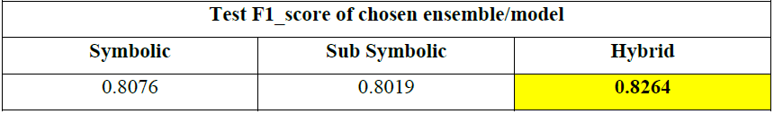
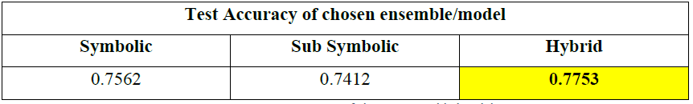
Proposed Architecture Results
Proposed Hybrid Architecture
Symbolic/Subsymbolic Methods
Baseline
(Senticnet)
>
>
Notes:
The overall results of the Hybrid Approach beat the individual Symbolic or Sub Symbolic Approaches implying the possible synergies that arise from this combination of scores

Slide 27
Proposed Architecture
Hybrid Architecture
Notes:
As such, here is our final proposed architecture.

Slide 28
Conclusion
Creation of 2 new lexicons STL and SentiDD
Automatic construction allows lexicons to be easily “updated” to current lingo and temporal awareness
Proven useful
Lexicon Ensemble outperforms individual lexicons
Best performance:
Ensemble of NTUSD, STL, Afinn, Vader and Senti DD
Leave 2 Out Voting
Proposed Hybrid Architecture
Symbolic
via Lexicons
+
BERT models outperforms RNN
Best performance
BERT
Trained on combined dataset (1 and 4)
Outperforms individual lexicons
Subsymbolic
via Learning-based models
Outperforms deep learning methods
Notes:
In this project, we discussed the methods which can be employed to predict financial sentiment of social media cryptocurrency content.
We propose the creation of 2 new lexicons StockTwitLexi and Senti-DD and used empirical evidence to back our selection of data used to create these lexicons.
Then, we explored the Lexicon Ensemble for our Symbolic Approach and found that the combination of NTUSD-Fin, StockTwitLexi, Afinn, Vader and Senti-DD lexicons using Leave 2 Out method performs the best. This combination outperforms the use of individual lexicons. Furthermore, both the created lexicons proved useful in the Ensemble methods, validating their value in our task.
To supplement our Symbolic Approach, we further explored the use of Language Models. Our results have shown that the BERT model trained on the combined dataset of Data 1 and 4 performs best. This model outperforms the various variants of RNNs.
Lastly, we propose a combined architecture with our Hybrid Approach where we combined the scores generated from both Symbolic and Sub Symbolic Approaches. Our experiments show that the combination of a 80/20 split performs best. The Hybrid Approach generated results that beat individual approaches in terms of Test F1_score and Test Accuracy.

Slide 29
Limitations
Future Work
Lexicons and language models are created/trained on the datasets which are collected from only Twitter and StockTwits. As such, it may not be as applicable to corpus with longer text size such as Reddit blogs.
Use the final sentiment score as a data input for downstream financial prediction tasks such as volatility forecasting, asset allocation, and market trend predictions.
Notes:
With the comprehensive research and experiments done in this project, we are now able to better predict the financial sentiments of social media cryptocurrency content. This is a gateway to perform many upstream financial prediction tasks such as volatility forecasting, asset allocation, and market trend predictions.
Future work can also focus on the fusion of the sentiment data using our architecture with other structured data coming from the financial market to build leading indicators and prediction models.
However, there may be limitations when performing such sentiment analysis on longer blogs such as Reddit since our models and lexicons are based on datasets collected from Twitter and Stocktwits only. Further work can target this aspect too.

Slide 30
Thank you!
Notes:
We have come to the end of the presentation, thank you!

Slide 31
