Slide 1
HPML Final Project · Spring 2026
Uncertainty-Aware Inference:
How Post-Training Quantization Effects LLM Confidence Calibration
Systematic PTQ calibration study on Mistral-7B: 5 configs × 3 datasets, CUDA-level profiling, Roofline analysis, uncertainty-based routing simulation and knowledge distillation.
Team 29 (Team B)
Anubha Vyasamudri · av3329
Rohit Ramesh · rr3713
GitHub: https://github.com/chuanbinp/uncertainty-aware-inference
WandB: https://wandb.ai/Uncertainty_Aware_Inference_Lab/UAI_Project
Sanjita Chandan Ballapur · sb5216
Tamanna Ananna Haque · ta2642
Vishal Menon · vm2820
Mentor: Ruchi Muhindru, IBM Research
Dr. Kaoutar El Maghraoui · Columbia University · Week of May 4, 2026

Slide 2
Motivation, Problem & Setup
Why this matters
Experimental setup
Quantization cuts GPU memory ~70% and raises throughput, but what happens to the model's confidence distribution?
High-stakes settings (medical, finance, autonomous ops) need to know when the model doesn't know
Top-1 accuracy can be preserved while calibration degrades severely
Model
Mistral-7B-Instruct-v0.2
Configs
FP16 · GPTQ INT4 · GPTQ INT8 · AWQ INT4 · NF4
Profiling
NVIDIA L4 24 GB (GCP) - ncu profiling A100 (Colab) - calibration, pytorch profiling, vllm
Goal
Characterise ECE, MCE, Brier score for 5 PTQ configs × 3 datasets on Mistral-7B
Profile at the CUDA kernel level
Simulate uncertainty-based routing.
ECE (15-bin) · MCE · Brier score · Avg entropy · Tok/s
Metrics
Datasets
TriviaQA (factual) [10,003]
HellaSwag (commonsense) [17,215]
PubMedQA (OOD biomedical) [1000]
HPML · Spring 2026
2 / 15

Slide 3
Results - Headline Numbers
1.78×
70%
-0.162
19x
NF4 (AI=388) & AWQ INT4 (AI=1865)
throughput speedup
GPU memory reduction
ECE shift on PubMedQA
GPTQ INT4 Marlin vs FP16
vLLM · L4 · batch=10
GPTQ INT4 / AWQ INT4
4.2 GB vs 14.5 GB (FP16)
AWQ INT4 (0.067) vs FP16 (0.229)
difference in arithmetic intensity between NF4 and AWQ INT4 at identical 4-bit precision
HPML · Spring 2026
3/ 15

Slide 4
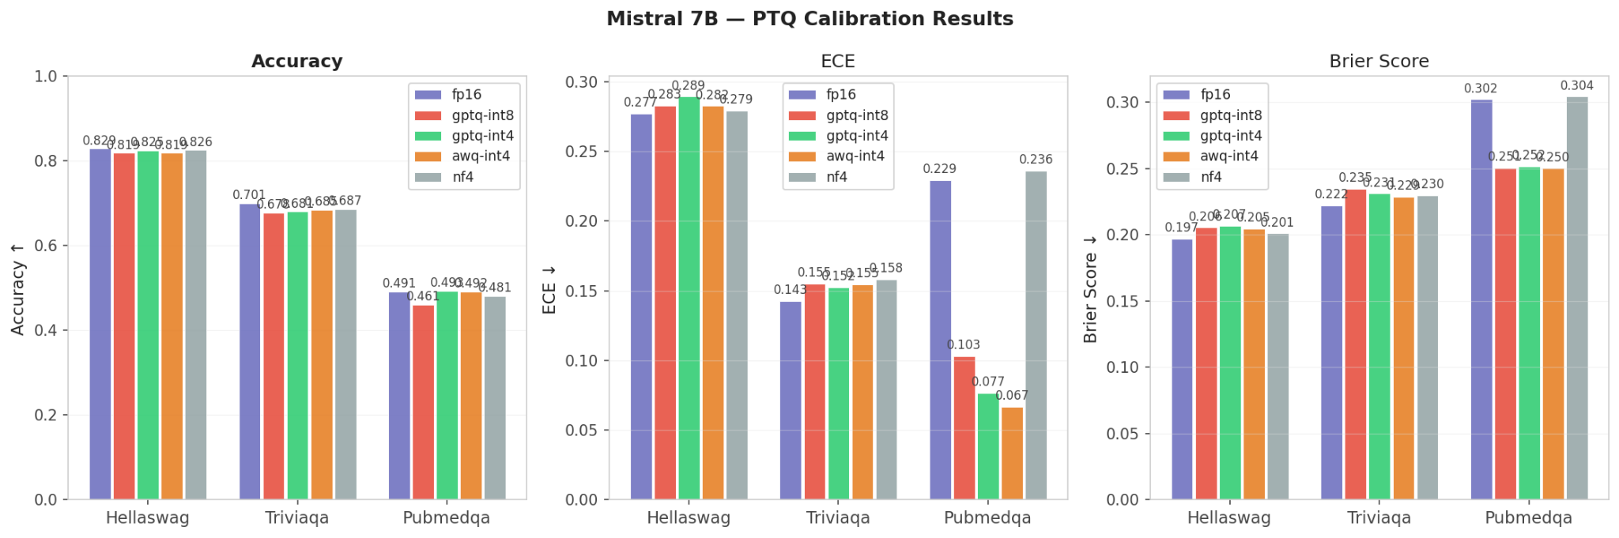
PTQ Calibration Run
On TriviaQA and HellaSwag, Quantization causes modest calibration degradation as seen with increase in ECE and Brier score
Accuracy on PubmedQA is uniformly low due to out of distribution nature of the dataset
HPML · Spring 2026
4 / 15

Slide 5
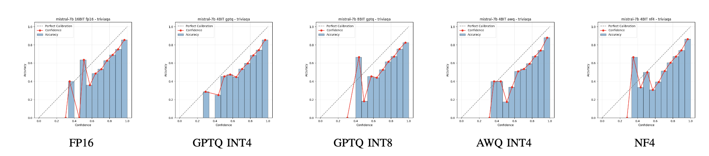
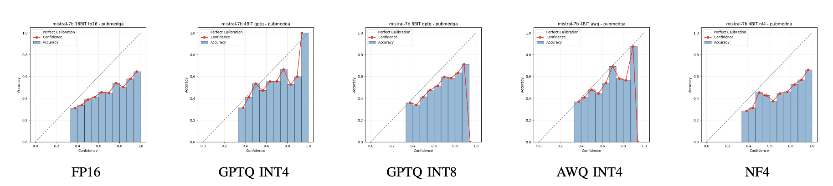
Reliability Diagrams
Reliability diagrams on TriviaQA across all quantization configurations. All configs show mild overconfidence. ECE increases modestly and Minimal accuracy loss from FP16 to quantized variants.
Reliability diagrams on PubMedQA across all quantization configurations. All configs show strong overconfidence (ECE=0.229) across all confidence bins. MCE worsens as probability mass concentrates in a single high-confidence bin

Slide 6
Results - Calibration Metrics (Mistral-7B)
Config | TriviaQA ECE | HellaSwag ECE | PubMedQA ECE | PubMedQA MCE | PubMedQA Brier | Avg Entropy | Accuracy (%)
FP16 | 0.143 | 0.277 | 0.229 | 0.330 | 0.302 | 0.402 / 1.088 / 0.656 | 70.1 / 82.9 / 49.1
GPTQ INT4 | 0.152 (+.009) | 0.289 (+.012) | 0.077 (−.152) | 0.302 | 0.252 | 0.431 / 1.116 / 0.938 | 68.1 / 82.5 / 49.3
GPTQ INT8 | 0.155 (+.012) | 0.283 (+.006) | 0.103 (−.126) | 0.944 | 0.251 | 0.428 / 1.114 / 0.924 | 67.8/ 81.9 / 46.1
AWQ INT4 | 0.155 (+.012) | 0.282 (+.005) | 0.067 (−.162) | 0.939 | 0.250 | 0.415 / 1.114 / 0.934 | 68.5 / 81.9 / 49.2
NF4 | 0.158 (+.015) | 0.279 (+.002) | 0.236 (+.007) | 0.330 | 0.304 | 0.397 / 1.097 / 0.663 | 68.7 / 82.6 / 48.1
Need all 3 calibration metric to capture the full picture
NF4 is the calibration-conservative choice
GPTQ INT4/AWQ INT4 have lower PubMedQA ECE and Brier Score than FP16 (0.077 vs 0.229) but MCE nearly triples to 0.944. Quantization spreads entropy, reducing average bin error while catastrophically miscalibrating one bin.
Only quantized method where ECE, MCE, Brier, and entropy all remain near FP16 on PubMedQA. Preserves the confidence distribution under distribution shift.
HPML · Spring 2026
5 / 15

Slide 7
Profiling Methodology and Roofline Analysis
Tools
Metrics captured
PyTorch Profiler / torch.profiler
NVIDIA Nsight Systems
[Other: vLLM logs, DCGM, perf, TensorBoard]
Weights & Biases for run-level tracking
Latency (p50, p95) and throughput
GPU utilization & SM occupancy
Peak GPU memory and HBM bandwidth
Time per stage: data → fwd → bwd → opt
Task quality metric (acc / perplexity / F1)
Config | Top PyTorch Op | Avg CUDA (ms) | AI (FLOPs/B) | Peak GPU (GB)
FP16 | aten::matmul (8.2%) | 7,772.6 | 57.7 | 14.50
GPTQ INT4 | QuantLinearFunction (12.7%) | 13737.0 | 195.1 | 4.29
GPTQ INT8 | QuantLinearFunction (12.6%) | 13731.3 | 107.2 | 7.81
AWQ INT4 | WQLinearMMFunction (9.9%) | 9,093.1 | 3.2 | 4.17
NF4 | bitsandbytes::gemv_4bit (3.8%) | 11,171.0 | 36.1 | 4.38
Config | Dominant Kernel | SM% | AI (FLOPs/B) | Roofline
FP16 | s16816gemm (cuBLAS) | 52% | 243 | Memory-bound
GPTQ INT4 | Marlin GEMM (W4A16) | 82% | 951 | Compute-bound
GPTQ INT8 | s16816gemm 128×128 | 58% | 266 | Memory-bound
AWQ INT4 | awq_gemm_kernel | 67% | 1865 | Compute-bound (prefill)
NF4 | kDequantize Blockwise | 81% | 388 | Near ridge
Pytorch Profiling (A100 80GB Kineto CUDA profiling)
Roofline (NVIDIA L4, prefill seq=128)
6 / 15

Slide 8
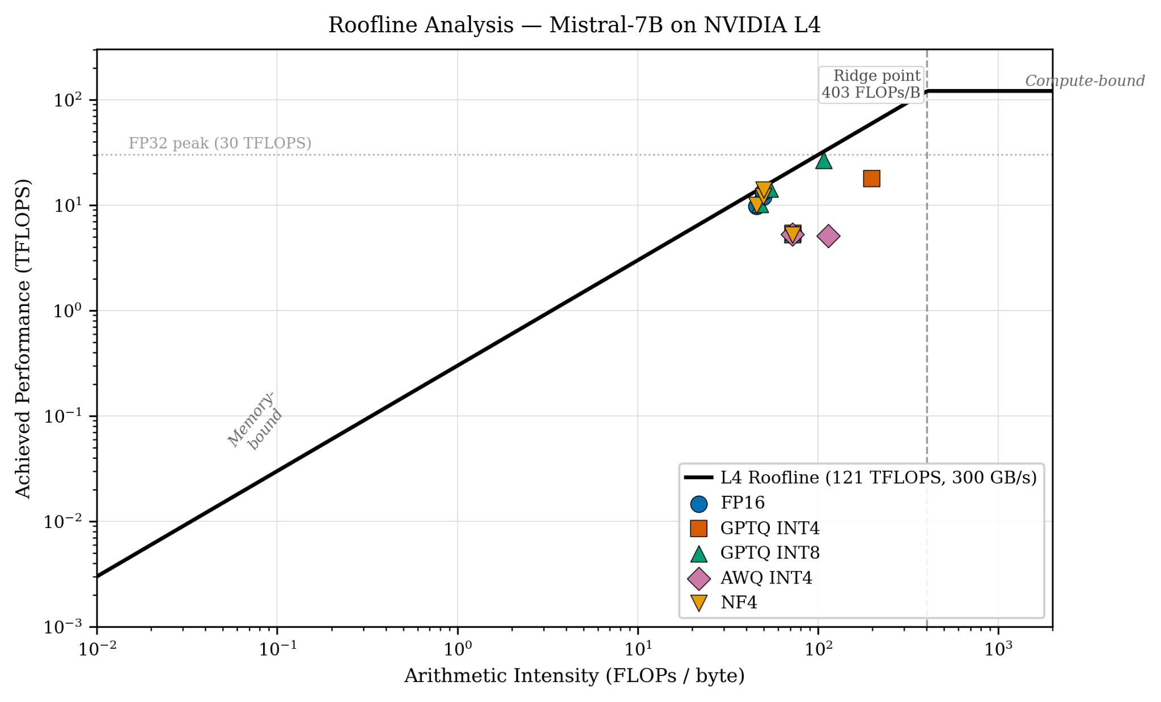
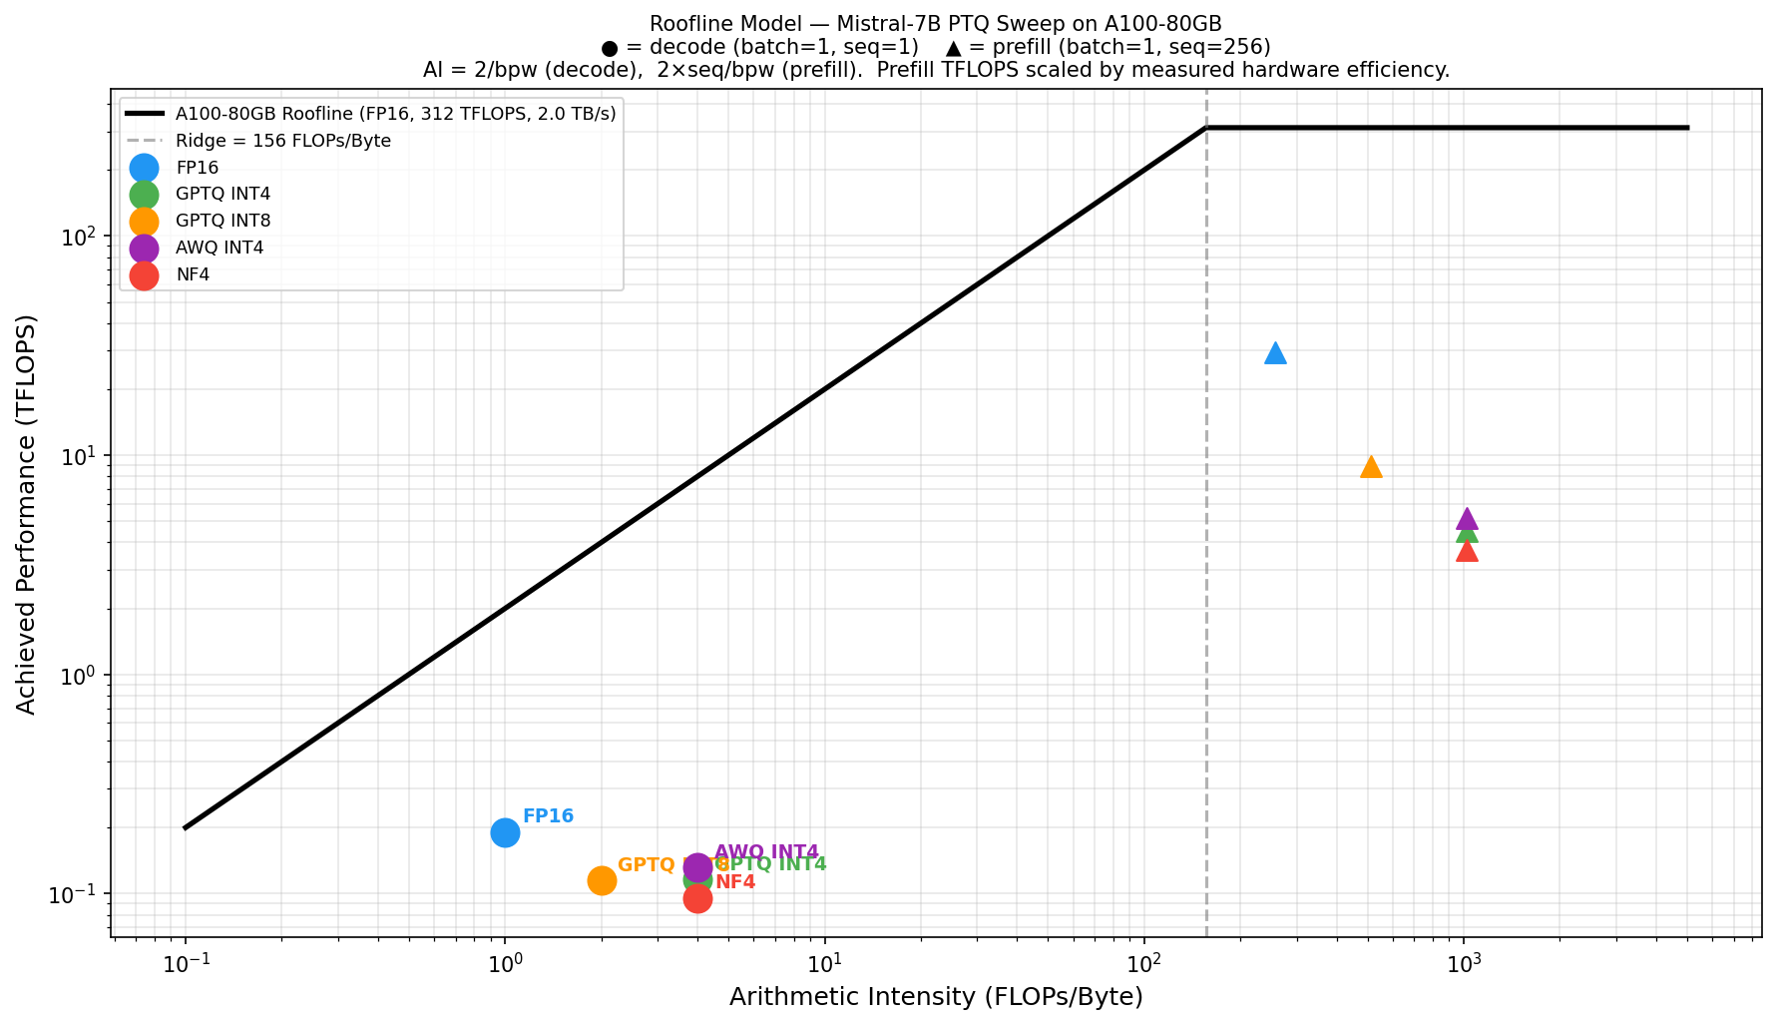
Roofline Analysis
Roofline - NSight Profiler
Roofline - PyTorch Profiler
HPML · Spring 2026
7 / 15

Slide 9
GPU Profiling - vLLM Throughput
Mistral-7B
Best: GPTQ INT4 (Marlin)
1677 tok/s · 1.78× FP16
Compute-bound via Marlin kernel
SM utilization: 82% | AI = 951 FLOPs/B
FP16
(cuBLAS)
942 tok/s (baseline)
GPTQ INT4
(Marlin)
1677 tok/s (1.78× FP16)
AWQ Paradox
AI = 1865 FLOPs/B (highest) but only
207 tok/s - fused GEMV is optimized for
single-batch prefill, not batched decode
GPTQ INT8
(exllama)
446 tok/s (0.47× FP16)
NF4: Memory-Bound Floor
89 tok/s · 0.09× FP16
No native vLLM support; HF fallback
does not use PagedAttention KV-cache
AWQ INT4
(fused GEMV)
207 tok/s (0.22× FP16)
NF4
(bitsandbytes†)
Key Takeaway
89 tok/s (0.09× FP16)
Kernel choice > bit-width.
GPTQ INT8 (0.47×) < FP16 < GPTQ INT4 (1.78×)
† HF batched fallback — not natively supported in vLLM
HPML · Spring 2026
8 / 15

Slide 10
Cross-Model vLLM Throughput
Marlin-backed GPTQ INT4 dominates across all model families | Routing viability is kernel-driven, not bit-width
Mistral-7B
LLaMA-1 7B
LLaMA-2 13B
FP16
942
FP16
868
FP16
449
GPTQ INT4
1677
GPTQ INT4
1665
GPTQ INT4
1215
GPTQ INT8
446
GPTQ INT8
478
GPTQ INT8
261
AWQ INT4
207
NF4†
89
AWQ INT4
206
AWQ INT4
98
FP16
baseline
FP16
baseline
FP16
baseline
GPTQ INT4 (Marlin) - compute-bound
FP16 baseline
GPTQ INT8 (exllama) - sub-FP16
AWQ INT4 (fused GEMV)
NF4 (HF fallback†)
GPTQ INT4 (Marlin) achieves 1.78–2.71× speedup over FP16 across all model families. AWQ fused-GEMV is optimized for single-batch prefill, not batched decode - explaining throughput collapse under vLLM.

Slide 11
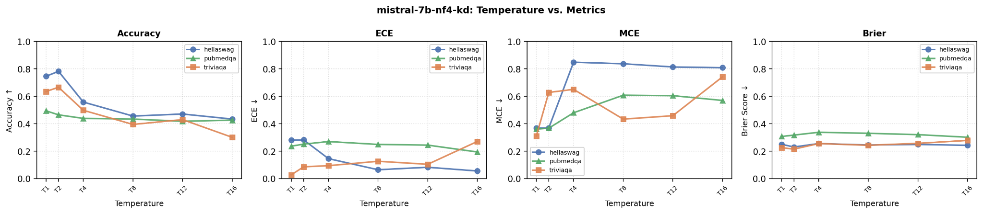
Routing Simulation & KD Recovery
Uncertainty-based routing (PubMedQA)
vLLM kernel slower than FP16 (inference still works, routing adds cost)
Model · Config | vLLM tok/s | Cost Saving | Eff. Acc
Mistral-7B GPTQ INT8 | 445.5 (0.47x FP16) | −59.4 % | 49.1%
Mistral-7B GPTQ INT4 | 1677 (1.78× FP16) | −108.8% | 49.6%
Mistral-7B AWQ INT4 | 207 (0.22× FP16) | −80.0% | 49.3%
Mistral-7B NF4 | 89 (0.09× FP16) | −122.8% | 49.1%
A faster kernel doesn't guarantee cheaper serving, routing has a price.
Mistral’s FP16 is already very efficient (13% faster than LLama1)
All Mistral-7B’s routing configs produce negative cost savings, as routing tax exceeds any throughput advantage, even for highly efficient serving such as GPTQ INT4
Knowledge Distillation Improvements at T=1,2, but collapses at Higher Temperatures
FP16 teacher, NF4 student
At T =1 and 2 wins HellaSwag and TriviaQA. Soft labels from FP16 teacher gives student useful signal that improves NF4 accuracy.
At T>2, MCE explodes for all dataset- worst case bins are severely overconfident.
At T >= 4, accuracy collapses. ECE remains low. Lose accuracy without gaining calibration.
10 / 15
HPML · Spring 2026

Slide 12
Lessons Learned & Next Steps
What worked
Next steps
Multi-metric evaluation (ECE + MCE + Brier) caught calibration artifacts invisible to single-metric analysis. Quantization can reduce average bin error but can distribute it to worst case bins, essential for OOD datasets
Roofline analysis cleanly explained the 1.78× vLLM speedup: Marlin kernel shifts inference from memory-bound to compute-bound
KD using FP16 as teacher at T=2 improves accuracy for in distribution tasks for NF4 student
A100 Roofline profiling with ncu access - compare L4 vs A100 Marlin kernel efficiency
Combine all 3 Team’s results into one cohesive story
Extend to MMLU, GSM8K, MedQA to confirm calibration trends generalise beyond 3 datasets
Challenges
Speculative decoding: quantized draft → FP16 target as an alternative routing strategy
ncu blocked on Colab (perf_event_paranoid=2) - required GCP L4 VM
KD at T≥4 looked like ECE improvement but MCE revealed distribution collapse
HPML · Spring 2026
11 / 15

Slide 13
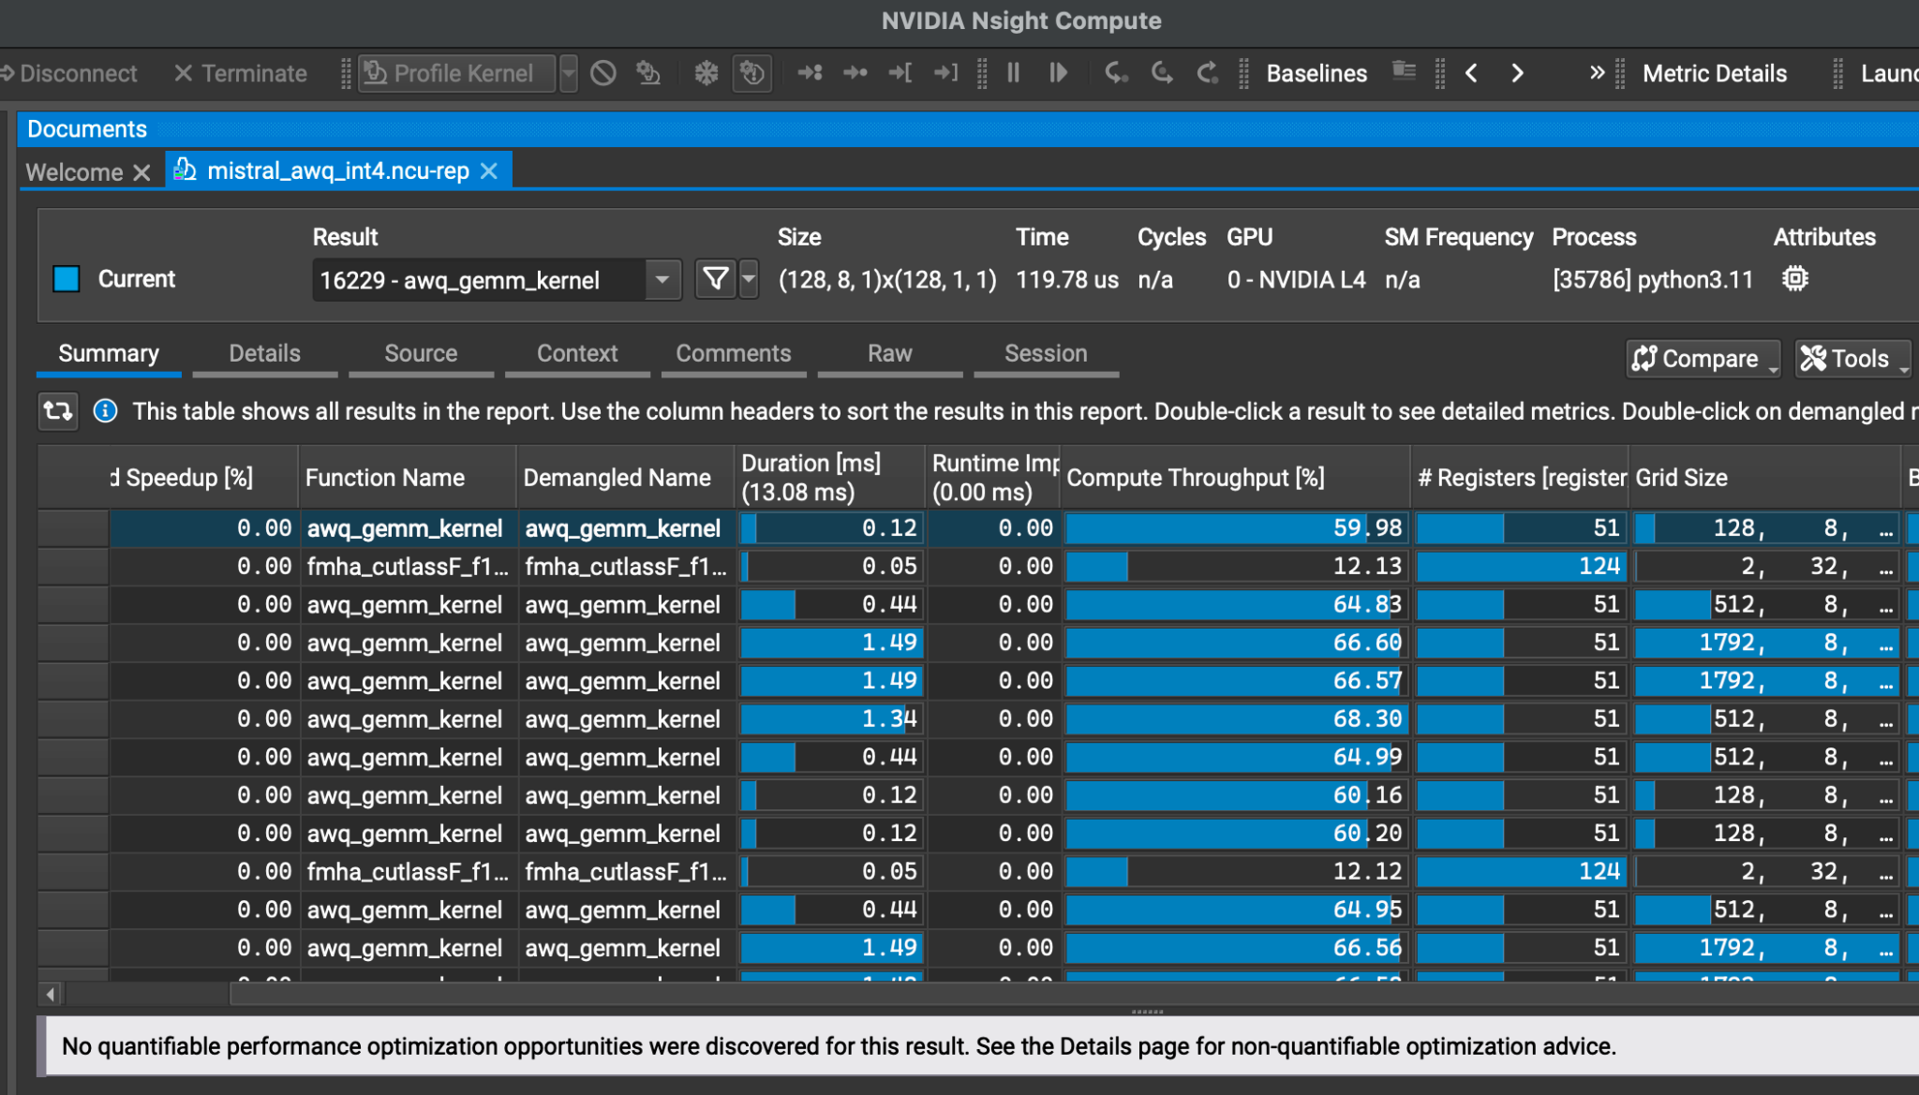
Profiler Evidence
HPML · Spring 2026
12 / 15

Slide 14
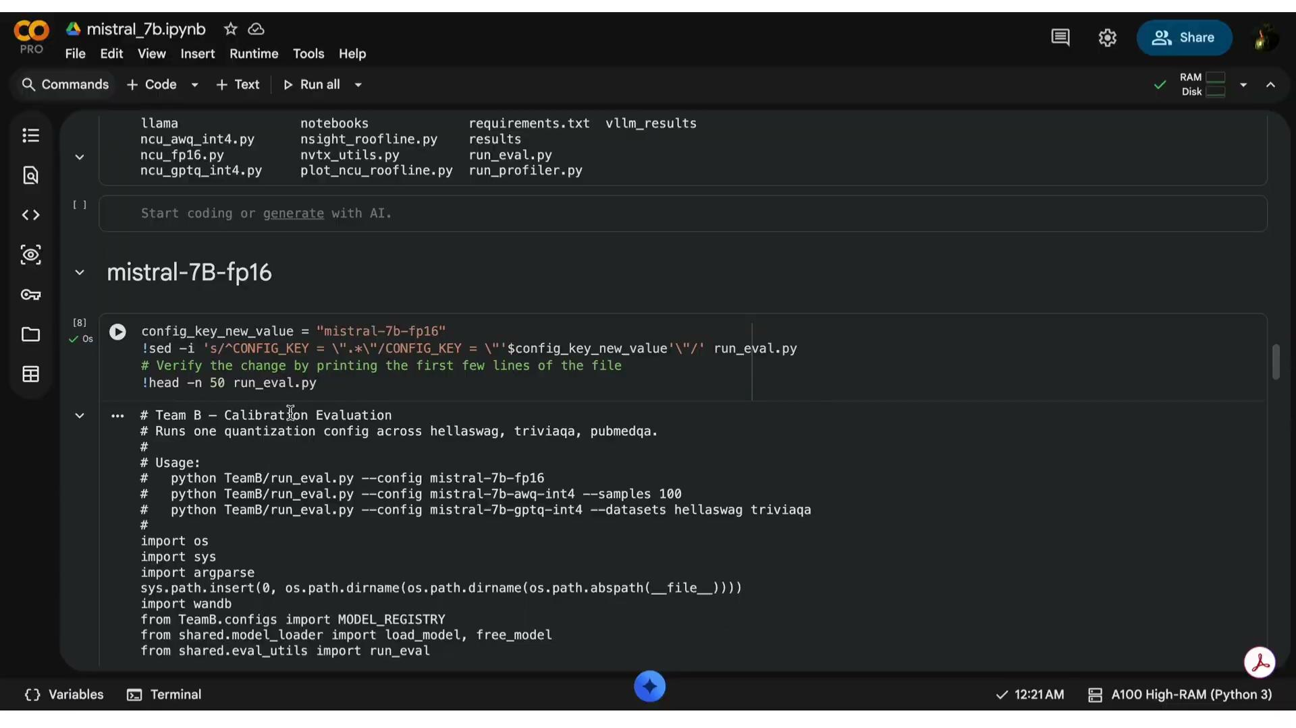
Demo / Visualization
HPML · Spring 2026
13 / 15

Slide 15
HPML Final Project · Spring 2026
Thank You
Questions?
GitHub: https://github.com/chuanbinp/uncertainty-aware-inference
WandB: https://wandb.ai/Uncertainty_Aware_Inference_Lab/UAI_Project
HPML · Spring 2026

