Slide 1
BU5-Diags Team
Diags Control Introduction
AUG 2009

Slide 2
Agenda
Introduce PMD Bay
Introduce Embedded antennas

Slide 3
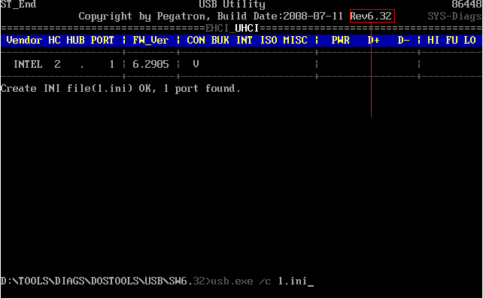
PMD Bay
Verify electrical functionality
a. Command: USB.exe /C <INI_FILE>
Program Version

Slide 4
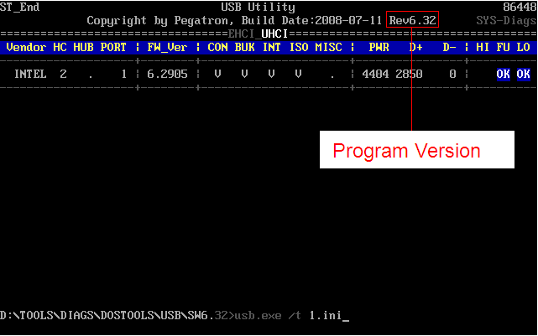
b. Verify mechanical functionality
Command: USB.exe /T <INI_FILE>

Slide 5
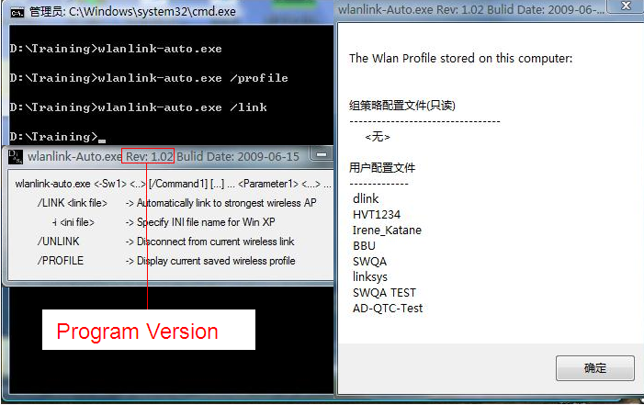
2. Introduce Embedded antennas
a. Verify functionality
Command: WLANLINK-auto.exe /LINK

Slide 6
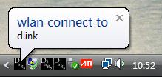
Result

Slide 7
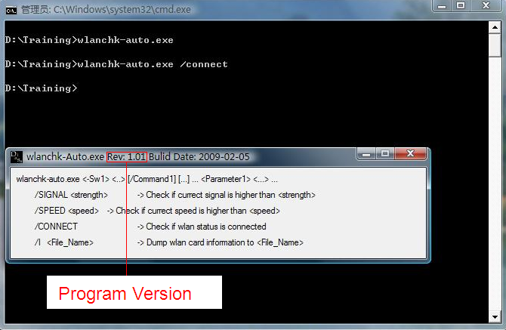
b. Verify any connection
WLANCHK-auto.exe /CONNECT

Slide 8
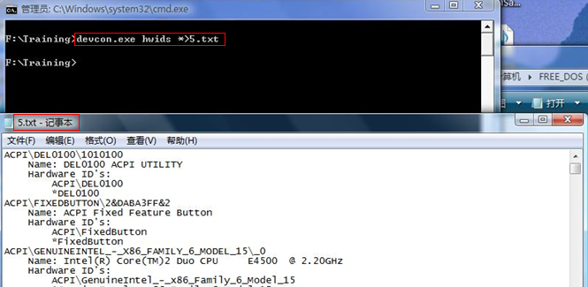
c. Verify LED functionality(where applicable)
Command: DEVCON.exe HWIDS
*><FILE>

Slide 9
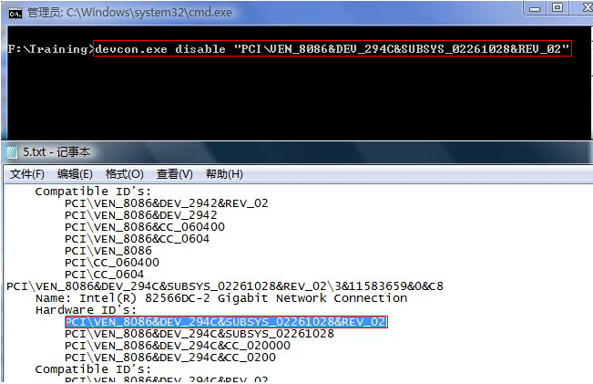
c. Verify LED functionality(where applicable)
Command: DEVCON.exe /DISABLE
<device\VID_NUMBER>

Slide 10
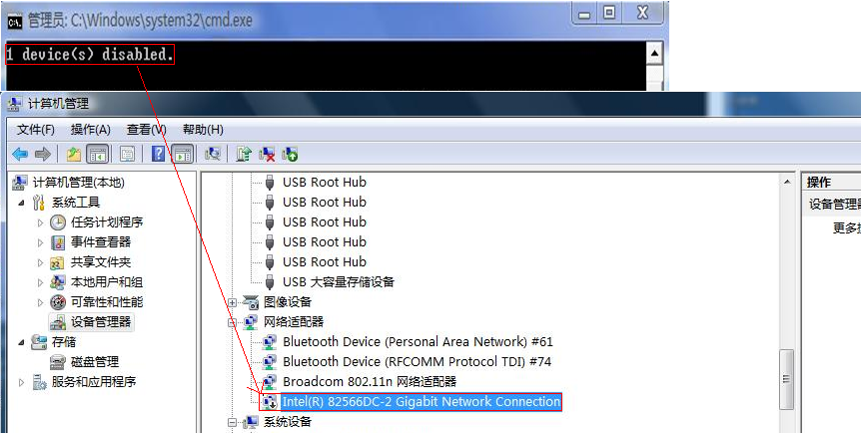
Result

Slide 11
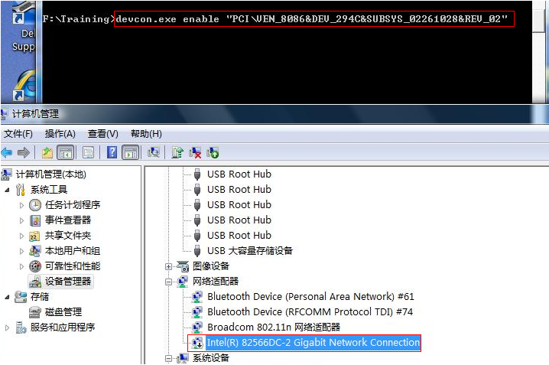
Command: DEVCON.exe /ENABLE <device\VID_NUMBER>

Slide 12
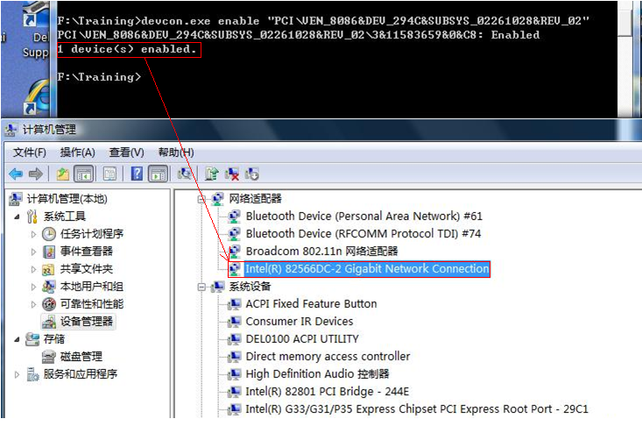
Result

Slide 13
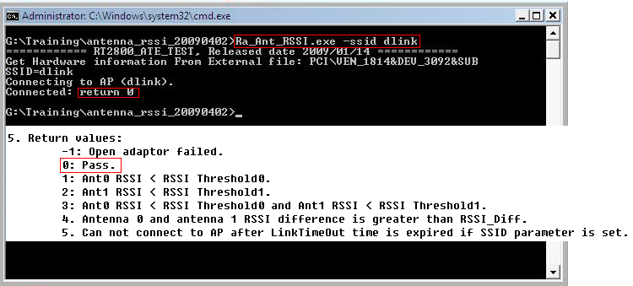
d. Verify any antennas
Command: Ra_Ant_RSSI.exe -SSID < RALINK_AP >

Slide 14
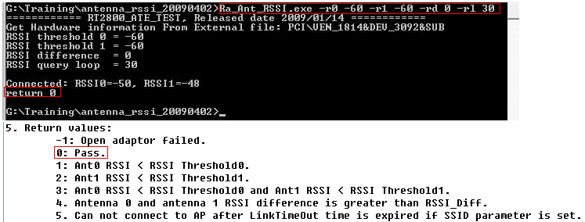
Command: Ra_Ant_RSSI.exe -r0 -60 -r1 -60 -rd 0 -rl 30

Slide 15
Any Questions?

Slide 16
Thanks for your attention.
Craig Hwang
08/10/09

