Slide 1






COMPETITION 2020
WHERE IDEAS BECOME R.E.A.L.
Organisers
Lead Collaborator

Slide 2





Better
Better
volunteer experiences,
one click at a
time
volunteer
Experiences,
one click at a
time
Presented to you by SEED S.I.G.

Slide 3
Better
Better
volunteer experiences,
one click at a
time
volunteer
Experiences,
one click at a
time
Presented to you by SEED S.I.G.

Slide 4

Who Are We? The Problem The Solution
Better volunteer experiences, one click at a time

Slide 5
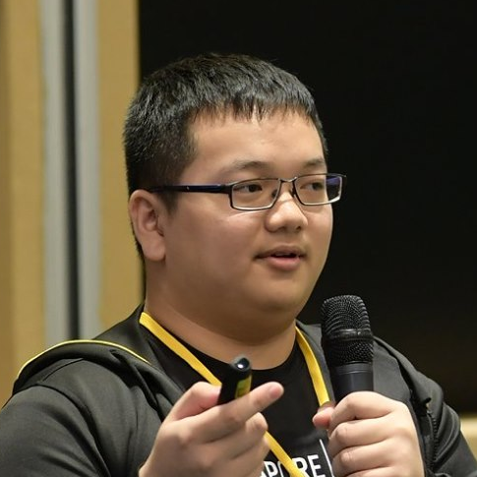
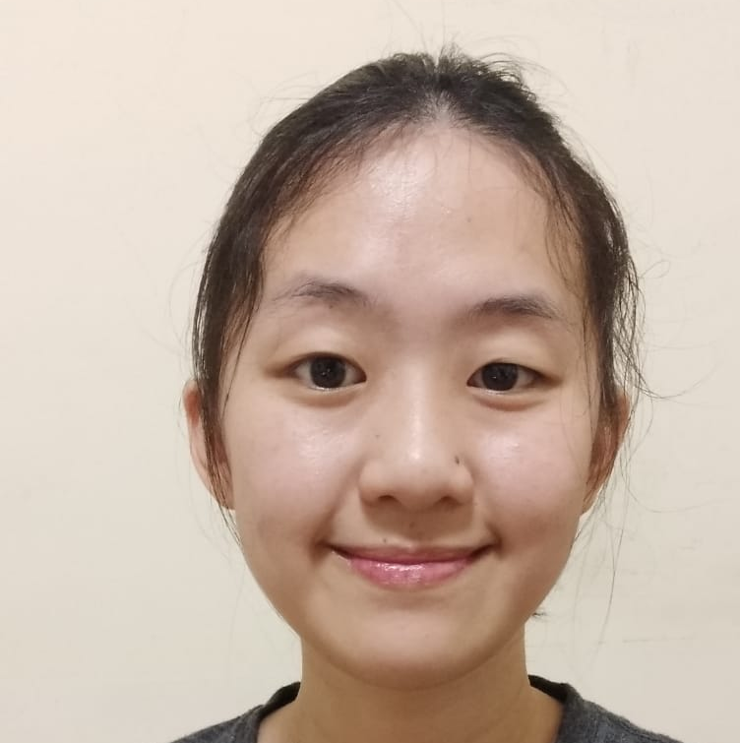
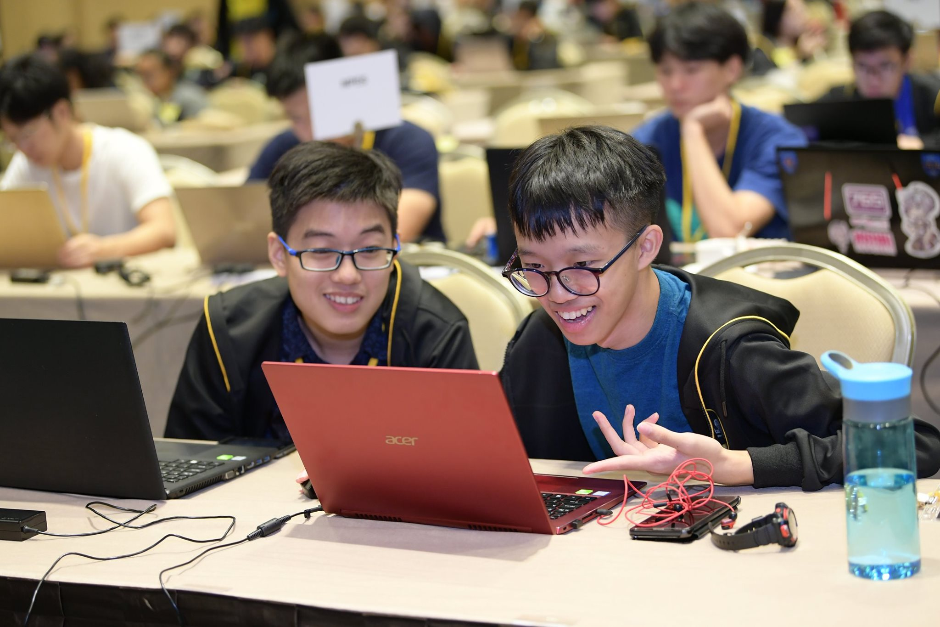
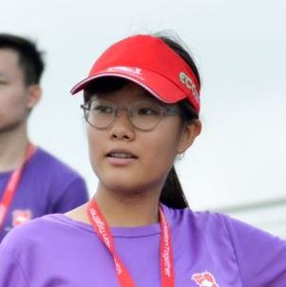
Who Are We?
Better volunteer experiences, one click at a time
CHUAN HAO
Team leader,
The Tech Dude
SILVIANA
Frontend Designer
Wizard Touch
DAVID
Also Tech Dude.
Backend Developer
The Problem The Solution
JESS
Cybersecurity Geek
Madlad
HENG WOON
Microsoft Magician
Comedian

Slide 6
Who Are We? THE PROBLEM The solution
Better volunteer experiences, one click at a time
CREATE A SYSTEM THAT MAKES IT EASIER TO RETRIEVE INFORMATION TO CREATE A BETTER EXPERIENCE.
Notes:
How can we create a system that keeps a database of the volunteers so that the event committee or the staff will be easier to retrieve information for insurance purposes and at the same time creating a better experience for the volunteers?

Slide 7
Who Are We? The Problem
Better volunteer experiences, one click at a time
CREATE A SYSTEM THAT MAKES IT EASIER TO RETRIEVE AND RETAIN INFORMATION TO CREATE A BETTER EXPERIENCE.
Current system
Volunteers
Organisation
The Solution
Notes:
The problem statement

Slide 8


Who Are We? The Problem
Better volunteer experiences, one click at a time
Current system
Volunteers
Organisation
The Solution
Volunteer
SYFC
Notes:
SMC

Slide 9
Who Are We? The Problem
Better volunteer experiences, one click at a time
Hey! Can I do this role for an event?
Yeah sure! Just give me the following details:
Name:
DoB: read more…
Current system
Volunteers
Organisation
Cool thanks!
Name: Jess
read more…
The Solution
Volunteer
SYFC
Notes:
SMC

Slide 10
Who Are We? The Problem
Better volunteer experiences, one click at a time
Hey! Can I do this role for an event?
Yeah sure! Just give me the following details:
Name:
DoB: read more…
Current system
Volunteers
Organisation
Cool thanks!
Name: Jess
read more…
The Solution
Volunteer
SYFC
Notes:
SMC

Slide 11




Who Are We? The Problem
Better volunteer experiences, one click at a time
Current system
Volunteers
Organisation
The Solution
Notes:
SMC

Slide 12


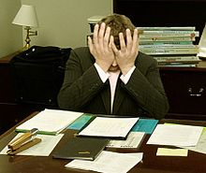
Who Are We? The Problem
Better volunteer experiences, one click at a time
Current system
Volunteers
Organisation
The Solution
Notes:
SMC

Slide 13


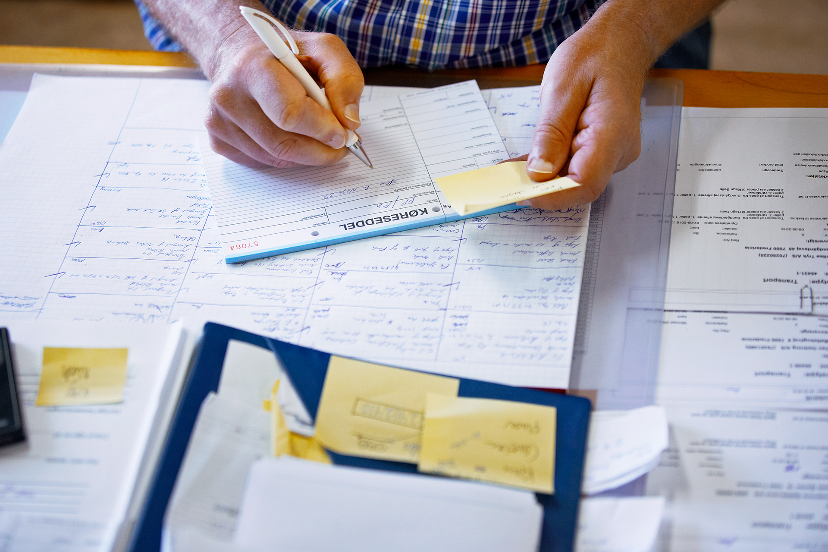

Who Are We? The Problem
Better volunteer experiences, one click at a time
POOF!
Current system
Volunteers
Organisation
2) NOT RETAINED
The Solution
1) TEDIOUS
Notes:
SMC

Slide 14
Who Are We? The Problem
Better volunteer experiences, one click at a time
Current system
Volunteers
Organisation
The Solution
Notes:
Win win

Slide 15

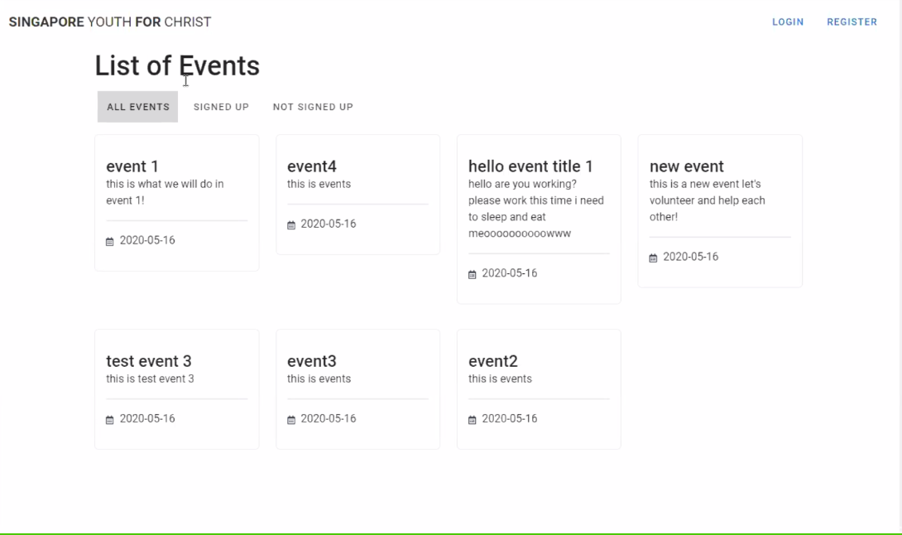
Who Are We? The Problem The Solution
Better volunteer experiences, one click at a time
Notes:
Switch to just showcasing the solution

Slide 16
Who Are We? The Problem The Solution
Better volunteer experiences, one click at a time
THANK YOU

Slide 17

Organisers
Lead Collaborator

