Slide 1
Analysis of usage of public transport and COE
PDS CA1, Done by: Lim Chuan Hao(1922264)

Slide 2
What are the datasets
Datasets used:
Public transport data
Public Transport Utilisation - Average Daily Public Transport Ridership
https://data.gov.sg/dataset/public-transport-utilisation-average-public-transport-ridership
Public Transport Utilisation - Average Trip Distance
https://data.gov.sg/dataset/public-transport-utilisation-average-trip-distance
COE data
Certificate of Entitlement (COE) Bidding Results
https://data.gov.sg/dataset/coe-bidding-results

Slide 3
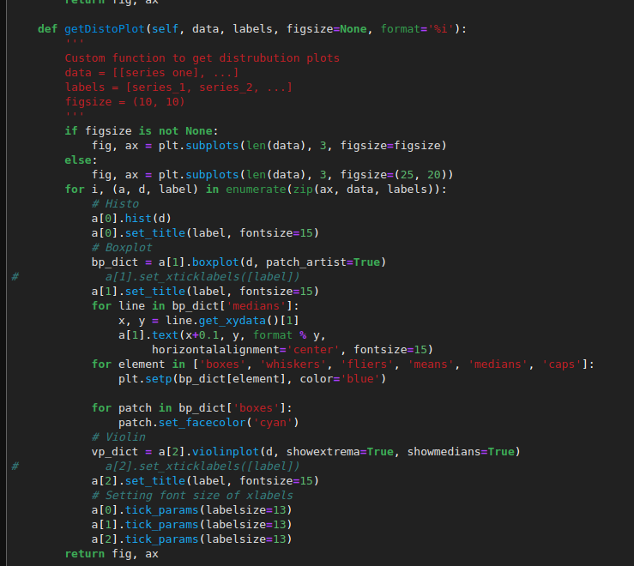
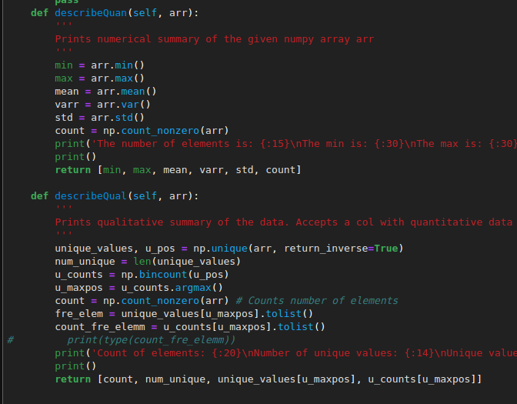
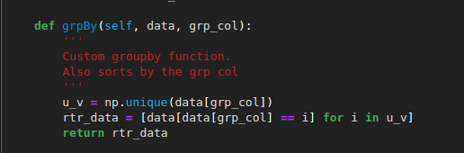

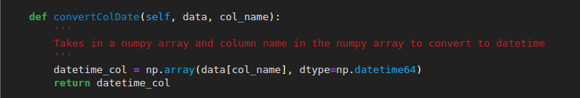
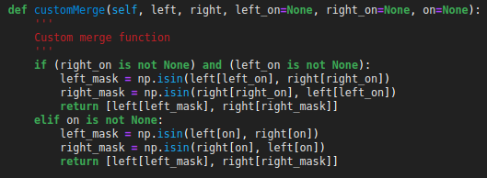
Before we begin
Made a custom utility class, utils
Describe qualitative/quantitative
groupby
Get distribution plot
Get datetime column
Custom merge

Slide 4
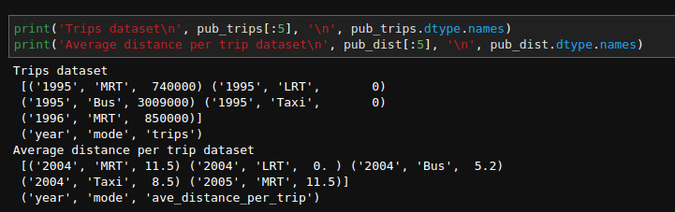
Looking at the public transport dataset
A quick look at the data we have

Slide 5
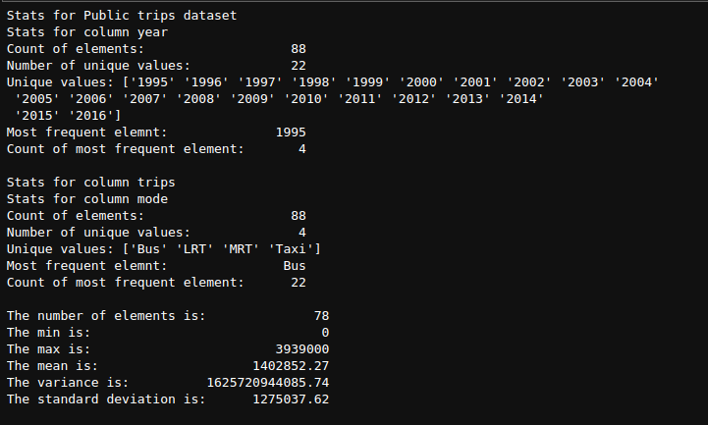
Getting some quick analysis
Pub_trips -> Average Daily Public Transport Ridership dataset

Slide 6
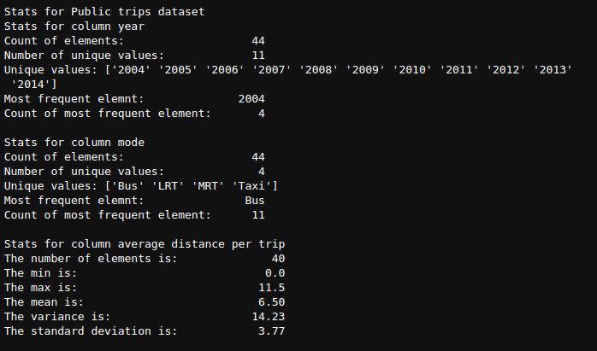
Getting some quick analysis
Pub_dist -> Average trip distance dataset

Slide 7
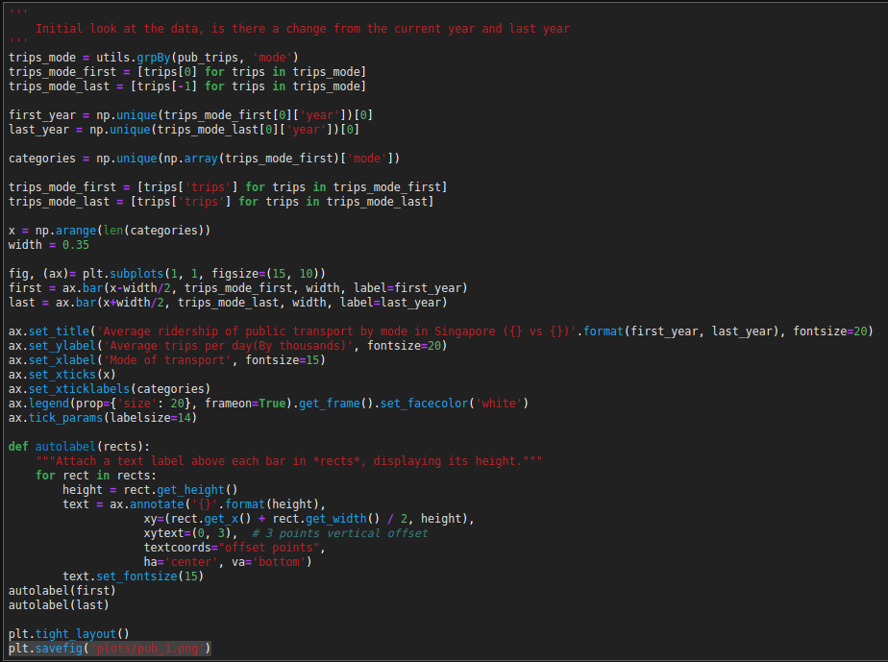
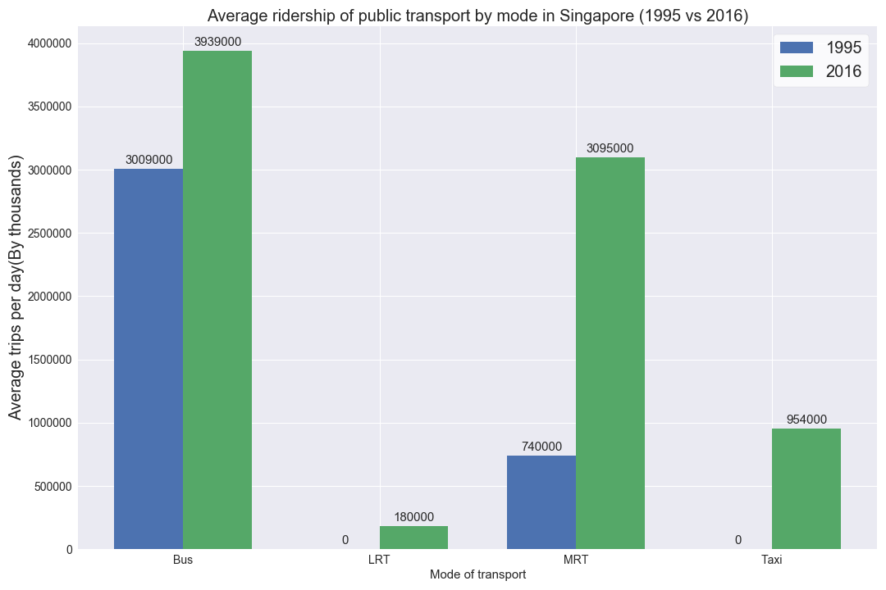
Did ridership increase from 1995 to 2016?
Introduction of taxis and LRT
Large increase in MRT usage
General increase for all modes
Notes:
Group the data by the year and took the first and last year, plotted by category
This was probably due to increase in population in Singapore from that time till now.
Mrt open more stations and became more accessible and convenient now than before

Slide 8
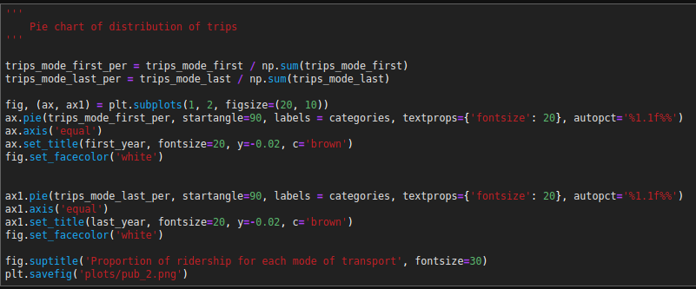
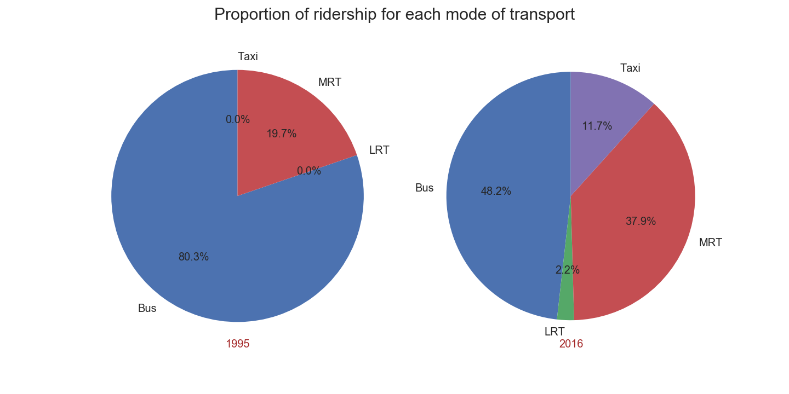
How did the proportion for each mode change?
Bus was majority before
Now bus is still majority, 50% and other are 50%
Notes:
Took the previous, divided all number by sum of trips in that year
Bus majority before as it was more accessible compared to MRT
A lot of people still use it now, due to policies and short trips? -> see later

Slide 9
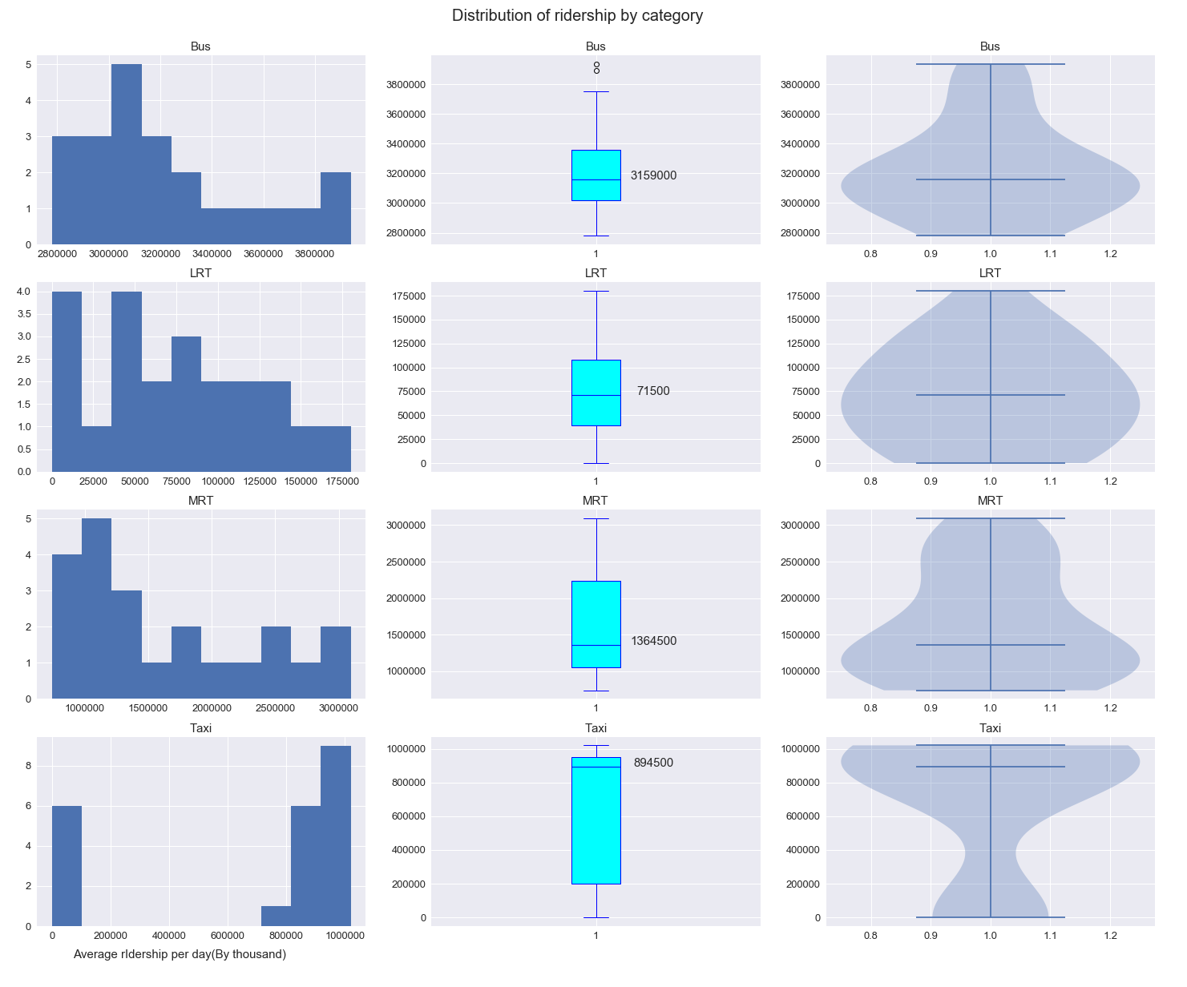
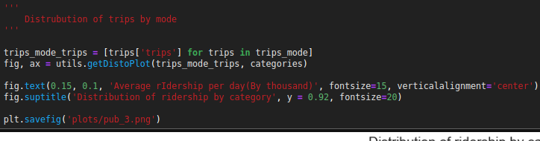
Looking at the distribution of trips
Data is mostly left skewed, except for Taxis
Long upper tail for MRT
Notes:
Used subplots to create histogram, boxplot and violin plot. (Utility class)
Left skewed means more datapoints were smaller than before.
Recent datapoints were much higher causing the range, top whiskers to be so large
Taxi is skewed because of 0 datapoints.
Looks to be largely normal for taxi

Slide 10
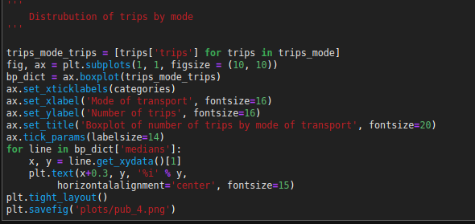
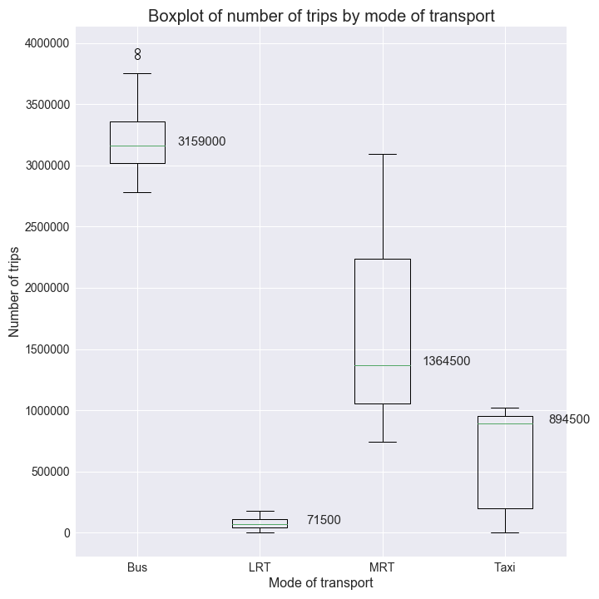
How do their boxplots compare?
More people usually take bus
MRT is catching up quite fast
Notes:
Plot the boxplot on the same axis
Similar to previous conclusions.

Slide 11
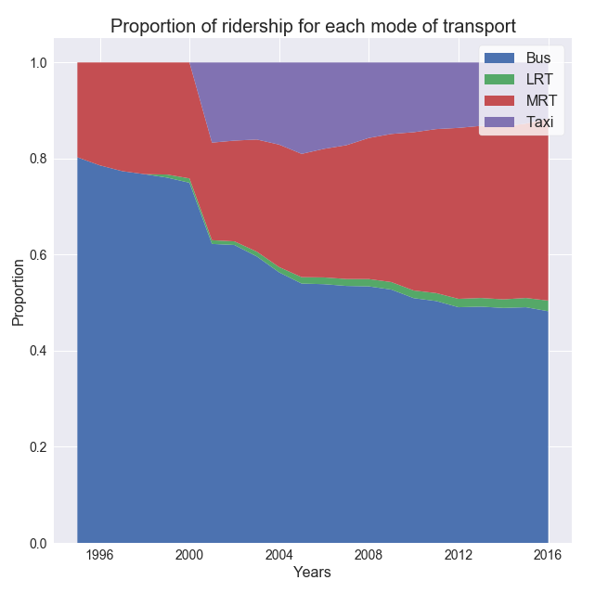
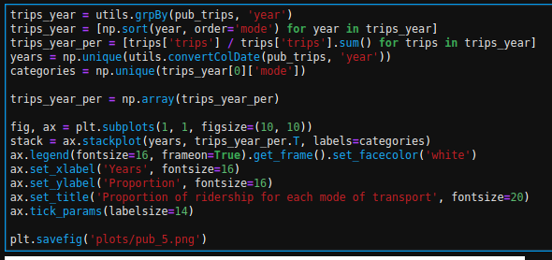
How did the proportion of usage change over time?
Bus proportion is decreasing
Mrt is increasing rapidly
LRT is a very small percentage
Notes:
For every year, took each trip by mode and divided by the sum of trips that year.

Slide 12
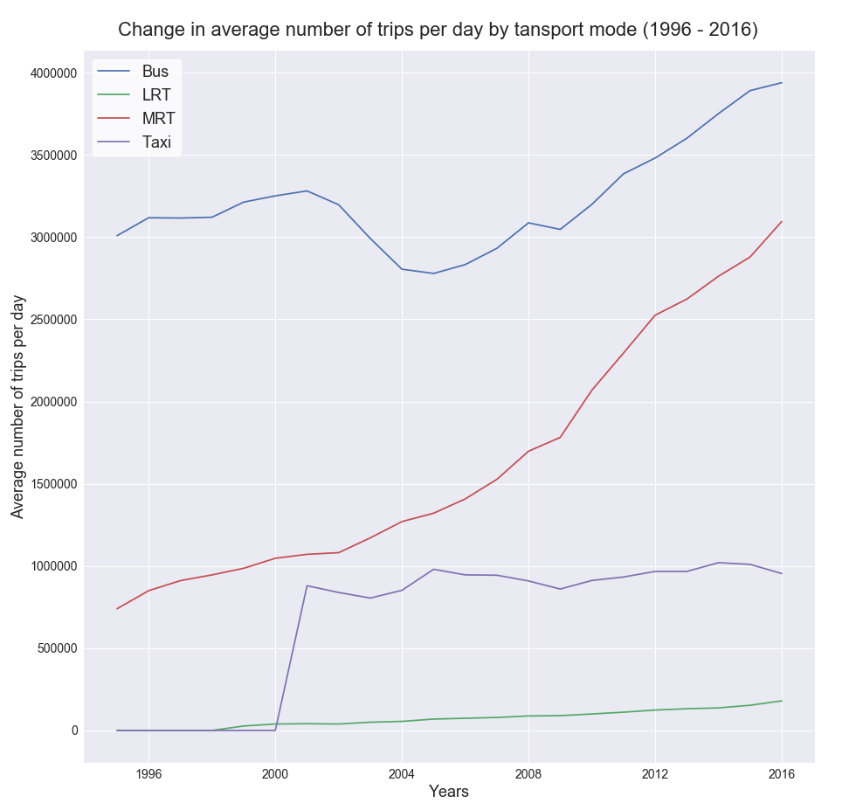
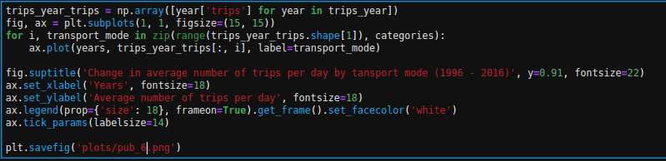
What was the change in numbers?
Bus did dip but then increased
MR was a constant increase.
Notes:
Category then plotted each based on year
Bus dip because of MRT?
In general increase ridership for all modes

Slide 13
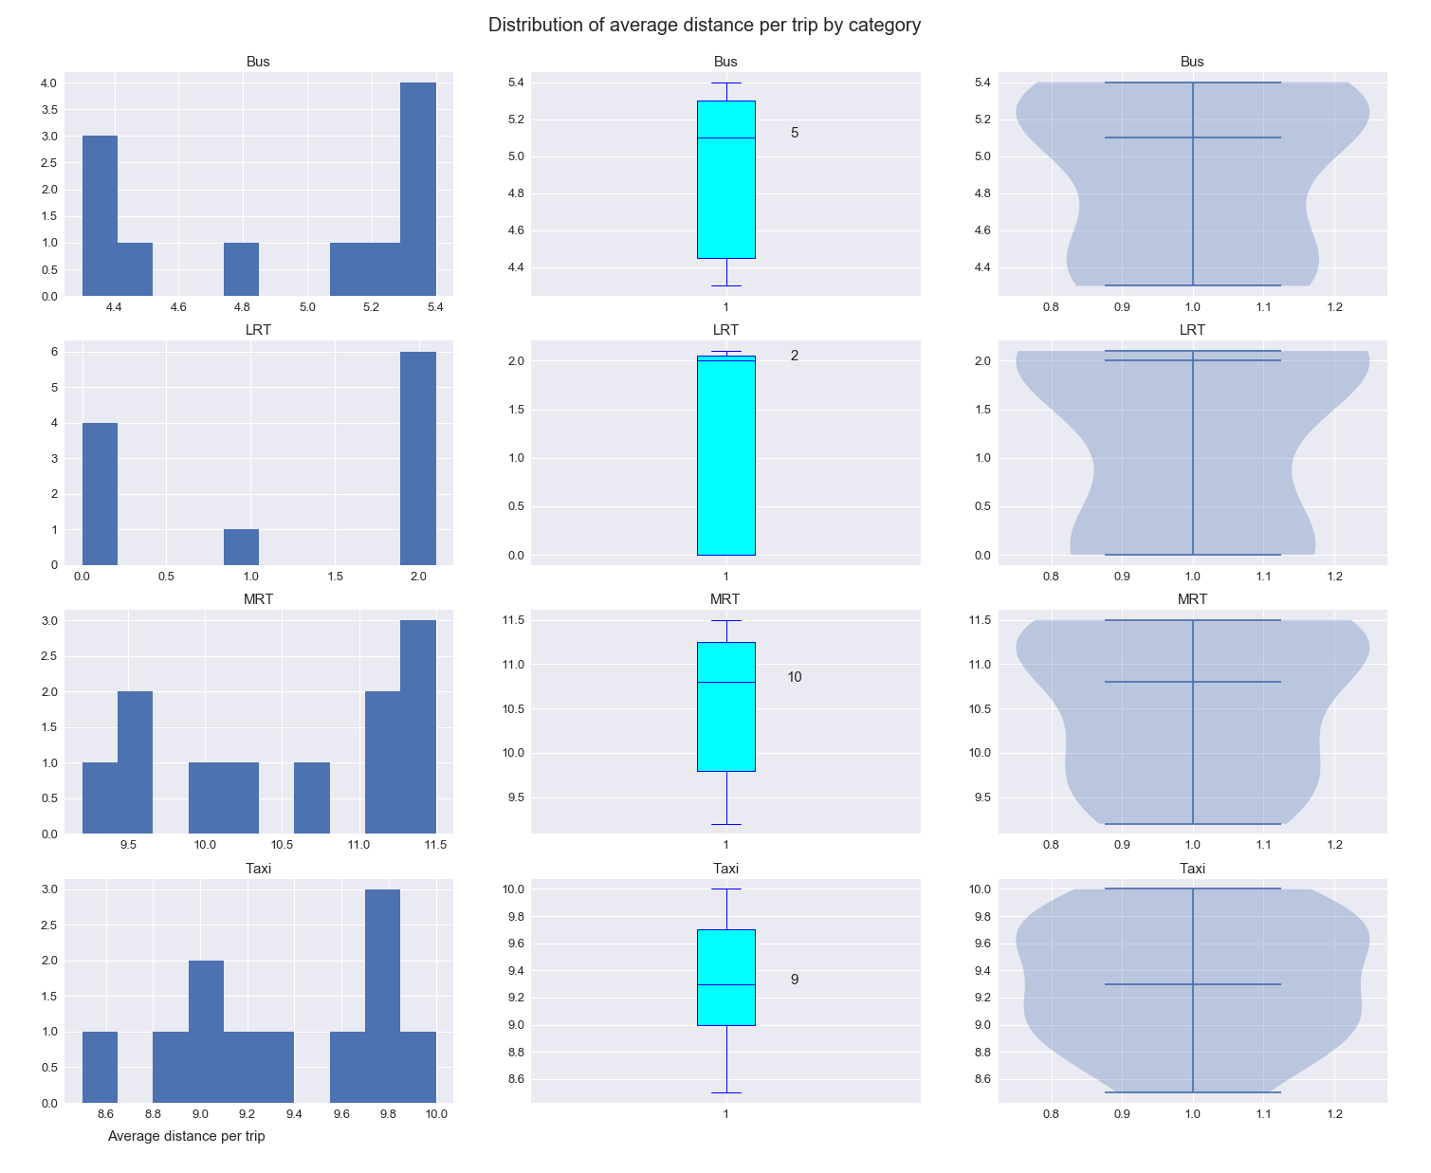
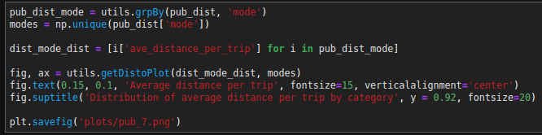
Distribution of average distance per trip
LRT long lower tail from 0
Distance in bus trips spiked
MRT seems to be a general increase
Taxi is normal
Notes:
Utility class to make plot
Agrees with common convention, take bus for with neighbourhood and MRT for going from regions. Long distance.
Taxis as well.

Slide 14
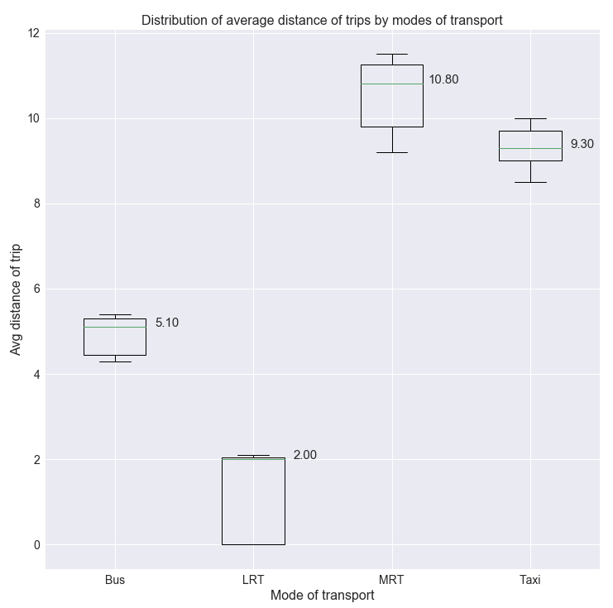
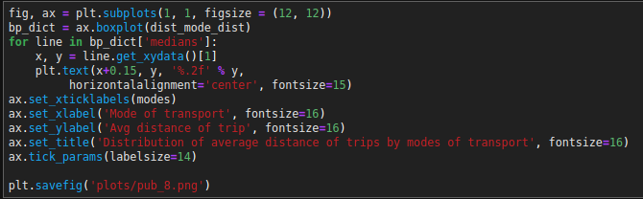
Comparing boxplot on same axis
MRT trips are the longest
Bus is about average
Taxi is similar to MRT
Notes:
Boxplot using data grouped by mode
MRT distance is about twice on average.
Question, which is more important? Breakdown, which affect more?

Slide 15
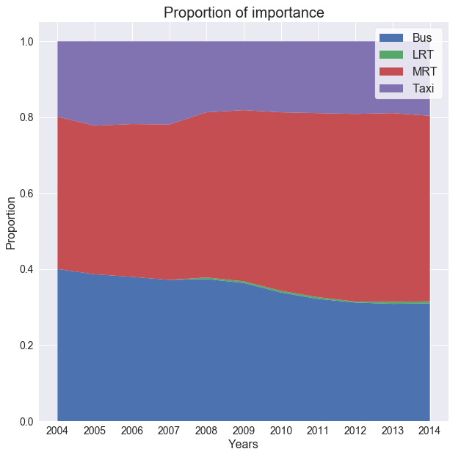
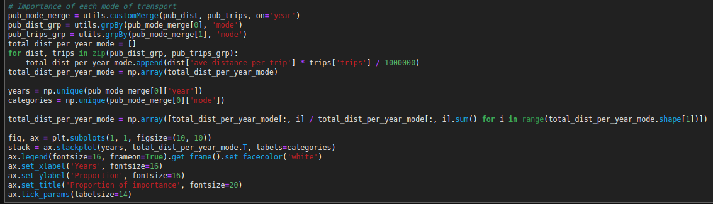
So, how important is each mode of public transport?
MRT is more important than Bus
Taxi also holds a surprising amount of importance
Notes:
Merged data by years, took trips * average distance. Total amount of distance transported by each mode of transport. Took sum of every year and divided each mode by sum.
MRT has largest, breakdown is massive jam. Cause now load for transport of so much distance done by other modes.
Bus is decreasing, prob more mrt open. Congested roads.
Note the years.

Slide 16
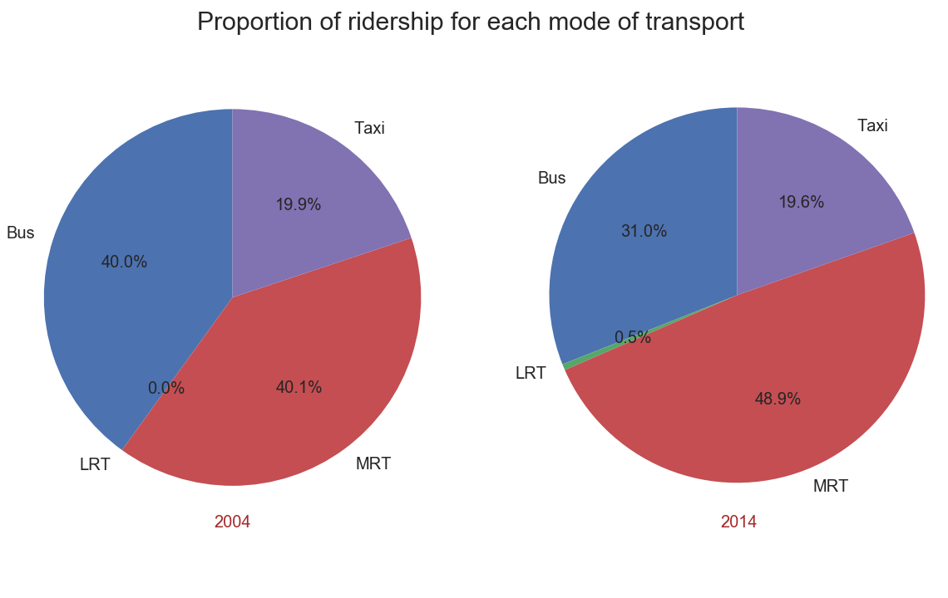
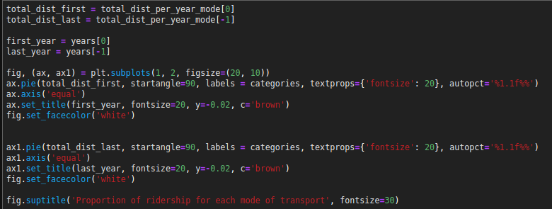
Closer look at change in proportion
MRT about 50%, other 50%
Notes:
Took only first and lst years from previous
Similar to previous

Slide 17
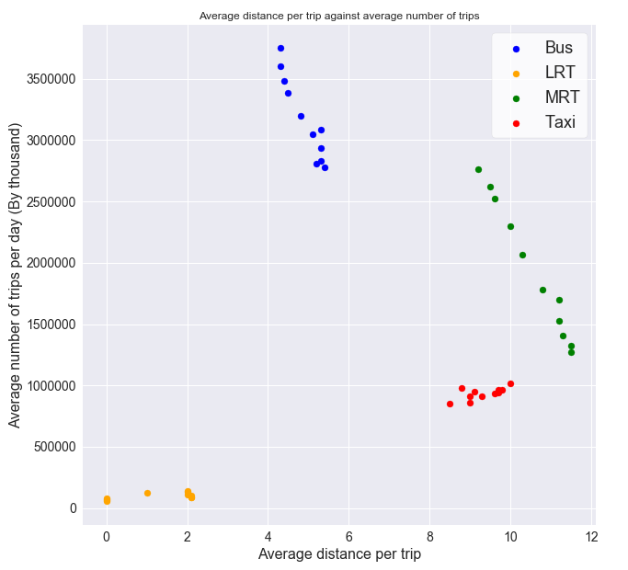
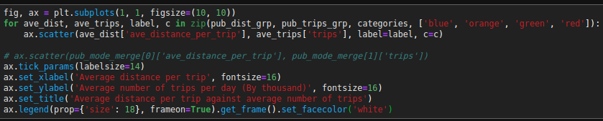
Relation between trips and distance?
First glance, not much correlation
Maybe?
Notes:
Took merge raw data, grouped by category and plotted the scatter for each, giving a different label
Does not seem to have a solid correlation between distance and number of trips?
Seems like for each mode, there might be a corrlation.

Slide 18
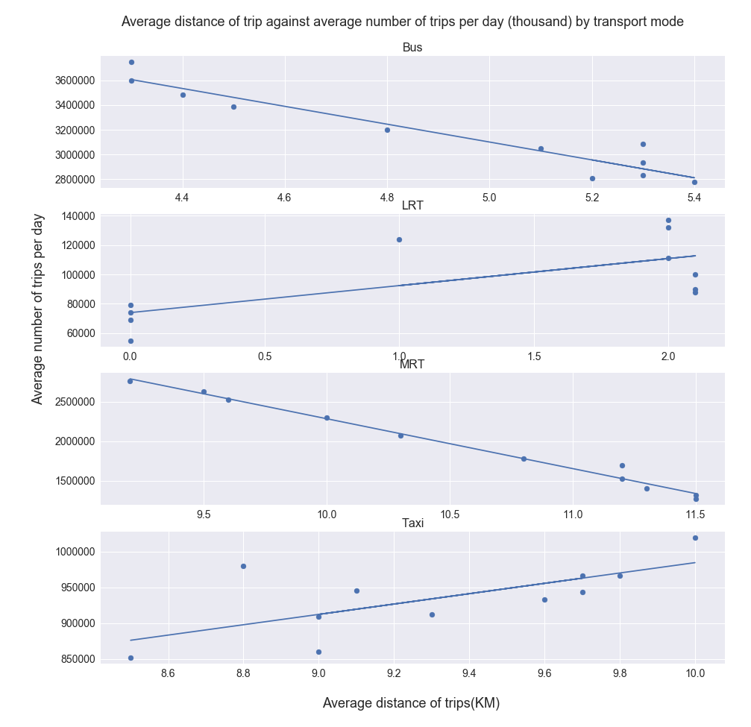
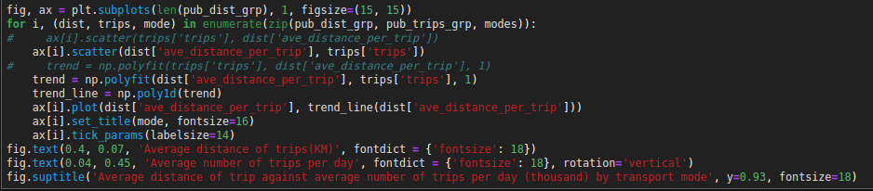
Closer look at the relations
There is a relation for each mode
LRT seems to be weakest
Notes:
Subplot by mode
Bus and MRT, as number of trips increase, average distance decrease.
Possibly due to more bus routes and mrt, people use it for convenience?
Taxi, more people can afford to take, distance increase.

Slide 19
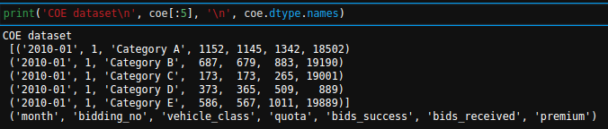
Quick look at the COE dataset
Columns: Month, bidding_no, vehicle_class, quota, bids_success, bids_recieved, premium

Slide 20
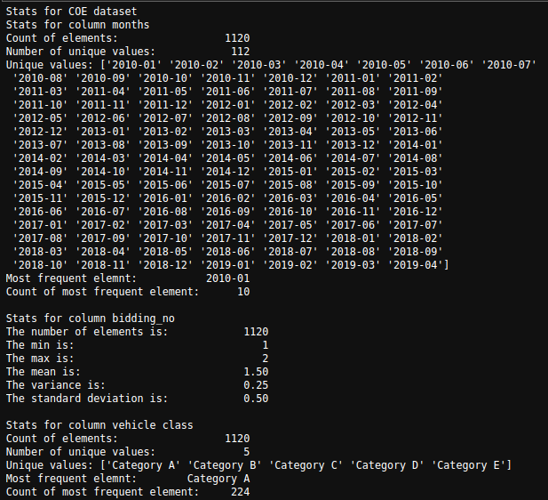
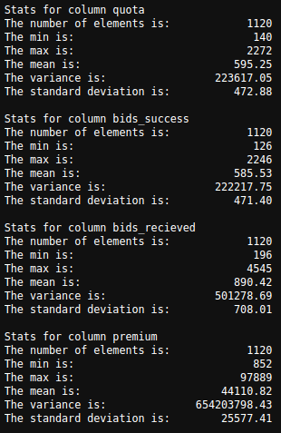
Some quick summaries
Not much to look at.

Slide 21
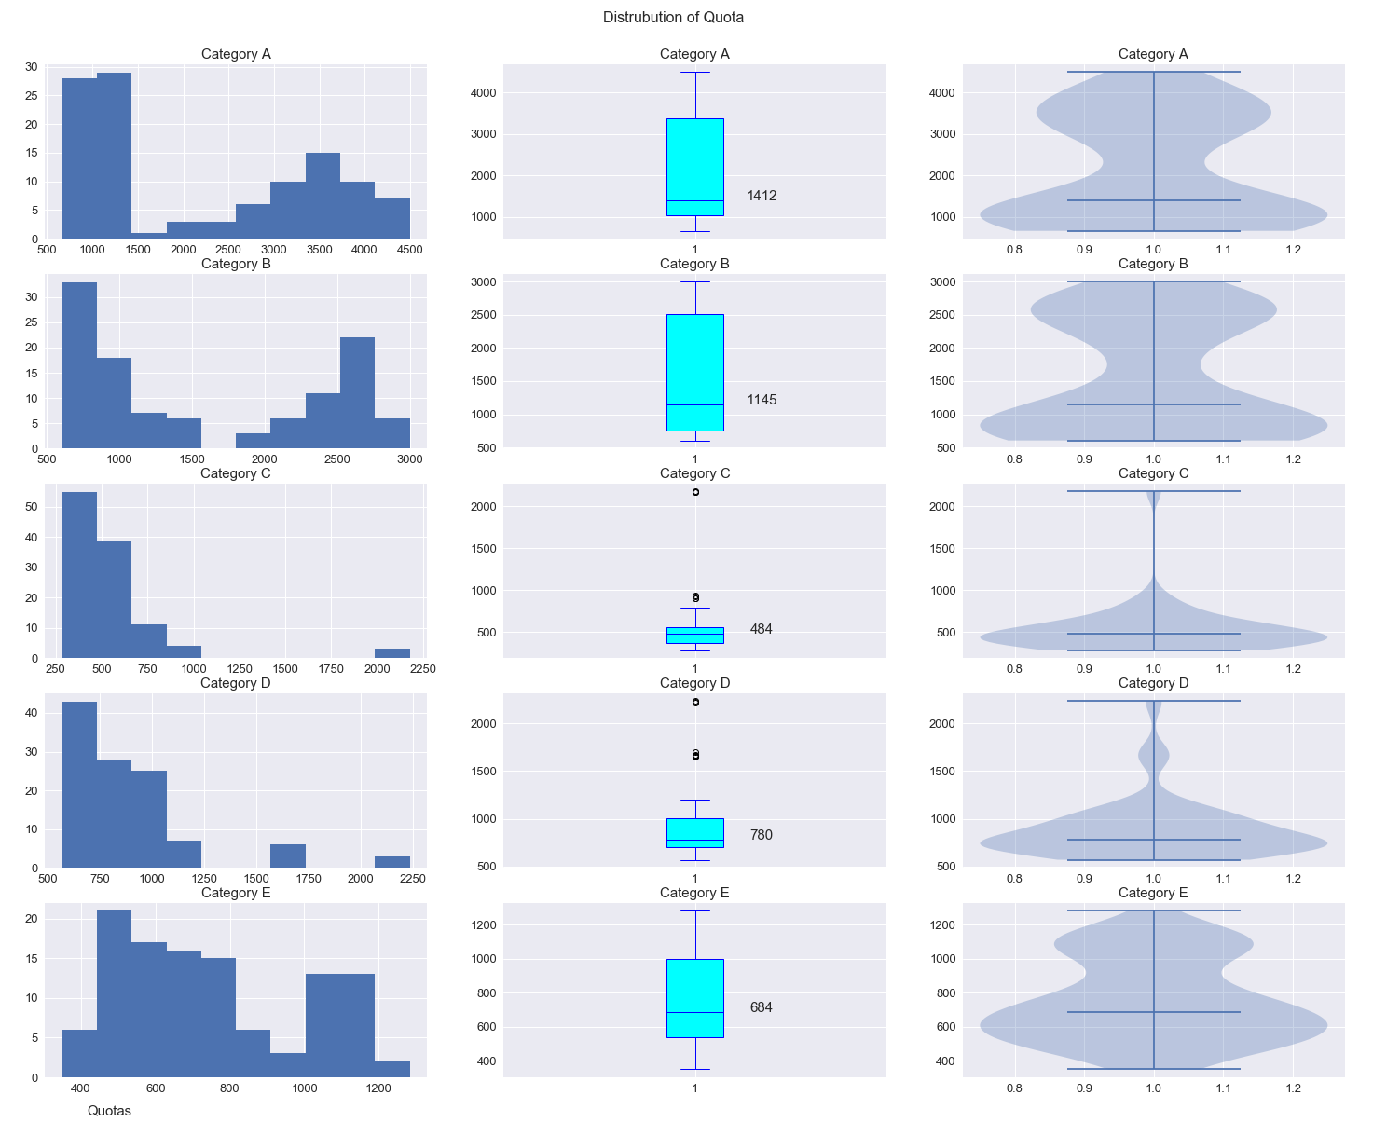
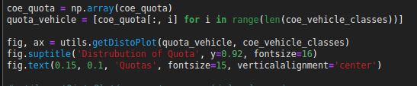
Looking at quota distribution
Most categories are left skewed.
Notes:
Utility function
Suggest quota used to be very small, and gradually increased

Slide 22
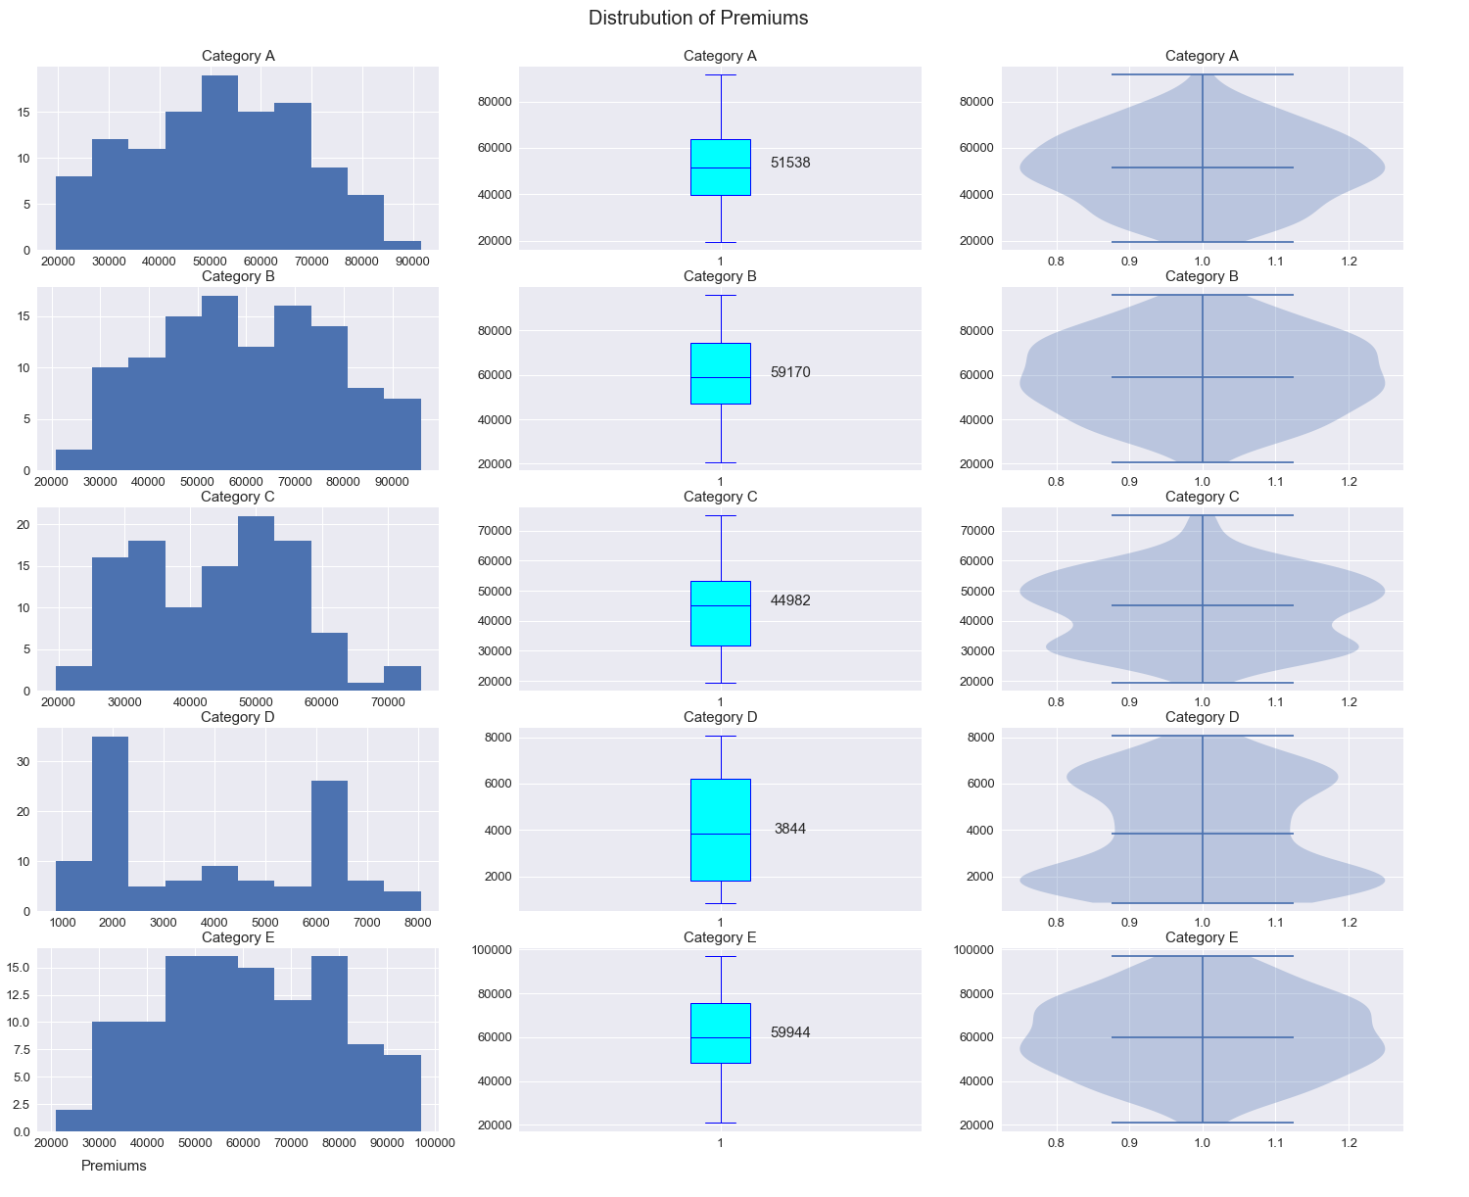
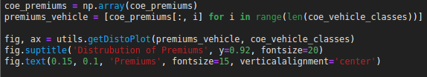
Looking at premiums distribution
Premiums mostly seem normal
Category D is left and right skewed.
Notes:
Major change in category D
Normal premiums seems to suggest quota does not play such a big role. Not much relation

Slide 23
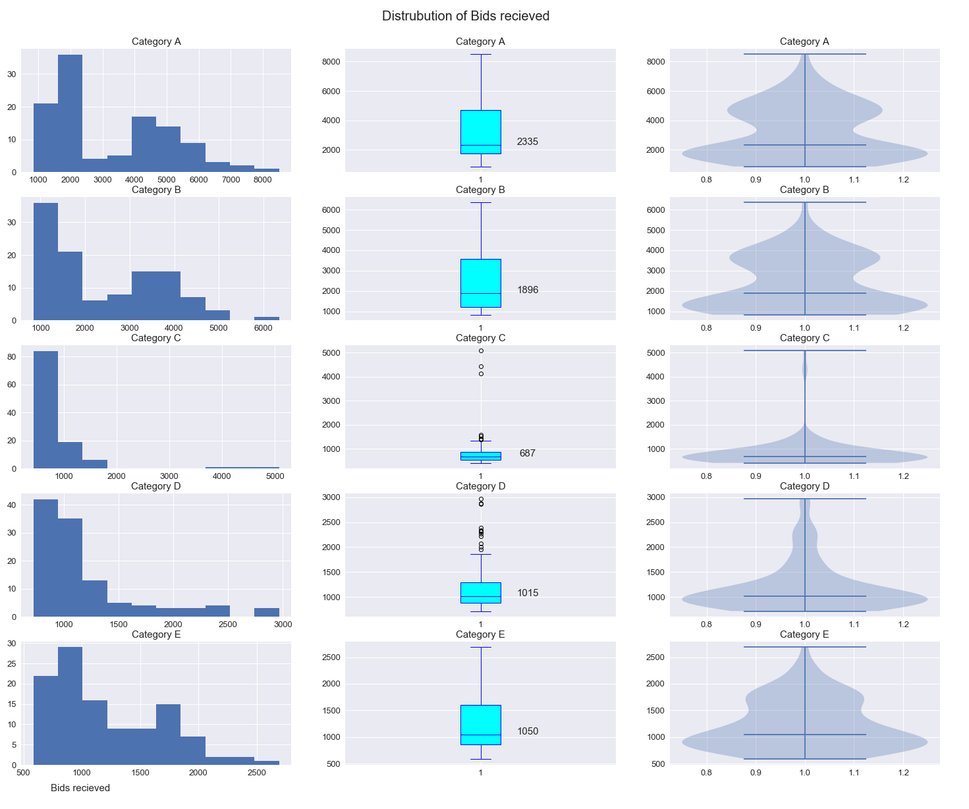
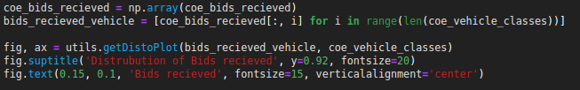
Distribution of bids received
Seems to be similar to quota distribution
Mostly left skewed with gradual increase
Notes:
Could be a strong correlation.

Slide 24
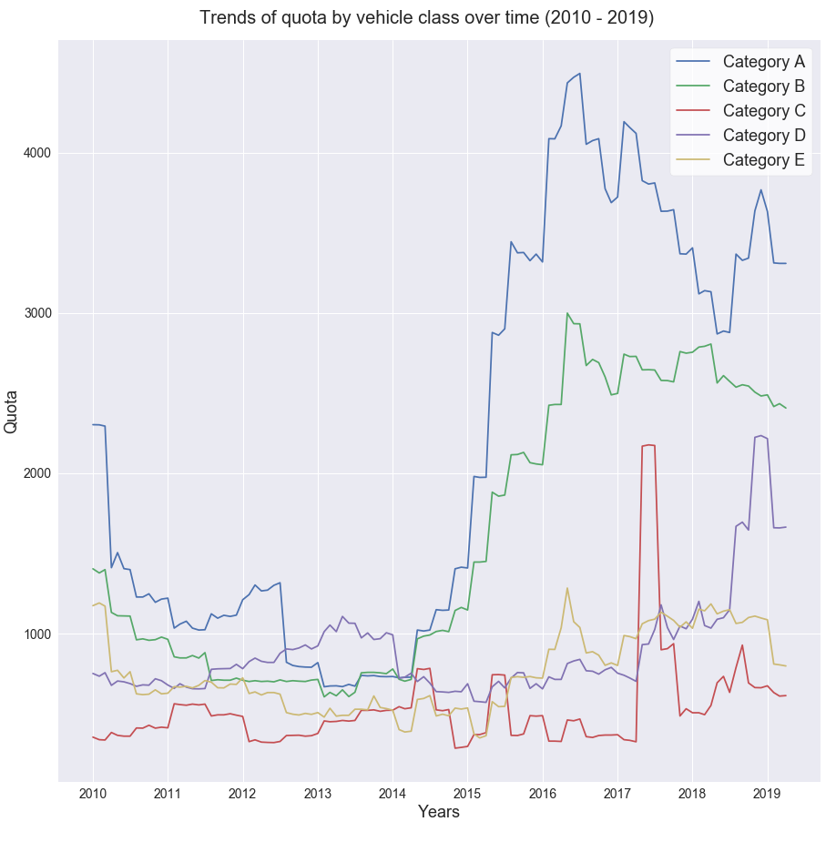
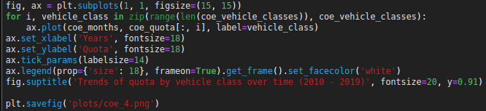
What is the trend of quota over the years?
Major increase in quotas from 2015 for all categories
Most for Category A
Notes:
Aggregated by year and category. Added quota for both session. Plotted the quota against respective time.
Could be encouraging EV?
Could also be alot of degregistered cars

Slide 25
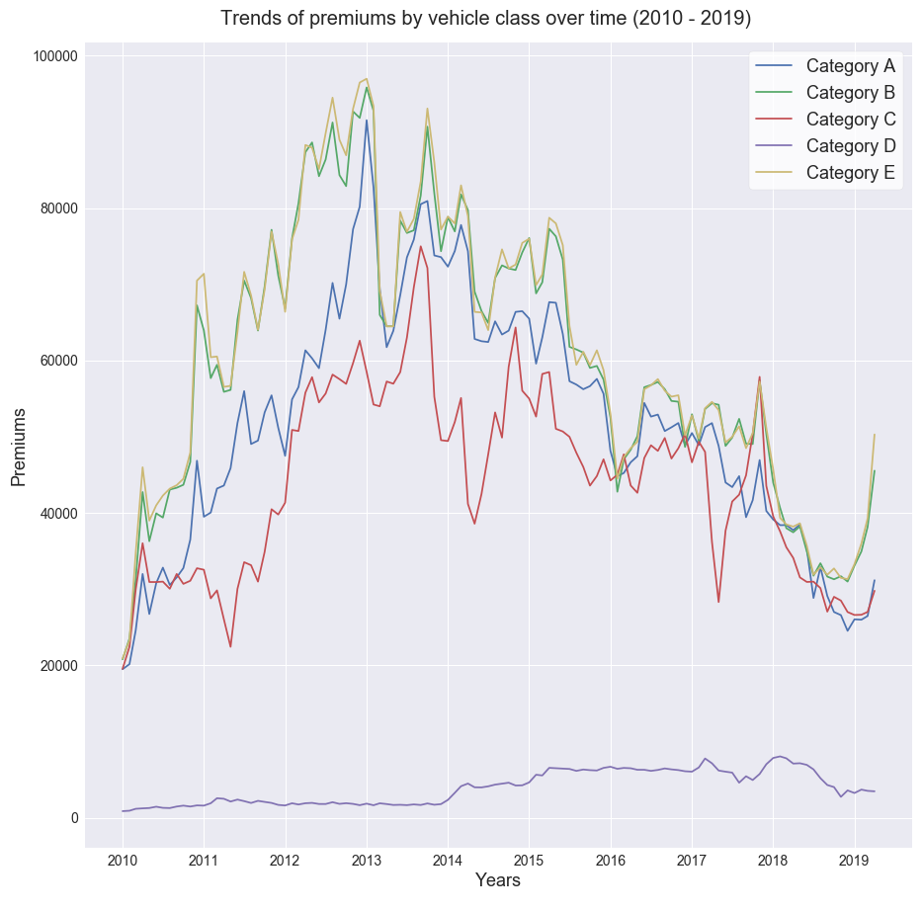
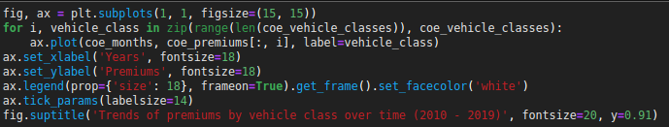
Trends of premiums over time
Decreasing trend for most categories
Category D is increasing
Notes:
Same as previous but for premiums

Slide 26
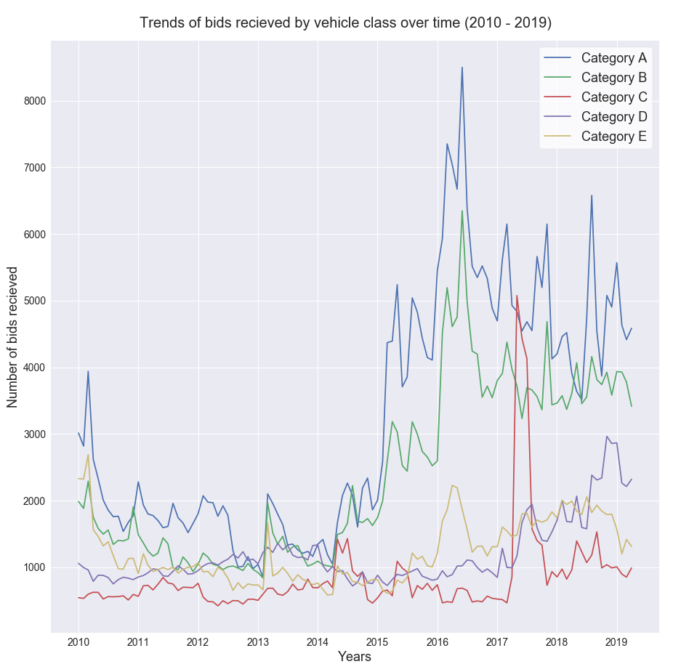
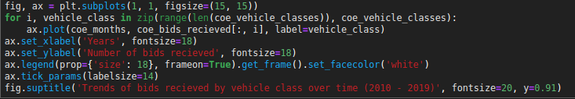
Trend of bids received by category
Similar to quota.
In general, decreased first before increasing.

Slide 27
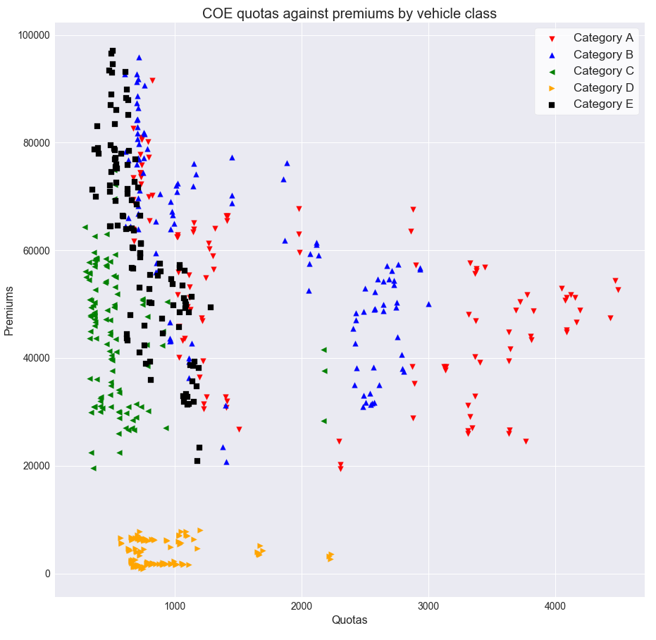
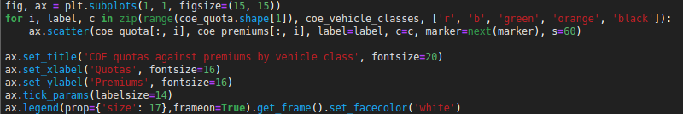
Relation of quota against premiums
Not much relation can be seen.
Notes:
Scatter plot of the quota against respective premiums, labeled by category

Slide 28
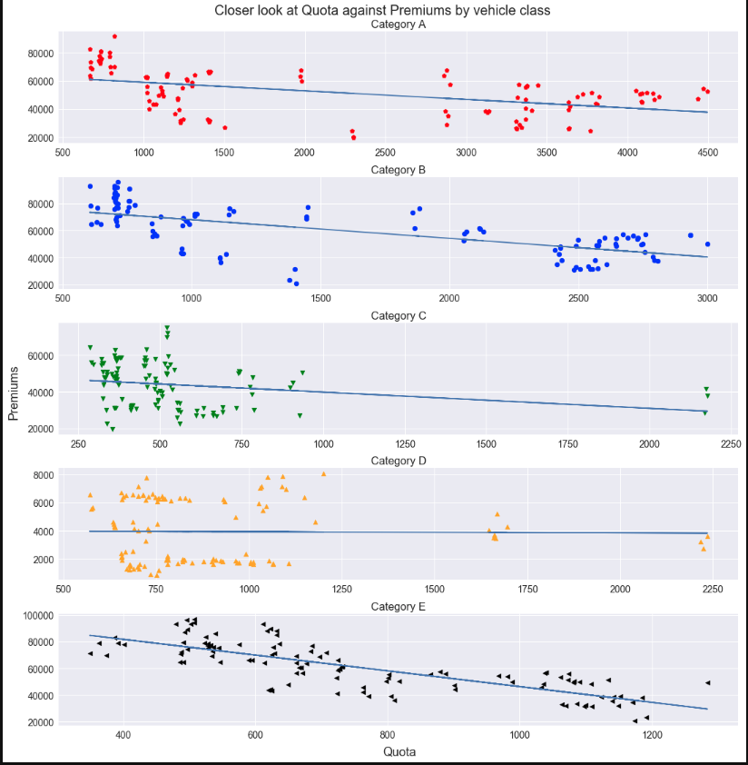

Closer look by category
Seems to be a very weak trend
As quota decreases, premiums increase.
Some have no relation
Notes:
Agrees with demand and supply, as there is a lesser supply of coe, demand increases.

Slide 29


Relation of quota, with bids received
Seems to be a quite strong relationship between quota and number of bids received

Slide 30


Separated by category
Similar to previous conclusion.

Slide 31


Proportion of quota, bids received and premiums
Low quota, increase in premiums
Increase in extra bids above quota, increase in premiums as well
Notes:
Agree with demand and supply

Slide 32
Thank you

