Slide 1

Digitz
Completely Connected

Slide 2
Digitz Company Overview
Digitz™ is a social media-bridging app that allows users to create a profile consisting of their phone number, email address, and social networking accounts (Facebook™, Twitter™, Instagram™, LinkedIn™, and Google+™) to help people become “Completely Connected”. Through geo-sensitive technology and social networking channels, Digitz™ allows users to effortlessly connect to others on all communication platforms in just 3 simple clicks.

Slide 3





The Problem
There are four main problems that Digitz™ can fix. . .
Exchanging phone numbers takes too long and if done incorrectly, is a counterproductive activity
The inconvenience of re-entering all your contacts for a new cell phone or losing contact with others when your personal information changes (Phone numbers, email addresses, etc.)
The inconvenience of having to connect with all of your friends/family on so many different channels (Facebook™, Twitter™, Instagram™, Linkedin™, Google+™)
With our information being “open to anyone,” many people refuse to publish information that is actually useful (Telephone numbers, personal email addresses, birthdays, home/work locations)

Slide 4
Exchanging Phone Numbers
When you meet somebody new, the most awkward part of the conversation is – “Can I have your phone number?”
The actual exchange takes way too long as both parties need to type in each others phone numbers and then each others names.
When the phone numbers/names are inserted incorrectly, by accident, the entire process has been counterproductive.
The, “I’ll just text/call you” approach can work, however if the phone is not quickly updated, or you meet multiple people at one time, then you have numbers with no names attached to them.

Slide 5
New Phone/ Change of Information
Replacing a broken phone requires hours of updating your contacts, which all need to be done individually.
A change in your phone number/email address can create a lack of communication with your friends/family until everybody knows and has updated their address book.
“I got a new phone/I have a new number – Text me!” posts on Facebook don’t work. They simply grab the attention of a small percentage of your friends, if they even see your post.
Trying to contact a friend who got a new number, but never told you, is useless.
Not only are these frustrating, but they add an additional inconvenience to find the correct information simply to send a text or make a simple phone call.

Slide 6
Multiple Channels
Most users have more than one profile of Social Media.
Connecting with your friends on Facebook™, Twitter™, Instagram™, Google+™, and Linkedin™ is a lot of work. Especially with the difficulty of figuring out their username
With Facebook you can search by name, but with over a 1 billion users, finding a single John Smith can be very difficult.
Instagram and Twitter’s unique usernames make it almost impossible to find your friends without directly asking them for their information.

Slide 7
Privacy
With our information online being “seen by everyone,” rarely will people share personal information that is actually useful.
I have over 1,000 Facebook Friends, but I have less than 1/10 of their phone numbers.
If I wanted to call an old friend from High School and their information wasn’t shared on Facebook, it could take hours to days before I could obtain that information
The Social Media idea is completely counter productive, if all I can do is look at a friends photos and send them an occasional message. – There needs to be a better way to contact anybody at any time.

Slide 8
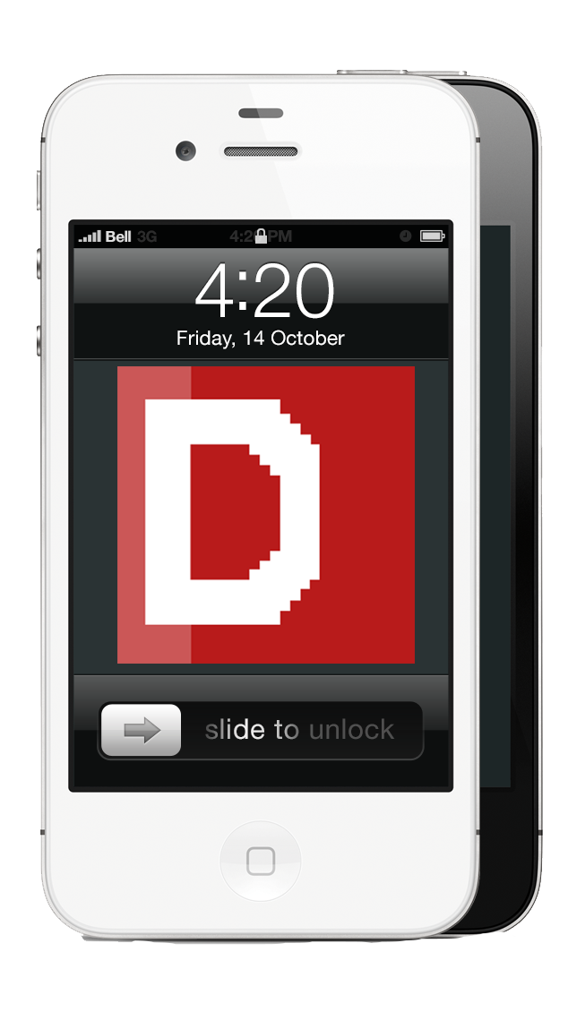







Solution
Digitz is the Social Media Hub. Digitz gives you access to all these mediums of Social Media in one place.

Slide 9
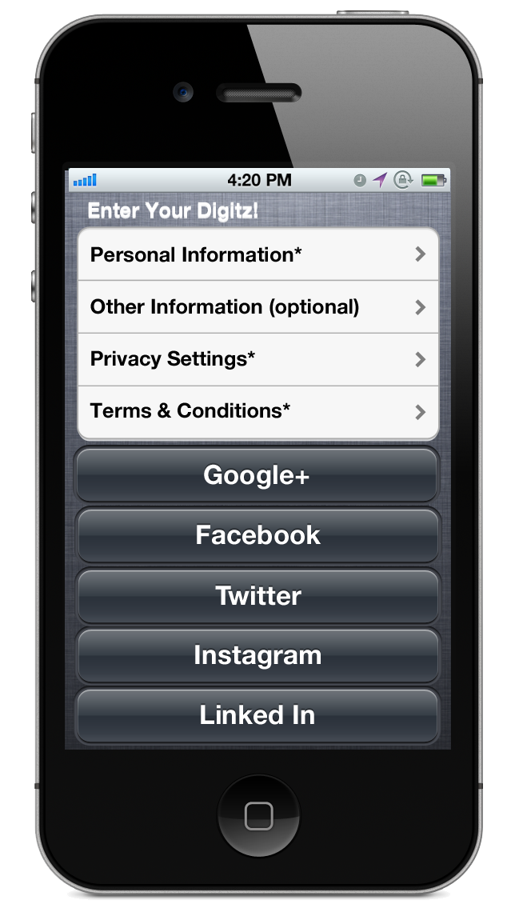
Exchanging Phone Numbers
Required Information
Name, Age, Gender, Phone Number, Email, Hometown
Optional Information
Birthday, Photo, Blog URL, Notes, etc.
Privacy Settings
Agree to Terms & Conditions
Users have the option to link their Google+™, Facebook™, Twitter™, Instagram™, and Linkedin™ profiles to their Digitz™ Profile.

Slide 10
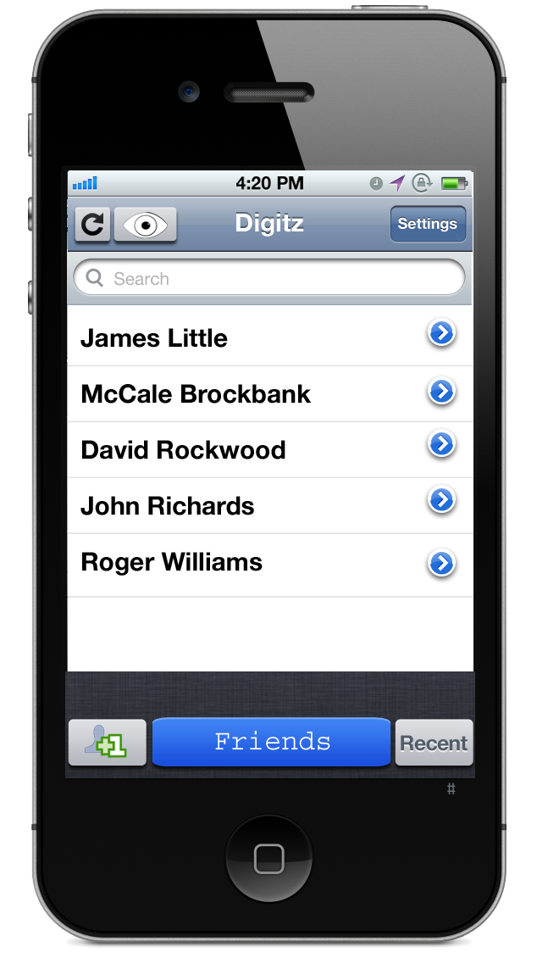
Exchanging Phone Numbers
Users are then taken to the Home Screen.
With Geo-Sensitive Technology, Digitz™ automatically finds all Digitz™ Users within 150 feet of your smartphone.
Their names are pulled up on the main screen
When you meet somebody new, all you need to do is click on their name in order to “transfer Digitz™.”

Slide 11
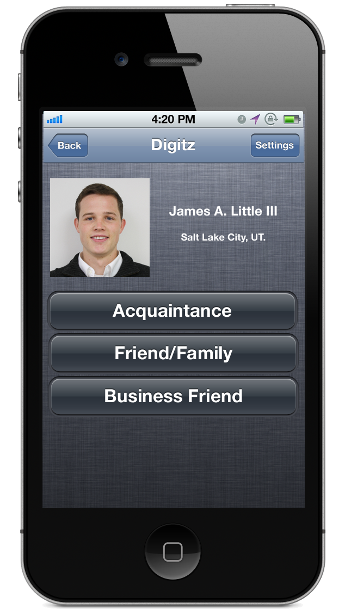
Exchanging Phone Numbers
A “Request Digitz™” page will appear where you can choose this person to be a “Acquaintance,” “Friends/Family,” or “Business Friend.”
After selecting your relationship, you have requested their Digitz™.

Slide 12
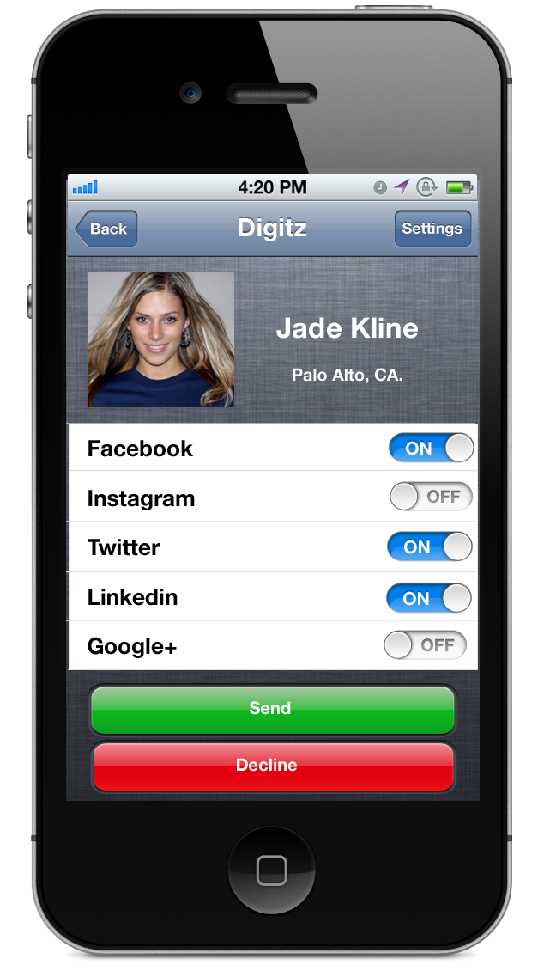
Exchanging Phone Numbers
Receiving Requests
You will be notified when somebody has requested your Digitz™.
At this point you may choose which forms of Social Media with which you would like to connect with this person.
When the “Send” button has been pushed, the users profile contact information are automatically inserted into the others contacts. – No Copy and Pasting needed!
Also the two have been connected with the Social Media Websites that they both agreed to.

Slide 13
Exchanging Phone Numbers
The process of exchanging numbers is no longer an awkward conversation
The process takes 3 clicks of a button and the time is more than cut in half
There is no worrying about entering the incorrect phone number or spelling the name incorrectly.
Not only are you sharing contact information – users can connect with their friends in 5 Social Media mediums at once.

Slide 14
New Phone/ Change of Information
Phones break, the get lost, and sometimes you need to get a new number entirely
With Digitz™ this is not a problem – with a new phone, all a user needs to do is download our Free App and log-in to their profile. All friends and their contacts will automatically update their contact list.
New number, new email, new address? No big deal – when you change the information on your profile, all your friends will be notified and their contacts will automatically be updated as well.

Slide 15
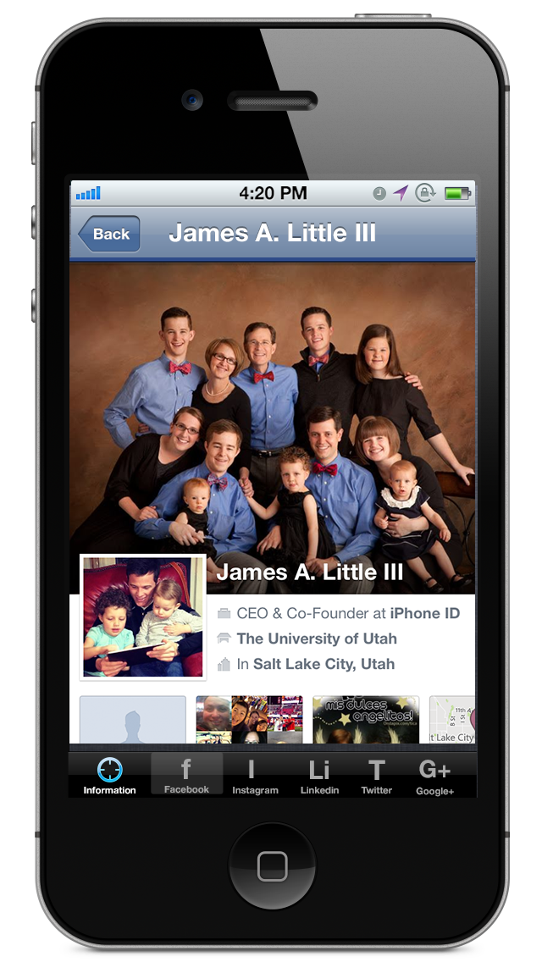
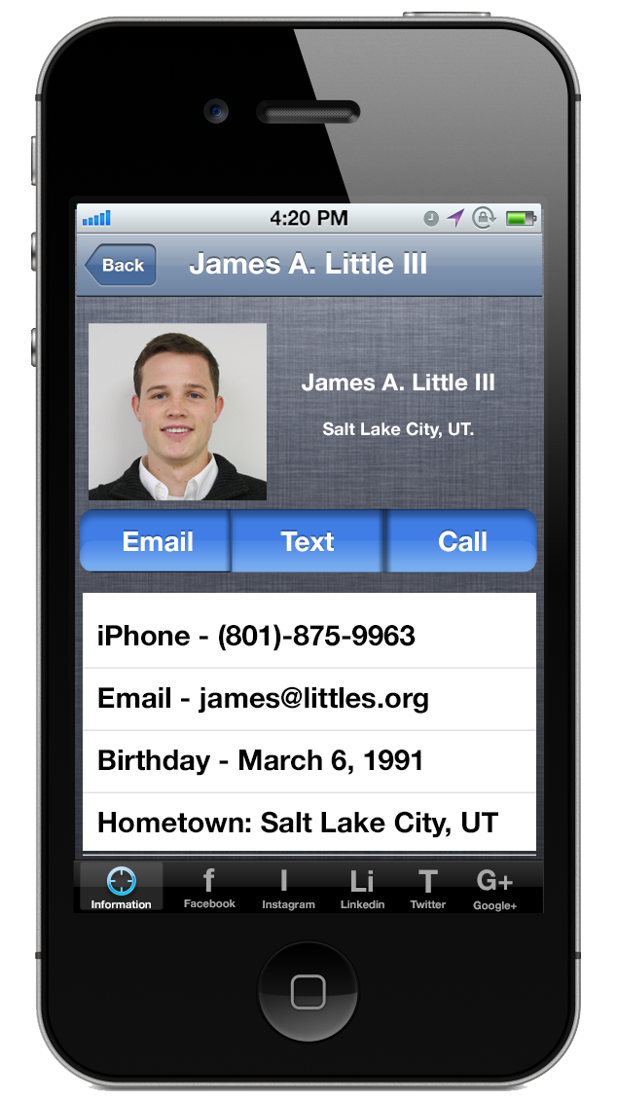
Multiple Channels
Digitz™ is the ultimate Social Media Hub.
On every users profile, you can find 6 tabs at the bottom of the screen.
Information, Facebook™, Instagram™, Linkedin™, Twitter™, Google+™
You can switch from Social Media to Social Media from tab to tab – no need to switch apps
Digitz™ users have complete access to all their friends Social Media information all in one place – their smartphone.

Slide 16
Privacy
Users have no need to fear posting information on Digitz™ – it is safe.
Your information is 100% secure and not shared unless BOTH parties agree.
Besides the required information at initial setup, all other information is optional and is only shared when your have accepted others requests.
Digitz is the most efficient way to share information and helps people from all over the world connect – safely!

