Slide 1
V2 : Non-Learnable Spatial Estimator
M.dC. , C.Z., 2022-08-04

Slide 2
Contents
Preparation
Concept
Datasets
Regions
Grid emission map versions
V0: polygon based
V1: gridded map with no time variance
V2: gridded map with time variance
V3: map refined with building details from ML models
Uncertainty

Slide 3
How we select the region
We take the envelope of the city’s corresponding Functional Urban Area (FUA), as defined by the OECD, https://ghsl.jrc.ec.europa.eu/documents/GHSL_FUA_2019.pdf

Slide 4
V2 : NLSE
f(Total Emission,
Spatial Modifier)
Spatial Modifier
Emission estimator
GHSL Population
Raster Layers
Spatial Modifier
Vector Layers
GHSL Population
Microsoft database
GHSL Building Height
(estimated with DEM)
Total near-real-time CO2 emission
(from carbon monitor database)
Nighttime Light
Spatial res:
100*100 m or 500*500 m
Output
Land use/cover

Slide 5
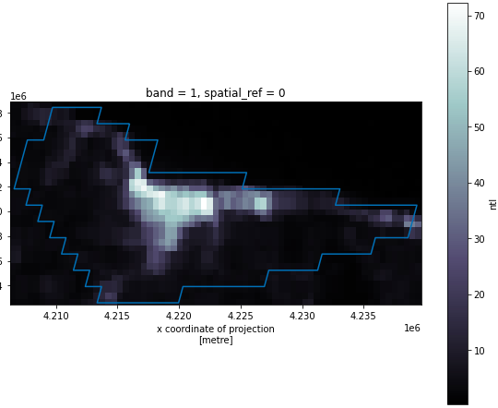
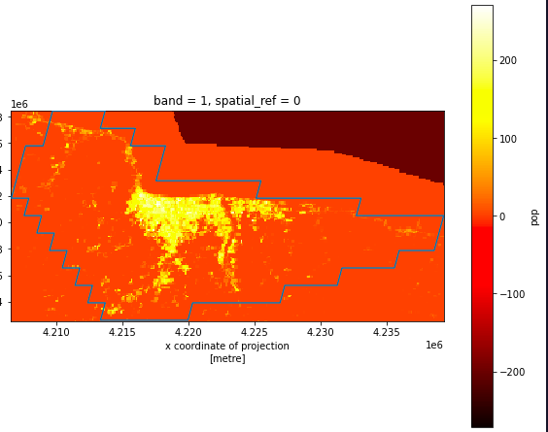
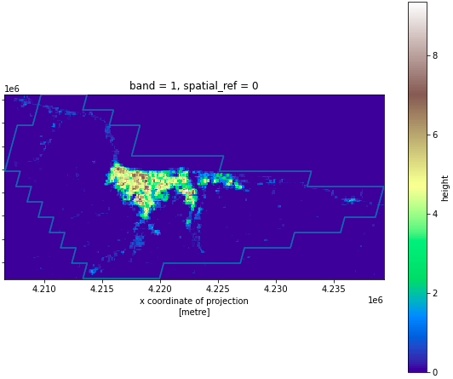
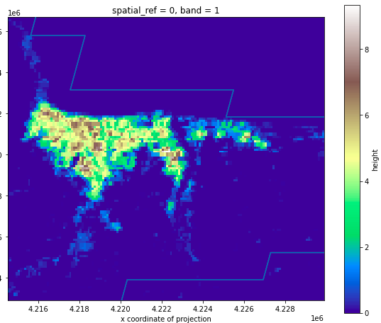
Visualization (Ordu)
NTL + FUA
Population + FUA
Building Height + FUA

Slide 6
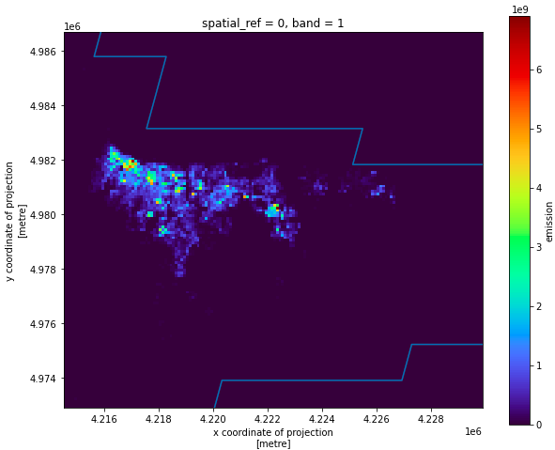
“Emission” distribution

Slide 7
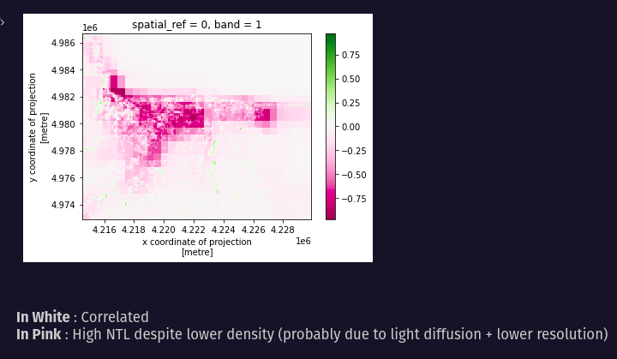
Difference Maps
Building density / NTL

Slide 8
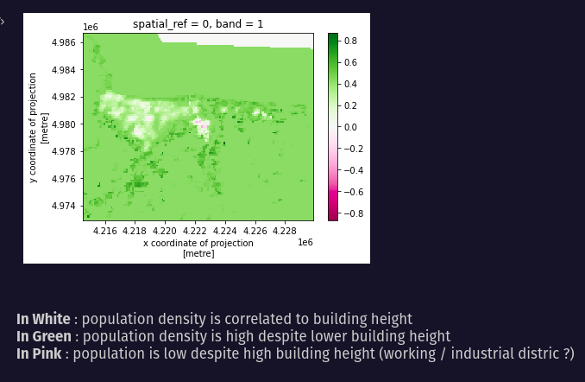
Population Density / Building Height

Slide 9
V2 : NLSE
f(Total Emission,
Spatial Modifier)
Spatial Modifier
Emission estimator
Census
Buildings
Population (GHSL), Households
(GDP, energy source,
Cooking/heating source to come)...
Area, Height, Type
ML model based on Open street map Buildings (OSMB) and other land use/cover datasets
Microsoft database (unlabeled)
Total near-real-time CO2 emission
(from carbon monitor database)
Building Prediction
Land use/cover
LCZ, human settlement layer, google landcover, …
Spatial res:
100*100 m or less
Output
Towards a “per building” estimator

Slide 10
Datasets
Resolution Level | data | source
Country level | heating/cooking source | Census data or governmental statistical data
 | energy structure
 | GDP
 | Other economic indicator
City/division level | Population
 | household number
 | household size
Polygon level | Building number | ML model output trained with MS building dataset (https://github.com/microsoft/USBuildingFootprints), OSMB dataset (https://osmbuildings.org/), and other grid-based dataset, such as LCZ, Copernicus DEM, night light, …
 | Building area, type, level
Grid level a: already used in our dataset b: will be used (in processing) c: important, considering to use d: might be used | a: LCZ (100*100m) | https://zenodo.org/record/6364594#.YsgpS3ZBybg
 | a: EU, VIIRS nightlights | https://eogdata.mines.edu/products/vnl/
 | b: Google, Land surface temperature | https://developers.google.com/earth-engine/datasets/tags/surface-temperature
 | b: EU, Human settlement layer | https://ghsl.jrc.ec.europa.eu
 | c: Copernicus, DEM | https://spacedata.copernicus.eu/web/cscda/dataset-details?articleId=394198
 | c: ERA5, Air temperature | https://www.ecmwf.int/en/forecasts/datasets/reanalysis-datasets/era5
 | c: Poverty | https://partage.lsce.ipsl.fr/service/home/~/?auth=co&loc=en_US&id=7160&part=2.2
 | d: Google, land cover | https://blog.google/products/earth/dynamic-world-land-cover-data/
Note: the datasets are not limited in those are listed, and we will replace some of those datasets if we find some alternative dataset with higher quality.

