Slide 1
AIAP 19 Technical Presentation
Ng Chuan Seng

Slide 2
Problem Statement
AgroTech innovations faces challenges in optimizing crop yields and resource management due to inefficiencies
Goal:
Predict temperature conditions within farms’ closed environment to ensure optimal plant growth
Categorize combined “Plant Type-Stage” based on sensor data to aid in strategic planning and resource allocation

Slide 3
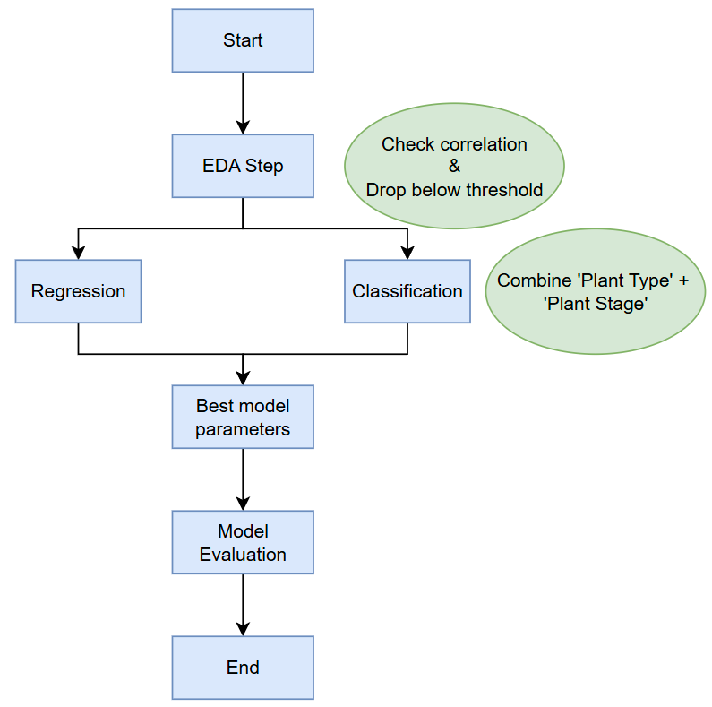
Overview

Slide 4
Exploratory Data Analysis (EDA)
Humidity Sensor
Dropped due to large number of missing values
Will induce heavy bias if missing values are replaced with mean/median
Data with non-standardized naming format are converted to lowercase
Absolute values of positive and negative values are taken
Metric units are removed to make values numeric
Task-specific (Label-encoded)
Regression - ‘Plant Stage’ is label-encoded as the data is ordered
Classification – ‘Plant Type’ and ‘Plant Stage’ are merged then both columns are dropped
Columns with ‘object’ type data are one-hot encoded
Other columns are standard-scaled

Slide 5
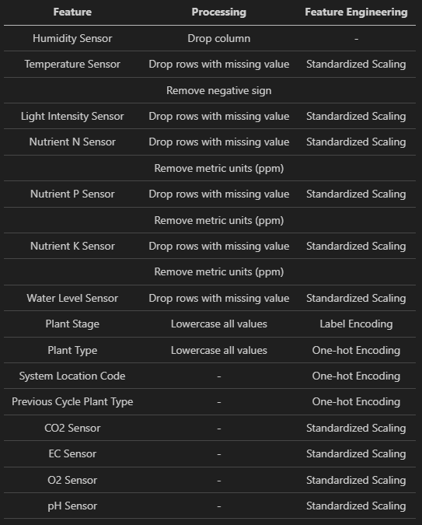
Regression EDA

Slide 6
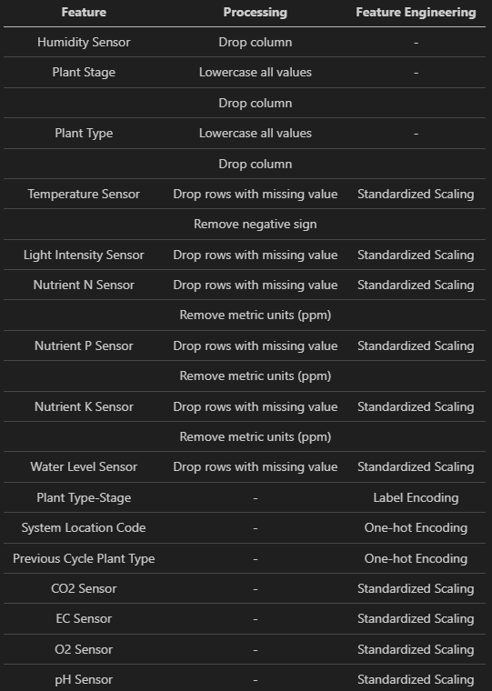
Classification EDA

Slide 7
Model Choice (Regression)
Linear Regression
Easiest to setup without needing to tune any hyper-parameters
Used as basis of reference for other comparison with other models
Easily interpretable due to the linear relationship plotted between target and other features
Random Forest Regression
Combines multiple decision trees to capture complex, non-linear relationships in the data
Less prone to overfitting – Reduced risk of poor performance on unseen data
Automatically handles feature interaction
XGBoost Regressor
High predictive power – Advanced gradient boosting algorithm
Handles non-linearity and feature interaction
Built-in regularization to prevent overfitting when dealing with noisy and complex datasets

Slide 8
Model Choice (Classification)
Logistic Regression
Easiest to setup without needing to tune any hyper-parameters
Used as basis of reference for other comparison with other models
Easily interpretable due to the linear relationship plotted between target and other features
Random Forest Regressor
Combines multiple decision trees to capture complex, non-linear relationships in the data
Robustness to overfitting
Handles numerical and categorical features well without needing for extensive preprocessing
Multi-Layer Perceptron (MLP) Classifier
Can learn complex non-linear relationships between features and target
Flexible model that can be adapted to different types of problems (Binary/Multi-class)

Slide 9
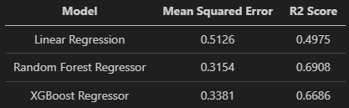
Metrics (Regression)
Mean Squared Error
Used when minimizing prediction error is of importance
Provides indication of how well model is fitting to data
More sensitive to outliers and gives a sense of error magnitude
Lower value == Better model predictive accuracy
R2 Score
Used to understand how well model is explaining variance in data
Variability/spread of target variable
Determine how well model captures underlying patterns in data
Might not be accurate if model is overfitting or contains outliers
Higher value == Higher percentage of variance is explained by model
Prediction error is of importance to predict temperature
Mean squared error needs to be monitored for prediction error
R2 Score is to ensure model is not overfitted

Slide 10
Metric (Classification) (1/2)
Confusion Matrix
Helps to visualize model performance by showing number of correct/incorrect predictions for each class
Helps to identify errors (false positive/false negative) and assess how well model is performing
Classification Report
Provides detailed performance evaluation of model by calculating precision, recall, f1-score, and support for each class
Useful in situations where there are imbalanced classes or need to evaluate model’s behavior for each class

Slide 11
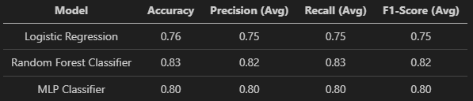
Metric (Classification) (2/2)
Classification Report Sub-metric
Precision
Proportion of instances predicted as particular class actually belongs to said class
Recall
Proportion of actual instances of a class are correctly identified by model
F1-Score
Harmonic mean of precision and recall
Support
Number of occurrences of each class in dataset

Slide 12

Thank You

Slide 13
Backup (Regression Runtime)

Slide 14
Backup (Classification Runtime)

