Slide 2
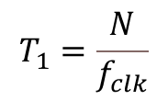
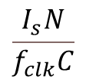
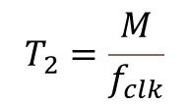
Voltage [V]
Pre-charge
Discharge
$$\frac{I_{s}N}{f_{clk}C}$$
Time [s]
$$T_{1}=\frac{N}{f_{clk}}$$
$$T_{2}=\frac{M}{f_{clk}}$$

Slide 3




Voltage [V]
$$\overline{V_{out}^{2}}$$
$$\overline{V_{in}^{2}}$$
$$A_{V}=36$$
Time [s]
$$f_{c}=48.3kHz$$

Slide 4
