Slide 2
Vout
M₁ ➔cutoff
M₂ ➔saturation
M₁ ➔saturation
M₂ ➔saturation
M₁ ➔triode
M₂ ➔saturation
IssRd
0.5 IssRd
Vin

Slide 3
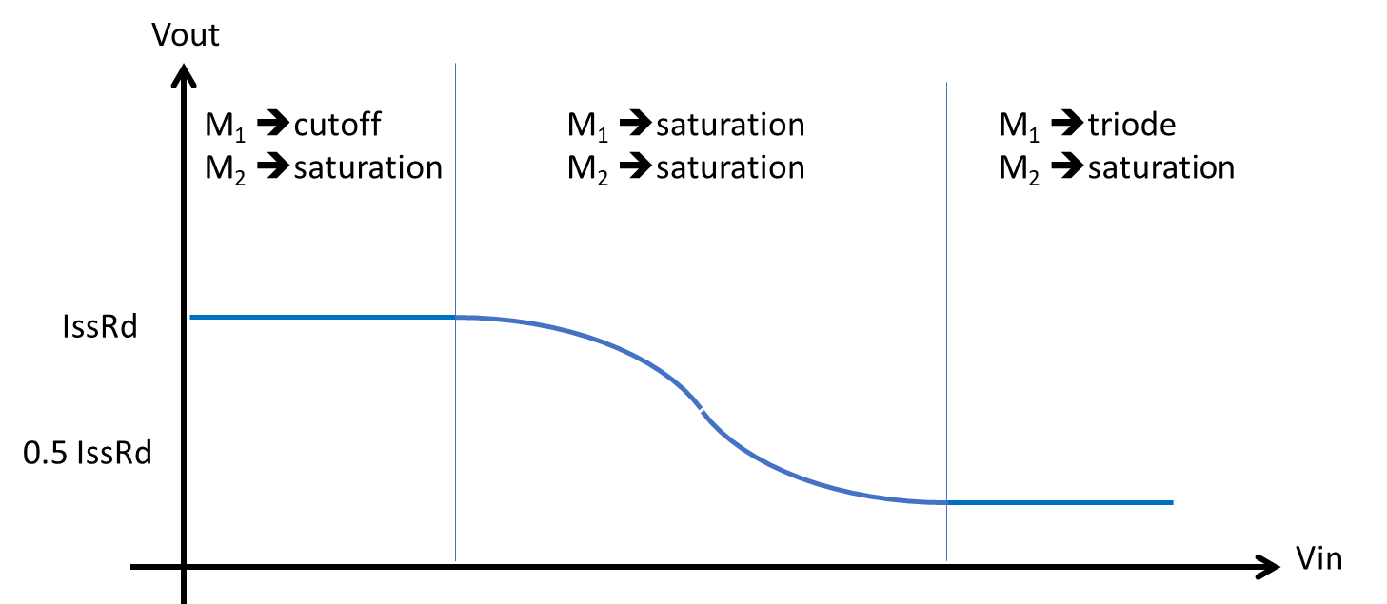

Slide 4
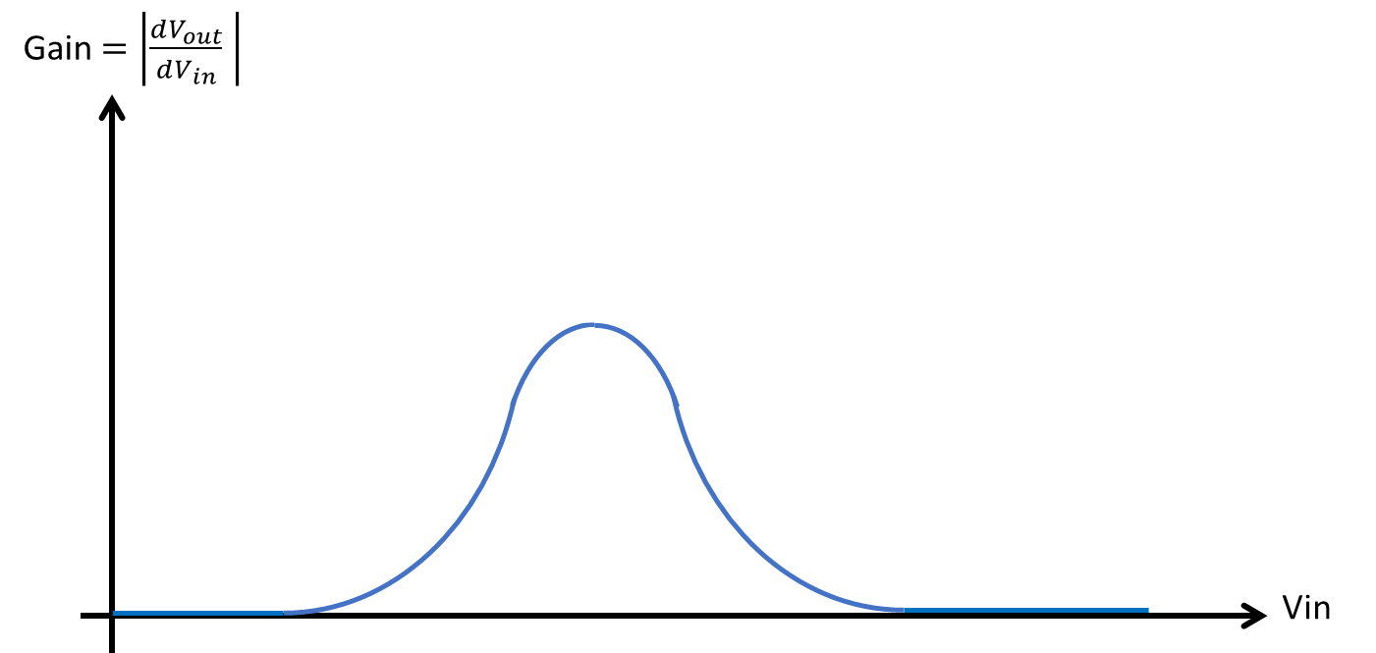
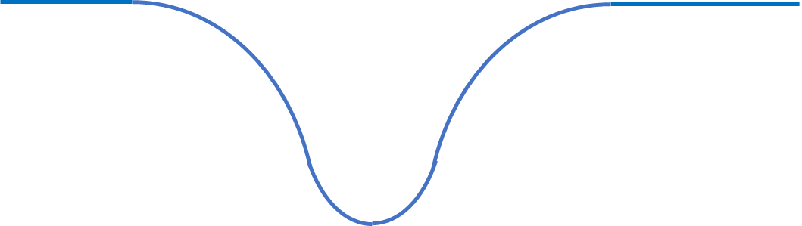

Gain $=\left|\frac{dV_{out}}{dV_{in}} \right|$
Vin

